Slide 1


Real Estate
Finance & Investment
Prepared by Dr. Emad Zaher
Assistant Professor of Accounting
REA 631
Lecture (1)
Introduction to Real Estate
Markets & Investment Principles

Slide 2
Introduction to Real Estate
Markets & Investment Principles
Understanding the world's largest asset class
$393T
Global market value (2025)
Reading: Baum & Hartzell , Chapter 1

Slide 3

By the End of This Lecture, You Will...
✓
Define real estate
✓
Classify property types
Explain what real estate is and identify its unique characteristics as an asset
Distinguish residential, commercial, industrial, retail, and hospitality assets
✓
Explain investment rationale
✓
Map the market structure
Articulate why investors include real estate in diversified portfolios
Use the Four Quadrants model to locate any property investment
✓
Recognize market cycles
✓
Understand global context
Identify the four phases of the real estate cycle with real examples
Compare global, MENA, Egyptian, and Saudi market data and dynamics
Lecture 1 | Introduction to Real Estate Markets and Investment Principles
Prepared by Dr. Emad Zaher
3 / 40

Slide 4
DEFINITION
What Is Real Estate?
Real Estate
Land plus anything permanently attached to it such as buildings, structures, and the bundle of legal rights that come with ownership.
01
02
03
LAND
IMPROVEMENTS
RIGHTS
The physical site itself fixed in location, finite in supply
Buildings, fences, roads, utilities permanently attached to the land
The legal right to use, lease, sell, or borrow against the property
Lecture 1 | Introduction to Real Estate Markets and Investment Principles
Prepared by Dr. Emad Zaher
5 / 40

Slide 5






The Six Major Types of Real Estate
Residential
Commercial
Single-family homes,
apartments
Office buildings,
business centers
Retail
Industrial
Shopping malls,
high-street shops
Warehouses, factories,
logistics centers
Hospitality
Special-Purpose
Hotels, resorts, serviced
apartments
Hospitals, schools, places
of worship
Prepared by Dr. Emad Zaher
Lecture 1 | Introduction to Real Estate Markets and Investment Principles
7 / 40

Slide 6
PROPERTY TYPES
Real Examples Across Egypt, KSA & the World
Type | Egypt Example | Saudi Arabia Example | Global Example
Residential | Madinaty (TMG) | ROSHN Sedra (Riyadh) | Burj Khalifa Apts
Commercial | Smart Village (6 Oct.) | KAFD (Riyadh) | Canary Wharf (London)
Retail | Mall of Egypt | Riyadh Park Mall | Dubai Mall
Industrial | 10th of Ramadan City | KAEC Industrial Zone | Amazon Warehouses
Hospitality | Four Seasons Sharm | Red Sea Project | Marriott / Hilton chains
Special-Purpose | Grand Egyptian Museum | King Faisal Hospital | Harvard University
NOTE: Many large projects today are mixed-use — combining several types in one development (e.g., a tower with retail on the ground floor, offices in the middle, and apartments on top).
Lecture 1 | Introduction to Real Estate Markets and Investment Principles
Prepared by Dr. Emad Zaher
8 / 40

Slide 7
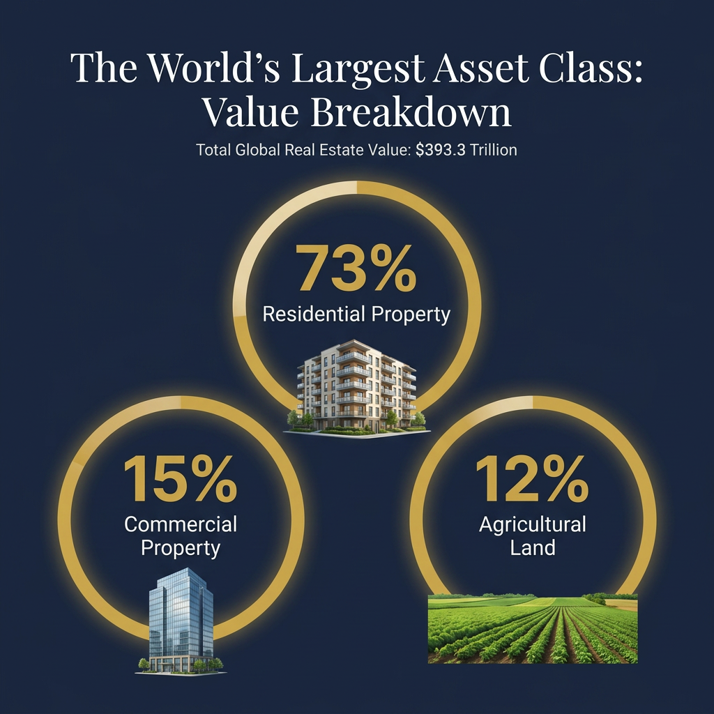
The World's Largest Asset Class
$393.3
TRILLION
Total global value of real estate at the start of 2025
≈ 4× global GDP
Larger than all global stocks, bonds, and gold combined.

Slide 8
GLOBAL OUTLOOK
Real Estate Dwarfs Other Asset Classes
Real estate is 19× larger than all gold
$393T vs $20.2T
Real estate is 3× larger than all stocks
$393T vs ~$124T
Real estate is 2.8× larger than all bonds
$393T vs ~$140T
Sources: Savills, World Federation of Exchanges, BIS, World Gold Council (2025)
Lecture 1 | Introduction to Real Estate Markets and Investment Principles
Prepared by Dr. Emad Zaher
22 / 40

Slide 9
COUNTRY RANKINGS
Top 10 Real Estate Markets by Total Value
Key Takeaways
44%
China + USA together control nearly half the global market
71%
Top 10 countries hold 71% of total real estate value
29%
Remaining 180+ countries share only 29% — including Egypt and KSA
Source: Savills Global Real Estate, 2025
Lecture 1 | Introduction to Real Estate Markets and Investment Principles
Prepared by Dr. Emad Zaher
23 / 40

Slide 10
Global Real Estate Market, 2024 → 2035
Growth, but uneven.
Asia-Pacific holds ~40% of global revenue share.
MEA is the fastest-growing region at ~6.5% CAGR.
Source: Precedence Research, 2026
Prepared by Dr. Emad Zaher
Prepared by Dr. Emad Zaher
4 / 20

Slide 11
IMPORTANT CONTEXT
Before We Begin: The 2008 Subprime Crisis
Why does it still matter?
U.S. banks issued home loans to borrowers who could not realistically afford them — known as subprime mortgages.
When U.S. house prices fell in 2007–2008, defaults exploded. Major institutions like Lehman Brothers collapsed, credit froze, and the world entered the worst recession since 1929.
Lecture 1 | Introduction to Real Estate Markets and Investment Principles
Prepared by Dr. Emad Zaher
4 / 40

Slide 12
INVESTMENT RATIONALE
Five Reasons Investors Buy Real Estate
1
Income (Cash Flow)
Monthly rent gives a steady stream — like a salary from your asset
2
Capital Appreciation
Property values tend to grow over the long run as land becomes scarce
3
Leverage
You can buy a $100k apartment with only $20k cash, using a mortgage
4
Tax Benefits
Depreciation, mortgage interest, and other deductions reduce tax bills
5
Inflation Hedge
When prices rise, both rent and property value usually rise with them
Lecture 1 | Introduction to Real Estate Markets and Investment Principles
Prepared by Dr. Emad Zaher
9 / 40

Slide 13
WORKED EXAMPLE · REALISTIC ANALYSIS
The Real Power of Leverage — After Interest & Costs
Same deal as the simple slide ($100,000 property → $130,000 in 5 years) — but now we count the interest, the rent, and the selling costs.
Scenario A — All Cash
no loan
Scenario B — With a Mortgage
80% loan
Purchase price
$100,000
Purchase price
$100,000
Your cash (equity in)
$100,000
Your cash (20% down)
$20,000
Loan @ 7%, 30-yr
$0
Loan from bank (80%) @ 7%, 30-yr
$80,000
Value in 5 yrs (+$30,000 gain)
$130,000
Value in 5 yrs (+$30,000 gain)
$130,000
(+) Net rent, 5 yrs
+$25,000
(+) Net rent, 5 yrs
+$25,000
(−) Interest paid, 5 yrs
$0
(−) Interest paid, 5 yrs
−$27,240
(−) Selling costs (6%)
−$7,800
(−) Selling costs (6%)
−$7,800
NET PROFIT (after all costs)
$47,200
NET PROFIT (after all costs)
$19,960
RETURN ON YOUR CASH
47%
RETURN ON YOUR CASH
74%
5-year total · on $100,000 cash in
5-year total · on $26,935 cash in
annualized ≈ 8.7% / yr
annualized ≈ 13.6% / yr
THE REALITY CHECK
Return on your cash (5-yr)
The simple slide's “150%” counted only the $20,000 down payment and ignored $27,240 of interest. Measured honestly, leverage earns 74% (≈13.6%/yr) vs 47% (≈8.7%/yr) all-cash — better, but about 1.6×, not 5×.
Claimed
150%
Golden rule — positive vs. negative leverage: debt boosts your return only when the property's own return (≈8.7%) beats the loan rate (7%). A higher rate than the property's return would shrink returns and magnify losses.
Real (mortgage)
74%
All-cash
47%
Prepared by Dr. Emad Zaher

Slide 14
Real Estate vs. Stocks, Bonds & Gold
Feature | Real Estate | Stocks | Bonds | Gold
Typical Return | 8–12% / yr | 9–11% / yr | 3–6% / yr | 4–7% / yr
Risk Level | Medium | High | Low–Medium | Medium
Liquidity | Low (weeks/months) | Very High (seconds) | High | High
Income Stream | Yes — rent | Sometimes dividends | Yes — coupons | None
Inflation Hedge | Strong | Moderate | Weak | Strong
Leverage Possible? | Yes — easily | Limited (margin) | Limited | Rare
Tangible Asset? | Yes — physical | No — paper | No — paper | Yes — physical
Lecture 1 | Introduction to Real Estate Markets and Investment Principles
Prepared by Dr. Emad Zaher
11 / 40

Slide 15
WORKED EXAMPLE
$100,000 Invested 10 Years Ago — Where Are You Today?
Bonds
+35%
Safe but slow — barely beats inflation
Gold
+78%
Solid hedge, no income generated
S&P 500
+145%
Strong growth, but with major swings
Cairo Rental
+190%
Capital growth + rental income combined
Prepared by Dr. Emad Zaher
Note: Hypothetical example for teaching purposes — past performance does not guarantee future results.
Lecture 1 | Introduction to Real Estate Markets and Investment Principles
12 / 40

Slide 16
MARKET STRUCTURE
Primary vs. Secondary Real Estate Markets
PRIMARY MARKET
SECONDARY MARKET
Brand-New Properties
Resold Properties
Buying directly from a developer when a project first launches.
Buying from a previous owner who already lived in or owned the property.
Examples:
Examples:
Off-plan apartment in NAC, Cairo
Re-selling an old apartment in Zamalek
New villa in NEOM, Saudi Arabia
Buying a 10-year-old villa in Riyadh
Pre-launch condo in Dubai Marina
Estate sale of a flat in London
TIP: Primary market = brand new from developer. Secondary market = used from previous owner.
Lecture 1 | Introduction to Real Estate Markets and Investment Principles
Prepared by Dr. Emad Zaher
13 / 40

Slide 17
Public vs. Private Real Estate Markets
PRIVATE MARKET
PUBLIC MARKET
Direct ownership of physical property — bought person-to-person or developer-to-buyer
Real estate accessed through securities traded on a stock exchange
Examples:
Examples:
Direct purchase of an apartment
REITs (Real Estate Investment Trusts)
Buying a villa from another owner
Listed property developer shares (e.g., TMG, Emaar)
Private real estate funds (institutional)
CMBS — bonds backed by commercial mortgages
~94% of total real estate value globally is held privately
Global listed real estate ≈ $2.2 trillion (FTSE EPRA Nareit Index, 2024)
Lecture 1 | Introduction to Real Estate Markets and Investment Principles
Prepared by Dr. Emad Zaher
14 / 40

Slide 18
The Four Quadrants of Real Estate
EQUITY (Ownership)
PRIVATE EQUITY
PUBLIC EQUITY
Every real estate investment lives in ONE of these four boxes.
Investors choose a quadrant based on:
• How much capital they have
• How much risk they accept
• How fast they need their money back (liquidity)
Private = Higher returns, less liquidity
Public = Lower returns, faster access to cash
Direct ownership of property
REITs & developer stocks
PRIVATE
PUBLIC
Example:
Example:
Buying a Cairo apartment
Shares in TMG or Emaar
PRIVATE DEBT
PUBLIC DEBT
Mortgages, construction loans
Bonds backed by mortgages
Example:
Example:
Bank mortgage on your home
CMBS in U.S. capital markets
DEBT (Lending)
Lecture 1 | Introduction to Real Estate Markets and Investment Principles
Prepared by Dr. Emad Zaher
17 / 40

Slide 19
WORKED EXAMPLE
Mapping Real Companies to the Four Quadrants
Quadrant | What Investors Buy | Egypt Example | Saudi Arabia Example
Private Equity | Direct ownership | TMG private projects | ROSHN unlisted assets
Public Equity | Listed shares & REITs | TMG Holding (EGX) | Dar Al Arkan (Tadawul)
Private Debt | Mortgages & loans | CIB / NBE mortgages | Al Rajhi Bank loans
Public Debt | Mortgage-backed bonds | EFG-Hermes securitisations | SRC sukuk / mortgage bonds
Lecture 1 | Introduction to Real Estate Markets and Investment Principles
Prepared by Dr. Emad Zaher
18 / 40

Slide 20
CAPITAL FLOWS
How Money Moves Through the Property Market
INVESTORS
$ Equity
DEVELOPERS
Buildings
BUYERS / TENANTS
Provide equity capital
Build & deliver projects
Buy or rent finished property
$ Returns
Rent / Sale
BANKS / LENDERS
Provide debt (mortgages and loans) to investors, developers, and buyers
KEY IDEA: Real estate sits at the intersection of equity (ownership) and debt (borrowing). Banks make most deals possible because property is too expensive to buy with cash alone.
Lecture 1 | Introduction to Real Estate Markets and Investment Principles
Prepared by Dr. Emad Zaher
16 / 40

Slide 21
Who's Who in the Real Estate Market
Investors
Developers
Lenders
Brokers / Agents
Buy properties seeking income and capital growth
Build new projects from raw land or redevelop old buildings
Provide mortgages and loans to fund purchases and projects
Connect buyers with sellers and tenants with landlords
e.g., You and me, pension funds
e.g., TMG, Emaar, ROSHN
e.g., Commercial banks, CBE, SAMA
e.g., Coldwell Banker, Aqarmap
Appraisers
Tenants
Property Managers
Government / Regulators
Estimate the fair market value of a property
Pay rent to use a property they don't own
Operate buildings on the owner's behalf — collect rent, do repairs
Set zoning, building codes, taxes, and ownership laws
e.g., Licensed valuation firms
e.g., Households, retailers, companies
e.g., JLL, CBRE, local firms
e.g., NUCA (Egypt), REGA (KSA)
Lecture 1 | Introduction to Real Estate Markets and Investment Principles
Prepared by Dr. Emad Zaher
15 / 40

Slide 22
MARKET CYCLES
The Four Phases of the Real Estate Cycle
1. RECOVERY
2. EXPANSION
3. HYPER-SUPPLY
4. RECESSION
Vacancies high, rents low — but starting to absorb
Demand strong, rents and prices rise quickly
Too much new construction; supply outpaces demand
Vacancies climb, prices fall, projects stall
Lecture 1 | Introduction to Real Estate Markets and Investment Principles
Prepared by Dr. Emad Zaher
19 / 40

Slide 23
REGIONAL COMPARISON
Egypt and Saudi Arabia — Side by Side
Indicator | Egypt | Saudi Arabia
Population (2025) | ~110 million | ~33 million
Urbanization rate | ~43% | ~85%
Real estate market size | ~$22 B | ~$77 B
Forecast CAGR | ~5.7% | ~6.7%
Avg. residential rental yield | ~6.7% | ~5–7%
Homeownership rate | ~80% (mostly informal) | ~63% (target 70% by 2030)
Foreign ownership rules | Limited — selected zones | Liberalized in 2026
Flagship project | New Administrative Capital | NEOM
Both markets are driven by population pressure, government mega-projects, and reforms — yet differ in scale, capital, and openness to foreign buyers.
Lecture 1 | Introduction to Real Estate Markets and Investment Principles
Prepared by Dr. Emad Zaher
28 / 40

Slide 24
CLASS DISCUSSION
Why Did Egyptian Property Prices Rise So Sharply?
Four reasons behind the surge
1
EGP devaluation
EGP fell from 8.8/$ in 2016 to 50+/$ in 2024 — investors fled to property
2
High inflation
Annual inflation peaked above 35% in 2023 — real estate hedged the loss
3
Mega-projects
NAC, New Alamein, North Coast launches drove new demand and pricing
4
Population growth
+1.5M per year — chronic housing shortage in major cities
Index is illustrative for teaching — sources: CBE inflation data, Aqarmap price tracker, JLL Cairo reports
Lecture 1 | Introduction to Real Estate Markets and Investment Principles
Prepared by Dr. Emad Zaher
26 / 40

Slide 25
RISK AWARENESS
What Can Go Wrong? The Main Risks
⚠
Market Risk
⚠
Liquidity Risk
⚠
Interest Rate Risk
⚠
Tenant / Vacancy Risk
Property values and rents fall during economic downturns
You may not find a buyer quickly if you need cash
Rising rates make mortgages and projects more expensive
Empty units mean no income while expenses continue
⚠
Currency Risk
⚠
Regulatory Risk
⚠
Operational Risk
⚠
Concentration Risk
Devaluation can hurt foreign investors and dollar-pegged costs
Sudden law or tax changes can wipe out profits
Maintenance, repairs, and management can be costly and time-consuming
Putting most of your wealth in one property is dangerous
Lecture 1 | Introduction to Real Estate Markets and Investment Principles
Prepared by Dr. Emad Zaher
29 / 40

Slide 26
QUICK GUIDE
THE GOLDEN RULE
"Buy when others are fearful; sell when others are greedy.
Lecture 1 | Introduction to Real Estate Markets and Investment Principles
Prepared by Dr. Emad Zaher
35 / 40

Slide 27
PART II
Question Bank
22 practice questions with full solutions
33 / 40

Slide 28
DEFINING REAL ESTATE
What Real Estate Really Is
Q1 MULTIPLE CHOICE
Which statement BEST defines real estate?
A. Only the buildings constructed on a piece of land
B. Land plus anything permanently attached to it, together with the legal rights of ownership ✓
C. Any financial asset that pays a fixed rate of interest
D. Movable property such as furniture, vehicles and equipment
Q2 TRUE / FALSE
The supply of land is finite and fixed in location.
● True ◯ False ✓ Correct: True
Real Estate Markets & Investment Principles | Question Bank (Answer Key)
Prepared by Dr. Emad Zaher
1 / 11

Slide 29
CORE COMPONENTS
Land, Improvements & Rights
Q1 MULTIPLE CHOICE
Which of the following is NOT one of the three core components of real estate?
A. Land
B. Improvements
C. Rights
D. Liquidity ✓
Q2 TRUE / FALSE
“Improvements” include buildings, fences, roads and utilities permanently attached to the land.
● True ◯ False ✓ Correct: True
Real Estate Markets & Investment Principles | Question Bank (Answer Key)
Prepared by Dr. Emad Zaher
2 / 11

Slide 30
PROPERTY TYPES
Classifying Property Assets
Q1 MULTIPLE CHOICE
A shopping mall such as Mall of Egypt is classified as which property type?
A. Residential
B. Retail ✓
C. Industrial
D. Hospitality
Q2 TRUE / FALSE
Warehouses and logistics centres are examples of industrial real estate.
● True ◯ False ✓ Correct: True
Real Estate Markets & Investment Principles | Question Bank (Answer Key)
Prepared by Dr. Emad Zaher
3 / 11

Slide 31
PROPERTY TYPES
Hospitality & Special-Purpose Assets
Q1 MULTIPLE CHOICE
Hotels, resorts and serviced apartments belong to which category?
A. Commercial
B. Special-purpose
C. Hospitality ✓
D. Residential
Q2 TRUE / FALSE
A hospital is best classified as a residential property.
◯ True ● False ✓ Correct: False
Real Estate Markets & Investment Principles | Question Bank (Answer Key)
Prepared by Dr. Emad Zaher
4 / 11

Slide 32
MARKET STRUCTURE
The Four Quadrants Model
Q1 MULTIPLE CHOICE
The Four Quadrants model classifies a real estate investment along which two dimensions?
A. Old vs. new and large vs. small
B. Private / public and equity / debt ✓
C. Local vs. foreign and cheap vs. expensive
D. Residential vs. commercial and rent vs. sale
Q2 TRUE / FALSE
A development combining retail, offices and apartments in one project is called a mixed-use development.
● True ◯ False ✓ Correct: True
Real Estate Markets & Investment Principles | Question Bank (Answer Key)
Prepared by Dr. Emad Zaher
5 / 11

Slide 33
GLOBAL OUTLOOK
The World's Largest Asset Class
Q1 MULTIPLE CHOICE
Approximately how many times larger is global real estate than all the gold in the world?
A. About 2 times
B. About 5 times
C. About 19 times ✓
D. About 50 times
Q2 TRUE / FALSE
At the start of 2025 the global value of real estate was roughly $393 trillion — about 4× global GDP.
● True ◯ False ✓ Correct: True
Real Estate Markets & Investment Principles | Question Bank (Answer Key)
Prepared by Dr. Emad Zaher
6 / 11

Slide 34
MARKET CYCLES
Reading the Real Estate Cycle
Q1 MULTIPLE CHOICE
According to the “golden rule”, the best phases to buy real estate are usually:
A. Peak and hyper-supply
B. Late recession or early recovery ✓
C. Boom and expansion only
D. The timing never matters
Q2 TRUE / FALSE
The real estate cycle has four phases: recovery, expansion, hyper-supply and recession.
● True ◯ False ✓ Correct: True
Real Estate Markets & Investment Principles | Question Bank (Answer Key)
Prepared by Dr. Emad Zaher
7 / 11

Slide 35
RISK AWARENESS
Identifying Investment Risks
Q1 MULTIPLE CHOICE
The risk that you cannot quickly find a buyer when you need cash is called:
A. Market risk
B. Liquidity risk ✓
C. Currency risk
D. Regulatory risk
Q2 TRUE / FALSE
Concentration risk means putting most of your wealth into a single property.
● True ◯ False ✓ Correct: True
Real Estate Markets & Investment Principles | Question Bank (Answer Key)
Prepared by Dr. Emad Zaher
8 / 11

Slide 36
RISK AWARENESS
Matching Risks to Definitions
Q1 MULTIPLE CHOICE
Rising rates that make mortgages and projects more expensive are an example of:
A. Tenant / vacancy risk
B. Operational risk
C. Interest rate risk ✓
D. Currency risk
Q2 TRUE / FALSE
Empty units that earn no income while expenses continue describe tenant / vacancy risk.
● True ◯ False ✓ Correct: True
Real Estate Markets & Investment Principles | Question Bank (Answer Key)
Prepared by Dr. Emad Zaher
9 / 11

Slide 37
REGIONAL MARKETS
Egypt, MENA & the Gulf
Q1 MULTIPLE CHOICE
Which factor most directly pushed Egyptian investors toward property as a store of value?
A. A falling population
B. Currency devaluation and high inflation ✓
C. Declining tourism revenues
D. Lower construction costs
Q2 TRUE / FALSE
Saudi Arabia's real estate market is larger than Egypt's — roughly $77 B versus $22 B.
● True ◯ False ✓ Correct: True
Real Estate Markets & Investment Principles | Question Bank (Answer Key)
Prepared by Dr. Emad Zaher
10 / 11

Slide 38
INVESTOR MINDSET
Thinking Like an Investor
Q1 MULTIPLE CHOICE
Which of the following is described as a current challenge facing real estate capital today?
A. A falling cost of debt
B. The refinancing wall of maturing commercial mortgages ✓
C. Unlimited market liquidity
D. Permanently rising office demand
Q2 TRUE / FALSE
Diversifying and using leverage wisely is part of thinking like a real estate investor.
● True ◯ False ✓ Correct: True
Real Estate Markets & Investment Principles | Question Bank (Answer Key)
Prepared by Dr. Emad Zaher
11 / 11

Slide 39



Thank You

