Slide 1

Object-Oriented Programming II
Prepared by Dr. Hamada I. AbdulWakel
Lecture 9
CYB550
Programming Foundations In Python

Slide 2

Lecture 9
MODULE OBJECTIVES
Learn more classes behaviors.
Explain how to use operator overloading.
Explain the meaning and uses of inheritance and polymorphism.
Explain how to handle exceptions.

Slide 3
Lecture 9
Getter and Setter Methods
The getattr is a built-in function, not a method on the object: it takes the object as its first parameter. The second parameter is the name of the variable as a string.
The setattr allows us to set the value of an attribute.
The hasattr detects whether an attribute exists.

Slide 4
Lecture 9
Getter and Setter Methods
Cont'd
Example
class test:
def __init__(self): self.x = 2; self.y = 1
t1 = test();
print(getattr(t1, 'x')); print(setattr(t1, 'y', 5))
print(getattr(t1, 'y')); print(hasattr(t1, 'z'))

Slide 5
Lecture 9
Array of Class Objects
You can create list of objects by appending class instances to list.
Exxample
class test:
def __init__(self): self.x = 2; self.y = 1
Testarray = []
t1 = test(); t2 = test();
Testarray.append(t1); Testarray.append(t2); #or Testarray[test(), test()]
for obj in Testarray:
print(obj.x)

Slide 6
Lecture 9
Operator Overloading
You can change the meaning of an operator in Python depending upon the operands used.
For example, the + operator will perform arithmetic addition on two numbers, merge two lists, or concatenate two strings.
Operators to overload:
  + by __add__()
  - by __sub__()
  * by __mul__()
  / by __div__()

Slide 7
Lecture 9
Operator Overloading
Cont'd
Example
class Point:
def __init__(self, x=0, y=0):
self.x = x; self.y = y
p1 = Point(1, 2)
p2 = Point(2, 3)
print(p1+p2) #TypeError: unsupported operand type(s) for +: 'Point' and 'Point'

Slide 8
Lecture 9
Operator Overloading
Cont'd
Example: Overloading the + Operator
class Point:
def __init__(self, x=0, y=0):
self.x = x; self.y = y
def __add__(self, other):
x = self.x + other.x; y = self.y + other.y; return Point(x, y)
p1 = Point(1, 2); p2 = Point(2, 3); print(p1+p2)

Slide 9
Lecture 9
Operator Overloading
Cont'd
Python does not limit operator overloading to arithmetic operators only. We can overload comparison operators as well.
Logical operators to overload:
  < by __lt__()
  <= by __le__()
  == by __eq__()
  != by __ne__()
  > by __gt__()
  >= by __ge__()

Slide 10
Lecture 9
Operator Overloading
Cont'd
Example: Overloading the + Operator
class Point:
def __init__(self, x=0, y=0):
self.x = x; self.y = y
def __lt__(self, other):
self_cords = (self.x ** 2) + (self.y ** 2)
other_cords = (other.x ** 2) + (other.y ** 2); return self_cords < other_cords
p1 = Point(1, 2); p2 = Point(2, 3); print(p1<p2)

Slide 11
Lecture 9
Classes Relationship
Inheritance and composition are two major concepts in OOP that model the relationship between two classes.
Both enable code reuse, but they do it in different ways.
Use class object inside another class

Slide 12
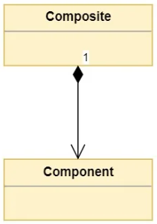
Lecture 9
Composition Relationship
Composition is a concept that models a has a relationship.
It enables creating complex types by combining objects of
other types.
This means that a class Composite can contain an object of
another class Component.

Slide 13
Lecture 9
Composition Relationship
Cont'd
Example:
class Course:
def __init__(self, name):
self.cname = name; self.hours = 3
class Student:
def __init__(self, name):
self.course = Course("OOP"); self.name = name
s = Student("ahmed")
print(s.course.cname)

Slide 14
Lecture 9
Composition Relationship
Cont'd
Use class object inside another class
from test import Course
class Student:
def __init__(self, name):
self.course = Course("OOP")
self.name = name
s = Student("ahmed")
print(s.course.cname)

Slide 15
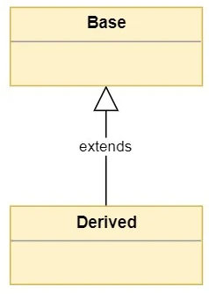
Lecture 9
Inheritance Relationship
Inheritance models what is called an is a relationship.
This means that when you have a Derived class that inherits
from a Base class, you created a relationship where Derived
is a specialized version of Base.
class DrivedClassName(BaseClassName):
# body

Slide 16
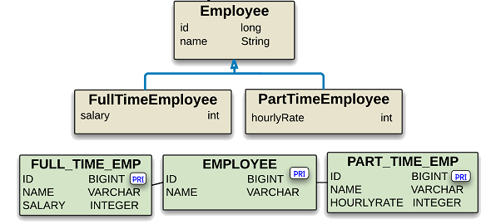
Lecture 9
Inheritance Relationship
Cont'd

Slide 17
Lecture 9
Inheritance Relationship
Cont'd
Example
class Point:
def __init__(self, x, y):
self.x = x; self.y = y
def __str__(self):
return f"The point is located in ({self.x}, {self.y})"
def displayX(self):
print("The point x coordinate = ", self.x)

Slide 18
Lecture 9
Inheritance Relationship
Cont'd
Example
class Circle(Point):
def __init__(self, r, x, y):
Point.__init__(self, x, y); self.radius = r
def __str__(self):
print(Point.__str__(self)); return f"The circle radius = {self.radius}"
c1 = Circle(2.5, 2, 3); print(c1); c1.displayX()
print(isinstance(c1,Circle)); issubclass(Circle, Point)

Slide 19
Lecture 9
Polymorphism Relationship
Polymorphism is taken from the Greek words Poly (many) and morphism (forms). It means that the same function name can be used for different types.
There are different methods to use polymorphism:
  Using functions.
  Using class methods.

Slide 20
Lecture 9
Polymorphism with Function and Objects
You can create a function that can take any object, allowing for polymorphism.
Create a function called func() which will take an object. Now, let’s give the function something to do that uses the ‘obj’ object we passed to it.

Slide 21
Lecture 9
Polymorphism with Function and Objects
Cont'd
Example
class Tomato:
def type(self): print("Vegetable")
def color(self): print("Red")
class Apple:
def type(self): print("Fruit")
def color(self): print("Red")

Slide 22
Lecture 9
Polymorphism with Function and Objects
Cont'd
def func(obj):
obj.type()
obj.color()
obj_tomato = Tomato()
obj_apple = Apple()
func(obj_tomato)
func(obj_apple)

Slide 23
Lecture 9
Polymorphism with Inheritance
Polymorphism defines methods in the child class that have the same name as the methods in the parent class.
In inheritance, the child class inherits the methods from the parent class. Also, it is possible to modify a method in a child class that it has inherited from the parent class.
This process of re-implementing a method in the child class is known as Method Overriding.

Slide 24
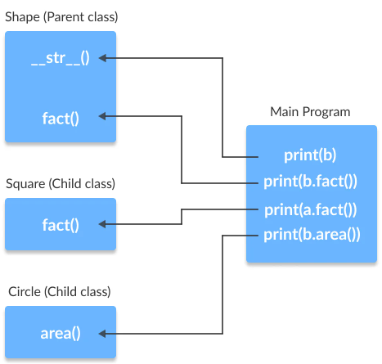
Lecture 9
Polymorphism with Inheritance
Cont'd

Slide 25
Lecture 9
Polymorphism with Inheritance
Cont'd
Example
class Bird:
def intro(self): print("There are different types of birds")
def flight(self): print("Most of the birds can fly but some cannot")
class parrot(Bird):
def flight(self): print("Parrots can fly")
class penguin(Bird):
def flight(self): print("Penguins do not fly")

Slide 26
Lecture 9
Polymorphism with Inheritance
Cont'd
Example
obj_bird = Bird(); obj_parr = parrot(); obj_peng = penguin()
obj_bird.intro(); obj_bird.flight()
obj_parr.intro(); obj_parr.flight()
obj_peng.intro(); obj_peng.flight()

Slide 27
Lecture 9
Exception Handling
Errors (e.g., Syntax error) are the problems in a program due to which the program will stop the execution.
Exceptions are raised when some internal events occur which changes the normal flow of the program.
Exception is the base class for all the exceptions in Python.

Slide 28
Lecture 9
Exception Handling
Cont'd
Example
marks = 10000
# perform division with 0
a = marks / 0
print(a) #ZeroDivisionError

Slide 29
Lecture 9
Exception Handling
Cont'd
You can choose to throw an exception if a condition occurs.
To throw (or raise) an exception, use the raise keyword.
You can define what kind of error to raise, and the text to print to the user.

Slide 30
Lecture 9
Exception Handling
Cont'd
Example
x = -1
if x < 0:
raise Exception("Sorry, no numbers below zero")

Slide 31
Lecture 9
Exception Handling
Cont'd
Example
x = "hello"
if not type(x) is int:
raise TypeError("Only integers are allowed")

Slide 32
Lecture 9
Exception Handling
Cont'd
Example
a = int(input("Enter a positive integer: "))
if a <= 0:
raise ValueError("That is not a positive number!")

Slide 33
Lecture 9
Catching Exceptions
Try and except statements are used to catch and handle exceptions.
Statements that can raise exceptions are kept inside the try clause and the statements that handle the exception are written inside except clause.
A try statement can have more than one except clause, to specify handlers for different exceptions.

Slide 34
Lecture 9
Catching Exceptions
Cont'd
Example
a = [1, 2, 3]
try:
print("Second element = ", a[1])
# Throws error since there are only 3 elements in array
print("Fourth element = ", a[3])
except:
print ("An error occurred")

Slide 35
Lecture 9
Catching Exceptions
Cont'd
Example
def fun(a):
if a < 4: b = a/(a-3)
print("Value of b = ", b)
try:
fun(3)
fun(5)
except ZeroDivisionError: print("ZeroDivisionError Occurred and Handled")
except NameError: print("NameError Occurred and Handled")

Slide 36
THANK YOU

