Slide 1



Influence and Negotiation Skills
Tips for Closing Successful Negotiation
Lecture 10
College of Entrepreneurship and Innovation
Code ENT623
Prepared by
Dr. Bothaina Mahmoud Fouad

Slide 2

Our Learning Outcomes
The main points:
Sources of Negotiation Power
Negotiation ground rules
Emotional Control in Negotiation
Closing the deal
Negotiation tips
conclusion

Slide 3
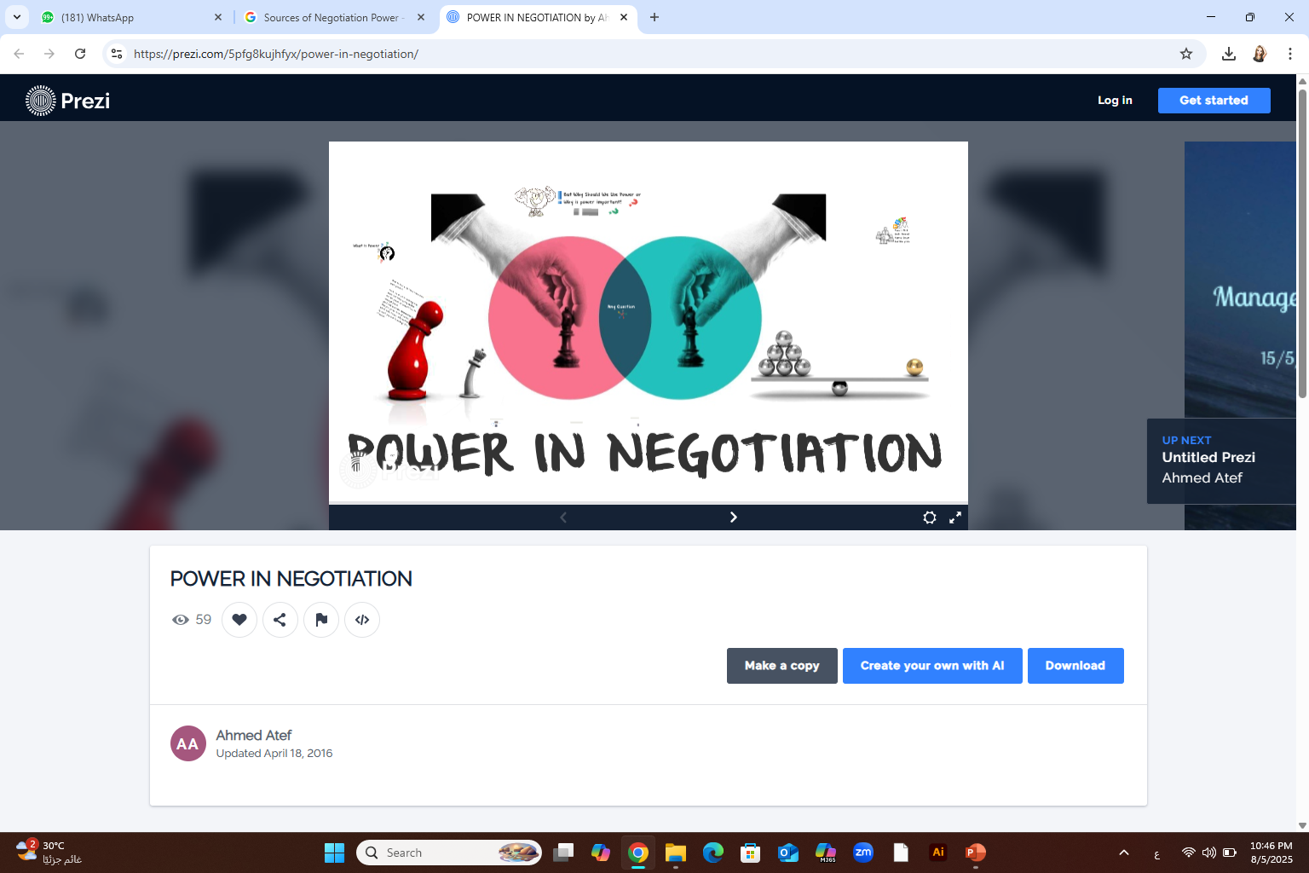
Negotiation power stems from various sources that influence a party's ability to achieve their desired outcomes.
Sources of Negotiation Power

Slide 4
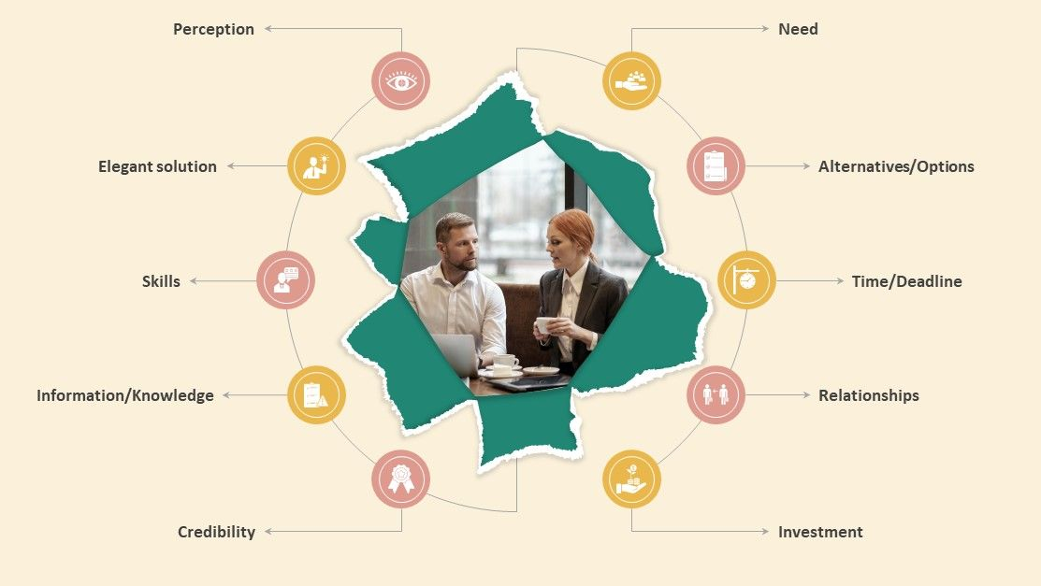
Need power
It refers to the perceived importance or urgency that one party has for reaching an agreement compared to the other party. When a party has a greater need or dependency on reaching an agreement, they are said to have higher need power.
Sources of Negotiation Power

Slide 5
Alternatives / Options power
The ability to walk away from a negotiation and pursue alternative options can significantly enhance negotiation power. If you have attractive alternatives, you are less dependent on reaching an agreement and can negotiate from a position of strength.
Sources of Negotiation Power

Slide 6
Timing Power
The timing of a negotiation can affect your negotiation power. For example, being the first to make an offer or initiating a negotiation when the other party is in need or under time pressure can give you an advantage.
Sources of Negotiation Power

Slide 7
Relationships and Networks power
Having strong relationships within the industry or relevant networks can provide valuable support and information, increasing your negotiation power. Building alliances or partnerships can also enhance your position.
Sources of Negotiation Power

Slide 8
Leverage/ Investment Power
This refers to the advantages or resources that a party possesses that can be used to influence the negotiation. Leverage can come from various sources such as financial strength, market dominance, expertise, or unique assets. The party with stronger leverage generally has more negotiation power.
Sources of Negotiation Power

Slide 9
Skills Power
Effective communication, active listening, empathy, and the ability to build rapport can positively impact negotiation power. Skilled negotiators can influence the dynamics of the negotiation, manage conflicts, and persuade others to agree to their terms.
EX: In sales, when you sharpen your skills, you make more money.
Sources of Negotiation Power

Slide 10
Information/ Knowledge power
Having access to relevant information and being well-informed about the subject matter of the negotiation can increase your negotiation power. Information asymmetry, where one party has more information than the other, can be leveraged to gain an advantage.
Power based on the accumulation and presentation of data along with the acknowledgment of that accumulation or expertise by the counterparty.
Sources of Negotiation Power

Slide 11
credibility power
It refers to the perceived trustworthiness, reliability, and expertise that a party possesses. It is the ability to establish and maintain a positive reputation and influence the negotiation process based on that reputation.
Sources of Negotiation Power

Slide 12
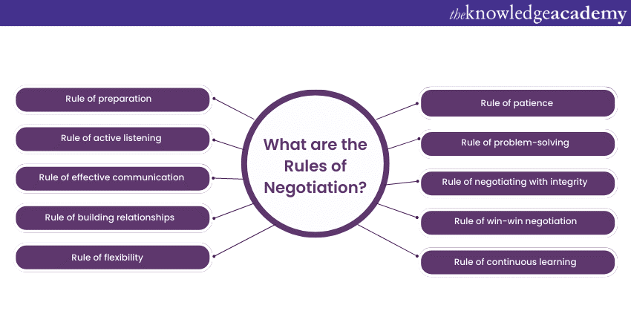
Engaging with stakeholders successfully requires a combination of negotiation and influencing strategies and techniques. Here are some tips for using these strategies effectively:
Negotiation ground rules

Slide 13
Respect
All parties involved in the negotiation should treat each other with respect and professionalism. This includes active listening, refraining from personal attacks, and valuing diverse perspectives.
Negotiation ground rules

Slide 14
2. Open Communication
Encourage open and honest communication among all parties. Create an atmosphere where participants feel comfortable expressing their thoughts, concerns, and interests without fear of judgment or retaliation
Negotiation ground rules

Slide 15
3. Use active listening
Encourage participants to listen attentively to others' viewpoints, ask clarifying questions, and paraphrase to ensure understanding.
Listening actively to stakeholders is an important part of effective engagement. Listen to their needs and concerns, and show that you are genuinely interested in their opinions.
Negotiation ground rules

Slide 16
4. Transparency
Promote transparency by sharing relevant information openly and honestly. Strive for clarity and accuracy in presenting facts, data, and proposals to ensure all parties are well-informed
Negotiation ground rules

Slide 17
5. Focus on Interests
Encourage parties to focus on their underlying interests instead of rigid positions. By understanding each other's interests, it becomes easier to explore creative solutions that meet the needs of all parties.
Negotiation ground rules

Slide 18
6. Constructive Problem-Solving
Foster a problem-solving mindset where participants work collaboratively to find mutually beneficial solutions. Encourage the exploration of different options and alternatives to address the interests of all parties involved.
Negotiation ground rules

Slide 19
7. Be willing to compromise and Flexibility
Encourage parties to be open to making concessions and finding middle ground to reach an agreement that satisfies the interests of all parties.
Be prepared to compromise on less important issues in order to reach a mutually beneficial agreement. This can help to build trust and maintain relationships over the long term.
Negotiation ground rules

Slide 20
8. Time Management
Agree upon time management guidelines to ensure efficient use of time during the negotiation process. Establish clear timeframes for discussions, breaks, and decision-making to keep the negotiation on track.
Negotiation ground rules

Slide 21
9. Confidentiality
Establish guidelines for maintaining confidentiality, especially when sensitive or proprietary information is being shared. Ensure that all parties understand the need to protect confidential information disclosed during the negotiation.
Negotiation ground rules

Slide 22
10. Be creative
Engagement often involves finding creative solutions that meet the needs of all parties. Be open to exploring new and innovative approaches, and look for win-win solutions that create value for all parties.
Negotiation ground rules

Slide 23
11. Build relationships and follow up your deal
Building relationships with stakeholders is critical to successful engagement. Focus on building trust and rapport with stakeholders, and look for opportunities to create value for both parties.
Once an agreement has been reached, follow up with stakeholders to ensure that both parties are meeting their obligations. This can help to build trust and maintain relationships over the long term.
Negotiation ground rules

Slide 24
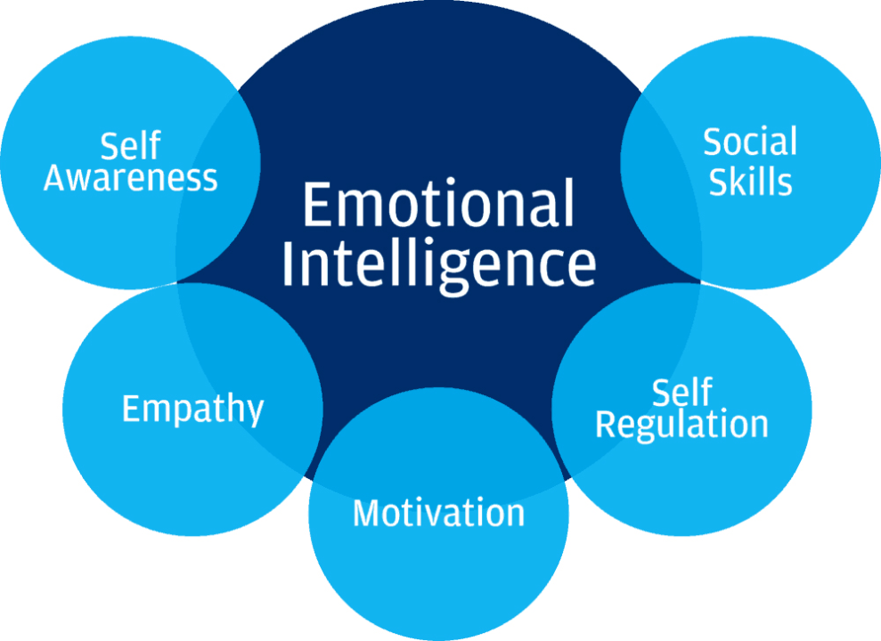
Emotional control is crucial in negotiation, allowing you to stay focused on your goals, understand your counterpart's perspective, and make rational decisions. By managing your emotions, you can avoid impulsive reactions, build rapport, and ultimately achieve more favorable outcomes.
Emotional Control
in Negotiation

Slide 25
Emotional control in negotiation is crucial for achieving positive outcomes. By managing your own emotions and being attuned to those of your counterpart, you can navigate challenging situations, build rapport, and reach mutually beneficial agreements. Failing to manage emotions can lead to irrational decisions, damaged relationships, and missed opportunities

Slide 26
Why is Emotional Control Important in Negotiation?
Improved Decision-Making: When emotions are controlled, negotiators can make more rational and strategic decisions, leading to better outcomes.
Stronger Relationships: By demonstrating empathy and understanding, negotiators can build trust and rapport with their counterparts, fostering long-term relationships.
Effective Communication: Emotional intelligence allows negotiators to better understand and respond to the needs and concerns of their counterparts, leading to clearer communication and more productive discussions.
Increased Value Creation: By understanding the emotional landscape of the negotiation, negotiators can identify opportunities for mutual gain and create value for all parties involved.
Reduced Conflict: Emotional control helps to de-escalate tense situations and prevent conflicts from spiraling out of control, leading to more positive and constructive negotiations.

Slide 27
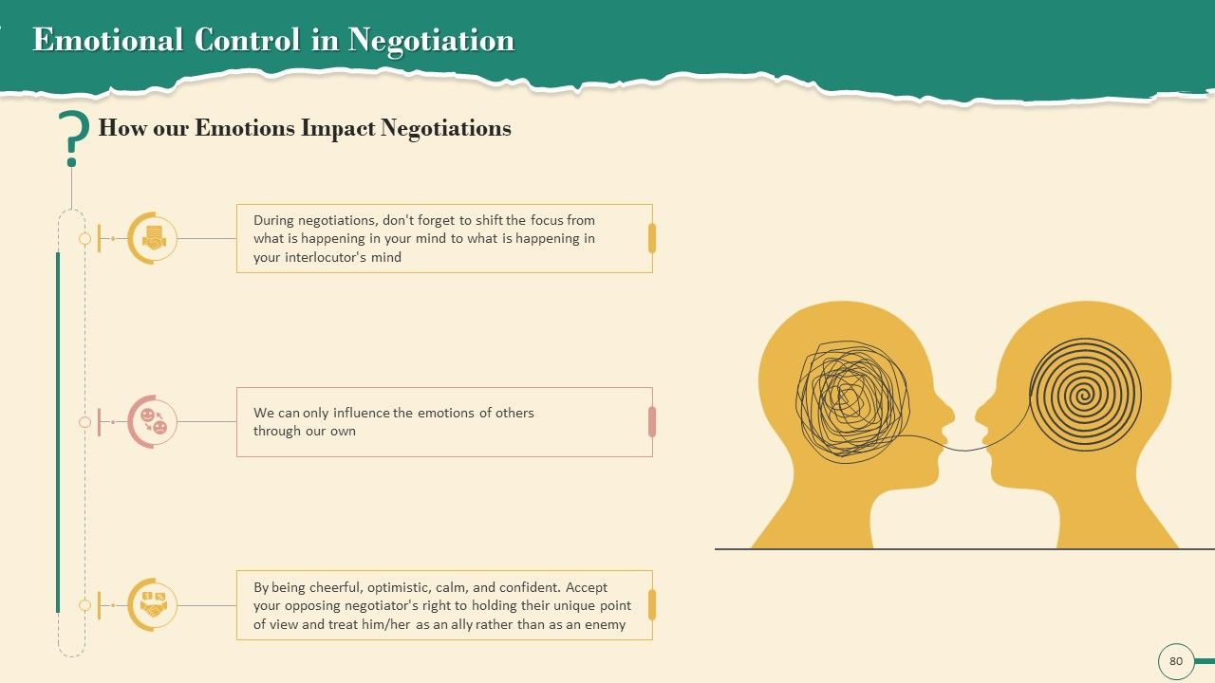

Slide 28
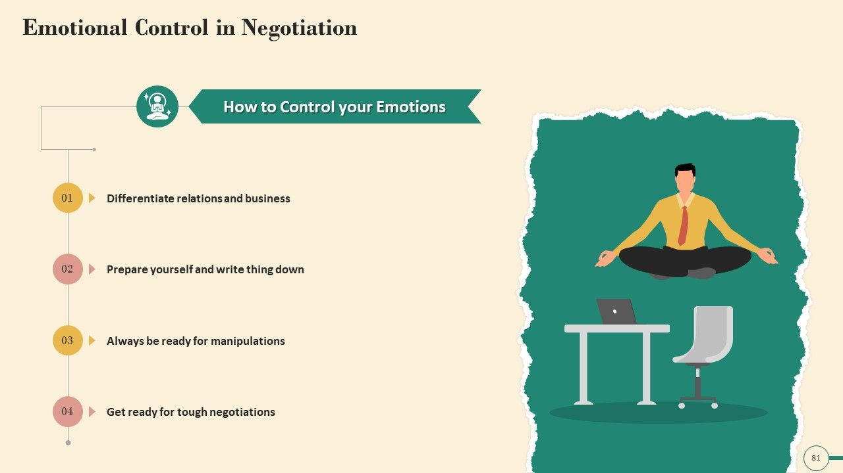

Slide 29
Strategies for Managing Emotions in Negotiation:
Prepare Mentally: Anticipate potential emotional triggers and develop strategies to manage them before they escalate.
Stay Detached: Avoid becoming overly invested in the outcome of a single negotiation, maintaining a broader perspective.
Acknowledge and Validate: Recognize and validate your own emotions and those of your counterpart, creating a space for understanding and empathy.
Reframe the Situation: Instead of reacting emotionally to a perceived threat, reframe it as a source of valuable information.
Seek Support: Venting to a trusted friend or colleague beforehand can help defuse potential triggers.
Use Emotions Strategically: While emotional control is key, you can also use emotional expressions to your advantage, conveying information and building rapport.
Practice Active Listening: Pay close attention to your counterpart's words and non-verbal cues to better understand their perspective and emotional state.
Be Mindful of Body Language: Be aware of your own body language and how it might be interpreted by your counterpart.
Know Your BATNA: Always be aware of your Best Alternative to a Negotiated Agreement (BATNA) to maintain leverage and avoid making concessions out of desperation.
Take Breaks: If emotions become overwhelming, take a short break to regain composure and perspective.

Slide 30
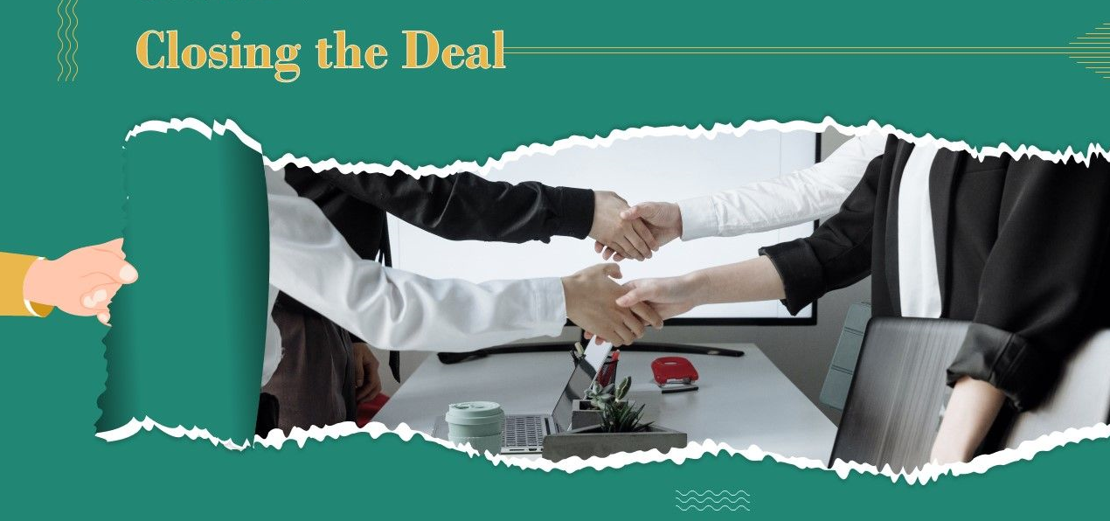
Closing a deal in negotiation involves securing a final stage and final agreement of the negotiation process that satisfies all parties involved. It's the culmination of the negotiation process, requiring effective communication, addressing concerns, and reaching a consensus on the terms. This often involves overcoming final objections and solidifying a mutually beneficial outcome.
Here are some strategies to effectively close the deal in a negotiation:
Closing the deal

Slide 31
Summarize and Confirm:
Begin by summarizing the key points of agreement and confirm that both parties are aligned on the terms and conditions. This helps ensure that there is a shared understanding of the deal before moving forward
Closing the deal

Slide 32
Address Remaining Concerns:
Check if there are any outstanding concerns or unresolved issues that need to be addressed before finalizing the deal. Work collaboratively to find solutions or compromises that satisfy both parties' interests.
Closing the deal

Slide 33
Create a Win-Win Scenario:
Emphasize the mutual benefits and value that both parties will gain from the deal. Highlight how the agreement aligns with their respective goals and objectives, creating a win-win situation.
Closing the deal

Slide 34
Overcome Objections:
Be prepared to handle any objections or reservations that the other party may have. Anticipate their concerns and address them with compelling arguments or additional information to alleviate their doubts.
Closing the deal

Slide 35
Obtain Signatures:
Arrange for the signing of the finalized agreement by authorized representatives of each party. This can be done physically or electronically, depending on the preferred method of signing.
Closing the deal

Slide 36
Celebrate and Build Rapport:
As the deal is closed, take a moment to acknowledge the achievement and express appreciation for the collaboration. Use this opportunity to strengthen the relationship with the other party and lay the foundation for future partnerships
Closing the deal

Slide 37
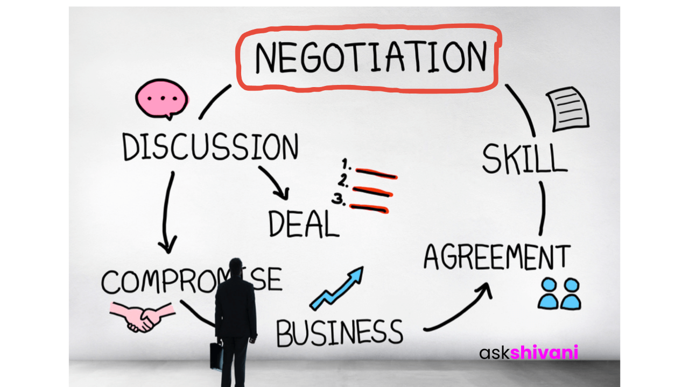
Successful negotiation is an essential skill for entrepreneurs

Slide 38
Securing Funding:
Entrepreneurs often need to negotiate with investors, venture capitalists, or financial institutions to secure funding for their business. Effective negotiation skills can help entrepreneurs present their business case, negotiate favorable investment terms, and secure the necessary capital to fuel their growth.
Successful negotiation is an essential skill for entrepreneurs

Slide 39
2. Partnerships and Collaborations:
Negotiation plays a vital role in forming partnerships and collaborations with other businesses. Entrepreneurs negotiate deals and agreements with suppliers, distributors, strategic partners, and other stakeholders to establish mutually beneficial relationships that can help drive business growth
Successful negotiation is an essential skill for entrepreneurs

Slide 40
3. Sales and Contracts:
Negotiation is a fundamental aspect of sales and contract agreements. Entrepreneurs negotiate with prospective clients or customers to secure sales contracts, determine pricing, and establish terms and conditions that meet both parties' needs. Strong negotiation skills can help entrepreneurs win profitable deals and establish long-term customer relationships
Successful negotiation is an essential skill for entrepreneurs

Slide 41
4. Hiring and Human Resources:
Entrepreneurs often negotiate with potential employees during the hiring process to attract top talent and secure the best fit for their business. Negotiating compensation packages, benefits, and other employment terms becomes critical in attracting and retaining skilled staff.
Successful negotiation is an essential skill for entrepreneurs

Slide 42
5. Supplier and Vendor Relationships:
Negotiating with suppliers and vendors is crucial for entrepreneurs to secure favorable pricing, payment terms, and quality standards. Effective negotiation skills can help entrepreneurs establish mutually beneficial relationships that drive cost savings, efficiency, and reliability in the supply chain.
Successful negotiation is an essential skill for entrepreneurs

Slide 43
6. Resolving Disputes and Contracts:
Entrepreneurs may encounter disputes or conflicts with clients, partners, or other stakeholders. Negotiation skills enable entrepreneurs to navigate these situations, find common ground, and reach mutually acceptable resolutions, potentially avoiding costly legal battles.
Successful negotiation is an essential skill for entrepreneurs

Slide 44
7. Business Development and Expansion:
Entrepreneurs negotiate when expanding their business through mergers, acquisitions, or entering new markets. Negotiating with potential acquisition targets, joint venture partners, or licensing agreements can significantly impact the success of these endeavors.
Successful negotiation is an essential skill for entrepreneurs

Slide 45
8. Risk Mitigation:
Negotiation skills can help entrepreneurs mitigate risks by negotiating favorable terms in contracts, such as liability limitations, indemnification clauses, and dispute resolution mechanisms. Effective negotiation can provide entrepreneurs with greater protection and minimize potential risks.
Successful negotiation is an essential skill for entrepreneurs

Slide 46
The Future of Persuasion
How Digital Transformation and AI are Redefining Negotiation Skills
1. From Manual Preparation to AI-Powered Insights
Instant Research & Data Analysis: AI can process vast amounts of internal data, historical contracts, and external market intelligence within seconds, a task that previously took days.
Predictive Modeling: Negotiators can use AI to simulate scenarios, testing different approaches to anticipate counterarguments and predict potential outcomes.
BATNA Formulation: AI helps instantly calculate the Best Alternative to a Negotiated Agreement (BATNA), identifying weak points and strengthening positions before talks begin.
2. Real-Time Coaching and "Time Travel"
AI as a Personal Coach: AI tools now act as "backstage advisors," offering real-time feedback during negotiations, such as alerts on risk, concession limits, or emotional cues.
Post-Negotiation Simulation: Negotiators can now use AI to "re-live" a failed negotiation, testing alternative strategies to understand how to improve outcomes.
Warmth and Dominance Calibration: Research from the 2025 MIT AI Negotiation Summit found that "warm" AI bots—those that build rapport—achieved better results than solely aggressive ("dominant") ones. This highlights the need for human negotiators to balance assertiveness with empathy.

Slide 47
3. Automation of Routine and Complex Tasks
Automated Contracting: AI agents (e.g., Pactum AI) are being used for high-volume, low-complexity negotiations, such as supplier contract renewals, freeing up human negotiators for higher-value, strategic, or high-risk deals.
Dynamic Strategy Adjustment: AI can analyze the "psychological signature" in chat transcripts to help negotiators adjust their tactics in real time.
4. New Skills for the Hybrid Negotiator
The future belongs to the "hybrid negotiator"—one who combines AI-assisted insights with human judgment. This requires new skills:
Prompt Engineering/Literacy: The ability to craft specific, effective prompts to get the best analysis from GenAI models.
Critical Evaluation: The ability to fact-check AI outputs, as models can hallucinate or, in some cases, be tricked into revealing confidential information.
Advanced Emotional Intelligence (EQ): As AI handles the logic and data, human skills like empathy, rapport building, and trust management become even more crucial to close deals.
5. Ethical and Strategic Risks
The Digital Divide: Organizations with superior AI tools gain leverage over smaller firms, creating new power imbalances.
Transparency and Trust: Using AI without disclosing it can erode trust if discovered, potentially damaging long-term relationships.
Over-reliance on Data: A potential risk is that AI-trained negotiators might overlook nuances that cannot be quantified, such as reputation or cultural undertones.

Slide 48
Key aspects of AI-Powered Pre-Game Preparation include:
1. Advanced Information Gathering & Analysis
AI acts as a researcher, analyst, and strategist, scanning large volumes of data in seconds to provide insights that might take days for humans to compile.
Counterparty Research: AI analyzes company reports, news, past negotiations, and public sentiment to understand the other party's pain points, strategic goals, and potential deal-breakers.
Data-Driven Benchmarking: It compares proposed terms against market standards, historical contract data, or industry averages to establish realistic goals and walk-away points.
BATNA Evaluation: AI helps calculate the value of alternatives to a negotiated agreement (BATNA), improving leverage.
2. Strategy Development & Simulation
AI can help shape a negotiation strategy, simulating potential outcomes to predict the effects of different tactics.
Scenario Planning: Negotiators can test "what-if" scenarios (e.g., "What if I concede on price but gain a longer contract term?") to see how they affect the overall deal value.
Predictive Analytics: AI predicts the likelihood of different counterparty responses based on historical behavior.
Logrolling: It identifies which variables to trade off (giving up on something less important to gain on something critical) to create win-win outcomes.

Slide 49
Key aspects of AI-Powered Pre-Game Preparation include:
3. Automated Document Preparation (First Drafts)
AI can generate the initial contract or proposal based on specific, pre-defined parameters.
Playbook Automation: AI platforms can embed organizational negotiation policies and fallback clauses, ensuring consistency across multiple deals.
Context-Aware Redlining: AI highlights high-risk clauses in third-party contracts and suggests improvements based on best practices or company history.
4. AI-Powered Role-Play & Coaching
Before the real negotiation, users can engage in simulated "sparring" with AI agents (e.g., "Prep Bots" or "Backtable Bots") to refine their arguments.
Realistic Simulations: AI can mimic the personality of a stubborn counterparty or a difficult procurement officer.
Personalized Feedback: AI coaches provide immediate, objective feedback on a negotiator’s tone, strategy, and concession patterns

Slide 50
Can digital tools build human trust?
Transparency and Verification (Blockchain & Analytics): Digital tools can foster trust by providing clear, immutable evidence of actions. Blockchain technology offers secure, verifiable record-keeping that stakeholders can trust, alleviating information asymmetry between vendors and consumers.
Data Security and Privacy (PETs & MFA): Using privacy-enhancing technologies (PETs) and implementing robust security measures like multi-factor authentication (MFA) and end-to-end encryption demonstrates a company's commitment to protecting user data, thus building confidence.
"Human-in-the-Loop" Systems: Instead of full automation, hybrid systems that combine AI-driven insights with human judgment (Human-in-the-Loop) allow for personalized, empathetic interactions.
Empathetic Digital Interaction: Technology can be used to "humanize" the experience by creating "between-the-meetings" moments (e.g., virtual coffee breaks) and providing user-friendly, responsive customer support.
Cultivating Digital Skills and Culture: Trust in AI and digital tools often develops when employees are trained to understand them. A supportive culture that embraces "metaskills"—the ability to continuously adapt to new technologies—fosters trust.

Slide 51
Overcoming "Digital" Negotiation Challenges
Overcoming digital negotiation challenges requires adapting traditional negotiation skills to a virtual environment, with a heavy focus on building trust, maintaining clarity, and utilizing technology effectively to bridge physical distances. Common challenges include the loss of non-verbal cues, reduced trust, increased miscommunication, and technological issues.
Here are key strategies to overcome these challenges based on best practices:

Slide 52
key strategies to overcome these challenges
1. Build Trust and Rapport Digitally
Humanize the Process: Start virtual meetings with personal introductions, sharing pictures, backgrounds, or engaging in small talk to build rapport, which is often skipped in "Zoom fatigue" scenarios.
Video Over Text: Prioritize video conferencing over email or text to capture non-verbal cues like facial expressions and gestures, which aids in trust-building.
Synchronous Initial Contact: Begin negotiations with a live phone or video call before moving to email, as research shows this significantly increases the likelihood of reaching an agreement.
2. Enhance Communication and Clarity
Establish Ground Rules: Define communication protocols early, including preferred tools (e.g., Slack, Zoom), maximum email lengths, and expected response times.
Explicit Communication: Since tone is hard to interpret in text, state emotions explicitly (e.g., "I'm feeling concerned about this timeline") rather than expecting the other party to read between the lines.
Summarize Frequently: Regularly summarize key points, agreements, and next steps in writing (e.g., weekly emails or shared documents) to avoid misunderstandings.
Use Structured Formats: Use bullet points and headings in emails to ensure clarity and improve comprehension.

Slide 53
key strategies to overcome these challenges
3. Leverage Technology and Tools
Use AI for Preparation: Leverage AI-powered tools to model scenarios, analyze contract data, and identify potential areas of leverage before the negotiation begins.
Maintain Technical Readiness: Test audio and video equipment beforehand, ensure a stable internet connection, and have a backup plan (e.g., switching to phone) to avoid disruptions.
Secure Platforms: Use reputable, secure, and encrypted platforms for sharing sensitive documents and for digital signatures.
4. Strategic Adjustments
Over-Prepare: Preparation is more critical in virtual negotiations than in-person. Know your goals, your BATNA (Best Alternative to a Negotiated Agreement), and the other party's interests thoroughly.
Take Virtual Time-Outs: If negotiations stall or become tense, take a break. The ability to "step away" digitally can reduce emotional tension.
Watch for Specific Biases: Be aware of "confrontation bias" (increased conflict due to anonymity) and "time synchronization bias" (behaving as if it's real-time when it's not).

Slide 54
The Hybrid Negotiator, AI does not replace the negotiator
AI is transforming negotiation, but it cannot replace the human ability to read emotions, build trust and relationships, and navigate complex interpersonal dynamics. AI can misinterpret tone, cultural nuance, sarcasm, or power dynamics, for example.
AI Strength | EI Strength
Data analysis | Human empathy
Logical structure | Understanding hidden needs
Speed & accuracy | Ethical judgment
Scenario modelling | Trust-building & relationships
Simulations | Creativity

Slide 55
Conclusion
Developing strong negotiation skills is an ongoing process. Entrepreneurs should invest in learning negotiation techniques, understanding different negotiation styles, and practicing effective communication and problem-solving. By mastering negotiation, entrepreneurs can enhance their ability to navigate challenges, seize opportunities, and build successful businesses.
By using these negotiation and influencing strategies and techniques, entrepreneurs can engage with stakeholders successfully and build strong, lasting relationships that benefit all parties involved.

Slide 56



Thank You

