Slide 1



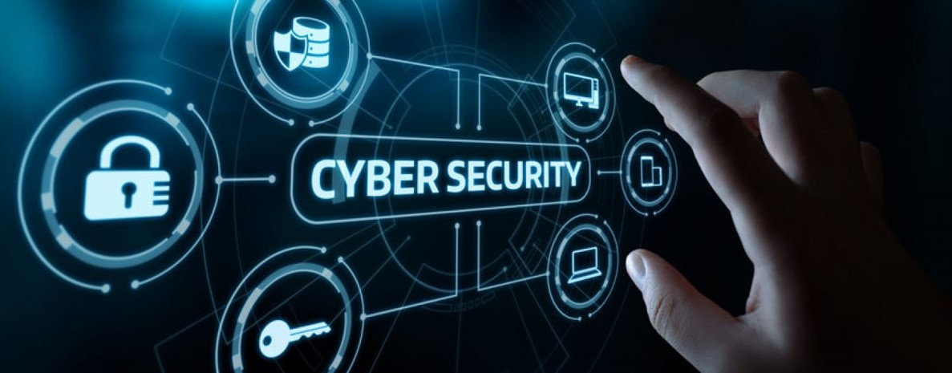
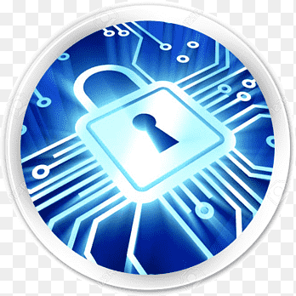
Lecture: #02
Introduction to Cybersecurity Concepts
Dr. Redhwan M. A. Saad
Head of Cybersecurity Department
Faculty of Informatics
Midocean University
CyberSecurity Fundamentals (CYB670)
www.midocean.ae

Slide 2

Outline
Lecture
02
The module covers the basics of Cybersecurity Concepts including:
The Importance and challenges in Cybersecurity
Cyberspace, Cyber threats, Cyberwarfare
CIA Triad, Threats, and Attacks
Cyber Terrorism
Cyber Security of Critical Infrastructure
Cybersecurity - Organizational Implications
Cybersecurity Fundamentals, Dr. Redhwan M. A. Saad
2
www.midocean.ae

Slide 3
The Definition of Cybersecurity
Lecture
02
    Cybersecurity refers to the body of technologies, processes, and practices designed to protect networks, devices, programs, and data from attack, damage, or unauthorized access. Cyber security may also be referred to as information technology security.
    Cybersecurity is the practice of protecting critical systems and sensitive information from digital attacks (IBM)
    Cybersecurity is the protection of internet-connected systems such as hardware, software and data from cyberthreats (TeachTarget)
    Cybersecurity is the application of technologies, processes and controls to protect systems, networks, programs, devices and data from cyber attacks.(itgovernance.co.uk)
Cybersecurity Fundamentals, Dr. Redhwan M. A. Saad
3
www.midocean.ae

Slide 4

The Definition of Cybersecurity
Lecture
02
Can be divided into a few common categories:
Operational security includes the processes and decisions for handling and protecting data assets. The permissions users have when accessing a network and the procedures that determine how and where data may be stored or shared all fall under this umbrella.
Disaster recovery and business continuity define how an organization responds to a cyber-security incident or any other event that causes the loss of operations or data. Disaster recovery policies dictate how the organization restores its operations and information to return to the same operating capacity as before the event. Business continuity is the plan the organization falls back on while trying to operate without certain resources.
Cybersecurity Fundamentals, Dr. Redhwan M. A. Saad
4
www.midocean.ae

Slide 5
The Definition of Cybersecurity
Lecture
02
Can be divided into a few common categories:
Network security is the practice of securing a computer network from intruders, whether targeted attackers or opportunistic malware.
Application security focuses on keeping software and devices free of threats. A compromised application could provide access to the data its designed to protect. Successful security begins in the design stage, well before a program or device is deployed.
Information security protects the integrity and privacy of data, both in storage and in transit.
Cybersecurity Fundamentals, Dr. Redhwan M. A. Saad
5
www.midocean.ae

Slide 6
The Definition of Cybersecurity
Lecture
02
Can be divided into a few common categories:
Operational security includes the processes and decisions for handling and protecting data assets. The permissions users have when accessing a network and the procedures that determine how and where data may be stored or shared all fall under this umbrella.
Disaster recovery and business continuity define how an organization responds to a cyber-security incident or any other event that causes the loss of operations or data. Disaster recovery policies dictate how the organization restores its operations and information to return to the same operating capacity as before the event. Business continuity is the plan the organization falls back on while trying to operate without certain resources.
Cybersecurity Fundamentals, Dr. Redhwan M. A. Saad
6
www.midocean.ae

Slide 7
The Definition of Cybersecurity
Lecture
02
Can be divided into a few common categories:
End-user education addresses the most unpredictable cyber-security factor: people. Anyone can accidentally introduce a virus to an otherwise secure system by failing to follow good security practices. Teaching users to delete suspicious email attachments, not plug in unidentified USB drives, and various other important lessons is vital for the security of any organization. (www.kaspersky.com)
Cybersecurity Fundamentals, Dr. Redhwan M. A. Saad
7
www.midocean.ae

Slide 8
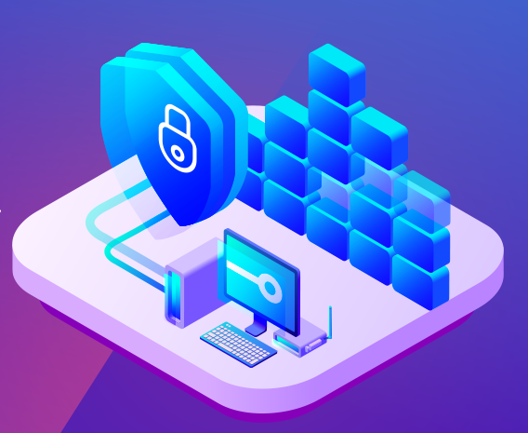
The Importance and challenges in Cybersecurity
Lecture
02
Cyber security is important because it protects all categories of data from theft and damage. This includes sensitive data, personally identifiable information (PII), protected health information (PHI), personal information, intellectual property, data, and governmental and industry information systems.
Why is Cyber Awareness Important?
Cyber crime is a growing trend
Raise awareness of threats
As with most crimes the police can’t tackle this problem alone
To encourage reporting
Promote Government backed scheme ‘Cyber Essentials’
Cyber crime is massively under reported.
Cybersecurity Fundamentals, Dr. Redhwan M. A. Saad
8
www.midocean.ae

Slide 9
Challenges of Cybersecurity
Lecture
02
    For effective cyber security, an organization needs to coordinate its efforts throughout its entire information system.
    Elements of cyber encompass all of the following:
Network security: The process of protecting the network from unwanted users, attacks and intrusions.
Application security: Apps require constant updates and testing to ensure these programs are secure from attacks.
Endpoint security: Remote access is a necessary part of business, but can also be a weak point for data. Endpoint security is the process of protecting remote access to a company’s network.
Data security: Inside of networks and applications is data. Protecting company and customer information is a separate layer of security.
Identity management: Essentially, this is a process of understanding the access every individual has in an organization.
Cybersecurity Fundamentals, Dr. Redhwan M. A. Saad
9
www.midocean.ae

Slide 10
Challenges of Cybersecurity
Lecture
02
    Elements of cyber encompass all of the following:
Database and infrastructure security: Everything in a network involves databases and physical equipment. Protecting these devices is equally important.
Cloud security: Many files are in digital environments or “the cloud”. Protecting data in a 100% online environment presents a large amount of challenges.
Security for mobile devices: Cell phones and tablets involve virtually every type of security challenge in and of themselves.
Disaster recovery/business continuity planning: In the event of a security breach, natural disaster or other event data must be protected and business must go on. For this, you’ll need a plan.
End-user education: Users may be employees accessing the network or customers logging on to a company app. Educating good habits (password changes and having a strong password, 2-factor authentication, etc.) is an important part of cybersecurity.
Cybersecurity Fundamentals, Dr. Redhwan M. A. Saad
10
www.midocean.ae

Slide 11
Challenges of Cybersecurity
Lecture
02
The most difficult challenge in cyber security is the ever-evolving nature of security risks themselves. Traditionally, organizations and the government have focused most of their cyber security resources on perimeter security to protect only their most crucial system components and defend against known threats. Today, this approach is insufficient, as the threats advance and change more quickly than organizations can keep up with. As a result, advisory organizations promote more proactive and adaptive approaches to cyber security.
Cybersecurity Fundamentals, Dr. Redhwan M. A. Saad
11
www.midocean.ae

Slide 12
Cyberspace
Lecture
02
    Cyberspace is more than the internet, including not only hardware, software, data and information systems, but also people and social interaction within these networks and the whole infrastructure.
    The International Telecommunication Union (ITU) uses the term to describe the “systems and services connected either directly to or indirectly to the internet, telecommunications and computer networks.”
    The International Organisation for Standardisation (ISO) defining cyber as “the complex environment resulting from the interaction of people, software and services on the internet by means of technology devices and networks connected to it, which does not exist in any physical form.”
Cybersecurity Fundamentals, Dr. Redhwan M. A. Saad
12
www.midocean.ae

Slide 13
Cyber threats,
Lecture
02
A cyber or cybersecurity threat is a malicious act that seeks to damage data, steal data, or disrupt digital life in general. Cyber threats include computer viruses, data breaches, Denial of Service (DoS) attacks, and other attack vectors.
Cyber threats also refer to the possibility of a successful cyber attack that aims to gain unauthorized access, damage, disrupt, or steal an information technology asset, computer network, intellectual property or any other form of sensitive data. Cyber threats can come from within an organization by trusted users or from remote locations by unknown parties.
Cybersecurity Fundamentals, Dr. Redhwan M. A. Saad
13
www.midocean.ae

Slide 14
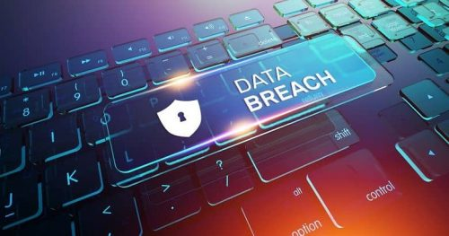
Cyber threats,
Lecture
02
Cyber threats come from numerous threat actors including:
Hostile Nation-States.
Corporate Spies and Organized Crime Organizations
Terrorist Groups
Hacktivists (across political ideals and issues)
Disgruntled Insiders
Hackers
Natural Disasters
Accidental Actions of Authorized Users
Cybersecurity Fundamentals, Dr. Redhwan M. A. Saad
14
www.midocean.ae

Slide 15
Types of Cyber Security Threats
Lecture
02
Common cyber threats include:
Malware
‍Malware is software that does malicious tasks on a device or network such as corrupting data or taking control of a system.
Spyware
Spyware is a form of malware that hides on a device providing real-time information sharing to its host, enabling them to steal data like bank details and passwords.
Phishing Attacks
‍Phishing is when a cybercriminal attempts to lure individuals into providing sensitive data such as personally identifiable information (PII), banking and credit card details and passwords.
Distributed Denial of Service (DDoS) Attacks
‍Distributed denial of service attacks aim to disrupt a computer network by flooding the network with superfluous requests to overload the system and prevent legitimate requests being fulfilled.
Cybersecurity Fundamentals, Dr. Redhwan M. A. Saad
15
www.midocean.ae

Slide 16
Types of Cyber Security Threats
Lecture
02
Common cyber threats include:
Ransomware
Ransomware is a type of malware that denies access to a computer system or data until a ransom is paid.
Zero-Day Exploits
A zero-day exploit is a flaw in software, hardware or firmware that is unknown to the party or parties responsible for patching the flaw.
Advanced Persistent Threats
‍An advanced persistent threat is when an unauthorized user gains access to a system or network and remains there without being detected for an extended period of time.
Trojans
A trojan creates a backdoor in your system, allowing the attacker to gain control of your computer or access confidential information.
Cybersecurity Fundamentals, Dr. Redhwan M. A. Saad
16
www.midocean.ae

Slide 17
Types of Cyber Security Threats
Lecture
02
Common cyber threats include:
Wiper Attacks
A wiper attack is a form of malware whose intention is to wipe the hard drive of the computer it infects.‍
Intellectual Property Theft
Intellectual property theft is stealing or using someone else's intellectual property without permission.
Theft of Money
‍Cyber attacks may gain access to credit card numbers or bank accounts to steal money.
Data Manipulation
‍Data manipulation is a form of cyber attack that doesn't steal data but aims to change the data to make it harder for an organization to operate.
Data Destruction
‍Data destruction is when a cyber attacker attempts to delete data.
Cybersecurity Fundamentals, Dr. Redhwan M. A. Saad
17
www.midocean.ae

Slide 18
Types of Cyber Security Threats
Lecture
02
Common cyber threats include:
Man-in-the-Middle Attack (MITM Attack)
‍A MITM attack is when an attack relays and possibly alters the communication between two parties who believe they are communicating with each other.
Drive-by Downloads
‍A drive-by download attack is a download that happens without a person's knowledge often installing a computer virus, spyware, or malware.
Malvertising
‍Malvertising is the use of online advertising to spread malware.
Rogue Software
‍Rogue software is malware that is disguised as real software.
Unpatched Software
‍Unpatched software is software that has a known security weakness that has been fixed in a later release but not yet updated.
Cybersecurity Fundamentals, Dr. Redhwan M. A. Saad
18
www.midocean.ae

Slide 19
Types of Cyber Security Threats
Lecture
02
Common cyber threats include:
Data Centre Disrupted by Natural Disaster
‍The data centre your software is housed on could be disrupted by a natural disaster like flooding.
SQL Injection
A Structured Query Language (SQL) injection is a type of cyber attack that results from inserting malicious code into a server that uses SQL. When infected, the server releases information. Submitting the malicious code can be as simple as entering it into a vulnerable website search box.
Password Attacks
With the right password, a cyber attacker has access to a wealth of information. Social engineering is a type of password attack that Data Insider defines as “a strategy cyber attackers use that relies heavily on human interaction and often involves tricking people into breaking standard security practices.” Other types of password attacks include accessing a password database or outright guessing.
Cybersecurity Fundamentals, Dr. Redhwan M. A. Saad
19
www.midocean.ae

Slide 20
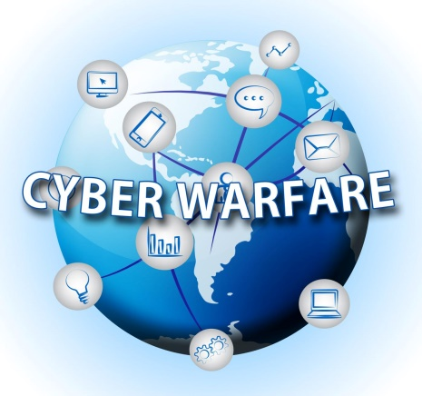
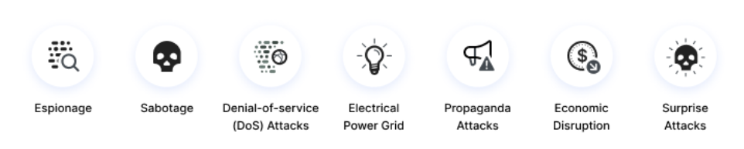
Cyber Warfare
Lecture
02
Cyber warfare is usually defined as a cyber attack or series of attacks that target a country. It has the potential to wreak havoc on government and civilian infrastructure and disrupt critical systems, resulting in damage to the state and even loss of life.
Here are some of the main types of cyber warfare attacks
Cybersecurity Fundamentals, Dr. Redhwan M. A. Saad
20
www.midocean.ae

Slide 21
Cyber Warfare
Lecture
02
Here are some of the main types of cyber warfare attacks
Espionage
Refers to monitoring other countries to steal secrets. In cyber warfare, this can involve using botnets or spear phishing attacks to compromise sensitive computer systems before exfiltrating sensitive information.
Sabotage
Government organizations must determine sensitive information and the risks if it is compromised. Hostile governments or terrorists may steal information, destroy it, or leverage insider threats such as dissatisfied or careless employees, or government employees with affiliation to the attacking country.
Denial-of-service (DoS) Attacks
DoS attacks prevent legitimate users from accessing a website by flooding it with fake requests and forcing the website to handle these requests. This type of attack can be used to disrupt critical operations and systems and block access to sensitive websites by civilians, military and security personnel, or research bodies.
Cybersecurity Fundamentals, Dr. Redhwan M. A. Saad
21
www.midocean.ae

Slide 22
Cyber Warfare
Lecture
02
Here are some of the main types of cyber warfare attacks
Electrical Power Grid
Attacking the power grid allows attackers to disable critical systems, disrupt infrastructure, and potentially result in bodily harm. Attacks on the power grid can also disrupt communications and render services such as text messages and communications unusable.
Propaganda Attacks
Attempts to control the minds and thoughts of people living in or fighting for a target country. Propaganda can be used to expose embarrassing truths, spread lies to make people lose trust in their country, or side with their enemies.
Cybersecurity Fundamentals, Dr. Redhwan M. A. Saad
22
www.midocean.ae

Slide 23
Cyber Warfare
Lecture
02
Here are some of the main types of cyber warfare attacks
Economic Disruption
Most modern economic systems operate using computers. Attackers can target computer networks of economic establishments such as stock markets, payment systems, and banks to steal money or block people from accessing the funds they need.
Surprise Attacks
These are the cyber equivalent of attacks like Pearl Harbor and 9/11. The point is to carry out a massive attack that the enemy isn’t expecting, enabling the attacker to weaken their defenses. This can be done to prepare the ground for a physical attack in the context of hybrid warfare.
Cybersecurity Fundamentals, Dr. Redhwan M. A. Saad
23
www.midocean.ae

Slide 24

Cyber Terrorism
Lecture
02
Cyber terrorism is often defined as any premeditated, politically motivated attack against information systems, programs and data that threatens violence or results in violence. The definition is sometimes expanded to include any cyber attack that intimidates or generates fear in the target population.
The nature of cyberterrorism covers conduct involving computer or Internet technology that:
is motivated by a political, religious or ideological cause
is intended to intimidate a government or a section of the public to varying degrees
seriously interferes with infrastructure
Cybersecurity Fundamentals, Dr. Redhwan M. A. Saad
24
www.midocean.ae

Slide 25
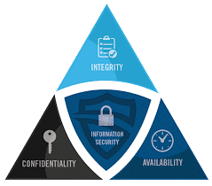
The CIA Triad
Lecture
02
The Three Goals of Cyber Security-CIA Triad Defined
Confidentiality – Keeping sensitive information private. Encryption services can protect your data at rest or in transit and prevent unauthorized access to protected data.
Integrity – is the consistency of data, networks, and systems. This includes mitigation and proactive measures to restrict unapproved changes, while also having the ability to recover data that has been lost or compromised.
Availability – refers to authorized users that can freely access the systems, networks, and data needed to perform their daily tasks. Resolving hardware and software conflicts, along with regular maintenance is crucial to keep systems up and available.
Cybersecurity Fundamentals, Dr. Redhwan M. A. Saad
25
www.midocean.ae

Slide 26
Security Attacks
Lecture
02
Interruption:
This is an attack on availability
Interception:
This is an attack on confidentiality
Modification:
This is an attack on integrity
Fabrication:
This is an attack on authenticity
S
D
S
D
S
D
A
S
D
S
D
A
A
Cybersecurity Fundamentals, Dr. Redhwan M. A. Saad
26
www.midocean.ae

Slide 27
Type of Security Threat
Lecture
02
Attacks
Passive Threats
Active Threats
Release of Message Contents
Traffic Analysis
Masquerade
Replay
Modification of Message Contents
Denial of Service
Cybersecurity Fundamentals, Dr. Redhwan M. A. Saad
27
www.midocean.ae
Notes:
التخفي او التنكر masquerade

Slide 28
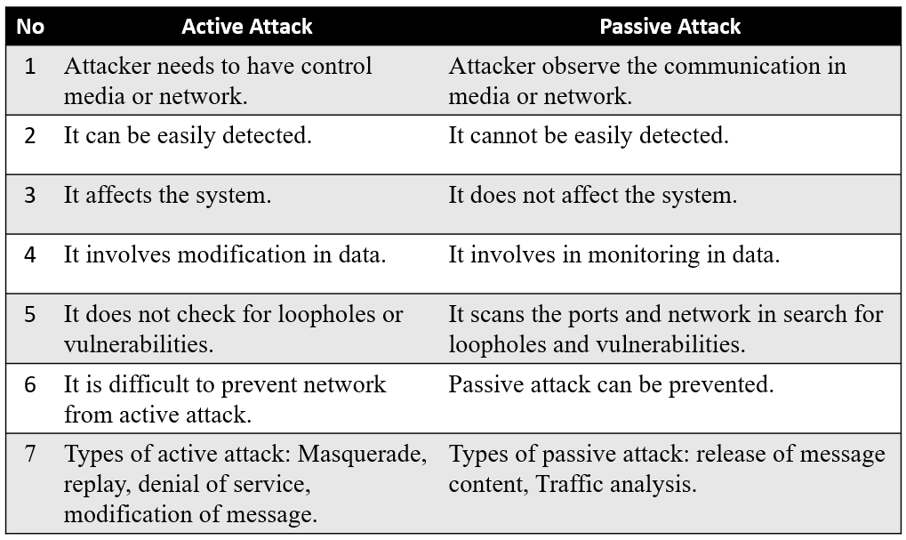
Difference between Active attack and Passive attack
Lecture
02
Cybersecurity Fundamentals, Dr. Redhwan M. A. Saad
28
www.midocean.ae

Slide 29
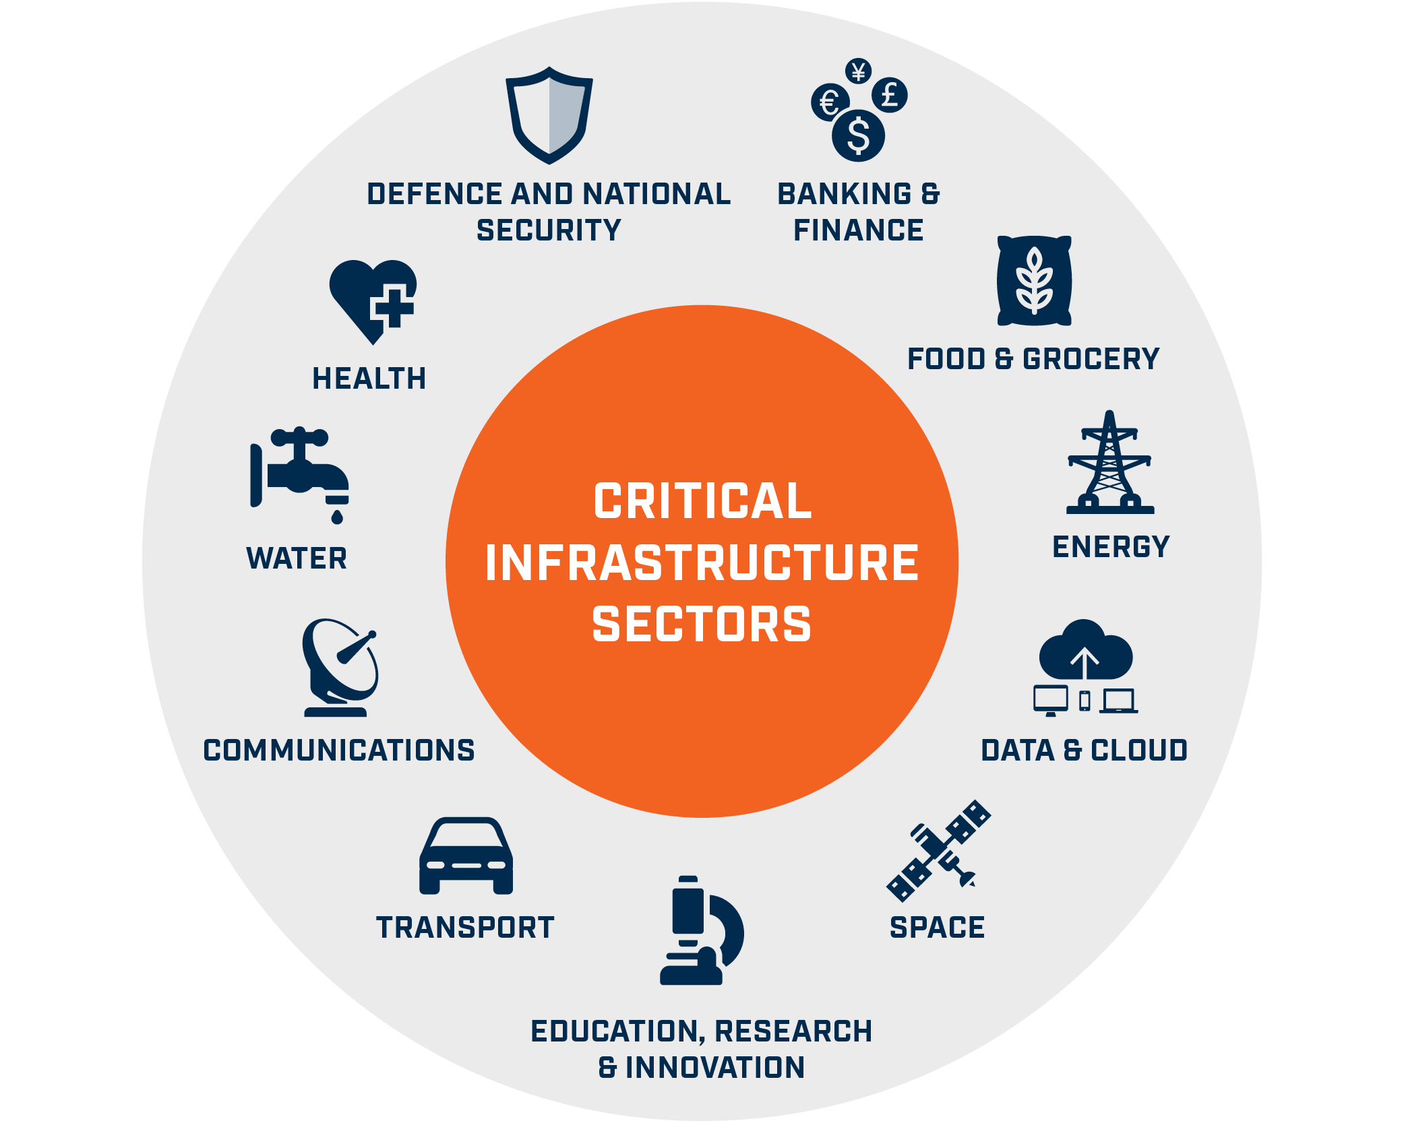
Cyber Security of Critical Infrastructure
Lecture
02
Critical infrastructure describes the physical and cyber systems and assets that are so vital to the countries that their incapacity or destruction would have a debilitating impact on physical or economic security or public health or safety.
Critical infrastructure sector
Chemical | Dams | Financial services | Information technology
Commercial facilities | Defense industrial base | Food and agriculture | Nuclear reactors, nuclear materials, and waste
Communications | Emergency services | Government facilities | Transportation systems
Critical manufacturing | Energy | Health care, public health | Water and wastewater systems
Cybersecurity Fundamentals, Dr. Redhwan M. A. Saad
29
www.midocean.ae
Notes:
تصف البنية التحتية الحيوية الأنظمة والأصول المادية والسيبرانية التي تعتبر حيوية للغاية للبلدان بحيث يكون لعجزها أو تدميرها تأثير مدمر على الأمن المادي أو الاقتصادي أو الصحة العامة أو السلامة.
قطاع البنية التحتية الحيوية

Slide 30
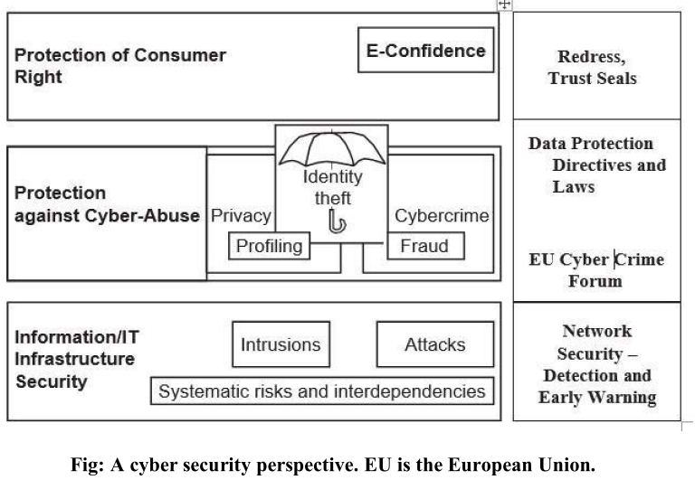
Cybersecurity - Organizational Implications
Lecture
02
In the global environment with continuous network connectivity, the possibilities for cyberattacks can emanate from sources that are local, remote, domestic or foreign. They could be launched by an individual or a group. They could be casual probes from hackers using personal computers (PCs) in their homes, hand-held devices, or intense scans from criminal groups.
Cybersecurity Fundamentals, Dr. Redhwan M. A. Saad
30
www.midocean.ae
Notes:
في البيئة العالمية ذات الاتصال المستمر بالشبكة ، يمكن أن تنبثق احتمالات الهجمات الإلكترونية من مصادر محلية أو بعيدة أو محلية أو أجنبية. يمكن إطلاقها من قبل فرد أو مجموعة. يمكن أن تكون تحقيقات عرضية من قراصنة يستخدمون أجهزة كمبيوتر شخصية في منازلهم ، أو أجهزة محمولة ، أو عمليات مسح مكثفة من الجماعات الإجرامية.

Slide 31
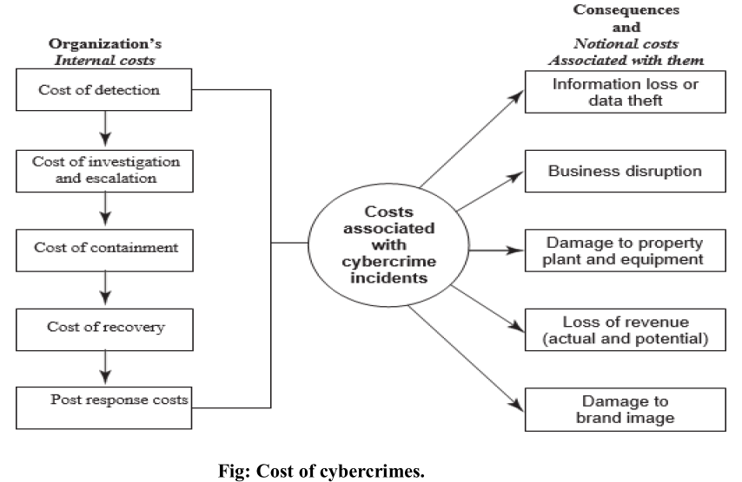
The Cost of Cybercrimes
Lecture
02
Cybercrimes cost a lot to organizations.
When a cybercrime incidence occurs, there are a number of internal costs associated
with it for organizations and there are organizational impacts as well.
Cybersecurity Fundamentals, Dr. Redhwan M. A. Saad
31
www.midocean.ae
Notes:
تكلف الجرائم الإلكترونية الكثير للمنظمات .عند حدوث جريمة إلكترونية ، هناك عدد من التكاليف الداخلية المرتبطة بها بالنسبة للمؤسسات وهناك تأثيرات تنظيمية أيضًا.
containment الاحتواء
redress
containment
escalation
post response cost
incidents
property
revenue
الجبر الاحتواء
التصعيد
تكلفة ما بعد الاستجابةتكلف الجرائم الإلكترونية الكثير للمنظمات .عند حدوث جريمة إلكترونية ، هناك عدد من التكاليف الداخلية المرتبطة بها بالنسبة للمؤسسات وهناك تأثيرات تنظيمية أيضًا.
containment الاحتواء
redress
containment
escalation
post response cost
incidents
property
revenue
الجبر الاحتواء
التصعيد
تكلفة ما بعد الاستجابة
الحوادث
ملكية
ربح
الحوادث
ملكية
ربح

Slide 32
Selfe Assignment
Lecture
02
Case Studies for:
Biggest Cyber Threats in 2021. Case Study.
Examples of Cyber Warfare Operations
The End ☺
Cybersecurity Fundamentals, Dr. Redhwan M. A. Saad
32
www.midocean.ae

Slide 33
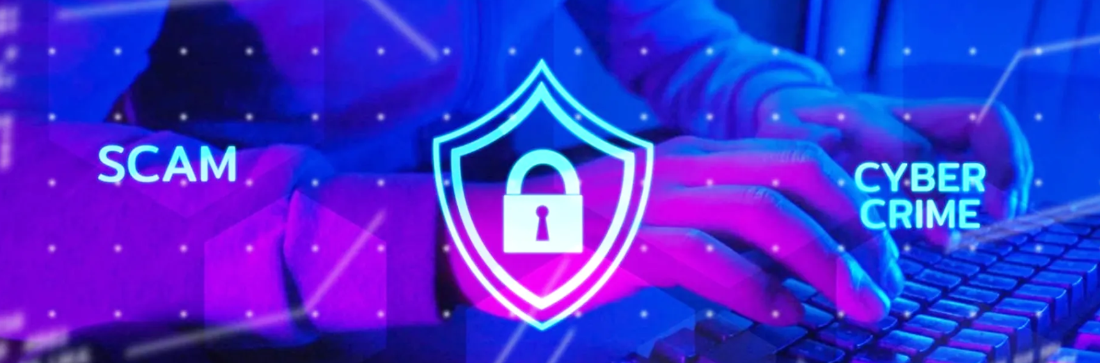

Thank You

