Slide 1


Financial Management
Prepared by
Dr. Mohamed Hussein
Assistant Professor of Accounting
MGM424
Lecture 5

Slide 2



Financial Management
Lecture 5
MGM424 Time value of money
Prepared by
Dr. Mohamed Hussein

Slide 3

Chapter
05
Time value of money

Slide 4

Chapter
05
Time value of money
Time value of money
simple and compound interest.
Compute the future value of a single amount.
Compute the present value of a single amount.
Annuity

Slide 5

Chapter
Introduction to Time Value of Money
05
Time Value of Money (TVM): A core financial concept stating that money available today is worth more than the identical sum in the future due to its potential earning capacity.
Foundation:
TVM is essential in finance for:
  Investment Valuations
  Loan Amortizations
  Financial Planning

Slide 6
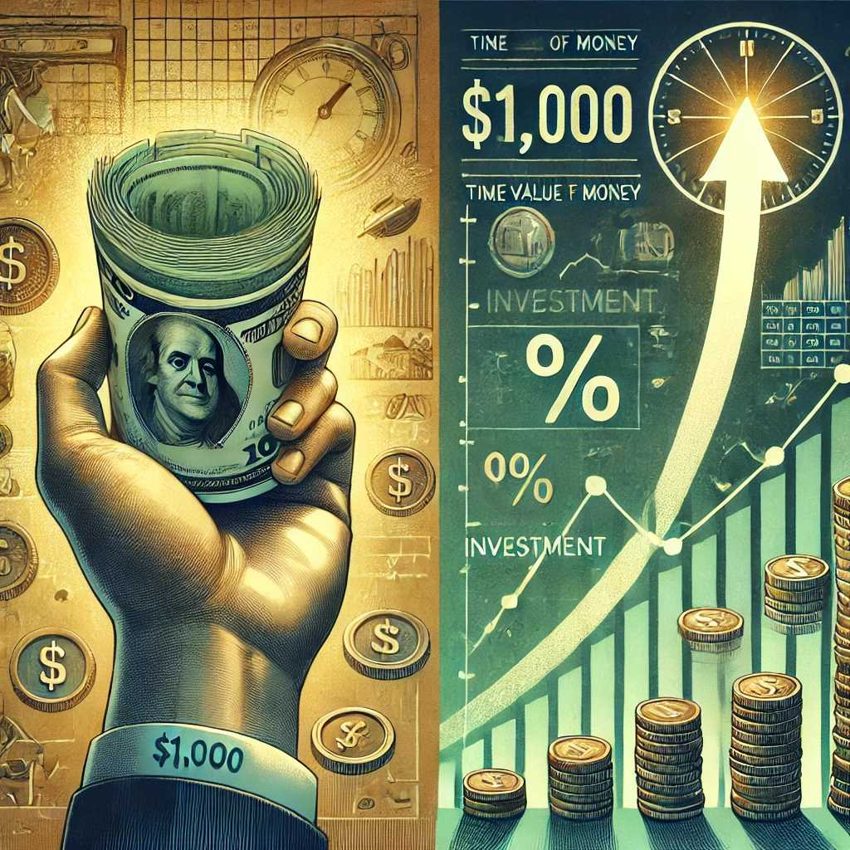
Chapter
Introduction to Time Value of Money
05
Understanding TVM:
  The principal hinges on the opportunity to earn interest or returns on money over time.
  Key Idea: Receiving $1,000 today is more valuable than receiving $1,000 a year from now because you can invest it and earn additional income.

Slide 7
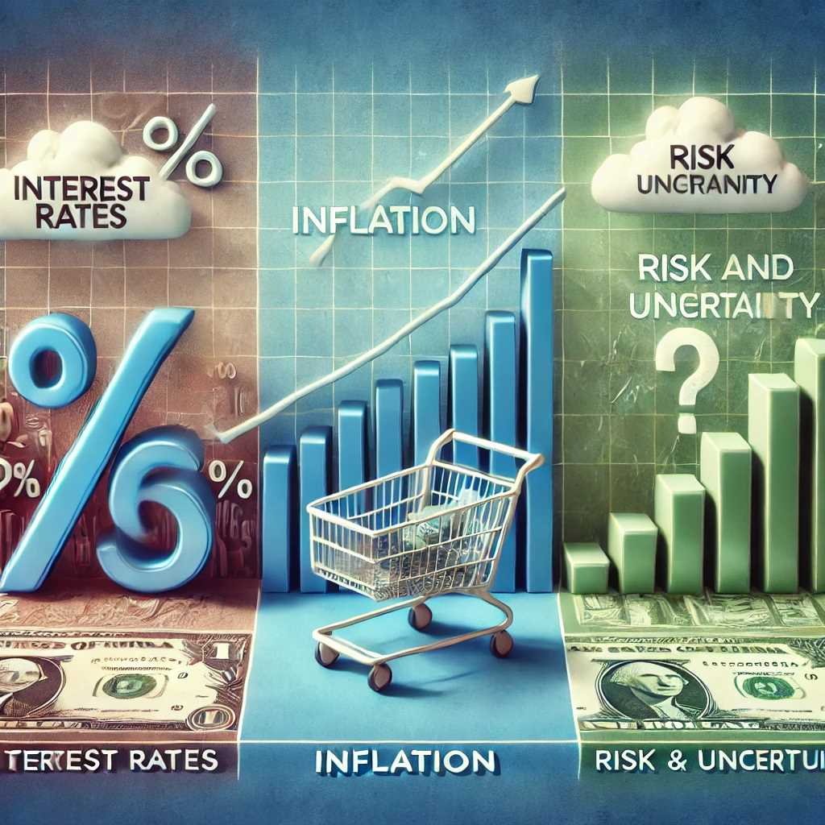
Chapter
Introduction to Time Value of Money
05
Factors Influencing TVM:
  Interest Rates: The cost of borrowing money or the return on investment.
  Inflation: Erodes purchasing power over time, making future money less valuable.
  Risk and Uncertainty: Future payments may not be guaranteed.

Slide 8
Chapter
Introduction to Time Value of Money
05
Foundation:
Investment Valuations:
  Present Value (PV): Calculating the current worth of a future sum of money or stream of cash flows given a specified rate of return.
  Future Value (FV): Determining how much a current investment will grow over time with compound interest.
  Example: Evaluating whether to invest in a project by discounting future cash flows to their present value.
Loan Amortizations:
  Amortization Schedules: Break down each loan payment into interest and principal components.

Slide 9
Chapter
Introduction to Time Value of Money
05
Loan Amortizations:
  Understanding Interest Payments: Knowing how much interest you pay over the life of a loan.
  Example: Calculating monthly mortgage payments and understanding the interest versus principal repayment over time.
Financial Planning:
  Retirement Planning: Estimating how much you need to save now to achieve a desired retirement fund.
  Education Savings: Planning for future education expenses by investing early.
  Example: Using TVM to determine regular savings needed to reach a financial goal.

Slide 10
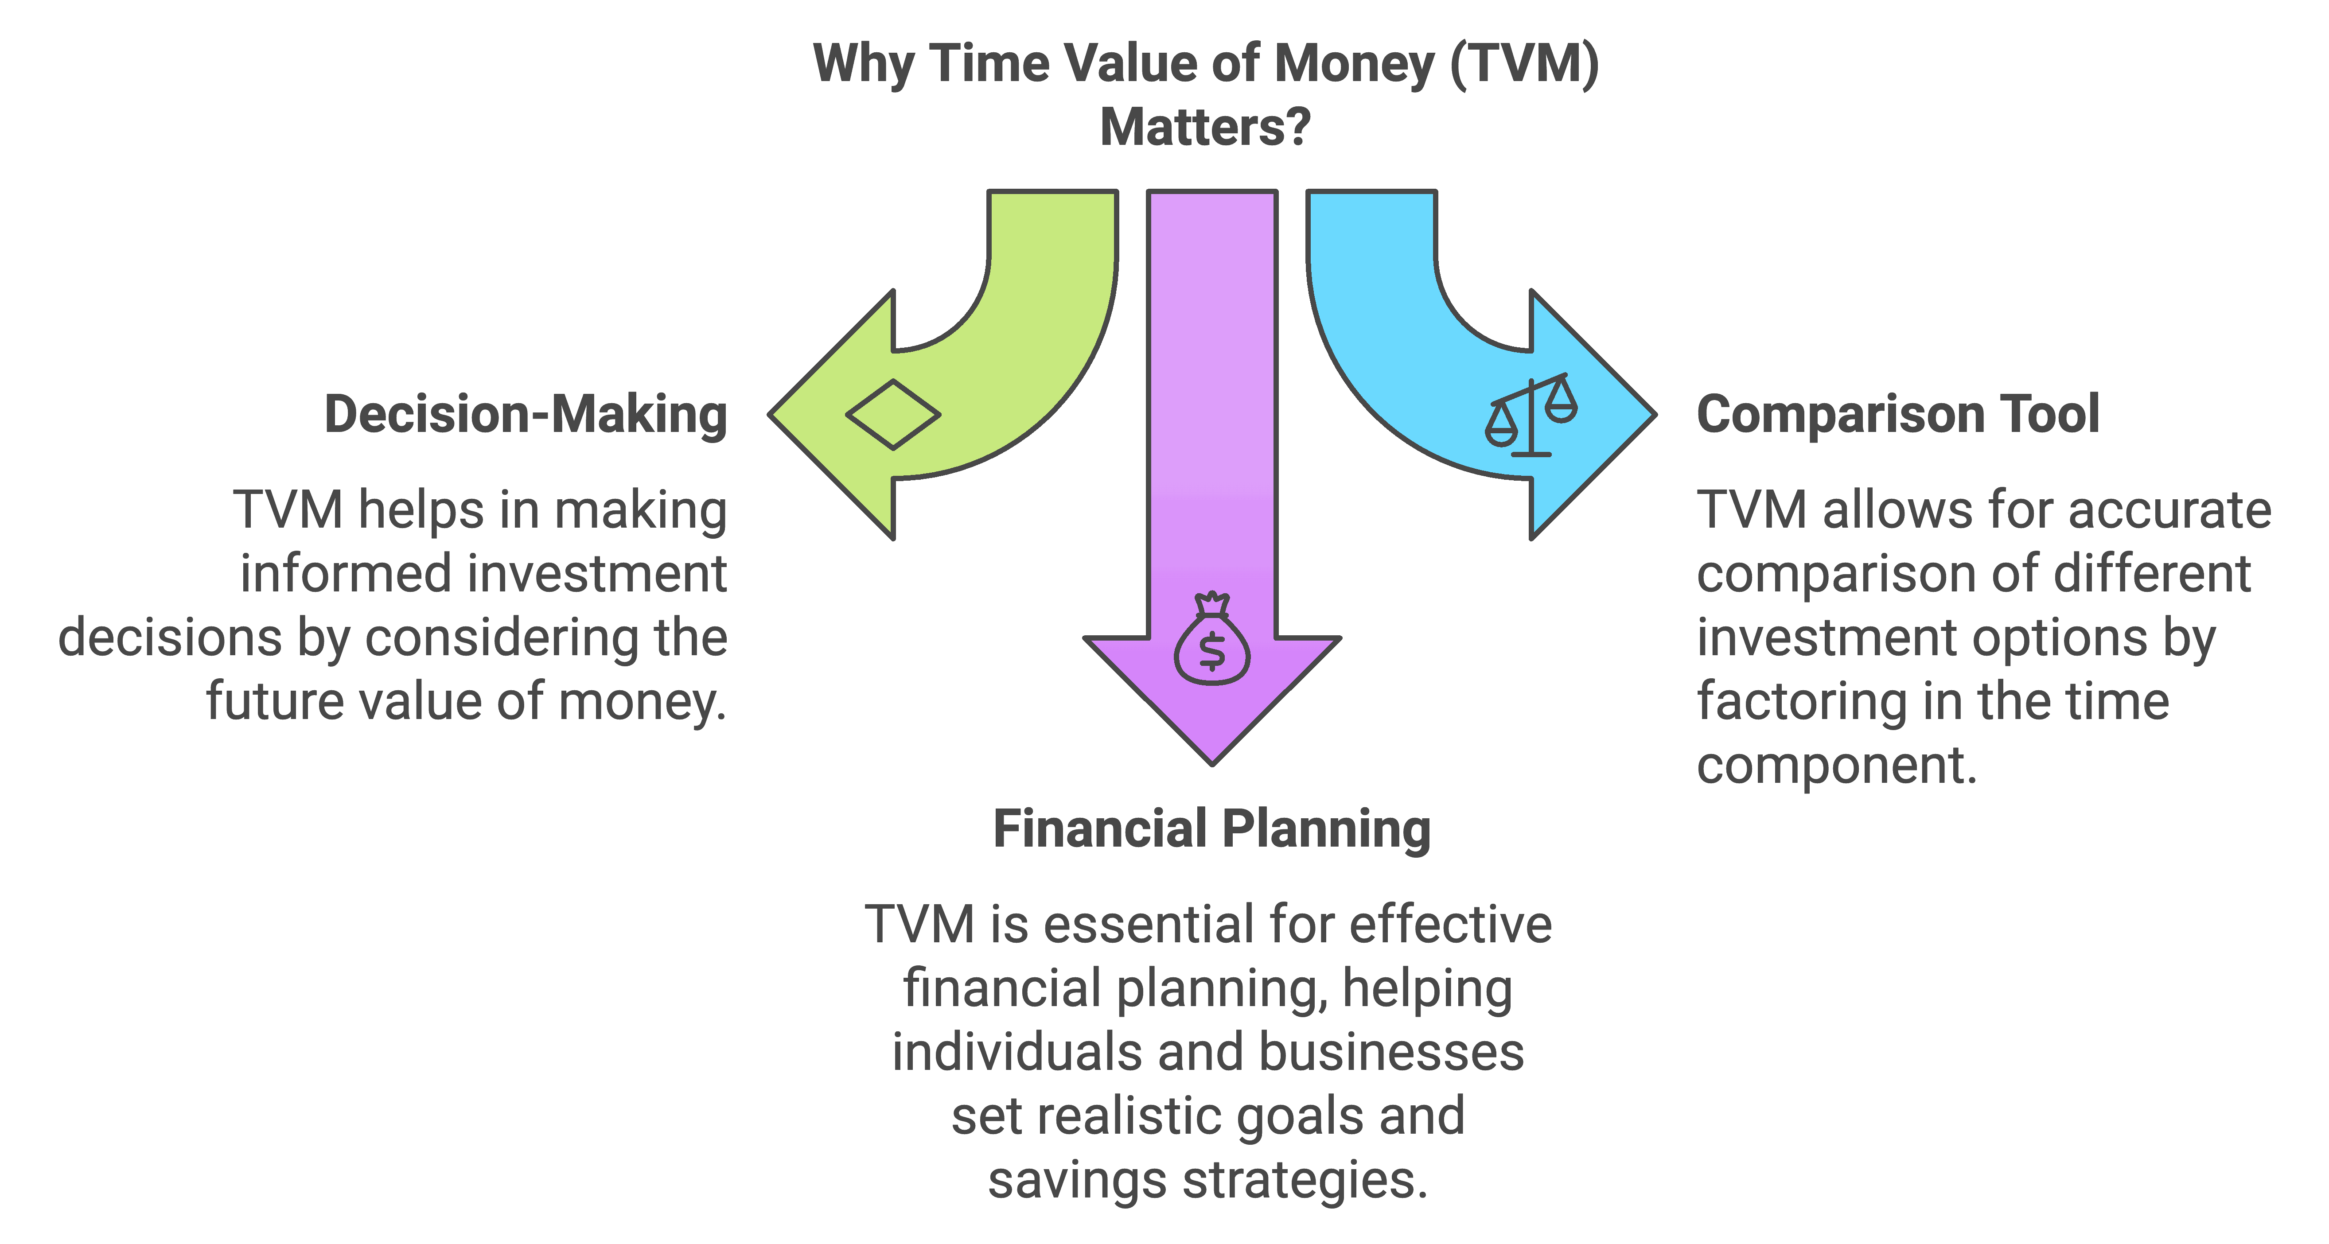
Chapter
Why Time Value of Money Matters
05

Slide 11
Chapter
Why Time Value of Money Matters
05
Highlight Importance: The Time Value of Money (TVM) is not just a theoretical concept; it's a practical tool that significantly impacts our financial decisions.
Engage the Audience: Ask if anyone has considered why receiving $100 today is better than receiving $100 a year from now.
Decision-Making:
Evaluating Investments:
  Net Present Value (NPV): Explain how NPV uses TVM to determine the profitability of an investment by discounting future cash flows.
  Internal Rate of Return (IRR): Mention how IRR calculates the expected growth rate of an investment.
  Example: Consider investing in a project that promises returns over several years. TVM helps us determine if the future returns outweigh the initial investment.

Slide 12
Chapter
Why Time Value of Money Matters
05
Informed Financial Choices:
  Loan Assessment: Discuss how TVM helps evaluate different loan options by calculating the total cost over time.
  Mortgage Decisions: Compare fixed-rate and adjustable-rate mortgages using TVM principles.
Comparison Tool:
Analyzing Cash Flows:
  Present Value Calculations: Show how to bring future cash flows to present terms for an apples-to-apples comparison.
  Example: Deciding between a lump-sum payment today or annuity payments over several years.

Slide 13
Chapter
Why Time Value of Money Matters
05
Cost-Benefit Analysis:
  Opportunity Cost: Emphasize the potential earnings lost when choosing future money over present money.
  Scenario: Choosing between receiving $10,000 now or $12,000 in three years.
Financial Planning:
Budgeting:
  Inflation Consideration: Explain how TVM accounts for inflation, ensuring purchasing power is maintained.
  Expense Forecasting: Use TVM to estimate future expenses and plan accordingly.

Slide 14
Chapter
Why Time Value of Money Matters
05
Investing:
  Compound Interest: Illustrate how reinvesting earnings can significantly increase wealth over time.
  Investment Growth: Project how a one-time investment or regular contributions grow due to compounding.
Retirement Planning:
  Savings Goals: Calculate how much needs to be saved now to reach a desired retirement fund.
  Pension Plans: Evaluate different pension options using TVM to determine the best financial outcome.

Slide 15
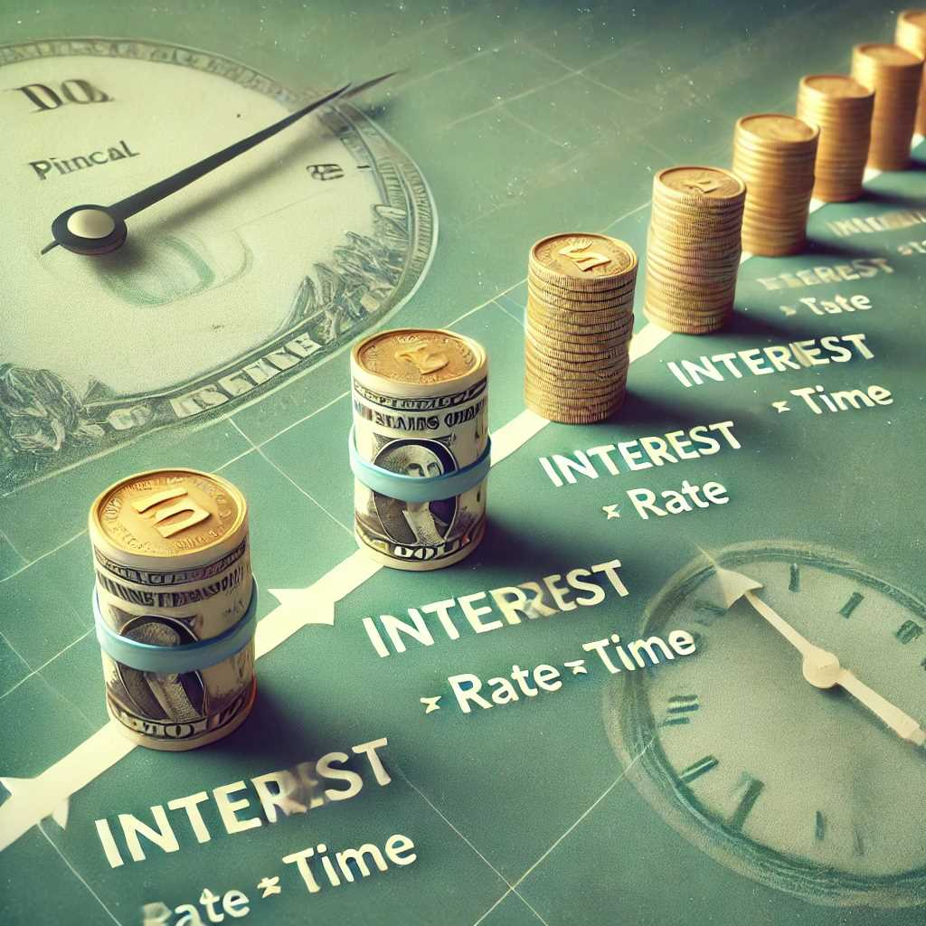
Chapter
simple and compound interest
05
Interest:
is the “rent” paid for the use of money for some period of time. In dollar terms, it is the amount of money paid or received in excess of the amount of money borrowed or lent.
Simple interest:
is computed by multiplying an initial investment times both the applicable interest rate and the period of time.
Ex1, simple interest earned each year on a $1000 investment paying 10% is $100

Slide 16
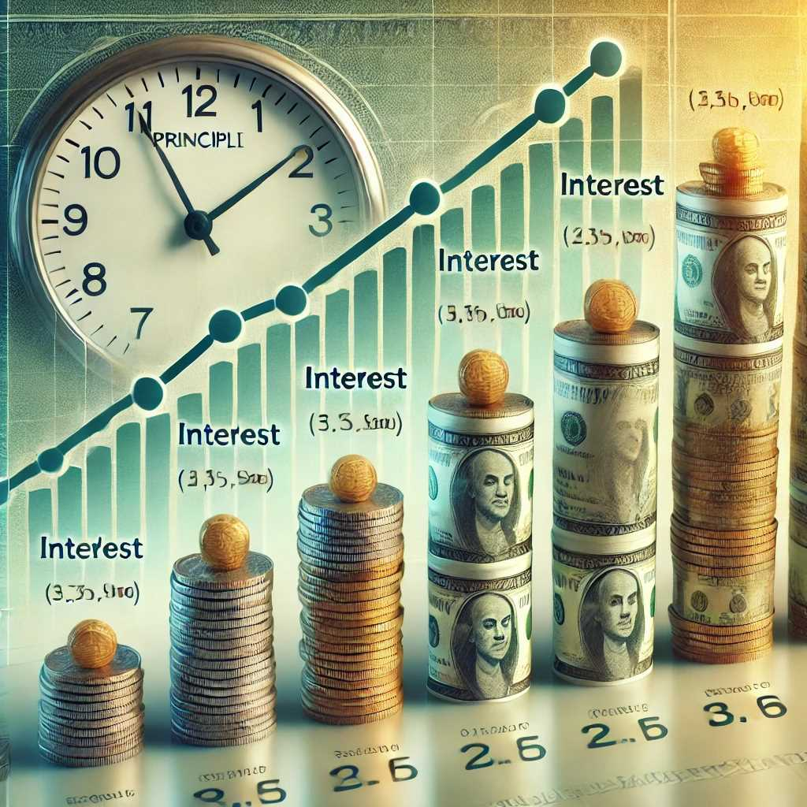
Chapter
simple and compound interest
05
Compound interest:
results in increasingly larger interest amounts for each period of the investment. The reason is that interest is now being earned not only on the initial investment amount but also on the accumulated interest earned in previous periods.

Slide 17
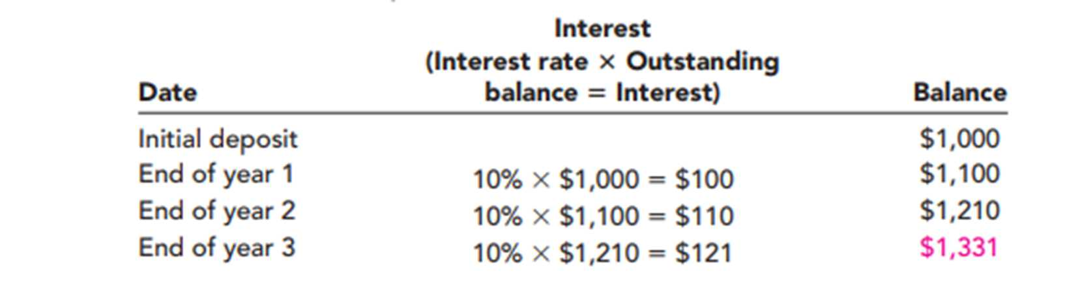
Chapter
simple and compound interest
05
Compound interest:
Compound interest is a larger interest amounts for each period of the investment.
Interest is now earned not only on the initial amount but also on the accumulated interest earned in previous periods.
Ex2,

Slide 18
Chapter
simple and compound interest
05
Compound interest:
Most banks compound interest more than once a year (Daily compound is common for saving accounts).
More rapid compounding has the effect of increasing the actual rate, which is called the effective rate, at which money grows per year.
Interest rate per compounding period is determined by dividing the annual interest rate by the number of compounding periods.

Slide 19
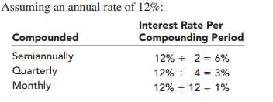
Chapter
simple and compound interest
05
Effective rate:
is the rate at which money actually will grow during a full year.

Slide 20
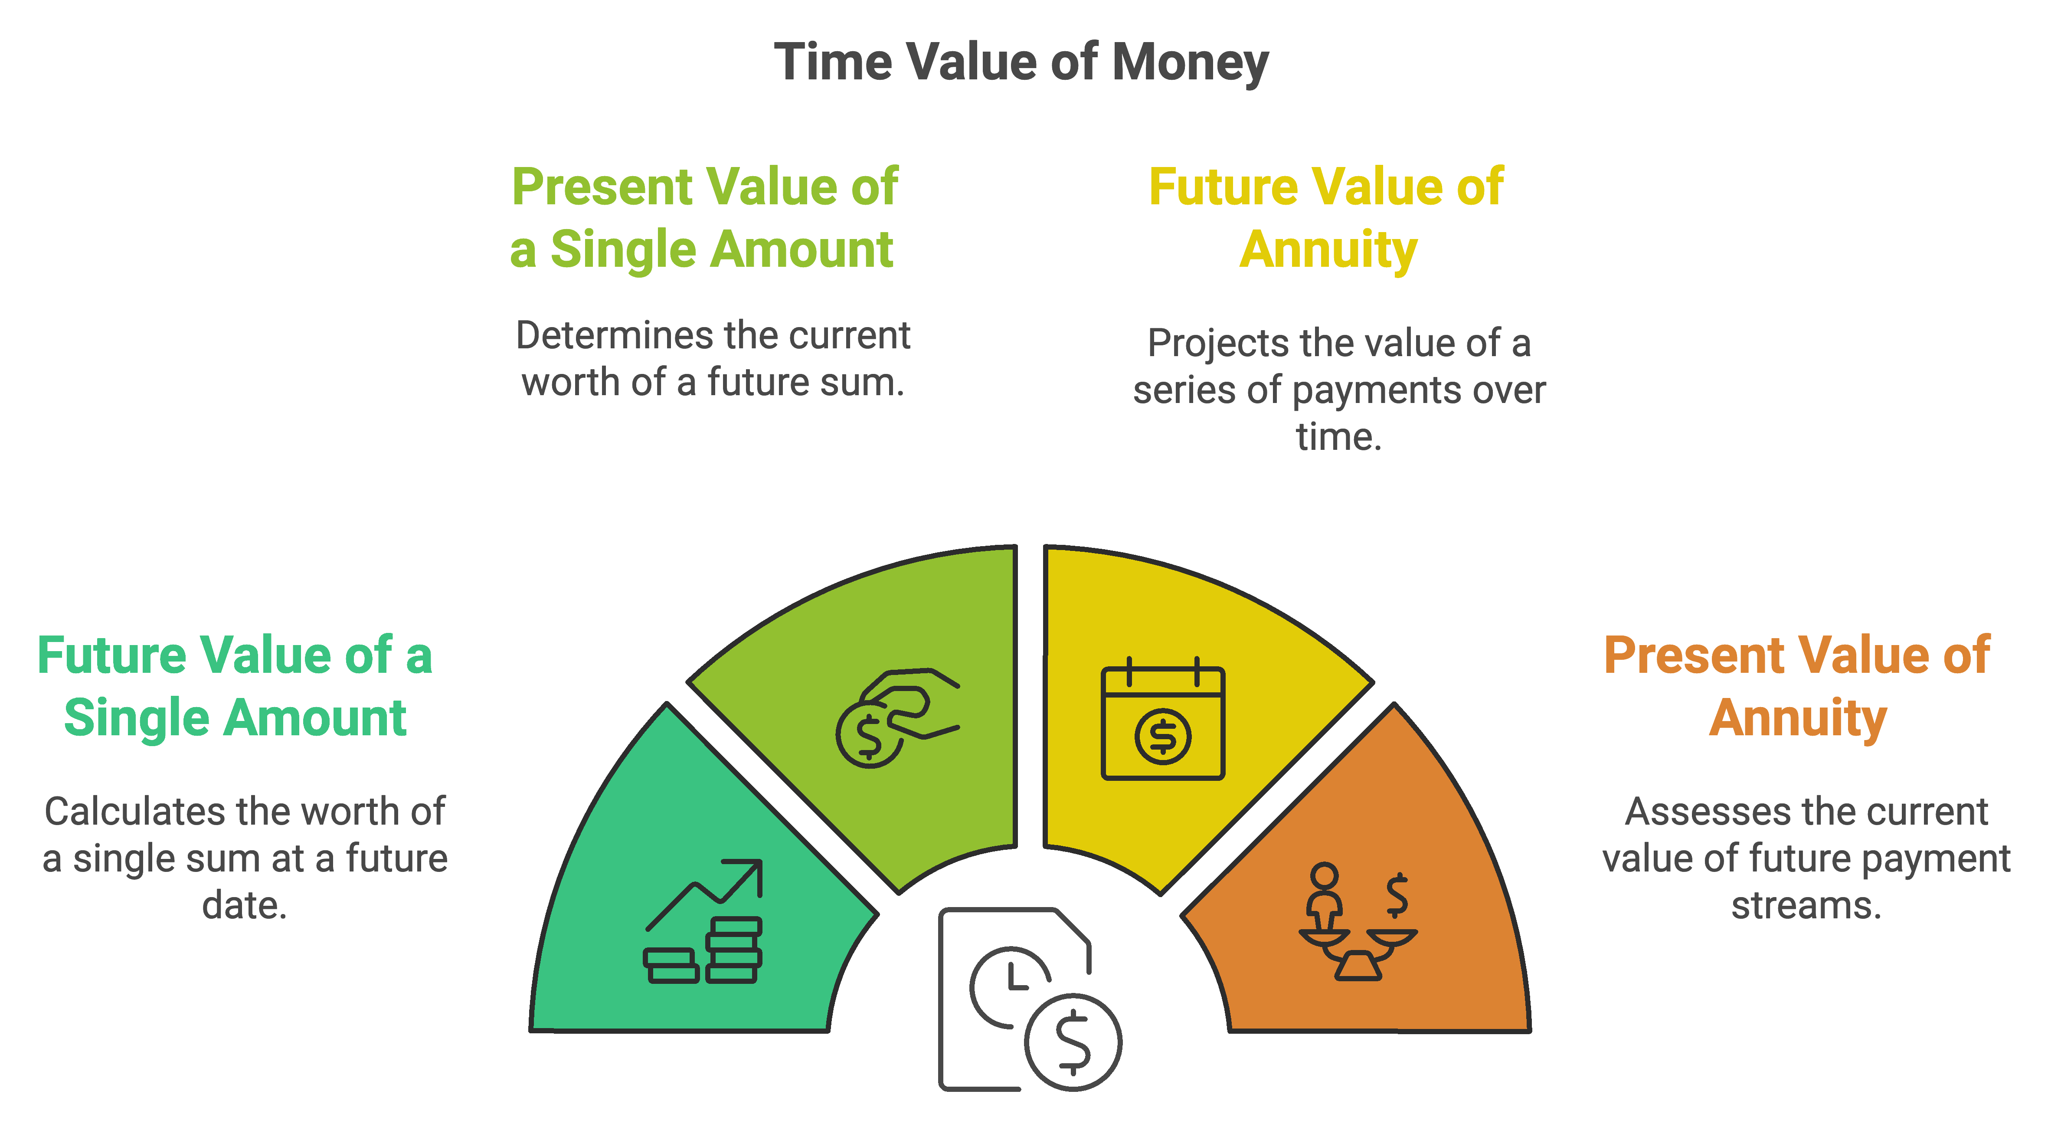
Chapter
Time value of money
05

Slide 21
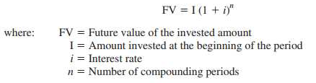

Chapter
Compute the future value of a single amount.
05
Future Value of a Single Amount
future value is the amount of money that a dollar will grow to at some point in the future.

Slide 22
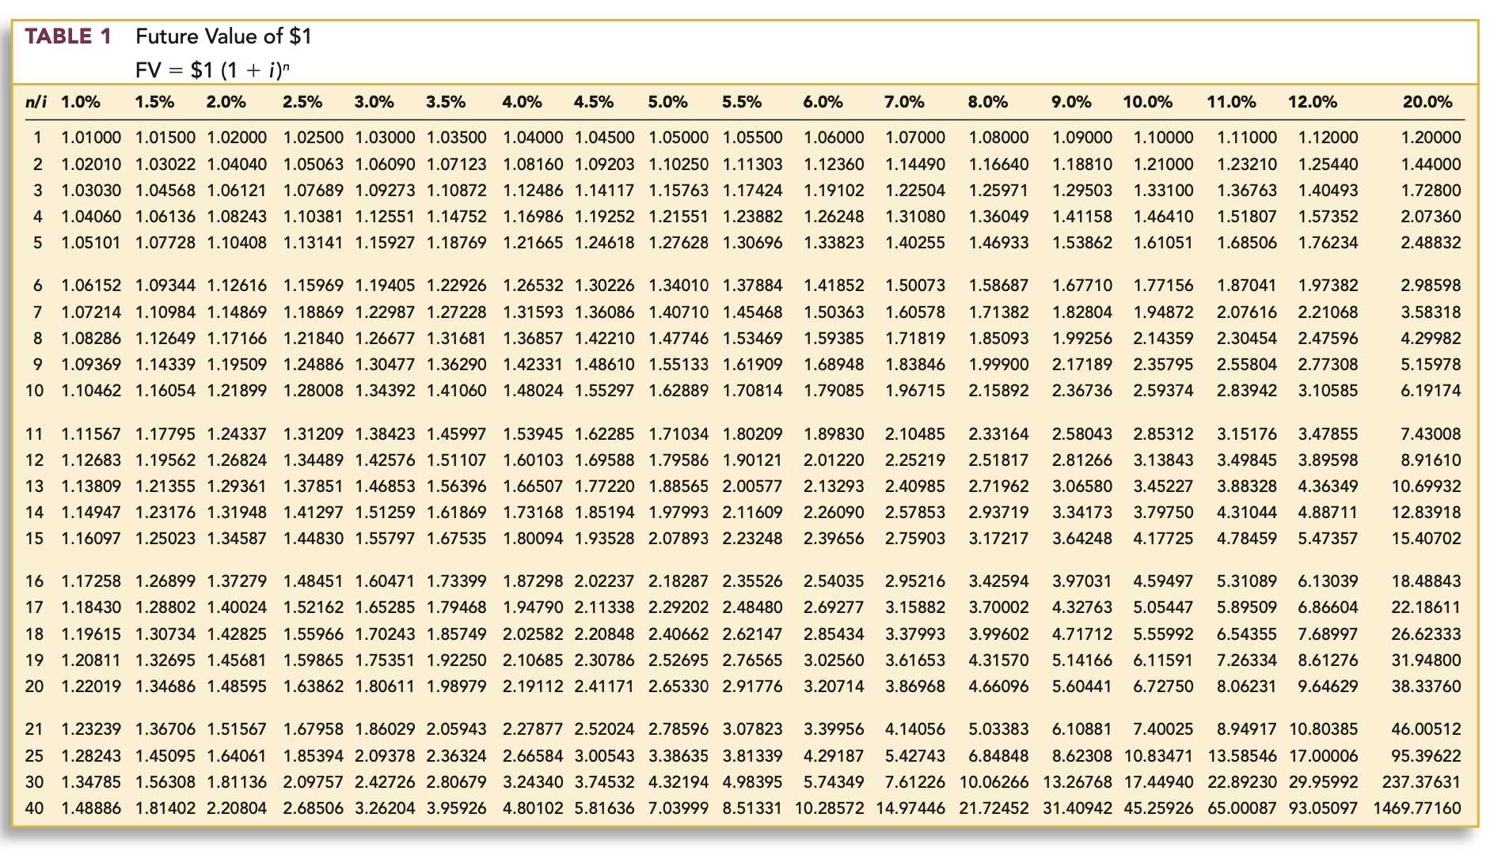

Slide 23
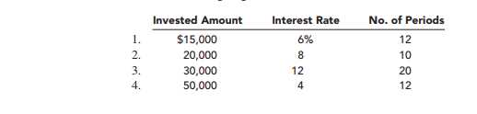
Chapter
Compute the future value of a single amount.
05
Example
Determine the future value of the following single amounts:

Slide 24
Chapter
Compute the future value of a single amount
05
Solution
1- FV = $15,000 *2.01220 = $30,183
Future value of $1: n=12, i=6% )
2- 20,000*2.15892 = 43,178
* Future value of $1: n=10, i=8%

Slide 25
Chapter
Compute the future value of a single amount
05
Solution
3- 30,000*9.64629 = $289,389
Future value of $1: n=20, i=12%
4- 50,000*1.60103= 80,051.
Future value of $1: n=12, i=4%

Slide 26

Chapter
Compute the future value of a single amount
05
Example
Determine the future value of $10,000 under each of the following sets of assumptions:

Slide 28
Chapter
Compute the future value of a single amount
05
Solution
1. n =10*2=20
i= 10/2=5%
FV = $10,000 (2.65330* ) = $26,533
*Future value of $1: n=20, i=5% (from Table 6A-1)
2. n =5*4=20
i= 12/4=3%
FV = $10,000 (1.80611* ) = $18,061
* Future value of $1: n=20, i=3% (from Table 6A-1)

Slide 29
Chapter
Compute the future value of a single amount
05
Solution
3. n =30
i= 24/12=2%
FV = $10,000 (1.81136* ) = $18,114
* Future value of $1: n=30, i=2% (from Table 6A-1)

Slide 30
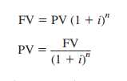
Chapter
Compute the present value of a single amount
05
present value of a single amount
present value is today’s equivalent to a particular amount in the future.
PV= FV* PV Factor

Slide 31
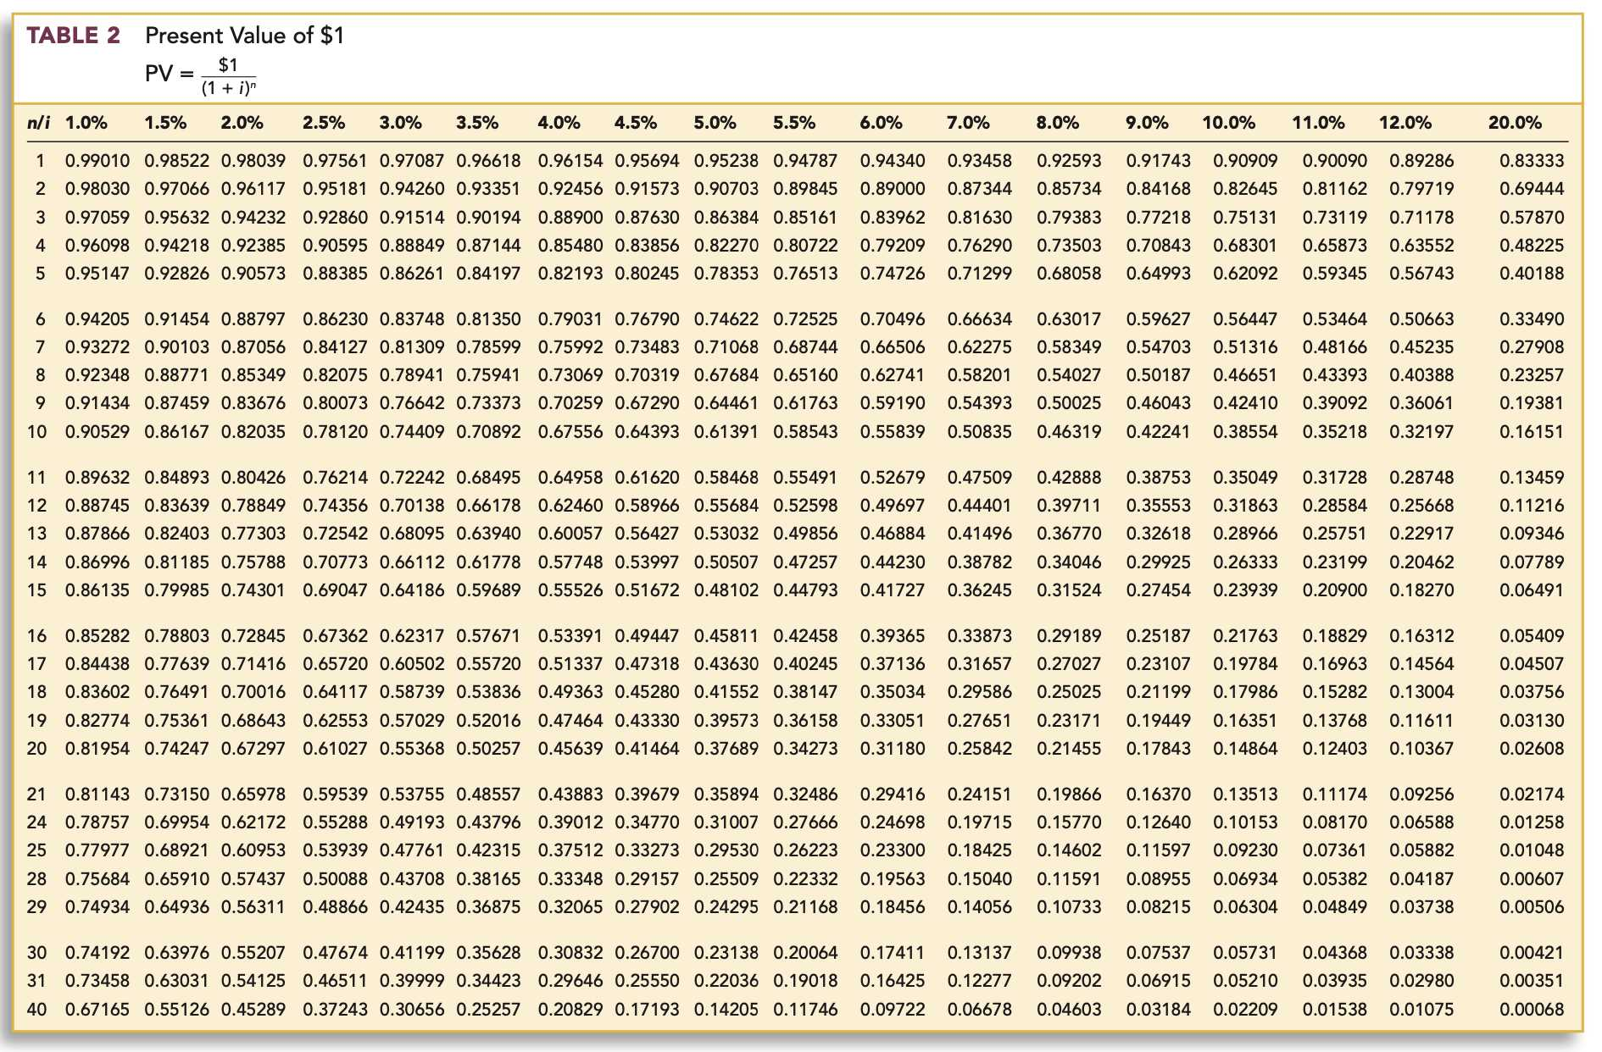

Slide 32
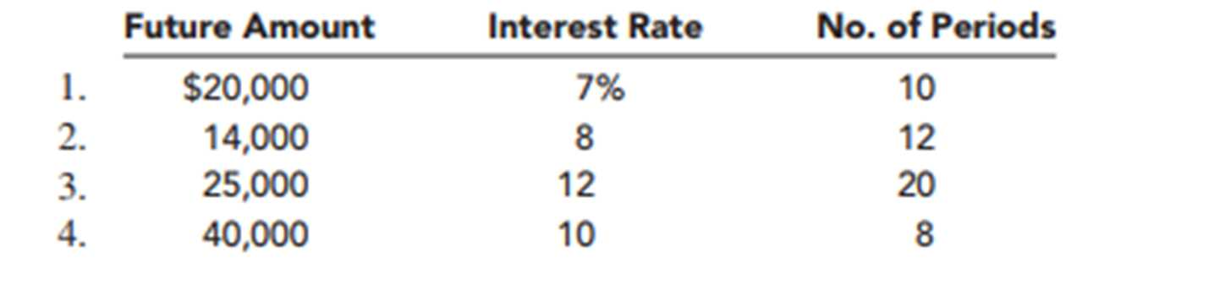
Chapter
Compute the future value of a single amount
05
Example
Determine the present value of the following single amounts:

Slide 33
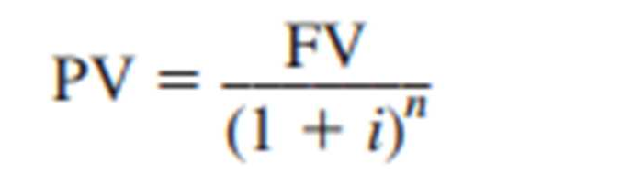
Chapter
Compute the future value of a single amount
05
Solution
PV= FV* 1/(1 + i)n
1- PV= 20,000*0.50835=10167
* Present value of $1: n=10, i=7% (from Table 6A-2)
PV= FV* PV Factor

Slide 34
Chapter
Compute the future value of a single amount
05
Solution
PV= FV* 1/(1 + i)n
2- PV= 14,000*0.39711=5559
* Present value of $1: n=12, i=8% (from Table 6A-2)
PV= FV* PV Factor

Slide 35
Chapter
Compute the future value of a single amount
05
Solution
PV= FV* 1/(1 + i)n
3- PV= 25,000*0.10367=2,591
* Present value of $1: n=20, i=12% (from Table 6A-2)
PV= FV* PV Factor

Slide 36
Chapter
Compute the future value of a single amount
05
Solution
PV= FV* 1/(1 + i)n
4- PV= 40,000*0.46651=18,660
* Present value of $1: n=8, i=10% (from Table 6A-2)
PV= FV* PV Factor

Slide 37
Chapter
Compute the future value of a single amount
05
Example
What is the future value of $5,000 at the end of six periods at 8% compound interest?
Solution
FV = $5,000 × 1.58687* = $7,937
*Future value of $1: n = 6, i = 8% (from Table 1)

Slide 38
Chapter
Compute the future value of a single amount
05
Example
What is the present value of $8,000 to be received eight periods from today assuming a compound interest rate of 12%?
Solution
PV= FV* 1/(1 + i)n
PV = $8,000 × .40388* = $3,231
*Present value of $1: n = 8, i = 12% (from Table 2)

Slide 39
Chapter
Compute the future value of a single amount
05
Example
What is the present value of $10,000 to be received two years from today assuming an annual interest rate of 24% and monthly compounding?
Solution
PV= FV* 1/(1 + i)n
n= 2*12=24
i=24/12=2
PV = $10,000 × .62172* = $6,217
*Present value of $1: n = 24, i = 2% (from Table 2

Slide 40
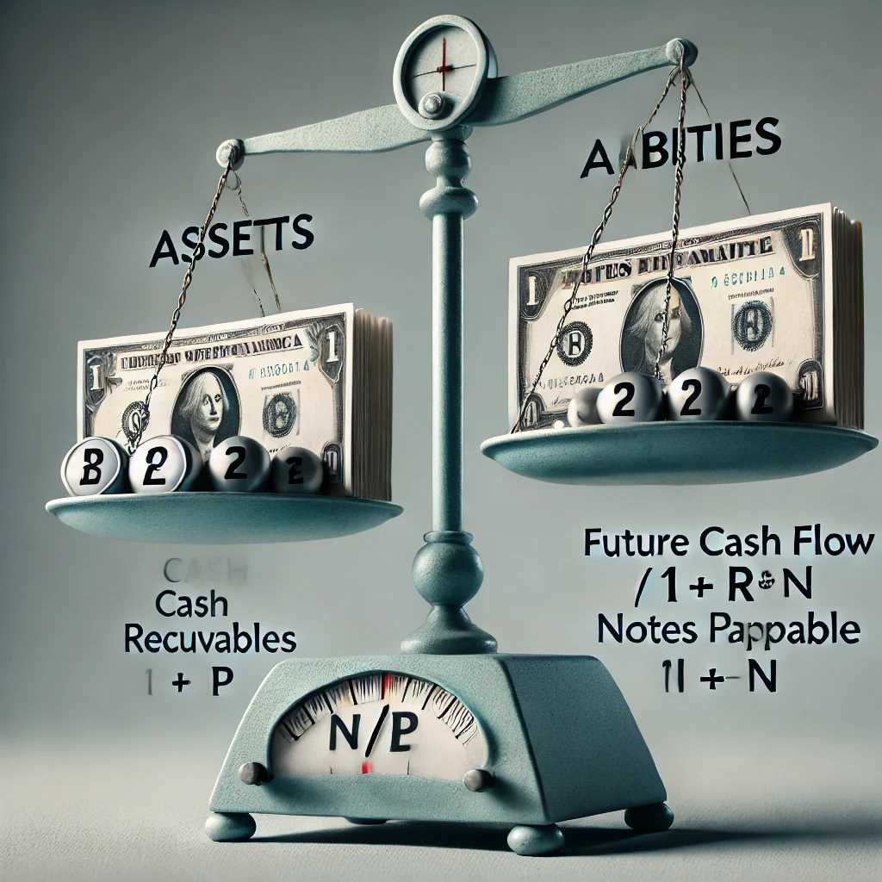
Chapter
Compute the future value of a single amount
05
Accounting Applications of Present Value
Techniques—Single Cash Amount
Many assets and most liabilities are monetary in nature. assets include money and claims to be received, and liabilities are obligations to be paid, the amount of which is fixed or determinable.
Ex, if you borrow money from a bank and signed a N/P the amount of cash to be repaid is fixed
We value most receivables and payables at PV of future cash flows.

Slide 41
Chapter
Compute the future value of a single amount
05
Example:
The Field Detergent Company sold merchandise to the Abel Company on June 30, 2013. Payment was made in the form of a noninterest-bearing note requiring Abel to pay $85,000 on June 30, 2015. Assume that a 10% interest rate properly reflects the time value of money in this situation.
Required:
Calculate the amount at which Field should record the note receivable and corresponding sales revenue on June 30, 2013.

Slide 42
Chapter
Compute the future value of a single amount
05
Solution
FV= 85,000
i= 10%
n= 2 y
PV=FV*(1/1+i)^n
pv= 85,000*0.82645= 70,248
Field should record the note receivable and corresponding sales revenue on June 30, 2013, at PV 70,248

Slide 43
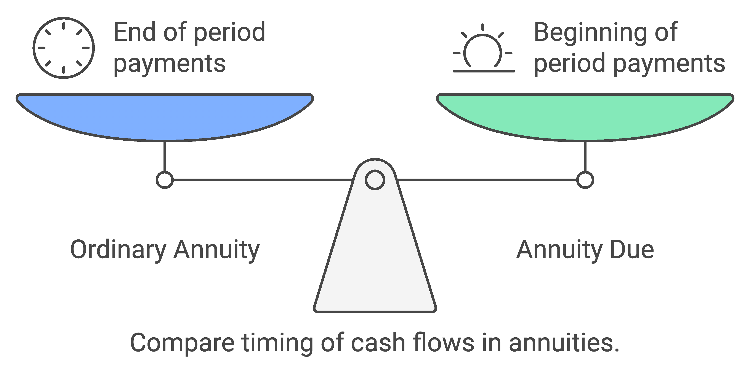
Chapter
Annuity
05
Ordinary Annuity: In an ordinary annuity cash flows occur at the end of each period.
Annuity Due: In an annuity due cash flows occur at the beginning of each period.

Slide 44
Chapter
Annuity
05
Example:
What is the future value of an annuity of $2,000 invested at the end of each of the next six periods at 8% interest?
Solution
A=2000
n= 6
i= 8%
Ordinary Annuities
FVA = $2,000 × 7.3359* = $14,672
*Future value of an ordinary annuity of $1: n = 6, i = 8% (from Table 3)

Slide 45
Chapter
Annuity
05
Example:
What is the future value of an annuity of $2,000 invested at the beginning of each of the
next six periods at 8% interest?
Solution
A=2000
n= 6
i= 8%
Annuity due
FVAD = $2,000 × 7.9228* = $15,846
*Future value of an annuity due of $1: n = 6, i = 8% (from Table 5)

Slide 46
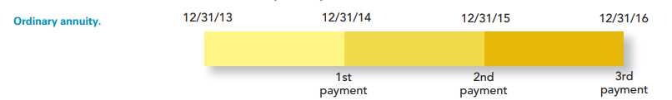
Chapter
Annuity
05
Ordinary Annuity VS Annuity Due
$14,672 VS $15,846

Slide 47
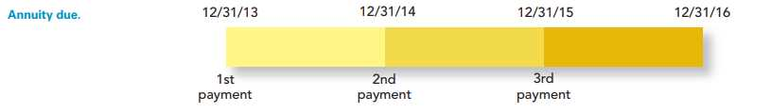
Chapter
Annuity
05
Ordinary Annuity VS Annuity Due
$14,672 VS $15,846
Note: no interest is charged on the last payment of ordinary annuity

Slide 48
Chapter
Present Value of an Annuity:
05
Example
What is the present value of an annuity of $6,000 to be received at the end of each of the next eight periods assuming an interest rate of 10%?
Solution
A=6000
n= 8
i= 10%
Ordinary Annuities
PVA = $6,000 × 5.33493* = $32,010
*Present value of ordinary annuity of $1: n = 8, i = 10% (from Table 4)

Slide 49
Chapter
05
Present Value of an Annuity:
Example
What is the present value of an annuity of $6,000 to be received at the beginning of each of the next eight periods assuming an interest rate of 10%?
Solution
A=6000
n= 8
i= 10%
Annuity due
PVAD = $6,000 × 5.86842* = $35,211
*Present value of an annuity due of $1: n = 8, i = 10% (from Table 6)

Slide 50



Thank You

