Slide 1


Change Management
Prepared by Dr. Ranya Mahfouz
MGM323
Lecture 2

Slide 2


Change Management
Lecture 2
Team change
MGM323
Prepared by
Dr. Ranya mahfouz

Slide 3
Agenda Team change
Introduction
What is a group and when is it a team?
What is the difference between Groups And Teams?
Why do you need teams?
What types of organizational teams are there?
How do you improve team effectiveness?
What does team change look like?
How do individuals affect team dynamics?
How well do teams initiate and adapt to organizational change?

Slide 4

Change Management
This subject is about learning how to manage change. The world around us is changing very quickly. Almost every day, there is a new discovery or innovation, especially in science. Globalization also has a big effect on how we think about politics and business. At the same time, the problems that come with globalization are growing just as fast, which is also a big concern.
.

Slide 5
Agenda Team change
Introduction
What is a group and when is it a team?
What is the difference between Groups And Teams?
Why do you need teams?
What types of organizational teams are there?
How do you improve team effectiveness?
What does team change look like?
How do individuals affect team dynamics?
How well do teams initiate and adapt to organizational change?

Slide 6
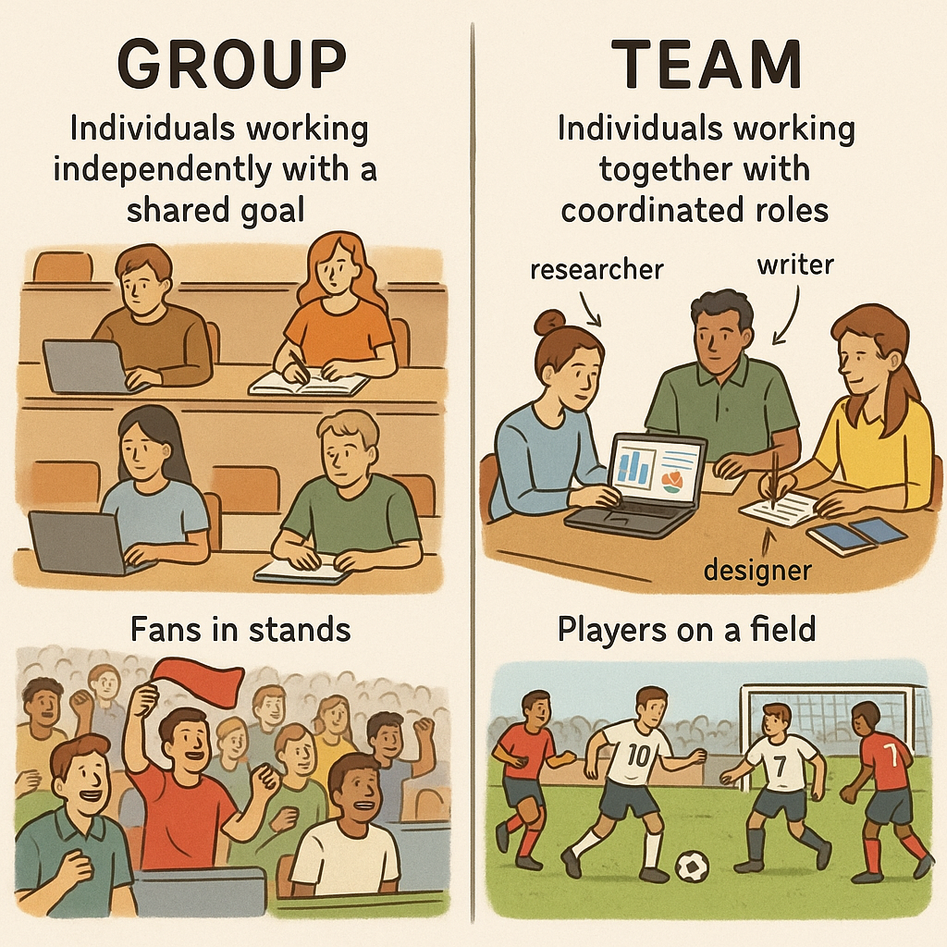
Chapter
02
Groups And Teams
1- What is a group and when is it a team ?

Slide 7

Chapter
02
The Groups
What is meaning Group?
Schein and Bennis (1965) suggest that a group is ‘any number of people who interact with each other, are psychologically aware of each other, and who perceive themselves to be a group.

Slide 8

Chapter
02
The Teams
What is meaning Teams?
Morgan et al (1986) suggest that a team is a distinguishable set of two or more individuals who interact adaptively to achieve specified, shared, and valued objectives.
A small group of individuals who share responsibility for outcomes for their organizations.

Slide 9
Agenda Team change
Introduction
What is a group and when is it a team?
What is the difference between Groups And Teams?
Why do you need teams?
What types of organizational teams are there?
How do you improve team effectiveness?
What does team change look like?
How do individuals affect team dynamics?
How well do teams initiate and adapt to organizational change?

Slide 10
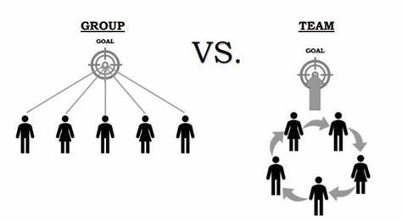
The Impact of Context on Groups vs. Teams
While the structural differences between groups and teams are clear, it’s essential to consider how context influences their effectiveness. For example, in crisis situations, teams often outperform groups due to their shared objectives and adaptive communication. Conversely, groups may be more efficient for tasks requiring independent contributions (e.g., research panels). Highlighting real-world examples (e.g., emergency response teams vs. focus groups) can clarify these distinctions further.

Slide 11
Chapter
Key differences between Group and Team
02
Group | Team
Indeterminate size | Restricted in size
Common interests | Common general objectives
Sense of being part of something or seen as being part of something | Interaction between members to accomplish individual and group goals
Interdependent as much as individuals might wish to be | Interdependency between members to accomplish individual and group goals

Slide 12
Chapter
Key differences between Group and Team
02
Group | Team
May have no responsibilities other than a sense of belonging to the group | Shared responsibilities
May have no accountabilities other than ‘contractual’ ones | Individual accountabilities
A group does not necessarily have any work to do or goals to accomplish | The team works together, physically or virtually

Slide 13
Agenda Team change
Introduction
What is a group and when is it a team?
What is the difference between Groups And Teams?
Why do you need teams?
What types of organizational teams are there?
How do you improve team effectiveness?
What does team change look like?
How do individuals affect team dynamics?
How well do teams initiate and adapt to organizational change?

Slide 14
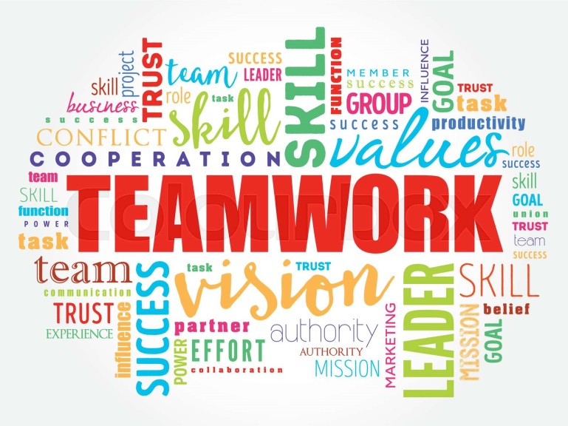
Chapter
Why do we need teams and teamwork?
02
Casey (1993), researched this question by asking a simple question: ‘Why should you work together as a team?’ The simplest answer is, ‘Because of the work we need to accomplish

Slide 15

Chapter
Why do we need teams and teamwork?
02
Casey believes that there is a clear link between the level of uncertainty of the task being handled and the level of teamwork needed.

Slide 16
Chapter
The Dark Side of Teamwork
02
While teamwork provides numerous benefits, it also presents several challenges that can hinder performance. Common issues such as groupthink (Janis, 1972), social loafing, and role conflicts may compromise a team's effectiveness.

Slide 17
Chapter
The Dark Side of Teamwork
02
To counter these problems, strategies like encouraging constructive criticism and implementing structured feedback mechanisms can help maintain productivity. This balanced perspective highlights both the potential rewards and inherent difficulties of collaborative work.

Slide 18
Agenda Team change
Introduction
What is a group and when is it a team?
What is the difference between Groups And Teams?
Why do you need teams?
What types of organizational teams are there?
How do you improve team effectiveness?
What does team change look like?
How do individuals affect team dynamics?
How well do teams initiate and adapt to organizational change?

Slide 19
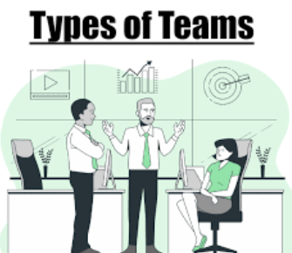
Chapter
Types of organizational teams
02

Slide 20
Chapter
Types of organizational teams
02
1- Work team
Work teams are usually part of the normal hierarchical structure of an organization. This means that one person manages a group of individuals, and that person is responsible for delivering a particular product or service either to the customer or to another part of the organization. Their agenda is normally focused on the maintenance and management of what is.

Slide 21
Chapter
Types of organizational teams
02
2- Project team
Project teams are teams that are formed for the specific purpose of completing a project. They therefore are time-limited, and we would expect to find clarity of objectives. The project might be focused on an external client or it might be an internal one-off or cross-cutting project with an internal client group.

Slide 22
Chapter
Types of organizational teams
02
3- Matrix team
Matrix teams generally occur in organizations that are run along project lines. The organization typically has to deliver a number of projects to achieve its objectives. Each project has a project manager, but the project team members are drawn from functional areas of the organization. (for example, aerospace, defence or oil industry projects).

Slide 23
Chapter
Types of organizational teams
02
4- Virtual team
Increasing globalization and developments in the use of new technologies mean that teams are not necessarily co-located any more. Townsend et al (1998) defined virtual teams as ‘groups of geographically and/or organizationally dispersed co-workers that are assembled using a combination of telecommunications and information technologies to accomplish an organizational task’.

Slide 24
Chapter
Types of organizational teams
02
5-Management team
The management team is ultimately responsible for the overall performance of the business unit. Management teams are pivotal in translating the organization’s overarching goals into specific objectives for the various sub-units to do their share of the organization's tasks.

Slide 25
Chapter
Types of organizational teams
02
6- Change team
Change teams are often formed within organizations when a planned or unplanned change of significant proportions is necessary. Sometimes the senior management team is called the change team, responsible for directing and sponsoring the changes. Sometimes the change team is a special project team set up to implement change.

Slide 26
Chapter
Types of organizational teams
02
7- Emerging Team Structures in the Digital Age
Modern organizations are experimenting with hybrid team models, such as:
Agile Squads: Cross-functional teams with iterative goals (common in tech).
Gig Teams: Short-term teams assembled for freelance-based projects.
Ecosystem Teams: Collaborations across organizations (e.g., startups partnering with corporates).
These reflect evolving workplace trends and technological advancements.

Slide 27
Agenda Team change
Introduction
What is a group and when is it a team?
What is the difference between Groups And Teams?
Why do you need teams?
What types of organizational teams are there?
How do you improve team effectiveness?
What does team change look like?
How do individuals affect team dynamics?
How well do teams initiate and adapt to organizational change?

Slide 28
Chapter
HOW TO IMPROVE TEAM EFFECTIVENESS
02
Rollin and Christine Glaser (1992) have identified four elements that
contribute to the level of a team’s effectiveness or ineffectiveness over time. They are:
1 team mission, planning and goal setting;
2 team roles;
3 team operating processes;
4 team interpersonal relationships;

Slide 29
Chapter
02
HOW TO IMPROVE TEAM EFFECTIVENESS
Measuring Team Effectiveness: Key Metrics
Beyond Glaser’s four elements, teams should track quantitative and qualitative metrics:
Output Quality: Error rates, customer satisfaction scores.
Process Efficiency: Time-to-decision, meeting productivity.
Psychological Safety: Surveys on trust and inclusivity (Edmondson, 1999).

Slide 30
Agenda Team change
Introduction
What is a group and when is it a team?
What is the difference between Groups And Teams?
Why do you need teams?
What types of organizational teams are there?
How do you improve team effectiveness?
What does team change look like?
How do individuals affect team dynamics?
How well do teams initiate and adapt to organizational change?

Slide 31
Chapter
WHAT TEAM CHANGE LOOKS LIKE
02
All teams go through a change process when they are first formed, and when significant events occur such as a new member arriving, a key member leaving, a change of scope, increased pressure from outside, or a change in organizational climate.

Slide 32
Chapter
WHAT TEAM CHANGE LOOKS LIKE
02
Tuckman (1965) is one of the most widely quoted researchers into
the linear model of team development.
Team building within organizations. Most people will have heard of it as the ‘forming, storming, norming, performing’ model of team development.

Slide 33
Chapter
Tuckman’s model of team change
02
1- Forming
Forming is the first stage. This involves the team asking a set of fundamental questions:
• What is our primary purpose?
• How do we structure ourselves as a team to achieve our purpose?
• What roles do we each have?
• Who is the leader?
• How will we work together?
• How will we relate together?
• What are the boundaries of the team?

Slide 34
Chapter
Tuckman’s model of team change
02
2- Storming
Tuckman’s next stage is storming. Statements articulated (or left unsaid) in some fashion or form might include ones such as:
• I don’t think we should be aiming for that.
• This structure hasn’t taken account of this.
• There are rather a lot of grey areas in our individual accountabilities.
• Why was he appointed as team leader when he hasn’t done this before?
• I don’t know whether I can work productively with these people.
• How can we achieve our goals without the support from others in the organization?

Slide 35
Chapter
Tuckman’s model of team change
02
2- Storming
Tuckman’s next stage is storming. Statements articulated (or left unsaid) in some fashion or form might include ones such as:
• It is a natural part of the process.
• It is a healthy part of the process.
• It is an important part of the process.
The storming phase – if successfully traversed – will achieve clarity on all the fundamental questions of the first phase, and enable a common understanding of purpose and roles to be achieved.

Slide 36
Chapter
Tuckman’s model of team change
02
3- Norming
The third stage of team development occurs when the team finally settles down into working towards the achievement of its task without too much attention needed on the fundamental questions.

Slide 37
Chapter
Tuckman’s model of team change
02
4- Performing
The final stage of team development is performing. The team has successfully traversed the three previous stages and therefore has clarity about its purpose, its structure and its roles. It has engaged in a strict process of working out how it should work and relate together and is comfortable with the team norms it has established.

Slide 38
Agenda Team change
Introduction
What is a group and when is it a team?
What is the difference between Groups And Teams?
Why do you need teams?
What types of organizational teams are there?
How do you improve team effectiveness?
What does team change look like?
How do individuals affect team dynamics?
How well do teams initiate and adapt to organizational change?

Slide 39
Chapter
HOW INDIVIDUALS AFFECT TEAM DYNAMICS
02
The individual personalities might influence and be influenced by the team & tasks. This means that when it comes to change, people with different preferences react differently to change, both when they initiate it and when they are on the receiving end of it. This is also true when you are a member of a team. Different people will bring their individual preferences to the table and behave in differing ways.

Slide 40
Agenda Team change
Introduction
What is a group and when is it a team?
What is the difference between Groups And Teams?
Why do you need teams?
What types of organizational teams are there?
How do you improve team effectiveness?
What does team change look like?
How do individuals affect team dynamics?
How well do teams initiate and adapt to organizational change?

Slide 41
Chapter
HOW WELL TEAMS INITIATE AND ADAPT TO
ORGANIZATIONAL CHANGE
02
Throughout the last decades of the 20th century, many organizations
repeated the mantra, ‘people are our greatest assets’, and many would then apologize profusely when they were forced into downsizing or ‘rightsizing’ the workforce. Similarly, many organizations have sung the praises of teams and how essential they are within the modern organization.

Slide 42


