Slide 1


Marketing Management
MGM612
Dr. Ayman Hassan
  Lecture - 9 -
Pricing Strategies

Slide 2

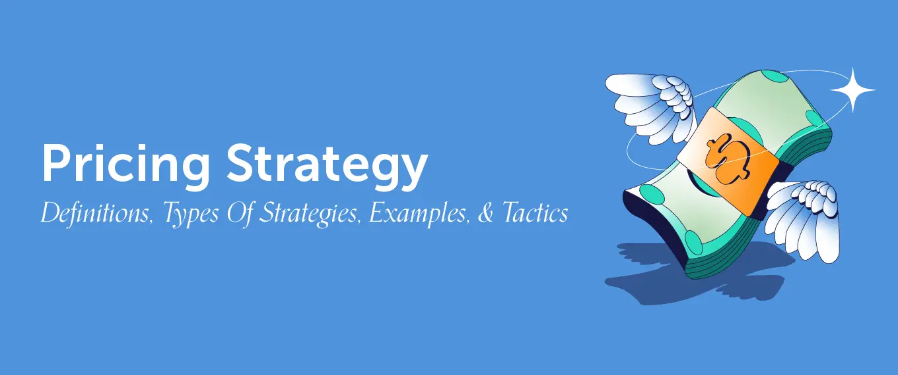
Chapter
9
Pricing Strategies
Lecture : 9
Dr. Ayman Hassan

Slide 3
In the previous lecture,
We have discussed
In the previous lecture, we presented the topic of the Branding, We explained a set of topics, which are as follows:
Explain the role of marketing communications
Describe How do marketing communications work
Discuss the major steps in developing effective communications
the communications mix and how should it be set
Explain an integrated marketing communications program

Slide 4
Learning Outcomes
Chapter
9
After studying this chapter you will be able to know all of the following:
Major Pricing Strategies
New-Product Pricing Strategies
Product Mix Pricing Strategies
Price Adjustment Strategies
Price Changes

Slide 5
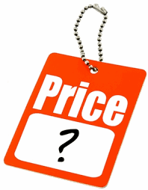
Chapter
9
What Is a Price?
Narrowly defined, price is the amount of money charged for a product or service.
Broadly defined, price is the sum of all of the values that consumers give up in order to gain the benefits of having or using the product or service.
A price is the (usually not negative) quantity of payment or compensation expected, required, or given by one party to another in return for goods or services.
In some situations, especially when the product is a service rather than a physical good, the price for the service may be called something else such as "rent" or "tuition"
Prices are influenced by production costs, supply of the desired product, and demand for the product. A price may be determined by a monopolist or may be imposed on the firm by market conditions.

Slide 6
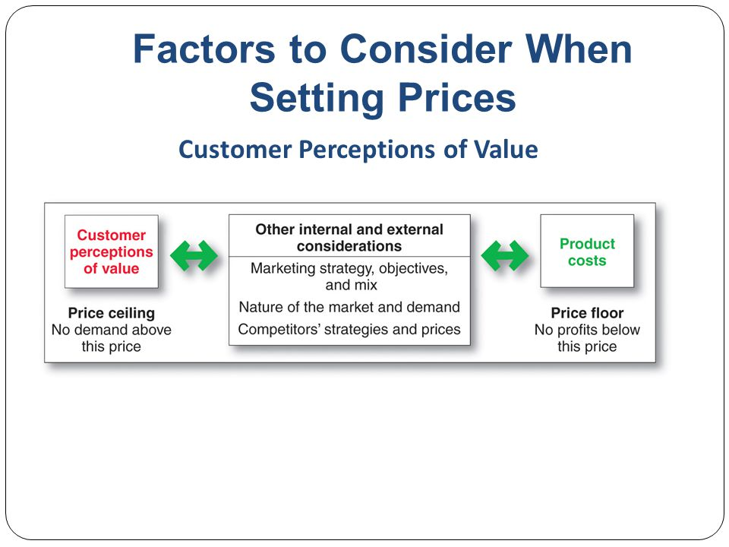

Chapter
9
Factors to Consider When Setting Price
Customer perceptions of value:
  No demand exists above price ceiling.
Other internal and external considerations:
  Marketing strategy, objectives, mix.
  Nature of the market and demand.
  Competitors’ strategies and prices.
Product costs:
  No profits are available below the price floor.

Slide 7
Chapter
9
Major Pricing Strategies
Customer value-based pricing:
  Setting prices based on buyers’ perceptions of value rather than the seller’s cost.
Cost-based pricing:
  Setting prices based on the cost of producing, distributing, and selling product at a fair rate of return.
Competition-based pricing:
  Setting prices based on competitors’ strategies, costs, prices, and market offerings.

Slide 8
Chapter
9
Customer Value-Based Pricing
Customer value-based pricing:
  Price is considered along with the other marketing mix variables before the marketing program is set.
    Customer needs and value perceptions are assessed.
    Target price is based on value perception.
  Types of value-based pricing:
    Good value pricing.
    Value-added pricing.

Slide 9
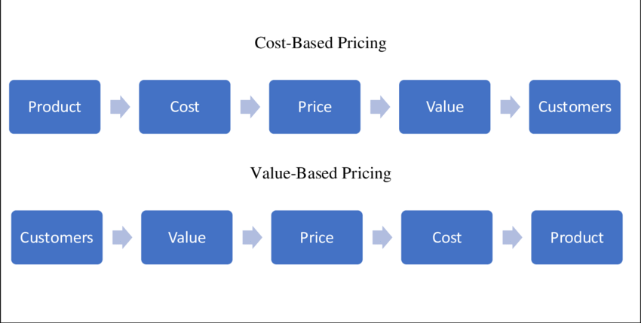
Chapter
9
Cost-Based Pricing
Cost-based pricing:
  Costs set the floor for the price that the company can charge.
  Product-driven, rather than value-driven.
Types of costs:
  Fixed costs:
    Do not vary with production or sales level.
  Variable costs:
    Vary directly with the level of production.

Slide 10
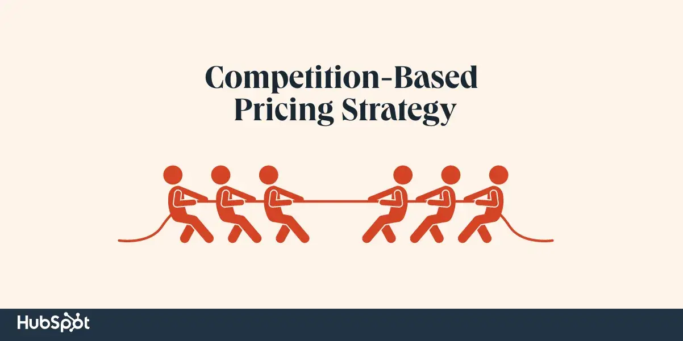
Chapter
9
Competition-Based Pricing
Competition-based pricing:
Assumes consumers base their judgments of a product’s value on the prices charged by competitors for similar products.
Assessing competitors’ pricing strategies:
  How does the firm’s offering compare in terms of customer value?
  How strong are competitors; what are their pricing strategies?
  What principle should guide pricing decisions relative to those of the competition?

Slide 11
Chapter
9
Other Factors Affecting Pricing Decisions
Internal factors:
  Overall marketing strategy, objectives, and the marketing mix.
  Organizational considerations.
External factors:
  The market and demand.
  The economy.
  Other external factors.

Slide 12
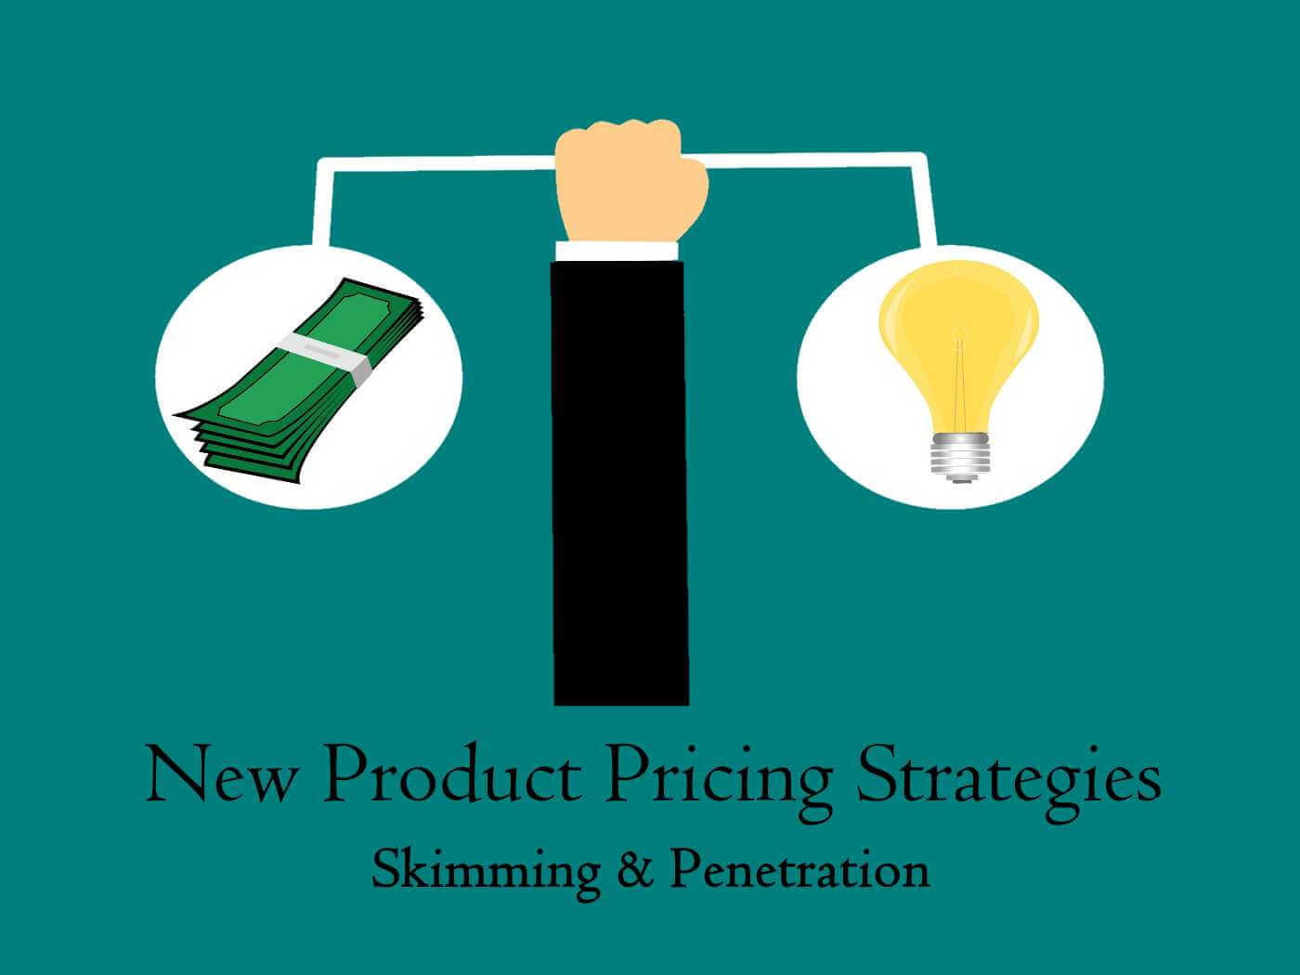
Chapter
9
New-Product Pricing Strategies
Two Broad Strategies
Market skimming pricing
– set a high initial price
Market penetration pricing
– set a low initial price

Slide 13
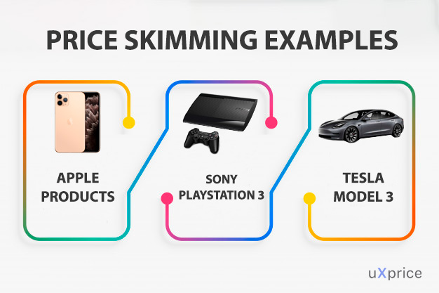
Chapter
9
New-Product Pricing Strategies -1
Market skimming pricing
is a strategy with high initial prices to “skim” revenues layer-by-layer from the market.
  Product quality and image must support the price.
  Buyers must want the product at the price.
  The costs of producing a smaller volume cannot be so high that they cancel the advantage of higher prices.
  Competitors should not be able to enter the market easily and undercut the high price.

Slide 14
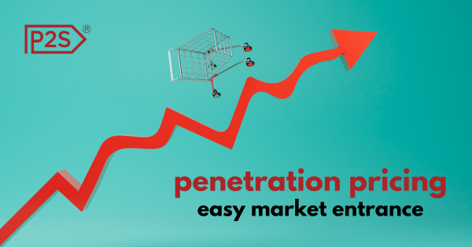
Chapter
9
New-Product Pricing Strategies - 2
Market penetration pricing
sets a low initial price in order to penetrate the market quickly and deeply to attract a large number of buyers quickly to gain market share.
  Price sensitive market
  Production and distribution costs must fall as sales volume increases
  Low prices must keep competition out of the market.

Slide 15

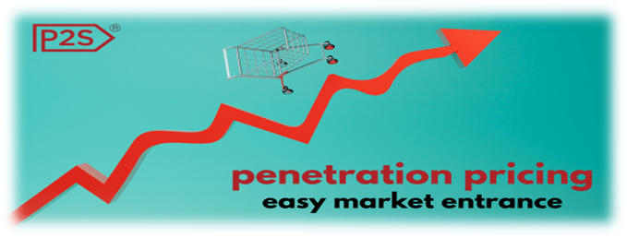
Chapter
9
New Product Pricing Strategies
Market Skimming
Market Penetration
Setting a high price for a new product to maximize revenues from the target market.
Results in fewer, more profitable sales.
Setting a low Price for a new product in order to attract a Large number of buyers.
Results in a larger market share.

Slide 16
Chapter
9
Product-Mix Pricing Strategies
The firm looks for a set of prices that maximizes the profits on the total product mix.
Five product mix pricing situations
Product line pricing – the products in the product line
Optional product pricing – optional or accessory products
Captive product pricing - complementary products
By-product pricing – by-products
Product bundle pricing – several products

Slide 17




Chapter
9
Product-Mix Pricing Strategies
Product line pricing
takes into account the cost difference between products in the line, customer evaluation of their features, and competitors’ prices. – the price differences represent the perceived quality differences
Normal Hair
$3.90
Anti-dandruff
$4.90
Hair Fall Defense
$4.90
Oily Hair
$3.90

Slide 18


Chapter
9
Product-Mix Pricing Strategies
Optional product pricing
takes into account optional or accessory products along with the main product.
Decide which items to include in the base price and which to offer as options
New car with ordinary rims
$59,000
New car with sports rims
$60,000

Slide 19
Chapter
9
Product-Mix Pricing Strategies
Captive product pricing
involves products that must be used along with the main product.
  Price the main, or driver product low and seek high margins on the supplies
For services: two-part pricing
is where the price is broken into fixed fee and variable usage fee.
  Decide how much to charge for the basic service and how much for the variable usage
  The fixed amount should be low enough to induce usage of the service; profit can be made on the variable fees

Slide 20
Chapter
9
Product-Mix Pricing Strategies
By-product pricing
refers to products with little or no value produced as a result of the main product.
Producers will seek little or no profit
Producers should accept any price that covers more than the cost to cover storage and delivery.

Slide 21

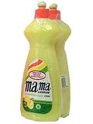
Chapter
9
Product-Mix Pricing Strategies
Product bundle pricing
combines several products and offer the bundle at a reduced price.
Price bundling can promote the sales of products
1 bottle: $2.70
Bundled 2 bottles: $4.90

Slide 22
Chapter
9
Product Mix Pricing Strategies
Product Line Pricing
Setting Price Steps Between Product Line Items
i.e. $299, $399
Product
Mix
Pricing
Strategies
Optional-Product Pricing
Pricing Optional or Accessory Products Sold With The Main Product “ i.e. Car Options “
Captive-Product Pricing
Pricing Products That Must Be Used With The Main Product
i.e. Razor Blades, Film, Software
By-Product Pricing
Pricing Low-Value By-Products To Get Rid of Them
i.e. Lumber Mills, Zoos
Product-Bundle Pricing
Pricing Bundles Of Products Sold Together
i.e. Season Tickets, Computer Makers

Slide 23
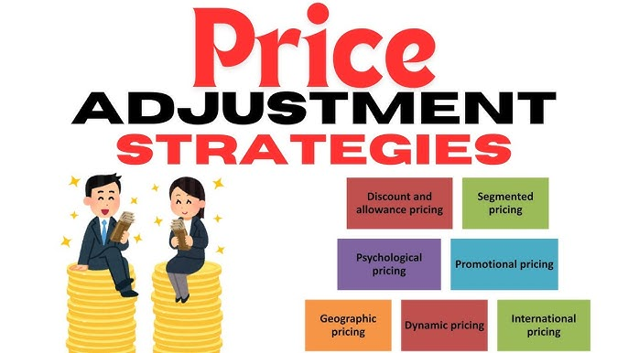
Chapter
9
Price Adjustment Strategies
Companies adjust basic prices to account for various customer differences and changing situations.
Discount and allowance pricing
Segmented pricing
Psychological pricing
Promotional pricing
Geographical pricing
Dynamic pricing
International pricing

Slide 24
Chapter
9
Price Adjustment Strategies
Discount and allowance pricing
Reduces prices to reward customer for certain responses such as paying early, volume purchases, and off-season buying.
  Discounts
    Cash discount for paying promptly
    Quantity discount for buying in large volume
    Functional (trade) discount for selling, storing, distribution, and record keeping
  Allowances
    Trade-in allowance for turning in an old item when buying a new one
    Promotional allowance to reward dealers for participating in advertising or sales support programs

Slide 25
Chapter
9
Price Adjustment Strategies
Segmented pricing
is used when a company sells a product at two or more prices even though the difference is not based on cost.
Adjust basic prices to allow for differences in customers, products, and locations
Airlines, hotels and restaurants – revenue management or yield management
To be effective:
    Market must be segmentble
    Segments must show different degrees of demand
    Watching the market cannot exceed the extra revenue obtained from the price difference
    Must be legal

Slide 26
Chapter
9
Price Adjustment Strategies
Customer segment pricing
is when different customer pay for different prices for the same product or service.
Product form segment pricing
is when different versions of the product are priced differently but not according to differences in cost.
Location pricing
is when the product is sold in different geographic areas and priced differently in those areas even though the cost is the same.
Time pricing
is when a firm varies its prices by the season, the month, the day, and even the hour.

Slide 27
Discount & Allowance
Reducing Prices to Reward Customer Responses such as
Paying Early or Promoting the Product.
Segmented
Adjusting Prices to Allow for Differences in Customers,
Products, or Locations.
Chapter
9
Price Adjustment Strategies
Cash Discount
Customer
Quantity Discount
Product Form
Functional Discount
Location
Seasonal Discount
Time
Trade-In Allowance

Slide 28
Chapter
9
Price Adjustment Strategies
Psychological pricing
Occurs when sellers consider the psychology of prices and not simply the economics.
  Reference prices : Are prices that buyers carry in their minds and refer to when looking at a given product.
  Noting current prices
  Remembering past prices
  Assessing the buying situations

Slide 29
Chapter
9
Price Adjustment Strategies
Promotional pricing
Is when prices are temporarily priced below list price or cost to increase demand.
  Loss leaders
  Special event pricing
  Cash rebates
  Low interest financing
  Longer warrantees
  Free maintenance
Risks of promotional pricing
  Used too frequently
  Copies by competitors can create “deal-prone” customers who will wait for promotions and avoid buying at regular price.
  Creates price wars.

Slide 30
Chapter
9
Price Adjustment Strategies
Promotional Pricing
Loss leaders are products sold below cost to attract customers in the hope they will buy other items at normal markups.
Special event pricing is used to attract customers during certain seasons or periods.
Cash rebates are given to consumers who buy products within a specified time.
Low interest financing, longer warrantees, and free maintenance lower the consumer’s “total price.”

Slide 31
Chapter
9
Price Adjustment Strategies
Geographical pricing
Is used for customers in different parts of the country or the world.
  FOB pricing
  Uniformed delivery pricing
  Zone pricing
  Basing point pricing
  Freight absorption pricing

Slide 32
Chapter
9
Price Adjustment Strategies
FOB (free on board) pricing : means that the goods are placed free on board a carrier. At that point the title and responsibility passes to the customer, who pays the freight from the factory to the destination.
Uniformed delivery pricing : means the company charges the same price plus freight to all customers, regardless of location.
Zone pricing : means that the company sets up two or more zones where customers within a given zone pay a single total price.
Basing point pricing : means that a seller selects a given city as “basing point” and charges all customers the freight cost associated from that city to the customer location regardless of the city from which the goods are actually shipped.
Freight absorption pricing : means that the seller absorbs all or part of the actual freight charge as an incentive to attract business in competitive markets.

Slide 33
Chapter
9
Price Adjustment Strategies
Dynamic pricing
Is when prices are adjusted continually to meet the characteristics and needs of the individual customer and situations.
International pricing
Is when prices are set in a specific country based on country-specific factors.
  Economic conditions
  Competitive conditions
  Laws and regulations
  Infrastructure
  Company marketing objectives

Slide 34
Chapter
9
Psychological Pricing
Price Adjustment Strategies
Promotional Pricing
Adjusting Prices for Psychological effect.
Price Used as a Quality Indicator.
Temporarily Reducing Prices to Increase Short-Run Sales.
i.e. Loss Leaders, Special-Events
Geographical Pricing
Adjusting Prices to Account for the geographic Location of Customers, i.e. FOB-Origin, Uniform-Delivered, Zone Pricing, Basing-Point, & Freight-Absorption.
Adjusting Prices for International Markets.
Price Depends on Costs, Consumers, Economic Conditions & Other Factors.
International Pricing

Slide 35
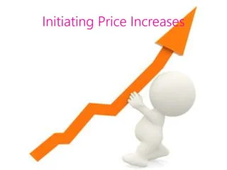
Chapter
9
Price Changes
Initiating Pricing Changes
Price cuts : is a reduction in selling price.
  Excess capacity
  Increase market share
Price increases is an increase in selling price
  Cost inflation
  Increased demand and lack of supply
  Company greed

Slide 36
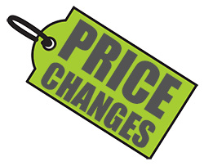
Chapter
9
Price Changes
Buyers’ Interpretation to Price Changes
Price cuts
  New models will be available
  Models are not selling well
  Quality issues
Price increases
  Product is “hot”
  Company greed

Slide 37
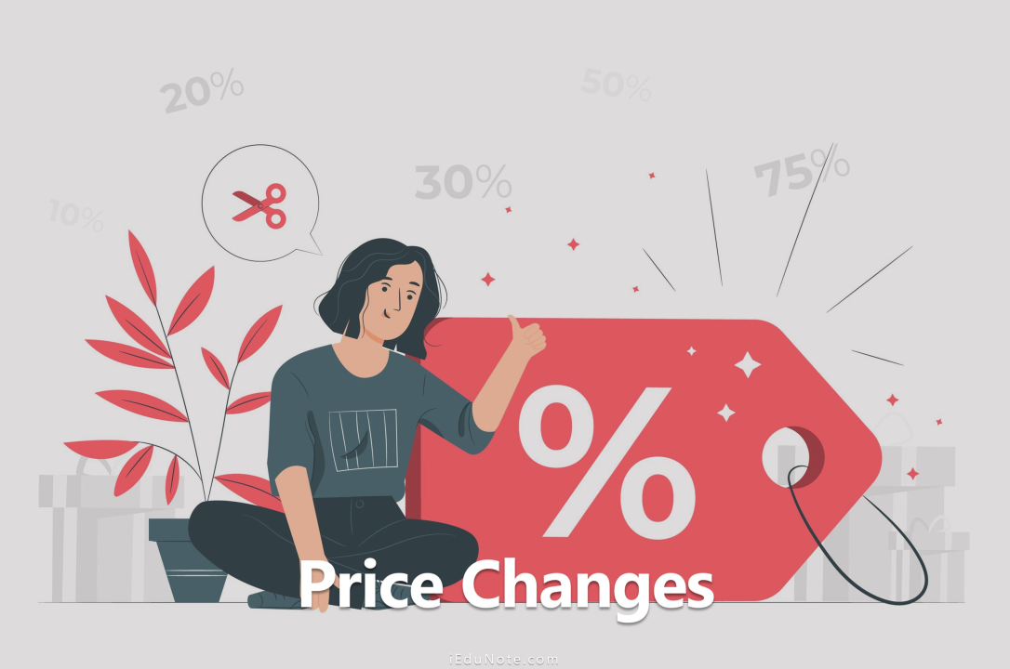
Chapter
9
Price Changes
Responding to Price Changes
Questions
  Why did the competitor change the price?
  Is the price cut permanent or temporary?
  What is the effect on market share and profits?
  Will competitors respond?
Solutions
  Reduce price to match competition
  Maintain price but raise the perceived value through communications
  Improve quality and increase price
  Launch a lower-price “fighting brand”

Slide 38
Chapter
9
Initiating and Responding to Price Changes
Competitor
reactions to price changes
Initiating
Price Cuts
Price Changes
Buyer
Reactions to Price Changes
Initiating
Price
Increases

Slide 39
Chapter
9
Price - Quality Strategies
Price
Higher Lower
Premium
Strategy
Good-Value
Strategy
Higher
Overcharging
Strategy
Economy
Strategy
Quality
Lower

Slide 40
Chapter
9
Price-Adjustment Strategies
Hold Current Price
Continue to Monitor competitor’s Price.
Has Competitor Cut Price?
No
Will Lower Price negatively affect Our Market Share & Profits?
No
Reduce Price
No
Raise Perceived Quality
Can/ Should Effective Action be Taken?
Yes
Improve Quality & Increase Price
Launch Low-Price “Fighting Brand”

Slide 41
See you in the next lecture

Slide 42
Resources and References
The Ultimate Guide to Pricing Strategies & Models
Cost-Based vs. Value-Based Pricing | Download Scientific Diagram
Penetration Pricing: Easy Market Entrance
Captive Product Pricing. What it is, How it Works, Examples.

Slide 43

Thanks for listening.
01
Best wishes
Dr. Ayman Hassan

