Slide 1


Operations Strategy in a Global Environment
&
Problem Solving
Prepared by Dr. Injy Nashaat
Lecture 10

Slide 2



Operations Strategy in a Global Environment
www.midocean.ae

Slide 3
Global Strategies
Boeing – sales and production are worldwide
Benetton – moves inventory to stores around the world faster than its competition by building flexibility into design, production, and distribution
Sony – purchases components from suppliers in Thailand, Malaysia, and around the world

Slide 4
Global Strategies
Volvo – considered a Swedish company but until recently was controlled by an American company, Ford. The current Volvo S40 is built in Belgium and shares its platform with the Mazda 3 built in Japan and the Ford Focus built in Europe.
Haier – A Chinese company, produces compact refrigerators (it has one-third of the US market) and wine cabinets (it has half of the US market) in South Carolina

Slide 5
Reasons to Globalize
Reasons to Globalize
Tangible Reasons
Reduce costs (labor, taxes, tariffs, etc.)
Improve supply chain
Provide better goods and services
Understand markets
Learn to improve operations
Attract and retain global talent
Intangible Reasons

Slide 6

Reduce Costs
Foreign locations with lower wage rates can lower direct and indirect costs
  Maquiladoras
  World Trade Organization (WTO)
  North American Free Trade Agreement (NAFTA)
  APEC, SEATO, MERCOSUR, CAFTA
  European Union (EU)

Slide 7
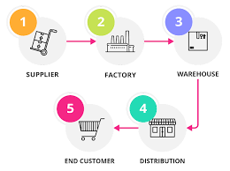
Improve the Supply Chain
Locating facilities closer to unique resources
  Auto design to California
  Athletic shoe production to China
  Perfume manufacturing in France

Slide 8

Provide Better Goods and Services
Objective and subjective characteristics of goods and services
  On-time deliveries
  Cultural variables
  Improved customer service

Slide 9
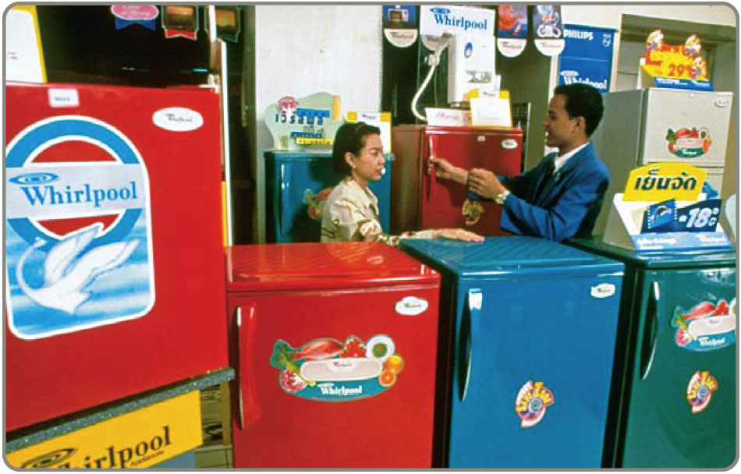
Understand Markets
Interacting with foreign customers and suppliers can lead to new opportunities
  Cell phone design from Europe
  Cell phone fads from Japan
  Extend the product life cycle

Slide 10

Learn to Improve Operations
Remain open to the free flow of ideas
  General Motors partnered with a Japanese auto manufacturer to learn new approaches to production and inventory control
  Equipment and layout have been improved using Scandinavian ergonomic competence

Slide 11

Attract and Retain Global Talent
Offer better employment opportunities
  Better growth opportunities and insulation against unemployment
  Relocate unneeded personnel to more prosperous locations

Slide 12
Cultural and Ethical Issues
Cultures can be quite different
Attitudes can be quite different towards
Punctuality
Lunch breaks
Environment
Intellectual
property
Thievery
Bribery
Child labor

Slide 13
Companies Want To Consider
National literacy rate
Rate of innovation
Rate of technology change
Number of skilled workers
Political stability
Product liability laws
Export restrictions
Variations in language
Work ethic
Tax rates
Inflation
Availability of raw materials
Interest rates
Population
Number of miles of highway
Phone system

Slide 14
Match Product & Parent
Braun Household Appliances
Firestone Tires
Godiva Chocolate
Haagen-Dazs Ice Cream
Jaguar Autos
MGM Movies
Lamborghini Autos
Alpo Petfoods
Volkswagen
Bridgestone
Campbell Soup
Tata Motors Limited
Proctor and Gamble
Nestlé
Pillsbury
Sony

Slide 15
Match Product & Parent
Braun Household Appliances
Firestone Tires
Godiva Chocolate
Haagen-Dazs Ice Cream
Jaguar Autos
MGM Movies
Lamborghini Autos
Alpo Petfoods
Volkswagen
Bridgestone
Campbell Soup
Tata Motors Limited
Proctor and Gamble
Nestlé
Pillsbury
Sony

Slide 16
Match Product & Country
Braun Household Appliances
Firestone Tires
Godiva Chocolate
Haagen-Dazs Ice Cream
Jaguar Autos
MGM Movies
Lamborghini Autos
Alpo Pet Foods
Great Britain
Germany
Japan
United States
Switzerland
India

Slide 17
Match Product & Country
Braun Household Appliances
Firestone Tires
Godiva Chocolate
Haagen-Dazs Ice Cream
Jaguar Autos
MGM Movies
Lamborghini Autos
Alpo Pet Foods
Great Britain
Germany
Japan
United States
Switzerland
India

Slide 18
Developing Missions and Strategies
Mission statements tell an organization where it is going
The Strategy tells the organization how to get there

Slide 19

Mission
Mission - where are you going?
  Organization’s purpose for being
  Answers ‘What do we provide society?’
  Provides boundaries and focus

Slide 20

Merck
The mission of Merck is to provide society with superior products and services—innovations and solutions that improve the quality of life and satisfy customer needs—to provide employees with meaningful work and advancement opportunities and investors with a superior rate of return.

Slide 21

Our Mission: To spread the spirit of Rock ’n’ Roll by delivering an exceptional entertainment and dining experience. We are committed to being an important, contributing member of our community and offering the Hard Rock family a fun, healthy, and nurturing work environment while ensuring our long-term success.

Slide 22
Factors Affecting Mission
Philosophy and Values
Profitability and Growth
Environment
Mission
Customers
Public Image
Benefit to Society

Slide 23
Sample Missions
Sample Company Mission
To manufacture and service an innovative, growing, and profitable worldwide microwave communications business that exceeds our customers’ expectations.
Sample Operations Management Mission
To produce products consistent with the company’s mission as the worldwide low-cost manufacturer.

Slide 24
Sample Missions
Sample OM Department Missions
Product design | To design and produce products and services with outstanding quality and inherent customer value.
Quality management | To attain the exceptional value that is consistent with our company mission and marketing objectives by close attention to design, procurement, production, and field service operations
Process design | To determine, design, and produce the production process and equipment that will be compatible with low-cost product, high quality, and good quality of work life at economical cost.

Slide 25
Sample Missions
Sample OM Department Missions
Location | To locate, design, and build efficient and economical facilities that will yield high value to the company, its employees, and the community.
Layout design | To achieve, through skill, imagination, and resourcefulness in layout and work methods, production effectiveness and efficiency while supporting a high quality of work life.
Human resources | To provide a good quality of work life, with well-designed, safe, rewarding jobs, stable employment, and equitable pay, in exchange for outstanding individual contribution from employees at all levels.

Slide 26
Sample Missions
Sample OM Department Missions
Supply-chain management | To collaborate with suppliers to develop innovative products from stable, effective, and efficient sources of supply.
Inventory | To achieve low investment in inventory consistent with high customer service levels and high facility utilization.
Scheduling | To achieve high levels of throughput and timely customer delivery through effective scheduling.
Maintenance | To achieve high utilization of facilities and equipment by effective preventive maintenance and prompt repair of facilities and equipment.

Slide 27

Solving Problems
Notes:
Creating a methodical problem-solving plan is often difficult for students. This section of the module presents several different strategies students may practice in the module activities.

Slide 28
Problem-Solving Strategies
1. Draw a diagram.
“A picture is worth a thousand words.”
Are you a visual learner?
Turn an abstract problem into a concrete problem by making a sketch.
Example: Determine the order of the houses.
Notes:
“Draw a diagram” example: Five houses on the block. one is blue, one is green, two are red, and one is yellow. Both red houses are to the left of the green house; the blue house is between two red houses, and the yellow house is the first house on the block. What is the order of the houses on the block? A sketch will quickly reveal the correct pattern.

Slide 29
Problem-Solving Strategies
2. Make a list.
A systematic listing of options/choices can make the answer clearer.
Use a methodical approach to cover all options/choices.
Example: How many possible tile arrangements are there?
Notes:
“Make a list” example: Four colored tiles: Red, Yellow, Blue, and Green are to be mounted side-by-side for a store display. How many possible color sequences are there? Simply listing the possible sequences in an orderly fashion will yield the answer without the need for a clever math formula and calculation.
On the other hand, this is an example where the power of math can be helpful. This is an example application of n! (that is, n factorial). When you have n different items, there are n! possible arrangements, if the order is significant (that is, AB is different from BA). So, for our four colors, there are 4! = 4•3•2•1 = 24 possible ways to arrange the tiles, as can be verified by listing and counting the possible arrangements: RYGB, RYBG, RGYB, RGBY, and so forth.

Slide 30
Problem-Solving Strategies
3. Trial and error
Sometimes known as “guess and check.”
Good if the cost of a wrong guess is minimal.
Good if the number of possible answers is not too large.
Example: The product of five consecutive integers is greater than one million. What are the smallest values that do this?
Notes:
“Trial and error” example: One could solve an algebraic expression (hard) or just try several sets of five consecutive values with a calculator, notice a trend, and eventually close in on the answer (14•15•16•17•18=1,028,160).
Another example: A radio station’s high-low jackpot; callers guess the jackpot value and are told they’re high or low. Keeping track of the results will eventually yield the correct answer. Often “guess and check” is a perfectly legitimate problem-solving technique.
Many professional trade workers apply this technique. For example, a carpenter may start with an approximate length of lumber that is close to the desired amount, repeatedly check the result and trim away a little more, being careful not to trim away too much, until the result is satisfactory.

Slide 31
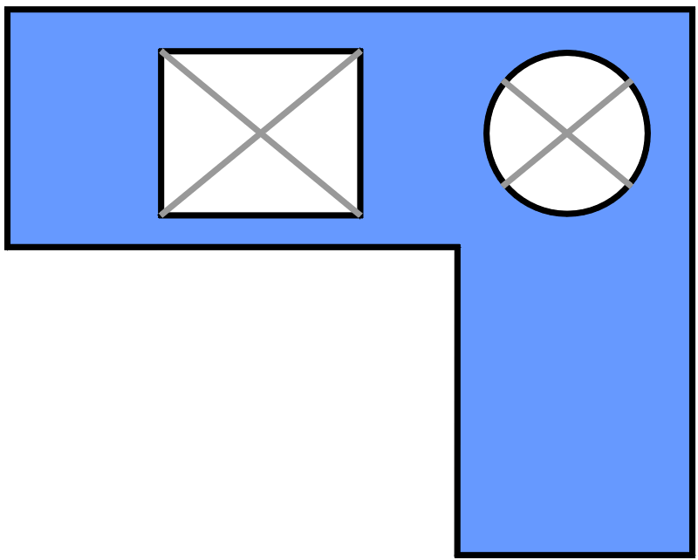
Problem-Solving Strategies
4. Divide and conquer.
Break big problems into several smaller problems that are more easily solved.
Example: How many tiles should be ordered for
a countertop with complex geometry?
Notes:
“Divide and conquer” example: Ordering tiles for a countertop with a complex geometry is best solved by breaking the complex geometry down into manageable regions. Using the example on screen, identify rectangular regions, then subtract the area of the rectangular and circular regions. Notice that a diagram plays an important role here, too.

Slide 32
Problem-Solving Strategies
5. Look for a pattern.
Often other approaches yield a pattern that suggests a possible solution. Test the solution.
Example: 1000 students have 1000 lockers. Starting at locker 0001, Student #1 opens every locker. Student #2 closes every other locker. Student #3 changes every 3rd locker. Student #4 changes every 4th locker. And so on, through Student #1000. What lockers will be left open?
Notes:
“Look for a pattern” example: We could make a table of all 1000 lockers, but if we just look at the first few lockers (for example make a list of the first 25 lockers) it will become evident that the locker numbers that will remain open are perfect squares (1, 4, 9, 25, 49, etc.). Thus there is no need to actually diagram all 1000 lockers. The answer is that the locker numbers that are perfect squares will be open after all 1000 students have taken their pass at open/closing the lockers.
The Fibonacci series that occurs amazingly often in nature seems quite bizarre and unpredictable, until one detects the pattern.

Slide 33
Problem-Solving Strategies
6. Working backward might be useful when...
The result is clear, but the initial conditions are not.
The beginning situation is complicated, but the end is simple.
The direct approach would involve a complicated equation.
The problem involves a sequence of reversible actions.
Example: What was your previous month’s bank balance if this month’s statement shows $493.18, after checks for $17.73 and $88.10, and a deposit of $193.22 and interest of $0.26?
Notes:
“Working backward” example: Rather than developing a formula to calculate the previous month’s balance, we can start with the current balance and reverse the actions throughout the month. So, reversing the checks means adding (rather than subtracting) those amounts. Reversing the deposits means subtracting (rather than adding) those amounts). Thus, $493.18 + $17.73 + $88.10 – $193.22 – $0.26 = $405.53, and so the previous month’s statement balance was $405.53.
“Working backward” might be the best strategy when we pause to consider the problem, rather than jumping right into the typical approach. A maze is a good example. Few people consider starting at the Finish and working backwards to reach the Start. Another example comes from the childhood puzzle showing three fishermen with tangled fishing lines winding all over the page, one of which is connected to a big fish in the opposite corner. To answer the question “Which fisherman will catch the fish?” the best strategy is to start at the fish and follow the line back to the winning fisherman--working backward.

Slide 34
Quality Improvement

Slide 35
Seven-Step Strategy for Quality Improvement
Identify and define the problem.
  Brainstorming
  Impact changeability tool
  Problem statement
Study the current situation.
  Force-field analysis
  Flow chart
Notes:
See the complete plan presented in the Student Handout. Many slight variations of such problem-solving plans exist. They all typically include variations of the essential four steps: 1) understanding the problem, 2) developing a plan, 3) implement the plan, and 4) check the outcome.
Impact changeability tools help teams prioritize problems to address based on the degree of impact the process has on the whole system.
A force-field analysis is essentially a more complex pros/cons or risk/benefit analysis.
A flow chart is a start-to-finish graphic representation of tasks within a whole process.

Slide 36
Seven-Step Strategy for Quality Improvement
Find the root cause.
  Asking “why” five times
  Fishbone diagram
Choose a solution.
  Brainstorming
  Evaluation grid
Notes:
See the complete plan presented in the Student Handout. Many slight variations of such problem-solving plans exist. They all typically include variations of the essential four steps: 1) understanding the problem, 2) developing a plan, 3) implement the plan, and 4) check the outcome.
Asking “why” repeatedly helps determine a chain of events leading to a problem.

Slide 37
Seven-Step Strategy for Quality Improvement
Develop and action plan.
  Specific and clear
  Logical sequence
  Comprehensive
  Shared with whole team
  Reviewed frequently
Notes:
See the complete plan presented in the Student Handout. Many slight variations of such problem-solving plans exist. They all typically include variations of the essential four steps: 1) understanding the problem, 2) developing a plan, 3) implement the plan, and 4) check the outcome.

Slide 38
GANTT Chart
A type of bar chart that illustrates a project schedule
Illustrates the beginning and completion dates for sub-tasks within a project
Notes:
Gantt charts illustrate the start and finish dates of the many steps and milestones of a project. There are many varieties of Gantt charts, some using shapes, colors, and symbols to communicate different aspects of project progress. They all have in common the concept of precedence and dependency of multiple subtasks. Usually (but not always) progress correlates with the underlying timeline. The task flow sometimes is separated from the time/schedule flow.
Gantt charts were invented by Henry Gantt around 1910, and were considered revolutionary at the time. Today, they are common in business and project planning and presentations.

Slide 39
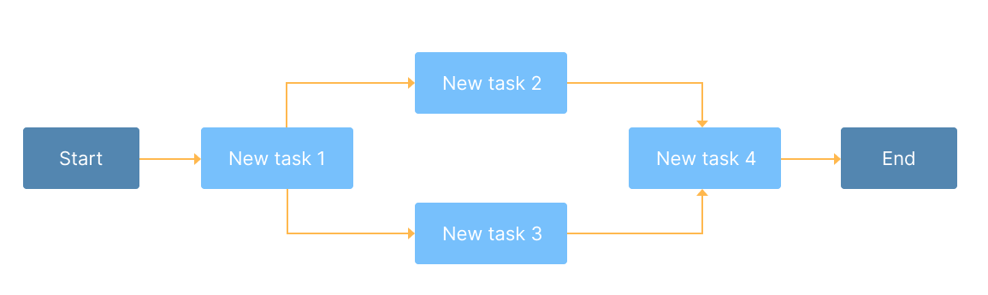
PERT Chart
a tool used to schedule, organize, and map out tasks within a project.
Project Evaluation and Review (PERT) shows the sequence of tasks in a project or problem-solving process

Slide 40
Seven-Step Strategy for Quality Improvement
6.Implement the action plan.
  Includes five Ws and one H:
    Who
    What
    Where
    When
    Why
    How
Notes:
See the complete plan presented in the Student Handout. Many slight variations of such problem-solving plans exist. They all typically include variations of the essential four steps: 1) understanding the problem, 2) developing a plan, 3) implement the plan, and 4) check the outcome.
An action plan clearly outlines Who will do What; Where; When; Why; and How.

Slide 41
Seven-Step Strategy for Quality Improvement
Check the results.
  Force-field analysis
  Brainstorming
  Evaluation grid
Notes:
See the complete plan presented in the Student Handout. Many slight variations of such problem-solving plans exist. They all typically include variations of the essential four steps: 1) understanding the problem, 2) developing a plan, 3) implement the plan, and 4) check the outcome.

Slide 42
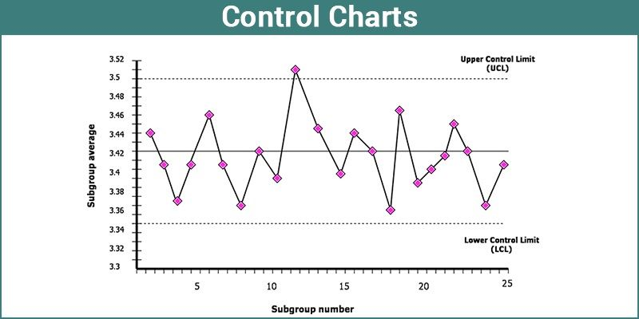
Quality-Control Charting
In statistics, Control charts are the tools in control processes to determine whether a manufacturing process or a business process is in a controlled statistical state. This chart is a graph which is used to study process changes over time. These charts are also known as Shewhart charts or process-behavior charts. The data is plotted in a timely order
Notes:
Ongoing processes (typically factory production and assembly lines) can be monitored by workers who periodically take sample measurements that are chosen as indicators of the health of the production process. While much can be analyzed in such measurements, quality control practice is to focus on two major statistics: the average (x-bar) and the range (R). The average and range of a small number of measurements (typically 4-5) are relatively easy to calculate, record, and chart, and provide good early indicators of unwanted changes in calibration and variation of the process, preventing (hopefully) greater problems down the road.

Slide 43




Thank You

