Slide 1

Secure Operating systems
by Dr. Hesham Abou Elfetouh
Lecture 7

Slide 2

07 Introduction
In Previous Lecture you learned:
User authentication
  Password authentication
  Access control
  Probable Passwords
  Passwords Likely for a User

Slide 3
Lecture
7
Lecture 7 TOPICS
This chapter covers the following topics and concepts:
Password Selection Criteria
One-Time Passwords
Challenge-response Authentication
Attacks on Passwords

Slide 4
07 Lecture 7 GOALS
When you complete this chapter, you will be able to:
Describe the Password Selection Criteria
Explain the One-Time Passwords
Describe the Advantages of salt
Explain the Attacks on Passwords

Slide 5
Password Selection Criteria
7
Use characters other than just AZ.
  If passwords are chosen from the letters AZ, there are only 26 possibilities for each character.
  Adding digits expands the number of possibilities to 36.
  Using both uppercase and lowercase letters plus digits expands the number of possible characters to 62.
  It takes about 100 hours to test all 6-letter words chosen from letters of one case only, but it takes about 2 years to test all 6-symbol passwords from upper- and lowercase letters and digits.

Slide 6
Password Selection Criteria (count)
Choose long passwords
  Choosing longer passwords makes it less likely that a password will be uncovered.
  Remember that a brute force penetration can stop as soon as the password is found.
  Some penetrators will try the easy cases known words and short passwords and move on to another target if those attacks fail.
Avoid actual names or words
  there are 26⁶ or about 300 million 6-letter "words", but there are only about 150,000 words in a good dictionary.

Slide 7
Password Selection Criteria (count)
Choose an unlikely password
  To remember the password easily, you want one that has special meaning to you
  you don't want someone else to be able to guess this special meaning.
  The first letters of words from a song, a few letters from different words of a private phrase, or a memorable football team are examples of reasonable passwords.
  Password-cracking tools also test replacements of 0 (zero) for o or O (letter "oh") and 1 (one) for l (letter "ell") or $ for S (letter "ess").

Slide 8
Password Selection Criteria (count)
Change the password regularly
  Even if there is no reason to suspect that the password has been compromised, change is advised.
  Don't write it down
Don't tell anyone else
  The easiest attack is social engineering, in which the attacker contacts the system's administrator or a user to elicit the password in some way.
  Under no circumstances should you ever give out your private password.

Slide 9
Password Selection Techniques
user education
users can be told the importance of using hard to guess passwords and can be provided with guidelines for selecting strong passwords
computer generated passwords
users have trouble remembering them
reactive password checking
system periodically runs its own password cracker to find guessable passwords
proactive password checking
user is allowed to select their own password, however the system checks to see if the password is allowable, and if not, rejects it
goal is to eliminate guessable passwords while allowing the user to select a password that is memorable

Slide 10
One-Time Passwords
A one-time password is one that changes every time it is used.
Instead of assigning a static phrase to a user, the system assigns a static mathematical function.
The system provides an argument to the function, and the user computes and returns the function value.

Slide 11
one-time password functions
f(x) = x + 1.
  the system prompts with a value for x, and the user enters the value x + 1.
  The kinds of mathematical functions used are limited only by the ability of the user to compute the response quickly and easily.
  Other similar possibilities are:
    f(x) = 3x² - 9x + 2.
    f(x) = d * h, where d is the date and h is the hour of the current time.

Slide 12
one-time password functions
(x) = r(x)
  the receiver uses the argument as the seed for a random number generator.
  The user replies with the value of the first random number generated.
  A variant of this scheme uses x as a number of random numbers to generate.
  The receiver generates x random numbers and sends the xth of these to the host.

Slide 13
one-time password functions
f(a₁a₂a₃a₄a₅a₆) = a₃a₁a₁a₄
  the system provides a character string, which the user must transform in some predetermined manner.
f(E(x)) = E(D(E(x)) + 1)
  In this function, the computer sends an encrypted value, E(x).
  The user must decrypt the value, perform some mathematical function, and encrypt the result to return it to the system.

Slide 14



Challenge-response Authentication
Goal: Bob wants Alice to “prove” her identity to him
Protocol ap1.0: Alice says “I am Alice”
“I am Alice”
Failure scenario??

Slide 15
Authentication
Goal: Bob wants Alice to “prove” her identity to him
Protocol ap1.0: Alice says “I am Alice”
in a network,
Bob can not “see” Alice, so Trudy simply declares
herself to be Alice
“I am Alice”

Slide 16
Authentication: another try
Protocol ap2.0: Alice says “I am Alice” in an IP packet
containing her source IP address
Alice’s
IP address
“I am Alice”
Failure scenario??

Slide 17
Authentication: another try
Protocol ap2.0: Alice says “I am Alice” in an IP packet
containing her source IP address
Trudy can create
a packet “spoofing”
Alice’s address
Alice’s
IP address
“I am Alice”

Slide 18
Authentication: another try
Protocol ap3.0: Alice says “I am Alice” and sends her
secret password to “prove” it.
Alice’s
IP addr
Alice’s
password
“I’m Alice”
Failure scenario??
Alice’s
IP addr
OK

Slide 19
Authentication: another try
Protocol ap3.0: Alice says “I am Alice” and sends her
secret password to “prove” it.
Alice’s
IP addr
Alice’s
password
“I’m Alice”
playback attack: Trudy records Alice’s packet
and later
plays it back to Bob
Alice’s
IP addr
OK
Alice’s
IP addr
Alice’s
password
“I’m Alice”

Slide 20
Authentication: yet another try
Protocol ap3.1: Alice says “I am Alice” and sends her
encrypted secret password to “prove” it.
Alice’s
IP addr
encrypted
password
“I’m Alice”
Failure scenario??
Alice’s
IP addr
OK

Slide 21
Authentication: another try
Protocol ap3.1: Alice says “I am Alice” and sends her
encrypted secret password to “prove” it.
Alice’s
IP addr
encrypted
password
“I’m Alice”
record
and
playback
still works!
Alice’s
IP addr
OK
Alice’s
IP addr
encrypted
password
“I’m Alice”

Slide 22
Authentication: yet another try
Goal: avoid playback attack
Nonce: number (R) used only once –in-a-lifetime
ap4.0: to prove Alice “live”, Bob sends Alice nonce, R. Alice
must return R, encrypted with shared secret key
“I am Alice”
R
Alice is live, and only Alice knows key to encrypt nonce, so it must be Alice!
K (R)
A-B

Slide 23
Authentication: ap5.0
ap4.0 doesn’t protect against server database reading
can we authenticate using public key techniques?
ap5.0: use nonce, public key cryptography
“I am Alice”
Bob computes
R
+
-
-
K
(K (R)) = R
K (R)
A
A
A
and knows only Alice could have the private key, that encrypted R such that
+
-
K
(K (R)) = R
A
A

Slide 24
Password File Access Control
can block offline guessing attacks by denying access to encrypted passwords
make available only to privileged users
vulnerabilities
weakness in the OS that allows access to the file
accident with permissions making it readable
users with same password on other systems
access from backup media
sniff passwords in network traffic
shadow password file
  a separate file from the user IDs where the hashed passwords are kept

Slide 25
Password File?
Bad idea to store passwords in a file
But need a way to verify passwords
Cryptographic solution: hash the pwd
  Store y = h(password)
  Can verify entered password by hashing
  If Trudy obtains “password file”, she does not obtain passwords
But Trudy can try a forward search
  Guess x and check whether y = h(x)

Slide 26
Salt
Hash password with salt
Choose random salt s and compute
y = h(password, s)
and store (s,y) in the password file
Note: The salt s is not secret
Easy to verify salted password
But Trudy must re-compute dictionary hashes for each user
  Lots more work for Trudy!
Secure operating Systems Dr. Hesham Salman

Slide 27
Advantages of salt
Without salt
  Same hash functions on all machines
    Compute hash of all common strings once
    Compare hash file with all known password files
With salt
  One password hashed 2¹² different ways
    Precompute hash file?
      Need much larger file to cover all common strings
    Dictionary attack on known password file
      For each salt found in file, try all common strings

Slide 28
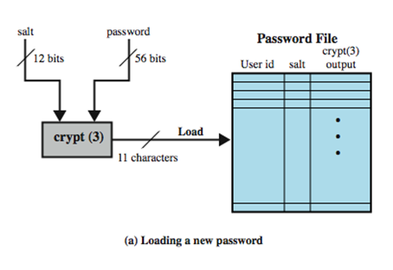

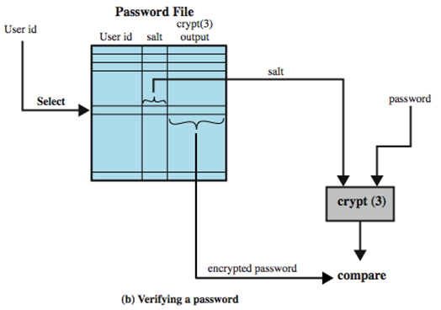
Use of Hashed Passwords
prevents duplicate passwords from being visible in the password file.
greatly increases the difficulty of offline dictionary attacks. For a salt of length b bits, the number of possible passwords is increased by a factor of 2^{b}.
becomes nearly impossible to find out whether a person with passwords on two or more systems has used the same password on all of them.

Slide 29
Attacks on Passwords
Some ways you might be able to determine a user's password, in decreasing order of difficulty.
  Try all possible passwords.
  Try frequently used passwords.
  Try passwords likely for the user.
  Search for the system list of passwords.
  Ask the user.

Slide 30
12 steps an attacker might try in order to determine a password
no password
the same as the user ID
is, or is derived from, the user's name
common word list (for example, "password," "secret," "private") plus common names and patterns (for example, "asdfg," "aaaaaa")
short college dictionary
brute force, full character set
common non-English language dictionaries
short college dictionary with capitalizations (PaSsWorD) and substitutions (0 for O, and so forth)
complete English with capitalizations and substitutions
common non-English dictionaries with capitalization and substitutions
brute force, lowercase alphabetic characters
complete English word list

Slide 31
Exhaustive Attack (brute force attack)
the attacker tries all possible passwords, usually in some automated fashion.
if passwords are words consisting of the 26 characters AZ and can be of any length from 1 to 8 characters:
  there are 26¹ passwords of 1 character, 26² passwords of 2 characters, and 26⁸ passwords of 8 characters.
  the system as a whole has 26¹ + 26² + ... + 26⁸ = 26⁹ - 1 almost equals 5 * 10¹² or five million possible passwords.

Slide 32
Exhaustive Attack (brute force attack)
If we want to use a computer to create and try each password at a rate of checking one password per millisecond, it would take on the order of 150 years to test all.
But if we can speed up the search to one password per microsecond, the work factor drops to about two months.

Slide 33
Exhaustive Attack (brute force attack)
Searching for a single particular password does not necessarily require all passwords to be tried.
an intruder needs to try only until the correct password is identified.
people tend to pick simple passwords.

Slide 34
Attacking Systems via Passwords
A common attack path for Trudy would be:
outsider normal user administrator
One weak password on a system –or one week password on an entire network- could be enough for the first stage of the attack to succeed.

Slide 35
Attacks on Passwords
Attacker could…
  Target one particular account
  Target any account on system
  Target any account on any system
  Attempt denial of service (DoS) attack
Common attack path
  Outsider → normal user → administrator
  May only require one weak password!

Slide 36
Dictionary Attack – some numbers
Typical password dictionary
  1,000,000 entries of common passwords
    people's names, common pet names, and ordinary words.
  Suppose you generate and analyze 10 guesses per second
    This may be reasonable for a web site; offline is much faster
  Dictionary attack in at most 100,000 seconds = 28 hours, or 14 hours on average
If passwords were random
  Assume six-character password
    Upper- and lowercase letters, digits, 32 punctuation characters
    689,869,781,056 password combinations.
    Exhaustive search requires 1,093 years on average

Slide 37
Dictionary Attack
Trudy pre-computes h(x) for all x in a dictionary of common passwords
Suppose Trudy gets access to password file containing hashed passwords
  She only needs to compare hashes to her pre-computed dictionary
  After one-time work, attack is trivial
Can we prevent this attack? Or at least make attacker’s job more difficult?

Slide 38
Password Cracking
dictionary attacks
  develop a large dictionary of possible passwords and try each against the password file
  each password must be hashed using each salt value and then compared to stored hash values
rainbow table attacks
  pre-compute tables of hash values for all salts
  a mammoth table of hash values
  can be countered by using a sufficiently large salt value and a sufficiently large hash length

Slide 39
Password Cracking
Password crackers exploit the fact that people choose easily guessable passwords
  Shorter password lengths are also easier to crack
John the Ripper
  Open-source password cracker first developed in in 1996
  Uses a combination of brute-force and dictionary techniques

Slide 40
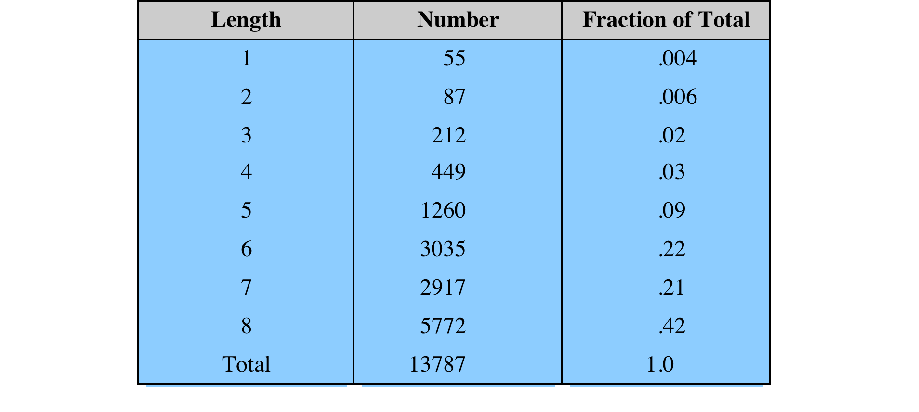
Observed Password Lengths
Purdue University study on 54 systems and 7000 users

Slide 41
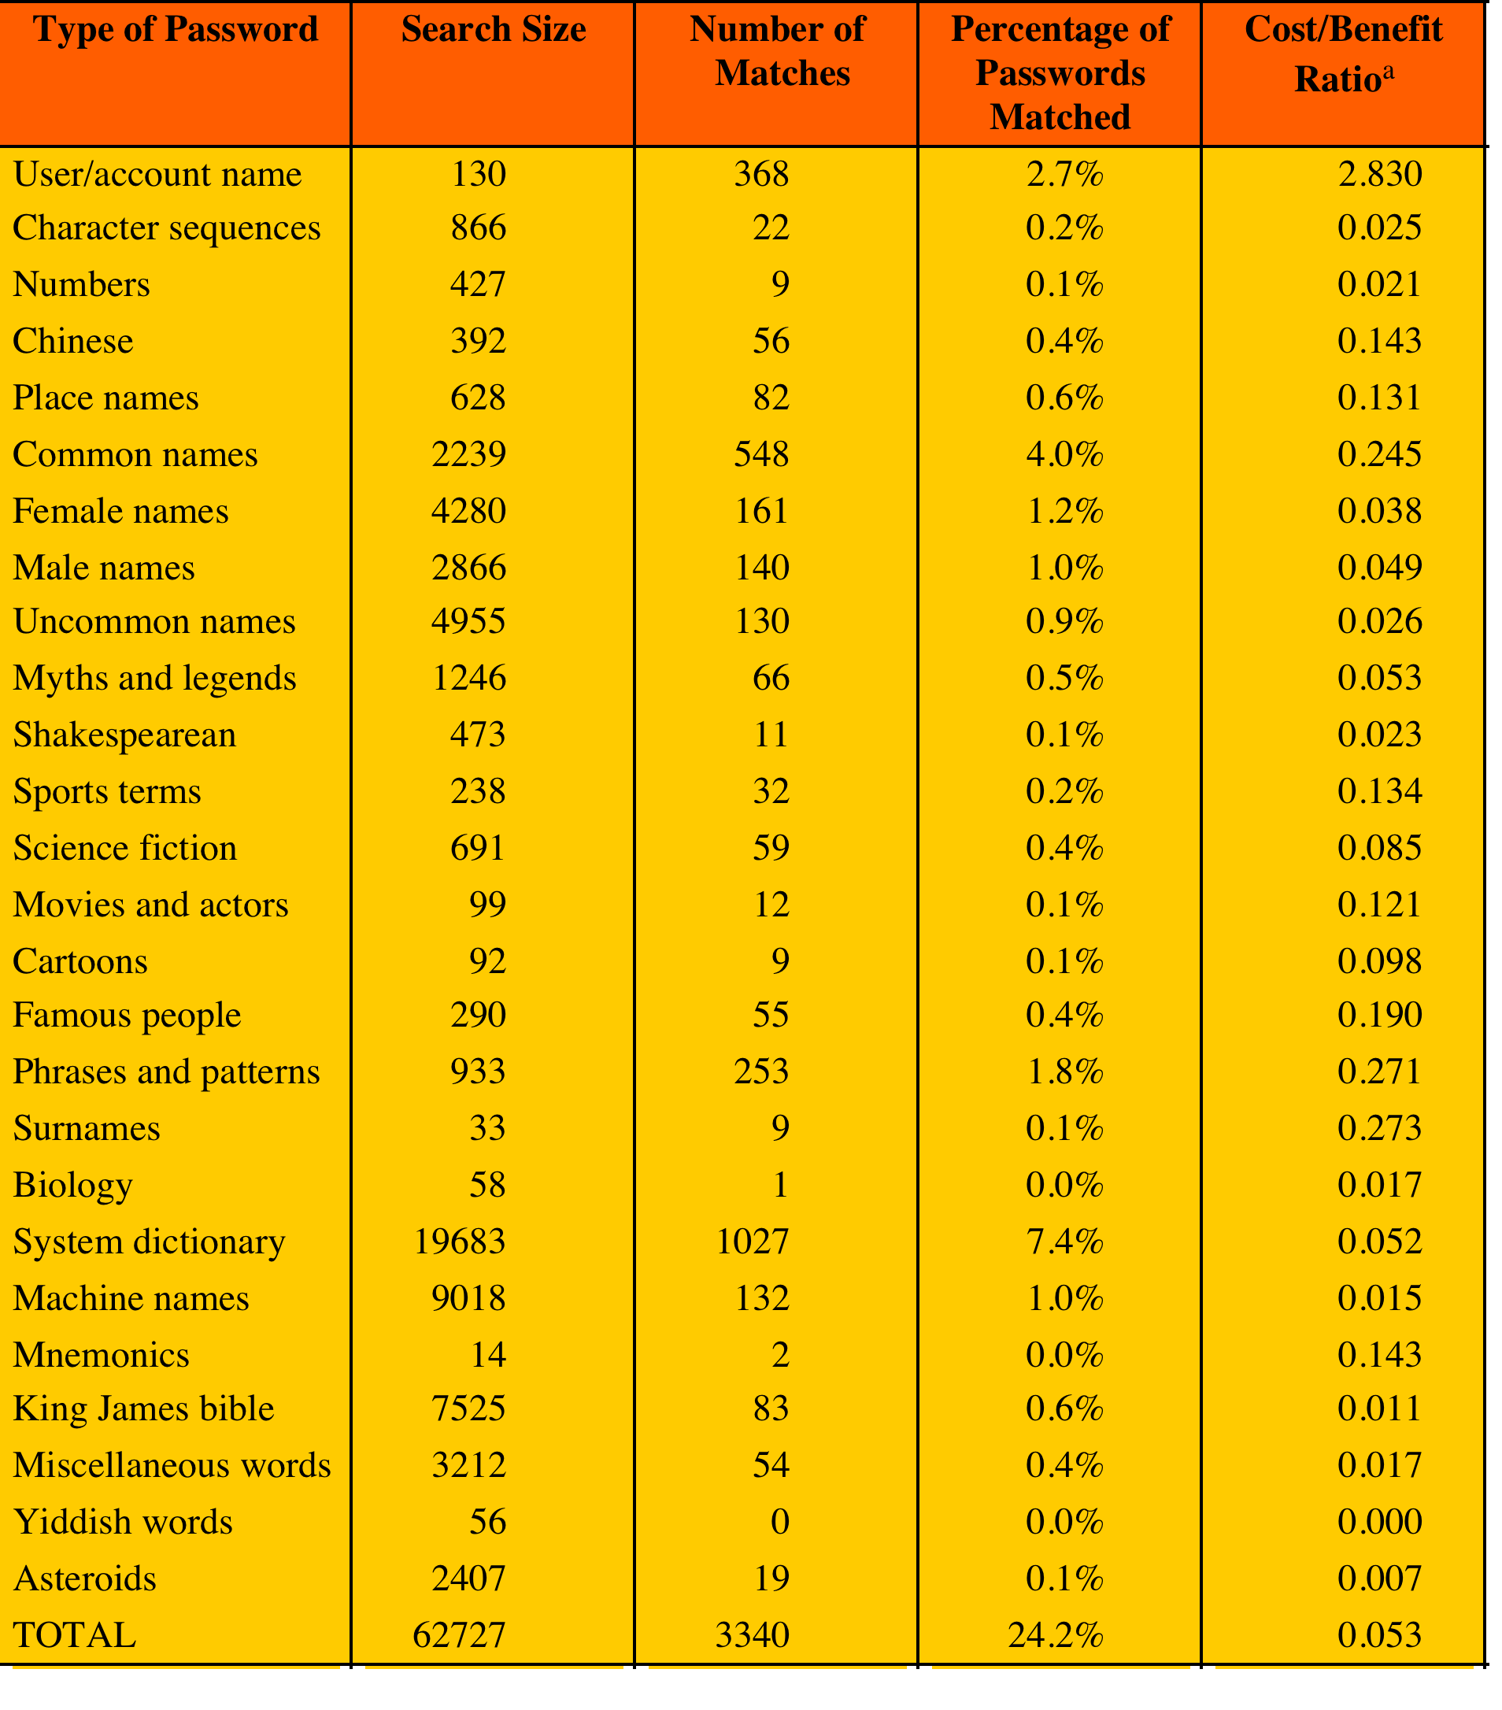
Passwords Cracked from a Sample Set of 13,797 Accounts Compiled 3M dictionary words and their variations.
The more words that need to be tested for a match, the lower the cost/benefit ratio.

Slide 42
study in 2013
25,000 students
at university with
complex password
policy

Slide 43
Improved Implementations
much stronger hash/salt schemes available for Unix
recommended hash function is based on MD5
  salt of up to 48-bits
  password length is unlimited
  produces 128-bit hash
  uses an inner loop with 1000 iterations to achieve slowdown
OpenBSD (Open source UNIX O.S) uses Blowfish block cipher based hash algorithm called Bcrypt
  most secure version of Unix hash/salt scheme
  uses 128-bit salt to create 192-bit hash value

Slide 44
Modern Approaches
Complex password policy
  Forcing users to pick stronger passwords
However, password-cracking techniques have also improved
  The processing capacity available for password cracking has increased dramatically
  The use of sophisticated algorithms to generate potential passwords
  Studying examples and structures of actual passwords in use

Slide 45
Proactive Password Checking
rule enforcement
  specific rules that passwords must adhere to
password cracker
  compile a large dictionary of passwords not to use
Bloom filter
  used to build a table based on dictionary using hashes
  check desired password against this table

Slide 46
Lecture
7
Summary
This chapter explained :
Password Selection Criteria
One-Time Passwords
Challenge-response Authentication
Attacks on Passwords

