Slide 1

Sentiment Analysis for Mobile App Reviews:
A Comparative Study
Prepared By:
Name: Sultan Khalaf Alotaibi ID No: 222000226
Name: Abdel Hafez Adeeb Alassar ID No: 251002398
Supervised By: Dr. Wesam Ahmed

Slide 2
Agenda
Introduction
Objectives
Contribution
Related Work
Proposed Framework
Dataset Information
Hardware and Software
References

Slide 3
Introduction
With mobile application growth, user reviews are crucial for product improvement. This project uses sentiment analysis to classify Mobile Legends reviews and extract insights. It compares machine learning, deep learning, and LLM-based models to find the most effective method for enhancing user experience.

Slide 4
Objectives
The primary objective of this study is to provide an in-depth analysis of user sentiments toward the Mobile Legends application, while evaluating and comparing the effectiveness of different models for sentiment classification.

Slide 5
Contribution
Developed a robust preprocessing pipeline to handle noisy and inconsistent app review data.
Implemented and compared sentiment analysis models, including traditional ML, deep learning, and LLM.
Delivered best practices and actionable insights to improve user experience in mobile apps like Mobile Legends.

Slide 6
Related Work
Machine Learning Models ` | Study | Model | Dataset | Key Findings | Limitations/Gaps
 | Jannah et al. [1] | SVM, Naive Bayes | Synthetic Shopee beauty product reviews | SVM achieved 86.14% accuracy; Naive Bayes 85.53%; TF-IDF + lemmatization effective | Synthetic dataset limits generalizability; no error analysis or feature importance; neutral class not fully addressed
 | Wirawan et al. [2] | SVM + EDA | Instagram cyberbullying comments | Accuracy improved to 92% (+2.5% from baseline SVM); domain-specific improvement | No comparison with LR or Decision Tree baselines
Deep Learning Models | Amirkhalili & Wong [3] | LSTM, Naive Bayes | 2,025 mobile banking reviews (Canada) | LSTM: 82%, NB: 77%; LSTM captures subtle sentiment patterns better | Small dataset; region-specific; no per-class metrics; no transformer benchmark
 | Ranjan & Mishra [4] | LSTM + GloVe embeddings | Google Apps reviews + Student App Reviews (SAR) | Accuracy: 95.2%, F1-score: 88; LSTM + embeddings outperforms traditional ML models | No transformer comparison; generalization to other apps/domains not evaluated
Large Language Models | Nkhata et al. [5] | Hybrid: BERT + BiLSTM; data augmentation (SMOTE, NLPAUG) | IMDb (binary), SST-5 (five-level) datasets | IMDb: 97.67% accuracy; SST-5: 59.48% accuracy; better than standard BERT | Focused on movies, not app reviews; neutral/ambivalent sentiment not handled
 | Nugroho et al. [6] | Fine-tuned BERT (multilingual + Indonesian) with score-based and lexicon-based labeling | Google Play Store reviews of top 10 Indonesian apps | Indonesian BERT: 84% accuracy (lexicon-based) | No multilingual expansion; comparison with RoBERTa/DeBERTa missing; noisy/informal text not fully addressed

Slide 7
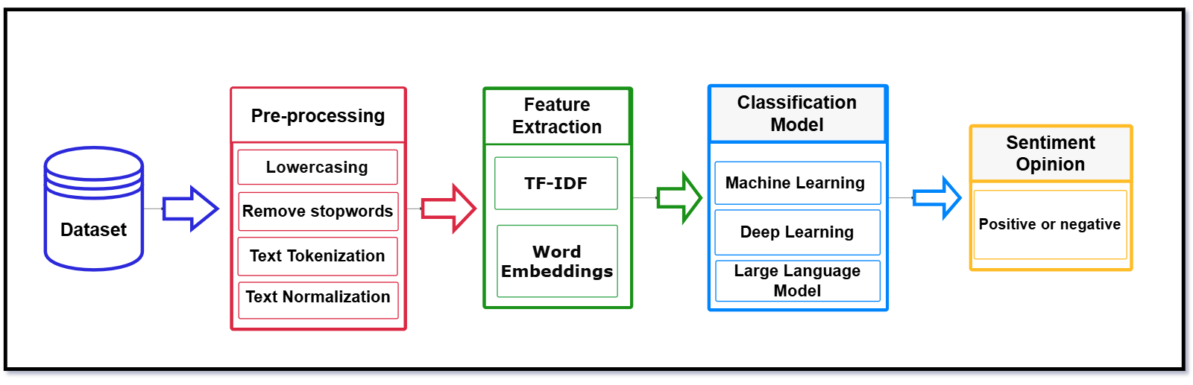
Fig 1 : Proposed Framework

Slide 8
Dataset Information
Dataset Source: https://www.kaggle.com/datasets/abiyyurasyiq/mobile-legends-google-play-reviews Mobile Legends Google Play Reviews Scraped from Google Play Store for the mobile game Mobile Legends: Bang Bang
Columns Included: Review ID: Unique identifier for each review Username: Display name of the reviewer Content: The actual review text Score: Rating given by the user (1 to 5 stars) thumbsUpCount: Number of likes the review received At: Timestamp of the review
Key Details: Total Rows: 52,000 reviews Time Range: February - June 2025 Number of Columns: 6

Slide 9
Hardware and Software
Hardware: Computing Environment: Kaggle
Software: Python Libraries: Pandas, NumPy Data Visualization: Matplotlib, Seaborn NLP Tools: NLTK, Text Blob, SpaCy Machine Learning: Scikit-learn Deep learning: TensorFlow

Slide 10
References
[1] Jannah, N. Z. B., & Kusnawi, K. (2024). Comparison of Naïve Bayes and SVM in sentiment analysis of product reviews on marketplaces. Sinkron: Jurnal dan Penelitian Teknik Informatika, 8(2), 727–733.
[2] Wirawan, A., & Cahyono, H. D. (2023). Easy data augmentation in sentiment analysis of cyberbullying. In Proceedings of the 6th International Conference on Information and Communications Technology (ICOIACT), Yogyakarta, Indonesia (pp. 443–447).
[3] Amirkhalili, Y., & Wong, H. Y. (2025). Banking on feedback: Text analysis of mobile banking iOS and Google app reviews. arXiv preprint arXiv:2503.11861.
[4] Ranjan, S., & Mishra, S. (2022). Perceiving university students' opinions from Google app reviews. Concurrency and Computation: Practice and Experience, 34(10), e6800.
[5] Nkhata, G., Gauch, S., Anjum, U., & Zhan, J. (2025). Fine-tuning BERT with Bidirectional LSTM for fine-grained movie reviews sentiment analysis. arXiv preprint arXiv:2502.20682.
[6] Nugroho, K. S., Sukmadewa, A. Y., Wuswilahaken, D. W. H., Bachtiar, F. A., & Yudistira, N. (2021). BERT fine-tuning for sentiment analysis on Indonesian mobile apps reviews. In Proceedings of the 6th International Conference on Sustainable Information Engineering and Technology (pp. 258–264).
[7] Juliane, C. (2021, November). Implementation of naive bayes algorithm on sentiment analysis application. In 2nd International Seminar of Science and Applied Technology (ISSAT 2021) (pp. 193-200). Atlantis Press.
[8] Azeraf, E., Monfrini, E., & Pieczynski, W. (2021). Improving usual Naive Bayes classifier performances with Neural Naive Bayes based models. arXiv preprint arXiv:2111.07307.
[9] Sumantiawan, D. I., Suseno, J. E., & Syafei, W. A. (2023). Sentiment analysis of customer reviews using Support Vector Machine and SMOTE-Tomek Links for identifying customer satisfaction. Jurnal Sistem Informasi Bisnis, 13(1), 1–9.

Slide 11
Thank you

