Slide 1



Human Resource
Management
Prepared by Dr. Anas M. Bashayreh
HRM 611
Lecture

Slide 2



Human Resource
Management
Lecture
HRM 611
Introduction to HRM
Prepared by
Dr. Anas M. Bashayreh
www.midocean.ae

Slide 3

Lecture
About the course:
This course provides students with critical understanding of the nature of human resource management (HRM) and the conditions which enables the applications of HRM concepts, values, practices, and its varying contexts of application. You will appreciate the challenges associated with the transferability of management practices across organizations, sectors, and cultures.
Credit Hours: 3 credit hours
www.midocean.ae

Slide 4
Lecture
Learning Outcomes
Critical understanding of the nature of HRM in terms of its emergence, philosophy, and values.
Knowledge of various theories and models of managing people.
Critical understanding of the applicability of theories and models in different organizational, cultural, and institutional contexts.
Ability to provide line managers with advice regarding the implications of theories and models.
Ability to provide line managers on how to modify HR practices to fit organization’s contexts.
www.midocean.ae

Slide 5
Topics:
Lecture
Introduction: HRM
HRM Strategy and Analysis
Job Analysis
Employee Recruitment
Selecting Employees
Training & Developing Employees
Career Development
Performance Management
Compensation
www.midocean.ae

Slide 6
Textbook:
The main material and reference for this course will be mainly based on:
Dessler, G. (2011). Human resource management. twelfth edition. Pearson International Edition.
www.midocean.ae

Slide 7


Slide 8


Slide 9
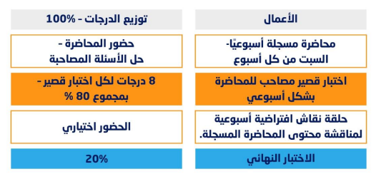
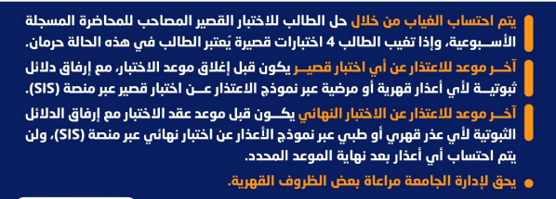
توزيع الدرجات
www.midocean.ae

Slide 10


Thank You

Slide 11
www.midocean.ae

