Slide 1


Writing in
Organizations
Prepared by Dr. Magdy Alhaj
MGM 202
Lecture 4

Slide 2



Writing Letters: Some Basics for Communicating with Audiences Worldwide
Lecture 4
MGM 202
Prepared by
Dr. Magdy Alhaj

Slide 3

Lecture
4
Course Outline
Lecture 1: Getting Started: Writing and Your Career.
Lecture 2: The Writing Process and Collaboration at Work.
Lecture 3: Writing Routine Business Correspondence & Meeting
Lecture 4: Writing Letters: Some Basics for Communicating with Audiences Worldwide.
Lecture 5: E-Communications at Work Email, Blogs, Messaging, and Social Media
Lecture 6: Making Successful Presentations at Work
Lecture 7: Writing Instructions and Procedures.
Lecture 8: Writing Effective Short Reports.
Lecture 9: Writing Careful Long Reports
Lecture 10: Designing Clear Visuals

Slide 4
Lecture
LECTURE OUTLINE
4
1- Letters in the Age of the Internet.
2- Letter Formats.
3- Parts of a Letter.
4- The Appearance of Your Letter.
5- Organizing a Standard Business Letter.
6- Making a Good Impression on Your Reader.
7- The Five Most Common Types of Business Letters.
A- Inquiry Letters.
B- Cover Letters
www.midocean.ae

Slide 5
Lecture
4
LECTURE OUTLINE
C- Special Request Letters.
D- Sales Letters.
E- Customer Relations Letters.
8- International Business Correspondence.
9- Sending Letter-Quality Messages: Final Advice to Seal Your Success.

Slide 6
Lecture
4
Writing Letters
1- Letters in the Age of the Internet:
Even in this age of the Internet, letters are still vital in the world of work. A professional-looking letter is one of the most significant symbols in the business world for the following reasons:
1. Letters represent your company’s public image and your competence. A firm’s corporate image is on the line when it sends a letter. Carefully written letters can create goodwill; poorly written letters can anger customers, cost your company business, and project an unfavorable image of you.

Slide 7
Lecture
4
Writing Letters
2. Letters are far more formal—in tone and structure—than any other type of business communication. Memos, e-mails, and IMs are the least formal communications.
3. Letters constitute an official legal record of an agreement. They state, modify, or respond to a business commitment. When sent to a customer, a signed letter constitutes a legally binding contract.
4. Unlike e-mails, many businesses require letters to be routed through channels before they are sent out. Because they convey how a company looks and what it offers to customers, letters often must be approved at a variety of corporate levels.

Slide 8
Lecture
4
Writing Letters
5. Letters are more permanent than e-mails. They provide a documented hard copy. Unlike e-mails that can be erased, letters are often logged in, filed, and bear a written, authorized signature.
6. A letter is the official and expected medium through which important documents and attachments (contracts, specifications, proposals) are sent to readers. Sending such attachments via e-mail or with a memo lacks the formality and respect readers deserve and expect.

Slide 9
Lecture
4
Writing Letters
7. A letter is still the most formal and approved way to conduct business with many international audiences. These readers see a letter as more polite and honorable than an e-mail for initial contacts and even for subsequent business communications.
8. A hard-copy letter is confidential. It is more likely to be delivered to the proper recipient in its sealed envelope and less likely to be forwarded to unintended readers, as an e-mail might be.

Slide 10
Lecture
4
Writing Letters
2- Letter Formats:
Letter format refers to the way in which you print a letter—where you indent and where you place certain kinds of information. Several letter formats exist. Two of the most frequently used business letter formats are full-block and modified-block, but you should also be familiar with a third format, the semi-block.

Slide 11
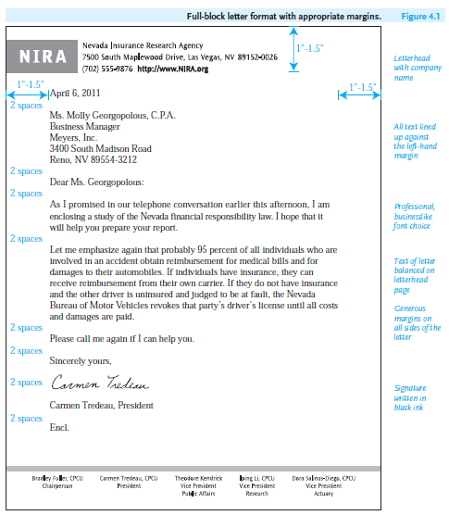
Lecture
4
Writing Letters
- Full-Block Format
In full-block format all information is flush against the left margin, double spaced between paragraphs. Figure 4.1 shows a full-block letter. Many employers prefer this format when your letter is on letterhead stationery (specially printed paper giving a company’s name and logo, business and Web addresses, fax and telephone numbers, and sometimes the names of its executives).

Slide 12
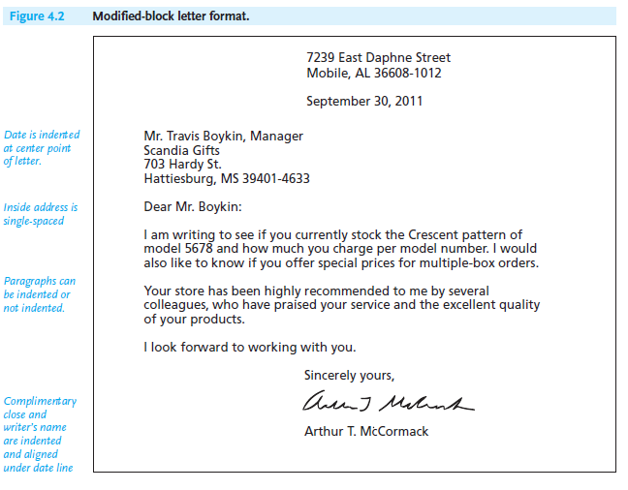
Lecture
4
Writing Letters
- Modified-Block Format
In modified-block format (see Figure 4.2), the writer’s address (if it is not imprinted on a letterhead), the date, the complimentary close, and the signature are positioned at the center point and then keyed toward the right side of the letter. The date aligns with the complimentary close. The inside address, the salutation, and the body of the letter are flush against the left margin.

Slide 13
Lecture
4
Writing Letters
- Semi-Block Format
The semi-block format looks just like the modified-block format in terms of aligning the date line with the complimentary close, signature, and any enclosures at the center point of the letter. But the paragraphs in the semi block format are always indented five to seven spaces. Though not as frequently used as the full-block or modified-block formats, the semi-block format is a template an employer may ask you to use.

Slide 14
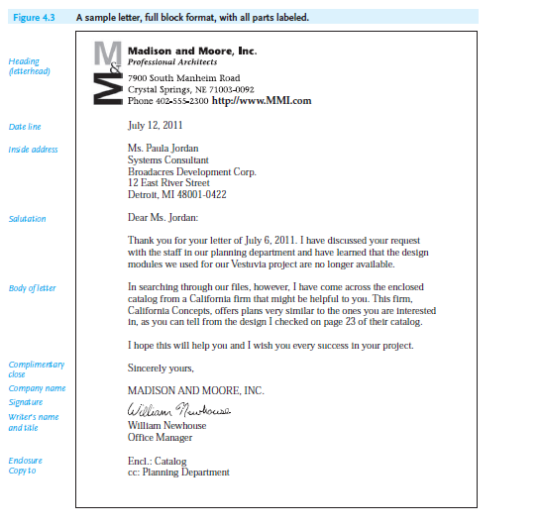
Lecture
4
Writing Letters
3- Parts of a Letter:
A letter contains many parts, each of which contributes to your overall message. The parts and their placement in your letter form the basic conventions of effective letter writing. Readers look for certain information in key places. The parts of a letter discussed in the following sections will appear in every letter you write. Figure 4.3 is a sample letter containing all of the parts discussed here. Note where each part is placed in the letter.

Slide 15
Lecture
4
Writing Letters
- Heading
The heading of a letter may be either your company’s letterhead or your full return address. (See Figure 4.2 for an example of a full return address when letterhead is not used.)
- Date Line
Spell out the name of the month in full—“September” or “March” rather than “Sept.” or “Mar.” The date line is usually keyboarded this way: November 12, 2012. Different cultures express dates in different ways. Most countries, including those in Europe, list the day first, then the month, and then the year.

Slide 16
Lecture
4
Writing Letters
- Inside Address
The inside address, the address of the recipient, is always placed against the left margin, two lines below the date line. It contains the name, title (if any), company, street address, city, state, and ZIP code of the person to whom you are writing.
- Salutation
Begin with Dear, and then follow with a courtesy title, the reader’s last name (unless you are on a first-name basis), and a colon (Dear Mr. Brown:). Never use a comma for a formal letter. Avoid the sexist “Dear Sir,” “Gentlemen,” or “Dear Madam” and the stilted “Ladies and Gentlemen” or “Dear Sir/Madam.”

Slide 17
Lecture
4
Writing Letters
- Body of the Letter
The body of the letter contains your message. Some of your letters will be only a few lines long, while others may extend to three or more paragraphs. Keep your sentences concise, and try to hold your paragraphs to under six or seven lines.
- Complimentary Close
A close is the equivalent of a formal goodbye. For most business correspondence, use one of these standard closes:
Sincerely.
Respectfully.
Sincerely yours.
Yours sincerely.

Slide 18
Lecture
4
Writing Letters
- Signature
Allow four spaces between the complimentary close and your typed name/title so that your signature will not look squeezed in. Always sign your name in black ink. An unsigned letter indicates carelessness or, worse, indifference toward your reader. A stamped signature tells readers you could not give them personal attention.

Slide 19

Lecture
4
Writing Letters
Some firms prefer using their company name along with the employee’s name in the signature section. If so, type the company name in capital letters two line spaces below the complimentary close and then sign your name. Add your title underneath your typed name. Here is an example:
Sincerely yours,
THE FINELLI COMPANY
Helen Stravopoulos
Cover Coordinator

Slide 20
Lecture
4
Writing Letters
- Enclosure(s) Line
The enclosure line informs the reader that additional materials (such as brochures, diagrams, forms, contracts, a proposal) accompany your letter.
Enclosure (only one item is enclosed)
Enclosures (2)
Encl.: Spring Quarter Sales Report

Slide 21
Lecture
4
Writing Letters
- Copy Notation
The abbreviation cc: (courtesy copy) informs your reader that a copy of your letter has been sent to one or more individuals.
cc: Service Dept.
cc: Hannah Pittman
Ivor Vas

Slide 22
Lecture
4
Writing Letters
4- The Appearance of Your Letter:
The way your letter looks can determine how readers will respond to your message. Here are some tips on how to format and print professional-looking letters:
■ Use a letter-quality printer and check toner cartridge levels to avoid sending a fuzzy, faint, or messy letter.
■ Stay away from fancy fonts and scripts. Use the business-like Times New Roman or Arial.
■ Consider using letter wizards to help format and design your letters.

Slide 23
Lecture
4
Writing Letters
■ Leave generous margins of at least 1 to 1 and 1/4 inches all around your message.
■ Leave double spaces between key parts of a letter.
■ Single space within each paragraph, but double space between paragraphs.
■ Avoid crowding too much text onto one page.
■ Be careful about lopsided letters.
■ Used Print Preview to see an image of your letter before you print a hard copy so you can make any necessary changes or adjustments to correct it.
■ Always print your letter on high-quality white bond paper (20-pound, 8-1/2 × 11) and matching standard-size (#10) business envelopes.

Slide 24
Lecture
4
Writing Letters
5- Organizing a Standard Business Letter:
Like the memo in Figure 3.3, a standard business letter can be divided into an introduction, a body, and a conclusion, each section responding to or clarifying a specific issue for your recipient. These three sections can each be one paragraph long, as in Figures 4.1, 4.2, and 4.3, or the body of your letter may be two or more paragraphs, as in Figure 4.4.

Slide 25
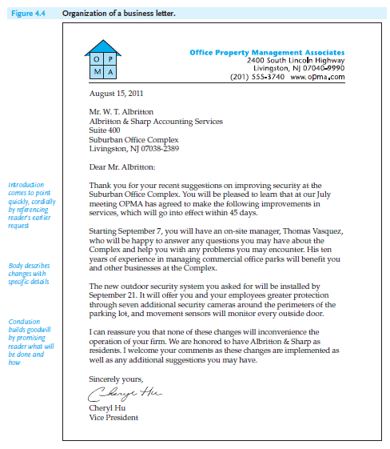
Lecture
4
Writing Letters

Slide 26
Lecture
4
Writing Letters
6- Making a Good Impression on Your Reader:
You have just learned about formatting and organizing your letters. Now we turn to the content of your letters—what you say (your message) and how you say it (your style and tone). Writing letters means communicating to influence your readers, not to alienate or antagonize them. Keep in mind that writers of effective letters are like successful diplomats; they represent both their company and themselves. You want readers to see you as courteous, well informed, and professional.

Slide 27
Lecture
4
Writing Letters
First, put yourself in the reader’s position. What kinds of letters do you like to receive: vague, impersonal, sarcastic, pushy, and condescending; or polite, businesslike, and considerate? If you have questions, you want them answered honestly, courteously, and fully.

Slide 28
Lecture
4
Writing Letters
- Achieving the “You Attitude”: Four Guidelines
As you draft and revise your work, pay special attention to the following four guidelines for making a good impression on your reader.
1. Never forget that your reader is a real person. Avoid writing cold, impersonal letters that sound as if they were form letters or voice mail instructions. Let the readers know that you are writing to them as individuals. The letter below violates every rule of personal and personable communications.

Slide 29
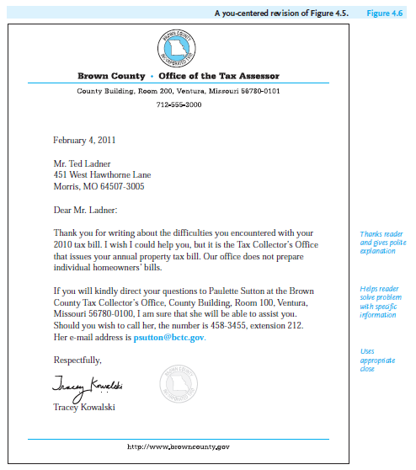
Lecture
4
Writing Letters
2. Keep the reader in the forefront of your letter. Make sure the reader’s needs control the tone, message, and organization of your letter—the essence of the “you attitude.” Stress the “you,” not the “I” or the “we.”
3. Be courteous and tactful. Refrain from turning your letter into a punch through the mail. Don’t inflame your letter or e-mail readers, as the example in Figures 3.6 does. Again, when you capture the reader’s goodwill, your rewards will be greater.

Slide 30
Lecture
4
Writing Letters
4. Don’t sound pompous or bureaucratic. Write to your reader as if you were carrying on a professional conversation with her or him. A business letter should be upbeat, clear, and to the point. It needs to be reader-friendly and believable, not stuffy and overbearing.

Slide 31
Lecture
4
Writing Letters
7- The Five Most Common Types of Business Letters:
The following section discusses the common types of business correspondence that you will be expected to write on the job.
1. Inquiry letters
2. Cover letters
3. Special request letters
4. Sales letters
5. Customer relations letters

Slide 32
Lecture
4
Writing Letters
A - Inquiry Letters:
An inquiry letter asks for information about a product, service, or procedure. Businesses frequently exchange such letters. As a customer, you too have occasion to ask in a letter about a service or a special line of products, the price, the size, the color, delivery arrangements or recent technological changes. The clearer your letter, the quicker and more helpful your answers are likely to be.

Slide 33
Lecture
4
Writing Letters
B - Cover Letters:
A cover letter accompanies a document (a proposal, a report, a catalogue, a portfolio) that you send to your readers. It identifies the type of document you are sending and prepares your audience to read it. A cover letter should do the following:
■ Provide a written record that you have transmitted a document.
■ Tell readers why you are sending them the document.
■ Briefly summarize what the document contains—number of sections, visuals, statistics, appendices, etc.

Slide 34
Lecture
4
Writing Letters
C - Special Request Letters:
Special request letters make a special demand, not a routine inquiry.
Make your request clear and easy to answer. Follow these seven guidelines when asking for information in a special request letter.
1. Address your letter to the appropriate person.
2. State who you are and why you are writing—e.g., student doing a paper, employee compiling information for a report, and so on.

Slide 35
Lecture
4
Writing Letters
3. Indicate clearly your reason for requesting the information. Mention any individuals who may have suggested you write for help and information.
4. State precisely and succinctly the questions you want answered; list and number your questions.
5. Specify exactly when you need the information. Allow sufficient time—at least three weeks. Be reasonable; don’t ask for the impossible.
6. Offer to forward a copy of your report, paper, or survey in thanks of the anticipated help.
7. Thank the reader for helping.

Slide 36
Lecture
4
Writing Letters
D - Sales Letters:
A sales letter is written to persuade the reader to buy a product, try a service, support some cause, or participate in some activity. No matter what profession you have chosen, there will always be times you have to sell a product, a service, a community or charitable program, a point of view, or yourself! In fact, an application letter for a job as an introduction to a new or prospective customer is a sales letter.

Slide 37
Lecture
4
Writing Letters
- The Four A’s of Sales Letters
Successful sales letters follow a time-honored and workable plan—what can be called the “Four A’s”:
1. It gets the reader’s attention.
2. It highlights the product’s or service’s appeal.
3. It shows the customer the product’s or service’s application.
4. It ends with a specific request for action.

Slide 38
Lecture
4
Writing Letters
E- Customer Relations Letters:
Much business correspondence deals explicitly with establishing and maintaining friendly working relations. Customer relations letters show how you and your company regard the people with whom you do business. The letters should reveal your sensitivity to their needs.
- Follow-Up Letters
A follow-up letter is sent by a company after a sale to thank the customer for buying a product or using a service and to encourage the customer to buy more products and services. A follow-up letter is a combination thank-you note and sales letter.

Slide 39
Lecture
4
Writing Letters
- Complaint Letters
Each of us, either as customers or businesspeople, at some time has been frustrated by a defective product, inadequate or rude service, or incorrect billing. When we get no satisfaction. Usually, our first response is to write a letter in an intimidating font (LIKE THIS), dripping with juicy insults.

Slide 40
Lecture
4
Writing Letters
- Adjustment Letters
Adjustment letters respond to complaint letters by telling customers dissatisfied with a product or service how their claim will be settled. Adjustment letters should reconcile the differences that exist between a customer and a company and restore the customer’s confidence in that company.

Slide 41
Lecture
4
Writing Letters
- Collection Letters
Collection letters require the same tact and fairness as do complaint and adjustment letters. Each nonpayment case needs to be evaluated separately. A nasty collection letter sent to a customer who is a good credit risk after only one month’s nonpayment can send the customer elsewhere. On the other hand, three easygoing letters to a customer who is a poor credit risk may encourage that individual to postpone payment, perhaps indefinitely.

Slide 42
Lecture
4
Writing Letters
8 - International Business Correspondence:
After e-mails, letters are the most frequent type of communication you are likely to have with international readers. Formal letter writing is a highly prized skill in the global marketplace.
- Ten Guidelines for Communicating with International Readers
The following ten guidelines will help you communicate more successfully with an international audience, significantly reducing the chances of their misunderstanding you.

Slide 43
Lecture
4
Writing Letters
1. Use common, easily understood vocabulary.
2. Keep your sentences simple and easy to understand.
3. Avoid ambiguity.
4. Be careful about technical vocabulary.
5. Avoid idiomatic expressions.

Slide 44
Lecture
4
Writing Letters
6. Delete sports and gambling metaphors.
7. Don’t use unfamiliar abbreviations, acronyms, or contractions.
8. Watch units of measure.
9. Avoid culture-bound descriptions of place and space.
10. Use appropriate salutations, complimentary closes, and signature lines.

Slide 45
Lecture
4
Writing Letters
9 - Sending Letter-Quality Messages: Final Advice to Seal Your Success:
Judging your letters in light of the following guidelines will help you to draft, tailor, and evaluate the types of business correspondence you will be asked to write:
■ Identify your reader: one individual.
■ Determine your purpose for writing.
■ Determine reader’s reason for writing.
■ Organize information.
■ Include essential information.
■ Use appropriate style and tone.

Slide 46


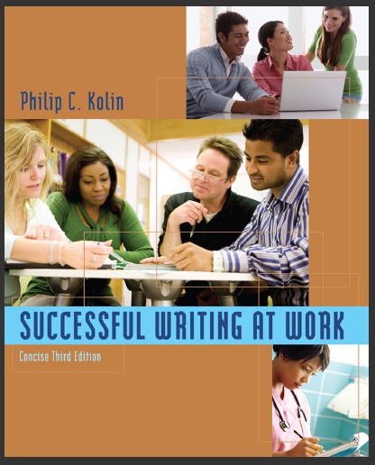
References:
Successful Writing at Work,,
By: Philip C. Kolin
University of Southern Mississippi
Chapter 3
Thank You

Slide 47


Thank You

