Slide 1

PMG510
Fundamentals of Risk Management
Prepared by Dr. Ayman Elmaasarawy
Impact of risk on Organizations
Lecture 2

Slide 2

Lecture 1 Summery
Risk management in context
Nature of risk
Benefits of risk management
Risk management
Features of risk management
Definitions of risk
Types of risks
Risk description
Inherent level of risk
Risk classification systems
Risk likelihood and magnitude

Slide 3
Lecture 2 Organization
Impact of risk on organizations:
Level of risk
Impact of hazard risks
Attachment of risks
Risk and reward
Attitudes to risk
Risk and triggers
Types of risks:
Timescale of risk impact
Four types of risk
Embrace opportunity risks
Manage uncertainty risks
Mitigate hazard risks
Minimize compliance risks

Slide 4
Chapter 2 Impact of risk on organizations
Level of risk:
By taking a proactive approach to risk and risk management, organizations will be able to achieve the following four areas of improvement:
Strategy, because the risks associated with different strategic options will be fully analyzed and better strategic decisions will be reached.
Tactics, because consideration will have been given to selection of the tactics and the risks involved in the alternatives that may be available.
Operations, because events that can cause disruption will be identified in advance and actions taken to reduce the likelihood of these events occurring, limit the damage caused by these events and contain the cost of the events.
Compliance will be enhanced because the risks associated with failure achieve compliance with statutory and customer obligations will be recognized

Slide 5
Chapter 2 Impact of risk on organizations
Level of risk:
Stakeholders now expect that organizations will take full account of the risks that may cause disruption within operations, late delivery of projects or failure to deliver strategy.
The exposure presented by an individual risk can be defined in terms of the likelihood of the risk materializing and the impact of the risk when it does materialize.
As risk exposure increases, the likely impact will also increase. Guide 73 refers to this measurement of likelihood and impact as being the current or residual ‘level of risk’.
This level of risk should be compared with the risk attitude and risk appetite of the organization for risks of that type.
The risk appetite will sometimes be described as a set of risk criteria.

Slide 6
Chapter 2 Impact of risk on organizations
Level of risk:
The term ‘magnitude’ is used to indicate the size of the event that has occurred or might occur.
The term ‘impact’ is used to define how the event affects the finances, operations, reputation and/or marketplace (FIRM) of the organization.
This use of terminology is also consistent with the use of impact in business continuity planning evaluations. This is a measure of the risk at the current level.
The term ‘consequences’ is used to indicate the extent to which the event results in failure to achieve effective and efficient strategy, tactics, operations and compliance (STOC)

Slide 7
Chapter 3 Types of risks
Four types of risk:
For example, consider people reviewing their financial position and the risks they currently face regarding finances. It may be that the key financial dependencies relate to achieving adequate income and managing expenditure.
The review should include an analysis of the risks to job security and pension arrangements, as well as property ownership and other investments. This part of the analysis will provide information on the risks to income and the nature of those risks (opportunity risks).

Slide 8
Chapter 3 Types of risks
Four types of risk:
As a practical example of the nature of compliance, hazard, control and opportunity risks, Table 3.1 considers the risks associated with owning a car.
In this case, the compliance risks relate to the legal obligations associated with owning and driving a car. The hazard risks relate to events that the owner does not want to occur.
Uncertainties are the costs that are known to be involved, but these may vary. Finally, the opportunities are the benefits that car ownership offers.

Slide 9
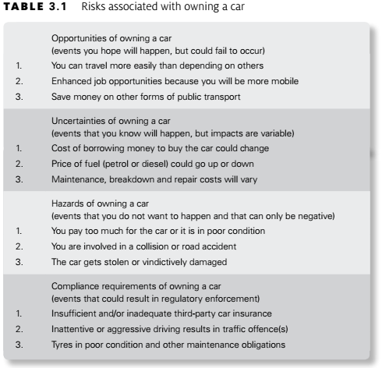
Chapter 3 Types of risks
Four types of risk:

Slide 10
Chapter 3 Types of risks
Embrace opportunity risks:
Opportunity risks are the type of risk with potential to enhance (although they can also inhibit) the achievement of the mission of the organization. These risks are the ones associated with embracing business opportunities.
All organizations have some appetite for seizing opportunities and are willing to invest in them
There will always be a desire for the organization to have effective and efficient operations, tactics and strategy.
Opportunity risks are normally associated with the development of new or amended strategies, although opportunities can also arise from enhancing the efficiency of operations and implementing change initiatives.

Slide 11
Chapter 3 Types of risks
Embrace opportunity risks:
Opportunity risks are the type of risk with potential to enhance (although they can also inhibit) the achievement of the mission of the organization. These risks are the ones associated with embracing business opportunities.
All organizations have some appetite for seizing opportunities and are willing to invest in them
There will always be a desire for the organization to have effective and efficient operations, tactics and strategy.
Opportunity risks are normally associated with the development of new or amended strategies, although opportunities can also arise from enhancing the efficiency of operations and implementing change initiatives.

Slide 12
Chapter 3 Types of risks
Embrace opportunity risks:
The example below, related to personal lifestyle decisions, considers risk factors by classifying them as controllable and uncontrollable. Although the example relates to personal health risk factors, consideration of whether business risks are within the control of the organization or not is an important component of successful business risk management.
Example:
Heart disease risk factors
Controllable risk factors for heart disease and stroke are those that can be changed through diet, physical activity and no tobacco use. These risk factors are in contrast to those that are uncontrolled, such as age, gender, race or genetic traits. Having one or more uncontrollable risk factors does not mean a person will have a heart attack or stroke; however, with proper attention to those risk factors that are controllable, one may reduce the impact of those risk factors that cannot be controlled or changed.
Controllable risk factors for heart disease or stroke include high blood pressure, high blood cholesterol, type-2 diabetes and obesity. Healthy lifestyle habits, such as developing good eating habits, increasing physical activity and abstaining from tobacco use, are effective steps in both preventing and improving the controllable risk factors.

Slide 13
Chapter 3 Types of risks
Manage uncertainty risks:
Uncertainty or control risks are an inevitable part of undertaking a project. A contingency fund to allow for the unexpected will need to be part of a project budget, as well as contingent time built into project schedules.
When looking to develop appropriate responses to control risks, the organization must make the necessary resources available to identify the controls, implement the controls and respond to the consequences of any control risk materializing.
Uncertainty represents a deviation from the required or expected outcome. When an organization is undertaking a project, such as a process enhancement, the project has to be delivered on time, within budget and to specification. Also, the enhancement has to deliver the benefits that were required.

Slide 14
Chapter 3 Types of risks
Mitigate hazard risks:
In the case of health and safety risks, it is generally accepted that organizations should be intolerant of these and should take all appropriate actions to eliminate them.
In practice, this is not possible and organizations will minimize safety risks to the lowest level that is cost-effective and in compliance with the law.
For example, an automatic braking system fitted to trains to stop them passing through red lights is technically feasible.
However, this may represent an unreasonable investment for the train operating company. The consequences of trains going through red lights may be regarded as the risk exposure or hazard tolerance of the organization but the cost of introducing the automatic braking system may be considered to be prohibitively high.

Slide 15
Chapter 3 Types of risks
Mitigate hazard risks:
Example: Shop Security Standards
An example can be seen in the operation of a security-conscious jewellery shop. Customers are allowed into the shop one at a time. They are recorded on CCTV as they wait to enter.
Items are held securely, and customers are invited to ask to see specific items under the suspicious gaze of the shop assistants. Of course, some customers are put off, but equally the shops suffer negligible rates of shoplifting.
Contrast this with a supermarket, where there are no barriers on entry and customers are allowed to handle all of the items.
There is CCTV monitoring the shops, and there are likely to be store detectives patrolling – but the object of the security is to deter rather than to prevent shoplifting. Shoplifting does occur, but at rates that are acceptable to the shop owners. Conversely, few potential customers are put off visiting the shop because of the measures.

Slide 16
Chapter 3 Types of risks
Mitigate hazard risks:
Table 3.2 provides a list of the events that can cause unplanned disruption or inefficiency. These events are divided into several categories, such as people, premises, processes and products.
For each category of hazard risks, the organization needs to evaluate the types of incidents that could occur, the sources of those incidents and their likely impact on normal efficient operations.
Management of hazard risks involves analysis and management of three aspects of the hazard risk.

Slide 17
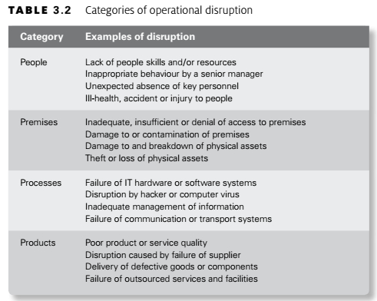
Chapter 3 Types of risks
Mitigate hazard risks:

Slide 18
Chapter 3 Types of risks
Minimize compliance risks:
Generally speaking, organizations will work towards ensuring full compliance with all applicable rules and regulations and, thereby, minimize the compliance risks.
In many cases, dedicated teams of specialist risk professionals will be employed and this is particularly the case in relation to health and safety, money-laundering and security arrangements.
It is important for organizations to recognize their compliance risks and include consideration of these risks in their risk management activities.
It is also important to ensure that the various areas of risk management expertise within the company co-operate with each other, so that an organized and/or coordinated approach to compliance is achieved.

Slide 19
Conclusion

Slide 20
Thanks

