Slide 1


Database Management System
IT 261
Bachelor of Information Technology
Prepared by Dr. Khaled Eskaf
Lecture 5

Slide 2

Week | Topic | Objective | MySQL Practical Activities
1 | Introduction to Database Concepts | Understand basic database concepts. | Install MySQL, explore the interface, create a basic database.
2 | Relational Data Model | Learn about the relational data model. | Create relational tables in MySQL.
3 | Relational Integrity Rules | Understand relational integrity constraints. | Implement primary and foreign key constraints in MySQL.
4 | Relational Algebra and Basic SQL | Explore relational algebra and basic SQL commands. | Use basic SQL queries in MySQL.
5 | Advanced SQL Queries | Delve into complex SQL operations. | Execute advanced SQL commands in MySQL.
6 | Introduction to Database Normalization | Begin learning database normalization principles. | Apply the first normal form (1NF) in MySQL.
7 | Advanced Database Normalization | Explore advanced normalization techniques. | Normalize a database in MySQL to 2NF and 3NF.
8 | Data Modeling and ER Diagrams | Understand data modeling and ER diagrams. | Create an ER diagram and implement it in MySQL.
9 | Database Design for Real-World Apps | Apply database design to real-world scenarios. | Develop a database schema based on a real-world example.
10 | Project and Review | Apply all learned concepts in a comprehensive project. | Complete a project in MySQL incorporating all learned skills.
www.midocean.ae

Slide 3

www.midocean.ae

Slide 4

Chapter
04
www.midocean.ae

Slide 5
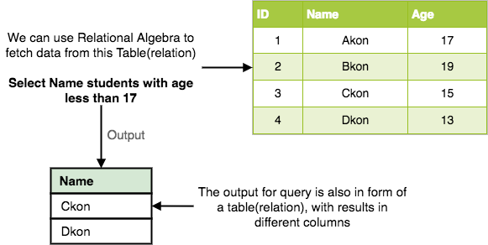
Chapter
04
Every database management system must define a query language to allow users to access the data stored in the database. Relational Algebra is a procedural query language used to query the database tables to access data in different ways.
In relational algebra, input is a relation(table from which data has to be accessed) and output is also a relation(a temporary table holding the data asked for by the user).
www.midocean.ae
Notes:
يجب على كل نظام إدارة قاعدة بيانات تحديد لغة استعلام للسماح للمستخدمين بالوصول إلى البيانات المخزنة في قاعدة البيانات. الجبر العلائقي هو لغة استعلام إجرائية تستخدم للاستعلام عن جداول قاعدة البيانات للوصول إلى البيانات بطرق مختلفة.
في الجبر العلائقي، المدخلات هي علاقة (جدول يجب الوصول إلى البيانات منه) والمخرجات هي أيضًا علاقة (جدول مؤقت يحتوي على البيانات التي يطلبها المستخدم).

Slide 6
Chapter
04
Relational Algebra works on the whole table at once, so we do not have to use loops etc to iterate over all the rows(tuples) of data one by one. All we have to do is specify the table name from which we need the data, and in a single line of command, relational algebra will traverse the entire given table to fetch data for you.
The primary operations that we can perform using relational algebra are:
Select
Project
Union
Set Different
Cartesian product
Rename
www.midocean.ae

Slide 7
Chapter
04
Select Operation (σ):
This is used to fetch rows(tuples) from table(relation) which satisfies a given condition.
Syntax: σ_{p}(r)
Where, σ represents the Select Predicate, r is the name of relation(table name in which you want to look for data), and p is the prepositional logic, where we specify the conditions that must be satisfied by the data. In prepositional logic, one can use unary and binary operators like =, <, > etc, to specify the conditions.
Let's take an example of the Student table we specified above in the Introduction of relational algebra, and fetch data for students with age more than 17.
σ_{age > 17} (Student)
This will fetch the tuples(rows) from table Student, for which age will be greater than 17.
You can also use, and, or etc operators, to specify two conditions, for example,
σ_{age > 17 and gender = 'Male'} (Student)
This will return tuples(rows) from table Student with information of male students, of age more than 17.(Consider the Student table has an attribute Gender too.)
www.midocean.ae

Slide 8
Chapter
04
A | B | C
1 | 2 | 4
2 | 2 | 3
3 | 2 | 3
4 | 3 | 4
Example:
For the above relation, σ(c>3)R will select the tuples which have c more than 3.
Note: The selection operator only selects the required tuples but does not display them. For display, the data projection operator is used.
A | B | C
1 | 2 | 4
4 | 3 | 4
www.midocean.ae

Slide 9
Chapter
04
Project Operation (∏):
Project operation is used to project only a certain set of attributes of a relation. In simple words, If you want to see only the names all of the students in the Student table, then you can use Project Operation.
It will only project or show the columns or attributes asked for, and will also remove duplicate data from the columns.
Syntax: ∏_{A1, A2...}(r)
where A1, A2 etc are attribute names(column names).
For example,
∏_{Name, Age}(Student)
Above statement will show us only the Name and Age columns for all the rows of data in Student table.
www.midocean.ae

Slide 10
Chapter
04
Projection(π):
It is used to project required column data from a relation.
Example: Consider Table 1. Suppose we want columns B and C from Relation R.
π(B,C)R will show following columns.
Note: By Default, projection removes duplicate data.
B | C
2 | 4
2 | 3
3 | 4
www.midocean.ae

Slide 11
Chapter
04
Union Operation (∪):
This operation is used to fetch data from two relations(tables) or temporary relation(result of another operation).
For this operation to work, the relations(tables) specified should have same number of attributes(columns) and same attribute domain. Also the duplicate tuples are autamatically eliminated from the result.
Syntax: A ∪ B
where A and B are relations.
For example, if we have two tables RegularClass and ExtraClass, both have a column student to save name of student, then,
∏_{Student}(RegularClass) ∪ ∏_{Student}(ExtraClass)
Above operation will give us name of Students who are attending both regular classes and extra classes, eliminating repetition.
www.midocean.ae

Slide 12
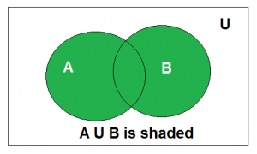
Chapter
04
Union
Union of the sets A and B, denoted by A ∪ B, is the set of distinct elements that belong to set A or set B, or both.
                Venn diagram of A ∪ B
Above is the Venn Diagram of A U B.
Example: Find the union of A = {2, 3, 4} and B = {3, 4, 5}; Solution : A ∪ B = {2, 3, 4, 5}.
www.midocean.ae

Slide 13
Chapter
04
Union(U): Union operation in relational algebra is the same as union operation in set theory.
Example:
Student_Name | Roll_Number
Ram | 01
Mohan | 02
Vivek | 13
Geeta | 17
GERMAN
Student_Name | Roll_Number
Vivek | 13
Geeta | 17
Shyam | 21
Rohan | 25
Consider the following table of Students having different optional subjects in their course.
π(Student_Name)FRENCH U π(Student_Name)GERMAN
www.midocean.ae

Slide 14
Chapter
04
Consider the following table of Students having different optional subjects in their course.
Student_Name
Ram
Mohan
Vivek
Geeta
Shyam
Rohan
Note: The only constraint in the union of two relations is that both relations must have the same set of Attributes.
www.midocean.ae

Slide 15
Chapter
04
Set Difference (-) :
This operation is used to find data present in one relation and not present in the second relation. This operation is also applicable on two relations, just like Union operation.
Syntax: A – B
where A and B are relations.
For example, if we want to find name of students who attend the regular class but not the extra class, then, we can use the below operation:
∏_{Student}(RegularClass) - ∏_{Student}(ExtraClass)
www.midocean.ae

Slide 16
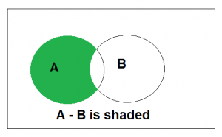
Chapter
04
Set Difference
The difference between sets is denoted by ‘A – B’, which is the set containing elements that are in A but not in B. i.e., all elements of A except the element of B.
Example: If A = {1, 2, 3, 4, 5} and B = { 2, 4, 6, 8}, find A-B Solution: A-B = {1, 3, 5}
www.midocean.ae

Slide 17
Chapter
04
Set Difference(-): Set Difference in relational algebra is the same set difference operation as in set theory.
Example: From the above table of FRENCH and GERMAN, Set Difference is used as follows
π(Student_Name)FRENCH - π(Student_Name)GERMAN
Student_Name
Ram
Mohan
Note: The only constraint in the Set Difference between two relations is that both relations must have the same set of Attributes.
www.midocean.ae

Slide 18
Chapter
04
Set Intersection(∩)
Set Intersection(∩): Set Intersection in relational algebra is the same set intersection operation in set theory.
Example: From the above table of FRENCH and GERMAN, the Set Intersection is used as follows
π(Student_Name)FRENCH ∩ π(Student_Name)GERMAN
Student_Name
Vivek
Geeta
Note: The only constraint in the Set Difference between two relations is that both relations must have the same set of Attributes.
www.midocean.ae

Slide 19
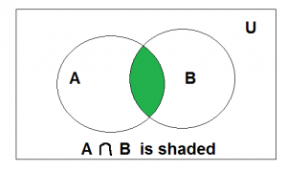
Chapter
04
Intersection
The intersection of the sets A and B, denoted by A ∩ B, is the set of elements that belong to both A and B i.e. set of the common elements in A and B.
Example: Find the intersection of A = {2, 3, 4} and B = {3, 4, 5} Solution : A ∩ B = {3, 4}.
www.midocean.ae

Slide 20
Chapter
04
Rename Operation (ρ):
This operation is used to rename the output relation for any query operation which returns result like Select, Project etc. Or to simply rename a relation(table)
Syntax: ρ(RelationNew, RelationOld)
www.midocean.ae

Slide 21
Chapter
04
Rename(ρ): Rename is a unary operation used for renaming attributes of a relation.
ρ(a/b)R will rename the attribute 'b' of the relation by 'a'.
www.midocean.ae

Slide 22
Chapter
04
Cartesian Product (X) - Cross Product(X):
This is used to combine data from two different relations(tables) into one and fetch data from the combined relation.
Syntax: A X B
For example, if we want to find the information for Regular Class and Extra Class which are conducted during morning, then, we can use the following operation:
σ_{time = 'morning'} (RegularClass X ExtraClass)
For the above query to work, both RegularClass and ExtraClass should have the attribute time.
www.midocean.ae

Slide 23
Chapter
04
Cross Product(X): Cross-product between two relations. Let’s say A and B, so the cross product between A X B will result in all the attributes of A followed by each attribute of B. Each record of A will pair with every record of B.
Example:
A
B
Name | Age | Sex
Ram | 14 | M
Sona | 15 | F
Kim | 20 | M
ID | Course
1 | DS
2 | DBMS
www.midocean.ae

Slide 24
Chapter
04
A X B
Name | Age | Sex | ID | Course
Ram | 14 | M | 1 | DS
Ram | 14 | M | 2 | DBMS
Sona | 15 | F | 1 | DS
Sona | 15 | F | 2 | DBMS
Kim | 20 | M | 1 | DS
Kim | 20 | M | 2 | DBMS
Note: If A has ‘n’ tuples and B has ‘m’ tuples then A X B will have ‘ n*m ‘ tuples.
www.midocean.ae

Slide 25
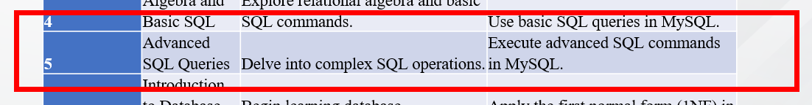
Chapter
05
www.midocean.ae

Slide 26
Chapter
05
Apart from these common operations Relational Algebra is also used for Join operations like,
Natural Join
Conditional Join
www.midocean.ae

Slide 27
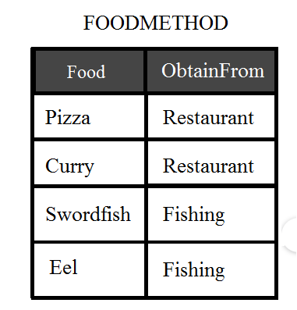
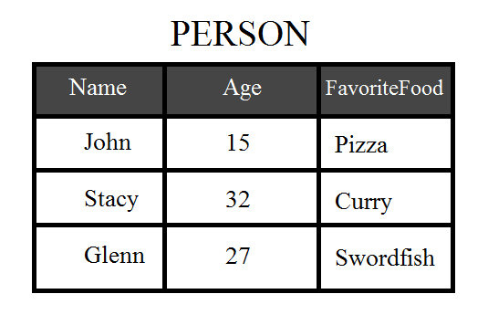
Chapter
05
Join Operation
When we have two relations that have a single column (let’s just call this column C) in common, we can perform what is known as a natural join. Essentially two tables are naturally joined by taking the cross product of the two tables, then eliminating all combinations in which the column C from table 1 and column C from table 2 are not equal.
So let’s take a look at a table of food, and the corresponding best way to obtain them.
www.midocean.ae

Slide 28
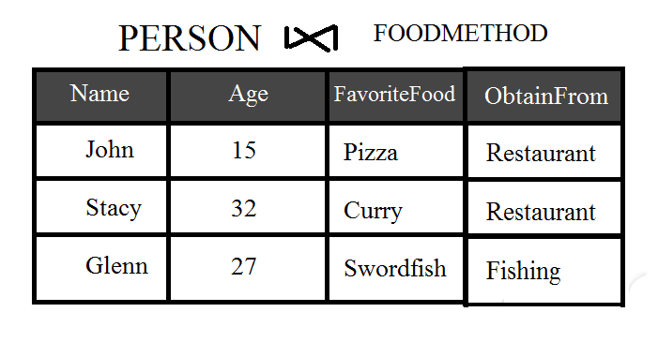
Chapter
05
www.midocean.ae

Slide 29
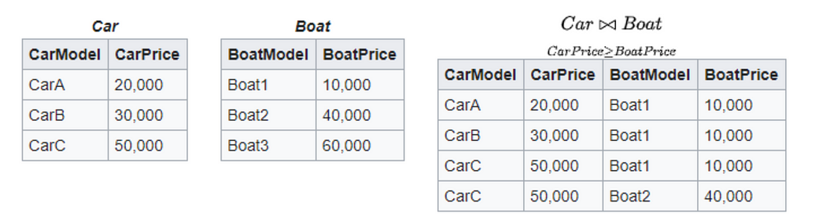
Chapter
05
There are other ways to join two tables, especially for tables which don’t have a common column. This is known as theta join. This operation joins two tables based on a condition that is defined when declaring the join.
The condition of this join was all combinations where the Car Price is greater than or equal to the Boat Price. For whatever reason, our potential customer wants a car and boat, but doesn’t want to spend more on the boat than the car.
www.midocean.ae

Slide 30
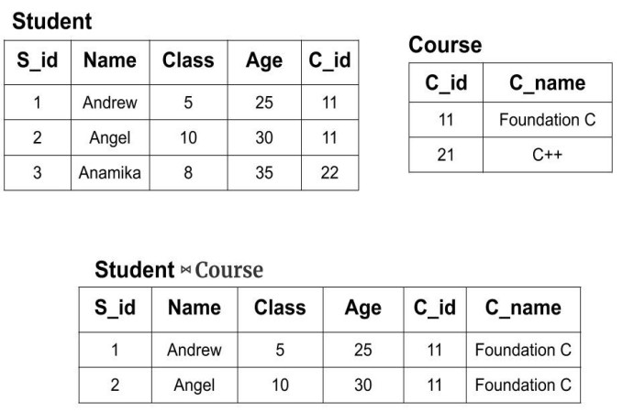
Chapter
05
Student ⋈ Course
www.midocean.ae

Slide 31
Chapter
05
Natural Join(⋈): Natural join is a binary operator. Natural join between two or more relations will result in a set of all combinations of tuples where they have an equal common attribute.
Example:
EMP
DEPT
Name | ID | Dept_Name
A | 120 | IT
B | 125 | HR
C | 110 | Sales
D | 111 | IT
Dept_Name | Manager
Sales | Y
Production | Z
IT | A
Natural join between EMP and DEPT with condition :
EMP.Dept_Name = DEPT.Dept_Name
www.midocean.ae

Slide 32
Chapter
05
Natural join between EMP and DEPT with condition :
EMP.Dept_Name = DEPT.Dept_Name
EMP
Name | ID | Dept_Name
A | 120 | IT
B | 125 | HR
C | 110 | Sales
D | 111 | IT
EMP ⋈ DEPT
Name | ID | Dept_Name | Manager
A | 120 | IT | A
C | 110 | Sales | Y
D | 111 | IT | A
DEPT
Dept_Name | Manager
Sales | Y
Production | Z
IT | A
www.midocean.ae

Slide 33
Chapter
05
Conditional Join: Conditional join works similarly to natural join. In natural join, by default condition is equal between common attributes while in conditional join we can specify any condition such as greater than, less than, or not equal.
Example:
R
S
ID | Sex | Marks
1 | F | 45
2 | F | 55
3 | F | 60
ID | Sex | Marks
10 | M | 20
11 | M | 22
12 | M | 59
Join between R and S with condition R.marks >= S.marks
www.midocean.ae

Slide 34
Chapter
05
Join between R and S with condition R.marks >= S.marks
R
R.ID | R.Sex | R.Marks | S.ID | S.Sex | S.Marks
1 | F | 45 | 10 | M | 20
1 | F | 45 | 11 | M | 22
2 | F | 55 | 10 | M | 20
2 | F | 55 | 11 | M | 22
3 | F | 60 | 10 | M | 20
3 | F | 60 | 11 | M | 22
3 | F | 60 | 12 | M | 59
ID | Sex | Marks
1 | F | 45
2 | F | 55
3 | F | 60
S
ID | Sex | Marks
10 | M | 20
11 | M | 22
12 | M | 59
www.midocean.ae

Slide 35

Chapter
05
What is SQL?
Structured query language (SQL) is a programming language for storing and processing information in a relational database.
SQL stands for Structured Query Language
SQL lets you access and manipulate databases
SQL became a standard of the American National Standards Institute (ANSI)
www.midocean.ae

Slide 36
Chapter
05
What Can SQL do?
SQL can execute queries against a database
SQL can retrieve data from a database
SQL can insert records in a database
SQL can update records in a database
SQL can delete records from a database
SQL can create new databases
SQL can create new tables in a database
SQL can create stored procedures in a database
SQL can create views in a database
SQL can set permissions on tables, procedures, and views
www.midocean.ae

Slide 37
Chapter
05
The SQL CREATE DATABASE Statement
The CREATE DATABASE statement is used to create a new SQL database.
Syntax
CREATE DATABASE databasename;
The SQL CREATE TABLE Statement
The CREATE TABLE statement is used to create a new table in a database.
Syntax
CREATE TABLE table_name (
column1 datatype,
column2 datatype,
column3 datatype,
....
);
www.midocean.ae

Slide 38
Chapter
05
SQL CREATE TABLE Example
The following example creates a table called "Persons" that contains five columns:
PersonID, LastName, FirstName, Address, and City:
CREATE TABLE Persons (
PersonID int,
LastName varchar(255),
FirstName varchar(255),
Address varchar(255),
City varchar(255)
);
The empty "Persons" table will now look like this:
PersonID | LastName | FirstName | Address | City
www.midocean.ae

Slide 39
Chapter
05
MySQL supports a variety of data types, categorized into three main types: numeric, string (character and byte), and date/time.
Numeric Types
INT: A standard integer, capable of storing both positive and negative numbers.
BIGINT: A larger integer for when INT is not sufficient.
FLOAT: A single-precision floating point number for approximate numeric data.
DOUBLE: A double-precision floating point number for more precision.
DECIMAL: For fixed-point numbers, offering exact precision; useful for storing monetary values.
www.midocean.ae

Slide 40
Chapter
05
String Types
VARCHAR: A variable-length string, with a defined maximum length.
CHAR: A fixed-length string; if the string is shorter than the defined length, it's right-padded with spaces.
TEXT: For long text data, storing up to 65,535 bytes.
BLOB: For binary data, such as images or files, with a maximum length similar to TEXT.
www.midocean.ae

Slide 41
Chapter
05
Date and Time Types
DATE: Stores a date (YYYY-MM-DD).
TIME: Stores time (HH:MM:SS).
DATETIME: Stores both date and time (YYYY-MM-DD HH:MM:SS).
TIMESTAMP: Similar to DATETIME, but used for tracking changes, automatically updating upon row modification.
YEAR: Stores a year in a 2-digit or 4-digit format.
www.midocean.ae

Slide 42
Chapter
05
CREATE TABLE NumericExamples (
id INT AUTO_INCREMENT PRIMARY KEY,
intValue INT,
bigIntValue BIGINT,
floatValue FLOAT,
doubleValue DOUBLE,
decimalValue DECIMAL(10,2)
);
In this table:
id is a unique identifier for each row, automatically incrementing.
intValue will store INT values.
bigIntValue is for BIGINT values, useful for very large numbers.
floatValue will contain FLOAT type numbers, which are single-precision floating point numbers.
doubleValue stores DOUBLE type numbers, which are double-precision floating point numbers for more accuracy.
decimalValue is a DECIMAL type, precise for fixed-point numbers like monetary values, defined to hold a maximum of 10 digits, with 2 digits after the decimal point.
www.midocean.ae

Slide 43
Chapter
05
INSERT INTO NumericExamples (intValue, bigIntValue, floatValue, doubleValue, decimalValue)
VALUES
(2147483647, 9223372036854775807, 12345.12345, 1234567890.1234567, 1234567890.12),
(-2147483648, -9223372036854775808, -12345.12345, -1234567890.1234567, -1234567890.12);
.INT vs. BIGINT: INT can store values from -2,147,483,648 to 2,147,483,647. For numbers outside this range, BIGINT is used, which can store values from -9,223,372,036,854,775,808 to 9,223,372,036,854,775,807.
FLOAT vs. DOUBLE: Both store floating-point numbers, but FLOAT is less precise than DOUBLE. For instance, when storing a number with many digits after the decimal point, FLOAT might round off sooner than DOUBLE.
DECIMAL: This type is used for numbers where precision is crucial, such as financial transactions. Unlike FLOAT and DOUBLE, DECIMAL does not lose precision after the decimal point.
www.midocean.ae

Slide 44
Chapter
05
Create the Table
We'll start by creating a table named products with columns for each data type:
CREATE TABLE products (
id INT AUTO_INCREMENT PRIMARY KEY,
name VARCHAR(100),
description TEXT,
image BLOB,
price DECIMAL(10, 2),
weight DOUBLE,
category CHAR(10)
);
In this table:
id is an INT, suitable for auto-incrementing unique identifiers.
name uses VARCHAR(100), allowing variable-length names up to 100 characters.
description is a TEXT type, ideal for long textual descriptions.
image is stored as a BLOB, perfect for binary data like images.
price uses DECIMAL(10, 2) for precise monetary values, supporting 10 digits with 2 decimal places.
weight is a DOUBLE for more precise numeric data, like weights that can be fractional.
category is a CHAR(10), useful for fixed-length category codes.
www.midocean.ae

Slide 45
Chapter
05
INSERT INTO products (name, description, price, weight, category) VALUES
('Widget', 'A small tool useful for various purposes.', 9.99, 0.25, 'TOOL'),
('Gadget', 'An electronic device with practical uses.', 15.50, 0.50, 'ELEC');
VARCHAR vs. CHAR:
  name as VARCHAR will store the string as is, without padding.
  category as CHAR(10) will pad the value 'TOOL' with spaces until it's 10 characters long.
TEXT:
  description can store a long text about the product. It's much larger than you'd typically need for a name, allowing for extensive descriptions.
BLOB:
  While not demonstrated with a direct insert here, image could store binary data like an image file. This demonstrates its capacity for large binary data storage.
www.midocean.ae

Slide 46
Chapter
05
Create the Table
First, we create the EventLog table with columns for each of the date and time types:
CREATE TABLE EventLog (
ID INT AUTO_INCREMENT PRIMARY KEY,
EventName VARCHAR(100),
EventDate DATE,
EventTime TIME,
EventDateTime DATETIME,
EventTimestamp TIMESTAMP DEFAULT CURRENT_TIMESTAMP ON UPDATE CURRENT_TIMESTAMP,
EventYear YEAR
);
INSERT INTO EventLog (EventName, EventDate, EventTime, EventDateTime, EventYear)
VALUES ('Conference', '2024-03-15', '14:30:00', '2024-03-15 14:30:00', '2024');
www.midocean.ae

Slide 47
Chapter
05
ID | EventName | EventDate | EventTime | EventDateTime | EventTimestamp | EventYear
1 | Conference | 2024-03-15 | 14:30:00 | 2024-03-15 14:30:00 | 2024-02-24 10:00:00 | 2024
www.midocean.ae

Slide 48

Chapter
05
www.midocean.ae

Slide 49
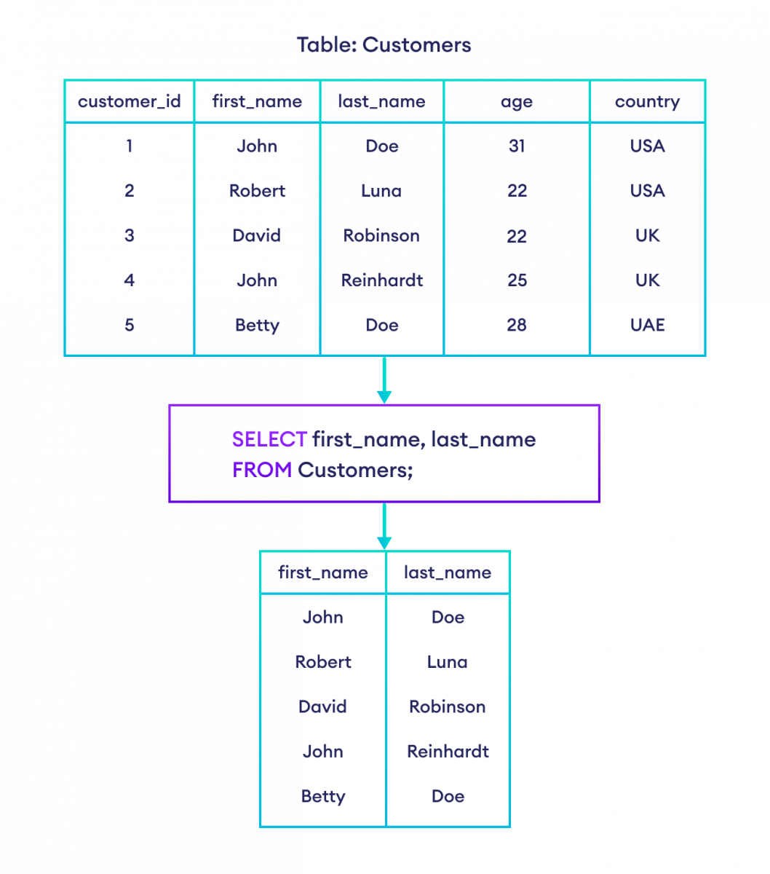
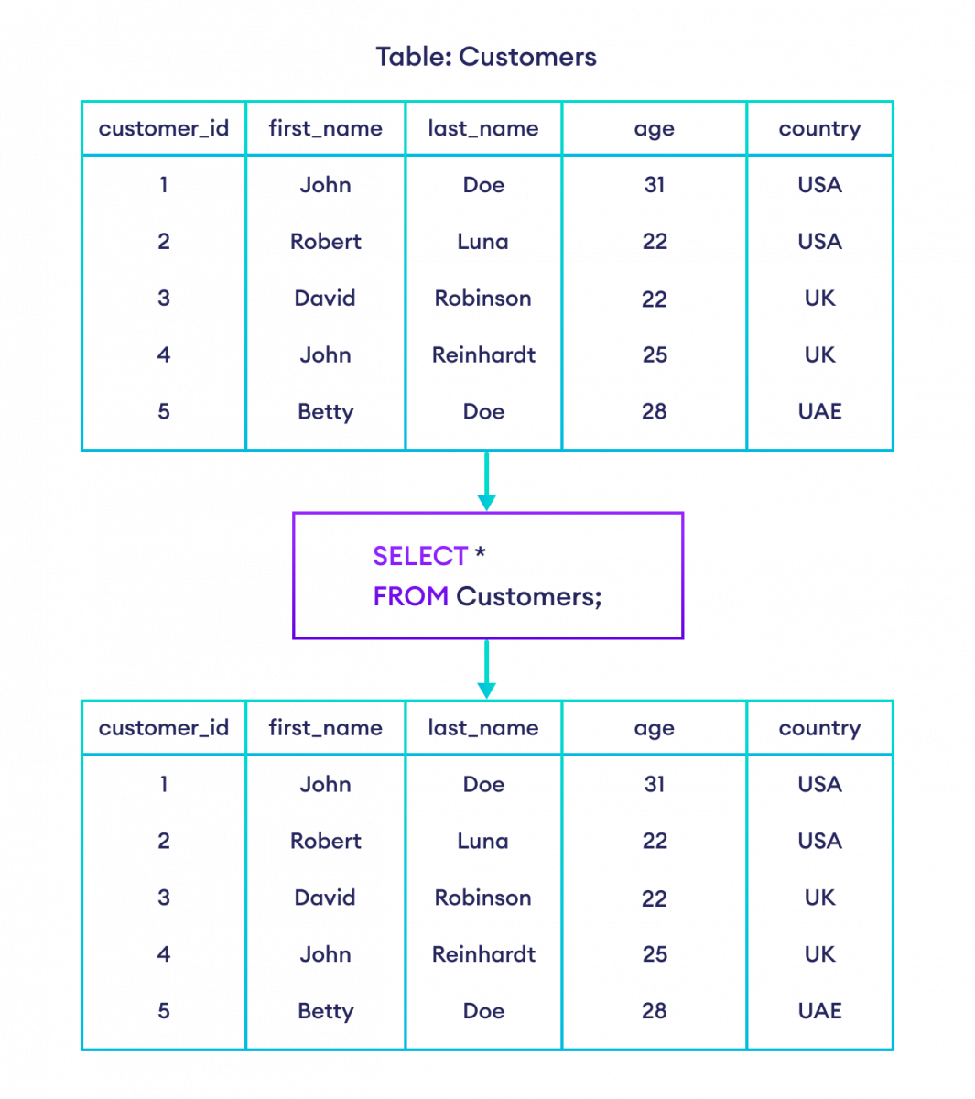
Chapter
05
www.midocean.ae

Slide 50



Chapter
05
The SELECT statement is used to select data from a database.
Syntax:
SELECT column1, column2, ...
FROM table_name;
SELECT first_name, last_name FROM Customers;
www.midocean.ae

Slide 51
Chapter
05
SQL SELECT ALL
To select all columns from a database table, we use the * character. For example,
www.midocean.ae

Slide 52
Chapter
05
SQL SELECT WHERE Clause
A SELECT statement can have an optional WHERE clause. The WHERE clause allows us to fetch records from a database table that matches specified condition(s). For example,
-- select all columns from the customers table with last_name 'Doe'
SELECT *
FROM Customers
WHERE last_name = 'Doe';
Here, the SQL command selects all customers from the Customers table with the last_name Doe.
www.midocean.ae

Slide 53
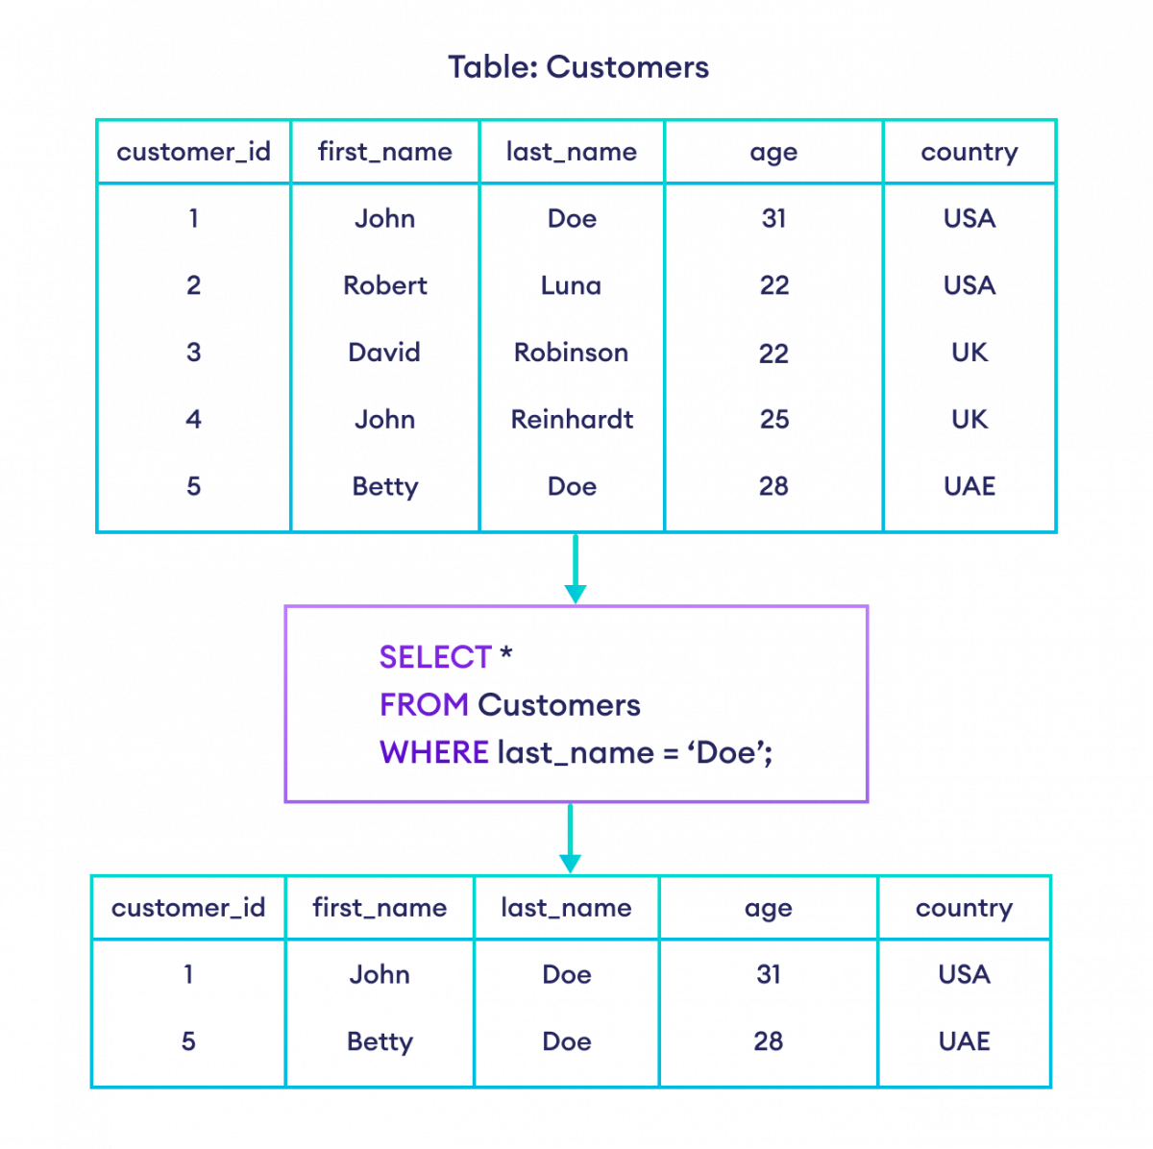
Chapter
05
Here, the SQL command selects all customers from the Customers table with the last_name Doe.
www.midocean.ae

Slide 54
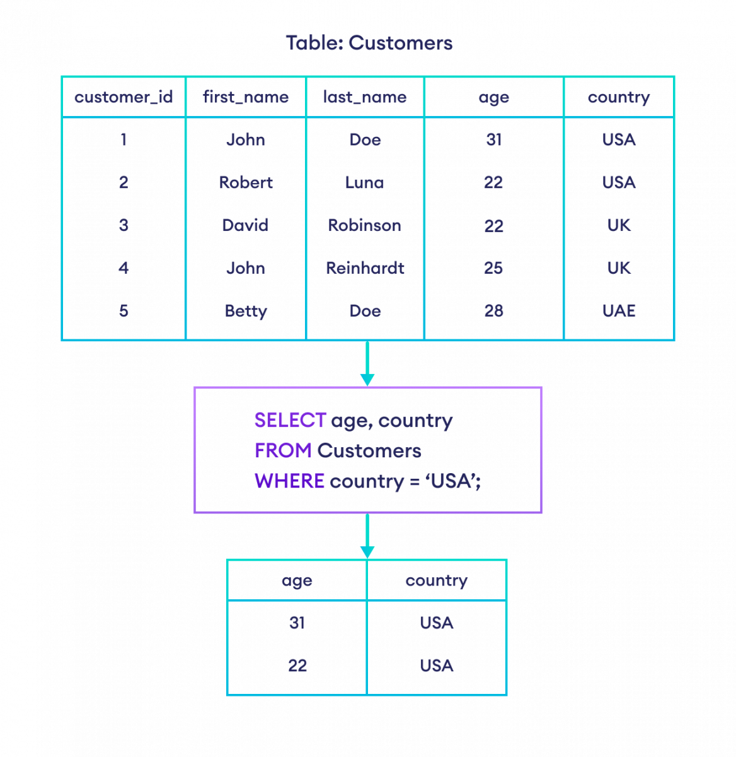
Chapter
05
Another example.
-- select age and country columns from customers table where the country is 'USA'
SELECT age, country
FROM Customers
WHERE country = 'USA';
Note: In SQL, we must enclose textual data inside either single or double quotations like 'USA'.
SQL command selects the age and country columns of all the customers whose country is USA.
www.midocean.ae

Slide 55
Chapter
05
SQL Operators
The WHERE clause uses operators to construct conditions. Some of the commonly used operators are:
1. Equal to Operator (=)
-- select all columns from Customers table with first name 'John'
SELECT *
FROM Customers
WHERE first_name = 'John';
selects all the customers from the Customers table having first_name John.
www.midocean.ae

Slide 56
Chapter
05
2. Greater than (>)
-- select all columns from Customers table with age greater than 25
SELECT *
FROM Customers
WHERE age > 25;
selects all the customers from the Customers table whose age is greater than 25.
www.midocean.ae

Slide 57
Chapter
05
3. AND Operator (AND)
-- select all columns from Customers table with last_name 'Doe' and country 'USA'
SELECT *
FROM Customers
WHERE last_name = 'Doe' AND country = 'USA';
selects all the customers from the Customers table having last_name Doe and country USA.
Note: If none of the rows meet the WHERE clause condition, an empty result set is returned.
www.midocean.ae

Slide 58
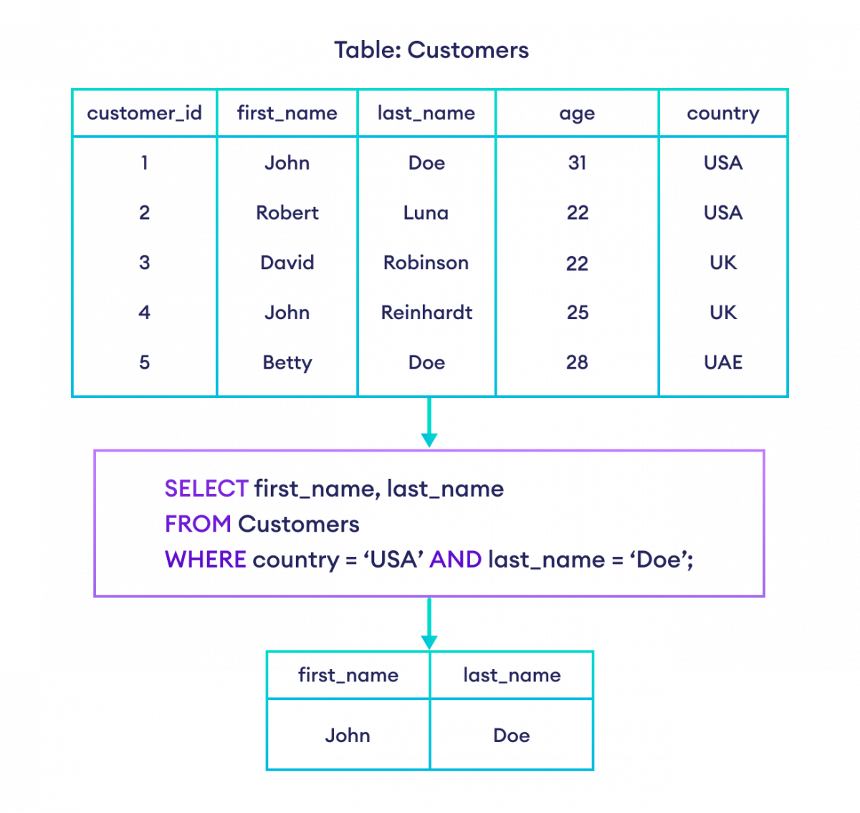
Chapter
05
selects first_name and of last_name all customers whose country is USA and last_name is Doe from the Customers table.
-- select the first_name and last_name of all customers
-- who live in 'USA' and have the last name 'Doe'
SELECT first_name, last_name
FROM Customers
WHERE country = 'USA' AND last_name = 'Doe';
www.midocean.ae

Slide 59
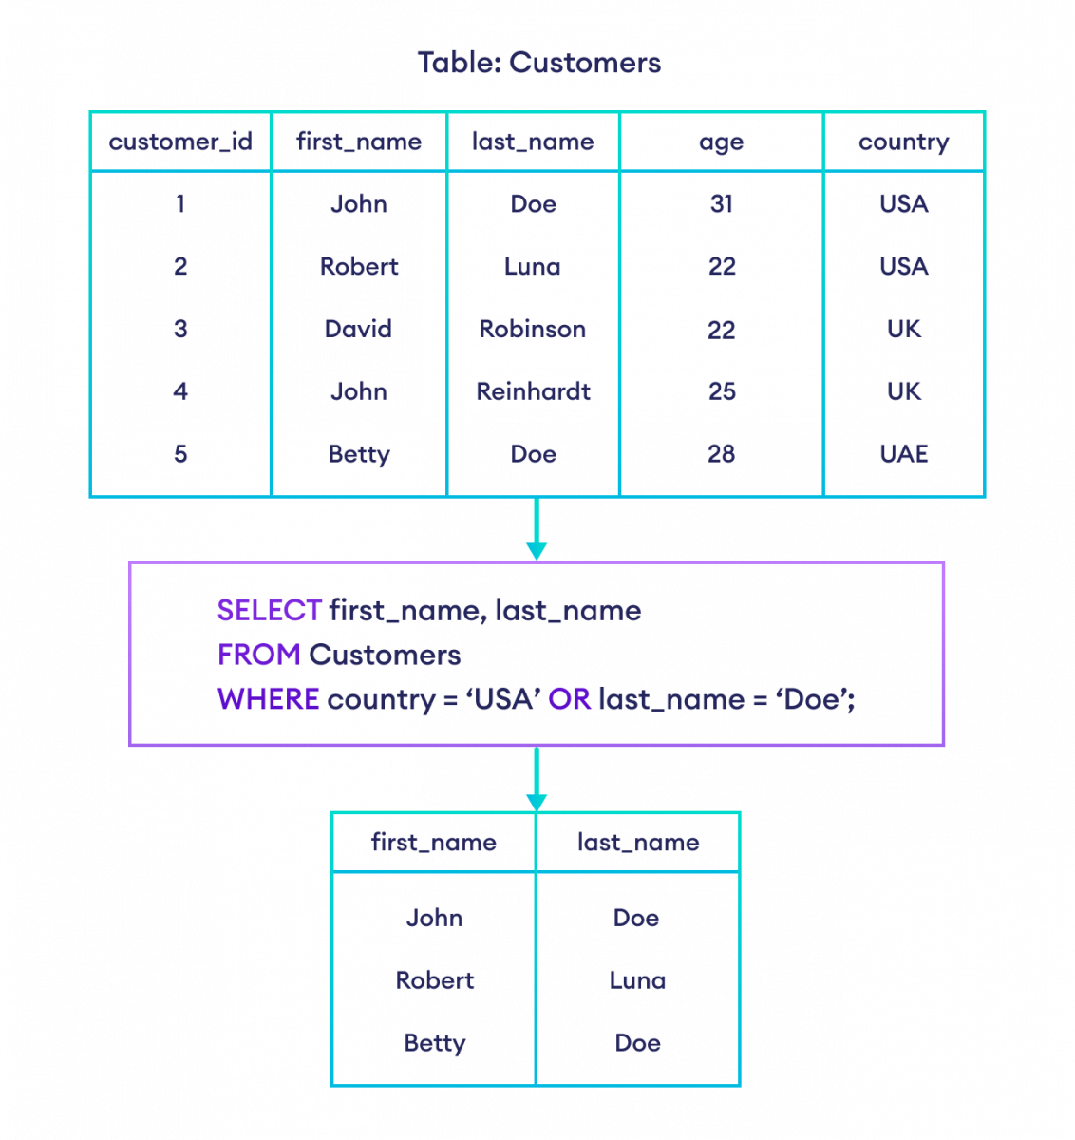
Chapter
05
SQL OR Operator
The SQL OR operator selects data if any one condition is TRUE. For example,
selects first_name and last_name of all customers where the country is USA or if their last name is Doe from the Customers table.
-- select first and last name of customers
-- who either live in the USA
-- or have the last name 'Doe'
SELECT first_name, last_name
FROM Customers
WHERE country = 'USA' OR last_name = 'Doe';
www.midocean.ae

Slide 60
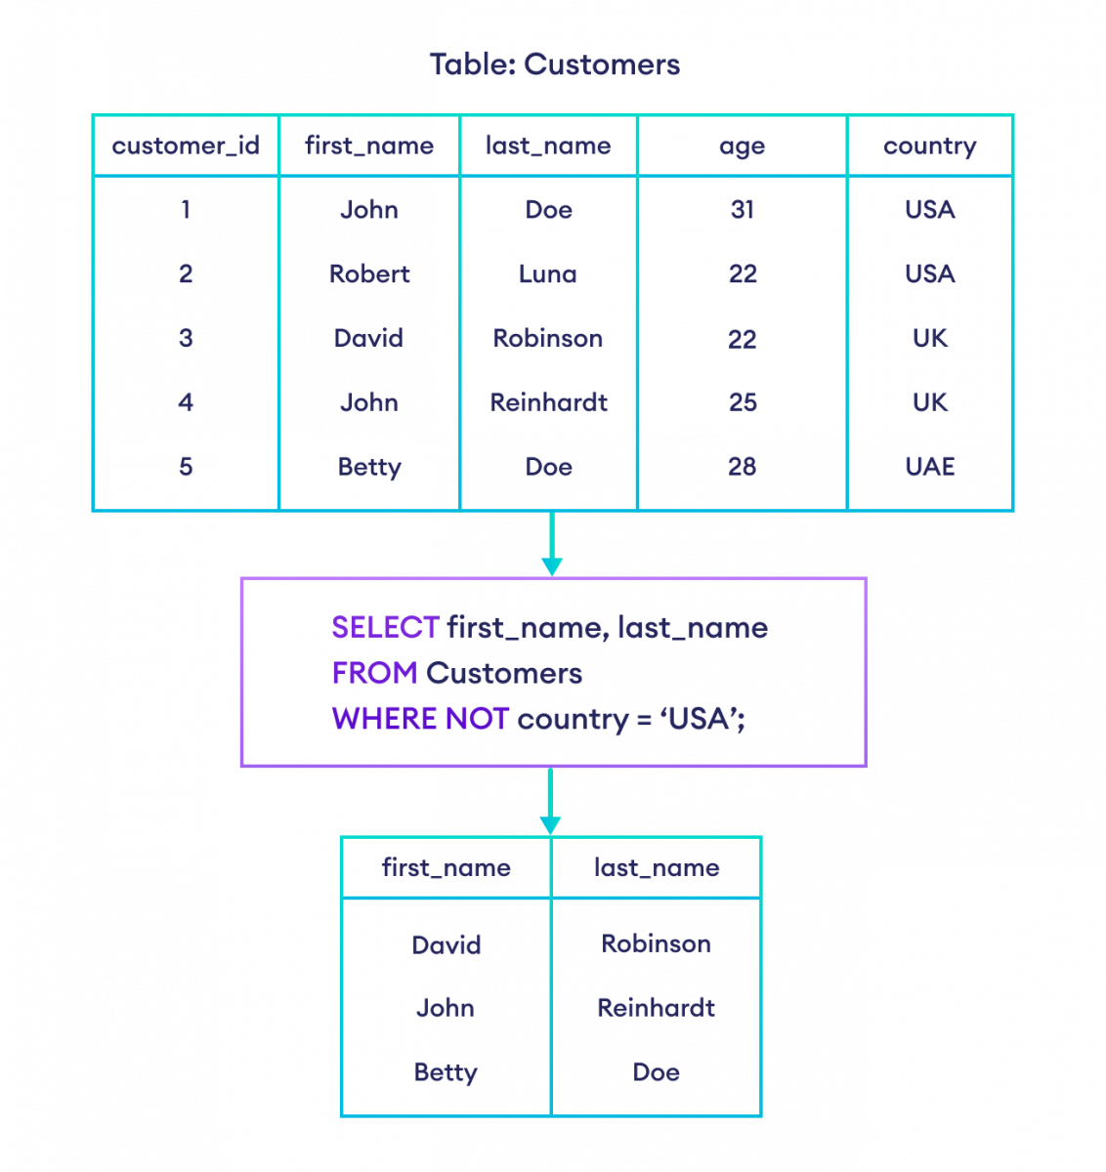
Chapter
05
SQL NOT Operator
The SQL NOT operator selects data if the given condition is FALSE. For example,
selects first_name and last_name of all customers where the country is not USA from the Customers table.
-- select customers who don't live in the USA
SELECT first_name, last_name
FROM Customers
WHERE NOT country = 'USA';
www.midocean.ae

Slide 61
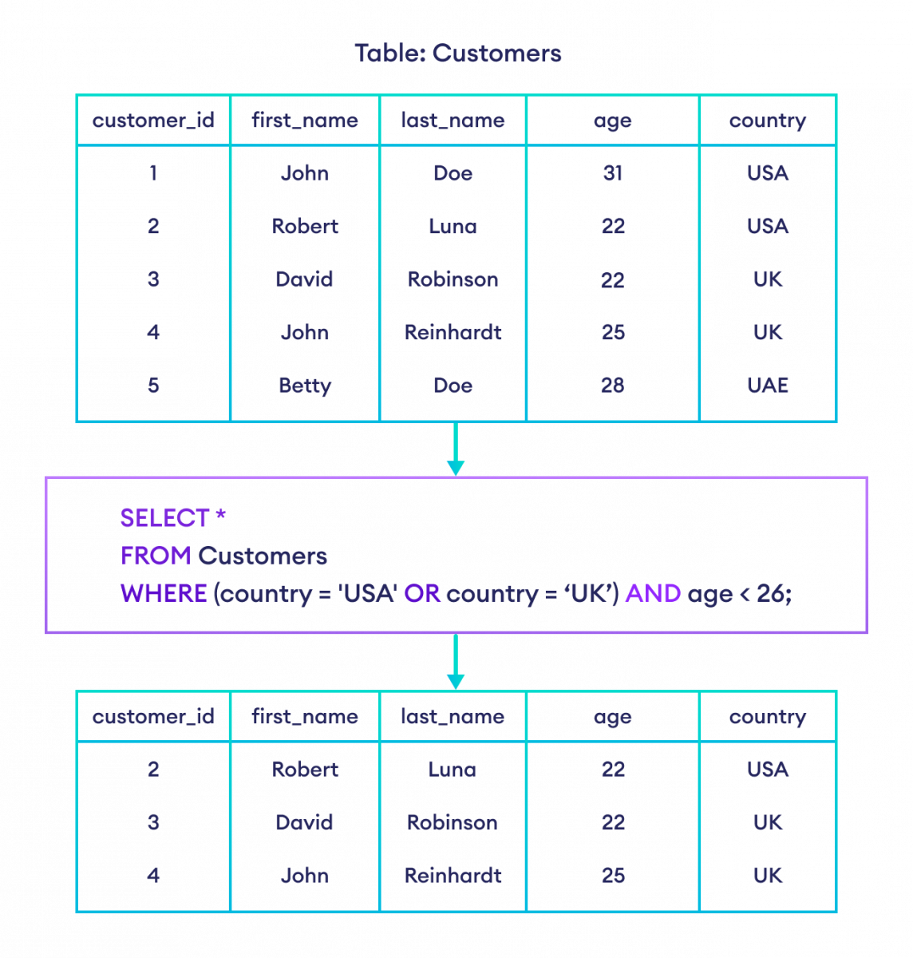
Chapter
05
Combining Multiple Operators
It is also possible to combine multiple AND, OR and NOT operators in an SQL statement.
For example, let's suppose we want to select customers where country is either USA or UK, and age is less than 26.
-- select customers who live in either USA or UK and whose age is less than 26
SELECT *
FROM Customers
WHERE (country = 'USA' OR country = 'UK') AND age < 26;
www.midocean.ae

Slide 62
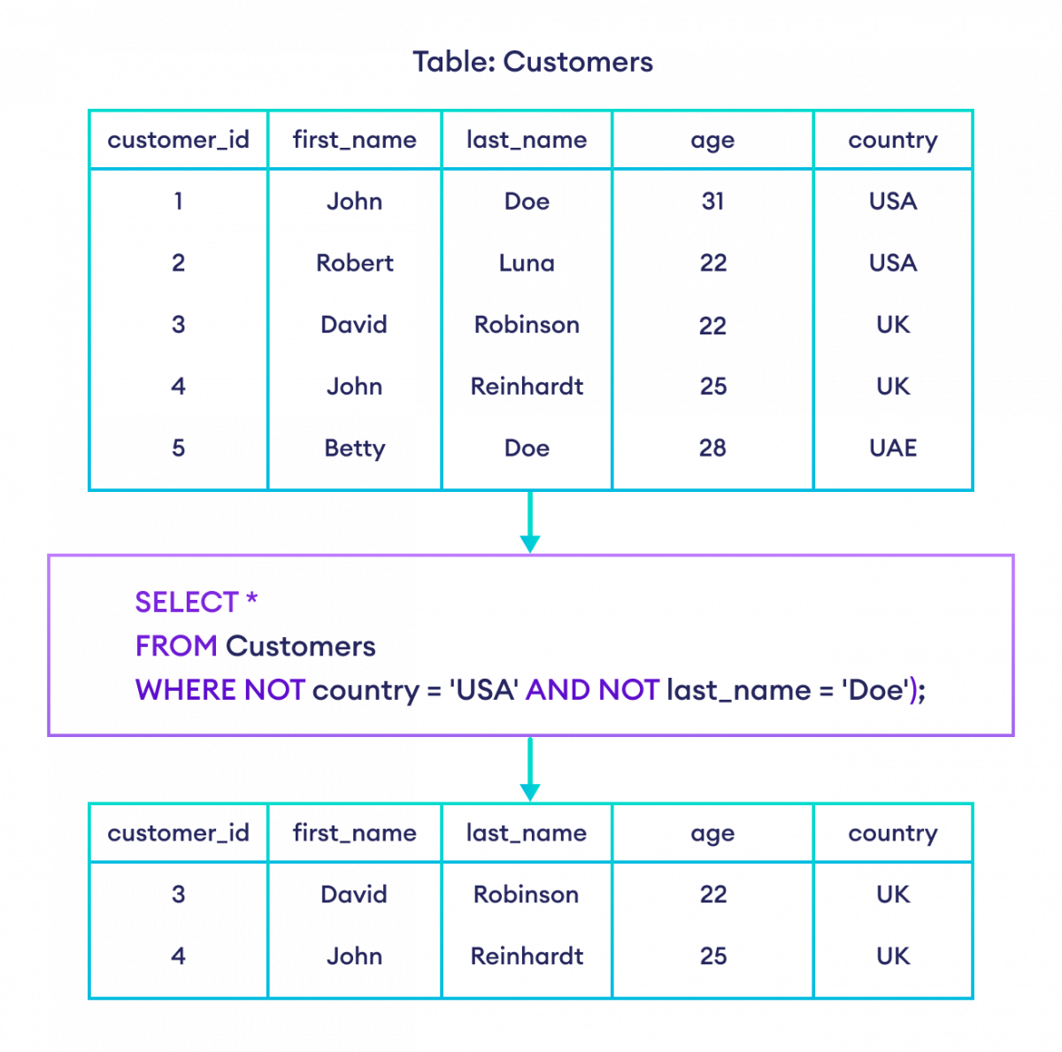
Chapter
05
Example: Combining Multiple Operators in SQL
selects all customers where the country is not USA and last_name is not Doe from the Customers table.
-- exclude customers who are from the USA and have 'Doe' as their last name
SELECT *
FROM customers
WHERE NOT country = 'USA' AND NOT last_name = 'Doe';
www.midocean.ae

Slide 63



Thank You

