Slide 1



Introduction to Digital Media
Media and Digital Technologies
DGM 711
Lecture 1
Prepared by
Dr. Shereen Kedwany

Slide 2

Reminder
Lecture 1
Digital media have become part of everyday life.
We have witnessed the birth of a new Digital Environment.
Digital media Studies is considered Interdisciplinary .
There are now more than 5 billion internet users around the globe.

Slide 3
Outline
Lecture 1
The Digital Environment Characteristics.
The Digital Media Definition.
The Digital Media Types .
The evolution of the Digital Media.
New and Old Media.
Conclusion.

Slide 4




Lecture 1
I. The Digital Environment Characteristics
Media studies scholars Nick Couldry and Andreas Hepp put the term of “Mediatization”, to refer to “the increasing temporal, spatial and social spread of mediated communication”:
They believe that we are surrounded by more and more media technologies in all aspects of our lives, in many different contexts, and across time and space.

Slide 5


Lecture 1
I. The Digital Environment Characteristics
Nick Couldry and Andreas Hepp said that “Mediatization is indeed a process with far‐reaching consequences”.
The transformations introduced by digital technologies are changing the ways in which we produce and distribute information and knowledge, as well as the ways in which we work and socialize.

Slide 6



Lecture 1
I. The Digital Environment Characteristics
Processes of Mediatization, that is the increasing presence of media in all aspects of life, have pushed social theorists to propose that we live what Mark Deuze calls Media lives .
"Media are to us as water is to fish.“, he said.
The digital media environment that we live in is widespread, fluid, and highly efficient.
Indeed, We only note its absence: when we are disconnected, it is stressful and problematic.
Think of when your phone stops working as the train you are riding goes into a tunnel.

Slide 7
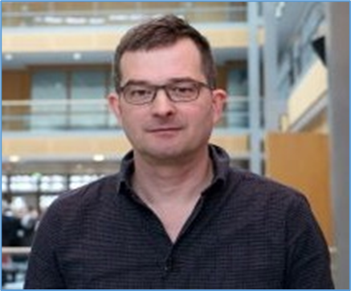

Lecture 1
I. The Digital Environment Characteristics
Media theorist Felix Stalder describes this as the “Digital Condition,” a state in which computer networks have become “the key infrastructure for all aspects of life” .

Slide 8
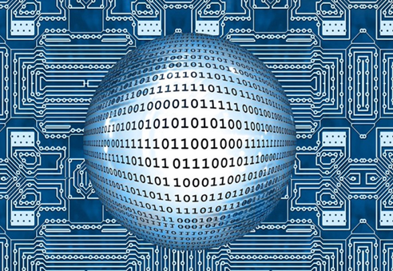
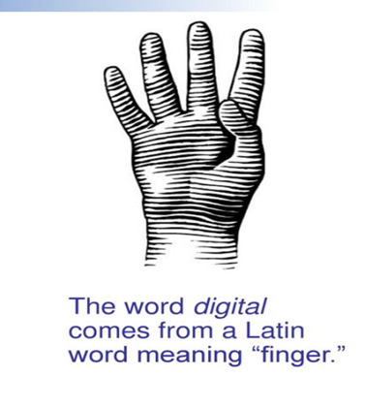
Lecture 1
II. The Digital Media Definition :
“Digital” refers to “recording or storing information as a series of the numbers 1 and 0”.
We get the adjective digital, of the Latin word “digitus”, that means "finger or toe," as fingers are often used for counting.

Slide 9
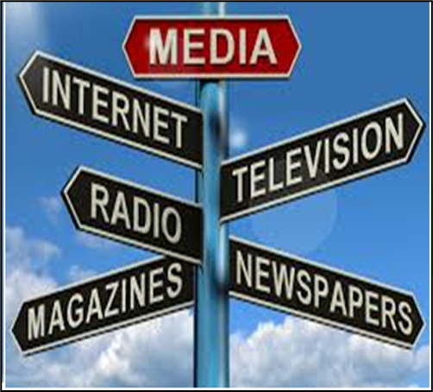
Lecture 1
II. The Digital Media Definition :
Media is used as a plural of medium.
Media refers to the medium through which information is transmitted.
There are many ways to transmit information, but no matter what way.
Media refers to any mass communication vehicle such as newspapers, magazines, radio, television and internet that produce information, news, entertainment, and advertising messages to an audience.

Slide 10
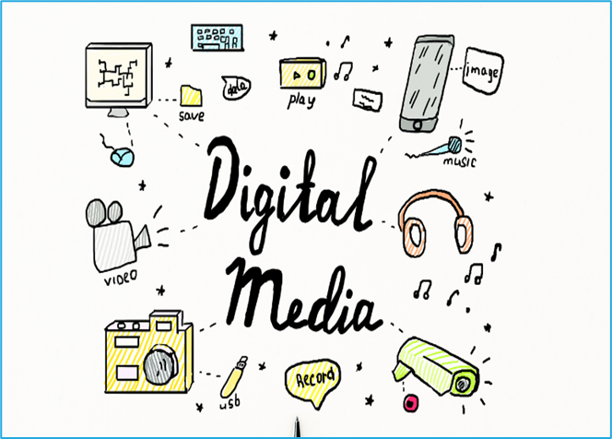
Lecture 1
II. The Digital Media Definition :
“Digital Media” refers to “the means that they carry information represented by a numeric code and then transform it into human language”.
This code is “digital” in the sense that it is based on the binary distinction between two symbols, 1 and 0.

Slide 11
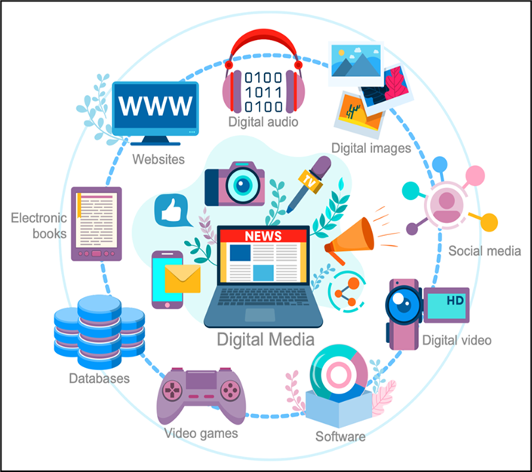
Lecture 1
II. The Digital Media Definition :
Personal computers, mobile phones and smartphones, tablets, digital cameras, video game consoles, telecommunications satellites, credit cards, MP3 players, televisions, servers, browsers, social media services, or self‐tracking gadgets are all based on the processing of information in digital formats.

Slide 12
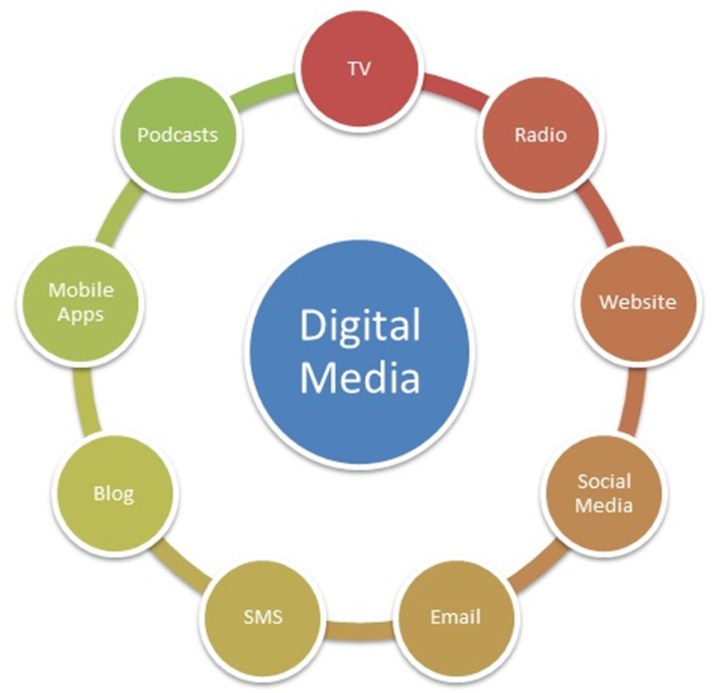
Lecture 1
II. The Digital Media Definition :

Slide 13


Lecture 1
III. The Digital Media Types :
At present, the main types of digital media are text, image, video and audio.
Digital media is sometimes called multimedia.

Slide 14

Lecture 1
III. The Digital Media Types :
Texts :
Traditionally, people consumed text via books, print newspapers, magazines, and the like.
Even though digital media has proliferated, the desire for those kinds of reading experiences has increased.
The proliferation of news websites, the popularity of resources like Wikipedia, and the rise of e-readers underline the continued importance of written work in digital media.

Slide 15


Lecture 1
III. The Digital Media Types :
Video:
Many digital media outlets are visual, from streaming movies and television services such as Shahid & Netflix .
One of the biggest players in visual digital media is YouTube, which hosts billions of videos.

Slide 16

Lecture 1
III. The Digital Media Types :
Images :
Visual content is online content that's primarily image-based.
Common forms of visual content include pictures, diagrams, charts, infographics, screenshots, memes and slide decks.

Slide 17

Lecture 1
III. The Digital Media Types :
Audio:
Audio forms of digital media include digital radio stations, podcasts, and audiobooks.

Slide 18



Lecture 1
III. The Digital Media Types :
Ai-generated content (AIGC) :
AI-generated content is text, images, video, or audio content created by an artificial intelligence tool as a result of human input or prompts.
You can produce AI-generated media using tools like OpenAI’s ChatGPT and Midjourney, as well as AI-powered features inside content software like HubSpot and Canva.

Slide 19
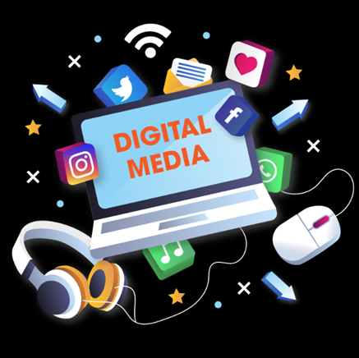

Lecture 1
IV. The evolution of the Digital Media :
The history of the electronic computers and computer networks that constitute digital media goes back several decades .
The spread of digital media has grown steadily since the 1980s.
In sum, digital media have become so pervasive that the changes, challenges, and opportunities that they bring along assume a ubiquitous reach.

Slide 20

Lecture 1
IV. The evolution of the Digital Media :
The introduction of the World Wide Web in the 1990s brought internet connectivity into most homes and businesses in the advanced economies.
The 2000s gave us the collaborative web: software and online platforms that allow all users to produce and distribute digital content.
Mobile technologies such as smartphones and tablets have transformed the daily experience of the internet, further integrating digital media into the flow of everyday life.
The spread of digital media has been explosive. Globally, the number of internet users has passed five billion, or more than half of the world’s population.

Slide 21
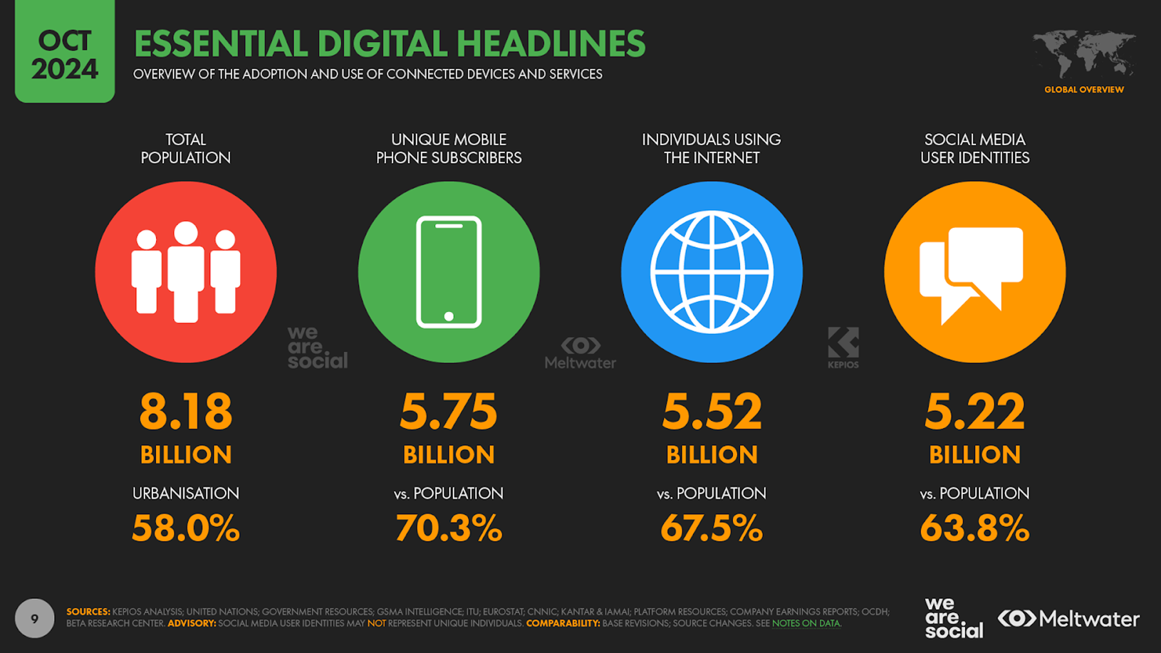
Lecture 1
IV. The evolution of the Digital Media :
Source: https://wearesocial.com/uk/blog/2024/01/digital-2024/

Slide 22
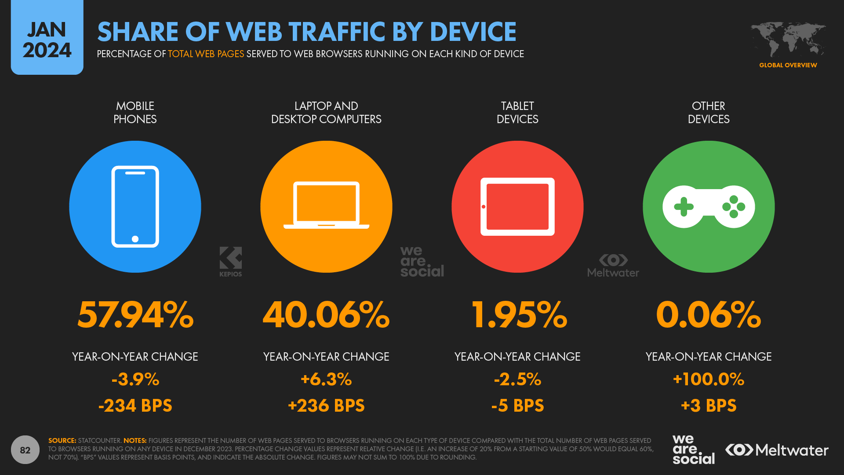
Lecture 1
IV. The evolution of the Digital Media :
Source: https://datareportal.com/reports/digital-2024-deep-dive-how-the-world-goes-online

Slide 23
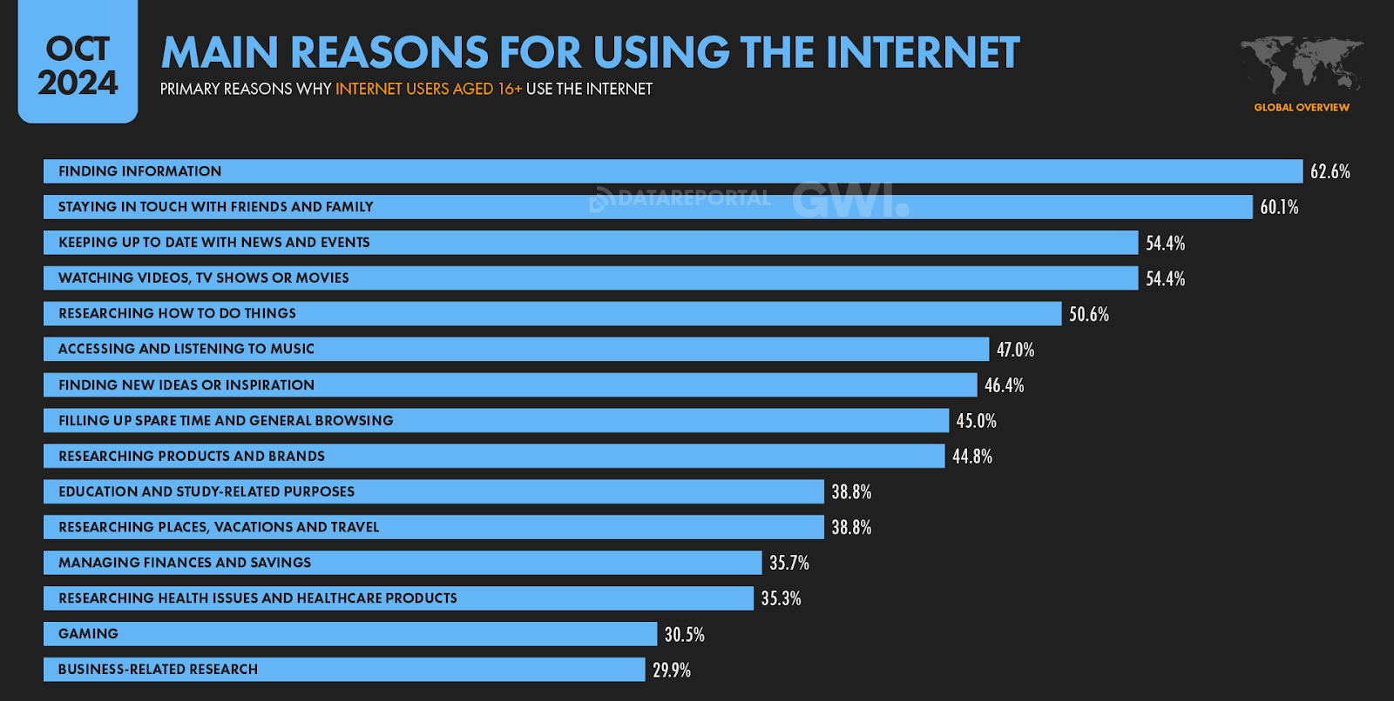
Lecture 1
IV. The evolution of the Digital Media :
Source: https://wearesocial.com/uk/blog/2024/01/digital-2024/

Slide 24
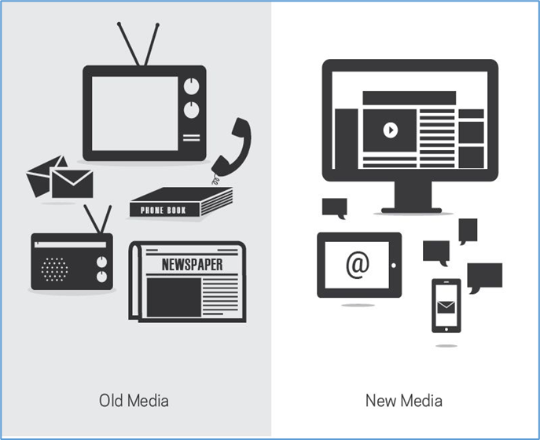
Lecture 1
V. New and Old Media
In early scholarship about the rise of digital media, the definition “New Media” was used to describe information and communication technologies based on digital code.
“New media” signified the set of media technologies that had emerged since the last decades of the twentieth century.
This distinguished them from “Old Media,” which was a definition used to identify traditional mass media like television, newspapers, or radio.
Traditional (nondigital) media includes several types of communication technologies, some of which have existed for hundreds of years.

Slide 25
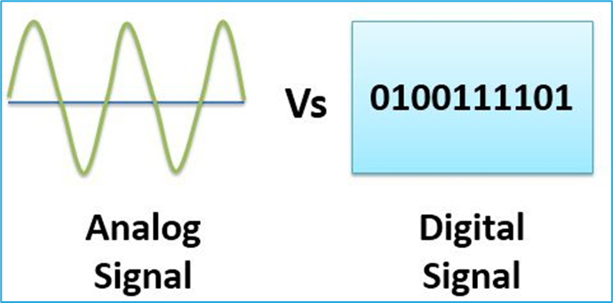
Lecture 1
V. New and Old Media
Digital media have certain common characteristics that distinguish them from Analog media.
“Digital Media” carry information represented by a numeric code based on the binary distinction between two symbols,
1 and 0.
Analog media instead rely on continuous scales, like the scale of colors that can be represented by the chemical composition of a piece of celluloid film, or the letters of the alphabet that can be rearranged into words and expressions.
Thanks to their binary code, digital media can carry information very efficiently.

Slide 26


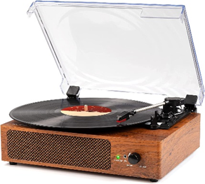
Lecture 1
V. New and Old Media
Yet new media that have emerged in the last 40 years or so are based on heterogeneous computing technologies and are very different from each other.
Conversely, old media are sometimes held to be better than new media, as older technologies can be represented as more authentic.
For example, many claim to have a deeper relationship with books than with e‐books, or with vinyl records than with MP3 files.

Slide 27

Lecture 1
V. New and Old Media
When new media are introduced, they do not replace old media, but rather integrate or change them.
The introduction of television has not caused the disappearance of the newspaper.
The introduction of the tablet did not cause the disappearance of the book.

Slide 28


Lecture 1
V. New and Old Media
Books evolved into different technological formats.

Slide 29
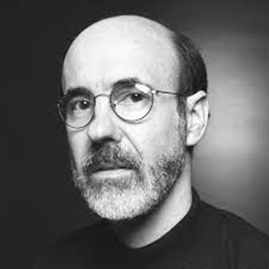


Lecture 1
V. New and Old Media
Bolter and Grusin (2000) called this process of evolution, “Remediation”, that entails competition as well as coevolution and cooperation among different media .

Slide 30
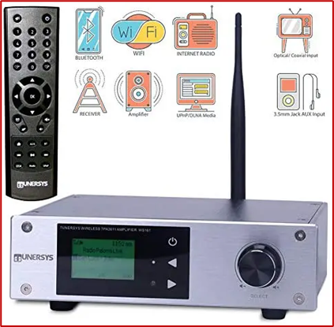

Lecture 1
V. New and Old Media
A practice, content, or format can be re‐mediated by a new technology that mimics or reworks previous formats.
For example, the design of some web radio receivers reproduces 1950s radio sets.

Slide 31
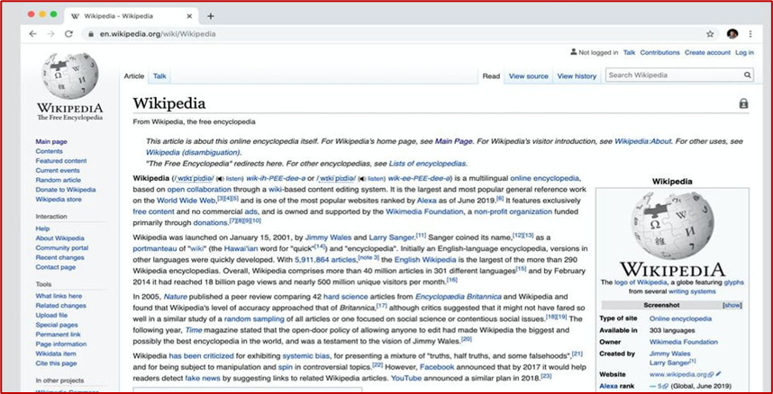


Lecture 1
V. New and Old Media
Wikipedia mirrors and is structured like a traditional encyclopedia, so that cross‐references between entries allow a non‐linear reading path, although this is made possible via hyperlinking technologies rather than by manually turning the pages.

Slide 32

Lecture 1
V. New and Old Media
Overall, new media do not come out of nowhere, but rather evolve from existing practices and media technologies.
The concept of remediation allows the recognition that the history of media is a continuous, non‐linear process that can go in several directions, as old and new media continue to influence each other.

Slide 33

Lecture 1
V. New and Old Media
For example, newer formats can provide content and aesthetics that are adapted in older formats,
Assassin’s Creed is a franchise based on a video game but its stories are expanded to a broader set of media, such as films, comic books, and novels .

Slide 34



Lecture 1
V. New and Old Media
The early stages of life of an emerging media technology are characterized by uncertainty about its role.
New media are not immediately accepted as natural components of the social world, and their meaning is initially open and contested.
This phase has been defined as the “Identity Crisis” of new media (Lisa Gitelman and Goeffrey Pingree).

Slide 35

Lecture 1
V. New and Old Media
After its introduction, the meanings and functions of a new technology are slowly shaped by existing patterns of media usage and by the habits and desires of new users, as well as by technological characteristics.
For example, new media such as the telephone in the mid‐twentieth century has been met with anxieties about their role in the life of .

Slide 36
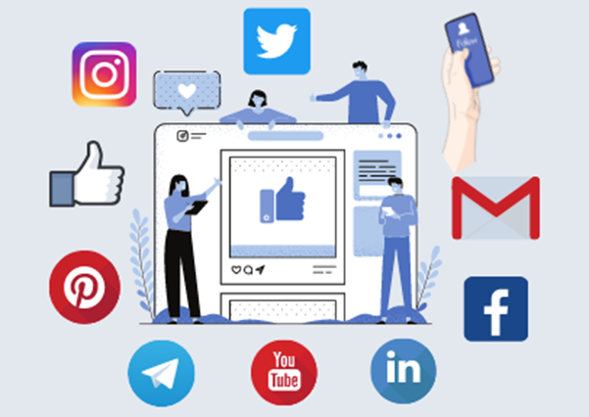
Lecture 1
V. New and Old Media
The phase of crisis and novelty is resolved when a new technology becomes a mass consumer product.
In a process of “Domestication,” the new technology is accepted in a society, it becomes everyday and understandable and tends not to cause rejection or fear anymore .

Slide 37
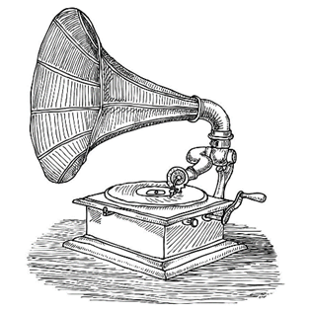
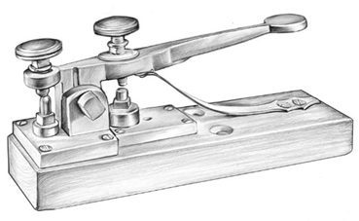
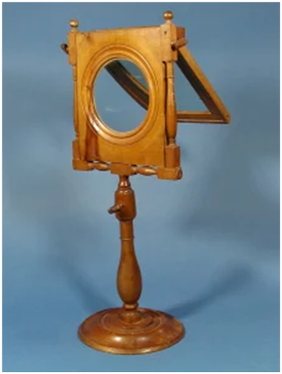
Lecture 1
V. New and Old Media
Some media may be abandoned, as happened to the Phonograph or the Telegraph.
Some can even disappear and be forgotten, as the Zograscope, an eighteenth‐century device that used a lens to artificially provide depth to two‐dimensional images; it now survives only in museums.

Slide 38

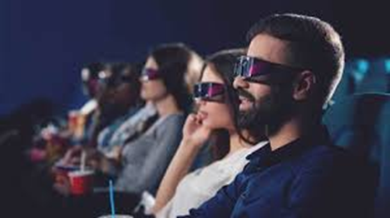
Lecture 1
V. New and Old Media
However, often times media that seem to have disappeared leave traces behind or are updated onto new media formats and technologies.
Contemporary 3D media are indebted to a series of previous technologies, from the Zograscope to the red and cyan glasses used to obtain anaglyph stereoscopic effects.

Slide 39
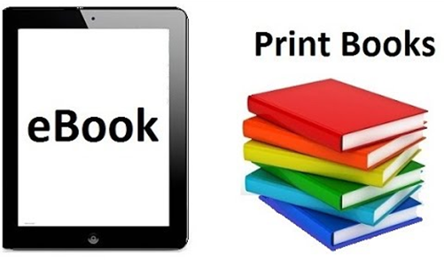


Lecture 1
V. New and Old Media
Many old media can be seen as “undead”: their imminent death is announced or assumed but they refuse to disappear.
This is the case of the printed book, which was thought to be doomed by the emergence of e‐books, or the analog radio, which was to be killed by podcast and streaming technologies.
Instead, both have experienced a resurgence in the last few years.

Slide 40

Lecture 1
Conclusion
Mediatization is the increasing presence of media in all aspects of life.
Computer networks have become “the key infrastructure for all aspects of life in the digital environment.
“Digital Media” are “the means that they carry information represented by a numeric code and then transform it into human language”.
Digital media is sometimes called multimedia.
Digital media can carry information very efficiently than old media.
The introduction of new media has not caused the disappearance of the old media.
A practice, content, or format can be re‐mediated by a new technology .

Slide 41



Thank You

