Slide 1

Global Project Management
Lecture 11
Everyone’s Smart
University
PMG 661
Collaborative Project Management

Slide 2

Collaborative Project Management
Most companies use scheduling software tools and have templates for project records, such as issue logs, risk logs and meeting minutes. Other companies have consolidated the project records into a global project binder, to improve the effectiveness of online meetings. All these companies can improve their maturity on global project management by implementing collaborative project management software tools.

Slide 3

Collaborative Project Management
This chapter makes suggestions on how to improve the adoption of collaborative project management software, by having all project managers and team members across the globe using the same rules and practices, with the help of senior stakeholders.

Slide 4
Collaborative Project Management
All e-mails discussing important project elements – such as actions, issues, risks and changes – should always refer to the project management system, which must in turn be updated with the results of the discussion. The information in the project virtual room and the project management system will then form the basis for all regular meetings.

Slide 5
Understanding what can be improved
You can develop a structured interview (illustrated by Table 25.1) below to identify the opinion and recommendations of program managers, project managers, project office teams and the team members on the current project management software (if any).

Slide 6
Understanding what can be improved
After conducting the interviews, combine the answers with the other recommendations in this chapter, and write the first set of good practices. You could use the same interview at a later stage, in order to detect the effectiveness of the practices you have implemented, and to identify areas for improvement.

Slide 7
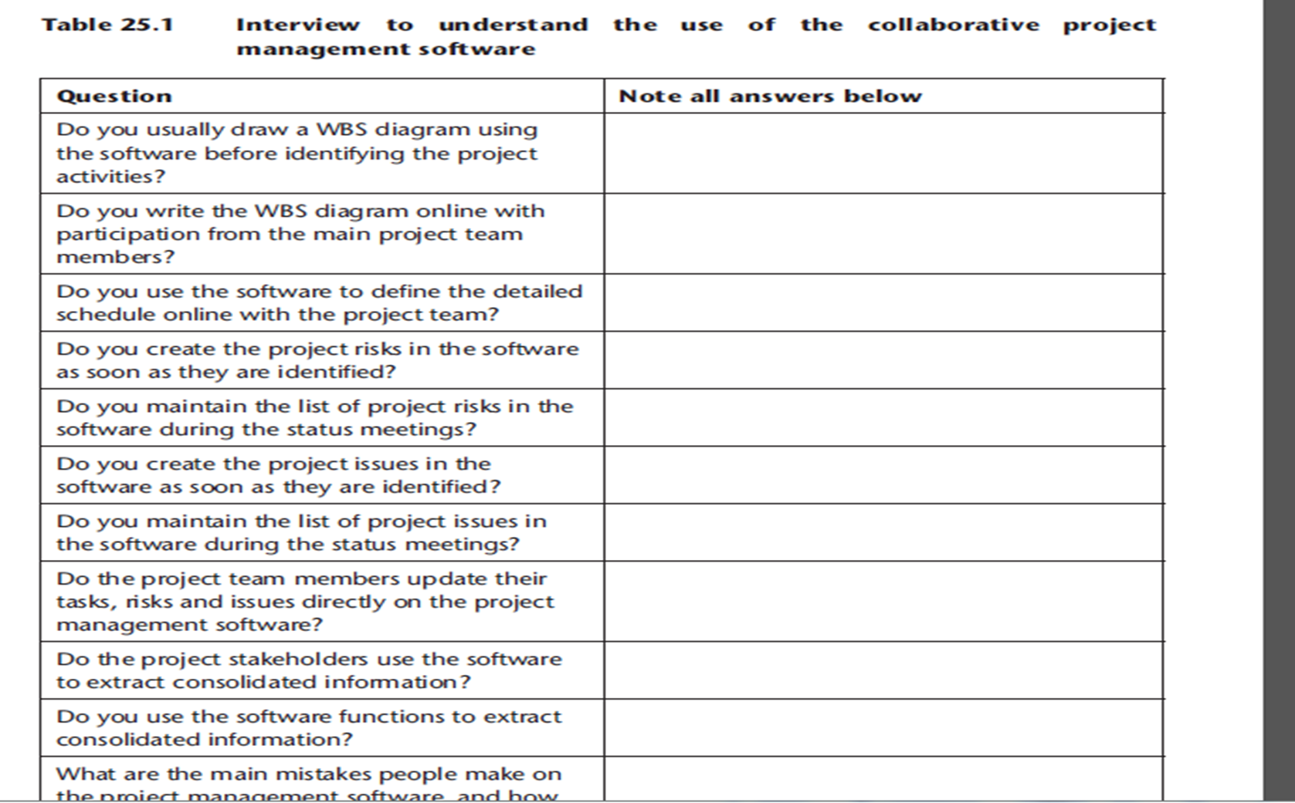

Slide 8
Updating information on the project management software
Global projects involving people in different time zones will have fewer opportunities for synchronous communication. In this case, a planning workshop with the whole team in the same location becomes almost mandatory for project success. However, the project execution, monitoring and controlling processes will rely almost exclusively on asynchronous information exchange to complete the project scope within acceptable levels of cost, time and quality.

Slide 9
Updating information on the project management software
The project team members must update the information on the project management software as soon as possible, allowing other team members to be informed of the changes, and making the project metrics reflect the reality. Some examples of updates that must be performed by every project team member are:

Slide 10
Updating information on the project management software
Activities must be marked as complete, as soon as they are performed.

Slide 11

Updating information on the project management software
The project manager must be informed as soon as variances are detected in the target duration, resources required, or estimated costs. The team members can proceed with updating the activity attributes with the variances, and the software tool sends an e-mail to the project manager automatically.

Slide 12
Updating information on the project management software
When the tool does not provide this option, the team members can send an e-mail, instant message or make a telephone call to the project manager who will update the information directly, and perform an impact analysis of the change. Depending on the methodology in place, and the degree of variance, a change request may be required.

Slide 13
Updating information on the project management software
When the project stakeholders need to update the project scope, time, cost or quality elements, they can raise a change request automatically on the project management software. The software will need to activate a process workflow to inform other stakeholders, and request approval for the change. In these instances, the project manager will need to perform a detailed impact analysis before requesting the approval and making the updates.

Slide 14
Updating information on the project management software
The project stakeholders can update the risks under their ownership directly on the project management software, or insert new risks when they are identified. The software tool must then inform the project manager, who will coordinate the risk analysis and response planning processes.

Slide 15
Updating information on the project management software
When the ownership of any activity, risk or issue is transferred to another team member, this must be reflected in the software tool, which will inform the project manager, the former and the new owner. This will avoid duplication of activities (as the former owner will be informed and stop handling it), the lack of follow-up (the new owner will receive the information and start handling it) and the lack of monitoring (the project manager knows who can provide more information on the status of the item).

Slide 16
Information pushed by the project management software
The software tool can help project managers to monitor the activities, risks and issues under the responsibilities of team members in different time zones, by sending automated messages.
Some examples being:

Slide 17
Information pushed by the project management software
Actions that are due shortly. The team members must update the actions if they are completed, or follow the established process if the activity will be delayed.

Slide 18
Information pushed by the project management software
Issues that are due shortly. The team members must use problem-solving techniques and update the project management system with the issue resolution strategy.

Slide 19
Information pushed by the project management software
Risks that are about to be triggered. The risk owners must review and complete the risk register with the recommended corrective and preventive actions, as well as revisiting the risk response.

Slide 20
Information pushed by the project management software
Risks that just happened. The owners must activate the risk response plan and conduct an impact assessment, involving and informing the project manager.

Slide 21
Pulling information from the project management software
The project manager can identify the stakeholder requirements when performing the communications planning, and produce an index of the information available directly in the project management software tool, with instructions on how to obtain it.

Slide 22
Pulling information from the project management software
The project manager can also work with the PMO administrators to define shortcuts in the software interfaces for the different types of information requested. The stakeholders must use the software to obtain more information on the project, and only request it from the project manager when specific requirements cannot be satisfied by the existing reports and interfaces.

Slide 23
Pulling information from the project management software
Senior executives and members of the project office may also follow this rule and inform the project managers when the information cannot be found. By doing this, they can reinforce the use and adoption of the software tools. Some examples of information that can be produced automatically by the software tools are:

Slide 24
Pulling information from the project management software
up-to-date milestone chart;
list of the ten risks with higher probability and impact;
list of the ten open issues with higher impact;
earned value metrics, indicating the project performance;
project budget and variances;
consolidated views of the project portfolio metrics;
consolidated views of the program metrics.

Slide 25
Interfaces between the project management software and other tools
The project management system may not contain all tools for specialized tasks, but should provide easy interfaces with them. Some examples being:

Slide 26
Interfaces between the project management software and other tools
Quality tools – statistical and flow-charting tools used during quality planning and control activities will often be related to the project domain (for example, chemical, construction and manufacturing). Ideally, these tools will send a summary of the control measurements to the project management system, which will help the project manager to trigger corrective or preventive actions.

Slide 27
Interfaces between the project management software and other tools
Procurement tools – organisations usually have strict standards for the financial analysis tools and spreadsheets, supply relationship management suites, screening systems and payment systems, some of them interfacing with the project management software. Project managers can benefit from direct information exchanges related to the project budget and to the completeness of contractual and payment activities that have an impact on the project schedule.

Slide 28
Interfaces between the project management software and other tools
Risk tools – the outcomes of brainstorming sessions, cause-and-effect diagrams, process flow charts, statistic tools and modelling techniques will produce a list of risks that can be imported into the project management software.

Slide 29
Interfaces between the project management software and other tools
Financial systems – information on project costs and budget can be exchanged with the organisational financial systems, which will reflect the actual project expenditure, trigger invoices and monitor the payments.

Slide 30

Interfaces between the project management software and other tools
Timesheet entry systems – when the project management software does not provide a consolidated timesheet system that allows project team members to report the time spent on different projects together with non-project activities, an external system may be required. This system must be synchronized with the project management software, to allow the tracking of project costs and earned value management

Slide 31
Resources:
Global Project Management
Communication, Collaboration and Management Across Borders
© Jean Binder 2007
Chapter 25

