Slide 1



Project Business
Analysis
PMG 461 – MGM 461
Lecture 10
Delivering Requirements, Managing Changes, Growing Trends and Tools in Project Business Analysis
Prepared by
Eng. Ahmed Hussein, MBA, PfMP©, PMP©, CMP APMG

Slide 2

Lecture
What we will cover
10
Delivering Requirements
Managing Changes to Requirements
Trends in Project Business Analysis
Tools for Project Business Analysis
10 – 2

Slide 3


Delivering Requirements
Lecture
10
10 – 3

Slide 4
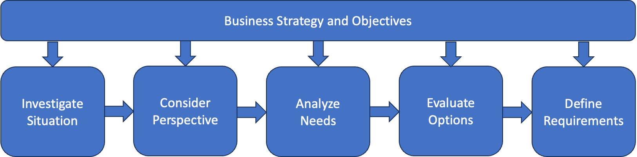
In Previous Lectures
Pre-Project
Project
Elicitation
10 – 4

Slide 5
Business Change Lifecycle
for Delivering Projects
Lecture
10
Business Case
Alignment
Definition
Design
Implementation
Testing/Quality Control
Realization
10 – 5

Slide 6


Agile vs. Traditional Lifecycle
Traditional: Requirements Engineering is performed at the beginning of the project
Agile : Requirements Engineering is done throughout the project
Plan
Develop
Test
Final Outcome
Deploy
Classic/Traditional/Predictive/Waterfall Approach
Project Timeline
Agile/Incremental/Iterative Approach
Iteration 1
Iteration 2
Iteration 3
………….
Iteration N
Develop
Test
Develop
Test
Develop
Test
Develop
Test
Plan
Deploy
Plan
Deploy
Plan
Deploy
Plan
Deploy
Intermediate Outcome
Intermediate Outcome
Intermediate Outcome
Final Outcome
10 – 6

Slide 7
Lecture
Agile vs. Traditional Lifecycle
10
 | Waterfall | Agile
Requirements | Fixed | Dynamic
# of Deliveries | Single delivery | Frequent small deliveries
Activities | Performed once for the entire project | Repeated until correct
Goal | Manage cost | Customer value via frequent deliveries and feedback
Change | Constrained as much as possible | Incorporated in real-time delivery
Stakeholders | Involved at specific milestones | Continuously involved
Risks and Costs | Controlled by detailed planning or mostly knowable considerations | Controlled as requirements and constraints emerge
Source: Project Management Institute, Agile Practice Guide, Project Management Institute Inc., 2017, Page 18.
10 – 7

Slide 8
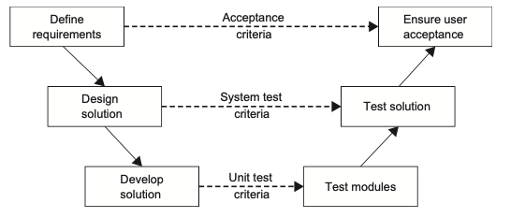
Lecture
Other Lifecycles
10
Adaptive
Halfway between traditional and agile
Hybrid
Mixing Traditional and Agile
V-Lifecycle
V-Lifecycle
10 – 8

Slide 9
Lecture
Factors Impacting the Lifecycle
10
Context
Nature of organization and the project
Lifecycle and Approach
process, methods, and standards adopted for developing and implementing the solution
Roles
key roles in the project;
Deliverables
Products or services to be delivered
Techniques
Management and development techniques used to plan, analyze and document work.
10 – 9

Slide 10
Business Analyst Role in
Delivering Requirements (1 / 3)
Lecture
10
Facilitating Communication
  Act as a liaison between stakeholders, including business users, developers, and project managers, to ensure clear communication of requirements throughout the implementation process.
Stakeholder Engagement
  Maintain ongoing communication and collaboration with stakeholders to address concerns, resolve issues, and ensure satisfaction with the delivered solution.
Requirement Traceability
  Establish traceability between business requirements, system specifications, and test cases to ensure that all requirements are adequately addressed in the final solution.
10 – 10

Slide 11
Business Analyst Role in
Delivering Requirements (2 / 3)
Lecture
10
Acceptance Testing/Quality Control
  Collaborate with stakeholders to define acceptance criteria and participate in acceptance testing to verify that the implemented solution meets business requirements and quality standards.
Requirement Verification
  Verify requirements with stakeholders through reviews, walkthroughs, and demonstrations to ensure accuracy, completeness, and alignment with expectations.
Requirement Engineering for New Requirements
  New or modified requirements elicitation, prioritization, documentation, and validations.
10 – 11

Slide 12
Business Analyst Role in
Delivering Requirements (3 / 3)
Lecture
10
Change Management
  Manage changes to requirements throughout the implementation process, assessing their impact on scope, schedule, and budget, and obtaining stakeholder approval as needed.
Continuous Improvement:
  Identify opportunities for improvements and enhancements based on lessons learned, aiming to optimize future projects and deliver greater value to the organization.
10 – 12

Slide 13
Lecture
Roles in Execution based on Lifecycle
10
Traditional
Agile
Project Manager
Business Analyst
Architect/Designer
Developer/Team Member
Tester /Quality Control
Product Owner: Business representative
Team Leader/Agile Coach/Project Manager
Team Member: team is 5-9 people, cross-functional or T-Shaped
10 – 13

Slide 14
Lecture
Testing/Quality Control
10
Based upon
Use Case Scenarios (Traditional)
User Stories in (Agile)
Role of Business Analyst
Develop Use case scenarios or user stories
Detail Acceptance criteria
Participate in testing
Facilitate testing between stakeholders (or end users) and technical teams
10 – 14

Slide 15
Lecture
Verification of Requirements
10
Performed after Testing results and involves Stakeholders to confirm requirement is met
Business analyst with technical team, might do a demo, walkthrough or test.
Uses Requirements Traceability Matrix as bases, and verification results are recorded in it.
Requirement Information |  |  | Relationship Traceability
ID | Requirement | Source | Business Objective | Deliverable | Verification | Validation
Unique ID for requirement | Description of the requirement | Name Of person who identified the requirements | List the business objective that is met by fulfilling the requirement. | Identify the deliverable that is associated with the requirement. | Describe the metric that is used to measure the satisfaction of the requirement. | Describe the technique that will be used to validate that the requirement meets the stakeholder needs.
10 – 15

Slide 16
Managing Changes to Requirements
Lecture
10
10 – 16

Slide 17
Lecture
Requirements Changes in Execution?
10
Why?
Unforeseen Needs
Shifting priorities
Evolving stakeholder expectations
What?
New Requirements
Modify Requirements
Remove Requirement
10 – 17

Slide 18
How to Handle Requirement Changes?
Lecture
10
Assessing the impact of modifications
Obtaining appropriate approvals
Implementing adjustments
Minimizing disruption
“any change with the potential to affect the main project baselines—scope, cost, schedule, and quality—necessitates careful analysis through a change management process”.
10 – 18

Slide 19
Change Management Process
Change Identification
Identify the need for changes to the project and the reason such as new requirements, unexpected events, or shifts in priorities.
Change Assessment
Perform Impact Assessment of Change on Scope, Solution. Schedule, Budget, Quality and Risk
Change Evaluation
Change Board reviews Change Request
They can Approve/Reject/Defer Change
Fill the Assessment in a Change request Form
Change Documentation and Communication
Adjust solution and requirements document based on new change
Implement
Implement Change
Communicate Change to all relevant stakeholders and team members
Monitor and Evaluate results
10 – 19

Slide 20
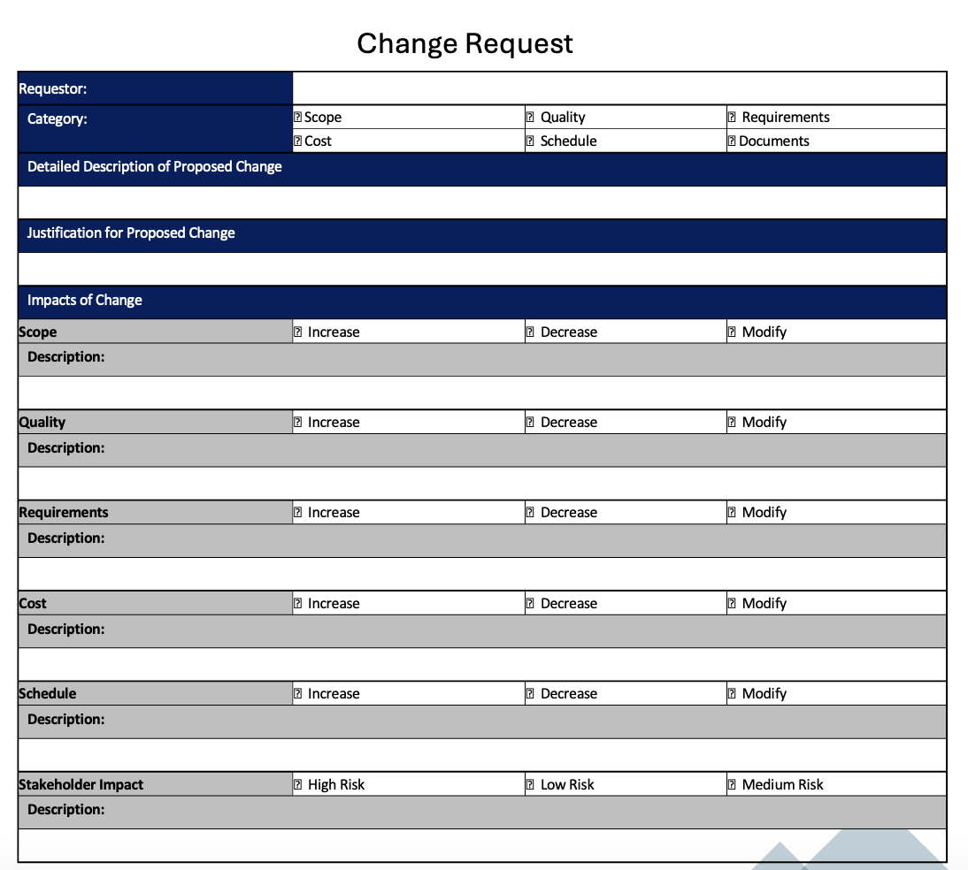
Change Request Form
A change request is a formal document submitted to project sponsor or relevant stakeholders to request modifications in the project.
Change requests include rationale for the change, impact on project objectives, potential risks, required resources, and any supporting documentation.
Change requests are subject to review and approval or rejection.
10 – 20

Slide 21
Lecture
Change Log Form
10
A change log is a document that records and tracks all changes made to a project over its lifecycle.
Captures information as description, status, approval status, implementation details, and any associated comments or notes.
Serves as a centralized repository for documenting and managing changes.
It enables project stakeholders to monitor the status of change requests.
10 – 21

Slide 22
Trends in Project Business Analysis
Lecture
10
10 – 22

Slide 23
Lecture
Why Project Business Analysis Matters Today
10
Organizations face increasing complexity and rapid change
Business analysts bridge strategy, execution, and customer needs
Demand is rising for analysts who integrate business, data, and digital capabilities
Shift from documentation → value-driven decision support
10 – 23

Slide 24
Lecture
1: Digital Transformation & AI-Driven Analysis
10
Use of AI for requirements discovery, impact analysis, and risk prediction
Automation of repetitive BA tasks (user stories, test cases)
Increased use of analytics platforms, natural language tools, and intelligent dashboards
BA roles evolving into digital product advisors
10 – 24

Slide 25
Lecture
2: Shift Toward Product-Centric Ways of Working
10
BAs contribute to continuous product evolution, not just project delivery
Stronger alignment with product managers
Focus on value streams, customer journey mapping, and MVP thinking
Long-term ownership of outcomes instead of temporary project lifecycle
10 – 25

Slide 26
Lecture
3: Agile & Hybrid Delivery Models
10
Increased use of Scrum, Kanban, SAFe, and hybrid Agile–Waterfall
BA responsibilities embedded within cross-functional Agile teams
Emphasis on incremental requirements, story refinement, backlog management
Rise of the Agile Business Analyst
10 – 26

Slide 27
Lecture
4: Data-Driven Decision Making
10
Business analysts increasingly leverage:
Descriptive & diagnostic analytics
Process mining
Predictive modelling for forecasting project outcomes
Integration of BA with BI/Analytics team workflows
Data literacy becoming a mandatory BA skill
10 – 27

Slide 28
Lecture
5: Customer-Centered & Experience-Driven Analysis
10
Greater focus on human-centered design (Design Thinking)
Use of service blueprints, empathy maps, and customer journey analysis
Co-creation with users and non-technical stakeholders
Requirements validated through prototypes and usability testing
10 – 28

Slide 29
Lecture
6: Enterprise Analysis & Strategic Alignment
10
BAs increasingly involved in strategy formulation
Linking business cases to enterprise OKRs, KPIs, and benefits realization
Prioritizing initiatives using value-driven frameworks
Expansion of the BA role into portfolio and strategy management
10 – 29

Slide 30
Tools for Project Business Analysis
Lecture
10
10 – 30

Slide 31
Lecture
Key Tool Categories for Project Business Analysis
10
Project Business Analysts typically work across multiple tool types that support discovery, analysis, solution design, and decision-making.
Requirements & Documentation Tools
Process Modeling & Mapping Tools
Data & Analytics Platforms
Project & Portfolio Management Tools
Collaboration & Communication Tools
Testing & Validation Tools
AI-Assisted BA Tools
10 – 31

Slide 32
Lecture
Requirements Management Tools
10
Used for capturing requirements, linking user stories, traceability matrices, change control, include tools as:
  Jira / Jira Service Management
  Azure DevOps
  Confluence
  Jama Connect
  Helix RM
  ClickUp
10 – 32

Slide 33
Lecture
Process Mapping & Modeling Tools
10
Used to visualize current-state, future-state, and gaps, such as:
  Miro / Mural – whiteboards for workshops, ideation
  Visio – process diagrams, swimlanes
  Lucidchart – BPMN, UML, value stream mapping
  Bizagi Modeler – BPMN process modeling
  ArchiMate Tools (Archi, Bizzdesign) – enterprise architecture
  Draw.io – free modeling tool
10 – 33

Slide 34
Lecture
Data & Insights Tools Supporting BA Decisions
10
These tools help validate assumptions using real operational data, such as:
  Power BI – dashboards, insight visualization
  Tableau – advanced analytics
  Excel – data cleaning, modeling, feasibility calculations
  SQL / Databricks – for querying and validating data
  Process Mining Tools (Celonis, UiPath Process Mining) – identifying bottlenecks
10 – 34

Slide 35
Lecture
Project & Portfolio Tools for BA Alignment
10
Key BA role: ensuring requirements align with roadmap, backlog, and priorities.
  MS Project Online / Primavera P6 – timeline & dependency planning
  Smartsheet – flexible PMO oversight
  Wrike / Monday.com – hybrid workflows
  Trello, Slack, Clickup, Notion for Agile Project Planning and collaboration
  Jira Align – enterprise value stream management
10 – 35

Slide 36
Lecture
Business Case & Financial Analysis Tools
10
BAs create business cases, benefits maps, and investment justification.
Excel / Google Sheets
Anaplan / Adaptive Planning
Value Realization Tools (Amplify, Planview Evergreen)
ROI, NPV, cost-benefit analysis
financial modeling
benefits tracking
10 – 36

Slide 37
Lecture
Testing, Validation & Traceability Tools
10
BAs often support UAT, acceptance criteria clarity, and traceability. Examples of tools are:
Zephyr (Jira plugin) – user story test cases
TestRail – structured testing
Postman – API testing and data validation
Selenium / Cypress – automated testing
10 – 37

Slide 38
Lecture
AI-Assisted Business Analysis Tools
10
AI helps accelerate:
  User story generation
  Impact analysis
  Document writing
  Risk identification
  Workflow recommendations
ChatGPT / AI Copilots – drafting requirements, analyzing feedback
ClickUp AI / Jira AI – automated summaries, risk detection
Figma AI – rapid prototyping and interface suggestions
10 – 38

Slide 39
Lecture
What the Future BA Looks Like
10
Project Business Analysis is evolving into a high-impact, insight-driven, strategic discipline.
Competencies of the next-generation BA:
  AI-assisted analysis & data fluency
  Strategic and product mindset
  Strong facilitation & stakeholder co-design
  Multi-framework adaptability (Agile, hybrid, value stream)
Ability to connect business needs → technology → measurable outcomes
10 – 39

Slide 40
Lecture
Key Points
10
Business Analyst role is involved throughout execution in various activities as facilitating communication, stakeholders' engagement, requirements traceability and verifications, and requirements change management.
The role and activities for the business analyst differs between Traditional and Agile Lifecycles.
Requirements Traceability Matrix is the main document used to monitor and control requirements.
Requirements Changes that leads to changes in scope, schedule, cost or quality need to a follow a formal change request process.
Growing trends focus on AI, digital transformation, BA strategic role, Customer and Product Centered approaches, and using Agile and Hybrid models.
There are several tools for different BA tasks that a BA should be familiar with and use in projects.
10 – 40

Slide 41

Reading, Chapters 12 “Delivering the Requirements” and 14 “Implementing Business Change”
from textbook “Business Analysis” by James Cadle, Malcolm Eva, Keith Hindle, Debra Paul, 2nd edition
Lecture
10
For Discussion Panel and Next Lecture
10 – 41

Slide 42



Thank You

