Slide 1



Influence and Negotiation Skills
Tips for Closing Successful Negotiation
Prepared by:
Dr. Bothaina Mahmoud Fouad
College of
Entrepreneurship and Innovation
Code ENT623
Week 11

Slide 2

Lec. 10 Overview
The main points:
Sources of Negotiation Power
Negotiation ground rules
Emotional Control in Negotiation
Closing the deal
Negotiation tips
conclusion

Slide 3



01
Sources of Negotiation Power

Slide 4

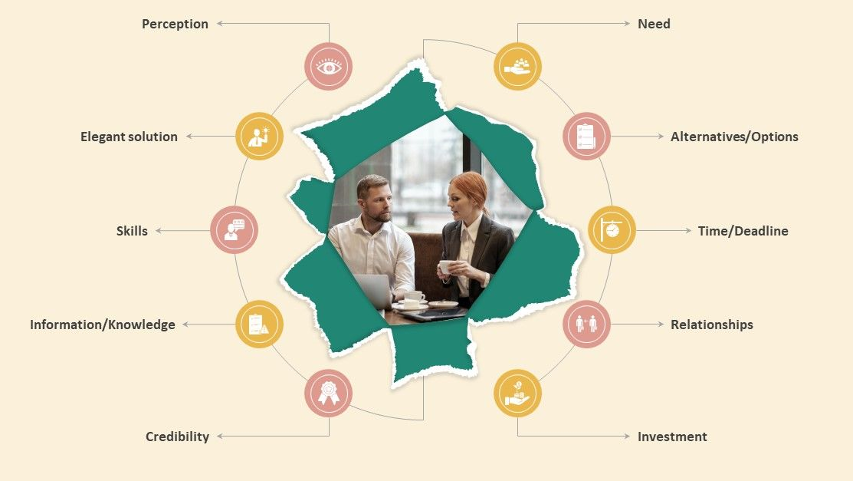
Sources of Negotiating Power

Slide 5
Need power
It refers to the perceived importance or urgency that one party has for reaching an agreement compared to the other party. When a party has a greater need or dependency on reaching an agreement, they are said to have higher need power

Slide 6
Alternatives / Options power
The ability to walk away from a negotiation and pursue alternative options can significantly enhance negotiation power. If you have attractive alternatives, you are less dependent on reaching an agreement and can negotiate from a position of strength.

Slide 7
Timing Power
The timing of a negotiation can affect your negotiation power. For example, being the first to make an offer or initiating a negotiation when the other party is in need or under time pressure can give you an advantage.

Slide 8
Relationships and Networks power
Having strong relationships within the industry or relevant networks can provide valuable support and information, increasing your negotiation power. Building alliances or partnerships can also enhance your position.

Slide 9
Leverage/ Investment Power
This refers to the advantages or resources that a party possesses that can be used to influence the negotiation. Leverage can come from various sources such as financial strength, market dominance, expertise, or unique assets. The party with stronger leverage generally has more negotiation power.

Slide 10
skills power
Effective communication, active listening, empathy, and the ability to build rapport can positively impact negotiation power. Skilled negotiators can influence the dynamics of the negotiation, manage conflicts, and persuade others to agree to their terms.
EX: In sales, when you sharpen your skills, you make more money.

Slide 11
Information/ Knowledge power
Having access to relevant information and being well-informed about the subject matter of the negotiation can increase your negotiation power. Information asymmetry, where one party has more information than the other, can be leveraged to gain an advantage.
Power based on the accumulation and presentation of data along with the acknowledgment of that accumulation or expertise by the counterparty.

Slide 12
credibility power
It refers to the perceived trustworthiness, reliability, and expertise that a party possesses. It is the ability to establish and maintain a positive reputation and influence the negotiation process based on that reputation.

Slide 13
Engaging with stakeholders successfully requires a combination of negotiation and influencing strategies and techniques. Here are some tips for using these strategies effectively:
02
Negotiation ground rules

Slide 14
Respect
All parties involved in the negotiation should treat each other with respect and professionalism. This includes active listening, refraining from personal attacks, and valuing diverse perspectives.

Slide 15
2. Open Communication
Encourage open and honest communication among all parties. Create an atmosphere where participants feel comfortable expressing their thoughts, concerns, and interests without fear of judgment or retaliation

Slide 16
3. Use active listening
Encourage participants to listen attentively to others' viewpoints, ask clarifying questions, and paraphrase to ensure understanding.
Listening actively to stakeholders is an important part of effective engagement. Listen to their needs and concerns, and show that you are genuinely interested in their opinions.

Slide 17
4. Transparency
Promote transparency by sharing relevant information openly and honestly. Strive for clarity and accuracy in presenting facts, data, and proposals to ensure all parties are well-informed

Slide 18
5. Focus on Interests
Encourage parties to focus on their underlying interests instead of rigid positions. By understanding each other's interests, it becomes easier to explore creative solutions that meet the needs of all parties.

Slide 19
6. Constructive Problem-Solving
Foster a problem-solving mindset where participants work collaboratively to find mutually beneficial solutions. Encourage the exploration of different options and alternatives to address the interests of all parties involved.

Slide 20
7. Be willing to compromise and Flexibility
Encourage parties to be open to making concessions and finding middle ground to reach an agreement that satisfies the interests of all parties.
Be prepared to compromise on less important issues in order to reach a mutually beneficial agreement. This can help to build trust and maintain relationships over the long term.

Slide 21
8. Time Management
Agree upon time management guidelines to ensure efficient use of time during the negotiation process. Establish clear timeframes for discussions, breaks, and decision-making to keep the negotiation on track.

Slide 22
9. Confidentiality
Establish guidelines for maintaining confidentiality, especially when sensitive or proprietary information is being shared. Ensure that all parties understand the need to protect confidential information disclosed during the negotiation.

Slide 23
10. Be creative
Engagement often involves finding creative solutions that meet the needs of all parties. Be open to exploring new and innovative approaches, and look for win-win solutions that create value for all parties.

Slide 24
11. Build relationships and follow up your deal
Building relationships with stakeholders is critical to successful engagement. Focus on building trust and rapport with stakeholders, and look for opportunities to create value for both parties.
Once an agreement has been reached, follow up with stakeholders to ensure that both parties are meeting their obligations. This can help to build trust and maintain relationships over the long term.

Slide 25
03
Emotional Control
in Negotiation

Slide 26
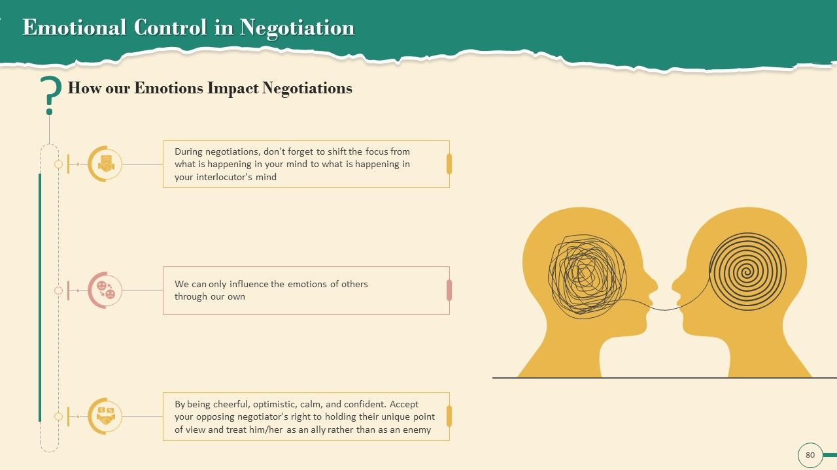

Slide 27
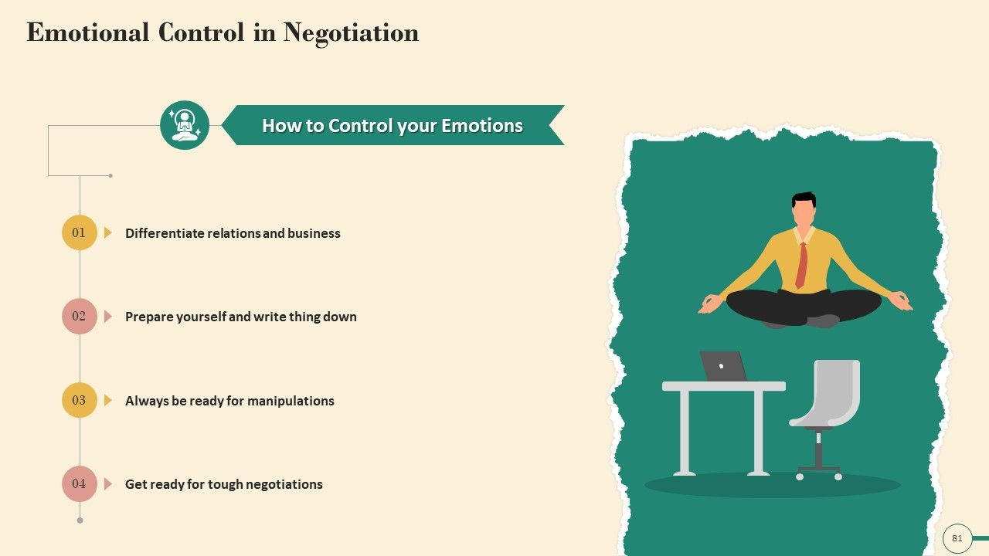

Slide 28
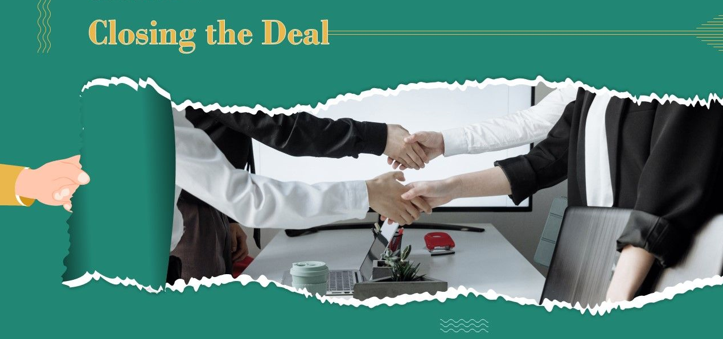
Closing the deal
Chapter
04

Slide 29
Closing the Deal
It refers to the final stage of the negotiation process where both parties come to an agreement on the terms and conditions and formally commit to the deal.
Here are some strategies to effectively close the deal in a negotiation:

Slide 30
Summarize and Confirm:
Begin by summarizing the key points of agreement and confirm that both parties are aligned on the terms and conditions. This helps ensure that there is a shared understanding of the deal before moving forward

Slide 31
Address Remaining Concerns:
Check if there are any outstanding concerns or unresolved issues that need to be addressed before finalizing the deal. Work collaboratively to find solutions or compromises that satisfy both parties' interests.

Slide 32
Create a Win-Win Scenario:
Emphasize the mutual benefits and value that both parties will gain from the deal. Highlight how the agreement aligns with their respective goals and objectives, creating a win-win situation.

Slide 33
Overcome Objections:
Be prepared to handle any objections or reservations that the other party may have. Anticipate their concerns and address them with compelling arguments or additional information to alleviate their doubts.

Slide 34
Obtain Signatures:
Arrange for the signing of the finalized agreement by authorized representatives of each party. This can be done physically or electronically, depending on the preferred method of signing.

Slide 35
Celebrate and Build Rapport:
As the deal is closed, take a moment to acknowledge the achievement and express appreciation for the collaboration. Use this opportunity to strengthen the relationship with the other party and lay the foundation for future partnerships

Slide 36
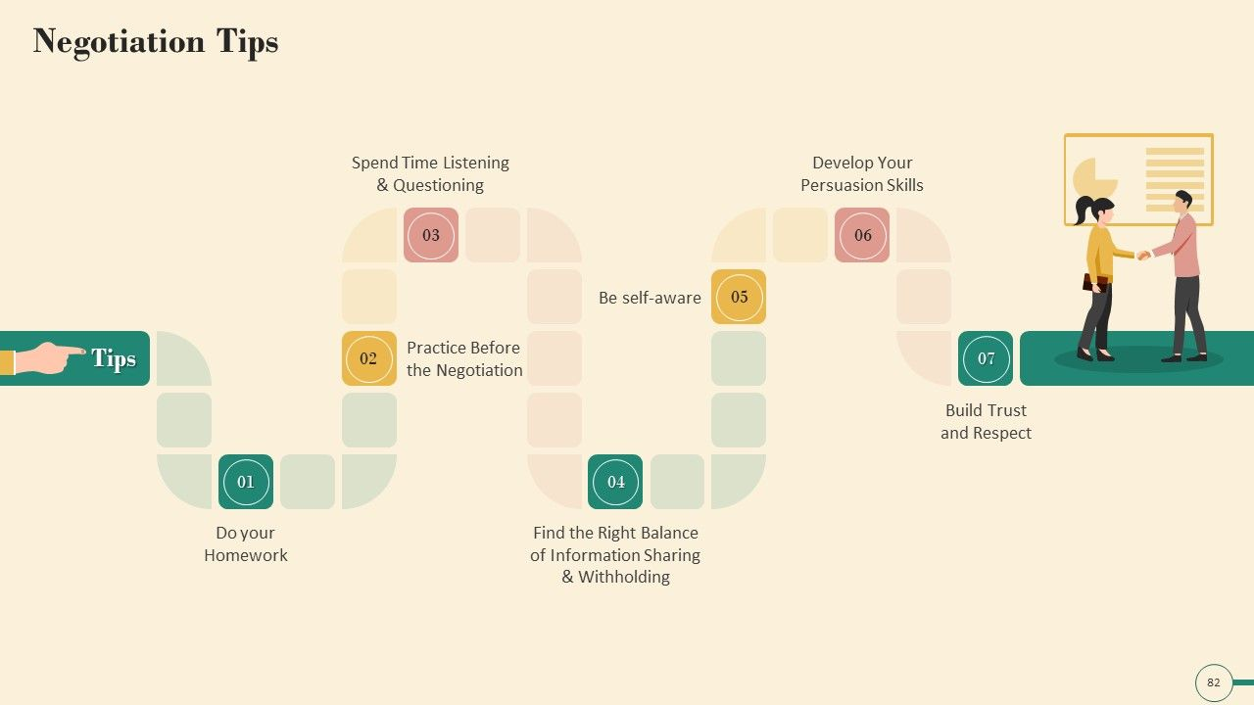
Negotiation Tips
Chapter
05

Slide 38
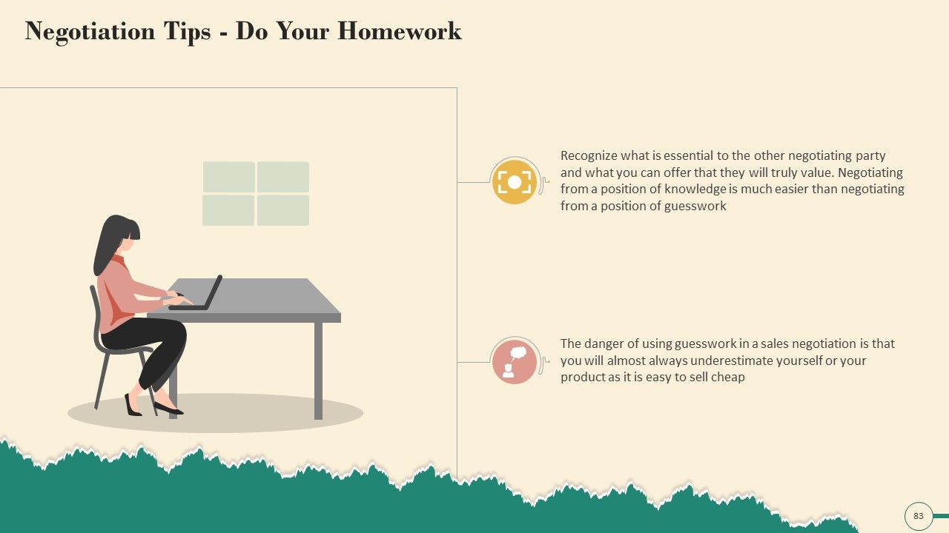

Slide 39
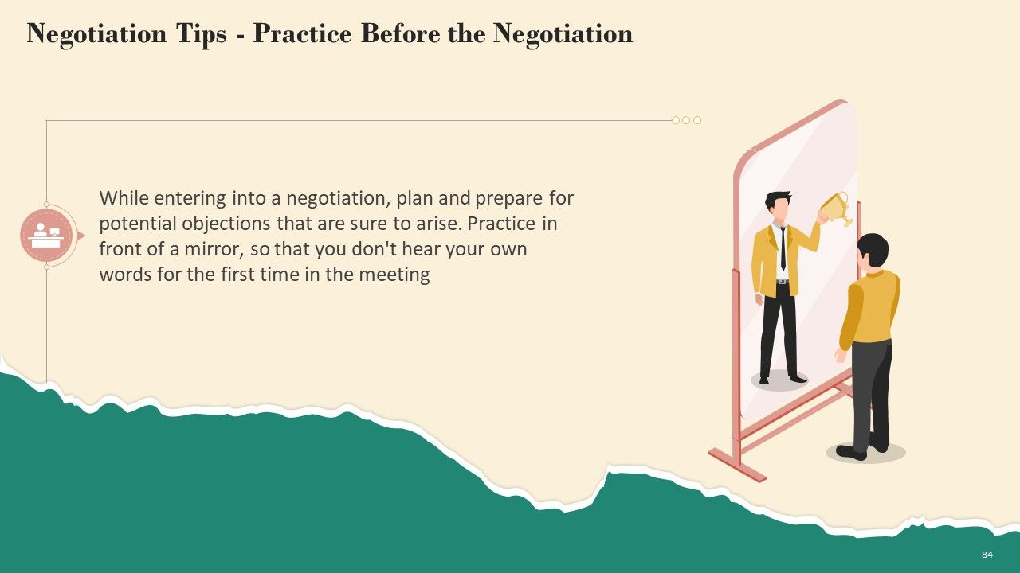

Slide 40
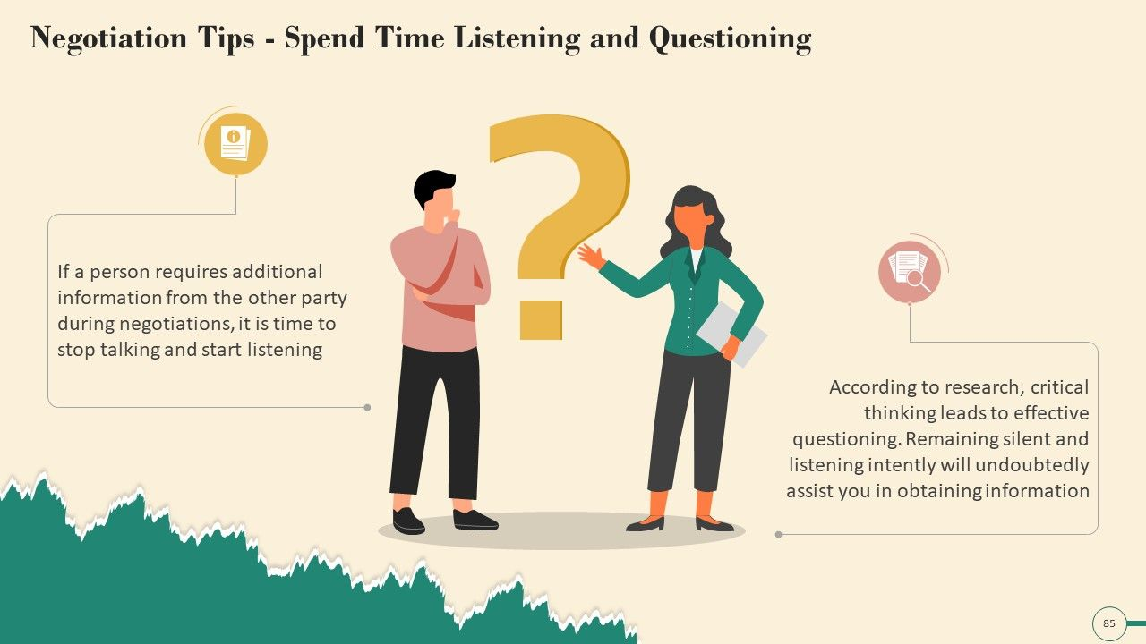

Slide 41
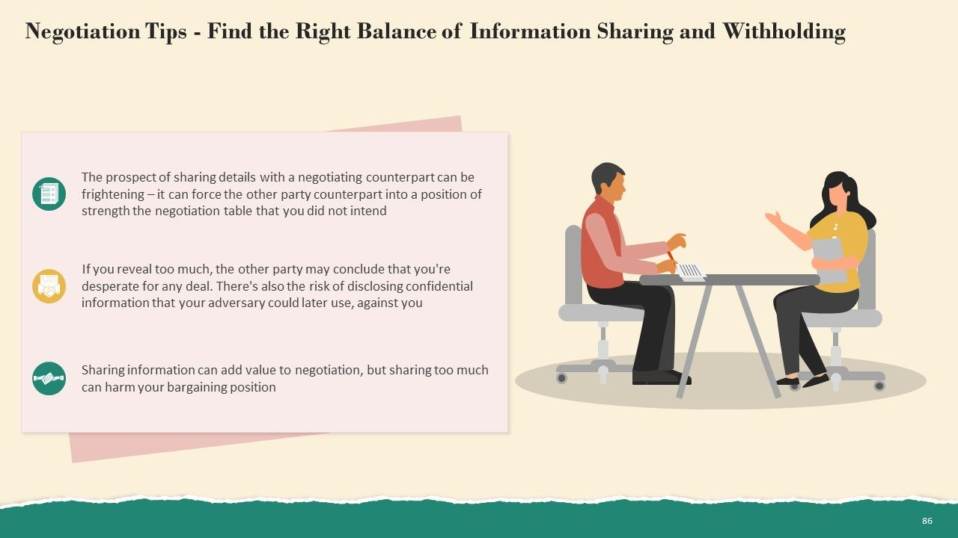

Slide 42
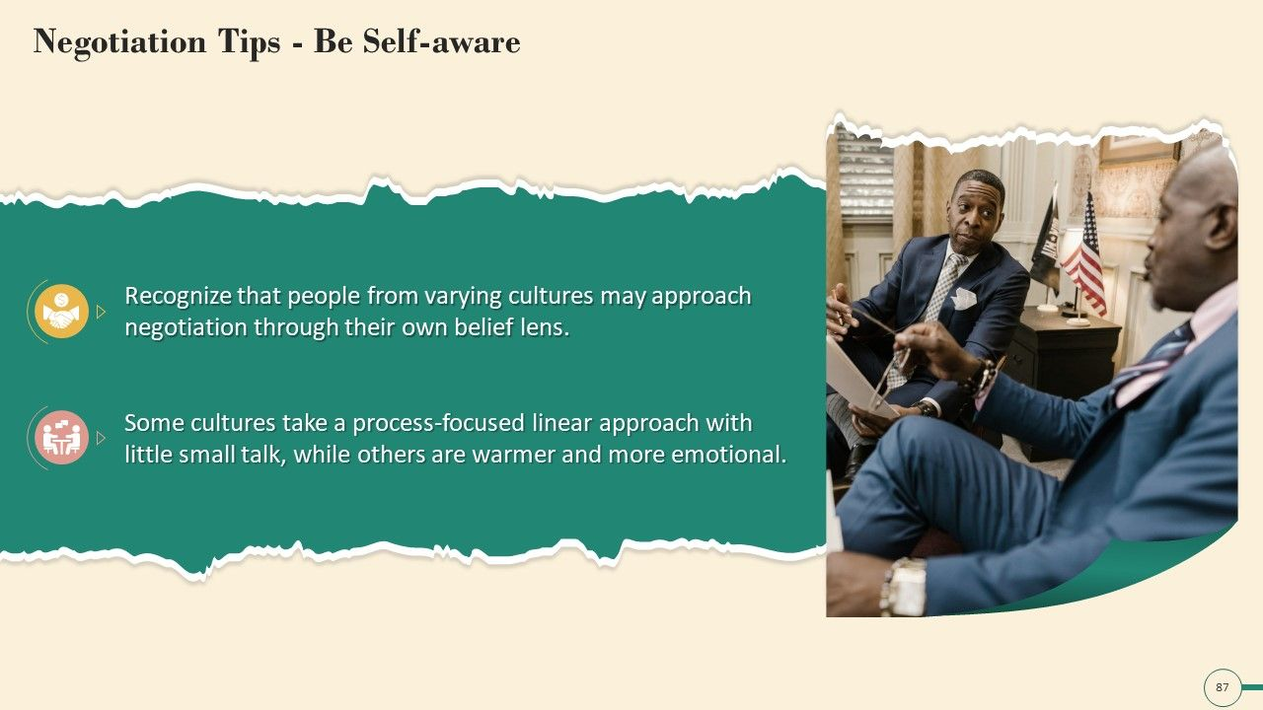

Slide 43
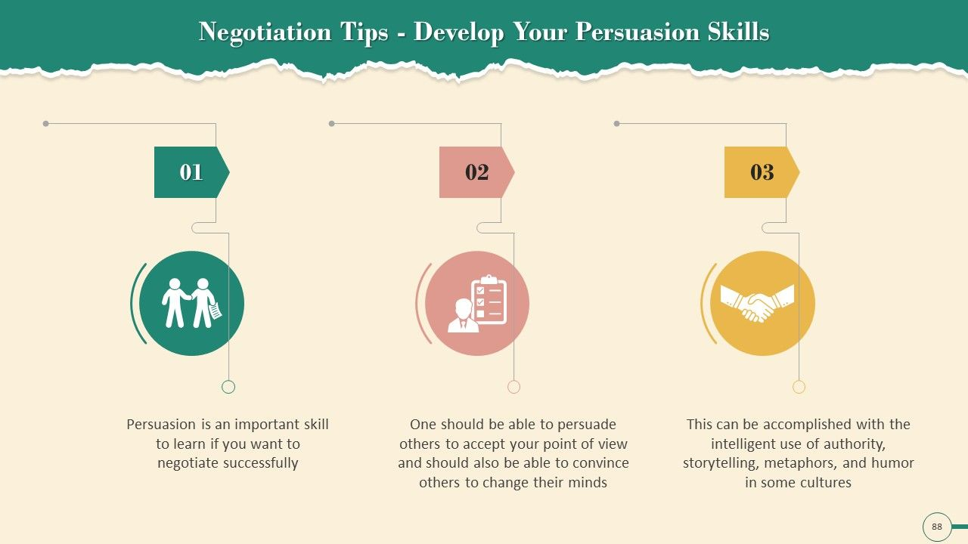

Slide 44
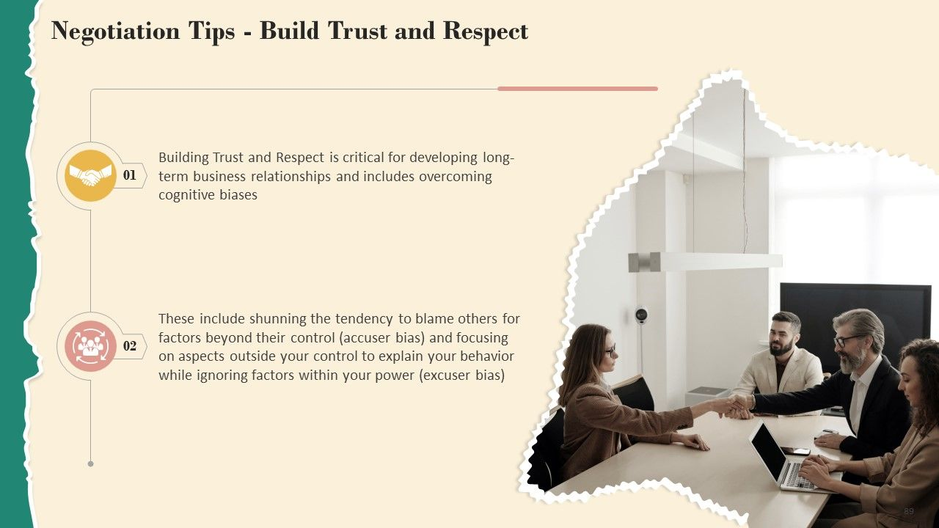

Slide 45
Successful negotiation is an essential skill for entrepreneurs
Securing Funding:
Entrepreneurs often need to negotiate with investors, venture capitalists, or financial institutions to secure funding for their business. Effective negotiation skills can help entrepreneurs present their business case, negotiate favorable investment terms, and secure the necessary capital to fuel their growth.

Slide 46
Successful negotiation is an essential skill for entrepreneurs
2. Partnerships and Collaborations:
Negotiation plays a vital role in forming partnerships and collaborations with other businesses. Entrepreneurs negotiate deals and agreements with suppliers, distributors, strategic partners, and other stakeholders to establish mutually beneficial relationships that can help drive business growth

Slide 47
Successful negotiation is an essential skill for entrepreneurs
3. Sales and Contracts:
Negotiation is a fundamental aspect of sales and contract agreements. Entrepreneurs negotiate with prospective clients or customers to secure sales contracts, determine pricing, and establish terms and conditions that meet both parties' needs. Strong negotiation skills can help entrepreneurs win profitable deals and establish long-term customer relationships

Slide 48
Successful negotiation is an essential skill for entrepreneurs
4. Hiring and Human Resources:
Entrepreneurs often negotiate with potential employees during the hiring process to attract top talent and secure the best fit for their business. Negotiating compensation packages, benefits, and other employment terms becomes critical in attracting and retaining skilled staff.

Slide 49
Successful negotiation is an essential skill for entrepreneurs
5. Supplier and Vendor Relationships:
Negotiating with suppliers and vendors is crucial for entrepreneurs to secure favorable pricing, payment terms, and quality standards. Effective negotiation skills can help entrepreneurs establish mutually beneficial relationships that drive cost savings, efficiency, and reliability in the supply chain.

Slide 50
Successful negotiation is an essential skill for entrepreneurs
6. Resolving Disputes and Contracts:
Entrepreneurs may encounter disputes or conflicts with clients, partners, or other stakeholders. Negotiation skills enable entrepreneurs to navigate these situations, find common ground, and reach mutually acceptable resolutions, potentially avoiding costly legal battles.

Slide 51
Successful negotiation is an essential skill for entrepreneurs
7. Business Development and Expansion:
Entrepreneurs negotiate when expanding their business through mergers, acquisitions, or entering new markets. Negotiating with potential acquisition targets, joint venture partners, or licensing agreements can significantly impact the success of these endeavors.

Slide 52
Successful negotiation is an essential skill for entrepreneurs
8. Risk Mitigation:
Negotiation skills can help entrepreneurs mitigate risks by negotiating favorable terms in contracts, such as liability limitations, indemnification clauses, and dispute resolution mechanisms. Effective negotiation can provide entrepreneurs with greater protection and minimize potential risks.

Slide 53
Conclusion
Developing strong negotiation skills is an ongoing process. Entrepreneurs should invest in learning negotiation techniques, understanding different negotiation styles, and practicing effective communication and problem-solving. By mastering negotiation, entrepreneurs can enhance their ability to navigate challenges, seize opportunities, and build successful businesses.

Slide 54
Conclusion
By using these negotiation and influencing strategies and techniques, entrepreneurs can engage with stakeholders successfully and build strong, lasting relationships that benefit all parties involved.

Slide 55


Thank You

