Slide 1

Probability and Statistics
Prepared by Dr.Israa Lewaa
Lecture 3
STA 201
Probability

Slide 2

Chapter
03
Probability
3.1 Basic Concepts of Probability and Counting
3.2 Conditional Probability and the Multiplication Rule
3.3 The Addition Rule
3. 4 Additional Topics in Probability and Counting

Slide 3
Chapter
03
3.1 Basic concepts of Probability and Counting
Identify the sample space of a probability experiment
Identify simple events
Distinguish among classical probability, empirical probability, and subjective probability
Determine the probability of the complement of an event
Use a tree diagram and the Fundamental Counting Principle to find probabilities

Slide 4
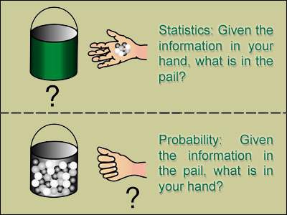
Chapter
03
Statistics and Probability

Slide 5
Chapter
03
Probability Experiments
Probability experiment
An action, or trial, through which specific results (counts, measurements, or responses) are obtained.
Outcome
The result of a single trial in a probability experiment.
Sample Space
The set of all possible outcomes of a probability experiment.
Event
Consists of one or more outcomes and is a subset of the sample space.

Slide 6

Chapter
03
Probability Experiments
Probability experiment: Roll a die
Outcome: {3}
Sample space: {1, 2, 3, 4, 5, 6}
Event: {Die is odd}={1, 3, 5}

Slide 7
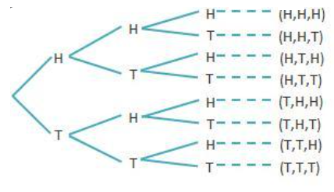

Chapter
03
Example: Identifying the Sample Space
A probability experiment consists of tossing a three coins. Describe the sample space.
Solution:{HHH, HHT, HTT, HTH, THH, THT, TTH, TTT}

Slide 8


Chapter
03
Types of Probabilities
Classical (equally probable outcomes)
Empirical
Subjective
Intuition, educated guesses, and estimates.

Slide 9

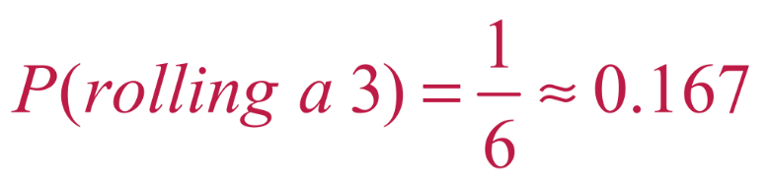
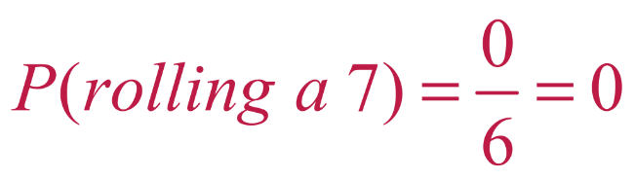
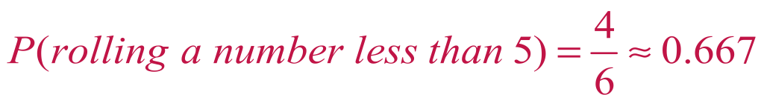
Chapter
03
Example of Finding Classical Probability
1. Event A: rolling a 3 Event A = {3}
Event B: rolling a 7 Event B= { } (7 is not in the sample space)
Event C: rolling a number less than 5
Event C = {1, 2, 3, 4}

Slide 10
Chapter
03
Example of Finding Empirical Probabilities
You survey a sample of 1000 employees at a company and record the age of each. Find the probability of randomly choosing an employee who is between 25 and 34 years old.
Event A = Age is between 25 and 34
Employee ages | Frequency, f
15 to 24 | 54
25 to 34 | 366
35 to 44 | 233
45 to 54 | 180
55 to 64 | 125
65 and over | 42
 | Σf = 1000

Slide 11

Chapter
03
Example of Subjective Probabilities
Subjective Probability
Intuition, educated guesses, and estimates.
e.g. A doctor may feel a patient has a 90% chance of a full recovery.
Probability = 0.9

Slide 12
Chapter
03
Definition: Complementary Events
Complement of event E
The set of all outcomes in a sample space that are not included in event E.
P(E ′) + P(E) = 1
P(E) = 1 – P(E ′)
P(E ′) = 1 – P(E)
E ′
E

Slide 13
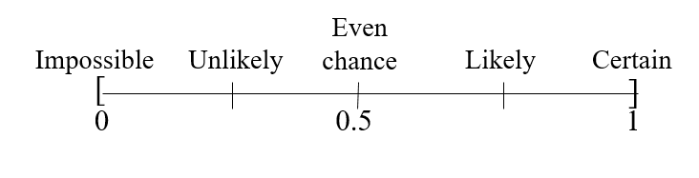
Chapter
03
Range of Probabilities Rule
Range of probabilities rule
The probability of an event E is between 0 and 1, inclusive.
0 ≤ P(E) ≤ 1

Slide 14
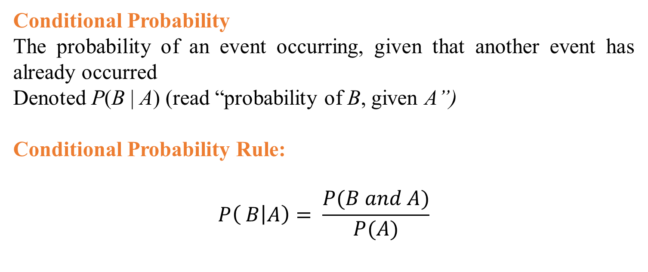
Chapter
03
Section 3.2 Conditional Probability and the Multiplication Rule
Conditional Probability
The probability of an event occurring, given that another event has already occurred
Denoted P(B | A) (read “probability of B, given A”)
Conditional Probability Rule:
$$P\left( B | A\right)= \frac{P(B and A)}{P(A)}$$

Slide 15
Chapter
03
Example: Finding Conditional Probabilities
The table shows the results of a study in which researchers examined a child’s IQ and the presence of a specific gene in the child. Find the probability that a child has a high IQ, given that the child has the gene.
 | Gene Present | Gene not present | Total
High IQ | 33 | 19 | 52
Normal IQ | 39 | 11 | 50
Total | 72 | 30 | 102

Slide 16

Chapter
03
Solution: Finding Conditional Probabilities
There are 72 children who have the gene. So, the sample space consists of these 72 children.
 | Gene Present | Gene not present | Total
High IQ | 33 | 19 | 52
Normal IQ | 39 | 11 | 50
Total | 72 | 30 | 102
Of these, 33 have a high IQ
$$P\left( High IQ | gene present\right)= \frac{P(High IQ and gene present)}{P(gene present)}$$

Slide 17
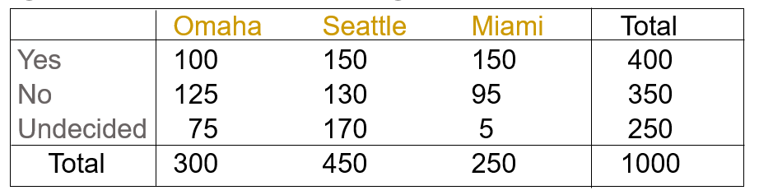
Chapter
03
Example: Probabilities from Contingency Table
The results of responses when a sample of adults in 3 cities was asked if they liked a new juice is:
One of the responses is selected at random. Find:
1. P(Yes)
2. P(Seattle)
3. P(Miami)
4. P(No | Miami) = probability the answer is “no” given that adult is a resident of Miami

Slide 18
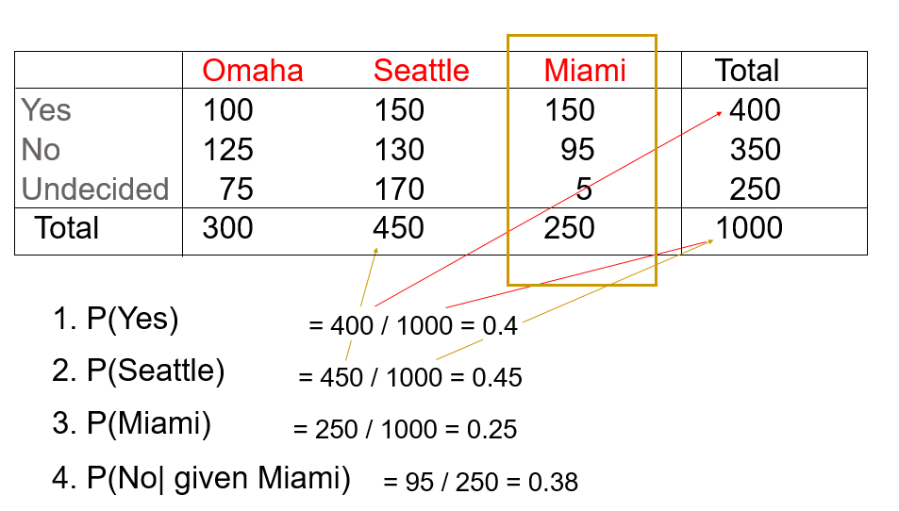
Chapter
03
Solution

Slide 19
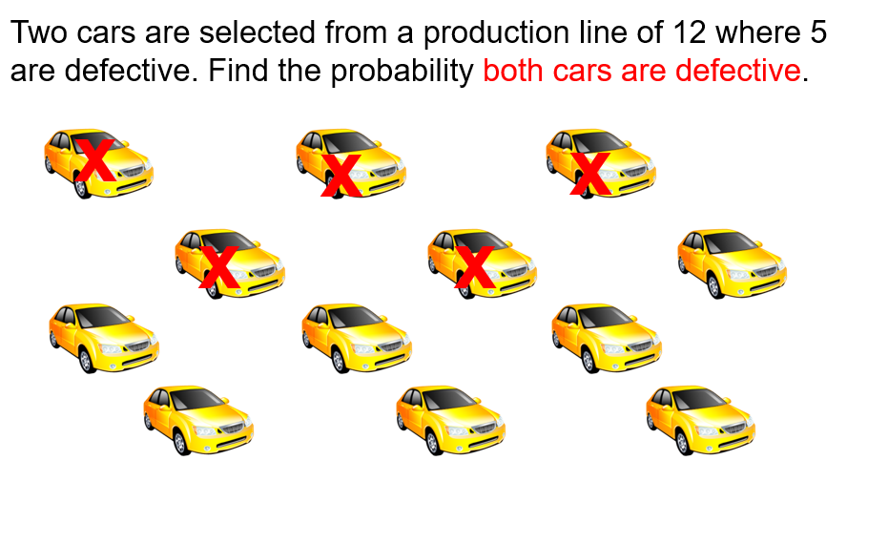
Chapter
03
Imagine this

Slide 20
Chapter
03
Multiplication Rule
To find the probability that two events, A and B will occur in sequence, multiply the probability A occurs by the conditional probability B occurs, given A has already occurred.
A = first car is defective B = second car is defective.
P(A and B) = P(A) x P(B|A)
P(A) = 5/12
P(B|A) = 4/11
P(A and B) = 5/12 x 4/11 = 5/33 = 0.1515

Slide 21
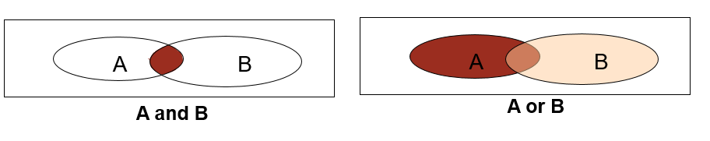
Chapter
03
Compare “A and B” to “A or B”
The compound event “A and B” means that A and B both occur in the same trial. Use the multiplication rule to find P(A and B).
The compound event “A or B” means either A can occur without B, B can occur without A or both A and B can occur. Use the addition rule to find P(A or B).

Slide 22
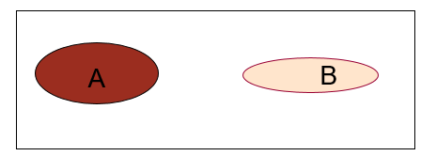
Chapter
03
Mutually Exclusive Events
Two events, A and B, are mutually exclusive if they cannot occur in the same trial.
A = A person is under 21 years old
B = A person is running for the U.S. Senate
A = A person was born in Philadelphia
B = A person was born in Houston
Mutually exclusive if P(A and B) = 0
When event A occurs it excludes event B in the same trial.

Slide 23
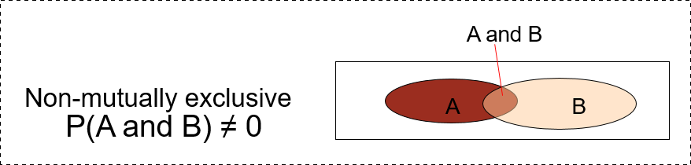
Chapter
03
Non-Mutually Exclusive Events
If two events can occur in the same trial, they are NOT mutually exclusive.
A = A person is under 25 years old
B = A person is a lawyer
A = A person was born in Philadelphia
B = A person watches “Jeopardy” on TV

Slide 24
Chapter
03
Section 3.3: The Additive Rule
The probability that one or the other of two events will occur is: P(A) + P(B) – P(A and B)
A card is drawn from a deck. Find the probability it is a king or it is red.

Slide 25
Chapter
03
The Additive Rule
The probability that one or the other of two events will occur is: P(A) + P(B) – P(A and B)
A card is drawn from a deck. Find the probability it is a king or it is red.
A = the card is a king
B = the card is red.
P(A) = 4/52 and P(B) = 26/52
but P(A and B) = 2/52
P(A or B) = 4/52 + 26/52 – 2/52
= 28/52 = 0.538

Slide 26
Chapter
03
The Additive Rule
A blood bank catalogs the types of blood given by donors during the last five days. A donor is selected at random.
1- Find the probability the donor has type O or type A blood.
2- Find the probability the donor has type B or is Rh-negative
 | Type O | Type A | Type B | Type AB | Total
Rh-Positive | 156 | 139 | 37 | 12 | 344
Rh-Negative | 28 | 25 | 8 | 4 | 65
Total | 184 | 164 | 45 | 16 | 409

Slide 27
Chapter
03
The Additive Rule
1- Find the probability the donor has type O or type A blood.
The events are mutually exclusive (a donor cannot have type O blood and type A blood)
 | Type O | Type A | Type B | Type AB | Total
Rh-Positive | 156 | 139 | 37 | 12 | 344
Rh-Negative | 28 | 25 | 8 | 4 | 65
Total | 184 | 164 | 45 | 16 | 409

Slide 28
Chapter
03
The Additive Rule
2- Find the probability the donor has type B or is Rh-negative
 | Type O | Type A | Type B | Type AB | Total
Rh-Positive | 156 | 139 | 37 | 12 | 344
Rh-Negative | 28 | 25 | 8 | 4 | 65
Total | 184 | 164 | 45 | 16 | 409

Slide 29
Chapter
03
3. 4 Additional Topics in Probability and Counting
1- Permutation
2- Combination

Slide 30
Chapter
03
Permutation
Permutation of n objects taken r at a time
The number of different permutations of n distinct objects taken r at a time
where r ≤ n

Slide 31
Chapter
03
Permutation
Find the number of ways of forming three-digit codes from 10 numbers in which no digit is repeated.
Solution

Slide 32
Chapter
03
Combination
Combination of n objects taken r at a time
A selection of r objects from a group of n objects without regard to order

Slide 33
Chapter
03
Combination
A state’s department of transportation plans to develop a new section of interstate highway and receives 16 bids for the project. The state plans to hire four of the bidding companies. How many different combinations of four companies can be selected from the 16 bidding companies?
Solution:
n = 16, r = 4
Order is not important

Slide 34
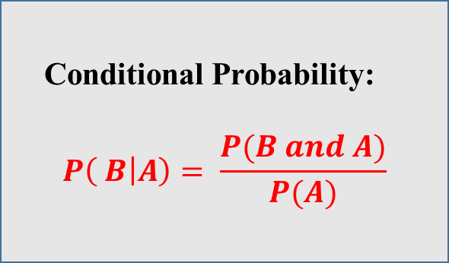
Chapter
03
Chapter Summary
Conditional Probability:
$$P\left( B | A\right)= \frac{P(B and A)}{P(A)}$$
Additional Topics in Probability and Counting
1- Permutation
2- Combination
Basic Concepts of Probability and Counting
Multiplication Rule: ( and )
P(A and B) = P(A) x P(B|A)
The Addition Rule: (or)
P(A or B) = P(A) + P(B) – P(A and B)

