Slide 1


Information Security Operations Center
(Info SOC)
Lecture 2
The Features and Characteristics of
the Linux Operating System
Prepared by
Dr. Ibrahim Gomaa

Slide 2

Lecture
Contents
2
Topic Title | Topic Objective
Linux Basics | Explain why Linux skills are essential for network security monitoring and investigation.
Working in the Linux Shell | Use the Linux shell to manipulate text files.
Linux Servers and Clients | Explain how client-server networks function.
Basic Server Administration | Explain how a Linux administrator locates and manipulates security log files.
The Linux File System | Manage the Linux file system and permissions.
Working in the Linux GUI | Explain the basic components of the Linux GUI.
Working on a Linux Host | Use tools to detect malware on a Linux host.
Information Security Operations Center
Lecture 2
Dr. Ibrahim Gomaa

Slide 3

Lecture
The features and characteristics of
the Linux Operating System
2
What is Linux?
Linux is an operating system that was created in 1991.
Linux is open source, fast, reliable, and small. It requires very little hardware resources to run and is highly customizable.
Linux is part of several platforms and can be found on
devices anywhere from wristwatches to supercomputers.
Linux is designed to be connected to the network, which makes it much simpler to write and use network-based applications.
A Linux distribution is the term used to describe packages created by different organizations and include the Linux kernel with customized tools and software packages.
Information Security Operations Center
Lecture 2
Dr. Ibrahim Gomaa

Slide 4
Lecture
The features and characteristics of
the Linux Operating System
2
The Value of Linux
Linux is often the operating system of choice in the Security Operations Center (SOC). These are some of the reasons to choose Linux:
Linux is open source - Any person can acquire Linux at no charge and modify it to fit specific needs.
The Linux CLI is very powerful - The Linux Command Line Interface (CLI) is extremely powerful and enables analysts to perform tasks not only directly on a terminal, but also remotely.
The user has more control over the OS - The administrator user in Linux, known as the root user, or superuser, can modify any aspect of the computer with a few keystrokes.
It allows for better network communication control - Control is an inherent part of Linux.
Information Security Operations Center
Lecture 2
Dr. Ibrahim Gomaa

Slide 5
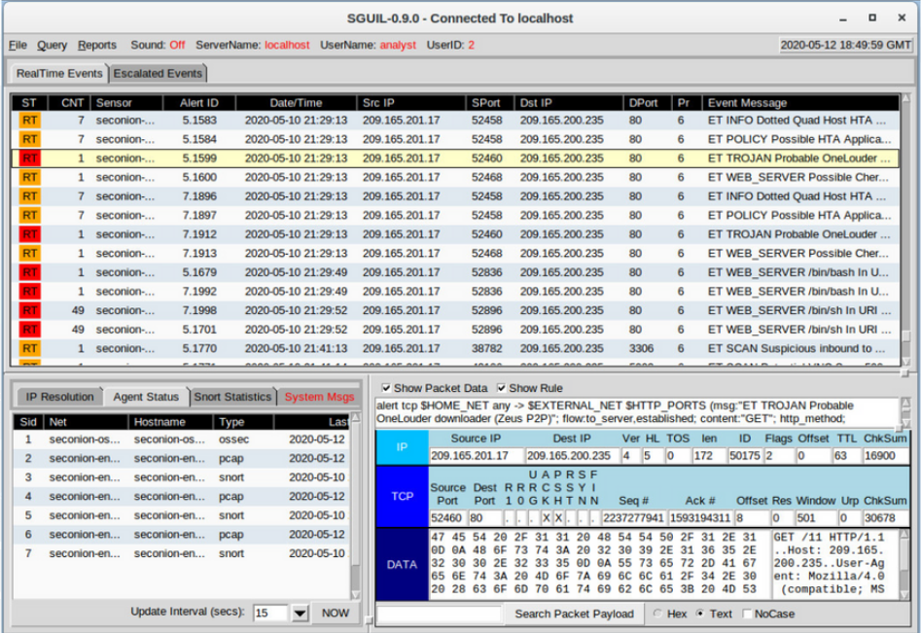
Lecture
The features and characteristics of
the Linux Operating System
2
Linux in the SOC
The flexibility provided by Linux is a
great feature for the SOC. The entire
operating system can be tailored to
become the perfect security analysis
platform.
Sguil is the cybersecurity analyst console in a special version of Linux called Security Onion.
Security Onion is an open source
suite of tools that work together for
network security analysis.
Information Security Operations Center
Lecture 2
Dr. Ibrahim Gomaa

Slide 6
Lecture
The features and characteristics of
the Linux Operating System
2
Linux in the SOC (Contd.)
The following table lists a few tools that are often found in a SOC:
SOC Tool | Description
Network packet capture software | A crucial tool for a SOC analyst as it makes it possible to observe and understand every detail of a network transaction. Wireshark is a popular packet capture tool.
Malware analysis tools | These tools allow analysts to safely run and observe malware execution without the risk of compromising the underlying system.
Intrusion detection systems (IDSs) | These tools are used for real-time traffic monitoring and inspection. If any aspect of the currently flowing traffic matches any of the established rules, a pre-defined action is taken.
Information Security Operations Center
Lecture 2
Dr. Ibrahim Gomaa

Slide 7
Lecture
The features and characteristics of
the Linux Operating System
2
Linux in the SOC (Contd.)
SOC Tool | Description
Firewalls | This software is used to specify, based on pre-defined rules, whether traffic is allowed to enter or leave a network or device.
Log managers | Log files are used to record events. Because a network can generate a very large number of log entries, log manager software is employed to facilitate log monitoring.
Security information and event management (SIEM) | SIEMs provide real-time analysis of alerts and log entries generated by network appliances such as IDSs and firewalls.
Ticketing systems | Task ticket assignment, editing, and recording is done through a ticket management system. Security alerts are often assigned to analysts through a ticketing system.
Information Security Operations Center
Lecture 2
Dr. Ibrahim Gomaa

Slide 8
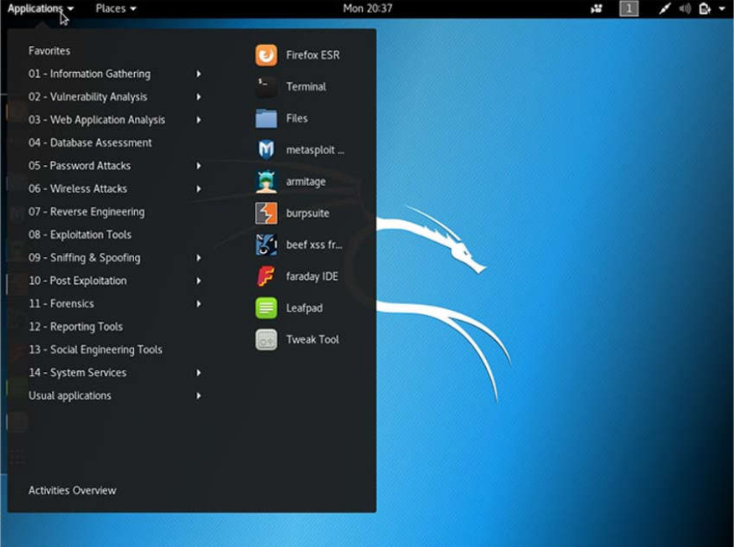
Lecture
The features and characteristics of
the Linux Operating System
2
Linux Tools
Linux computers that are used in the SOC often contain penetration testing tools.
A penetration test, also known as PenTesting, is the process of looking for vulnerabilities in a network or computer by attacking it.
Packet generators, port scanners, and proof-of-concept exploits are examples of PenTesting tools.
Kali Linux is a Linux distribution which contains many penetration tools together in a single Linux distribution.
Notice all the major categories of penetration testing tools of Kali Linux.
Information Security Operations Center
Lecture 2
Dr. Ibrahim Gomaa

Slide 9
Lecture
Working in the Linux Shell
2
The Linux Shell
In Linux, the user communicates with the OS by using the CLI or the GUI.
Linux often starts in the GUI by default. This hides the CLI from the user.
One way to access the CLI from the GUI is through a terminal emulator application. These applications provide user access to the CLI and are named as some variation of the word terminal.
In Linux, popular terminal emulators are Terminator, eterm, xterm, konsole, and gnome-terminal.
Fabrice Bellard has created JSLinux which allows an emulated version of Linux to run in a browser.
Note: The terms shell, console, console window, CLI terminal, and terminal window are often used interchangeably.
Information Security Operations Center
Lecture 2
Dr. Ibrahim Gomaa

Slide 10
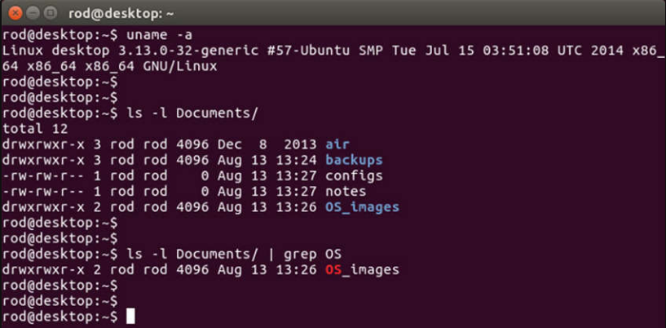
Lecture
Working in the Linux Shell
2
The Linux Shell (Contd.)
The figure shows gnome-terminal, a popular Linux terminal emulator.
Information Security Operations Center
Lecture 2
Dr. Ibrahim Gomaa

Slide 11
Lecture
Working in the Linux Shell
2
Basic Commands
Linux commands are programs created to perform a specific task.
As the commands are programs stored on the disk, when a user types a command, the shell must find it on the disk before it can be executed.
The following table lists basic Linux commands and their functions:
Command | Description
mv | Moves or renames files and directories.
chmod | Modifies file permissions.
chown | Changes the ownership of a file.
dd | Copies data from an input to an output.
pwd | Displays the name of the current directory.
ps | Lists the processes that are currently running in the system.
su | Simulates a login as another user or to become a superuser.
Information Security Operations Center
Lecture 2
Dr. Ibrahim Gomaa

Slide 12
Lecture
Working in the Linux Shell
2
Basic Commands (Contd.)
Command | Description
sudo | Runs a command as a super user, by default, or another named user.
grep | Used to search for specific strings of characters within a file or other command outputs.
ifconfig | Used to display or configure network card related information.
apt-get | Used to install, configure and remove packages on Debian and its derivatives.
iwconfig | Used to display or configure wireless network card related information.
shutdown | Shuts down the system and performs shut down related tasks including restart, halt, put to sleep or kick out all currently connected users.
passwd | Used to change the password.
cat | Used to list the contents of a file and expects the file name as the parameter.
man | Used to display the documentation for a specific command.
Information Security Operations Center
Lecture 2
Dr. Ibrahim Gomaa

Slide 13
Lecture
Working in the Linux Shell
2
File and Directory Commands
Many command line tools are included in Linux by default. The following table lists a few of the most common commands related to files and directories:
Command | Description
Is | Displays the files inside a directory.
cd | Changes the current directory.
mkdir | Creates a directory under the current directory.
cp | Copies files from source to destination.
mv | Moves files to a different directory.
rm | Removes files.
grep | Searches for specific strings of characters within a file or other commands outputs.
cat | Lists the contents of a file and expects the file name as the parameter.
Information Security Operations Center
Lecture 2
Dr. Ibrahim Gomaa

Slide 14
Lecture
Working in the Linux Shell
2
Working with text files
Linux has many different text editors, with various features and functions.
Some text editors include graphical interfaces while others are command-line only tools. Each text editor includes a feature set designed to support a specific type of task.
Some text editors focus on the programmer and include features such as syntax highlighting, parenthesis check, and other programming-focused features.
While graphical text editors are convenient and easy to use, command line-based text editors are very important for Linux users. The main benefit of command-line-based text editors is that they allow for text file editing from a remote computer.
Information Security Operations Center
Lecture 2
Dr. Ibrahim Gomaa

Slide 15
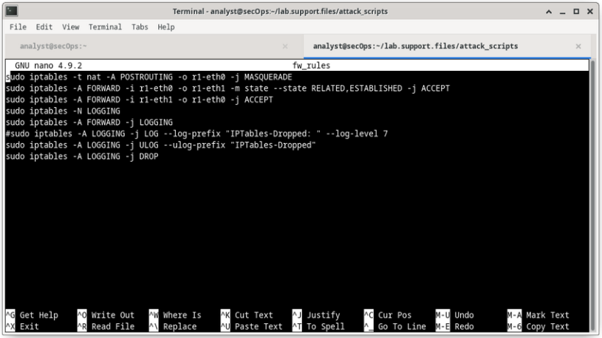
Lecture
Working in the Linux Shell
2
Working with text files (Contd.)
The figure shows nano, a popular command-line text editor.
The administrator is editing firewall rules. Text editors are often used for system configuration and maintenance in Linux.
Due to the lack of graphical support, nano (or GNU nano) can only be controlled with the keyboard.
Information Security Operations Center
Lecture 2
Dr. Ibrahim Gomaa

Slide 16
Lecture
Working in the Linux Shell
2
The importance of text files in Linux
In Linux, everything is treated as a file. This includes the memory, the disks, the monitor, and the directories.
Configuration files are text files which are used to store adjustments and settings for specific applications or services.
Users with proper permission levels can use text editors to change the contents of configuration files.
After the changes are made, the file is saved and can be used by the related service or application. Users are able to specify exactly how they want any given application or service to behave. When launched, services and applications check the contents of specific configuration files to adjust their behavior accordingly.
Note: The administrator used the command sudo nano /etc/hosts to open the file. The command sudo (short for “superuser do”) invokes the superuser privilege to use the nano text editor to open the host file.
Information Security Operations Center
Lecture 2
Dr. Ibrahim Gomaa

Slide 17
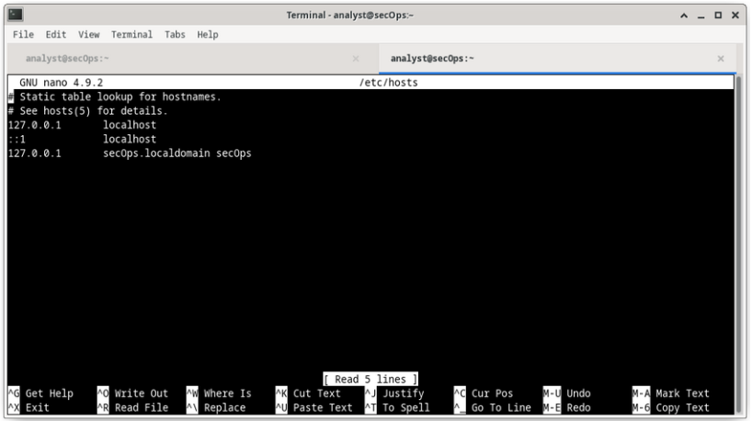
Lecture
Working in the Linux Shell
2
The importance of text files in Linux (Contd.)
In the figure, the administrator opened the host configuration file in nano for editing.
The host file contains static mappings of host IP addresses to names.
The names serve as shortcuts that allow connecting to other devices by using a name instead of an IP address. Only the superuser can change the host file.
Information Security Operations Center
Lecture 2
Dr. Ibrahim Gomaa

Slide 18
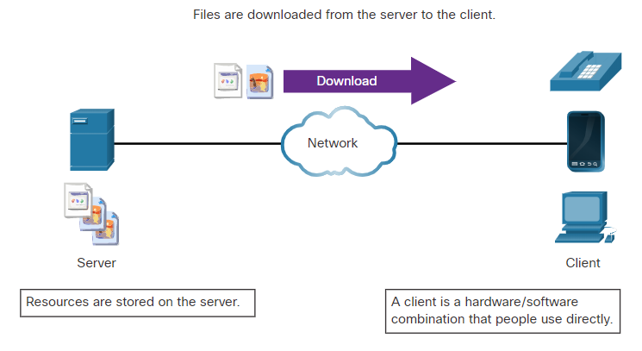
Lecture
Linux Servers and Clients
2
An Introduction to Client-Server Communications
Servers are computers with software installed that enables them to provide services to clients across the network.
Some provide external resources such as files, email messages, or web pages to clients upon request.
Other services run maintenance tasks such as log management, disk scanning and so on.
Each service requires separate server software.
The server in the figure uses file server software to provide clients with the ability to retrieve and submit files.
Information Security Operations Center
Lecture 2
Dr. Ibrahim Gomaa

Slide 19
Lecture
Linux Servers and Clients
2
Servers, Services, and Their Ports
A port is a reserved network resource used by a service.
While the administrator can decide which port to use with any given service, many clients are configured to use a specific port by default.
The following table lists a few commonly used ports and their services. These are also called as well-known ports.
Port | Description
20/21 | File Transfer Protocol (FTP)
22 | Secure Shell (SSH)
23 | Telnet remote login service
25 | Simple Mail Transfer Protocol (SMTP)
53 | Domain Name System (DNS)
67/68 | Dynamic Host Configuration Protocol (DHCP)
Information Security Operations Center
Lecture 2
Dr. Ibrahim Gomaa

Slide 20
Lecture
Linux Servers and Clients
2
Servers, Services, and Their Ports (Contd.)
Port | Description
69 | Trivial File Transfer Protocol (TFTP)
80 | Hypertext Transfer Protocol (HTTP)
110 | Post Office Protocol version 3 (POP3)
123 | Network Time Protocol (NTP)
143 | Internet Message Access Protocol (IMAP)
161/162 | Simple Network Management Protocol (SNMP)
443 | HTTP Secure (HTTPS)
Information Security Operations Center
Lecture 2
Dr. Ibrahim Gomaa

Slide 21
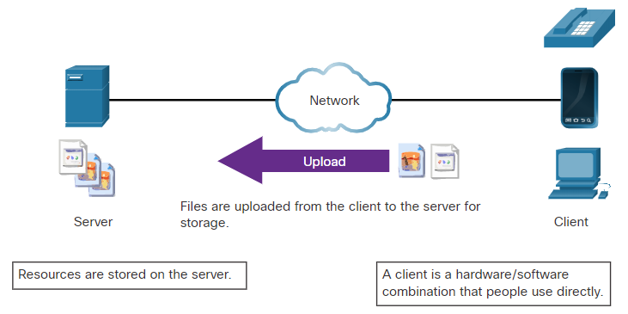
Lecture
Linux Servers and Clients
2
Clients
Clients are programs or applications designed to communicate with a specific type of server.
Clients use a well-defined protocol to communicate with the server.
Web browsers are web clients that are used to communicate with web servers through the Hyper Text Transfer Protocol on port 80.
The File Transfer Protocol client is software used to communicate with an FTP server.
The figure shows a client uploading files to a server.
Information Security Operations Center
Lecture 2
Dr. Ibrahim Gomaa

Slide 22
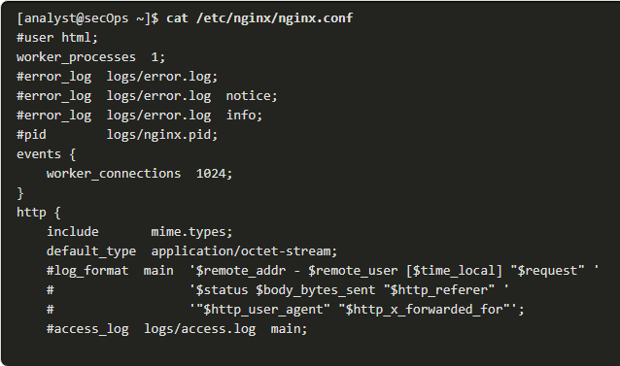
Lecture
Basic Server Administration
2
Service Configuration Files
In Linux, services are managed using configuration files.
Common options in configuration files are port number, location of the hosted resources, and client authorization details.
When the service starts, it looks for its configuration files, loads them into memory, and adjusts itself according to the settings in the files.
The command output shows a portion of the configuration file for Nginx, which is a lightweight web server for Linux.
Information Security Operations Center
Lecture 2
Dr. Ibrahim Gomaa

Slide 23
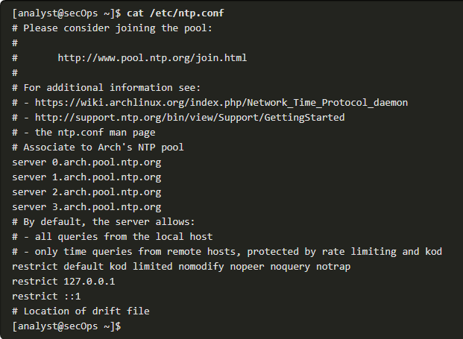
Lecture
Basic Server Administration
2
Service Configuration Files (Contd.)
The command output shows the configuration file for the network time protocol (NTP).
Information Security Operations Center
Lecture 2
Dr. Ibrahim Gomaa

Slide 24
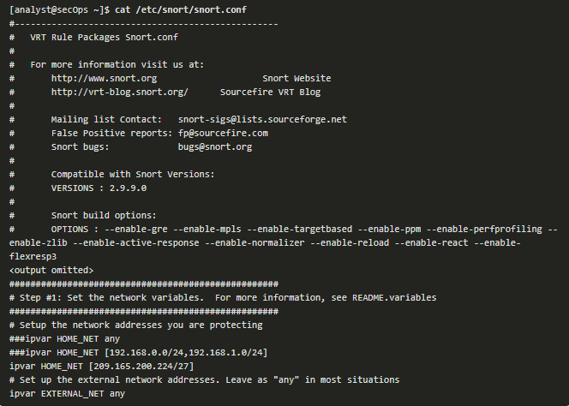
Lecture
Basic Server Administration
2
Service Configuration Files (Contd.)
The command output shows the configuration file for Snort, a Linux-based intrusion detection system (IDS).
There is no rule for a configuration file format. It is the choice of the service’s developer. However, the option = value format is often used.
Information Security Operations Center
Lecture 2
Dr. Ibrahim Gomaa

Slide 25
Lecture
Basic Server Administration
2
Hardening Devices
Device hardening involves implementing proven methods of securing the device and protecting its administrative access.
Some of these methods involve maintaining passwords, configuring enhanced remote login features, and implementing secure login with SSH.
Depending on the Linux distribution, many services are enabled by default. Stopping such services and ensuring they do not automatically start at boot time is another device hardening technique.
OS updates are extremely important to maintaining a hardened device. OS developers create and issue fixes and patches regularly.
Information Security Operations Center
Lecture 2
Dr. Ibrahim Gomaa

Slide 26
Lecture
Basic Server Administration
2
Hardening Devices (Contd.)
The following are basic best practices for device hardening:
Ensure physical security
Minimize installed packages
Disable unused services
Use SSH and disable the root account login over SSH
Keep the system updated
Disable USB auto-detection
Enforce strong passwords
Force periodic password changes
Keep users from re-using old passwords
Information Security Operations Center
Lecture 2
Dr. Ibrahim Gomaa

Slide 27
Lecture
The Linux File System
2
Linux Roles and File Permissions
Linux uses file permissions to organize the system and enforce boundaries within the computer.
Every file in Linux carries its file permissions, which define the actions that the owner, the group, and others can perform with the file.
The possible permission rights are Read, Write, and Execute.
The ls command with the -l parameter lists additional information about the file.
Information Security Operations Center
Lecture 2
Dr. Ibrahim Gomaa

Slide 28

Lecture
The Linux File System
2
Linux Roles and File Permissions (Contd.)
The output of the ls -l command provides a lot of information about the file space.txt:
The first field displays the permissions with space.txt (-rwxrw-r--).
The second field defines the number of hard links to the file (number 1 after the permissions).
The third and fourth field display the user (analyst) and group (staff) who own the file, respectively.
The fifth field displays the file size in bytes. The space.txt file has 253 bytes.
The sixth field displays the date and time of the last modification.
The seventh field displays the file name.
Information Security Operations Center
Lecture 2
Dr. Ibrahim Gomaa

Slide 29
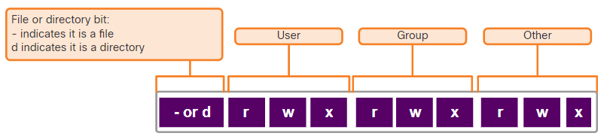
Lecture
The Linux File System
2
Linux Roles and File Permissions (Contd.)
The figure here shows a breakdown of file permissions in Linux. The file space.txt has the following permissions:
The dash (-) means that this is a file.
The first set of characters (rwx) is for user permission. The user (analyst) who owns the file can Read, Write and eXecute the file.
The second set of characters is for group permissions (rw-). The group (staff) who owns the file can Read and Write to the file.
The third set of characters is for any other user or
group permissions (r--) who can only Read the file.
Information Security Operations Center
Lecture 2
Dr. Ibrahim Gomaa

Slide 30
Lecture
The Linux File System
2
Linux Roles and File Permissions (Contd.)
Octal values are used to define permissions.
File permissions are a fundamental part of Linux and cannot be broken.
The only user that can override file permission on a Linux computer is the root user.
Binary | Octal | Permission | Description
000 | 0 | --- | No access
001 | 1 | --x | Execute only
010 | 2 | -w- | Write only
011 | 3 | -wx | Write and Execute
100 | 4 | r-- | Read only
101 | 5 | r-x | Read and Execute
110 | 6 | rw- | Read and Write
111 | 7 | rwx | Read, Write and Execute
Information Security Operations Center
Lecture 2
Dr. Ibrahim Gomaa

Slide 31
Lecture
Working with the Linux GUI
2
X Window System
The graphical interface present in most Linux computers is based on the X Window System.
X Window, also known as X or X11, is a windowing system designed to provide the basic framework for a GUI.
X includes functions for drawing and moving windows on the display device and interacting with a mouse and keyboard.
X works as a server, which allows a remote user to use the network to connect, start a graphical application, and have the graphical window open on the remote terminal.
X does not specify the user interface, leaving it to other programs, such as window managers, to define all the graphical components.
Information Security Operations Center
Lecture 2
Dr. Ibrahim Gomaa

Slide 32
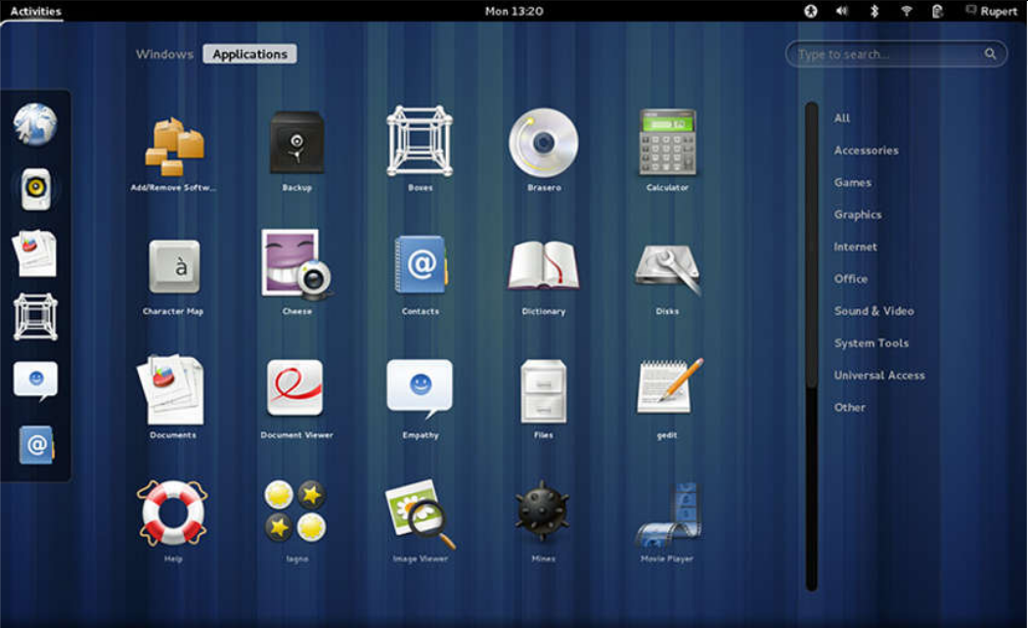
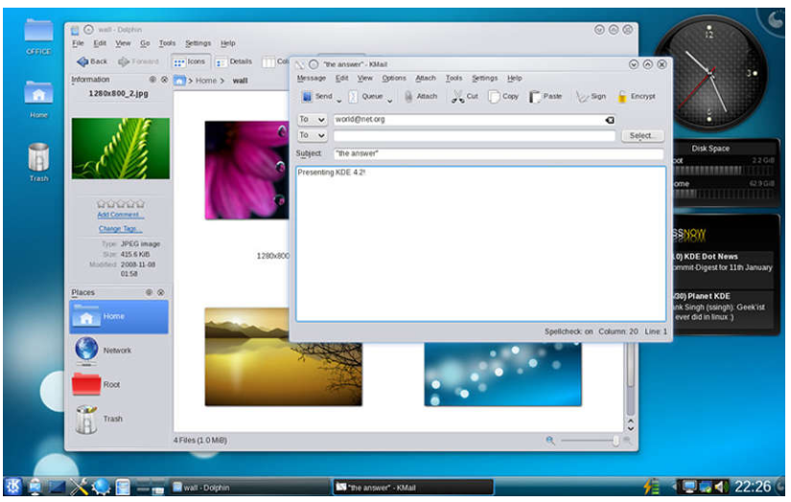
Lecture
Working with the Linux GUI
2
X Window System (Contd.)
Examples of window managers are Gnome and KDE.
The Gnome Window Manager
The KDE Window Manager
Information Security Operations Center
Lecture 2
Dr. Ibrahim Gomaa

Slide 33
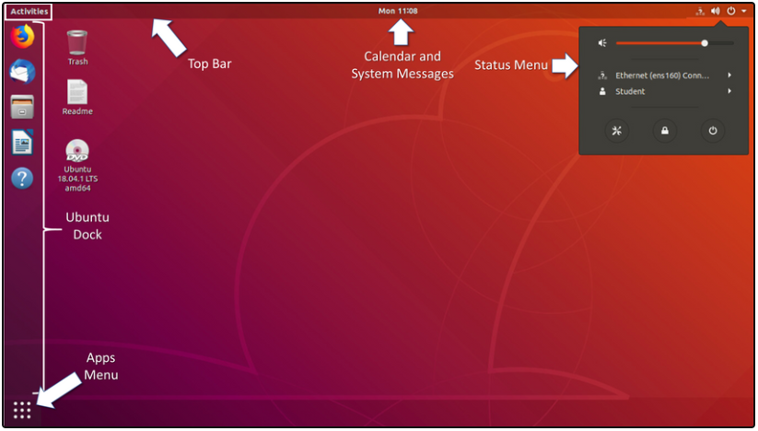
Lecture
Working with the Linux GUI
2
The Linux GUI
While an operating system does not require a GUI to function, GUIs are considered more user-friendly than the CLI. The Linux GUI can be easily replaced by the user.
Ubuntu is a very popular and user-friendly Linux distribution.
Ubuntu Linux uses Gnome 3 as its default GUI.
The figure shows the location of some of the features of the Ubuntu Gnome 3 Desktop.
Information Security Operations Center
Lecture 2
Dr. Ibrahim Gomaa

Slide 34
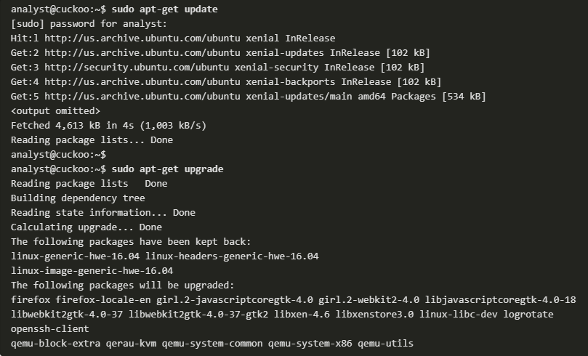
Lecture
Working on a Linux Host
2
Installing and Running Applications on a Linux Host
Many end-user applications are complex programs written in compiled languages.
To aid in the installation process, Linux includes programs called package managers.
By using a package manager to install a package, all the necessary files are placed in the correct file system location.
A package is the term used to refer to a program and all its supporting files.
The command output shows the output of a few apt-get commands used in Debian distributions.
Information Security Operations Center
Lecture 2
Dr. Ibrahim Gomaa

Slide 35
Lecture
Working on a Linux Host
2
Keeping the System Up to Date
OS updates, also known as patches, are released periodically by OS companies to address any known vulnerabilities in their operating systems.
Modern operating systems will alert the user when updates are available for download and installation, but the user can check for updates at any time.
The following table compares Arch Linux and Debian/Ubuntu Linux distribution commands to perform package system basic operations.
Task | Arch | Debian/Ubuntu
Install a package by name | pacman -S | apt install
Remove a package by name | pacman -Rs | apt remove
Update a local package | pacman -Syy | apt-get update
Upgrade all currently installed packages | pacman -Syu | apt-get upgrade
Information Security Operations Center
Lecture 2
Dr. Ibrahim Gomaa

Slide 36
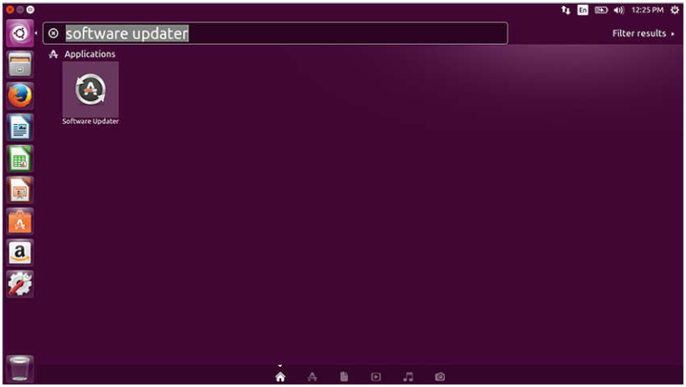
Lecture
Working on a Linux Host
2
Keeping the System Up to Date (Contd.)
A Linux GUI can also be used to manually check and install updates.
In Ubuntu for example, to install updates you would click Dash Search Box, type software updater, and then click the Software Updater icon.
Information Security Operations Center
Lecture 2
Dr. Ibrahim Gomaa

Slide 37
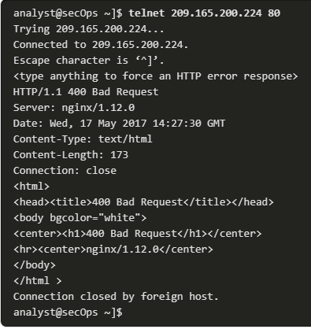
Lecture
Working on a Linux Host
2
Malware on a Linux Host
Linux malware includes viruses, Trojan horses, worms, and other types of malware that can affect the operating system.
A common Linux attack vector is its services and processes.
The command output shows an attacker using the Telnet command to probe the nature and version of a web server (port 80).
The attacker has learned that the server is running nginx version 1.12.0. The next step would be to research known vulnerabilities in the nginx 1.12.0 code.
Information Security Operations Center
Lecture 2
Dr. Ibrahim Gomaa

Slide 38
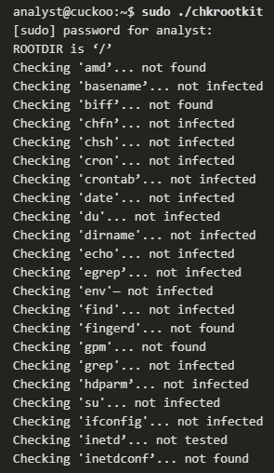
Lecture
Working on a Linux Host
2
Rootkit Check
A rootkit is a type of malware designed to increase an unauthorized user’s privileges or grant access to portions of the software that should not normally be allowed.
A rootkit is destructive as it changes kernel code and its modules, changing the most fundamental operations of the OS itself.
Rootkit detection methods include booting the computer from a trusted media.
Rootkit removal can be complicated. Re-installation of the operating system is the only real solution to the problem.
chkrootkit is a popular Linux-based program designed to check the computer for known rootkits.
The command output shows the output of chkrootkit on an Ubuntu Linux.
Information Security Operations Center
Lecture 2
Dr. Ibrahim Gomaa

Slide 39
Lecture
2
Thanks
Information Security Operations Center
Lecture 2
Dr. Ibrahim Gomaa

