Slide 1


College of Management
Business Ethics
Lecturer: Dr. Raef Baraka
PMG 750
Lecture 01

Slide 2

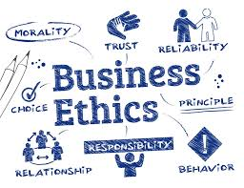
Chapter 1: THE IMPORTANCE OF BUSINESS ETHICS
CHAPTER OBJECTIVES:
Explore conceptualizations of business ethics from an organizational perspective.
Examine the historical foundations and evolution of business ethics.
Provide evidence that ethical value systems support business performance.
Gain insight into the extent of ethical misconduct in the workplace and the pressures for unethical behavior.

Slide 3
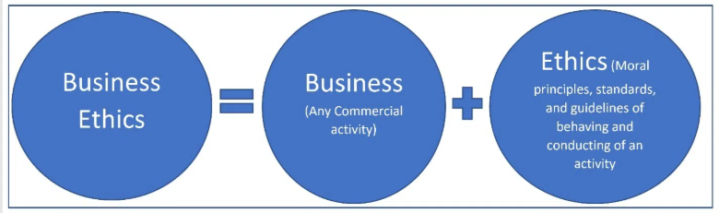
THE IMPORTANCE OF BUSINESS ETHICS
Business Ethics Defined
Ethics is defined as behavior or decisions made within a group’s values.

Slide 4
THE IMPORTANCE OF BUSINESS ETHICS
Business Ethics Defined
To understand business ethics, you must first recognize that most people do not have specific definitions they use to define ethics-related issues. The terms morals, principles, values, and ethics are often used interchangeably, and you will find this is true in companies as well.
Morals refer to a person’s personal philosophies about what is right or wrong.
The important point is that when one speaks of morals, it is personal or singular.
Morals, your philosophies, or sets of values of right and wrong, relate to you and you alone.
You may use your personal moral convictions in making ethical decisions in any context.

Slide 5
THE IMPORTANCE OF BUSINESS ETHICS
Business Ethics Defined
Principles are specific and pervasive boundaries for behavior that should not be violated. Principles often become the basis for rules.
Some examples of principles could include human rights, freedom of speech, and the fundamentals of justice.
Values are enduring beliefs and ideals that are socially enforced.
Several desirable or ethical values for business today are teamwork, trust, and integrity, which are often based on organizational or industry best practices.
Investors, employees, customers, interest groups, the legal system, and the community often determine whether a specific action or standard is ethical or unethical.

Slide 6
THE IMPORTANCE OF BUSINESS ETHICS
Business Ethics Defined
Ethics is defined as behavior or decisions made within a group’s values.
In our case, we are discussing decisions made in business by groups of people that represent the business organization.
Business ethics comprises organizational principles, values, and norms that may originate from individuals, organizational statements, or the legal system that primarily guide individual and group behavior in business.
The important concept in business ethics is that right and wrong behavior is defined by the group, which might be a company or an industry.

Slide 7
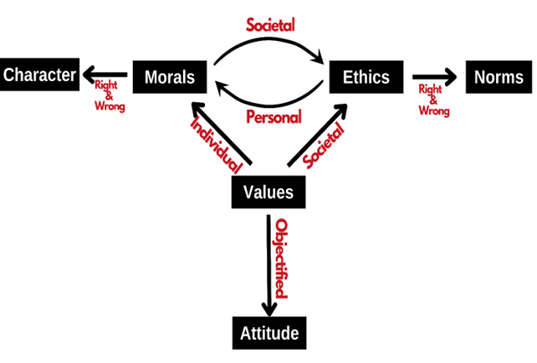
THE IMPORTANCE OF BUSINESS ETHICS
Business Ethics Defined

Slide 8

THE IMPORTANCE OF BUSINESS ETHICS
WHY STUDY BUSINESS ETHICS?
Decreased trust leads to a reduction in customer satisfaction and customer loyalty, which in turn can negatively impact the firm or industry

Slide 9
THE IMPORTANCE OF BUSINESS ETHICS
Why Study Business Ethics?
Several ethical issues must be addressed to prevent misconduct.
Misuse of company resources, abusive behavior, harassment, accounting fraud, conflicts of interest, defective products, bribery, product knockoffs, and employee theft are all identified as potential risk areas.
Whether they are made in the realm of business, politics, science, or sports, most decisions are judged as right or wrong, ethical or unethical.
Regardless of what an individual believes about a particular action, if society judges it to be unethical or wrong, new legislation usually follows.
Whether correct or not, that judgment directly affects a company’s ability to achieve its business goals.

Slide 10
THE IMPORTANCE OF BUSINESS ETHICS
Why Study Business Ethics?
Several ethical issues must be addressed to prevent misconduct.
These double standards are at least partly due to differences in wealth and the success between businesses and consumers.
The more successful a company, the more the public is critical when misconduct occurs.
For this reason alone, it is important to understand business ethics and recognize ethical issues

Slide 11
THE IMPORTANCE OF BUSINESS ETHICS
Why Study Business Ethics?
Business ethics decisions and activities have come under greater scrutiny by many different stakeholders, including consumers, employees, investors, government regulators, and special interest groups..
The next figure shows the percentage of global respondents who say they trust a variety of businesses in various industries.
Financial services have some of the lowest ratings, indicating that the financial sector has not been able to restore its reputation since the most recent recession.
There is no doubt that negative publicity associated with major misconduct lowered the public’s trust in certain business sectors.

Slide 12
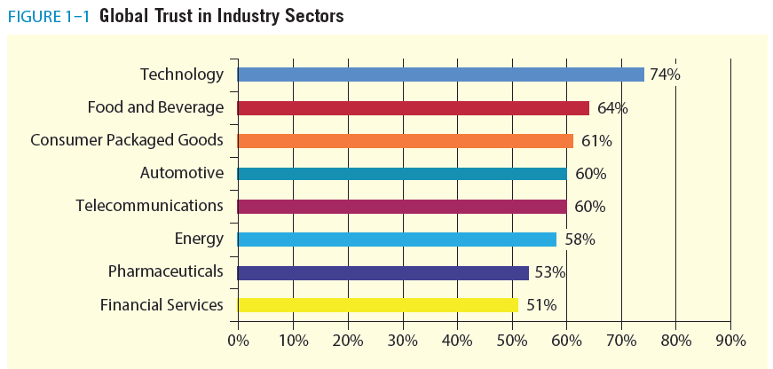
THE IMPORTANCE OF BUSINESS ETHICS
Why Study Business Ethics?

Slide 13
THE IMPORTANCE OF BUSINESS ETHICS
Why Study Business Ethics?
Workplace integrity is the pressure to compromise organizational standards, observed misconduct, reporting of misconduct when observed, and retaliation against reports.
The next table provides an overview of observed misconduct in the United States. While observed misconduct was 30 percent in the United States, it was 33 percent globally.
Globally, 73 percent of employees who felt pressure also witnessed misconduct.

Slide 14
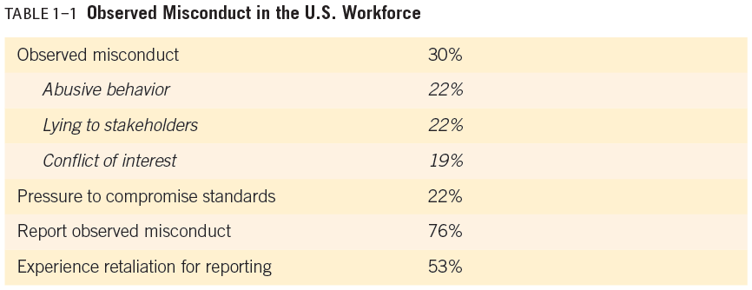
THE IMPORTANCE OF BUSINESS ETHICS
Why Study Business Ethics?

Slide 15
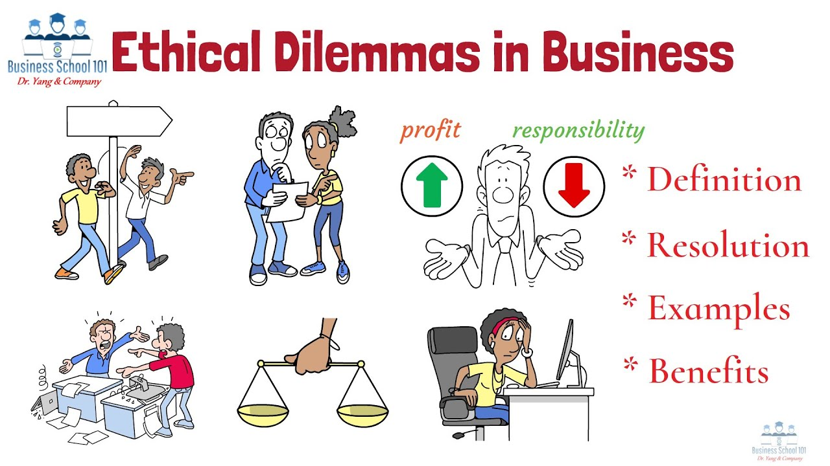
THE IMPORTANCE OF BUSINESS ETHICS
WHY STUDY BUSINESS ETHICS?

Slide 16
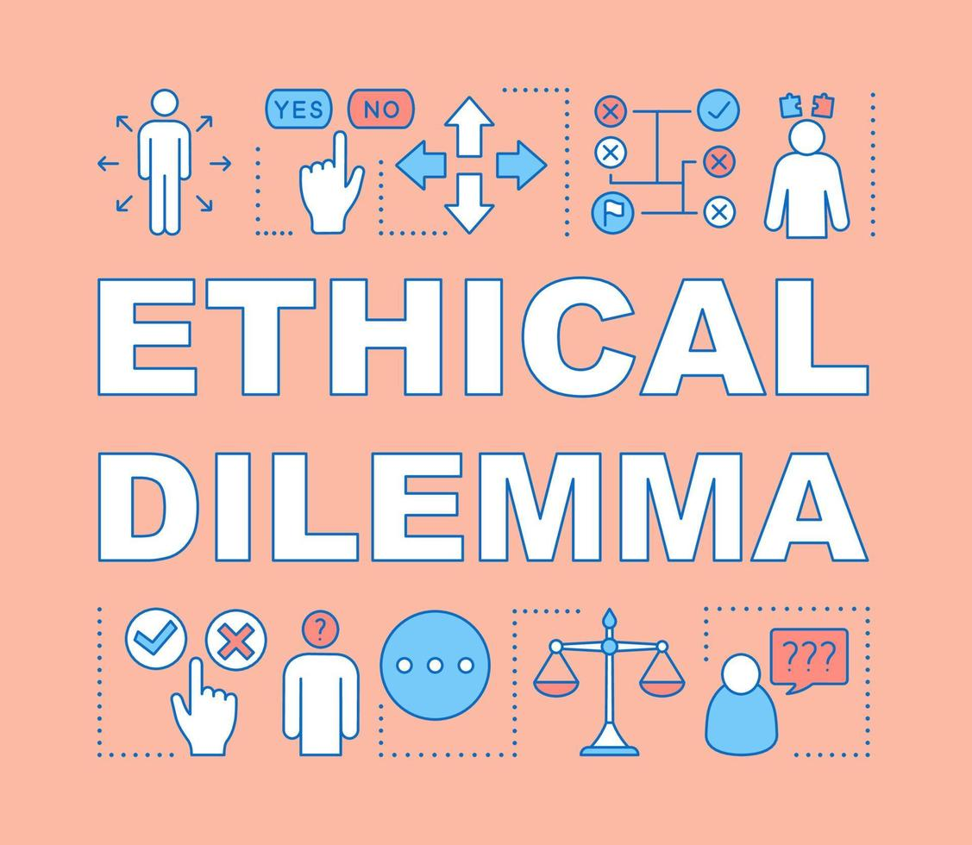
THE IMPORTANCE OF BUSINESS ETHICS
Why Study Business Ethics?
A moral dilemma is defined as a situation where a person is faced with multiple choices, all of which are undesirable as defined by the person.
A value dilemma is the same, only that the individual’s beliefs are grounded in societal norms.

Slide 17
THE IMPORTANCE OF BUSINESS ETHICS
Why Study Business Ethics?
Professionals in any field, including business, must deal with individuals’ personal moral dilemmas because such dilemmas affect everyone’s ability to function on the job.
Normally, a business does not dictate a person’s morals. Such policies would be illegal. Only when a person’s morals influence his or her performance on the job does it involve a dimension within business ethics.
Just being a good person and having sound personal values may not be sufficient to handle the ethical issues that arise in a business organization.
Although truthfulness, honesty, fairness, and openness are often assumed to be self-evident and accepted, business-strategy decisions involve complex and detailed discussions.

Slide 18
THE IMPORTANCE OF BUSINESS ETHICS
Why Study Business Ethics?
Some approaches to business ethics assume ethics training is for people whose personal moral development is unacceptable, but that is not the case.
Because organizations are culturally diverse and personal morals must be respected, ensuring collective agreement on organizational ethics (that is, codes reasonably capable of preventing misconduct) is as vital as any other effort an organization’s management may undertake.
Failure to establish shared values and ethics codes will result in a wide range of conduct when faced with the same ethical issues.

Slide 19
THE IMPORTANCE OF BUSINESS ETHICS
Why Study Business Ethics?
Many people with limited business experience suddenly find themselves making decisions about product quality, advertising, pricing, sales techniques, hiring practices, and pollution control.
The morals they learned from family, religion, and school may not provide specific guidelines for these complex business decisions. In other words, a person’s experiences and decisions at home, in school, and the community may be quite different from his or her experiences and decisions at work.
Many business ethics decisions are close calls. In addition to managerial responsibility and ethical leadership for the conduct of others requires knowledge of ethics and compliance processes, and systems.

Slide 20
THE IMPORTANCE OF BUSINESS ETHICS
Why Study Business Ethics?
Studying business ethics will help you begin to identify ethical issues when they arise and recognize the approaches available for resolving them.
You will learn more about the ethical decision-making process and about ways to promote ethical behavior within your organization.
By studying business ethics, you may also begin to understand how to cope with conflicts between your own personal values and those of the organization in which you work.
As mentioned earlier, if, after reading this book, you feel a little more unsettled about potential decisions in business, your decisions will be more ethical, and you will have knowledge within this area.

Slide 21
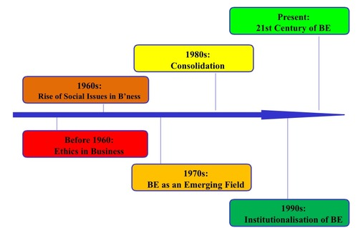
THE IMPORTANCE OF BUSINESS ETHICS
THE DEVELOPMENT OF BUSINESS ETHICS

Slide 22
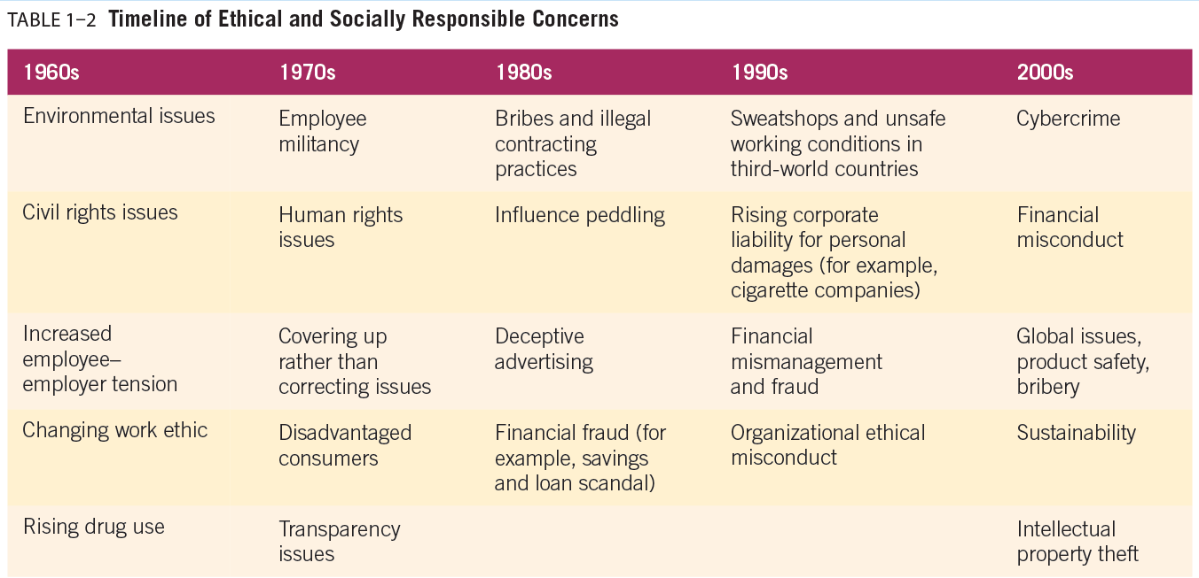
THE IMPORTANCE OF BUSINESS ETHICS
THE DEVELOPMENT OF BUSINESS ETHICS

Slide 23
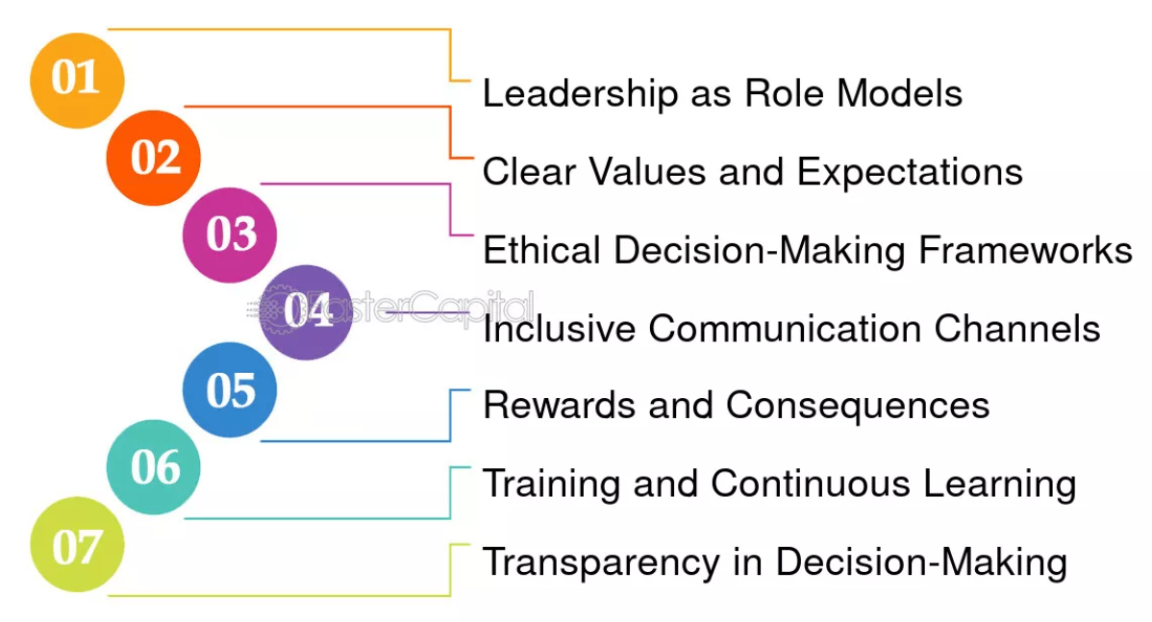
THE IMPORTANCE OF BUSINESS ETHICS
DEVELOPING ORGANIZATIONAL AND GLOBAL ETHICAL CULTURES

Slide 24
THE IMPORTANCE OF BUSINESS ETHICS
Developing Organizational And Global Ethical Cultures
Ethical culture is acceptable behavior as defined by the company and industry.
You will learn more about the ethical decision-making process and about ways to promote this area.
The ethical component of a corporate culture relates to the values, beliefs, and established and enforced patterns of conduct employees use to identify and respond to ethical issues.
Ethical culture is the component of corporate culture that captures the values and norms an organization defines and is compared to by its industry as appropriate conduct.

Slide 25
THE IMPORTANCE OF BUSINESS ETHICS
Developing Organizational And Global Ethical Cultures
Ethical culture is acceptable behavior as defined by the company and industry.
The goal of an ethical culture is to minimize the need for enforced compliance with rules and maximize the use of principles that contribute to ethical reasoning in difficult or new situations.
Ethical culture is positively related to workplace confrontation over ethics issues, reports to management of observed misconduct, and the presence of ethics hotlines.
To develop better ethical corporate cultures, many businesses communicate core values to their employees by creating ethics programs and appointing ethics officers to oversee them.

Slide 26
THE IMPORTANCE OF BUSINESS ETHICS
Developing Organizational And Global Ethical Cultures
Ethical culture is acceptable behavior as defined by the company and industry.
An ethical culture creates shared values and support for ethical decisions and is driven by the ethical leadership of top management. On the other hand,
Corrupt organizational cultures support unethical behavior.
These cultures have been identified as creating negative values and norms such as “the ends justify the means.” In these cultures, ethical employees may be punished for failure to engage in unethical activities.
Regulators want firms to focus on their culture to avoid excessive risk taking and unethical behavior. There is a fundamental belief that an ethical culture will lead to good behavior.

Slide 27
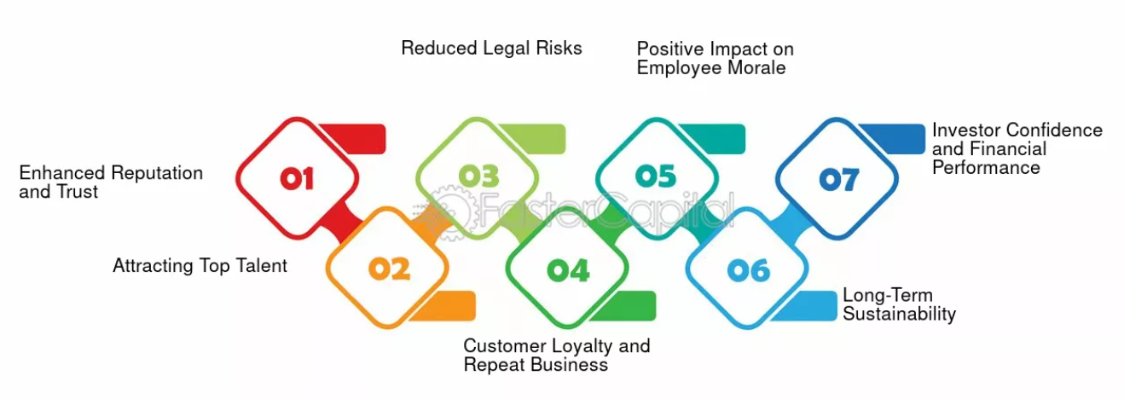
THE IMPORTANCE OF BUSINESS ETHICS
THE BENEFITS OF BUSINESS ETHICS

Slide 28
THE IMPORTANCE OF BUSINESS ETHICS
The Benefits of Business Ethics
Ethics contributes to employee commitment:
Employee commitment comes from workers who believe their future is tied to that of the organization and from a willingness to make personal sacrifices for the organization.
The more a company is dedicated to taking care of its employees, the more likely the employees will take care of the organization.
Issues that foster the development of an ethical culture for employees include the absence of abusive behavior, a safe work environment, competitive salaries, and the fulfillment of all contractual obligations toward employees.

Slide 29
THE IMPORTANCE OF BUSINESS ETHICS
The Benefits of Business Ethics
Ethics contributes to employee commitment:
Because employees spend a considerable number of their waking hours at work, a commitment by an organization to goodwill and respect for its employees usually increases the employees’ loyalty to the organization and their support of its objectives.

Slide 30
THE IMPORTANCE OF BUSINESS ETHICS
The Benefits of Business Ethics
Ethics contributes to investor loyalty:
Ethical conduct results in shareholder loyalty and contributes to success that supports even broader social causes and concerns.
Investors today are increasingly concerned about the ethics and social responsibility that creates the reputation of companies in which they invest, and various socially responsible mutual funds and asset management firms help investors purchase stock in ethical companies.

Slide 31
THE IMPORTANCE OF BUSINESS ETHICS
The Benefits of Business Ethics
Ethics contributes to investor loyalty:
Investors also recognize that an ethical culture provides a foundation for efficiency, productivity, and profits.
Investors know, too, that negative publicity, lawsuits, and fines can lower stock prices, diminish customer loyalty, and threaten a company’s long-term viability.

Slide 32
THE IMPORTANCE OF BUSINESS ETHICS
The Benefits of Business Ethics
Ethics contribute to customer satisfaction:
Although a company continues to develop and adapt products to keep pace with customers’ changing desires and preferences, it must also develop long-term relationships with its customers and stakeholders.
High levels of perceived corporate misconduct decrease customer trust.
Companies viewed as socially responsible increase customer trust and satisfaction.

Slide 33
THE IMPORTANCE OF BUSINESS ETHICS
The Benefits of Business Ethics
Ethics contribute to customer satisfaction:
Successful businesses provide an opportunity for customer feedback that engages customers in cooperative problem-solving.
Trust is essential to a good long-term relationship between a business and consumers.
The perceived ethicality of a firm is positively related to brand trust, emotional identification with the brand, and brand loyalty.

Slide 34
THE IMPORTANCE OF BUSINESS ETHICS
The Benefits of Business Ethics
Ethics contributes to profits:
A company cannot nurture and develop an ethical culture unless it has achieved adequate financial performance in terms of profits.
Businesses with greater resources—regardless of their staff size—have the means to be ethical and practice social responsibility while serving their customers, valuing their employees, and contributing to society.

Slide 35
THE IMPORTANCE OF BUSINESS ETHICS
The Benefits of Business Ethics
Ethics contributes to profits:
Ethical conduct toward customers builds a strong competitive position, shown to positively affect business performance and product innovation.
Companies perceived by their employees as having a high degree of honesty and integrity have a much higher average total return to shareholders than do companies perceived as having a low degree of honesty and integrity.

Slide 36
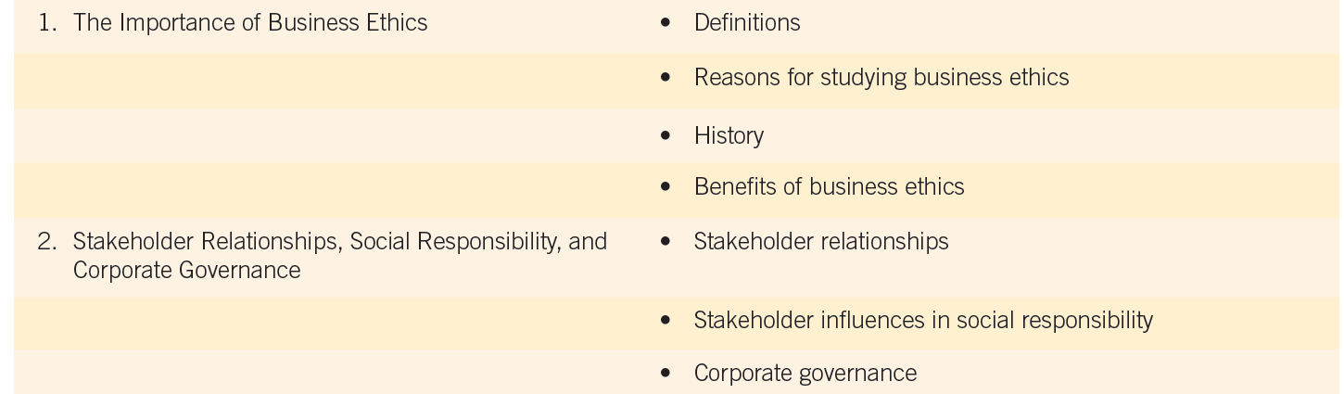
THE IMPORTANCE OF BUSINESS ETHICS
OUR FRAMEWORK FOR STUDYING BUSINESS ETHICS

Slide 37
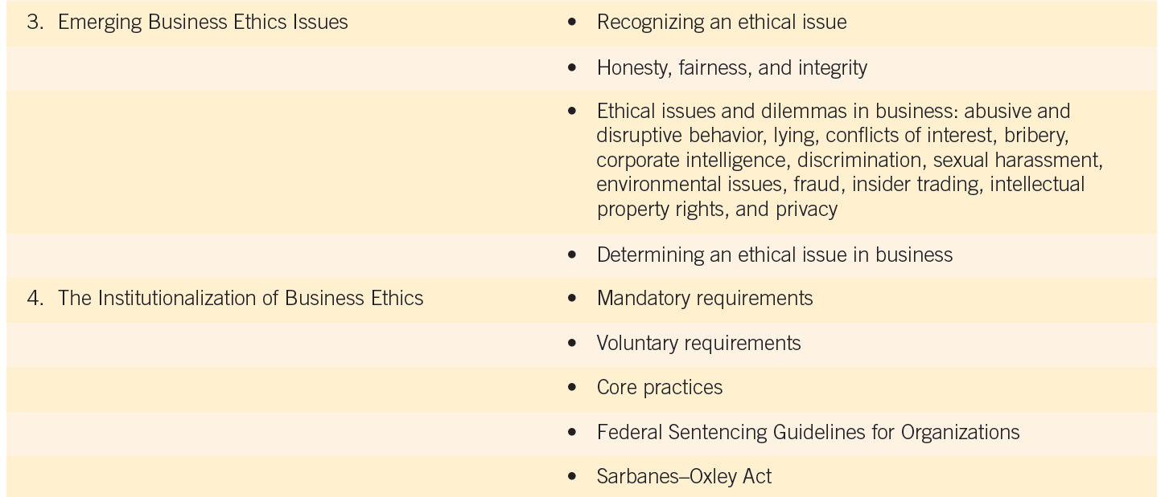
THE IMPORTANCE OF BUSINESS ETHICS
OUR FRAMEWORK FOR STUDYING BUSINESS ETHICS

Slide 38
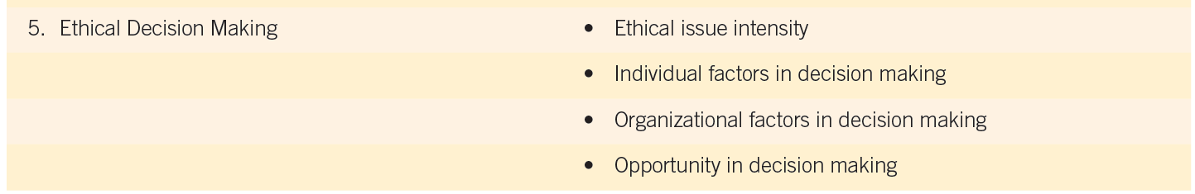

THE IMPORTANCE OF BUSINESS ETHICS
OUR FRAMEWORK FOR STUDYING BUSINESS ETHICS

Slide 39
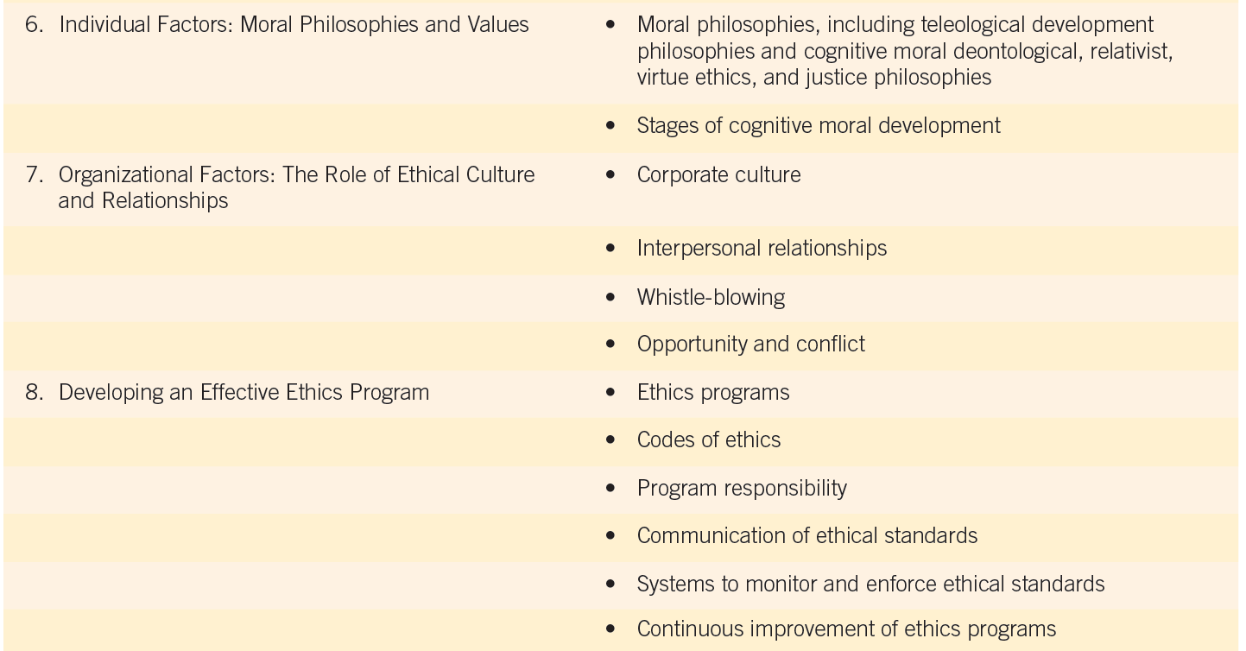
THE IMPORTANCE OF BUSINESS ETHICS
OUR FRAMEWORK FOR STUDYING BUSINESS ETHICS

Slide 40
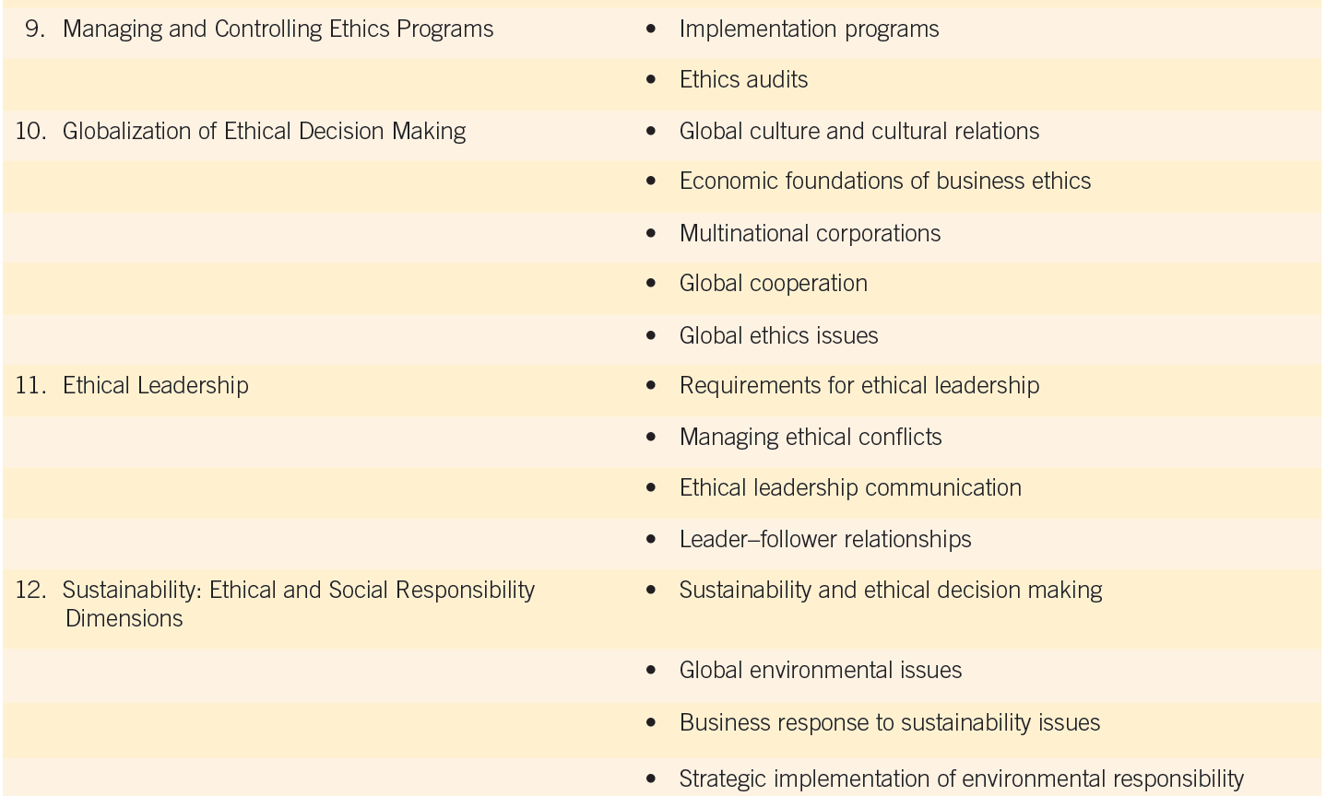
THE IMPORTANCE OF BUSINESS ETHICS
OUR FRAMEWORK FOR STUDYING BUSINESS ETHICS

Slide 41



Thank You

