Slide 1



Principles of Accounting
Prepared by
Dr. Hoda Metwally
MGM 227
Introductory Lecture

Slide 2



Principles of Accounting
Introductory Lecture
MGM 227
Prepared by
Dr. Hoda Metwally

Slide 3


Principles of
Accounting

Slide 4

Introduction
Dr. Hoda Metwally
PhD Degree in Accounting
Faculty of Business- Ain Shams University.
Experience in teaching Accounting.

Slide 5
Principles of Accounting Introduction
The environment of Accounting:
Accountants:
Not just counters’
–Varied and interesting work in a variety of roles
–More focus on analytical and communication skills.
Non-accountants:
–Benefits of basic understanding
–Engineers: product design; costs and prices
–Marketing: maximize sales
–HR: major organizational cost
–Managers: Planning and measuring performance

Slide 6
Principles of Accounting Introduction
Accounting evolves as society and business changes
•Some of these changes include:
–rapid developments in information and communication technologies
–increasing demand for information about organizational impact
–globalization of business
–development of international regulations and standards

Slide 7
Principles of Accounting Introduction
AA
Accounting is concerned with :
What the company owns .
The company’s resources, which are called Assets.
What the company owes .
The company’s uses, which are called Liabilities.

Slide 8
Principles of Accounting Introduction
bvbnb
And the owners’ rights in the company .
which are called Owner’s Equity , as the company is considered a separate legal entity.

Slide 9
Principles of Accounting Introduction
1–Course Description:
This course introduces accounting in general, then covers the basics of financial accounting through the accounting cycle for service and merchandising business.
The main objective of this course is to introduce the theoretical foundation of financial accounting (concepts, assumptions , and principles) and the financial statements of a profit seeking enterprise.
The course prepares the student to be capable of performing the different steps of the accounting cycle for service and merchandising businesses.

Slide 10
Principles of Accounting Introduction
2
Course Objectives:
Upon completion of this course, students should be able to:
A. Introduce accounting in general.
B. Identify the basics of financial accounting through the accounting cycle for service and merchandise business.
C. Apply the theoretical foundation of financial accounting (concepts, assumptions, and principles) and the financial statements of a profit seeking enterprise.
D. Perform the different steps of the accounting cycle for service and merchandising businesses

Slide 11
Principles of Accounting Introduction
3- Intended Learning Outcomes of the Course:
(A)Through knowledge and understanding, students will be able to:
* Identify the basis of measurement, presentation, and disclosure issues related to items presented in income statements and balance sheets .
* Define journal and ledger.
* Specify the significance of alternative accounting procedures.
* List the appropriate theories, principles, and concepts relevant to financial accounting.
(A)Through knowledge and understanding, students will be able to:
* Identify the basis of measurement, presentation, and disclosure issues related to items presented in income statements and balance sheets .
* Define journal and ledger.
* Specify the significance of alternative accounting procedures.
* List the appropriate theories, principles, and concepts relevant to financial accounting.

Slide 12
Principles of Accounting Introduction
3- Intended Learning Outcomes of the Course:
(B)Through intellectual skills, students will be able to:
*Apply an appropriate judgment in selecting and presenting information using various methods relevant to financial accounting.
*Discuss a reasonable argument to solve familiar and unfamiliar problems relevant to financial accounting.

Slide 13
Principles of Accounting Introduction
3- Intended Learning Outcomes of the Course:
(c)Through general and transferable skills, students will be able to:
*Articulate appropriate effective written and oral communication skills relevant to accounting.
*Demonstrate the ability to work effectively as part of a group, Involving leadership, group dynamics and interpersonal skills relevant to financial accounting.
* Show how to solve problems relevant to financial accounting using ideas and techniques .

Slide 14
Principles of Accounting Introduction
(A)Through knowledge and understanding, students will be able to:
* 4 – Course Outline:
Chapter 1: Accounting is the Language of Business
Chapter 2: Who uses Accounting Data
Chapter 3: The Recording Process Using Accounting Equation
Chapter 4: The Recording Process Using the double entry system
, presentation, and disclosure issues related to items presented in income staents and balance sheets .
* Define journal and ledger.
* Specify the significance of alternative accounting procedures.
* List the appropriate theories, principles, and concepts relevant to financial accounting.

Slide 15
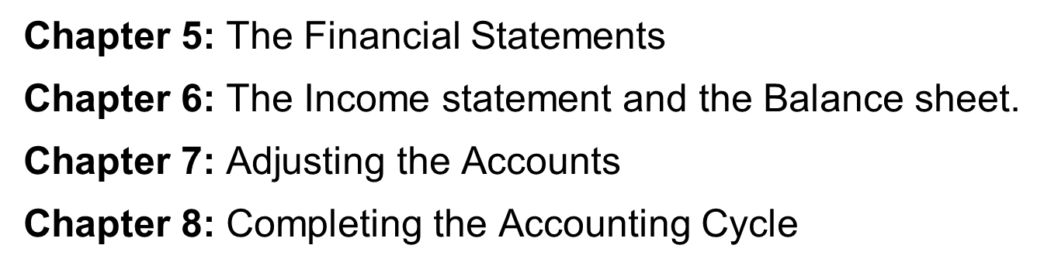
Principles of Accounting Introduction
(A)Through knowledge and understanding, students will be able to:
* Identify the basis of measurement, presentation, and disclosure issues related to items presented in income statements and balance sheets .
* Define journal and ledger.
* Specify the significance of alternative accounting procedures.
* List the appropriate theories, principles, and concepts relevant to financial accounting.

Slide 16
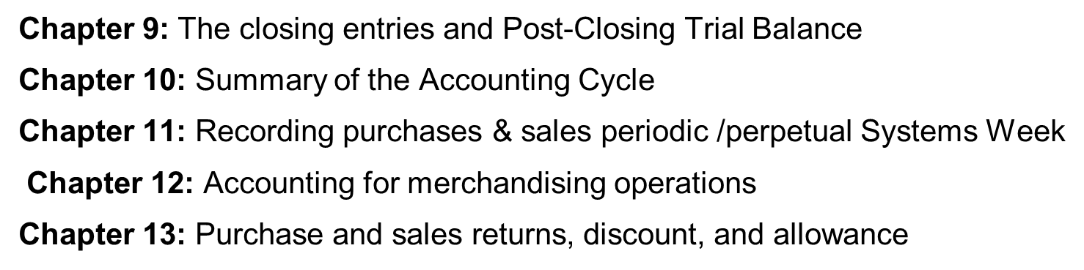
Principles of Accounting Introduction
(A)Through knowledge and understanding, students will be able to:
* Identify the basis of measurement, presentation, and disclosure issues related to items presented in income statements and balance sheets .
* Define journal and ledger.
* Specify the significance of alternative accounting procedures.
* List the appropriate theories, principles, and concepts relevant to financial accounting.

Slide 17

5- List of References:
- Meigs, R, , Williams J., Haka S. and Bettner M., Accounting the Basis For Business Decisions, Irwin McGraw-Hill , 11 th Edition,1999.
-Weygandt, J., Kieso, D., and Kimmel, P., Accounting Principles, Wiley & Sons, Inc., 7 th Edition, 2004.

Slide 18


Thank You

