Slide 1

A Comparative Study of Fake News Detection Using Machine Learning, Deep Learning, and Large Language Models
Prepared By
Name: Rayan Shukri ID No.: 251000636
Name: Sultan Hassan ID No.: 251002896
Subervized by
Wesam Ahmed

Slide 2
Agenda
Introduction
Objective
Contribution
Related work
Proposed framework
Dataset

Slide 3
Introduction
What is Fake News?
Fake news = false or misleading content presented as real news.
Goal: influence opinions or serve political/financial interests.
Social media algorithms amplify and accelerate its spread.
Example: COVID-19 misinformation caused real-world harm.
Role of AI:
Enhances accuracy, scalability, and adaptability.

Slide 4
Objective
Explore and compare three major AI paradigms
Machine Learning (ML)
Deep Learning (DL)
Large Language Models (LLMs)
In terms of their strengths, weaknesses, and effectiveness.

Slide 5
Contribution
1- Implement and evaluate ML, DL, and LLMs for fake news detection.
2- Apply all models on the same datasets and compare with standard metrics.
3- Assess strengths and weaknesses in performance, robustness, and generalization.
4- Present findings to guide future researchs and development.

Slide 6
Related Work
Ref | Year | Dataset(s) | Model(s) | Results | Advantages | Limitations
Machine Learning (ML)
Ajik et al. [30] | 2023 | FakeNewsNet, ISOT | Optimized CNN + LSTM | Accuracy: ~94.6% (FakeNewsNet), ~96.1% (ISOT) | Hybrid CNN-LSTM captured both local features and sequential dependencies; outperformed baseline DL models | Computationally expensive; requires large labeled datasets for training
Deep Learning (DL)
Hansrajh et al.[25] | 2021 | LIAR, ISOT | Ensemble: LR, SVM, LDA, SGD, Ridge | LIAR: F1 = 0.682, Acc = 0.681, Precision =0.685, Recall = 0.680 ISOT: F1 = 0.984, Acc = 0.985, Precision = 0.984, Recall = 0.984 | ensemble outperformed individual classifiers | lower accuracy on short claims, lack of contextual/social signals)
Large Language Models (LLM)
Huang et al. [32] | 2025 | Kaggle Fake News dataset (~5,000 articles; balanced real/fake) | Hybrid Transformer + BiGRU + Bayesian Optimization | Transformer+BiGRU: Train 100%, Test 99.67% Transformer+BiGRU+Bayesian: Train 100%, Test 99.73% | - Near-perfect detection accuracy - Bayesian optimization improved robustness (+0.06%) | - Small dataset (risk of overfitting) - No testing on multilingual or multimodal datasets

Slide 7
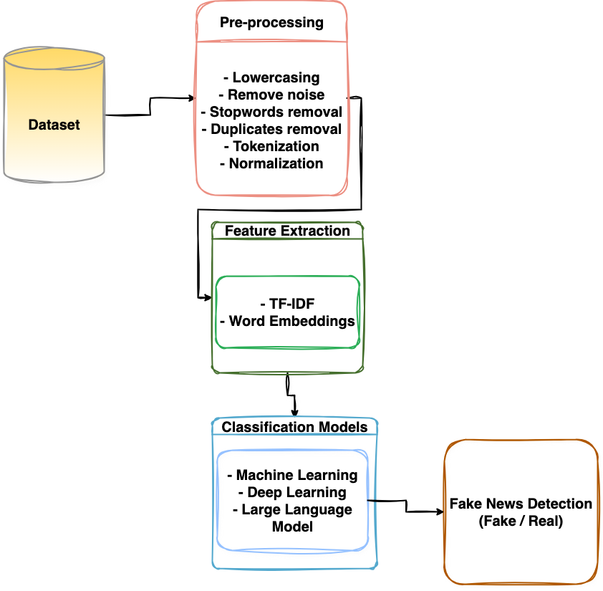
Proposed framework

Slide 8
COVID Fake News Dataset
The dataset consists of COVID-19 related news headlines labeled as either real or fake. Its purpose is to provide a benchmark for evaluating the performance of machine learning, deep learning, and transformer-based models in fake news detection.
Dataset Source:
Key Details:
https://doi.org/10.5281/zenodo.4282522
Total Rows: 10,201
Number of Columns: 2
Target Label: Fake News classification (yes/no)
Format: CSV
Columns Included:
headlines: COVID-related news headline text
outcome: Binary label (0 = fake, 1 = real)

Slide 9





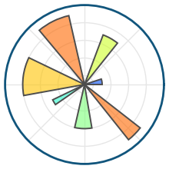

Hardware and Software Libraries
Hardware Environment
Software Environment
Kaggle / Google Colab (GPU-enabled)
RAM: ≥16 GB
GPU: NVIDIA Tesla T4 (or equivalent)
Storage: ~10 GB
Programming Language: Python
Core Libraries: Pandas, NumPy
Machine Learning: Scikit-learn
NLP Tools: NLTK, SpaCy
Transformers: Hugging Face Transformers
Deep Learning: TensorFlow, PyTorch
Visualization: Matplotlib, Seaborn

Slide 10
Thank You!

