Slide 1



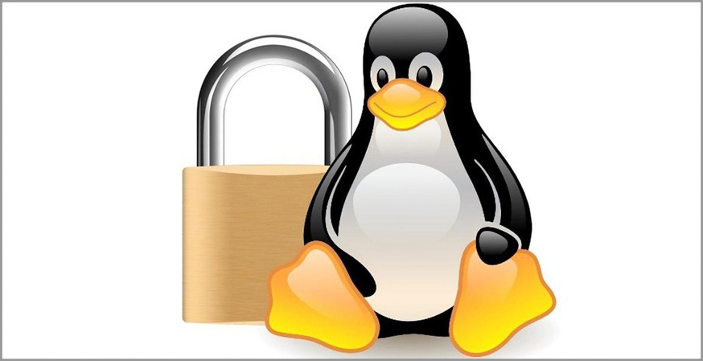
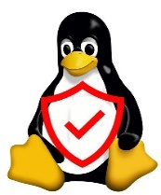
Lecture: #01
Security Threats to Linux
Dr. Hesham Abou Elfetouh
Cybersecurity Department
Faculty of Informatics
Midocean University
Secure Operating Systems (CYB610)
www.midocean.ae

Slide 2

Chapter
Outline
01
    This chapter covers the following topics and concepts
What the origins of Linux are
How security works in the open-source world
What distributions of Linux exist
What the C-I-A triad is
How Linux operates as a security device
What Linux’s place in the enterprise is
What some examples of recent security issues are
2
www.midocean.ae
Secure Operating Systems

Slide 3
Chapter
CHAPTER 1 GOALS
01
When you complete this chapter, you will be able to:
Describe the basics of security in an open-source world
Explain various roles of Linux systems in the IT architecture
Differentiate between Linux and the operating environment that runs on top of Linux
Explain threats that can target Linux
3
www.midocean.ae
Secure Operating Systems

Slide 4

Chapter
Learning Key Concepts
01
Key Concepts
The origins of Linux
Open-source software security considerations
The confidentiality, integrity, and availability (C-I-A) triad
Linux distributions
Linux security and security threats
4
www.midocean.ae
Secure Operating Systems

Slide 5
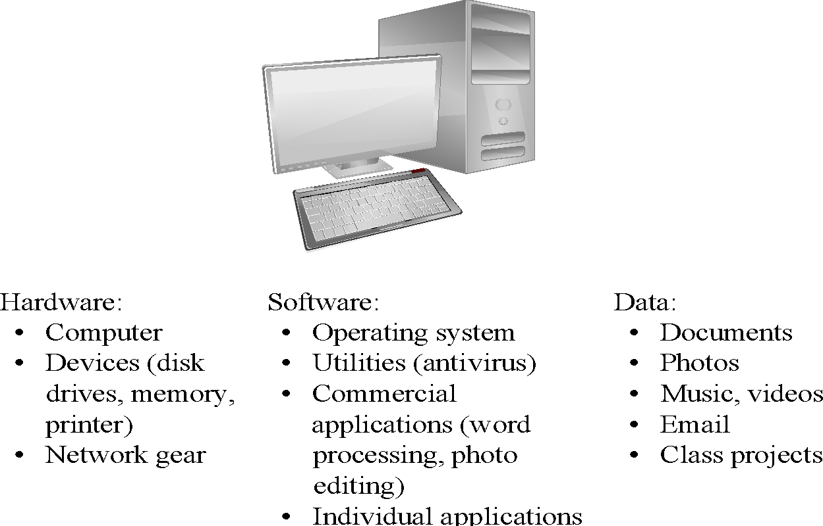
Chapter
Computer Security
01
Assets
5
www.midocean.ae
Secure Operating Systems
Notes:
Networking gear such as switches and routers

Slide 6
Chapter
Why need security at the OS level?
01
No more standalone computer system environments.
Any system can be globally accessible through a set of vast inter and intra-network connections.
Transition motivated by the need to work remotely,
convenience in accessing personal records, online shopping etc.
A single security loophole in the OS design and implementation known to a malicious attacker could do serious damage.
6
www.midocean.ae
Secure Operating Systems
Notes:
An intranet is a private network that only users within an organization can access. On the other hand, the internet is a public network that anyone can access.

Slide 7
Chapter
Who are the attackers?
01
Vandals (Hackers, crackers) driven by intellectual challenge.
Insiders: employees or customers seeking revenge or gain informal benefits
Natural disasters: flooding, fire, storms, earthquake…
Criminals seeking financial gain.
Organized crime seeking gain or hiding criminal activities.
Organized terrorist groups or nation states trying to influence national policy.
Foreign agents seeking information (spying) for economic, political, or military purposes.
Tactical countermeasures intended to disrupt military capability.
Large organized terrorist groups
Cyber attacks
7
www.midocean.ae
Secure Operating Systems
Notes:
Vandals مخربين

Slide 8
Chapter
What are the vulnerabilities?
01
Physical vulnerabilities (Eg. Computer can be stolen)
Natural vulnerabilities (Eg. Earthquake)
Hardware and Software vulnerabilities (Eg. Failures)
Media vulnerabilities (Eg. Hard disks can be stolen)
Communication vulnerabilities (Ex. Wires can be tapped)
Human vulnerabilities (Eg. Insiders)
Poorly chosen passwords
Software bugs (non reliability of software)
– buffer overflow attacks
8
www.midocean.ae
Secure Operating Systems
Notes:
A buffer overflow attack is a common cyberattack that deliberately exploits a buffer overflow vulnerability where user-controlled data is written to memory. By submitting more data than can fit in the allocated memory block, the attacker can overwrite data in other parts of memory.
هجوم تجاوز سعة المخزن المؤقت هو هجوم إلكتروني شائع يستغل عمدًا ثغرة أمنية في تجاوز سعة المخزن المؤقت حيث تتم كتابة البيانات التي يتحكم فيها المستخدم إلى الذاكرة. من خلال إرسال بيانات أكثر مما يمكن احتواؤه في كتلة الذاكرة المخصصة، يمكن للمهاجم الكتابة فوق البيانات الموجودة في أجزاء أخرى من الذاكرة.

Slide 9
Chapter
What are the vulnerabilities?
01
Automatically running active content: active-x, scripts, Java programs (applet)
Open ports: telnet, mail
Incorrect configuration
  file permissions
  administrative privileges
Untrained users/system administrators
9
www.midocean.ae
Secure Operating Systems
Notes:
ActiveX controls are small building blocks that create applications that work over the Internet through Web browsers. Examples include customized applications for collecting data, viewing certain kinds of files, and displaying animation.
تعد عناصر تحكم ActiveX عبارة عن كتل إنشاء صغيرة تعمل على إنشاء تطبيقات تعمل عبر الإنترنت من خلال متصفحات الويب. تتضمن الأمثلة التطبيقات المخصصة لجمع البيانات وعرض أنواع معينة من الملفات وعرض الرسوم المتحركة.

Slide 10
Chapter
Security Features in Operating System
01
An operating system manages and controls access to hardware components
Older operating systems focused on ensuring data confidentiality
Modern operating systems support four basic functions
  Positively identify a user
  Restrict access to authorized resources
  Record user activity
  Ensure proper communications with other computers and devices (sending and receiving data)
10
www.midocean.ae
Secure Operating Systems

Slide 11
Chapter
Security Features in ordinary Operating System
01
Authentication of users
  password comparison
Protection of memory
  user space, paging, segmentations
File and I/O device access control
  access control matrix
Allocation & access control to general objects
11
www.midocean.ae
Secure Operating Systems
Notes:
Ordinary عادي

Slide 12
Chapter
Security Features in ordinary Operating System
01
Enforcement of sharing resources
  To preserve integrity and consistency (critical section)
Fair service
  no starvation and deadlock
Inter-process communication & synchronization
  Shared variable (e.g, using semaphores)
Protection of data
  encryption, isolation
12
www.midocean.ae
Secure Operating Systems
Notes:
إنفاذ تقاسم المواردللحفاظ على النزاهة والاتساق (القسم النقدي)

Slide 13
Chapter
Security Features of Trusted OS
01
Identification and Authentication
Mandatory (enforce multilevel security by classifying the data and users into various security classes) and
Discretionary Access Control (grant privileges to users)
Object use and reuse protection (Subject and object)
Anti-virus scan
Accountability and Audit (security log)
Firewall
Intrusion detection (patterns of normal system usages, anomalies)
13
www.midocean.ae
Secure Operating Systems
Notes:
Discretionary Access Control
التحكم في الوصول التقديرية
Accountability and Audit
المسألة والتطبيق والمراجعة

Slide 14
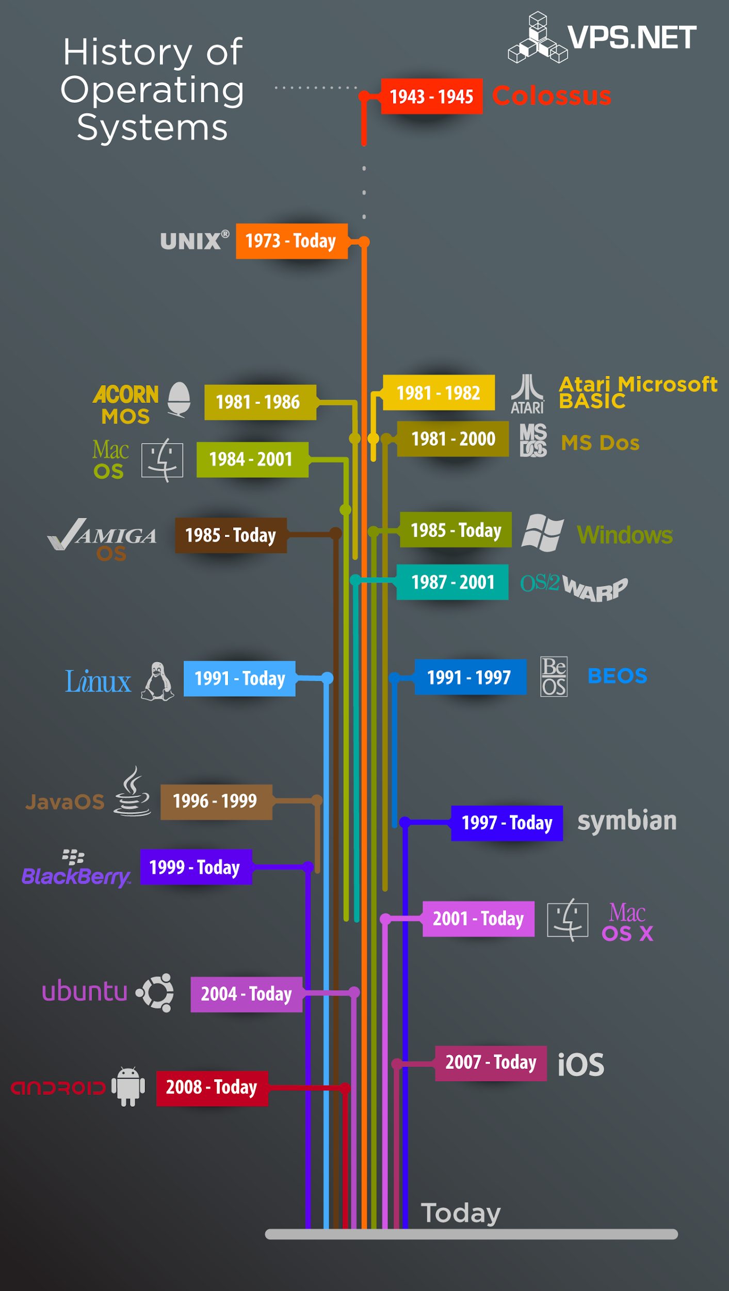
Chapter
History of Operating Systems
01
First, an entire computer was dedicated to one program at a time, but this approach proved wasteful
The first operating systems saved startup, loading, and shutdown time and made much better use of limited resources
The first personal computers took a major step back, as they were dedicated to single users and effectively one program at a time
Multitasking returned to the mainstream in the 1990s, and with it came all the lessons of the early shared computers
14
www.midocean.ae
Secure Operating Systems
Notes:
أولاً، تم تخصيص جهاز كمبيوتر كامل لبرنامج واحد في كل مرة، ولكن ثبت أن هذا النهج كان مضيعًا للوقتلقد وفرت أنظمة التشغيل الأولى وقت بدء التشغيل والتحميل وإيقاف التشغيل واستفادت بشكل أفضل من الموارد المحدودةأخذت أجهزة الكمبيوتر الشخصية الأولى خطوة كبيرة إلى الوراء، حيث كانت مخصصة لمستخدمين فرديين وبرنامج واحد في كل مرةعادت المهام المتعددة إلى الاتجاه السائد في التسعينيات، ومعها جاءت جميع الدروس المستفادة من أجهزة الكمبيوتر المشتركة المبكرة

Slide 15
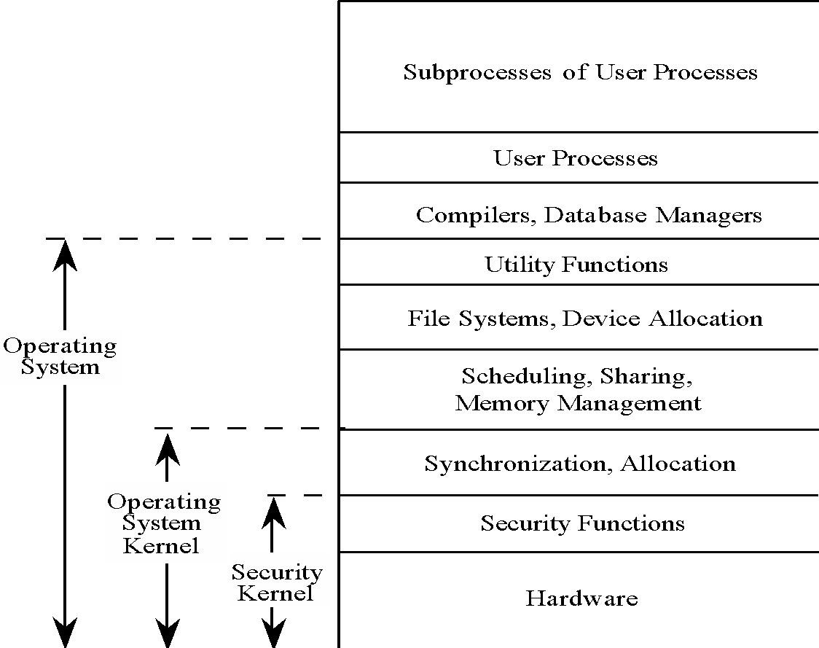
Chapter
OS Layered Design
01
Operating system visualized in layers, from most critical (bottom) to least critical.
15
www.midocean.ae
Secure Operating Systems

Slide 16
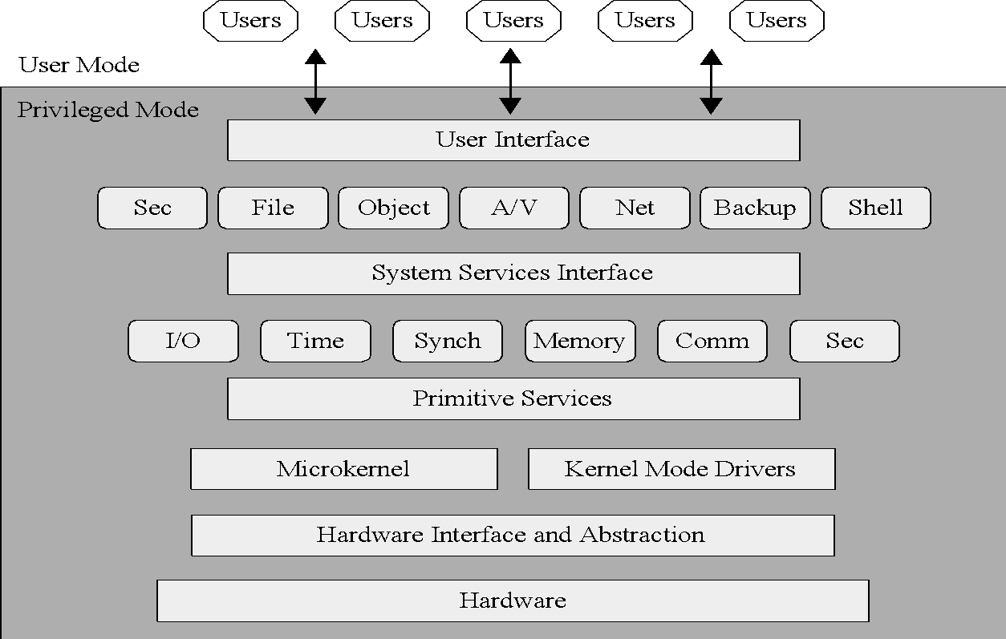
Chapter
Modular OS Design
01
Modern OSs are built from discrete modules. These modules generally come from a variety of sources and are subject to updating/overwriting, so they cannot trust one another.
16
www.midocean.ae
Secure Operating Systems

Slide 17
Chapter
Protected Objects
01
These are some of the common objects that need protection by and in OSs.
Memory
Sharable I/O devices, such as disks
Serially reusable I/O devices, such as printers
Sharable programs and sub procedures
Networks
Sharable data
17
www.midocean.ae
Secure Operating Systems

Slide 18
Chapter
Operating Systems Hardening
01
First critical step in securing a system is to secure the base operating system
Basic steps
  Install and patch the operating system
  Harden and configure the operating system to adequately address the identified security needs of the system by:
    Removing unnecessary services, applications, and protocols
    Configuring users, groups, and permissions
    Configuring resource controls
  Install and configure additional security controls, such as anti-virus, host-based firewalls, and intrusion detection system (IDS)
  Test the security of the basic operating system to ensure that the steps taken adequately address its security needs
18
www.midocean.ae
Secure Operating Systems
Notes:
Adequately بشكل كاف

Slide 19
Chapter
Operating Systems Hardening
01
Should stage and validate all patches on the test systems before deploying them in production
Initial installation should install the minimum necessary for the desired system
Overall boot process must also be secured
System security begins with the installation of the operating system
The integrity and source of any additional device driver code must be carefully validated
Critical that the system be kept up to date, with all critical security related patches installed
Ideally new systems should be constructed on a protected network
Full installation and hardening process should occur before the system is deployed to its intended location
19
www.midocean.ae
Secure Operating Systems

Slide 20
Chapter
Operating Systems Hardening
01
System planning process should consider:
  Categories of users on the system
  Privileges they have
  Types of information they can access
  How and where they are defined and authenticated
Default accounts included as part of the system installation should be secured
  Those that are not required should be either removed or disabled
  Policies that apply to authentication credentials configured
20
www.midocean.ae
Secure Operating Systems
Notes:
Credentials اعتمادات

Slide 21
Chapter
Application Configuration
01
May include:
  Creating and specifying appropriate data storage areas for the application
  Making appropriate changes to the application or service default configuration details
Some applications or services may include:
  Default data, Scripts and User accounts Of particular concern with remotely accessed services such as Web and file transfer services
  Risk from this form of attack is reduced by ensuring that most of the files can only be read, but not written, by the server
21
www.midocean.ae
Secure Operating Systems

Slide 22
Chapter
Security Maintenance
01
Process of maintaining security is continuous
Security maintenance includes:
  Monitoring and analyzing logging information
  Performing regular backups
  Regularly testing system security
  Using appropriate software maintenance processes to patch and update all critical software, and to monitor and revise configuration as needed
22
www.midocean.ae
Secure Operating Systems

Slide 23
Chapter
Security Maintenance
01
Can only inform you about bad things that have already happened
In the event of a system breach or failure, system administrators can more quickly identify what happened
Key is to ensure you capture the correct data and then appropriately monitor and analyze this data
Performing regular backups of data is a critical control that assists with maintaining the integrity of the system and user data
Backup
Archive
Needs and policy relating to backup and archive should be determined during the system planning stage
The process of retaining copies of data over extended periods of time in order to meet legal and operational requirements to access past data
Information can be generated by the system, network and applications
Range of data acquired should be determined during the system planning stage
Generates significant volumes of information and it is important that sufficient space is allocated for them
The process of making copies of data at regular intervals
Kept online or offline
May be legal or operational requirements for the retention of data
Automated analysis is preferred
Stored locally or transported to a remote site
Logging
Backup & Archive
23
www.midocean.ae
Secure Operating Systems

Slide 24
Chapter
The Origins of Linux
01
1960s
  1964: MIT joins with GE and Bell Labs to create a multiuser, time-sharing operating system
1980s
  Multiple Unix versions available from AT&T, University of California .
  1987: Unix-like operating system called MINIX released
1990s
  1991: Torvalds releases Linux in October
  Numerous open-source projects contributed to Linux over past 20 years.
24
www.midocean.ae
Secure Operating Systems

Slide 25
Chapter
The Origins of Linux
01
Linux is a common operating system used for Internet infrastructure.
With Linux, security is much more than just firewalls and permissions.
As with any operating system, a Linux implementation requires strategies to harden it against attack.
25
www.midocean.ae
Secure Operating Systems

Slide 26
Chapter
Linux Security
01
The reality is that no operating system can be called secure.
Security results from appropriate controls and processes
Has evolved into one of the world's most popular operating systems
  Free, Open-sourced
  Available in a wide variety of distributions targeted at almost every usage scenario imaginable
26
www.midocean.ae
Secure Operating Systems

Slide 27
Chapter
Linux Security
01
The traditional Linux security model can be summed up quite succinctly: People or processes with “root” privileges can do anything; other accounts can do much less
From the attacker’s perspective the challenge in cracking a Linux system is gaining root privileges
Once an attacker gains root privileges they can:
  Erase or edit logs & hide their processes, files, and directories
  Basically, redefine the reality of the system as experienced by its administrators and users
Thus, Linux security (and UNIX security in general) is a game of “root takes all”
27
www.midocean.ae
Secure Operating Systems
Notes:
quite succinctly بإيجاز شديد
Basically, redefine the reality of the system as experienced by its administrators and users
بشكل أساسي، إعادة تعريف واقع النظام كما يختبره مديروه ومستخدموه

Slide 28
Chapter
Security in an Open-Source World
01
Open source
  Software developed by teams that provide access to the source code and all the programming language text from which the final executable is generated
  Source code is open for anyone to see
Closed source
  Commercial software developed by companies that ask you to pay for the program
28
www.midocean.ae
Secure Operating Systems

Slide 29
Chapter
Security in an Open-Source World
01
Most open-source code is free and can be used without restriction.
Access to open source enables users to learn from source code, see what it does, and understand how a program operates.
Open source provides the ability for anyone to pick up source code and fix it.
  Enables speedy resolutions
Most open-source software is licensed in a way that requires changes to remain open as well.
29
www.midocean.ae
Secure Operating Systems

Slide 30
Chapter
Security in an Open-Source World
01
Open-source code may not be written securely.
Testing standards vary, and source code may not have sufficient security or regression testing.
Open-source projects are typically not process heavy.
If open-source code is modified by a user and then shared, there’s no guarantee of a quality fix.
30
www.midocean.ae
Secure Operating Systems

Slide 31
Chapter
Linux Distributions
01
RedHat
  Red Hat Enterprise Linux (RHEL)
  Fedora Core
CentOS was based on released versions of RHEL, now developed as CentOS Stream (non-Red Hat)
Debian
  Created by Ian Murdock years ago
  Debian is a merging of the name Ian with the name Debra (Ian’s girlfriend at the time)
  Mint and Ubuntu are derivatives
31
www.midocean.ae
Secure Operating Systems

Slide 32
Chapter
Linux Distributions
01
Advantages
  Stable
  Distributions have pre-compiled packages
  Can avoid unnecessary packages by building your own Linux
Disadvantages
  Distribution determines dependencies; may get packages you don’t want or need
  Source-based distributions must be compiled from source each time, can be time-consuming
32
www.midocean.ae
Secure Operating Systems

Slide 33
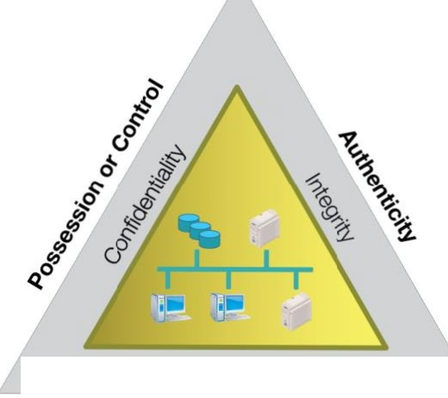
Chapter
The C-I-A Triad
01
Availability
Utility
33
www.midocean.ae
Secure Operating Systems

Slide 34
Chapter
The C-I-A Triad
01
Confidentiality
  Keeping secrets
Integrity
  Ensuring that the data that are sent are the data that are received
Availability
  Ensuring use of a service, such as a networked application
  Software that is buggy and crashes a lot affects availability
  A denial of service (DoS) attack is a specific and malicious form of a denial of service condition
34
www.midocean.ae
Secure Operating Systems

Slide 35
Chapter
The Parkerian Hexad
01
In the late 1990s, Donn Parker, a security professional, proposed an expansion of the C-I-A triad to cover additional concepts he felt were critical to the realm of information security:
  Confidentiality
  Possession or control
  Integrity
  Authenticity
  Availability
  Utility
35
www.midocean.ae
Secure Operating Systems
Notes:
Possession or control الحيازة أو السيطرة او الملكية
Authenticity أصالة
Utility الخدمة او المنفعةأو الفائدة

Slide 36
Chapter
Linux as a Security Device
01
Operating system hardening:
  Limit the number of software packages installed.
  Remove all but the most critical users from the system.
  Restrict permissions on files and directories.
  Remove all but necessary system services.
Can deploy a completely hardened operating system as a bastion host
  A bastion host is a system that is presented to the outside world that can be used to protect other systems that are more sensitive.
36
www.midocean.ae
Secure Operating Systems
Notes:
bastion host
مضيف الحصن او معقل

Slide 37
Chapter
Linux as a Security Device
01
Firewall
  Hardware or software capable of blocking networking communications based on established criteria, or rules
  Common firewalls available for Linux are iptables and firewalled
You can set up firewall rules to allow, drop, or log specific packets from the network.
If there are multiple network interfaces and a network behind a Linux firewall, you can have it perform network address translation (NAT), effectively hiding all the systems behind your Linux firewall.
On top of the firewall, you can deploy encryption services using Transport Layer Security (TLS).
37
www.midocean.ae
Secure Operating Systems
Notes:
إذا كانت هناك واجهات شبكة متعددة وشبكة خلف جدار حماية Linux، فيمكنك جعلها تقوم بترجمة عنوان الشبكة (NAT)، مما يؤدي بشكل فعال إلى إخفاء جميع الأنظمة خلف جدار حماية Linux الخاص بك.

Slide 38
Chapter
Linux in the Enterprise
01
Web server
  The way customers get access to information, products, and services offered by businesses.
Application server
  Software that provides a framework inside which applications can be written
Security systems
  Firewalls and intrusion-detection systems
Operating systems
  Linux is operating system for many security-based appliances
  You can use Linux as Proxy server or gateway, jump host, or bastion server
38
www.midocean.ae
Secure Operating Systems
Notes:
مَشرُوع

Slide 39
Chapter
Linux in the Enterprise
01
Filtering
  Between network segments
Remote Desktop Protocol (RDP) system
  Many packages support functions commonly found on Windows systems
File server / file sharing
  Makes use of Server Message Block (SMB) or Common Internet File System (CIFS) systems, or Network File System (NFS)
39
www.midocean.ae
Secure Operating Systems

Slide 40
Chapter
Recent Security Issues
01
Vulnerabilities
  Addition of more functions to a system increases complexity
  Increased complexity results in more potential for unforeseen problems
  Testing is essential but cannot account for all user behaviors
Increased prevalence of notification laws
  Businesses must notify customers of a breach
  Customers have the right to know when their personal information is at risk
40
www.midocean.ae
Secure Operating Systems
Notes:
Unforeseen غير متوقعة
زيادة انتشار قوانين الإخطار

Slide 41
Chapter
Recent Security Issues
01
Hacker
  Someone who shows great technical skills and creativity in completing specific tasks
  May or may not be a criminal
Black-hat hacker
  Someone who performs attacks against victims for malicious purposes
41
www.midocean.ae
Secure Operating Systems

Slide 42
Chapter
Recent Security Issues
01
White-hat hacker
  May use some of the same techniques as a black-hat hacker but is a good guy
Gray-hat hacker
  Performs a range of actions that a white-hat hacker will not undertake; somewhere in between a white-hat hacker and a black-hat hacker
42
www.midocean.ae
Secure Operating Systems

Slide 43
Chapter
Recent Security Issues
01
The Internet is filled with professional organizations and their skilled employees, running businesses that exist to steal information, extort money, or perform other illegal actions.
They may be related to the military for different countries, sometimes called nation-states.
Some attackers look for information, such as intellectual property, that could be sold. They also might engage in corporate espionage or inter-country espionage.
43
www.midocean.ae
Secure Operating Systems

Slide 44
Chapter
Recent Security Issues
01
A malware attack may be launched to get more zombie hosts for a botnet.
  This is also an attack for financial gain because the zombies may be running web server software as a front to an illegal storefront for, say, pharmaceuticals.
  The botnet may also be rented to an attacker for political or financial gain.
44
www.midocean.ae
Secure Operating Systems

Slide 45
Chapter
Summary
01
Who are the attackers
What are the vulnerabilities
Security features in Operating System
Operating Systems Hardening
Security Maintenance
The origins of Linux
Open-source software security considerations
The confidentiality, integrity, and availability (C-I-A) triad
Linux distributions
Linux security and security threats
45
www.midocean.ae
Secure Operating Systems

Slide 46



Thank You

