Slide 1


Prepared by Dr. Rana Maya
REA 621
Real Estate market analysis
Lecture 7

Slide 2



Predicting Real Estate Market Trends
Lecture 7
REA621
Real Estate market analysis
Prepared by
Dr. Rana Maya

Slide 3

lecture
Abstract
07
This lecture explores the drivers, methods, and applications of real estate market forecasting, supported by practical examples and analytical tools. It aims to equip readers with the skills to anticipate trends, make informed decisions, and contribute to resilient and sustainable real estate markets.

Slide 4

lecture
07
Contents
1. Introduction
2. Understanding Real Estate Market Trends
3. Real Estate Market Cycle
4. Key Drivers of Real Estate Market Trends
5. Data Sources for Market Trend Prediction
6. Methods for Predicting Real Estate Trends
7. Key Market Indicators for Forecasting
8. Impact of Global Events on Market Trends
9.Risk Factors in Real Estate Forecasting
10.Tools and Software for Market Prediction
11. Integrating Forecasting into Investment Decisions
12. Ethical Considerations in Market Forecasting

Slide 5
lecture
07
  Learning outcomes
By the end of the lecture, you will be able to:
Explain the importance and key drivers of real estate market trends.
Identify and interpret major market indicators (prices, supply–demand, vacancy, interest rates).
Apply basic forecasting methods such as time series and regression analysis and AI methods.
Evaluate the role of data analytics and technology in market prediction.
Analyze trends to support real estate investment and planning decisions.
Recognize risks, uncertainties, and ethical considerations in market forecasting.

Slide 6
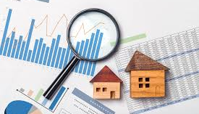
Real estate markets play a vital role in economic growth, urban development, and social stability, making trend prediction essential for investors, developers, and policymakers. Forecasting market movements helps reduce risk, improve investment decisions, and support sustainable housing strategies
However, real estate markets are complex systems influenced by economic conditions, demographic shifts, government policies, technological change, and behavioral factors.
Why?

Slide 7
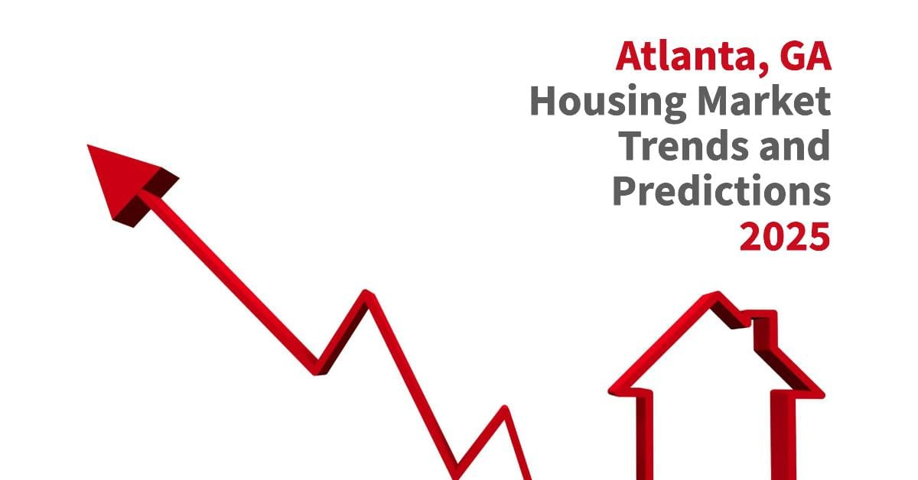
1. Introduction
Local conditions may not precisely mirror national trends. Not every metropolitan area benefits from a national economic boom, and some communities will survive a national recession relatively unscathed. As a result, real estate market studies usually give greater weight to metropolitan area economic indicators than to nationwide statistics.
Real estate markets are dynamic systems influenced by economic, demographic, financial, political, and technological factors. Predicting market trends is essential for:
Investors seeking profitable opportunities
Developers planning new projects
Governments shaping housing policy
Financial institutions managing risk
Urban planners guiding sustainable growth
Unlike stock markets, real estate trends evolve more slowly but involve higher capital commitments and long-term impacts.
Therefore, accurate forecasting reduces risk and improves strategic decision-making

Slide 8
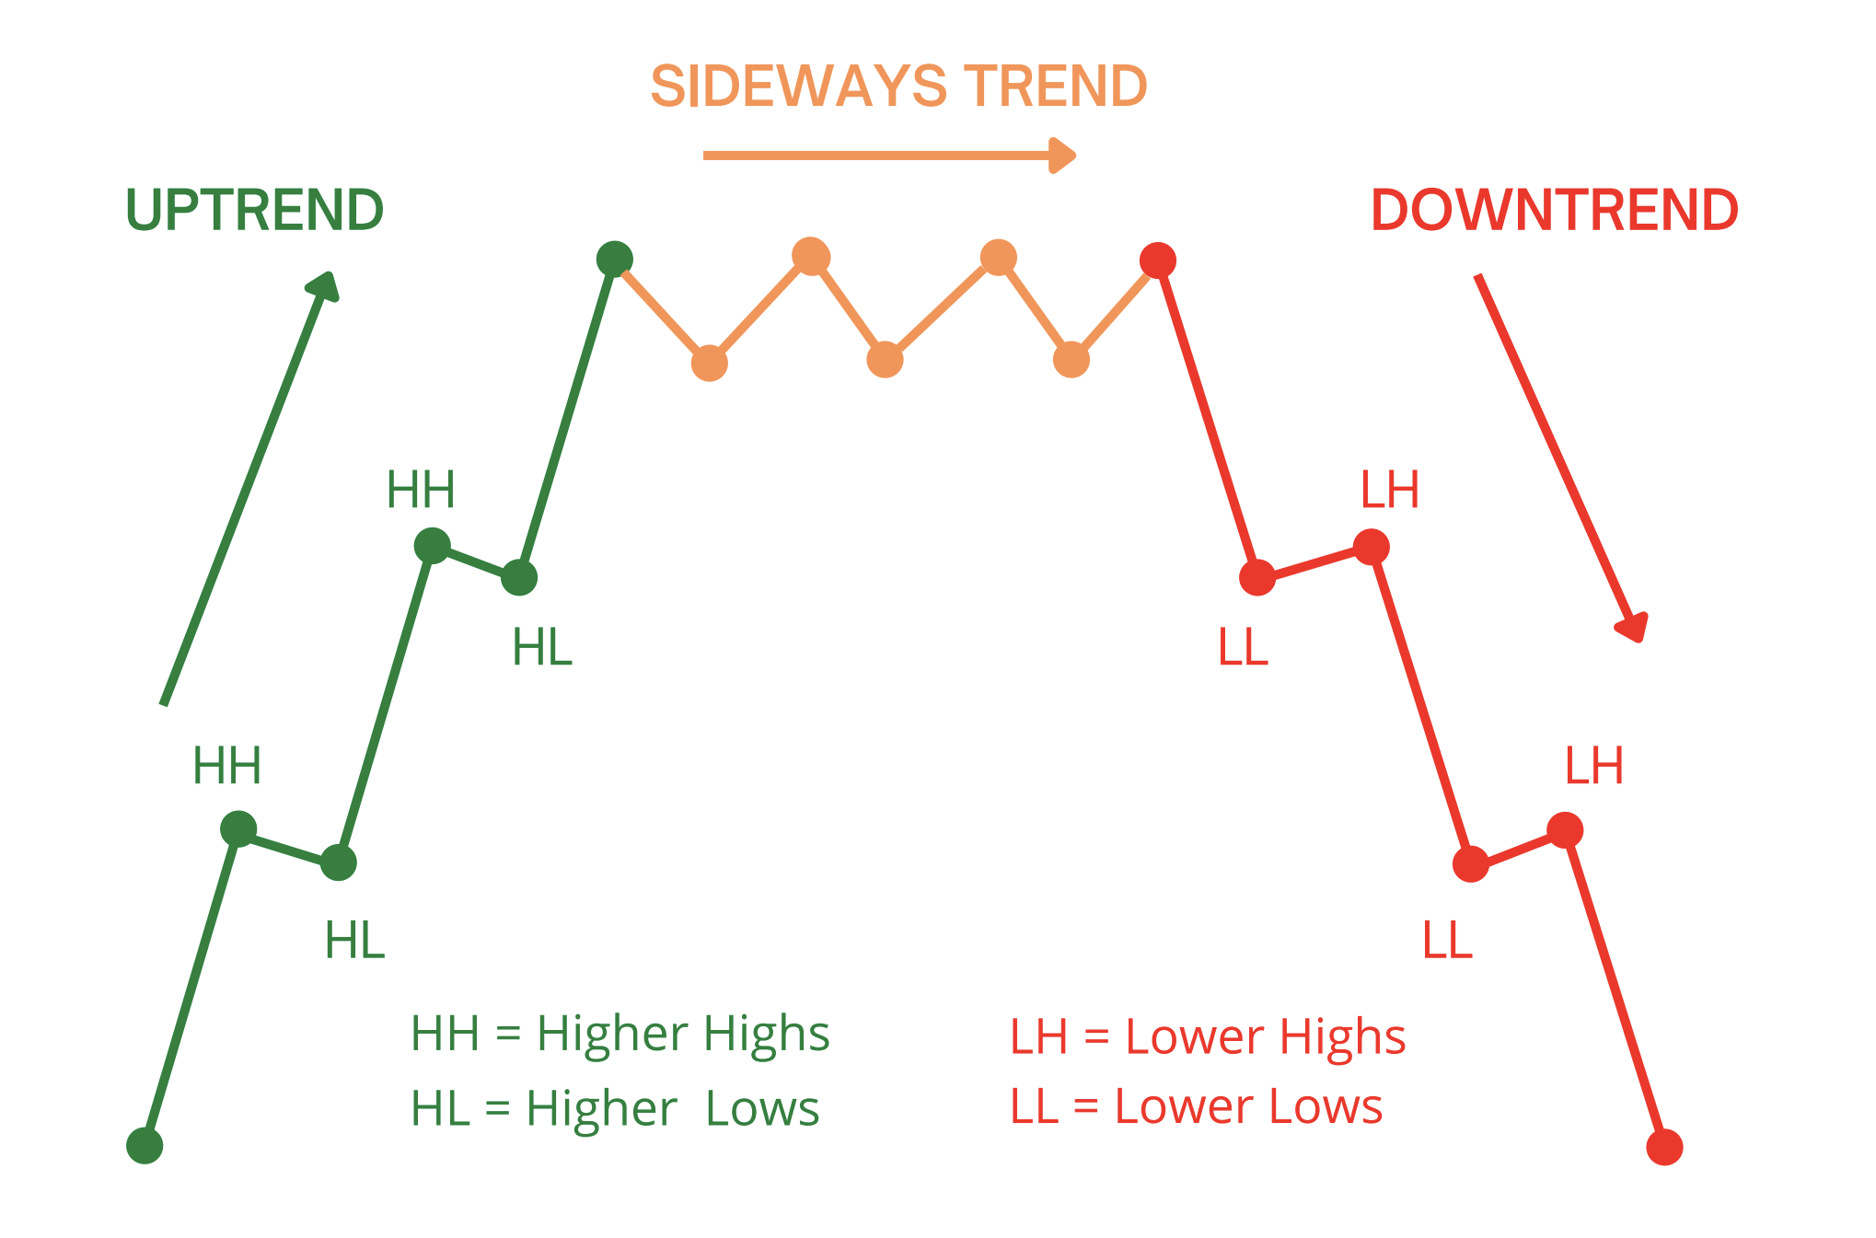
2. Understanding Real Estate Market Trends
2.1 What Are Market Trends?
A real estate market trend is the general direction in which property values, demand, supply, and investment activity move over time.
Key trend directions:
Upward (seller’s market)
Downward (buyer’s market)
Stable (balanced market)
Cyclical fluctuations

Slide 9

2. Understanding Real Estate Market Trends
2.2 Types of Real Estate Trends
Price Trends – Changes in property values
Demand Trends – Buyer and tenant activity
Supply Trends – New construction and listings
Rental Trends – Rent growth and vacancy rates
Investment Trends – Capital flows and yields

Slide 10
3. Real Estate Market Cycle
Phase | Characteristics | Investor Strategy
Recovery | Low demand, stable prices | Buy undervalued assets
Expansion | Rising demand and prices | Develop and invest
Hyper-supply | Excess construction | Cautious investment
Recession | Falling prices and demand | Hold or reposition
Example
After the 2008 global financial crisis, many markets entered recovery between 2010–2013, followed by expansion until 2019.

Slide 11
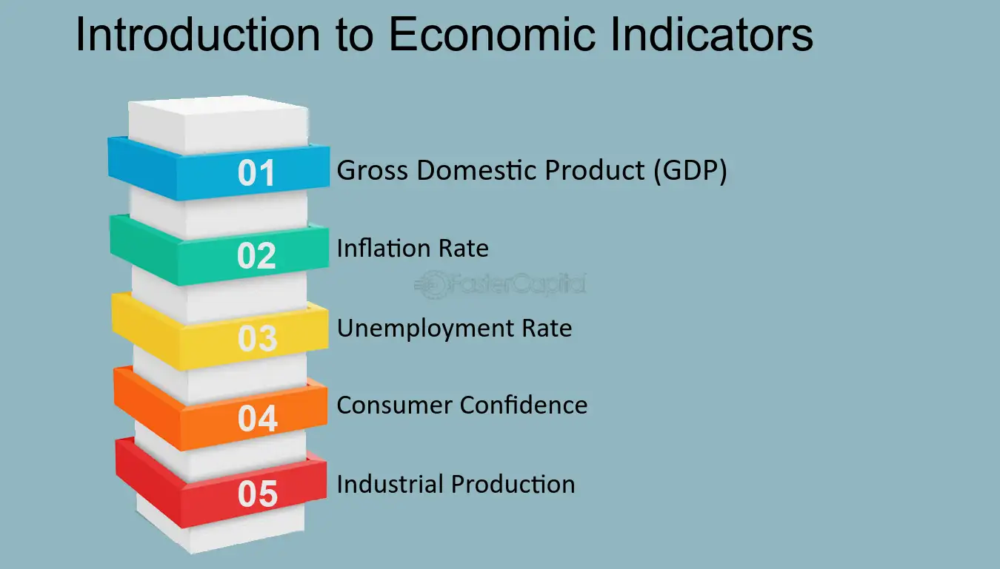
4. Key Drivers of Real Estate Market Trends
4.1 Economic Indicators
GDP growth
Employment rates
Inflation
Interest rates
Household income
Impact Example:
Lower interest rates increase affordability → higher demand → rising prices.

Slide 12

4. Key Drivers of Real Estate Market Trends
4.2 Demographic Factors
Population growth
Urbanization
Household formation
Migration patterns
Age distribution
Example:
A growing young population increases demand for rental housing.

Slide 13

4. Key Drivers of Real Estate Market Trends
4.3 Government Policies
Housing subsidies
Tax incentives
Zoning regulations
Foreign ownership laws
4.4 Technological Factors
PropTech platforms
Smart homes
Remote work trends
Example: Remote work increased demand for suburban housing after COVID-19.

Slide 14

5. Data Sources for Market Trend Prediction
https://www.smartdatacollective.com/big-data-20-free-big-data-sources-everyone-should-know/
5.1 Primary Data Sources
Surveys of buyers and tenants
Developer interviews
Market field studies
5.2 Secondary Data Sources
National statistics offices
Central bank reports
Property portals
Real estate agencies
International organizations (e.g., World Bank, IMF)

Slide 15

6. Methods for Predicting Real Estate Trends
6.1 Qualitative Methods
6.1.1 Expert Judgment
Using insights from market professionals.
Advantages:
Useful when data is limited
Limitations:
Subjective bias
6.1.2 Delphi Method
Structured expert consensus technique.
1.The Delphi Method is a structured expert consultation technique used to achieve consensus on future developments through iterative surveys. It is widely applied in urban planning, housing policy, and real estate forecasting to anticipate market trends under uncertainty.

Slide 16

6. Methods for Predicting Real Estate Trends
2. Objective of the Study :To forecast residential real estate trends over the next 5–10 years
3. Study Area :Metropolitan region example: Greater Dubai (UAE)
4. Methodology: Delphi Process
4.1 Panel Selection :A panel of 20 experts was selected:
Real estate developers
Urban planners
Mortgage bankers
Property consultants
Academic researchers
Selection criteria: Minimum 10 years of experience
Market-specific knowledge
Representation from public and private sectors

Slide 17

6. Methods for Predicting Real Estate Trends
4. Methodology: Delphi Process
4.2 Delphi Rounds
Round 1: Open-Ended Questionnaire :Experts were asked:
What factors will most influence housing demand in the next decade?
Which property types will experience the highest demand?
How will remote work affect residential location preferences?
What price trends do you anticipate?
How important will sustainability features be?
Key themes identified:
Remote work reshaping location preferences
Growing demand for affordable housing
Increased interest in suburban communities
Rising importance of green buildings

Slide 18
6. Methods for Predicting Real Estate Trends
4. Methodology: Delphi Process
Round 2: Structured Questionnaire
Experts rated the likelihood of identified trends (1–5 scale).
Trend | Mean Score
Demand for suburban housing | 4.6
Growth in affordable housing demand | 4. 8
Increase in property prices | 4.2
Demand for smart homes | 4.5
Importance of green buildings | 4.7

Slide 19

6. Methods for Predicting Real Estate Trends
4. Methodology: Delphi Process
Round 3: Consensus Building
Experts reviewed group responses and adjusted their ratings.
Consensus results:
Strong demand shift toward suburban and peripheral areas
Affordable housing shortage will intensify
Sustainability will become a key market differentiator
Smart home technology adoption will accelerate

Slide 20
6. Methods for Predicting Real Estate Trends
FV = PV(1+r)^n
5. Forecast Results
5.1 Predicted Market Trends
Trend | Forecast
Price Growth | Moderate (4–6% annually)
Housing Demand | Strong growth in affordable segment
Preferred Locations | Suburban areas
Key Features | Energy efficiency, smart technology
Market Risk | Oversupply in luxury segment

Slide 21
6. Methods for Predicting Real Estate Trends
6.Limitations
Time-consuming process
Dependent on expert selection quality
May not capture sudden economic shocks
Combining Delphi insights with quantitative models enhances forecasting accuracy and strategic planning.

Slide 22
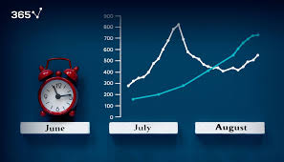
6. Methods for Predicting Real Estate Trends
6.2 Quantitative Methods
6.2.1 Time Series Analysis
Uses historical data to forecast future trends.
Common Models:
Moving averages
Example:
Predicting housing prices based on 10 years of historical data
Year | Jan | Feb | Mar | Apr | May | Jun
2022 | 2450 | 2470 | 2520 | 2600 | 2650 | 2680
2023 | 2700 | 2730 | 2800 | 2920 | 3000 | 3050
2024 | 3100 | 3150 | 3220 | 3300 | 3380 | 3450

Slide 23
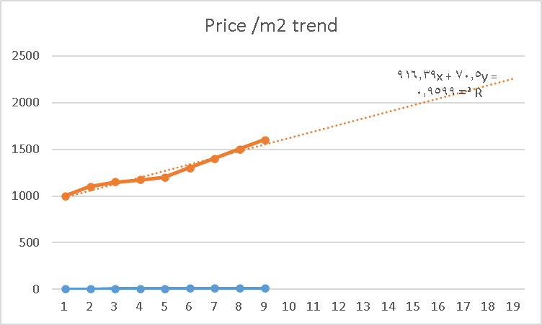
6. Methods for Predicting Real Estate Trends
| Month | Predicted Price ($/m²) |
| -------- | ---------------------- |
| Jan 2025 | 3,520 |
| Feb 2025 | 3,560 |
| Mar 2025 | 3,630 |
| Apr 2025 | 3,720 |
| May 2025 | 3,800 |
Sample Data
Monthly Average Price per m² (USD)
Month | Predicted Price ($/m²)
Jan 2025 | 3520
Feb 2025 | 3560
Mar 2025 | 3630
Apr 2025 | 3720
May 2025 | 3800
Interpretation
Expected annual growth ≈ 8–10%
Spring demand continues to drive price increases

Slide 24
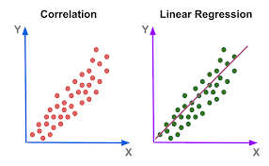
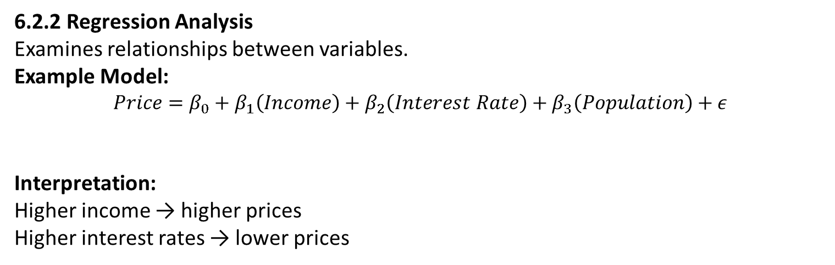
6. Methods for Predicting Real Estate Trends
📊 Final Answers
NPV: ≈ –$81,400
IRR: ≈ 9.4%
Payback Period: ≈ 4.4 years (≈ 4 years 5 months)
6.2.2 Regression Analysis
Examines relationships between variables.
Example Model:
$$Price=β_{0}+β_{1}\left(Income\right)+β_{2}\left(Interest Rate\right)+β_{3}\left(Population\right)+ε$$
Interpretation:
Higher income → higher prices
Higher interest rates → lower prices

Slide 25
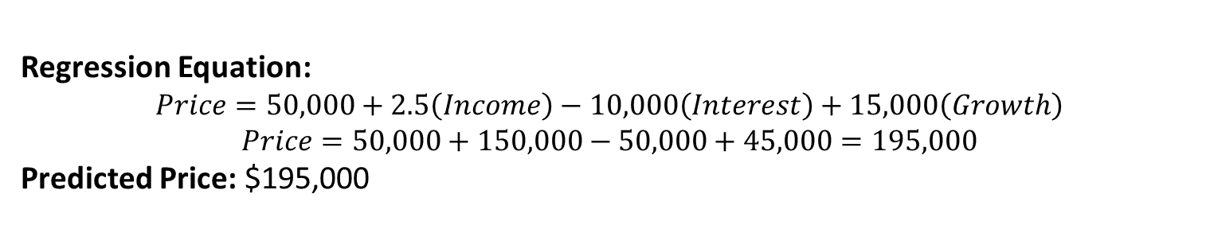
6. Methods for Predicting Real Estate Trends
nal Answers
NPV: ≈ –$81,400
IRR: ≈ 9.4%
Payback Period: ≈ 4.4 years (≈ 4 years 5 months)
Variable | Value
Median Income | $60000
Interest Rate | 5 %
Population Growth | 3 %
Regression Equation:
$$Price=50,000+2.5\left(Income\right)−10,000\left(Interest\right)+15,000\left(Growth\right)$$
$$Price=50,000+150,000−50,000+45,000=195,000$$
Predicted Price: $195,000

Slide 26
6. Methods for Predicting Real Estate Trends
6.2.3 Hedonic Pricing Models
Used to estimate property values based on characteristics:
Location
Size
Amenities
Accessibility
It assumes that a property's price reflects the sum of its characteristics.
𝑃𝑟𝑖𝑐𝑒=𝑓(𝑆𝑖𝑧𝑒,𝐿𝑜𝑐𝑎𝑡𝑖𝑜𝑛,𝐴𝑔𝑒,𝐴𝑚𝑒𝑛𝑖𝑡𝑖𝑒𝑠,𝐴𝑐𝑐𝑒𝑠𝑠𝑖𝑏𝑖𝑙𝑖𝑡𝑦,𝐸𝑛𝑣𝑖𝑟𝑜𝑛𝑚𝑒𝑛𝑡𝑎𝑙𝑄𝑢𝑎𝑙𝑖𝑡𝑦)

Slide 27
6. Methods for Predicting Real Estate Trends
Example : Hedonic Pricing Models
Data Description : Sample Dataset (100 Apartments)
Variable | Description | Expected Effect
Price (€) | Dependent variable | —
Size (m²) | Floor area | Positive
Bedrooms | Number of rooms | Positive
Distance to city center (km) | Accessibility | Negative
Building age (years) | Depreciation | Negative
Balcony (1=yes) | Amenity | Positive
Energy efficiency rating | Sustainability | Positive

Slide 28
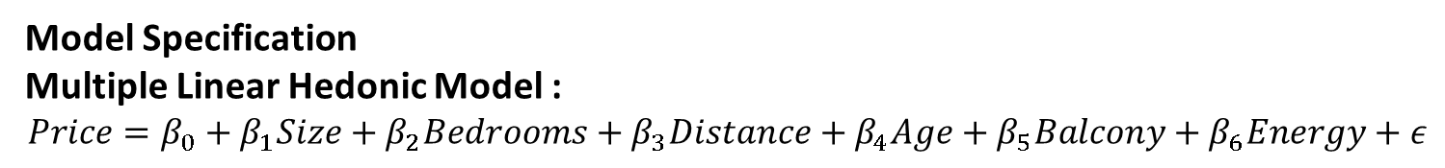
6. Methods for Predicting Real Estate Trends
Model Specification
Multiple Linear Hedonic Model :
$$Price=β_{0}+β_{1}Size+β_{2}Bedrooms+β_{3}Distance+β_{4}Age+β_{5}Balcony+β_{6}Energy+ε$$
Variable | Coefficient | Interpretation
Intercept | 45000 | Base price
Size | 3200 | Each extra m² adds €3,200
Bedrooms | 12000 | Additional bedroom increases value
Distance | -5500 | Each km from center reduces price
Age | -800 | Older buildings lower value
Balcony | 18000 | Balcony adds premium
Energy rating | 9500 | Higher efficiency increases value
Regression Results (Example)

Slide 29
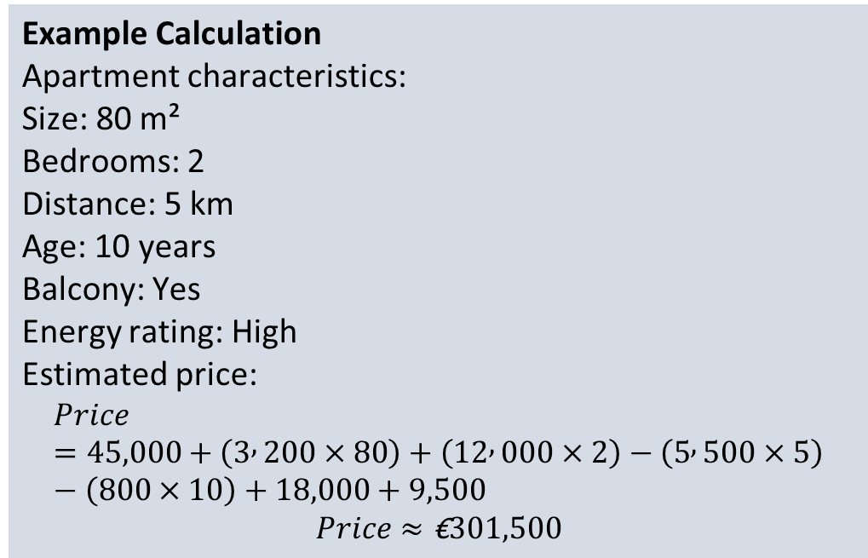
6. Methods for Predicting Real Estate Trends
A complete market study report should include a map that shows where the property sits within the metropolitan area or a major city. At a smaller scale, a map should show the boundaries of the primary and secondary market areas, location of the site, nearby interstate highways, and key
Example Calculation
Apartment characteristics:
Size: 80 m²
Bedrooms: 2
Distance: 5 km
Age: 10 years
Balcony: Yes
Energy rating: High
Estimated price:
$$Price=45,000+\left(3 , 200×80\right)+\left(12 , 000×2\right)−\left(5 , 500×5\right)−\left(800×10\right)+18,000+9,500$$
$$Price≈\text{€}301,500$$
Interpretation of Results
Key Insights
Size is the strongest predictor of price.
Proximity to the city center significantly increases value.
Sustainable buildings command price premiums.
Amenities like balconies add measurable value.

Slide 30
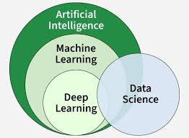
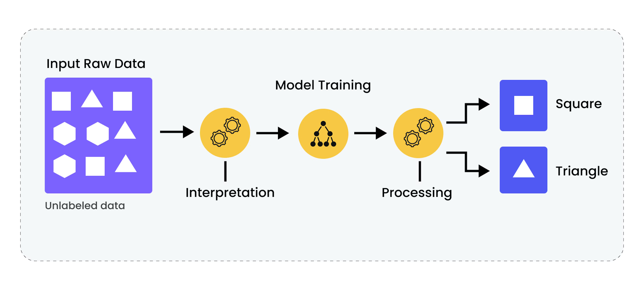
6. Methods for Predicting Real Estate Trends
6.2.4 Machine Learning Approaches
Machine learning (ML) is a subset of artificial intelligence (AI) that enables systems to learn from data, identify patterns, and make decisions or predictions without being explicitly programmed for every task.
It involves training algorithms—such as neural networks, decision trees, and regression models—on large datasets to improve performance over time

Slide 31
6. Methods for Predicting Real Estate Trends
Programming & Data Science Platforms
🥇 Python (Most Popular)
Best for: Full ML workflow and automation
Libraries used:
pandas → data preparation
scikit-learn → Random Forest, regression models
xgboost → boosting models
tensorflow / keras → neural networks (LSTM)
Machine Learning Approaches
Modern tools include:
Random Forest
Neural Networks
Applications:
Price prediction
Demand forecasting
Risk assessment

Slide 32
6. Methods for Predicting Real Estate Trends
Example: ML-Based Housing Demand Forecast
1. Scenario
A developer in a metropolitan area wants to forecast monthly apartment demand to decide how many units to build.
Objective
Predict number of apartment sales per month.

Slide 33
6. Methods for Predicting Real Estate Trends
Case Study 1: Mid-Rise Residential Development
Project Summary:
60 units
3-year development
Total cost: $8 million
Expected sales: $10.5 million
IRR = 16%
Required return = 15%
However, sensitivity analysis shows:
8% price drop → IRR falls to 11%
Conclusion:
Project is feasible but highly sensitive to price fluctuations.
2. Dataset (Sample) : Historical Data (24 Months)
Month | Interest Rate % | Population Growth % | Avg Price (€) | New Infrastructure (0/1) | Demand (Units Sold)
Jan | 4.5 | 1.2 | 2100 | 0 | 320
Feb | 4.4 | 1.2 | 2120 | 0 | 335
Mar | 4.3 | 1.3 | 2150 | 1 | 380
Apr | 4.1 | 1.3 | 2170 | 0 | 360
May | 4.0 | 1.4 | 2200 | 0 | 395
Jun | 3.9 | 1.4 | 2250 | 1 | 440
… | … | … | … | … | …

Slide 34
6. Methods for Predicting Real Estate Trends
3. Model Used
Random Forest Regression
Reason: Captures nonlinear effects (e.g., interest rates impact demand disproportionately)
Works well with small-to-medium datasets.
4. Model Results
Performance Metrics (Test Data)
✅ Interpretation:
The model explains 92% of demand variation — strong predictive accuracy.
Metric | Value
RMSE | 18 units
MAE | 14 units
R² | 0.92
Mean Absolute Error (MAE) is a common metric used to evaluate the accuracy of forecasting and machine learning models, including real estate demand prediction.

Slide 35
6. Methods for Predicting Real Estate Trends
Given that all 8 billion people on the planet must live somewhere, how do we organize ourselves?
5. Feature Importance (Quantitative)
insight
A 1% increase in interest rates reduces demand significantly.
Factor | Importance
Interest rates | 38%
Population growth | 27 %
Average price | 20 %
Infrastructure projects | 15 %

Slide 36
lecture
6. Methods for Predicting Real Estate Trends
Numerous areas of contemporary economics are connected to urban economics. My early professional goal was to become a | Source | % of Sessions |
| --------------------- | ------------- |
| Organic Search | 41% |
| Paid Ads (Google Ads) | 27% |
| Social Media | 18% |
| Direct | 14% |
macroeconomist. Understanding the causes and effects of booms and recessions is the goal of macroeconomists. Additionally, they aim to comprehend the
6. Forecast Example
Input for Next Month
Variable | Value
Interest rate | 3. 8%
Population growth | 1.5%
Avg price | €2300
Infrastructure | 1
Model Prediction
👉 Predicted Demand: 462 units

Slide 37
6. Methods for Predicting Real Estate Trends
| Competitor Project | Units | Price Range | Occupancy |
| -------------------- | ----- | ----------- | --------- |
| Sunrise Towers | 180 | $180k–$260k | 92% |
| Al Noor Residences | 250 | $160k–$240k | 95% |
| Palm View Apartments | 150 | $200k–$300k | 88% |
7. What-If Analysis (Sensitivity)
Scenario A: Interest Rate Increase to 4.5%
Predicted demand → 390 units
📉 Demand drops by 72 units (-15.6%)
Scenario B: New Metro Line Announced
Predicted demand → 495 units
📈 Increase of 33 units (+7.1%)
9. Visualization Insight (Conceptual)
Demand vs Interest Rate relationship learned by model:
Below 4% → sharp demand increase
Above 4.5% → steep decline
This nonlinear pattern is difficult to capture with traditional regression.

Slide 38
6. Methods for Predicting Real Estate Trends
8. Business Decision Impact
Without ML
Developer plans: 500 units → risk of oversupply.
With ML Forecast
Recommended supply: 460–480 units
Scenario | Unsold Units | Cost per Unit (€120k) | Loss
No forecasting | 40 | €120000 | €4.8M
With ML | 5 | €120000 | €600k
💰 Savings from ML forecasting: €4.2 million

Slide 39

7.Impact of Global Events on Market Trends
| Priority Factor | % Selecting as “Very Important” |
| ----------------------- | ------------------------------- |
| Proximity to work | 72% |
| Parking availability | 65% |
| Public transport access | 58% |
| Security | 76% |
| Retail/services nearby | 49% |
7.1 Financial Crises
Example: 2008 crisis led to global housing price declines.
7.2 Pandemics
COVID-19 effects:
Increased suburban demand
Growth in remote work housing preferences
7.3 Climate Change
Rising sea levels affect coastal property values.

Slide 40

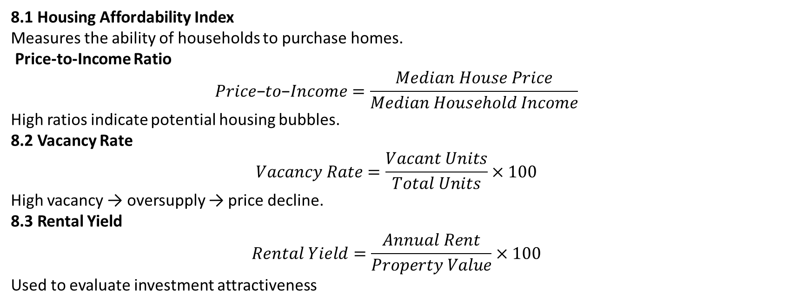
8. Key Market Indicators for Forecasting
8.1 Housing Affordability Index
Measures the ability of households to purchase homes.
Price-to-Income Ratio
$$Price\text{−}to\text{−}Income=\frac{Median House Price}{Median Household Income}$$
High ratios indicate potential housing bubbles.
8.2 Vacancy Rate
$$Vacancy Rate=\frac{Vacant Units}{Total Units}×100$$
High vacancy → oversupply → price decline.
8.3 Rental Yield
$$Rental Yield=\frac{Annual Rent}{Property Value}×100$$
Used to evaluate investment attractiveness

Slide 41

9. Risk Factors in Real Estate Forecasting
| Priority Factor | % Selecting as “Very Important” |
11. Risk Factors in Real Estate Forecasting
Economic downturns
Policy changes
Over-speculation
Construction cost inflation
Environmental risks
| ----------------------- | ------------------------------- |
| Proximity to work | 72% |
| Parking availability | 65% |
| Public transport access | 58% |
| Security | 76% |
| Retail/services nearby | 49% |
Economic downturns
Policy changes
Over-speculation
Construction cost inflation
Environmental risks

Slide 42

10. Tools and Software for Market Prediction
Using Qualitative Research
10. Tools and Software for Market Prediction
10.1 Analytical Tools
Excel forecasting models
R and Python for statistical modeling
GIS for spatial analysis
10.2 Real Estate Platforms
Zillow analytics
Real Capital Analytics
CoStar

Slide 43
11. Integrating Forecasting into Investment Decisions
Market analysis
Trend forecasting
Risk assessment
Financial feasibility
Investment decision
Decision Framework

Slide 44

12. Ethical Considerations in Market Forecasting
Avoid data manipulation
Ensure transparency
Prevent speculative bubbles
Promote housing affordability

Slide 45
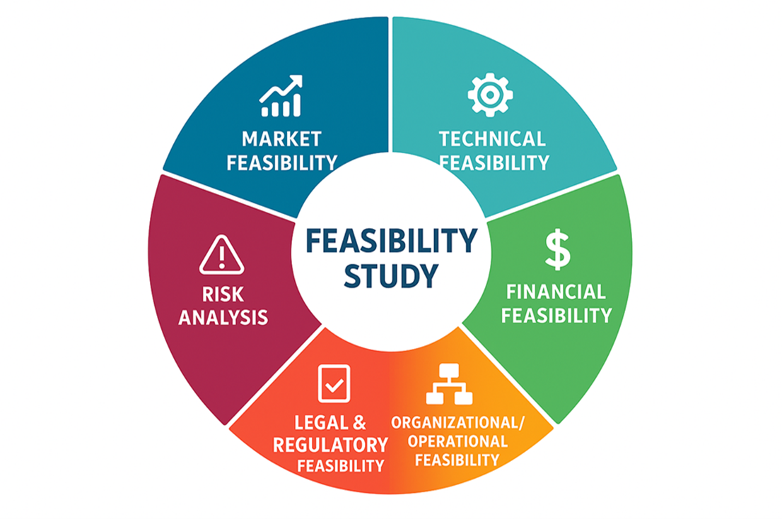
Conclusion
Predicting real estate market trends requires integrating economic indicators, demographic data, statistical models, and technological tools. Accurate forecasting enables investors, developers, and policymakers to make informed decisions, reduce risk, and promote sustainable urban growth.
lecture
07
Exercise
Predict real estate market analysis in your town?

Slide 46



Thank You

