Slide 1

Introduction to Economics
Prepared by Ms. Dina ElWakkad
Lecture 6
MGM112
GOVERNMENT ACTIONS
IN MARKETS

Slide 2

Chapter
4
GOVERNMENT ACTIONS IN MARKETS
In this chapter, look for the answers to these questions:
What are price ceilings and price floors?
  What are some examples of each?
How do price ceilings and price floors affect market outcomes?
What is the incidence of a tax?
  What determines the incidence?

Slide 3
Chapter
4
CONTROLS ON PRICES
Government policies can deliberately alter the private market outcome.
  Set a price ceiling: a legal maximum on the price
  of a good or service Example: rent control.
  Set a price floor: a legal minimum on the price of
  a good or service Example: minimum wage.
  Through taxes.
    The government can make buyers or sellers pay a specific amount on each unit.

Slide 4
Chapter
4
CONTROLS ON PRICES
Price ceiling
(Rent ceiling in housing market)

Slide 5
Chapter
4
1) Price ceiling
It is a regulation that makes it illegal to charge a price higher than a specified level
It is applied to a housing market it is called a rent ceiling.
Two outcomes are possible when government imposes price ceiling:
  If the rent ceiling is set above the equilibrium rent, it has no effect
  If the rent ceiling is set below the equilibrium rent, it leads t a shortage

Slide 6
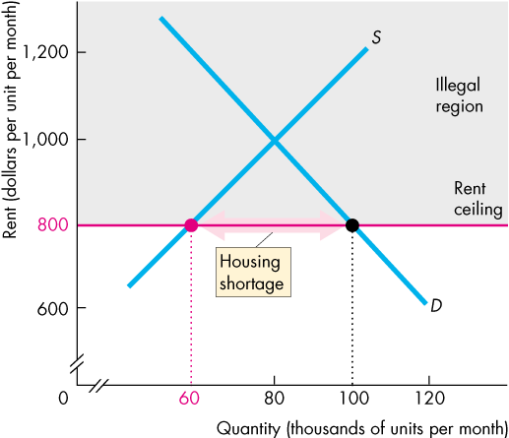
Chapter
4
1) Price ceiling
It leads to a shortage as it is set below the equilibrium rent.
The equilibrium rent is $1,000 a month.
A rent ceiling is set at $800 a month.
So, the equilibrium rent is in the illegal region.
There is a shortage of housing (Qs<Qd)

Slide 7
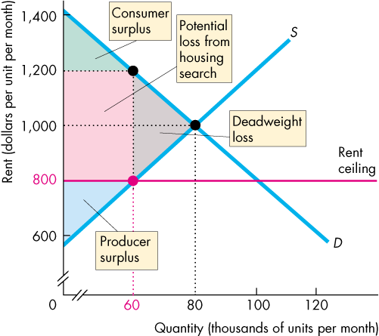
Chapter
4
1) Price ceiling
A rent ceiling set below the equilibrium rent leads to:
An inefficient underproduction of housing services (Shortage)→ Qs < Qd
A deadweight loss arises.
  Producer surplus decreases.
  Consumer surplus decreases.
  There is a potential loss from increased search activity.
  The full loss is the sum of the red and gray areas

Slide 8
Chapter
4
1) Price ceiling
Rent Ceilings is unfair, because;
According to the fair rules view, a rent ceiling is unfair because it blocks voluntary exchange.
According to the fair results view, a rent ceiling is unfair because it does not generally benefit the poor.
A rent ceiling decreases the quantity of housing, and the scarce housing is allocated by
  Lottery
    gives scarce housing to the lucky.
  First-come, first-served
    gives scarce housing to those who have the greatest foresight and get their names on the list first.
  Discrimination
  gives scarce housing to friends, family members, or those of the selected race or sex.
None of these methods leads to a fair outcome

Slide 9

Chapter
4
Think
A price ceiling is a price.
A) below which a seller cannot legally sell.
B) above which a seller cannot legally sell.
C) that creates a surplus of the good.
D) Both answers A and C are correct.
A price ________ is a regulated ________ that must be set below the equilibrium price to have an effect.
A) floor; price
B) floor; quantity
C) ceiling; price
D) ceiling; quantity

Slide 10
Chapter
4
Think
A rent ceiling ________.
A) increases the quantity of rental units supplied
B) cannot change the market price
C) set above equilibrium price has no effect
D) generally, aims at insuring that landlords receive a higher rent than would otherwise be the case
Which of the following is an effect of a price ceiling set below the equilibrium price?
A) Less of the good is produced with the ceiling than would be produced without the ceiling (Shortage / Excess demand)
B) The price ceiling has no effect on the market equilibrium.
C) Consumers can buy more than they can at the equilibrium price because the ceiling price is lower.
D) None of the above answers is correct.

Slide 11
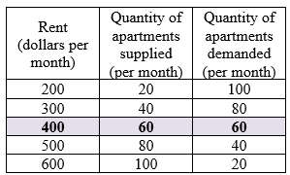
Chapter
4
Think
A rent ceiling creates a shortage. As a result, which of the following occurs?
A) only a loss of consumer surplus for tenants
B) only a loss of producer surplus for landlords
C) a loss of both consumer and producer surplus
D) a gain of both consumer and producer surplus
The This table gives the demand schedule and the supply schedule for housing in Anytown, U.S.A. If a rent ceiling of $300 is imposed in the housing market, then
A) there would be a surplus of apartments.
B) there would be a shortage of apartments.
C) the market would reach equilibrium at the quantity of 60 housing units.
D) the supply of housing would increase.

Slide 12
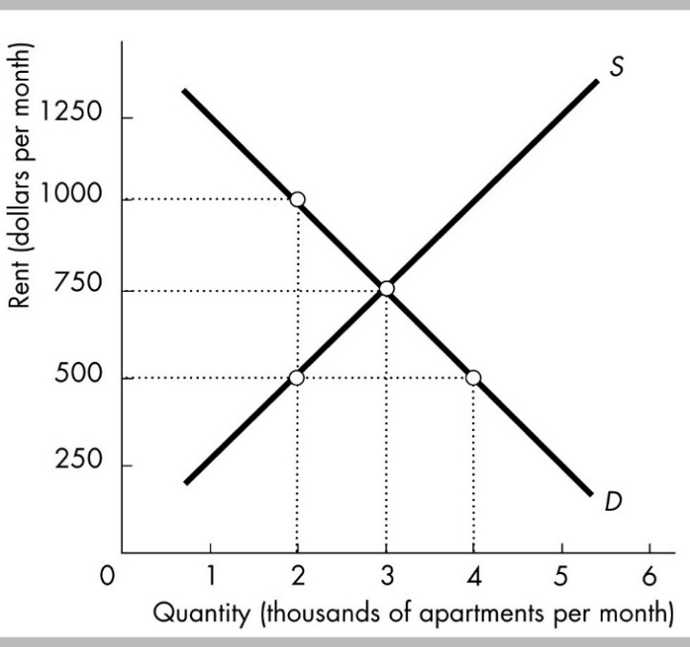
Chapter
4
Think
This figure shows the apartment rental market in Bigtown. At what rent will there be neither a shortage nor a surplus of apartments?
A) $1250 per month
B) $1000 per month
C) $750 per month
D) $500 per month

Slide 13
Chapter
4
CONTROLS ON PRICES
Price Floor
(Minimum wage in labor market)

Slide 14
Chapter
4
2) Price Floor
It is a regulation that makes it illegal to trade at a price lower than a specified level.is a regulation that
When a price floor is applied to labor markets, it is called a minimum wage.
If the minimum wage is set below the equilibrium wage rate, it has no effect. The market works as if there were no minimum wage.
  If the minimum wage is set above the equilibrium wage rate, it it leads to a surplus

Slide 15
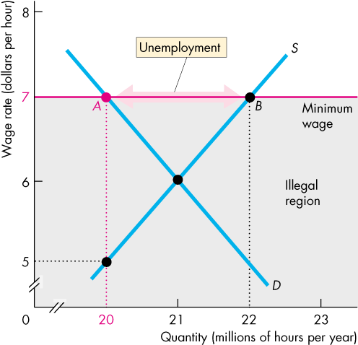
Chapter
4
2) Price Floor
It leads to an Unemployment as it is set above the equilibrium wage rate.
There is a surplus of labor (the quantity of labor supplied by workers > the quantity demanded by employers)
Because the quantity of labor hired at the minimum wage < the quantity that would be hired in an unregulated labor market.
the legal wage rate cannot eliminate the surplus, the minimum wage creates unemployment

Slide 16
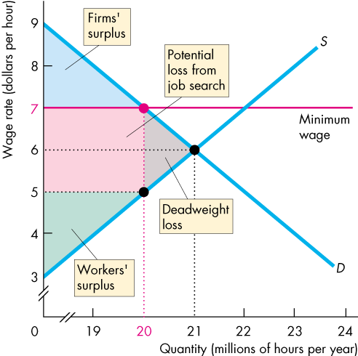
Chapter
4
2) Price Floor
A minimum wage set above the equilibrium wage rate leads to an inefficient outcome:
As a minimum wage set above the equilibrium wage decreases the quantity of labor employed.
  The quantity of labor employed is less than the efficient quantity (20 < 21)
A deadweight loss arises.
  The potential loss from increased job search decreases both workers’ surplus and firms’ surplus.
  The full loss is the sum of the red and gray areas.

Slide 17
Chapter
4
2) Price Floor
The Minimum Wage is Unfair, because; Most economists believe that minimum wage laws increase the unemployment rate of low-skilled younger workers

Slide 18
Chapter
4
Think
If policy makers believe that the equilibrium wage rate is too low, policy makers can raise wages by legislating a minimum wage, that is, a wage
A) ceiling above the equilibrium wage.
B) ceiling below the equilibrium wage.
C) floor above the equilibrium wage.
D) floor below the equilibrium wage.
A minimum wage set above the equilibrium wage rate is a price
A) ceiling that results in a shortage of low-skilled labor.
B) ceiling that results in a surplus of low-skilled labor.
C) floor that results in a shortage of low-skilled labor.
D) floor that results in a surplus of low-skilled labor.

Slide 19
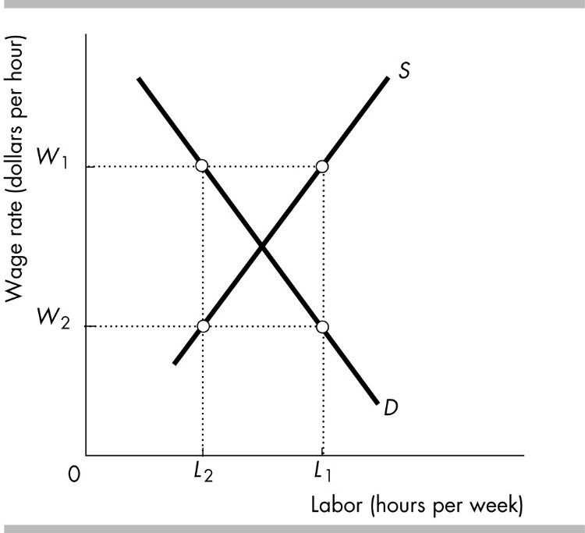
Chapter
4
Think
When a minimum wage is set above the equilibrium wage rate, ________.
A) the supply of low-skilled workers decreases, and the supply curve shifts rightward
B) unemployment increases
C) search activity decreases
D) the supply of low-skilled workers increases, and the supply curve shifts leftward
In the figure, a minimum wage of ________ would result in employment of ________.
A) W2; L1
B) W2; L2
C) W1; L1
D) W1; L2

Slide 20
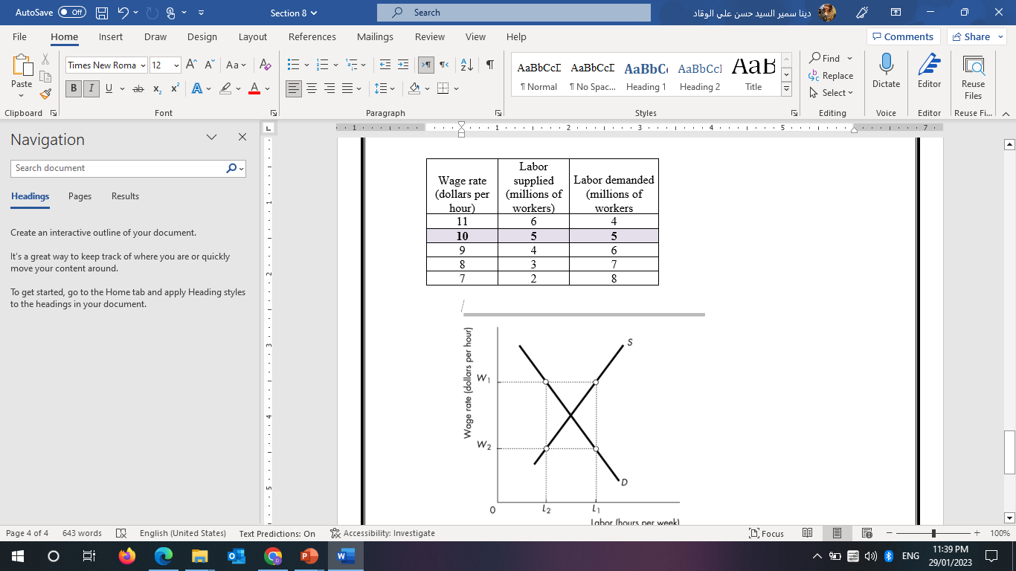
Chapter
4
Think
In the table, what is the equilibrium wage rate in an unregulated market?
A) $8.00 per hour
B) $9.00 per hour
C) $10.00 per hour
D) $11.00 per hour
In the table, what is the level of unemployment (in millions of workers) if the minimum wage is set at $8 per hour?
A) 0.
B) 1.
C) 3.
D) 4.
Because If the minimum wage is set below the equilibrium wage rate, it has no effect. The market works as if there were no minimum wage.

Slide 21
Chapter
4
CONTROLS ON PRICES
Tax Incidence

Slide 22
Chapter
4
3) Tax Incidence
It is the division of the burden of a tax between buyers and sellers.
If the price rises by the full amount of the tax,
  buyers pay the tax.
If the price rise by a lesser amount than the tax,
  buyers and sellers share the burden of the tax.
If the price doesn’t rise at all,
  sellers pay the tax.

Slide 23
Chapter
4
3) Tax Incidence
Tax incidence is the same regardless of whether the law says sellers pay or buyers pay.
HOW?

Slide 24
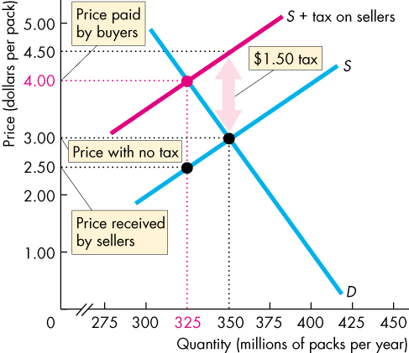
Chapter
4
3) Tax Incidence
The effect of tax on Sellers
With no tax, the equilibrium price is $3.00 a pack.
A tax on sellers of $1.50 a pack is introduced.
Supply decreases and the curve S + tax on sellers shows the new supply curve.
The market price paid by buyers rises to $4.00 a pack and the quantity bought decreases.
The price received by the sellers falls to $2.50 a pack.
So, with the tax of $1.50 a pack, buyers pay $1.00 a pack more and sellers receive 50¢ a pack less.

Slide 25
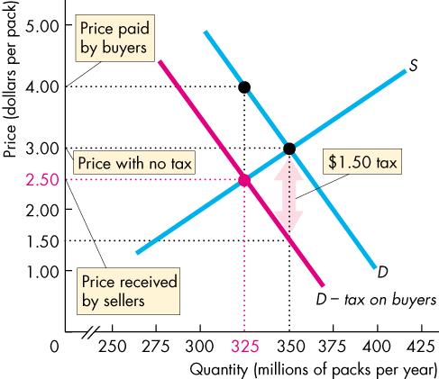
Chapter
4
3) Tax Incidence
The effect of tax on buyers
With no tax, the equilibrium price is $3.00 a pack.
A tax on buyers of $1.50 a pack is introduced.
Demand decreases and the curve D − tax on buyers shows the new demand curve.
The price received by sellers falls to $2.50 a pack and the quantity decreases.
The price paid by buyers rises to $4.00 a pack.
So, with the tax of $1.50 a pack, buyers pay $1.00 a pack more and sellers receive 50¢ a pack less.

Slide 26
Chapter
4
3) Tax Incidence
So, exactly as before when sellers were taxed:
  Buyers pay $1.00 of the tax.
  Sellers pay the other 50¢ of the tax.

Slide 27
Chapter
4
3) Tax Incidence
The division of the tax between buyers and sellers depend on the elasticities of demand and supply.
HOW?

Slide 28
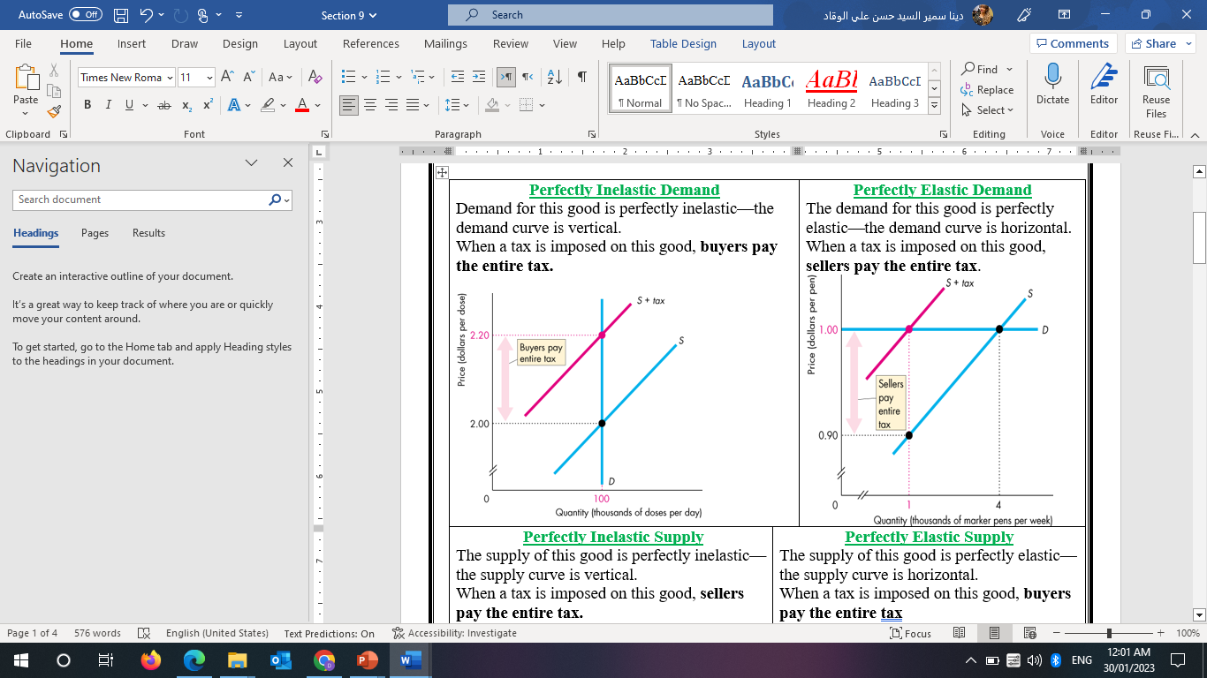
Chapter
4
3) Tax Incidence

Slide 29
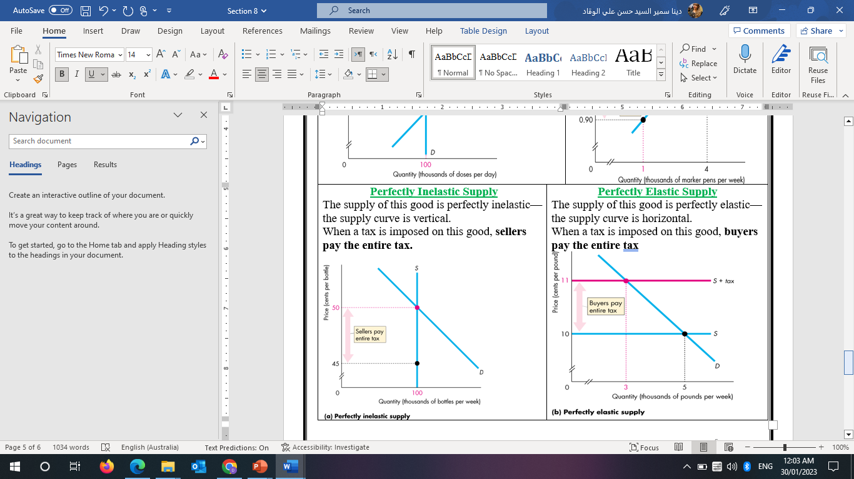
Chapter
4
3) Tax Incidence

Slide 30
Chapter
4
3) Tax Incidence
Buyers pay the entire tax when:
  Perfectly inelastic demand
  Perfectly elastic supply
Sellers pay the entire tax when:
  Perfectly elastic demand
  Perfectly inelastic supply

Slide 31
Chapter
4
3) Tax Incidence
So,
The more inelastic the demand, the larger is the buyers’ share of the tax.
The more elastic the supply, the larger is the buyers’ share of the tax.

Slide 32
Chapter
4
Think
A sales tax is imposed on the sellers of gasoline. This tax shifts
A) the supply of gasoline curve leftward.
B) the supply of gasoline curve rightward.
C) the demand for gasoline curve leftward.
D) both the supply curve of gasoline and demand curve for gasoline leftward.
A sales tax imposed on sellers shifts the supply curve leftward for the taxed good because the
A) tax is paid by the seller to the government and is, therefore, like a cost of production.
B) tax is actually shifted entirely onto the buyer who can afford only a smaller supply.
C) higher price causes entry into the market.
D) tax shifts the demand curve leftward.

Slide 33
Chapter
4
Think
How a sales tax is divided between buyers and sellers is determined by
A) the government's choice of whom to tax.
B) who the law says must pay the tax.
C) the elasticities of supply and demand.
D) the revenue needs of government.
The demand and the supply for a good are each neither perfectly elastic nor perfectly inelastic. If a sales tax on sellers of the good is imposed, the tax is paid by
A) only buyers.
B) only sellers.
C) both buyers and sellers.
D) neither buyers nor sellers.

Slide 34
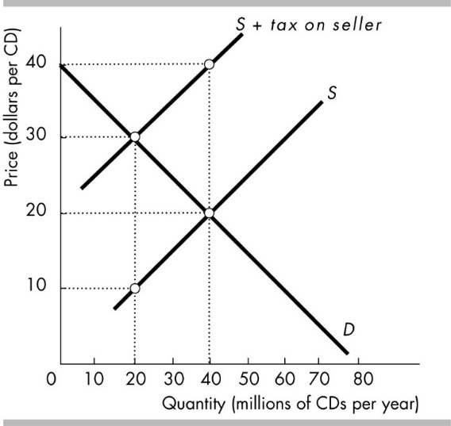
Chapter
4
Think
In the figure, the price paid by the buyer before the tax is ________ per compact disc, and the price paid by the buyer after the tax is ________ per compact disc.
A) $20; $20
B) $20; $30
C) $30; $20
D) $30; $30
In the figure, the price received by the seller before the tax is ________ per compact disc, and the price received and kept by the seller after the tax is ________ per compact disc.
A) $20; $20
B) $20; $10
C) $30; $20
D) $30; $10

Slide 35
Chapter
4
Think
If buyers of illegal goods are punished but sellers are not, then the price ________ and the equilibrium quantity ________. ( shift Demand leftward)
A) rises; increases
B) rises; decreases
C) falls; increases
D) falls; decreases
In general, a fine on smoking cigarettes shifts the ________ curve of cigarettes ________.
A) supply; rightward
B) supply; leftward
C) demand; rightward
D) demand; leftward

Slide 36
Chapter
4
Think
If penalties are imposed only on buyers (but not on sellers) of marijuana, the equilibrium price of marijuana ________, and the equilibrium quantity of marijuana sold ________.
A) rise; increase
B) rise; decrease
C) fall; increase
D) fall; decrease

Slide 37
Chapter
4
Summary outlines
A price ceiling is a legal maximum on the price of a good. An example is rent control. If the price ceiling is below the Equilibrium price, it is binding and causes a shortage.
A price floor is a legal minimum on the price of a good. An example is the minimum wage. If the price floor is above the Equilibrium price, it is binding and causes a surplus. The labor surplus caused by the minimum wage is unemployment

Slide 38
Chapter
4
Summary outlines
The incidence of a tax is the division of the burden of the tax between buyers and sellers and does not depend on whether the tax is imposed on buyers or sellers.
The incidence of the tax depends on the price elasticities of supply and demand.

Slide 39
Chapter
4
Important Notes
Among the factors that create a deadweight loss and inefficiency are minimum wages, rent ceilings, and taxes.
Price ceiling:
A price ceiling makes it illegal to charge a higher price than the specified price
To have an effect, a price ceiling must be set below the equilibrium price
A rent ceiling set above the equilibrium rent has no effect
A price ceiling, such as a rent ceiling, results in a shortage if the ceiling price is less than the equilibrium price.
The potential impact of a rent ceiling set below the equilibrium rent is Shortage, decrease consumer and producer surplus, and a deadweight loss
Price ceilings, such as rent ceilings, set below the equilibrium price decrease producer surplus

Slide 40
Chapter
4
Important Notes
Price ceiling:
Assume that your state government has placed a price ceiling of 30 per kilowatt hour on electricity. The equilibrium price per kilowatt hour for electricity is $.35. The government's action will result in a deadweight loss.
A rent ceiling set above equilibrium price has no effect

Slide 41
Chapter
4
Important Notes
Price floor
If policy makers believe that the equilibrium wage rate is too low, policy makers can raise wages by legislating a minimum wage, that is, a wage floor above the equilibrium wage.
When a minimum wage is set above the equilibrium wage rate, unemployment increases.
A minimum wage set above the equilibrium wage rate is a price floor that results in a surplus of low-skilled labor.
A price floor is a legal Minimum on the price of a good

Slide 42
Chapter
4
Important Notes
Tax Incidence:
The more elastic the demand for a good, the less a sales tax raises the price paid by buyers
The elasticity of demand for chocolate chip cookies is 0.5 and the elasticity of supply for these cookies is 1.8. If a tax is imposed on purchases of chocolate chip cookies, then the consumers would pay more of the tax.
A sales tax is divided so that the sellers pay the full amount if demand is perfectly elastic
A sales tax is imposed on the sellers. This tax shifts the supply curve leftward.
In general, a fine on buying a product led to the demand curve shifting leftward.
The more inelastic the demand, the larger is the buyers’ share of the tax.
The more elastic the supply, the larger is the buyers’ share of the tax.
A fine on smoking cigarettes shifts the demand curve of cigarettes leftward.

Slide 43
Thank You

