Slide 1


Project Time Management
مقرر: إداره وقت المشروع
Prepared by Dr. Amira Elfekky
PMG 212
Lecture 10

Slide 2

Agenda
Resource Loading
What is Resource Loading in Projects
Why use Resource Loading?
Resource Loading Benefits
Resource Loading Process
Baseline, Current, and Forecast Schedule Discipline
Schedule Analysis
Resource Leveling versus Resource smoothing
Estimate Cost Techniques
www.midocean.ae

Slide 3
Agenda
Resource Loading
What is Resource Loading in Projects
Why use Resource Loading?
Resource Loading Benefits
Resource Loading Process
Baseline, Current, and Forecast Schedule Discipline
Schedule Analysis
Resource Leveling versus Resource smoothing
Estimate Cost Techniques
www.midocean.ae

Slide 4
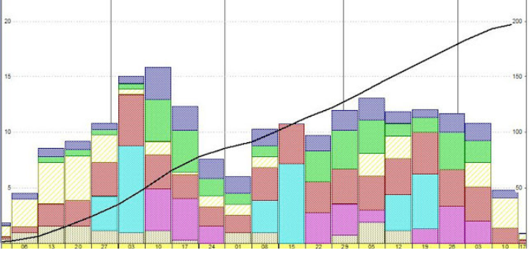
Chapter
10
Resource Loading
Resource loading is the step in resource planning where you assign tasks to each person in a team throughout a workweek. This process considers everyone's availability and assigns tasks to each resource according to their available hours.
www.midocean.ae

Slide 5
Chapter
10
Resource Loading
There are various ways that project tasks can be assigned within a team. Often each team member will be assigned a percentage of a task or activity until 100% of their work capacity for the week is filled. This way, project managers can divide project tasks efficiently, so that their resources are neither over-utilized or under-utilized.
In other cases, project managers may choose not to fill up 100% of each team member's available hours with critical tasks. Instead, they assign up to 75 - 80% to specific tasks. The remaining hours can be used for responsive activities such as checking and responding to email, bathroom breaks and other tasks. This way, team members can ensure the quality of their output by having manageable workloads.
www.midocean.ae

Slide 6
Chapter
10
Resource Loading
Why is resource loading essential in project management?
Project managers struggle to maximize the use of project resources while keeping the workload healthy. That’s where tracking your project’s resource load can help.
The benefits of resource loading are:
Accurately calculate (or visualize using a resource loading chart) resource availability to decide if you want to take up more work.
Visualize resource workload to spot under or over-allocation. Adjust to maximize utilization without burning out your team.
www.midocean.ae

Slide 7
Chapter
10
Resource Loading
Why is resource loading essential in project management?
The benefits of resource loading are:
Use team resources to their full potential and avoid disengaged workers by preventing under-allocation.
Keep stakeholders informed and happy by setting realistic expectations of project success.
Consider employee availability to accommodate changes and stick to the project schedule.
Stay on top of your team’s workload to identify and plan for resource risks beforehand.
www.midocean.ae

Slide 8
Chapter
10
Resource Loading
Resource loading vs. resource leveling
Resource loading and resource leveling are different resource management techniques applied in different situations. Both resource planning techniques, although different, help a project manager keep the project team’s workload healthy and deliver projects on time.
www.midocean.ae

Slide 9
Chapter
10
Resource Loading
Resource loading vs. resource leveling
Here’s a table that summarizes the key differences between the two techniques.
 | Resource loading | Resource leveling
Why? | Optimize assignments based on available resources | Optimize project timeline to prevent over/under allocation
What? | Assign work based on available capacity | Adjust resource allocation based on project priorities
When | During the initial project planning phase | After you allocate resources to the project
www.midocean.ae

Slide 10

Chapter
10
Resource Loading
What is resource scheduling?
Why do we use it?
How does it work?
www.midocean.ae

Slide 11
Agenda
Resource Loading
What is Resource Loading in Projects
Why use Resource Loading?
Resource Loading Benefits
Resource Loading Process
Baseline, Current, and Forecast Schedule Discipline
Schedule Analysis
Resource Leveling versus Resource smoothing
Estimate Cost Techniques
www.midocean.ae

Slide 12

Chapter
10
What is Resource Loading in Projects
People, equipment, money, space, bulks...
It defines which resources should be utilized on specific tasks - between which dates.
www.midocean.ae

Slide 13
Agenda
Resource Loading
What is Resource Loading in Projects
Why use Resource Loading?
Resource Loading Benefits
Resource Loading Process
Baseline, Current, and Forecast Schedule Discipline
Schedule Analysis
Resource Leveling versus Resource smoothing
Estimate Cost Techniques
www.midocean.ae

Slide 14
Chapter
10
Why use Resource Loading?
Produce more realistic schedules
Produce progress & resource curves
Comply with client requirements
Analytically manage and use schedule float
Analyze staffing requirements
Evaluate effects of limited staffing
Avoid wide fluctuations in daily need for various resources (leveling)
www.midocean.ae

Slide 15
Agenda
Resource Loading
What is Resource Loading in Projects
Why use Resource Loading?
Resource Loading Benefits
Resource Loading Process
Baseline, Current, and Forecast Schedule Discipline
Schedule Analysis
Resource Leveling versus Resource smoothing
Estimate Cost Techniques
www.midocean.ae

Slide 16
Chapter
10
Resource Loading Benefits
Helps maximize utilization of resources
Produces realistic start/finish dates
Avoids peaks and valleys in staff
Helps in scheduling constrained resources
Good resource scheduling is the basis for maximizing the productivity of people and equipment while minimizing their cost.
www.midocean.ae

Slide 17
Chapter
10
Resource Loading
ACTIVITY A
TF = O
ACTIVITY B
TF = 45
Competing for the same resource at the same time.
Activity with the least TF is scheduled first
www.midocean.ae

Slide 18
Agenda
Resource Loading
What is Resource Loading in Projects
Why use Resource Loading?
Resource Loading Benefits
Resource Loading Process
Baseline, Current, and Forecast Schedule Discipline
Schedule Analysis
Resource Leveling versus Resource smoothing
Estimate Cost Techniques
www.midocean.ae

Slide 19
Chapter
10
Resource Loading Process
Budget Estimate
Engineering
Job hours
Drawings
Construction
Job hours
Quantities
PROJECT SCHEDULE
Engineering
Procurement
Construction
www.midocean.ae

Slide 20
Agenda
Resource Loading
What is Resource Loading in Projects
Why use Resource Loading?
Resource Loading Benefits
Resource Loading Process
Baseline, Current, and Forecast Schedule Discipline
Schedule Analysis
Resource Leveling versus Resource smoothing
Estimate Cost Techniques
www.midocean.ae

Slide 21
Chapter
10
Baseline, Current, and Forecast
Schedule Discipline
Baseline Schedule
  Represents the approved project plan
  Contains project execution activities, logic, and budget resources
  Provides the means for measuring actual project progress against the plan
Revised Baseline Schedule
  The Baseline Schedule with updates for Schedule Change Notices (approved scope changes and Project Manager approved changes in the execution plan)
www.midocean.ae

Slide 22
Chapter
10
Baseline, Current, and Forecast
Schedule Discipline
Current/Forecast Schedule
  Presents the actual progress of the project
  Includes projections
www.midocean.ae

Slide 23
Agenda
Resource Loading
What is Resource Loading in Projects
Why use Resource Loading?
Resource Loading Benefits
Resource Loading Process
Baseline, Current, and Forecast Schedule Discipline
Schedule Analysis
Resource Leveling versus Resource smoothing
Estimate Cost Techniques
www.midocean.ae

Slide 24
Chapter
10
Schedule Analysis
Is the project on schedule?
  What activities are ahead or behind schedule?
  What impact will to-date poor or good productivity have on the to-go portion of schedule?
  Has the execution plan or work process changed?
www.midocean.ae

Slide 25
Chapter
10
Schedule Analysis
What is the critical path?
  Has it changed from the baseline?
What are the means to recover the schedule?
  What are the resource requirements?
  What will it cost?
www.midocean.ae

Slide 26
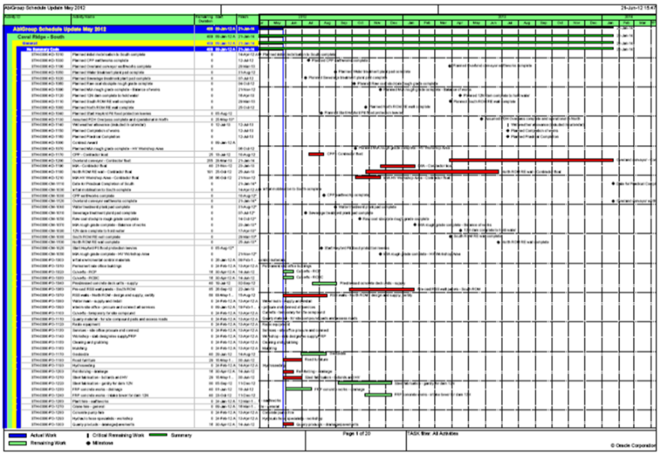
Chapter
10
Schedule Analysis Methods and Tools
Lecture 10
Critical path analysis
  Changes to the primary critical path and key milestones
  Impact on near critical path
Float analysis
  Impact on overall schedule (total and free float)
www.midocean.ae

Slide 27
Agenda
Resource Loading
What is Resource Loading in Projects
Why use Resource Loading?
Resource Loading Benefits
Resource Loading Process
Baseline, Current, and Forecast Schedule Discipline
Schedule Analysis
Resource Leveling versus Resource smoothing
Estimate Cost Techniques
www.midocean.ae

Slide 28
Chapter
10
Resource Leveling versus Resource smoothing
Resource leveling – This is used when scheduling the production of available resources is limited and needs to be used optimally.
Resource smoothing – This is used when time constraints are the biggest factor blocking production.
www.midocean.ae

Slide 29
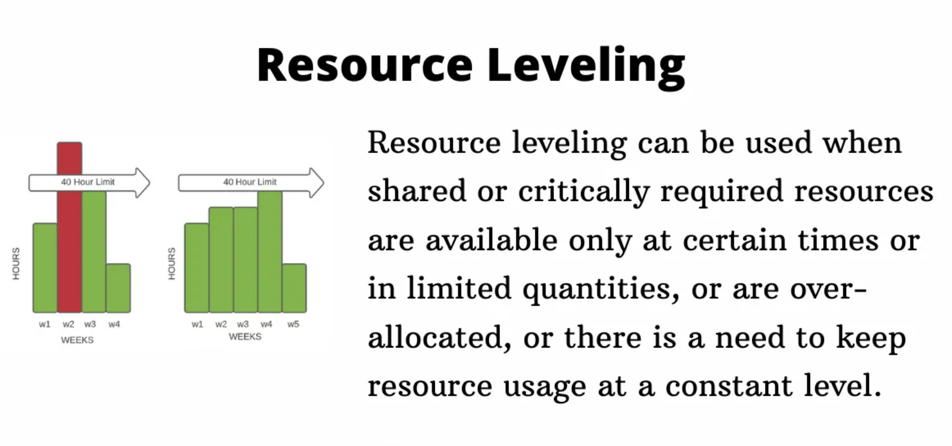
Chapter
10
Resource Loading
www.midocean.ae

Slide 30
Agenda
Resource Loading
What is Resource Loading in Projects
Why use Resource Loading?
Resource Loading Benefits
Resource Loading Process
Baseline, Current, and Forecast Schedule Discipline
Schedule Analysis
Resource Leveling versus Resource smoothing
Estimate Cost Techniques
www.midocean.ae

Slide 31
Chapter
10
Estimate Cost Techniques
Three-Point Estimates
  Triangular Distribution.
    cE = (cO + cM + cP) / 3
  Beta Distribution (from a traditional PERT analysis).
    cE = (cO + 4cM + cP) / 6
  Standard Deviation = (Pessimistic-optimistic) / 6
www.midocean.ae

Slide 32
Chapter
10
Estimate Cost Techniques
Earned Value Management (EVM) is a methodology that combines scope, schedule, and resource measurements to assess project performance and progress.
EVM can be used for analysis of cost and schedule baselines
Earned Value Management is carried out using the three main inputs:
Planned Value (PV)
Earned Value (EV)
Actual Cost (AC)
www.midocean.ae

Slide 33
Chapter
10
Earned Value Analysis
The earned value (EV), is a measure widely used in construction,
Earned Value Management (EVM) is a technique for calculating the 'percent complete' of a control account.
"Earned Value Analysis" is an industry standard way to:
• measure a project's progress,
• forecast its completion date and final cost,
• provide schedule and budget variances.
www.midocean.ae

Slide 34
Chapter
10
EVM Three Main Measurements
By integrating three measurements, it provides consistent, numerical indicators with which you can evaluate and compare projects.
Planned Value (PV) = Hourly Rate × Total Hours Planned
Actual Cost (AC) = Paid Hourly Rate x Actual Hours
Earned Value (EV) = Total value of work done = (Project value) x (% Completed)
EVM can measure VARIANCE and PERFORMANCE INDEX
www.midocean.ae

Slide 35
Chapter
10
Basic EVM Formulas
EVM is based on monitoring three aspects along the project in order to reveal the health of the project with the following indices:
(example of building 10 houses each has a value of US$10,000 expected to be completed in 10 Months in proportion):
Planned Value (PV) — The budgeted value of the work completed so far at a specific date
example: at end of Month 4, altogether 4 houses should be completed, the PV is US$40,000
Earned Value (EV) — The achieved value of the work completed so far at a specific date
example: by end of Month 4, only 3 houses are completed, the EV is US$30,000
Actual Cost (AC) — The total expenditure for the work so far at a specific date
example: by end of Month 4, $35,000 was spent, the AC is $35,000
www.midocean.ae

Slide 36
Chapter
10
Schedule and Cost Variance
Schedule Variance (SV) — difference between PV and EV, to tell whether the project work is
ahead of / on / behind schedule
  SV = EV – PV
  If the project is behind schedule the SV will be negative (i.e. achieved less than what planned)
  If the project is on schedule the SV = 0
  If the project is ahead of schedule the SV will be positive (i.e. achieved more than what planned)
  example: by end of Month 4, the SV = EV – PV = US$30,000 – US$40,000 = -US$10,000 (behind schedule)
www.midocean.ae

Slide 37
Chapter
10
Schedule and Cost Variance
Cost Variance (CV) — difference between PV and AC, to tell whether the project work is
under / on / over budget
  CV = EV – AC
  If the project is over budget the CV will be negative (i.e. achieved less than spent)
  If the project is on budget the CV = 0
  If the project is under budget the CV will be positive (i.e. achieved more than spent)
  example: by end of Month 4, the CV = EV – AC = $30,000 – $35,000 = - $5000 (over budget)
www.midocean.ae

Slide 38
Chapter
10
Schedule and Cost Performance Index
Schedule Performance Index (SPI) — ratio between EV and PV, to reflect whether the project work is ahead of / on / behind schedule in relative terms
  SPI = EV/PV
  If the project is behind schedule the SPI < 1 (i.e. achieved less than what planned)
  If the project is on schedule the SPI = 1
  If the project is ahead of schedule the SPI > 1 (i.e. achieved more than what planned)
  example: by end of week 4, the SPI = EV/PV = US$30,000/US$40,000 = 0.75 (behind schedule)
www.midocean.ae

Slide 39
Chapter
10
Schedule and Cost Performance Index
Cost Performance Index (CPI) — ratio between EV and AC, to reflect whether the project work is
under / on / over budget in relative terms
  CPI = EV/AC
  If the project is over budget the CPI < 1 (i.e. achieved less than spent)
  If the project is on budget the CPI = 1
  If the project is under budget the CPI > 1 (i.e. achieved more than spent)
  example: by end of week 4, the CPI = EV/AC = $30,000/ $35,000 = 0.86 (over budget)
Note both SV and SPI / CV and CPI give similar information on schedule / budget but the indices will give more insights into the actual performance with a meaning comparison.
www.midocean.ae

Slide 40

www.midocean.ae

Slide 41


Thank You
www.midocean.ae

