Slide 1



Organizational Behavior and Projects
PMG421
Prepared by Mrs. Deena Ibrahim
Lecture 1
Quality Foundations

Slide 2

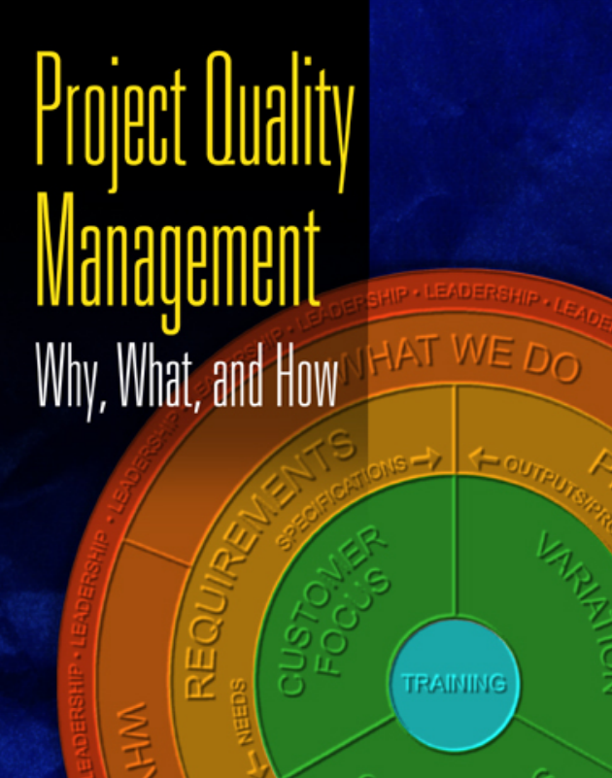


Slide 3



Chapter 1
Quality Foundations
Introduction
Traditional Definitions
Definition of Quality
Quality and the Triple Constraint
Cost of Quality
Benefits of Quality
Summery

Slide 4

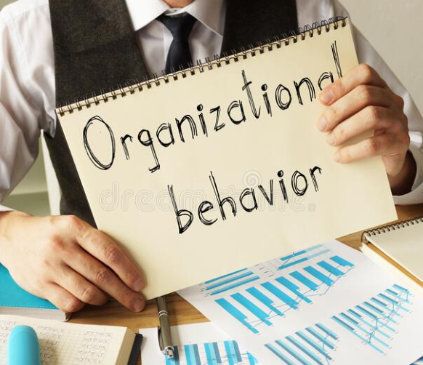

1- Introduction
What is the Organizational behavior?
Is there any connection between Organizational behavior and Quality?
Organizational behavior V. Organizational culture

Slide 5

Organizational behavior is the study of human behavior in organizations, focusing on individuals, teams, interpersonal processes, and organizational structures.
The ultimate goal of studying OB is to improve the performance of people, groups, and organizations, thus to improve the QUALITY of work life overall. Understanding OB will also help you develop the skills needed for a successful career. Because you are learning about behavior, you will no doubt sharpen your life skills, as well.

Slide 6

The organizational behavior studies include personality, motivation, organizational culture, ethics, teamwork, and leadership.
These are critically important for long-term career and life success. Learning about OB will provide foundational knowledge about human behavior, and prepare you to adapt and thrive in a dynamic and complex workplace.

Slide 7
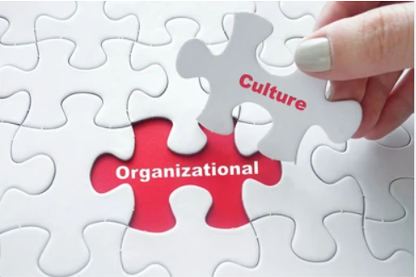
What is Organizational Culture?
Organizational culture refers to an organization’s shared values, beliefs, customs, practices, and social behavior. It is how things are done within an organization and includes unwritten rules and expectations, as well as the overall atmosphere created by the organization’s mission, vision, and values.
Organizational culture can significantly impact the behavior and performance of employees and the organization’s overall success. A strong, positive culture can foster employee engagement, creativity, and productivity, while a negative culture can lead to low morale, high turnover, and poor performance.

Slide 8

2. Traditional Definitions
Quality means “features of products which meet customer needs and thereby provide customer satisfaction.”
Quality improvement related to features usually costs more.
Quality also means “freedom from deficiencies.” Such failures “Deficiencies” may result in claims, customer dissatisfaction, or dire consequences to the user.

Slide 9
TITLE OF SLIDE
Traditional Definitions
Quality improvement related to deficiencies usually costs less.
The Project Management Institute “PMI” defines quality as “The degree to which a set of inherent characteristics fulfill requirements.”
This definition is taken directly from ISO 9000:2000

Slide 10
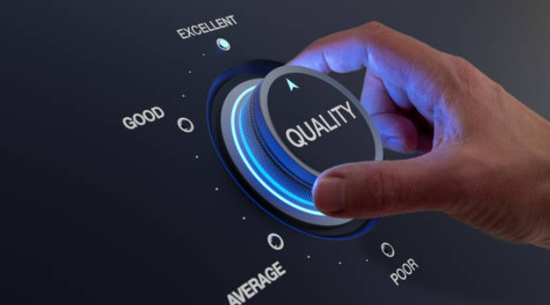
3. Definition of Quality
The key to project quality lies in making a more effective, meaningful transfer of proven quality methods to a general project management domain. Quality shares some central themes may be common to all. It may be:
“Products, defects, processes, customers, or systems”

Slide 11
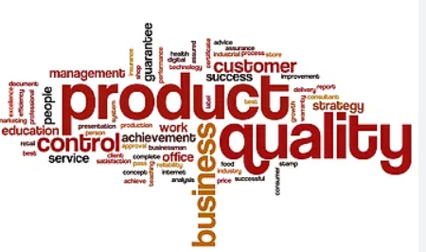

Products: quality is associated with products. This may be the most obvious linkage.
We define quality by our view of the features or attributes of some particular product:
This view can lead us with confidence to:
“I’ll know it when I see it” as a definition of quality.
Defects : The idea of defects in a product is closely related to the view of products themselves. We expect quality products to be free of defects.

Slide 12
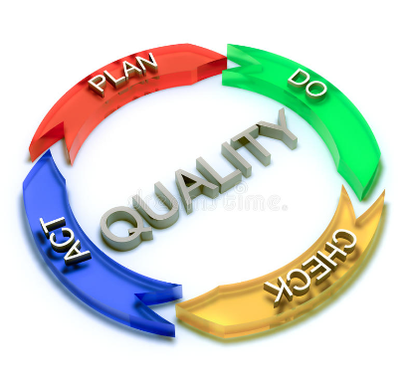
Processes: If we manufacture a product, we probably care very much about processes. Users focus more on the product and how it performs than on how it was produced. This issue is also very important to project managers. Whether they are delivering a product that results from manufacturing or purely intellectual activity, the processes that produce that product have great effect on the outcome.

Slide 13

Customers: People who sell what they make may be very product focused in their view of quality. They seek to make products that are superior to those of competitors and always strive to be the best, people who make what other people want to buy have a different view of quality and it is rooted in what customers want. To these people, quality is defined by customers, their needs, and their expectations.

Slide 14
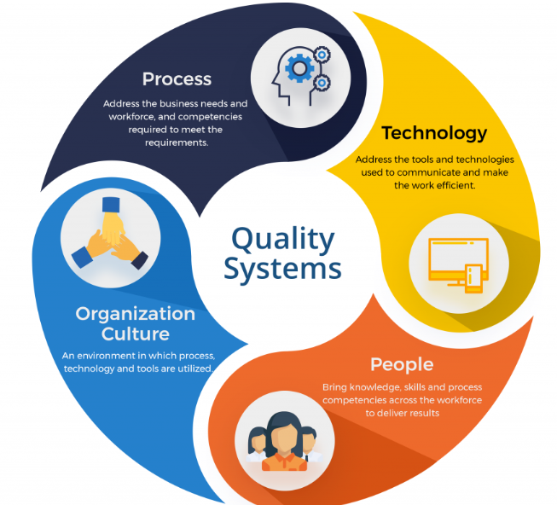
Systems
system is a group of things that work together. Quality may be viewed as arising from things that work together. Products, defects, processes, and customers are all part of a system that generates quality, as are suppliers, policies, organizations, and perhaps some other things unique to a specific situation.

Slide 15
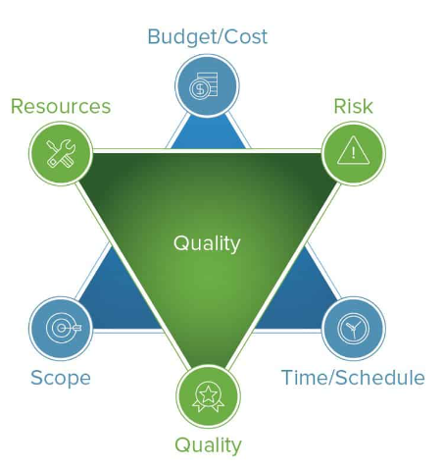
4. Quality and the Triple Constraint

Slide 16
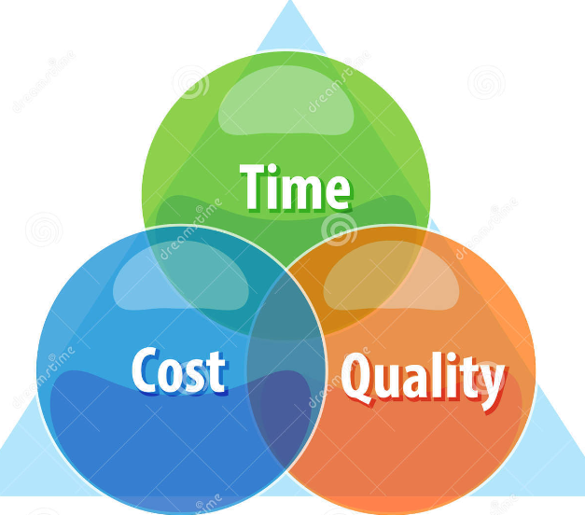
Quality and the Triple Constraint
Time, cost, and scope. All three elements are of equal importance to project success and to the project manager. Project managers typically try to balance the three when meeting project objectives, but they may make trade-offs among the three during project implementation in order to meet objectives and satisfy customers.

Slide 17
Quality is a fourth among equals. It may be most closely associated with scope because scope is based on customer requirements and quality is closely associated with customer requirements.

Slide 18
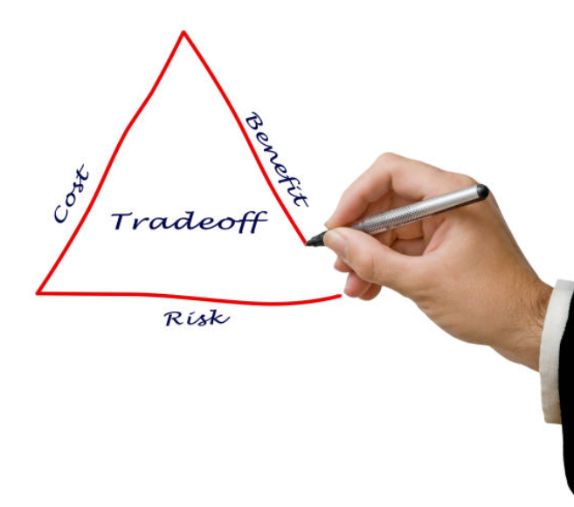
There is another important quality consideration: quality of the project itself. Quality processes that maintain cost and schedule constraints will ensure a quality project. Project managers routinely make trade-offs among the triple constraint to meet project objectives. A project manager should never, ever trade off quality during project implementation.

Slide 19
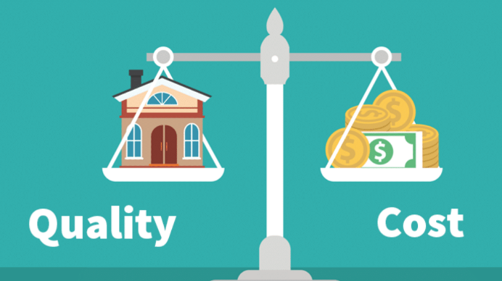
5. Cost of Quality

Slide 20
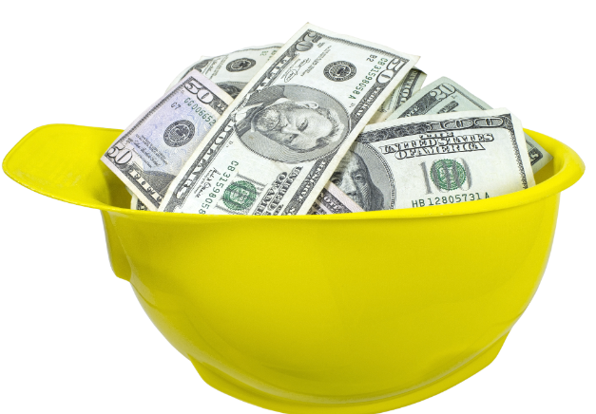
Cost of Quality
Quality is many things to many people, but quality is also not some things that have been assumed over time. Much misunderstanding exists about quality in spite of the various definitions in circulation.
An expensive process, When you improve the quality of a process, you reduce the defects that result from that process. While the new process may be more expensive - it may be less expensive, too - the resulting reduction of defects is something that pays back over and over and over. So if the payback is more than the cost, as it often is, quality is essentially free.

Slide 21

An expensive product, If a customer’s goal is to spend a lot of money, then an expensive product may be viewed as top quality. Customers generally seek the lowest price for a product that meets their functional needs, not the highest.

Slide 22

Time consuming, poor quality in production leads to rework. Delivery of poor quality products leads to replacement, warranty charges, lost customers, and loss of reputation. In the long run, quality saves time and much, much more.

Slide 23
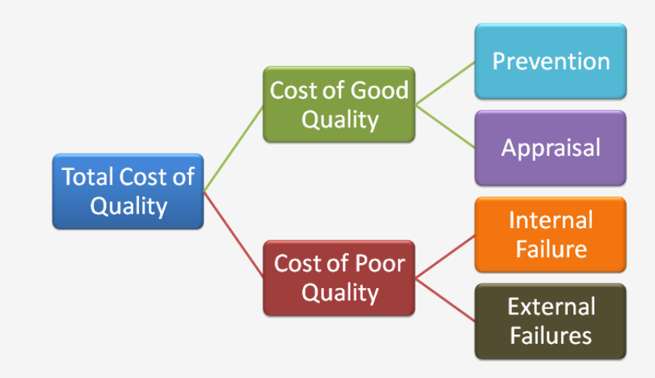
Crosby’s sources of cost of quality are three:
failure, prevention, and appraisal.
Philip Crosby (1926-2001) was an influential author, consultant and philosopher who developed practical concepts to define and communicate quality and quality improvement practices. He wrote the best-seller Quality is free in 1979.

Slide 24
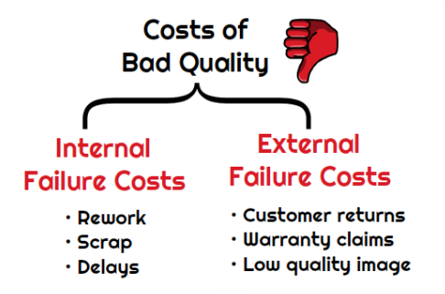
Failure, Failure costs may result from either internal or external failure. The major costs associated with internal failures, those that occur before a product has been delivered to a customer.
External failures, those that occur after a product has been delivered to a customer, may generate costs for repairs in accordance with product warranty obligations.

Slide 25
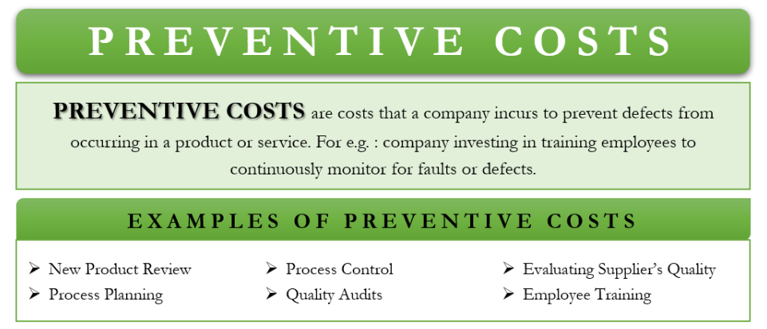
Prevention:
Prevention costs begin with planning. Prevention costs include both quality planning and audits, and process planning and control. Quality planning establishes the quality management system for the project. Quality audits ensure that the system works as intended.
Suppliers are a critical component of quality. Costs related to evaluating suppliers and their quality management systems are prevention costs.

Slide 26
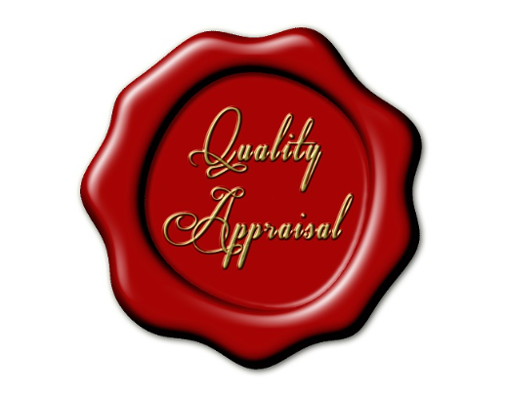
Appraisal, Appraisal costs begin with inspection of incoming supplies. The quality of a product is significantly affected by the quality of materials that go into its production. Supplier evaluations may have determined that a particular supplier will provide what is needed for a project, but inspection of actual deliveries is both prudent and essential.

Slide 27

6. Benefits of Quality

Slide 28

The benefits of quality in project performance are many.
First, a quality project and product will yield customer satisfaction. If you meet or exceed requirements and expectations, customers may come back to you for additional work when the need arises.

Slide 29
They may well become that oh-so-important unpaid sales representative and generate additional work from new customers through referrals.
A satisfied customer may perceive greater value than originally anticipated, which goes beyond customer satisfaction to customer delight.

Slide 30

Reduced costs are another benefit. Quality processes can reduce waste, improve efficiency, and improve supplies. As costs go down, profits may go up , or reduced costs may mean more sales to an existing customer within existing profit margins.

Slide 31

7. Summery

Slide 32

Quality involves products, defects, processes, customers, and systems.
Quality is the ability of a set of inherent characteristics of a product, system, or process to fulfill requirements of customers and other interested parties.
Quality is a fourth among equals in relation to the project triple constraint of time, cost, and scope.
Quality is not an expensive process, an expensive product, or time consuming.

Slide 33
The cost of quality may be viewed in terms of internal and external failure to conform to specifications.
The effects of failure to conform to specifications may include dissatisfied customers, loss of customers, loss of business, loss of revenue, and failure of the organization.
The effects of prevention and appraisal may include better products, better processes, more capable workers, and more satisfied customers.
Quality benefits include customer satisfaction, reduced costs, increased profits, and increased competitiveness.

Slide 34


Slide 35



