Slide 1



PMG 671
Leadership& Organizational
Behavior
Lecture 2
Overview
Prepared by
Dr. Walid K. El Leithy
www.midocean.ae

Slide 2

Attitudes & Job Satisfaction
Chapter Learning Objectives
Contrast the three components of an attitude.
Summarize the relationship between attitudes and behavior.
Compare and contrast the major job attitudes.
Define job satisfaction and show how it can be measured.

Slide 3
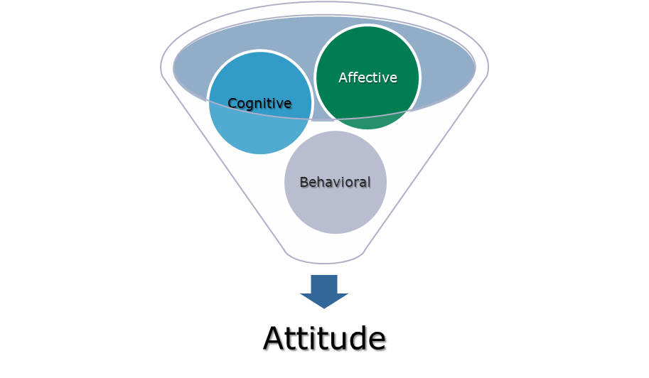
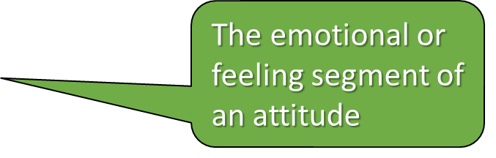
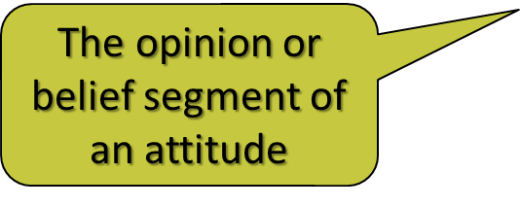
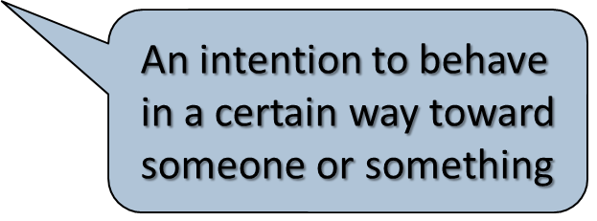
Organizational Behavior
Attitudes are evaluative statements or judgments concerning objects, people, or events.
Three components of an attitude:

Slide 4
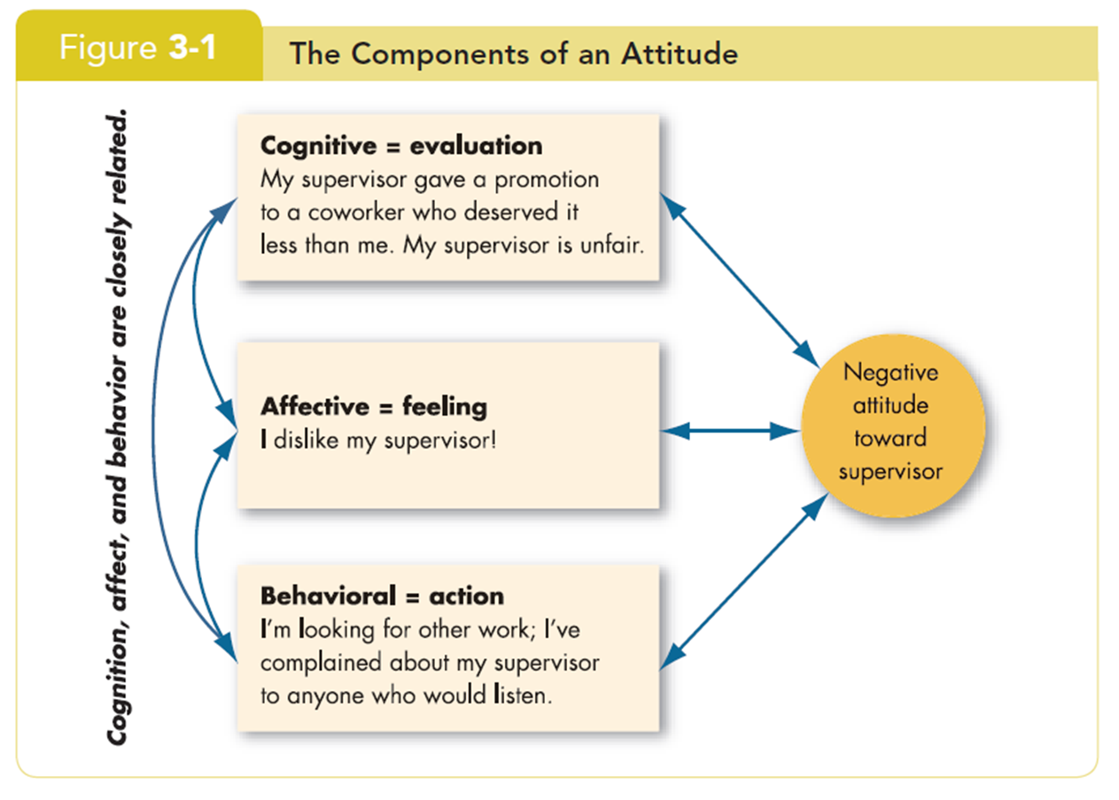
Attitudes

Slide 5
Does Behavior Always Follow from Attitudes?
No, the reverse is sometimes true!
Leon Festinger
Cognitive Dissonance is any incompatibility between two or more attitudes or between behavior and attitudes.
  Individuals seek to reduce this uncomfortable gap, or dissonance, to reach stability and consistency.

Slide 6
Does Behavior Always Follow from Attitudes?
  Consistency is achieved by changing the attitudes, modifying the behaviors, or through rationalization.
  Desire to reduce dissonance depends on:
    importance of elements;
    degree of individual influence;
    rewards involved in dissonance.

Slide 7
Predicting Behavior from Attitudes
  Important attitudes have a strong relationship to behavior.
  The closer the match between attitude and behavior, the stronger the relationship:
    Specific attitudes predict specific behavior.
    General attitudes predict general behavior.

Slide 8
Predicting Behavior from Attitudes
  The more frequently expressed an attitude is, the better predictor it is.
  High social pressures reduce the relationship and may cause dissonance.
  Attitudes based on personal experience are stronger predictors.

Slide 9
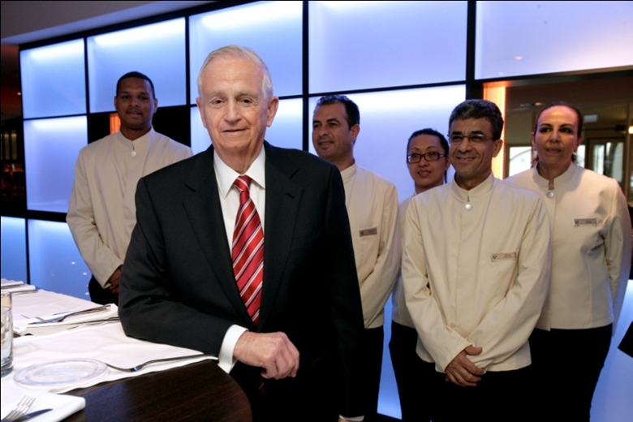
Predicting Behavior from Attitudes (cont’d)

Slide 10
Predicting Behavior from Attitudes (cont’d)
Marriott Hotels strives for consistency between attitudes and behavior through its motto ‘Spirit to Serve.’

Slide 11
What Are the Major Job Attitudes?
Job satisfaction
  A positive feeling about the job resulting from an evaluation of its characteristics.

Slide 12
What Are the Major Job Attitudes?
Job involvement
  Degree of psychological identification with the job where perceived performance is important to self-worth.

Slide 13
What Are the Major Job Attitudes?
Psychological Empowerment:
Employees’ beliefs in the degree to which they influence their work environment, their competence, the meaningfulness of their job, and their perceived autonomy.
12 One study of nursing managers in Singapore found that good leaders empower their employees by involving them in decisions, making them feel their work is important, and giving them discretion to “do their own thing

Slide 14
What Are the Major Job Attitudes?
Organizational Commitment
  Identifying with a particular organization and its goals, while wishing to maintain membership in the organization.
  Three dimensions:
    Affective commitment: emotional attachment to organization.
    Continuance commitment: economic value of staying.
    Normative commitment: moral or ethical obligations.

Slide 15
What Are the Major Job Attitudes?
  Has some relation to performance, especially for new employees.
  Less important now than in past—now perhaps more of occupational commitment, loyalty to profession rather than a given employer.

Slide 16
What Are the Major Job Attitudes?
Perceived organizational support (POS)
  The degree to which employees believe the organization values their contribution and cares about their well-being.
  Higher when rewards are fair, employees are involved in decision-making, and supervisors are seen as supportive.
  High POS is related to higher OCBs and performance.

Slide 17
What Are the Major Job Attitudes?
Employee engagement
  The degree of involvement with, satisfaction with, and enthusiasm for the job.
  Engaged employees are passionate about their work and company.

Slide 18

What Are the Major Job Attitudes?
To encourage employee engagement, Phillips has a program rewarding entrepreneurship in 22 Arab League states.

Slide 19
What Are the Major Job Attitudes?
Job Satisfaction
Job satisfaction is one of the primary job attitudes measured
  Broad term involving a complex individual summation of a number of discrete job elements.
How to measure it?
  Single global rating (one question/one answer) – Best.
  Summation score (many questions/one average) – OK.

Slide 20
What Are the Major Job Attitudes?
Are people satisfied in their jobs?
  Results depend on how job satisfaction is measured.
  Pay and promotion are the most problematic elements.
  Figures 3-2 and 3-3 show motivation and satisfaction levels in the Arab world.

Slide 21
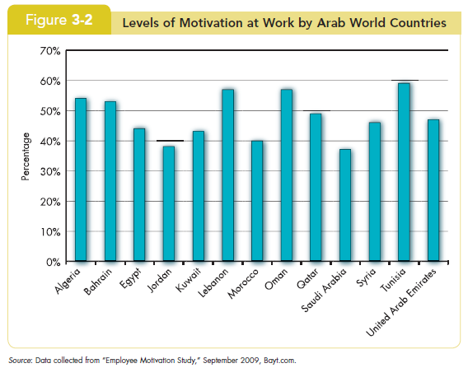
Job Satisfaction

Slide 22
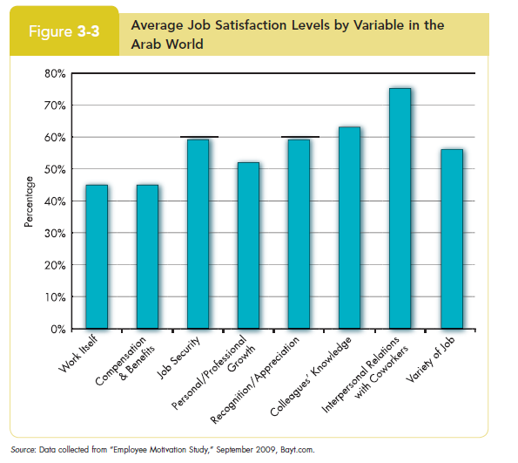
Job Satisfaction

Slide 23
Causes of Job Satisfaction
Pay influences job satisfaction only to a point
  Money may bring happiness, but not necessarily job satisfaction.
Personality can influence job satisfaction
  Negative people are usually not satisfied with their jobs.
  Those with positive core self-evaluation are more satisfied with their jobs.

Slide 24
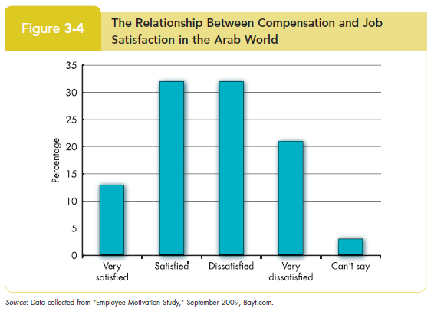
Causes of Job Satisfaction

Slide 25
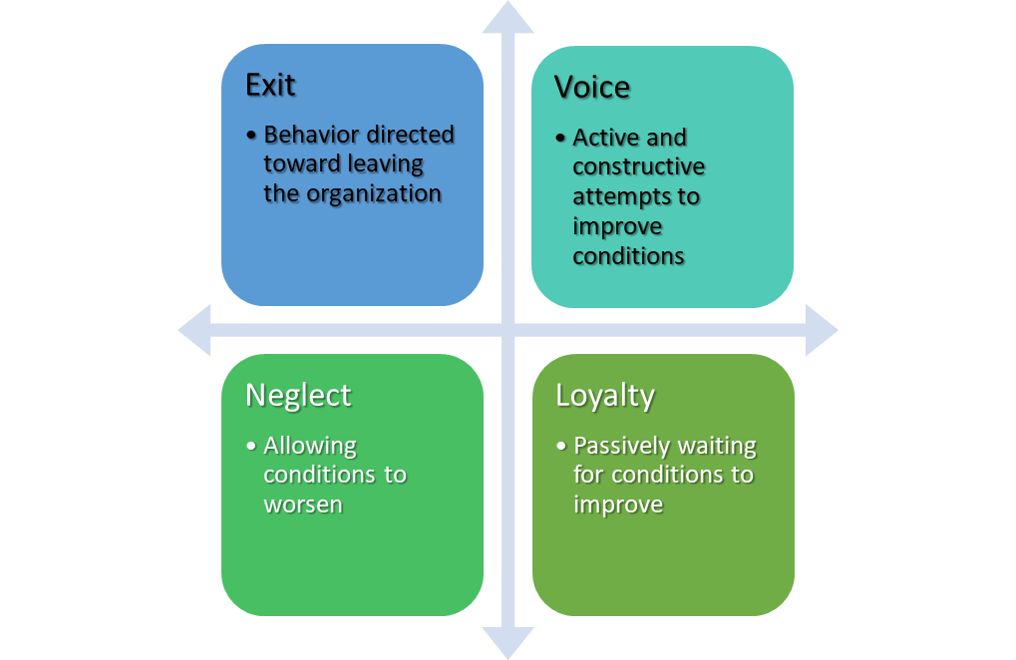
Employee Responses to Dissatisfaction

Slide 26
Outcomes of Job Satisfaction
Job performance
  Satisfied workers are more productive AND more productive workers are more satisfied!
  The causality may run both ways.

Slide 27
Outcomes of Job Satisfaction
Organizational citizenship behaviors
  Satisfaction influences OCB through perceptions of fairness.

Slide 28
Outcomes of Job Satisfaction
Customer satisfaction
  Satisfied frontline employees increase customer satisfaction and loyalty.

Slide 29
Outcomes of Job Satisfaction
Absenteeism
  Satisfied employees are moderately less likely to miss work.

Slide 30

Outcomes of Job Satisfaction
A major focus of Nissan Motor Company’s Diversity Development Office in Japan is helping female employees develop their careers.

Slide 31
Outcomes of Job Satisfaction
Lower turnover
  Satisfied employees are less likely to quit.
  Many moderating variables in this relationship.
    Economic environment and tenure.
    Organizational actions taken to retain high performers and to weed out lower performers.

Slide 32
Outcomes of Job Satisfaction
Workplace deviance
  Dissatisfied workers are more likely to unionize, abuse substances, steal, be tardy, and withdraw.

Slide 33
Outcomes of Job Satisfaction
Despite the overwhelming evidence of the impact of job satisfaction on the bottom line, most managers are either unconcerned about, or overestimate, worker satisfaction.

Slide 34
Global Implications
Is job satisfaction specific to cultures?
  Most of the research so far has been in the U. S., but the concept of job satisfaction is not specific to the U.S.
  More research is needed elsewhere.

Slide 35
Global Implications
Are employees in Western cultures more satisfied with their jobs?
  Western workers appear to be more satisfied than those in Eastern cultures.
  Perhaps because Westerners emphasize positive emotions and individual happiness more than do those in Eastern cultures.

Slide 36
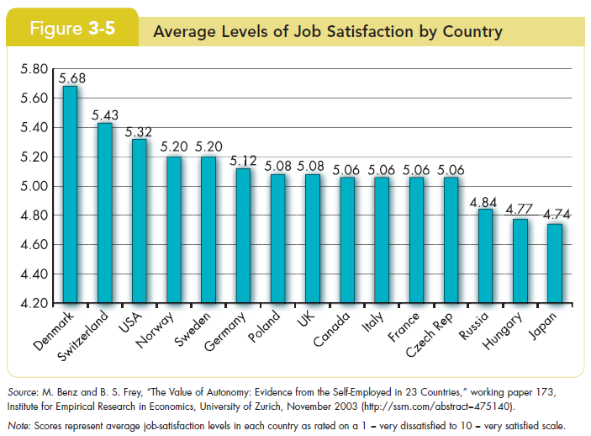
Global Implications

Slide 37
Summary and Managerial Implications
Managers should watch employee attitudes
  They give warnings of potential problems.
  They influence behavior.
Managers should try to increase job satisfaction and generate positive job attitudes
  Reduces costs by lowering turnover, absenteeism, tardiness, theft, and increasing OCB.
Focus on the intrinsic parts of the job
  Make work challenging and interesting.
  Pay is not enough.

Slide 38
Organizational Behavior
Stephen P. Robbins & Timothy A. Judg

Slide 39
Organizational Behavior
Stephen P. Robbins & Timothy A. Judg

Slide 40
Organizational Behavior
Stephen P. Robbins & Timothy A. Judg

