Slide 1



Information Systems
Prepared by Dr. Amjad Qtaish
IT372
Information Systems
Lecture 09

Slide 2




Module 5: IS in Business and Society
Information Systems
Dr. Amjad Qtaish
Faculty of Informatics
Midocean University
Chapter 15: Ethical and Social Issues in Information Systems
Information Systems (IT372)

Slide 3

Chapter
Outline
15
    IS in Business and Society :
Ethical and Social Issues
Information Systems and Ethics
Moral Dimensions
Technology Trends Affecting Ethics
Ethics in an Information Society
Moral Dimensions – Information Rights
Moral Dimensions – Property Rights
Moral Dimensions – Accountability, Liability, Control
Moral Dimensions – System Quality
Moral Dimensions – Quality of Life
Information Systems, Dr. Amjad Qtaish
3

Slide 4
Chapter
Learning Objectives
15
Identify ethical, social and political issues raised by information systems
Discuss codes of conduct
Identify the influence of information systems on privacy and intellectual property
Information Systems, Dr. Amjad Qtaish
4

Slide 5

Chapter
Ethical and Social Issues
15
The Web sites you visit track the search engine queries you enter, pages visited, Web content viewed, ads clicked, videos watched, content shared, and the products you purchase.
Google is the largest Web tracker, monitoring thousands of Web sites
Information Systems, Dr. Amjad Qtaish
5

Slide 6
Chapter
Ethical and Social Issues
15
Technology can be a double-edged sword:
It can be the source of many benefits (by showing you ads relevant to your interests)
but it can also create new opportunities for invading your privacy, and enabling the reckless use of that information in a variety of decisions about you
Information Systems, Dr. Amjad Qtaish
6

Slide 7
Chapter
Ethical and Social Issues
15
Search engine marketing is arguably the most effective form of advertising in history,
Banner display ad marketing is highly inefficient because it displays ads to everyone regardless of their interests.
Hence the search engine marketers cannot charge much for display ad space
Internet users, they can develop a very clear picture of who you are and use that information to show you ads that might be of interest to you. This would make the marketing process more efficient, and more profitable for all the parties involved
Information Systems, Dr. Amjad Qtaish
7

Slide 8
Chapter
Ethical and Social Issues
15
But this solution also creates an ethical dilemma:
Pitting the monetary interests of the online advertisers and search engines against the interests of individuals to maintain a sense of control over their personal information and their privacy.
As a manager,
You will need to be sensitive to both the negative and positive impacts of information systems for your firm, employees, and customers.
You will need to learn how to resolve ethical dilemmas involving information systems.
Information Systems, Dr. Amjad Qtaish
8

Slide 9
Chapter
Ethical and Social Issues
15
Ethics
Principles of right and wrong that individuals, acting as free moral agents, use to make choices to guide their behaviors
Ethics is about individual choice: When faced with alternative courses of action, what is the correct moral choice?
Information Systems, Dr. Amjad Qtaish
9

Slide 10
Chapter
Information Systems and Ethics
15
Information technology can be used to achieve social progress, but it can also be used to commit crimes and threaten social values.
For instance, Information systems raise new ethical questions because they create opportunities for:
Intense social change, threatening existing distributions of power, money, rights, and obligations
New kinds of crime
Information Systems, Dr. Amjad Qtaish
10

Slide 11
Chapter
Information Systems and Ethics
15
Ethics and the Internet:
Ethical issues in information systems have been given new urgency by the rise of the Internet and electronic commerce.
Internet and digital firm technologies make it easier than ever to assemble, integrate, and distribute information, unleashing new concerns about the appropriate use of customer information, the protection of personal privacy, and the protection of intellectual property.
Information Systems, Dr. Amjad Qtaish
11

Slide 12
Chapter
Information Systems and Ethics
15
Three levels: individual, social, and (legal) political
A model for thinking about ethical, social, and legal Issues
Think of a society as a calm pond
IT as rock dropped in pond, creating ripples of new situations not covered by old rules
Social (e.g. family, education, etc.) and legal (political) institutions cannot respond overnight to these ripples—it may take years to develop expectations and laws
Information Systems, Dr. Amjad Qtaish
12

Slide 13
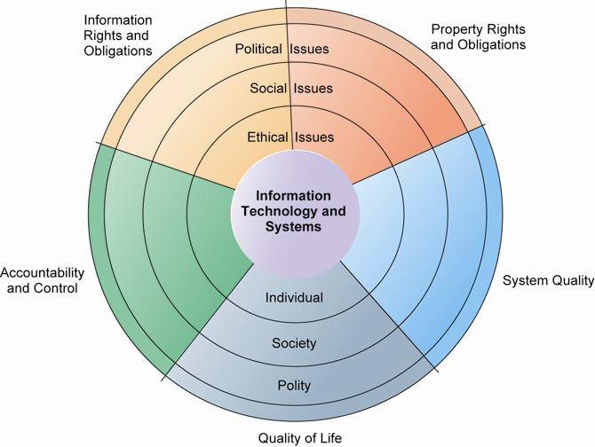
Chapter
Moral Dimensions
15
The introduction of new information technology has a ripple effect, raising new ethical, social, and legal issues that must be dealt with on the individual, social, and political levels. These issues have five moral dimensions: information rights and obligations, property rights and obligations, system quality, quality of life, and accountability and control.
Information Systems, Dr. Amjad Qtaish
13

Slide 14
Chapter
Moral Dimensions
15
Five moral dimensions of the information age:
Information rights and obligations
Property rights and obligations
Accountability and control
System quality
Quality of life
Information Systems, Dr. Amjad Qtaish
14

Slide 15
Chapter
Moral Dimensions
15
Information rights and obligations:
What information rights do individuals possess with respect to themselves? What can they protect?
Property rights and obligations
How will traditional intellectual property rights be protected in a digital society in which tracing and accounting for ownership are difficult?
Accountability and control
Who can and will be held accountable and liable for the harm done to individual and collective information and property rights?
Information Systems, Dr. Amjad Qtaish
15

Slide 16
Chapter
Moral Dimensions
15
System quality
What standards of data and system quality should we demand to protect individual rights and the safety of society?
Quality of life
What values should be preserved in an information-and knowledge-based society? Which institutions and values should we protect from violation?
Information Systems, Dr. Amjad Qtaish
16

Slide 17
Chapter
Technology Trends Affecting Ethics
15
Key technology trends that raise ethical issues
Doubling of computer power
More organizations depend on computer systems for critical operations.
Rapidly declining data storage costs
Organizations can easily maintain detailed databases on individuals.
Networking advances and the Internet
Copying data from one location to another and accessing personal data from remote locations are much easier.
Information Systems, Dr. Amjad Qtaish
17

Slide 18
Chapter
Technology Trends Affecting Ethics
15
Advances in data analysis techniques
Profiling
Combining data from multiple sources to create dossiers of detailed information on individuals
Nonobvious relationship awareness (NORA)
Combining data from multiple sources to find obscure hidden connections that might help identify criminals or terrorists
Mobile device growth
Tracking of individual cell phones
Information Systems, Dr. Amjad Qtaish
18

Slide 19
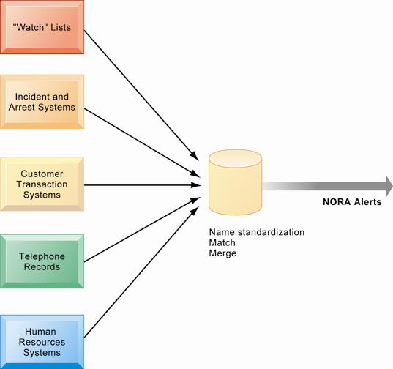
Chapter
Technology Trends Affecting Ethics
15
NORA technology can take information about people from disparate sources and find obscure, nonobvious relationships. It might discover, for example, that an applicant for a job at a casino shares a telephone number with a known criminal and issue an alert to the hiring manager.
Information Systems, Dr. Amjad Qtaish
19

Slide 20
Chapter
Ethics in an Information Society
15
Ethics is a concern of humans who have freedom of choice.
Ethical choices are decisions made by individuals who are responsible for the consequences of their actions.
Information Systems, Dr. Amjad Qtaish
20

Slide 21
Chapter
Ethics in an Information Society
15
Basic concepts for ethical analysis (key elements in ethical action):
Responsibility: Accepting the potential costs, duties, and obligations for decisions (accepting the consequences of your decision)
Accountability: means that mechanisms are in place to determine who took the action, and who is responsible.
Liability: Extends the concept of responsibility further to the area of laws. It means a body of laws is in place that permits individuals to recover the damages done to them by other actors.
Due process: a process in which laws are known and understood, and there is an ability to appeal to higher authorities to ensure that the laws are applied correctly. Individuals can recover damages done to them through a set of laws characterized by due process.
Information Systems, Dr. Amjad Qtaish
21

Slide 22
Chapter
Ethics in an Information Society
15
Five-step ethical analysis
Identify and clearly describe the facts.
Define the conflict or dilemma and identify the higher-order values involved.
Identify the stakeholders.
Identify the options that you can reasonably take.
Identify the potential consequences of your options.
Information Systems, Dr. Amjad Qtaish
22

Slide 23
Chapter
Ethics in an Information Society
15
Identify and clearly describe the facts: Find out who did what to whom, and where, when, and how
Define the conflict or dilemma and identify the higher-order values involved: The parties to a dispute all claim to be pursuing higher values, e.g. the need to improve health care record keeping and the need to protect individual privacy
Identify the stakeholders: players in the game who have an interest in the outcome, who have invested in the situation, etc
Information Systems, Dr. Amjad Qtaish
23

Slide 24
Chapter
Ethics in an Information Society
15
Identify the options that you can reasonably take: arriving at a good or ethical solution may not always be a balancing of consequences to stakeholders.
Identify the potential consequences of your options: Some options may be ethically correct but disastrous from other points of view. Other options may work in one instance but not in other similar instances
Information Systems, Dr. Amjad Qtaish
24

Slide 25
Chapter
Ethics in an Information Society
15
Once your analysis is complete, what ethical approachesor rules should you use to make a decision?
Although you are the only one who can decide which among many ethical principles you will follow, and how you will prioritize them, it is helpful to consider some ethical approacheswith deep roots in many cultures that have survived throughout recorded history, next slide
Information Systems, Dr. Amjad Qtaish
25

Slide 26
Chapter
Ethics in an Information Society
15
Candidate ethical approaches
Golden Rule
Do unto others as you would have them do unto you, Putting yourself into the place of others
Categorical Imperative
If an action is not right for everyone to take, it is not right for anyone. Ask yourself, “If everyone did this, could the organization, or society, survive?
Rule of Change
If an action cannot be taken repeatedly, it is not right to take at all. An action may bring about a small change now that is acceptable, but if it is repeated, it would bring unacceptable changes in the long run.
Information Systems, Dr. Amjad Qtaish
26

Slide 27
Chapter
Ethics in an Information Society
15
Utilitarian Principle
Take the action that achieves the higher or greater value. This rule assumes you can prioritize values in a rank order and understand the consequences of various courses of action
Risk Aversion Principle
Take the action that produces the least harm or potential cost. Some actions have extremely high failure costs of very low probability (e.g. building a nuclear generator)
Ethical “No Free Lunch” Rule
Assume that virtually all tangible and intangible objects are owned by someone unless there is a specific declaration otherwise. (relate to copyrights, patents, etc.)
Information Systems, Dr. Amjad Qtaish
27

Slide 28
Chapter
Ethics in an Information Society
15
Professional codes of conduct
Proclaimed by associations of professionals
Examples: American Medical Association (AMA)
Promises by professions to regulate themselves in the general interest of society (e.g. avoiding harm to others)
These professional groups take responsibility for the partial regulation of their professions by determining entrance qualifications and competence (put rules to be qualified).
Real-world ethical dilemmas
One set of interests pitted against another
Example: right of company to maximize productivity of workers versus workers right to use Internet for short personal tasks, replacing people for technology, reducing the size of workforce, etc.
Information Systems, Dr. Amjad Qtaish
28

Slide 29
Chapter
Moral Dimensions – Information Rights
15
Information rights: privacy and freedom in the Internet age
Privacy:
Claim of individuals to be left alone, free from surveillance or interference from other individuals, organizations, or state; claim to be able to control information about yourself
Information technology and systems threaten individual claims to privacy
In the United States, privacy protected by:
First Amendment (freedom of speech)
Fourth Amendment (unreasonable search and seizure)
Additional federal statues (e.g., Privacy Act of 1974)
Information Systems, Dr. Amjad Qtaish
29

Slide 30
Chapter
Moral Dimensions – Information Rights
15
Fair information practices (FIP):
Set of principles governing the collection and use of information
Basis of most U.S. and European privacy laws
Based on mutuality of interest between record holder and individual, once information is gathered by record holder, the individual maintains an interest in the record, and the record may not be used to support other activities without the individual’s consent.
Restated and extended by FTC (Federal Trade Commission) in 1998 to provide guidelines for protecting online privacy
Used to drive changes in privacy legislation
COPPA, Gramm-Leach-Bliley Act, HIPAA, Do-Not-Track Online Act of 2011
Information Systems, Dr. Amjad Qtaish
30

Slide 31
Chapter
Moral Dimensions – Information Rights
15
FTC FIP principles:
Notice/awareness (core principle)
Web sites must disclose practices before collecting data, e.g. uses of data; other recipients of data, etc.
Choice/consent (core principle)
Consumers must be able to choose how information is used for secondary purposes.
Access/participation
Consumers must be able to review and contest accuracy of personal data.
Security
Data collectors must take steps to ensure accuracy, security of personal data.
Enforcement
Must be mechanism to enforce FIP principles.
Information Systems, Dr. Amjad Qtaish
31

Slide 32
Chapter
Moral Dimensions – Information Rights
15
European Directive on Data Protection:
Companies must inform people that information is collected and disclose how it is stored and used.
Requires informed consent of customer.
EU member nations cannot transfer personal data to countries without similar privacy protection (e.g., the United States).
Information Systems, Dr. Amjad Qtaish
32

Slide 33
Chapter
Moral Dimensions – Information Rights
15
Internet challenges to privacy:
Cookies
Identify browser and track visits to site
Super cookies (Flash cookies)
Web beacons (Web bugs)
Tiny graphics embedded in e-mails and Web pages
Monitor who is reading e-mail message or visiting site
Spyware
Installed on user’s computer
May transmit user’s keystrokes or display unwanted ads
Google services and behavioral targeting
Information Systems, Dr. Amjad Qtaish
33

Slide 34
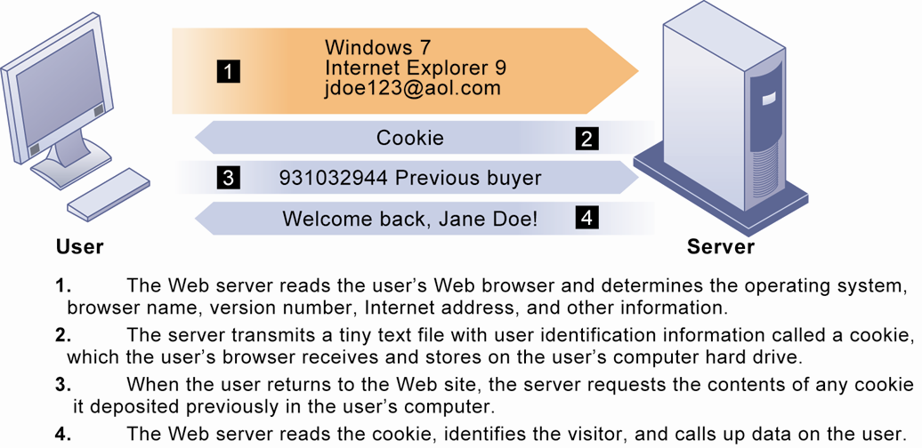
Chapter
Moral Dimensions
15
Cookies are written by a Web site on a visitor’s hard drive. When the visitor returns to that Web site, the Web server requests the ID number from the cookie and uses it to access the data stored by that server on that visitor. The Web site can then use these data to display personalized information.
Information Systems, Dr. Amjad Qtaish
34

Slide 35
Chapter
Moral Dimensions – Information Rights
15
Google has been using behavioral targeting to help it display more relevant ads based on users’ search activities.
One of its programs enables advertisers to target ads based on the search histories of Google users, along with any other information the user submits to Google that Google can obtain, such as age, demographics, region, and other Web activities
Google has also been scanning the contents of messages received by users of its free Web-based e-mail service called Gmail. Ads that users see when they read their e-mail are related to the subjects of these messages.
Information Systems, Dr. Amjad Qtaish
35

Slide 36
Chapter
Moral Dimensions – Information Rights
15
An opt-out model permits the collection of personal information until the consumer specifically requests that the data not be collected.
Opt-in model of informed consent in which a business is prohibited from collecting any personal information unless the consumer specifically takes action to approve information collection and use.
Information Systems, Dr. Amjad Qtaish
36

Slide 37
Chapter
Moral Dimensions – Information Rights
15
Besides legislations, there are Technical solutions to protect a user privacy:
E-mail encryption
Anti-spyware tools
Browser features
“Private ”browsing
“Do not track” options
Overall, few technical solutions
Information Systems, Dr. Amjad Qtaish
37

Slide 38
Chapter
Moral Dimensions – Property Rights
15
Property rights: Intellectual property
Intellectual property: intangible property of any kind created by individuals or corporations
Information technology has made it difficult to protect intellectual property because computerized information can be so easily copied or distributed on networks.
Information Systems, Dr. Amjad Qtaish
38

Slide 39
Chapter
Moral Dimensions – Property Rights
15
Three main ways that intellectual property is protected:
Trade secret: intellectual work or product belonging to business(e.g. formula for Coke)
Copyright: statutory grant protecting intellectual property from being copied for the life of the author, plus 70 years (copyright of a photo, book)
Patents: grants the owner an exclusive monopoly on the ideas behind an invention for 20 years (Amazon’s One Click shopping).
Information Systems, Dr. Amjad Qtaish
39

Slide 40
Chapter
Moral Dimensions – Property Rights
15
Challenges to intellectual property rights
Digital media different from physical media (e.g., books)
Digital media differ from books, periodicals, and other media in terms of ease of replication; ease of transmission; ease of alteration; difficulty in classifying a software work as a program, book, or even music; compactness—making theft easy; and difficulties in establishing uniqueness.
Mechanisms are being developed to sell and distribute books, articles, and other intellectual property legally on the Internet, and the Digital Millennium Copyright Act (DMCA) of 1998 is providing some copyright protection. Internet service providers (ISPs) are required to take down sites of copyright infringers that they are hosting once they are notified of the problem
Information Systems, Dr. Amjad Qtaish
40

Slide 41
Moral Dimensions – Accountability, Liability, Control
Chapter
15
Accountability, liability, control
Computer-related liability problems
if software fails, who is responsible?
If a person is injured by a machine controlled, in part, by software, who should be held accountable and, therefore, held liable?
Uploading offensive material, responsibility of website developers (e.g. youtube) or broadcasters?
In conclusion, it is difficult to ascribe liability to software developers for the same reason that it is difficult to ascribe a publisher liability for the effects of a book.
Information Systems, Dr. Amjad Qtaish
41

Slide 42
Chapter
Moral Dimensions – System Quality
15
System quality: Data quality and system errors
Liability and accountability for unintentional consequences lead the other moral dimension –System Quality
What is an acceptable, technologically feasible level of system quality?
Individuals and organizations may be held responsible for avoidable and foreseeable consequences, which they have a duty to perceive and correct. And the gray area is that some system errors are foreseeable and correctable only at very great expense, an expense so great that pursuing this level of perfection is not feasible economically—no one could afford the product (so in gray areas, what should organizations do?).
Information Systems, Dr. Amjad Qtaish
42

Slide 43
Chapter
Moral Dimensions – System Quality
15
Three principal sources of poor system performance:
Software bugs, errors
Hardware failures
Poor input data quality
Information Systems, Dr. Amjad Qtaish
43

Slide 44
Chapter
Moral Dimensions – Quality of Life
15
Quality of life: Equity, access, boundaries-
Computers and information technologies potentially can destroy valuable elements of our culture and society even while they bring us benefits.
Information Systems, Dr. Amjad Qtaish
44

Slide 45
Chapter
Moral Dimensions – Quality of Life
15
Negative social consequences of systems
Balancing power: centralized mainframe computers would centralize power at corporate headquarters and in the nation’s capital. However, the shift toward highly decentralized computing, coupled with an ideology of empowerment of thousands of workers, and the decentralization of decision making to lower organizational levels, have reduced the fears of power centralization in institutions.
Rapidity of change: Information systems have helped to create much more efficient national and international markets. However, businesses may not have enough time to respond to global competition
Maintaining boundaries: Technology impact the balance between Family, Work, and Leisure
Dependence and vulnerability: public and private organizations ever more dependent on computer systems, therefore, they are highly vulnerable if these systems fail.
Information Systems, Dr. Amjad Qtaish
45

Slide 46
Chapter
Moral Dimensions – Quality of Life
15
Computer crime and abuse
Computer crime: illegal acts through use of computer or against a computer system—computer may be object or instrument of crime
Computer abuse: unethical acts, not illegal
Spam: high costs for businesses in dealing with spam
Spam is junk e-mail sent by an organization or individual to a mass audience of Internet users who have expressed no interest in the product or service being marketed
Information Systems, Dr. Amjad Qtaish
46

Slide 47
Chapter
Moral Dimensions – Quality of Life
15
Employment:
Reengineering work resulting in lost jobs
Equity and access—the digital divide:
Certain ethnic and income groups in the United States less likely to have computers or Internet access. For example: A similar digital divide exists in U.S. schools, with schools in high-poverty areas less likely to have computers, high-quality educational technology programs, or Internet access availability for their students.
Information Systems, Dr. Amjad Qtaish
47

Slide 48
Chapter
Moral Dimensions – Quality of Life
15
Health risks:
Repetitive stress injury (RSI)
Largest source is computer keyboards
Carpal tunnel syndrome (CTS)
Computer vision syndrome (CVS)
Eyestrain and headaches related to screen use
Technostress
Aggravation, impatience, fatigue
Information Systems, Dr. Amjad Qtaish
48

Slide 49



Thank You

