Slide 1



Communication skills
Prepared by Dr. Merna Emad
Lecture 1
www.midocean.ae

Slide 2

Section 2
Social Media and Technology: Key Challenges in the Communication Age
Lecture
Communication Apprehension
Communication Ethics
Section 1
Understanding Communications
Business and Professional Communication
Understanding the Importance of Human Communication in Business

Slide 3
Section 1

Slide 4
Understanding Communications

Slide 5
Understanding Communications
Communication Defined
Communication is the collaborative process of using messages to create and participate in social reality. The most important aspects of our lives—our individual identities, relationships, organizations, communities, cultures, and ideas—are accomplished through com­munication. Each of these aspects is a part of social reality, or the set of social judgments members of a group agree upon. Social realities emerge through social interaction. Therefore, communication enables us to actualize possi­bility and achieve change and growth, both for ourselves and for our communities.

Slide 6
Understanding Communications
Communication Defined
Communication is collaborative
The word communication comes from the Latin prefix co- (with, or together) and root word munia (sharing, giving, servicing). Therefore, communication requires the involvement of others. Just like many other things that you cannot do without the cooperation of others, such as sing a duet, be in a marriage, or count as a bas­ketball team, you cannot communicate by yourself. Communication is a collective activity in which people work jointly to create and share meaning. Although we sometimes say “I communicated” or “You communicated,” in reality, communica­tion is not something that an I or a You can do alone. Communication must be accomplished by a We.

Slide 7
Understanding Communications
Communication Defined
Communication is Process
Communication is a dynamic, ongoing process. Unlike a thing, which is static, a process unfolds over time. As individuals exchange and interpret messages, their communication develops a particular history. The messages used in the past influ­ence the nature and the interpretation of the messages used in the present and the future.

Slide 8
Understanding Communications
Communication Defined
Communication involves Messages
Messages rely on a common system of symbols, signs, and gestures to carry information and to generate shared mean­ings between participants. Individuals give unique contribu­tions to communication interactions in the form of the verbal and/or nonverbal messages they use.

Slide 9
Understanding Communications
Communication Defined
Communication is participatory
In addition to playing a role in the creation of social reality, communication allows us to participate, or take part, in social reality. When people communicate, they rely on shared understandings to accomplish objectives. Communication allows us to entertain, persuade, inform, comfort, regulate, and support one another. The fact that communication involves both creation and participation demon­strates communication is fundamentally dual-natured. Communication makes and does. The ancient Greeks referred to the making and doing functions of communication as poiesis and praxis. Historically, most scholars and everyday people have paid more attention to communication praxis, or how communi­cation can be used as an instrument to accomplish things. Recently, however, the creative (poiesis) aspect of communication has received greater appreciation.

Slide 10
Understanding Communications
Communication Defined
Communication is Creative
Creativity is the act of transforming new and imagined ideas into reality. It sometimes appears that the process of communication merely conveys information about the world “as it is,” or that the messages we use simply describe a reality that already exists. In actuality, communication shapes and creates new social realities for ourselves and for oth­ers. Anyone who has witnessed the power of a label such as bully, loser, or genius to alter perceptions and reinforce behaviors has seen firsthand the ways in which communication creates reality.

Slide 11
Understanding Communications
Communication Process
The sender decides the message to be transmitted
The sender encodes the message
The sender selects the a appropriate channel of communication
The receiver receives the message
The receiver decodes the message
The receiver provides feedback to the sender

Slide 12
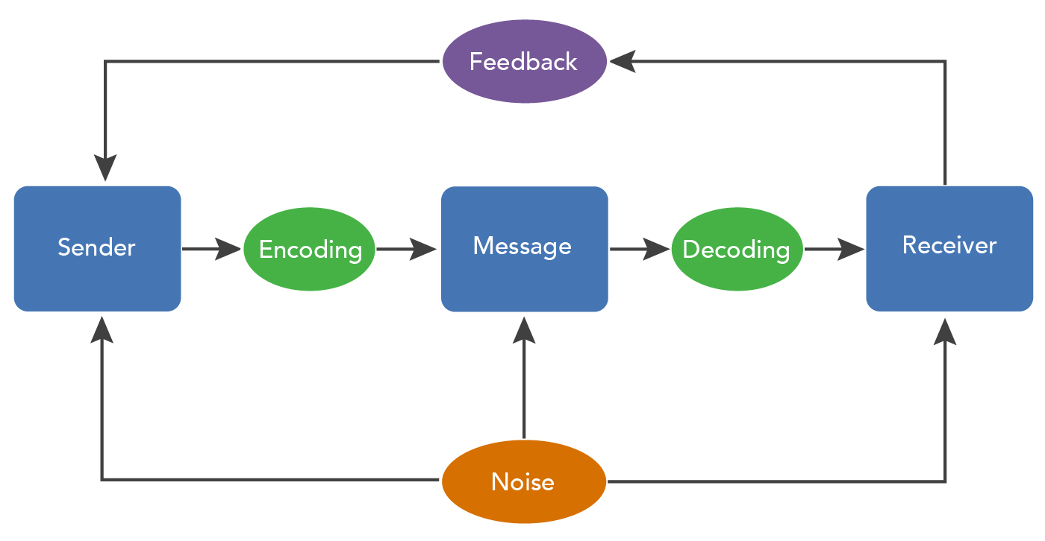
Understanding Communications
Communication Process

Slide 13
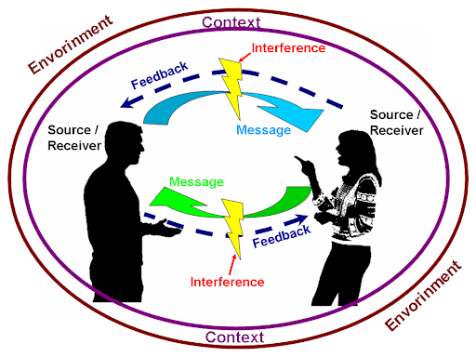
Understanding Communications
Communication elements
Sender
Message
Channel
Receiver
Feedback
Environment
Context
Interference

Slide 14
Understanding Communications
Communication elements
Sender
He/she is the one who wants to share information with someone else, usually for some intended purpose. The Sender is responsible for "encoding" the information into a message and then transmitting it.
Encoding is putting the targeted message into appropriate medium which may be verbal or non-verbal depending upon the situation, time, space and nature of the message to be sent. The sender puts the message into a series of symbols, pictures or words which will be communicated to the intended receiver. Encoding is an important step in the communication process as wrong and inappropriate encoding may defeat the true intent of the communication process.
Encoding

Slide 15
Understanding Communications
Communication elements
Message
The Message is the encoded information the Sender wants to share with the Receiver.

Slide 16
Understanding Communications
Communication elements
Channel
The channel is the way in which a message or messages travel between sender and receiver.
We can distinguish between two main forms of communication.
Verbal communication
Oral
Visual
Written
Electronic
talking to oneself
maps
reports
fax
discussion
graphic
letters
E-mail
advertisement
telephone calls
papers
social media
signals

Slide 17
Understanding Communications
Communication elements
Channel
Channel dimension
These dimensions permit the investigator to evaluate the effectiveness of different communication channels these dimensions include:
Channel Credibility
Channel feedback
Channel Availability
Channel Permanency
Channel Multiplicative Power
Channel Involvement

Slide 18
Understanding Communications
Communication elements
Channel
dimension
Channel Credibility
It is the expertness and trustworthiness of a channel as perceived by the receivers. Channel credibility is directly linked to communicator and audience characteristics however, print media are perceived by member of upper socio– economic grouping as being more credible, while television is perceived as more credible by lower socio-economic groupings.
Channel feedback
It is known as the opportunity a channel provides for the receiver to respond immediately and to affect the source of the message in communication process. Face-to-face communication tends to facilitate

Slide 19
Understanding Communications
Communication elements
Channel
dimension
Channel Involvement
It is the effort required by all senses in order to receive information from a communication channel, face-to-face communication offers the greatest possibility for involvement where print media offer the least possibility for involvement.
Channel Availability
The frequency and extent to which a channel may be used to reach a given audience. In some geographic areas, some channels may not be available such as television in mountained areas or print media in highly illiterate areas.

Slide 20
Understanding Communications
Communication elements
Channel
dimension
Channel Permanency
The ability of a communication channel over time to carry the message. Print media have this dimension but contrast radio does not.
Channel Multiplicative Power
The channel ability to cover areas with speed and timeliness. The mass media can multiply a message and make it available to large numbers of people while face-to-face communication is low in this dimension.

Slide 21
Understanding Communications
Communication elements
Receiver
The Receiver is the intended target of the message sent by the Sender. The Receiver is responsible for "decoding" the message and interpreting it.
Decoding refers to interpreting or converting the sent message into intelligible language. It simply means comprehending the message. The receiver after receiving the message interprets it and tries to understand it in the best possible manner.
Decoding

Slide 22
Understanding Communications
Communication elements
Feedback
Feedback is composed of messages the receiver sends back to the source. Verbal or nonverbal, all these feedback signals allow the source to see how well, how accurately (or how poorly and inaccurately) the message was received. Feedback also provides an opportunity for the receiver or audience to ask for clarification, to agree or disagree, or to indicate that the source could make the message more interesting.
Types
Negative Feedback or corrective comments about past behavior
Positive Feedback or affirming comments about future behavior

Slide 23
Understanding Communications
Communication elements
Environment
The environment is the atmosphere, physical and psychological, where you send and receive messages
Context
The context of the communication interaction involves the setting, scene, and expectations of the individuals involved.

Slide 24
Understanding Communications
Communication elements
Interference
Interference is anything that blocks or changes the source’s intended meaning of the message.
Channel Noise: This type of noise includes any disturbance, which interferes with the physical transmission of the message. In mass communication, channel noise includes static on the radio, ink in the newspaper, a rolling screen in television, or type too small to read in a magazine. In interpersonal communication, someone speaking in a room over another conversation, a door shutting etc.
Types

Slide 25
Understanding Communications
Communication elements
Interference
Interference is anything that blocks or changes the source’s intended meaning of the message.
Semantic Noise: This type of noise results in the wrong interpretation of messages, even though the message is received exactly as it was sent such as words too difficult, subject too difficult for receiver to understand also differences of selected meaning of words between the message sender and a receiver. for example receiver thinking that the words prints to something different than that is intended by the sender. One word may have many different interpretations.
Types

Slide 26
Business and professional communication

Slide 27
Business and professional communication
What is Business and Professional Communication
These are some of the core principles that will set the foundation of business and professional communication.
Written Documents
Presentational Speaking
Interviewing
Mediated Communication

Slide 28
Business and professional communication
What is Business and Professional Communication
Interviewing
Obviously your first step into the business world will involve landing a job. Interviewing is the process of making yourself available to employers in a formal setting and in the best possible light. Although the main goal of interviewing is to get a job, it also gives you the opportunity to determine whether the particular job is right for you. Interviewing is a two-way street; you should also use this time to make sure that an organization meets your needs as a professional and that the organizational culture will allow you to thrive.
Knowing how to prepare for an interview, anticipating questions, dressing appropriately, providing credible and effective answers, and following up after an interview are all critical aspects of being a competent interview participant.

Slide 29
Business and professional communication
What is Business and Professional Communication
Mediated Communication
The new media have opened numerous new channels for communication professionals.
Computer-mediated communication offers convenience and timely access to pertinent information, and it connects communicators across the globe via screen taps and mouse clicks.
However, as a communication professional you must be aware of the inherent drawbacks of mediated communication.
Be aware that traditional public speaking skills don’t always translate as effectively (e.g., video or telephone conferences) and must be altered to fit the situation at hand.

Slide 30
Business and professional communication
What is Business and Professional Communication
Presentational Speaking
Public speaking is one of the most feared—but also most important—functions of business and professional communication. This textbook will introduce you to various types of business presentations, including informative, persuasive, and public presentations. You will learn how to research and prepare your presentation, how to analyze your audience (as well as who your target audience should be), and how to create memorable and effective introductions and conclusions that will stick in the mind of your audience. You will learn about the balance of having excellent content while also delivering it to the audience in an engaging way. Also, you will learn about many of the multimedia presentation aids available to you, as well as when (and if) visual aids are appropriate for your presentation.

Slide 31
Business and professional communication
What is Business and Professional Communication
Written Documents
Effective professional communication asks you to be not only a great communicator and speaker, but also an effective writer. Although the type of written communication you engage in can vary greatly depending on your profession, there are certain universal skills you should always have.
You must know how to structure the information, select the right style/tone/language, and determine what length is appropriate to cover all the important information while also being short enough to keep the readers’ attention.
You must learn how to cultivate and maintain credibility, and use appropriate grammar and punctuation to emphasize professionalism. This may seem like a daunting to-do list, but through study and practice you will be able to create professional, engaging, and effective written communication for your business or organization.

Slide 32
Understanding the importance of Human Communication in Business and Professional Context

Slide 33
Understanding the importance of Human Communication in Business and Professional Context
Essential ways for Effective Communication in the workplace
Understanding the Importance of Human Communication in Business and Professional Contexts
There are several important ways in which the key areas of human communication as a whole influence and are essential for effective communication in the workplace.
Cultural Influences
Channels
Role taking
Previous Experiences

Slide 34
Understanding the importance of Human Communication in Business and Professional Context
Essential ways for Effective Communication in the workplace
Role Taking
The critical functions of human communication (sending and receiving messages, offering feedback, identifying the “role” of different communicators) must also be applied to the context of business communication.
For example, car salespeople must basically give sales “presentations” to any potential buyers who visit their car lot. Much of their success is determined by how well they can tailor their message depending on the individual needs of many different customers. If a customer gives verbal or nonverbal cues expressing concern about the fuel efficiency of their prospective vehicle, the salesperson must modify the message to emphasize each car’s gas mileage as a major selling point. This dynamic aspect of role-taking and feedback keeps the transaction flowing.

Slide 35
Understanding the importance of Human Communication in Business and Professional Context
Essential ways for Effective Communication in the workplace
Previous Experiences
The way people respond initially to new business transactions depends greatly on their previous communication experiences in similar situations. Using the previous example, have you experienced buying a new vehicle or making another major purchase (house, major appliance, business)? Depending on whether that experience was positive or negative, it helps form the basis for how you communicate in similar transactions in the future.
Therefore, from a business standpoint, your initial communication impression is of critical importance.

Slide 36
Understanding the importance of Human Communication in Business and Professional Context
Essential ways for Effective Communication in the workplace
Channels
Depending on your physical location, your communication approach can alter significantly. For example, your communication with a classmate will likely be much more informal than your communication with a professor. Similarly, the channel of communication can also affect communication. Many people feel comfortable taking a more aggressive or assertive tone when using e-mail than when engaging in face-to-face communication.

Slide 37
Understanding the importance of Human Communication in Business and Professional Context
Essential ways for Effective Communication in the workplace
Cultural influences
The way we communicate, with whom we communicate, and what we communicate are almost always influenced by culture. Culture is an ongoing social institution that has its own set of behavioral rules. For our discussion, organizational culture influences how we (as members of a business or professional organization) frame our communication with others both within and outside that organization. For example, the communication that takes place in a board meeting of lawyers will feature a different set of decorum, rules, and norms when compared with a brainstorming session among creative writers for a small company. To be a competent communicator in your organization, you must be dynamic in adhering to the rules and norms of different communication situations.

Slide 38
Social Media Technology: Key Challenges in the Communication Age

Slide 39
Social Media Technology: Key Challenges in the Communication Age
Social Media Technology
Simply because you have the ability to communicate with different people and cultures across the globe does not mean you are ready to work with these people if you lack training and cultural sensitivity.
Also, when relying almost exclusively on computer-mediated communication for business and professional interactions, you run the risk of letting your face-to-face communication skills suffer.
Another issue is that constant availability and connection with your work life can lead to stress, burnout, and information overload if you do not “unplug” from work from time to time. Here are some common challenges to business communication in the information age.

Slide 40
Social Media Technology: Key Challenges in the Communication Age
Social Media Technology
• Knowing when to use computer-mediated communication or face-to-face communication can be challenging. A common problem now is that we have almost too many choices available to us for communicating with others.
E-mail, texting, and instant messaging have become the de facto choice of communication for many people, but what about those who are not as connected to their smartphones or computers? There are still many “traditional” communicators who prefer the intimacy of face-to-face interactions and find e-mail or text interactions to be dismissive or insulting.

Slide 41
Social Media Technology: Key Challenges in the Communication Age
When is it appropriate to use face to face or computer mediated communication?
The choice between face-to-face and computer-mediated communication depends on various factors, including the nature of the communication, the context, and individual preferences. Here are some considerations for when each type of communication might be appropriate:
Face-to-Face Communication:
Complex or sensitive discussions: Face-to-face communication is often preferred for complex or sensitive discussions that require nuance, empathy, and immediate feedback. It allows for direct eye contact, body language, and nonverbal cues, which can enhance understanding and build rapport.

Slide 42
Social Media Technology: Key Challenges in the Communication Age
When is it appropriate to use face to face or computer mediated communication?
The choice between face-to-face and computer-mediated communication depends on various factors, including the nature of the communication, the context, and individual preferences. Here are some considerations for when each type of communication might be appropriate:
Face-to-Face Communication:
Building relationships: Face-to-face communication is valuable for building personal relationships, especially in professional settings. It allows for social bonding, trust-building, and establishing a stronger connection.
Resolving conflicts: Face-to-face communication can be effective for resolving conflicts, as it allows for real-time interaction, active listening, and the opportunity to address concerns directly.

Slide 43
Social Media Technology: Key Challenges in the Communication Age
When is it appropriate to use face to face or computer mediated communication?
The choice between face-to-face and computer-mediated communication depends on various factors, including the nature of the communication, the context, and individual preferences. Here are some considerations for when each type of communication might be appropriate:
Computer-Mediated Communication:
Geographical limitations: When individuals are physically separated by distance, computer-mediated communication becomes a practical choice. It enables communication across different locations, making it easier to connect with people who are not in close proximity.
Efficiency and convenience: Computer-mediated communication can be more efficient and convenient for quick exchanges, sharing information, and collaborating on projects remotely. It eliminates the need for travel time and can accommodate flexible schedules.

Slide 44
Social Media Technology: Key Challenges in the Communication Age
When is it appropriate to use face to face or computer mediated communication?
The choice between face-to-face and computer-mediated communication depends on various factors, including the nature of the communication, the context, and individual preferences. Here are some considerations for when each type of communication might be appropriate:
Computer-Mediated Communication:
Asynchronous communication: Computer-mediated communication offers the advantage of asynchronous communication, where participants can respond at their own pace. This can be useful when time zones or schedules don't align, allowing individuals to communicate without needing to be available simultaneously.

Slide 45
Communication Apprehension

Slide 46
Communication Apprehension
What is Communication Apprehension?
Communication apprehension refers to the anxiety or fear that individuals experience when communicating with others, either in public speaking situations or in interpersonal interactions. It is a psychological phenomenon that can manifest in various ways, including physical symptoms such as increased heart rate, sweating, trembling, and mental symptoms such as racing thoughts, self-doubt, and fear of being judged or evaluated negatively.
Communication apprehension can affect individuals in different contexts, such as giving presentations, participating in group discussions, or engaging in one-on-one conversations. It can significantly impact a person's ability to effectively express themselves, convey their ideas, and establish meaningful connections with others.

Slide 47
Communication Apprehension
Types of Communication Apprehension
Trait communication apprehension means that one possesses a “shy trait.” In general, shy people tend not to raise their hands in class a lot, avoid certain social situations, and feel extremely anxious about giving a professional presentation.
Context-based communication apprehension describes a fear of communicating in certain contexts. A fear of public speaking is a great example of context communication apprehension. For example, a student may not be nervous about meeting new people or participating in small groups, but presenting a speech in front of the class promotes a high degree of apprehension.

Slide 48
Communication Apprehension
Types of Communication Apprehension
Audience-based communication apprehension explains a person’s fear of speaking to certain people or groups. For example, a person may feel comfortable speaking in front of friends in his or her social circle, but speaking in front of colleagues at work makes him or her extremely nervous.
Situational communication apprehension refers to apprehension to communicate in specific sets of circumstances; everyone at some point in their lives is going to feel apprehensive about communicating something. Think of a person you might want to impress, such as a boss or an interviewer. In general, you are an outgoing person and don’t mind presenting in front of people, but someone you want to impress may promote an uneasy or anxious feeling.

Slide 49
Communication Apprehension
Causes Communication Apprehension
Novelty: If the type of communication situation, such as giving a speech or running a meeting, is not something you do every day, it can create apprehension until you become familiar with this task or situation.
Formality: Preparing and organizing something to be in the spotlight can promote the feeling of formality that makes you nervous or apprehensive.
Subordinate status: If someone in charge of you, such as a manager at work, is
evaluating your presentation, his or her higher status and evaluation can cause anxiety.
Peer evaluation: How are my coworkers going to respond to me? This question
addresses concerns you may have about your peers evaluating you. These concerns can in turn cause apprehension.

Slide 50
Communication Apprehension
Causes Communication Apprehension
Dissimilarity: Sometimes you may feel different from the audience. Having nothing in common with the audience causes anxiety.
Conspicuousness: Feeling as though you are in the spotlight and all eyes are on you can certainly cause anxiety.
Lack of attention: When you feel as though a listener or the audience is bored and uninterested in your message or presentation, you may begin to feel apprehension.
Prior history: Many people have had a bad experience during a communication interaction, such as an interview, a presentation, or a meeting. This negative experience can create anxiety the next time you find yourself in a similar situation.

Slide 51




Thank You

