Slide 1


Operations
Management
Prepared by Dr. Injy Nashaat
Orientation Session

Slide 2


the administration of business structure, practices, and processes to enhance efficiency and maximize profit.
It refers to the management of functions that a business needs to run effectively day-to-day, including multiple departments and providing goals.
www.midocean.ae

Slide 3

Ch 1: Introduction to Operations Management
  Define the terms operations management and supply chain
  Identify similarities and differences between production and service operations
  Explain the importance of learning about operations management
  Explain the key aspects of operations management decision making
  Describe the current issues in business that impact operations management.
  Explain the importance of ethical decision making
  Explain the need to manage the supply chain

Slide 4
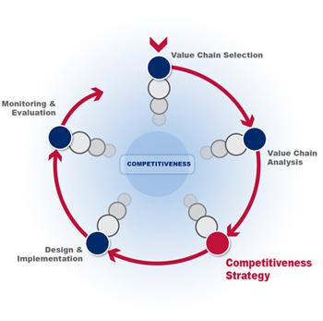
Ch 2: Competitiveness, Strategy, and Productivity
  List several ways that business organizations compete
  Name several reasons that business organizations fail
  Define the terms mission and strategy and explain why they are important
  Discuss and compare organization strategy and operations strategy and explain why it is important to link the two
  Describe and give examples of time-based strategies
  Define the term productivity and explain why it is important to organizations and to countries
  Describe several factors that affect productivity

Slide 5

Ch 3: Forecasting
  Explain why forecasts are generally wrong
  List the elements of a good forecast
  Outline the steps in the forecasting process
  Summarize forecast errors and use summaries to make decisions
  Describe four qualitative forecasting techniques
  Prepare a moving average forecast
  Prepare an expanding smoothing forecast
  Prepare a trend-adjusted exponential smoothing forecast
  Construct control charts and use them to monitor forecast errors

Slide 6

Ch 4: Reliability
  Define reliability
  Perform simple reliability computations
  Explain the term availability and perform simple calculations

Slide 7
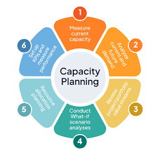
Ch 5: Strategic Capacity Planning for Products and Services
  Name the three key questions in capacity planning
  Explain the importance of capacity planning
  Describe ways of defining and measuring capacity
  Discuss factors to consider when deciding whether to perform in-house or outsource
  Discuss the major considerations related to developing capacity alternatives
  Describe the steps used to resolve constraint issues
  Briefly describe approaches that are useful for evaluating capacity alternatives

Slide 8

Ch 6: Process Selection and Facility Layout
  Explain the strategic importance of process selection and the influence it has on the organization and its supply chain
  Name the two main factors that influence process selection
  Explain the need for management of technology
  List some reasons for redesign of process
  Describe product layouts and their main advantages and disadvantages
  Describe process layouts and their main advantages and disadvantages
  Solve simple line-balancing problems
  Develop simple process layouts

Slide 9
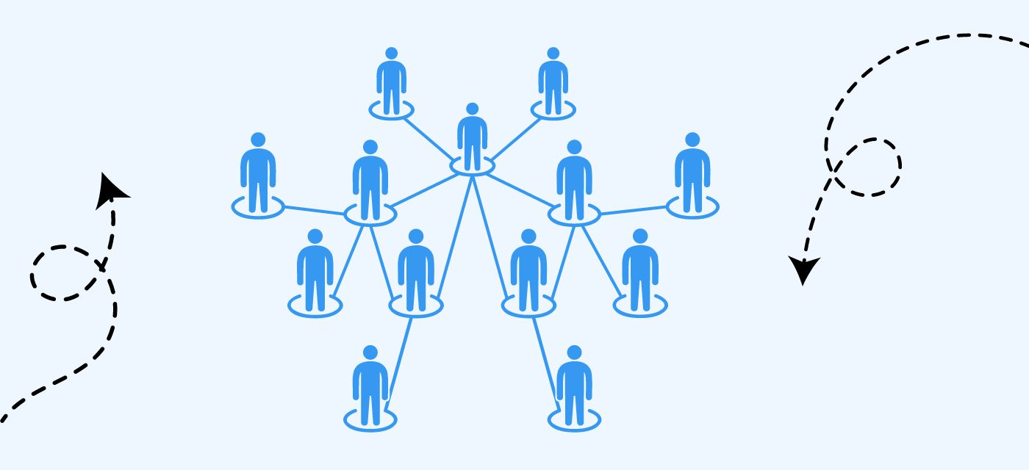
Ch 7: Work Design and Measurement
  Explain the importance of work design
  Compare and contrast the two basic approaches to job design
  Discuss the advantages and disadvantages of specialization
  Describe behavioral approaches to job design
  Discuss the impact of working conditions on job design
  Compare the advantages and disadvantages of time-based and output-based pay systems
  Explain the purpose of methods analysis and describe how methods studies are performed
  Define a standard time

Slide 10

Ch 8: Inventory Management
  Define the term inventory
  List the different types of inventory
  Describe the main functions of inventories
  Discuss the main requirements for effective management
  Explain periodic and perpetual review systems
  Describe the costs that are relevant for inventory management
  Describe the economic production quantity model and solve typical problems
  Describe the quantity discount model and solve typical problems
  Describe reorder point models and solve typical problems

Slide 11

Chapter 9: Management of Quality
  Discuss the philosophies of quality
  Define the term quality as it relates to products and as it relates to services
  Explain why quality is important and the consequences of poor quality
  Describe and give examples of the costs associated with quality
  Discuss the importance of ethics in managing quality
  Discuss quality certification and its importance
  Describe TQM
  Give an overview of problem solving
  Give an overview of process improvement
  Describe and use various quality tools

Slide 12
Ch 10: Quality Control
  Explain the need for quality control
  Discuss the basic issues of inspection
  List and briefly explain the elements of the control process
  Explain how control charts are used to monitor a process, and the concepts that underlie their use
  Use and interpret control charts
  Perform run tests to check for no randomness in process output
  Assess process capability

Slide 13



Thank You

