Slide 1

Project Risk &Supply Chain Risk
Prepared by Dr. Dalia Hosni
Lecture 5
PMG 663
Project Risk &Supply Chain Risk

Slide 2
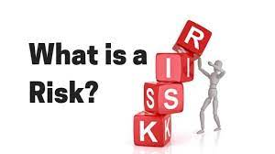

Chapter
05
Risk
Risk
An unplanned or uncertain event that can impact a project

Slide 3
Chapter
05
Risk
Risk
A risk is any uncertain event or condition that might affect your project. Not all risks are negative. Some events (like finding an easier way to do an activity) or conditions (like lower prices for certain materials) can help your project. When this happens, we call it an opportunity; but it’s still handled just like a risk.

Slide 4
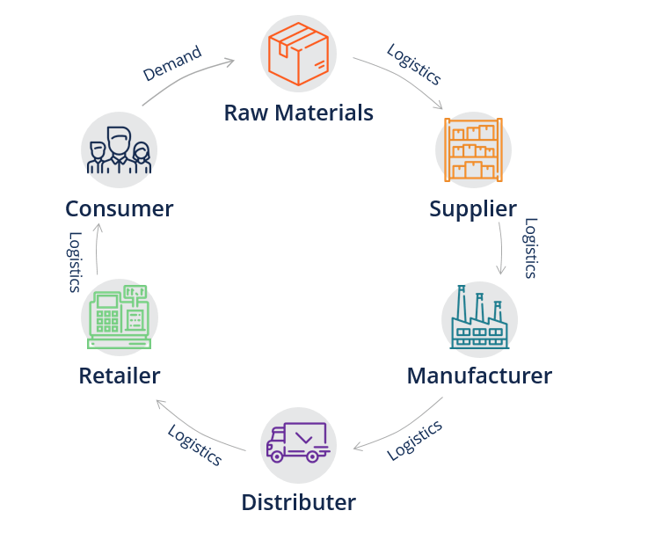
Chapter
05
Supply chain management
First appearing in 1982 :and used to describe connecting logistics with other functions.
The term was also used by Houlihan (1985, 1988) to describe the connections between logistics and internal functions and external
organizations
A supply chain consists of all activities associated with the flow and transformation of goods from raw materials to end users

Slide 5
Chapter
05
Risk in the supply chain
There are risks in the supply chain when unexpected events might disrupt the flow of materials on their journey from initial suppliers through to final customers.
These risks might prevent deliveries, cause delays, damage goods or somehow affect smooth operations. But these initial effects are only a beginning, and the consequences are generally much broader. A late delivery of raw materials might halt production; it might raise costs by forcing a move to alternative transport, materials or operations; it might raise stocks of work in progress; it might make partners reconsider their trading relationships. An interruption to the supply chain can have widespread effects,

Slide 6
Chapter
05
Supply Chain Risk Management (SCRM)
SCRM can be described as the intersection of supply chain management and risk management
A supply chain consists of all activities associated with the flow and transformation of goods from raw materials to end users.
a supply chain is a network of facilities and distribution options that performs the function of procurement of materials, transformation of these materials into intermediate and finished products, and the distribution of these finished products to customers.

Slide 7
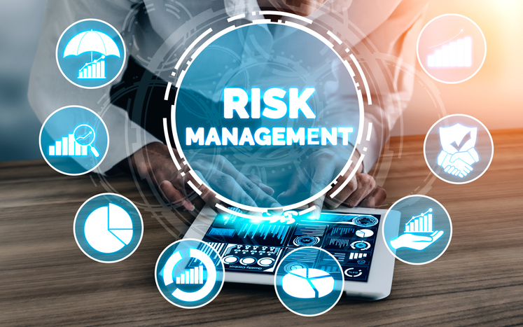
Chapter
05
Supply Chain Risk Management (SCRM)
Supply chain risk management (SCRM) is the process of taking strategic steps
To identify
To assess
To mitigate
_ the risk in the end-to-end supply chain

Slide 8
Chapter
05
What is Supply Chain Risk Management?
Supply chain risk management (SCRM) is the process of identifying, assessing, and mitigating the risks of an organization’s supply chain. Implementing global supply chain risk management strategies can help an enterprise operate more efficiently, reduce costs, and enhance customer service.

Slide 9
Chapter
05
What is Supply Chain Risk Management?
Supply chain management refers to how organizations manage the flow of their goods, including all the processes involved in transforming raw materials the organization consumes into finished products or services the organization offers. It includes planning and managing sourcing, procurement, conversion, and logistics management functions.

Slide 10
Chapter
05
What is Supply Chain Risk Management?
One of the main reasons companies implement global supply chain management strategies is to boost their competitive advantage. That said, the globalization of supply chains can also increase potential risks to quality, safety, business continuity, and reputation. Those issues need attention too.

Slide 11
Chapter
05
What is Supply Chain Risk Management?
Every company, regardless of industry, is exposed to both internal and external risk factors from supply chain disruption.

Slide 12
Chapter
05
What is Supply Chain Risk Management?
Internal supply chain risks include risk events caused by:
Not implementing proper cybersecurity policies and controls to protect against cyber-attacks and data breaches;
Not putting contingencies in place in case something goes wrong;
Disruptions of internal operations;
Changes in management, key personnel, and business processes;
Not having the goods to meet customers’ needs.
Not complying with environmental regulations or labor laws;

Slide 13
Chapter
05
What is Supply Chain Risk Management?
External supply chain risks include risk events caused by:
Social, governmental, and economic factors, including the threat of terrorism;
Interruptions to the flow of products, including raw materials, parts, and finished goods;
Unpredictable or misunderstood customer demand;
Natural disasters, such as earthquakes, hurricanes, and tornadoes.
Supplier risk management, including concerns related to a supplier’s physical facility and regulatory compliance;

Slide 14
Chapter
05
What is Supply Chain Risk Management?
An organization could fall victim to supply chain financial risk if something threatens financial health, such as higher component costs eating into profit margins. A company might suffer reputational risk if a supplier engages in unethical behavior, such as bribery, child labor, or anything that could reflect poorly on the company’s brand. Finally, a supplier’s social media activity can also harm your brand.

Slide 15
Chapter
05
What is Supply Chain Risk Management?
Supply Chain Risk Examples
Supply chain risk includes a wide variety of problems with vendors, suppliers, shipping agents, resellers, and other third parties. Those issues can disrupt production, operations, sales, and projects. They can also lead to quality issues, accountability, and reputational conflicts. Here are some examples that expose supply risk:
Price Increases
Shortages
Supplier Relationships
Quality Failures
Delivery Failures
Supply Shocks

Slide 16
Chapter
05
What is Supply Chain Risk Management?
Supply Chain Risk Examples
Price Increases
Rising prices are caused by supply, demand, currency instability, and customs tariffs. Volatility in prices can jeopardize financial projections and profitability of the business.

Slide 17
Chapter
05
What is Supply Chain Risk Management?
Supply Chain Risk Examples
Shortages
These can arise from lacking a component, material, or part needed to produce a finished product. Shortages may be short-term availability issues or long-term if the supplier has discontinued the required items.

Slide 18
Chapter
05
What is Supply Chain Risk Management?
Supply Chain Risk Examples
Supplier Relationships
If litigation or some other dispute ruptures your relationship with a supplier, the scenario will lead you to replace the supplier.

Slide 19
Chapter
05
What is Supply Chain Risk Management?
Supply Chain Risk Examples
Quality Failures
Quality failures occur when shipments of certain parts do not meet the given specifications or perform as expected.

Slide 20
Chapter
05
What is Supply Chain Risk Management?
Supply Chain Risk Examples
Delivery Failures
Carrier and logistical issues can result in late deliveries, damaged packages, or lost shipments.

Slide 21
Chapter
05
What is Supply Chain Risk Management?
Supply Chain Risk Examples
Supply Shocks
Sudden worldwide or industry-wide drop in supply due to events such as a pandemic, natural disaster, labor dispute, or trade embargo.

Slide 22
Chapter
05
Supply Chain Risk Management Strategies
The supply chain is the gas that makes the motor run for manufacturing and retail.
Without it, you have no product to sell, no inventory to stock, and no revenue to earn. Unfortunately, there will always be disruptions to the supply chain that throw everything out of whack and force both retailers and manufacturers to scramble to pick up the pieces.
In a Gartner survey, only 21% of respondents stated they had a highly resilient network, though more than half expected to be “highly resilient” within a few years. That’s a positive sign, but what exactly can be done to get ahead of those supply chain risk factors?

Slide 23
Chapter
05
Supply Chain Risk Management Strategies
Proper supply chain risk management enables businesses of all shapes and sizes to take advantage of tried-and-true strategies that mitigate risk and set them up for success. In order to develop your own risk management strategy, it helps to first understand what supply chain risks you might face.

Slide 24
Chapter
05
What Are Some Supply Chain Risks?
Supply chain risk management refers to the process by which businesses take strategic steps to identify, assess, and mitigate risks within their end-to-end supply chain. There are both internal and external risks that can disrupt your supply chain, so it’s helpful to understand the difference between the two.

Slide 25
Chapter
05
External Supply Chain Risks
As the name implies, these global supply chain risks come from outside of your organization. Unfortunately, that means that they are harder to predict and typically require more resources to overcome. Some of the top external supply chain risks include:
      Demand Risks: Demand risks occur when you miscalculate product demand and are often the product of a lack of insight into year-over-year purchasing trends or unpredictable demand.
      Supply Risks: Supply risks occur when the raw materials your business relies on aren’t delivered on time or at all, thereby causing disruption to the flow of product, material, and/or parts.
      Environmental Risks: Environmental risk in the supply chain is the direct result of social-economic, political, governmental, or environmental issues that affect the timing of any aspect of the supply chain.
      Business Risks: Business risks occur whenever unexpected changes take place with one of the entities you depend on to keep your supply chain running smoothly — for example, the purchase or sale of a supplier company.

Slide 26
Chapter
05
Internal Supply Chain Risks
This refers to any supply chain risk factors that are within your control, and that can be identified and monitored using supply chain risk assessment software, robust analytics programs, IoT capabilities, and more.
Although internal supply chain risks are more manageable than external ones, they’re still — to some degree — unavoidable. Here’s what to look for:

Slide 27
Chapter
05
Internal Supply Chain Risks
Manufacturing Risks: Manufacturing risks refer to the possibility that a key component or step of your workflow could be disrupted, causing operations to go off schedule.
Business Risks: Business risks are a product of disruptions to standard personnel, management, reporting, and other essential business processes.
Planning and Control Risks: Planning and control risks are caused by inaccurate forecasting and assessments and poorly planned production and management.
Mitigation and Contingency Risks: Mitigation and contingency risks can occur if your business doesn’t have a contingency plan for supply chain disruptions.

Slide 28
Chapter
05
Internal Supply Chain Risks
It’s important that you have a complete picture of the supply chain risk factors you’re susceptible to in order to get ahead of potential disruptions. Familiarizing yourself with any potential issues that might arise puts you in a better position to implement supply chain risk management strategies.

Slide 29
Chapter
05
Supply Chain Risk Management Strategies
In today’s connected and digital world, supply chain risk mitigation can be difficult due to globalization and potential cyber interference. That said, there are measures you can take to reduce your business’ exposure to risk:
1- Leverage the PPRR risk management model. The PPRR risk management model is a popular global supply chain risk management strategy and is used by businesses around the world. The “PPRR” stands for:

Slide 30
Chapter
05
Supply Chain Risk Management Strategies
The “PPRR” stands for:
Prevention: Take precautionary measures for supply chain risk mitigation.
Preparedness: Develop and implement a contingency plan in case of an emergency.
Response: Execute on your contingency plan in order to reduce the impact of the disruptive event.
Recovery: Resume operations and get things running at normal capacity as quickly as possible.
Prevention
Preparedness
Response
Recovery

Slide 31
Chapter
05
Supply Chain Risk Management Strategies
2- Manage environmental risk in your supply chain. This is more important than ever given that the COVID-19 pandemic exposed gaps in global retail and manufacturing supply chains that leave them prone to disruption . Back in December 2019, many retailers were forced to re-evaluate their vendor relationships because many of their suppliers and manufacturers were based in China, which was, at the time, the epicenter of the outbreak. With a significantly reduced workforce, retailers struggled to process and get shipments out on time, and there were questions of whether certain shipments would need to undergo quarantine before they could be delivered . As a result, some retailers decided to move from a single-sourcing to a multi-sourcing model, which would provide them with a contingency plan should their primary supplier become unavailable.

Slide 32
Chapter
05
Supply Chain Risk Management Strategies
Others opted to change their business model entirely in order to adapt to drastic changes in product seasonality and viability — for example, breweries and distilleries across the United States started to produce hand sanitizer on a massive scale, and Ford announced plans to produce ventilators for coronavirus patients at one of its facilities in Michigan .
Although there’s no way to prevent environmental risk in your supply chain, you can plan for it. Supply chain risk assessment software enables you to take a proactive approach to risk management by providing you with greater visibility into the structure of your supply chain. With such a solution, you’ll be able to identify weak points in your supply chain and receive data-driven insights into how you can strengthen them . It’s also important that you develop a contingency plan — something that’s come up a few times, now.

Slide 33
Chapter
05
Supply Chain Risk Management Strategies
Consider these strategies for improving supply chain resiliency:
Multisource – multiple sources mean multiple ways around a problem. Categorize your suppliers not just by what you’re spending, but also by potential impact if there’s a disruption. Search for additional suppliers that you can do business with, or work with a supplier that produces out of multiple locations.
Nearshore – look to find suppliers and distributors closer to your center of operation and/or the end point of your supply chain to reduce cycle times for product development and delivery. Regional suppliers can be more expensive, but by shortening the travel time you can also reduce potential risks.

Slide 34
Chapter
05
Supply Chain Risk Management Strategies
Stress test often – mapping your supply chain network is just the first step. Comprehensive, and reoccurring, stress tests are the best way to check for vulnerabilities, some which may lie hidden deep within the supply chain.
Build buffers for inventory and capacity – this is an added expense, but smart planning can make it worthwhile. New product launches and expansions into new areas are perfect times to create buffer capacity. To reduce climate-related environmental risks, consider stockpiling products during known periods of high risk (such as hurricane season).

Slide 35
Chapter
05
Supply Chain Risk Management Strategies
Invest in product and plant harmonization – the use of identical technology for different components allows greater flexibility in case of a disruption. Using the same software throughout your network, especially cloud-based architecture, reduces the inefficiency of siloed data and allows for better communication between systems.

