Slide 1



Project Planning
Lecture 6
PMG202
Project Planning- Human Resource management
Prepared by
Lec. Dina ElWakkad
www.midocean.ae

Slide 2


Slide 3
Project Planning

Slide 4
Project Planning
Once a project is selected for execution, the structural project planning approach prescribes that the project get planned in detail prior to the actual start of the project.
Project planning consists of 4 main stages:
Risk Management
Quality Management
Human Resource Management
The Project Schedule, and budget

Slide 5


Learning Outcomes
Look at the questions given below and try answering them.
Whom do you send your resume to when you see a job opening that interests you?
Who gives you the job offer and discusses your pay package with you?
Who inducts you into the organization when you are a new employee?
Whom do you contact when you have any doubts regarding your pay package, perks, benefits, conveyance, leave management etc.?
Who helps you in the final exit formalities when you leave an organization?

Slide 6

You must have guessed correctly. It is the Human Resource Managers and people from the HR Department who take care of you right from the time when you apply to a company, you get the job, you join the company, are working with the company till the time you leave the company.

Slide 7


Hence, in your entire lifecycle of involvement with the company, the HR always stands by you and supports you during your tenure with the company. Hence, HR managers are also known as ‘People Managers’, ‘People Enablers’ and the practice as ‘Human Resource or People Management’.

Slide 8
Definition of HRM

Slide 9
Definition of HRM
The process of defining HRM leads us to two different definitions. They are:
Traditional Definition
Contemporary Definition

Slide 10
Definition of HRM
Traditional Definition:
The first definition of HRM is that it is the process of managing people in organizations in a structured and thorough manner.
This covers the fields of staffing (hiring people), retention of people, pay and perks setting and management, performance management, change management and taking care of exits from the company to round off the activities.

Slide 11
Definition of HRM
Contemporary Definition:
The second definition of HRM encompasses the management of people in organizations from a macro perspective i.e., managing people in the form of a collective relationship between management and employees.
This approach focuses on the objectives and outcomes of the HRM function.
What this means is that the HR function in contemporary organizations is concerned with the notions of people enabling, people development and a focus on making the ‘employment relationship’ fulfilling for both the management and employees.
.

Slide 12
Importance of HRM for Organizational Success

Slide 13



Importance of HRM for Organizational Success
The following are the various reasons that organizations need to give importance to HRM:
.
The Evolving Business Paradigm
Strategic Management and HRM
Need for Adopting a Holistic Approach

Slide 14
Importance of HRM for Organizational Success
The Evolving Business Paradigm
One of the factors behind organizations giving a lot of attention to their people is the nature of the firms in the current business environment.
There has been a steady movement towards an economy based on services; hence, it becomes important for firms engaged in the service sector to keep their employees motivated and productive.
Even in the manufacturing and the traditional sectors, the need to remain competitive has meant that firms in these sectors deploy strategies that make effective use of their resources.
This changed business landscape resulted due to a paradigm shift in the way businesses and firms view their employees as more than just resources and instead adopt a ‘people first’ approach.
the human resource department is a service department, handles all the organization's activities pertaining to the employees.

Slide 15
Importance of HRM for Organizational Success
Strategic Management and HRM
Moreover, there is a need to align organizational goals with that of the HR strategy to ensure that there is alignment of the people policies with that of the management objectives.
This means that the HR department can no longer be viewed as an appendage of the firm but instead is a vital organ in ensuring organizational success.
The current HRM practices in many industries are taken as seriously as the marketing and production functions.

Slide 16
Importance of HRM for Organizational Success
Need for Adopting a Holistic Approach
The practice of HRM must be applied to the overall strategic goals for the organization instead of a standalone tint that takes a unit based or a micro approach.
The idea here is to adopt a holistic perspective towards HRM that ensures that there are no piecemeal strategies and the HRM policy enmeshes itself fully with those of the organizational goals.
The practice of HRM needs to be integrated with the overall strategy to ensure effective use of people and provide better returns to the organizations in terms of ROI (Return on Investment).
Unless the HRM practice is designed in this way, the firms stand to lose from not utilizing people fully and this does not bode well for the success of the organization.

Slide 17
Scope of Human Resource Management

Slide 18
Scope of Human Resource Management
HRM in Personnel Management:
The overall objective here is to ascertain individual growth, development and effectiveness which indirectly contribute to organizational development.
HRM in Personnel Management is typically direct manpower management that involves:
  manpower planning,
  hiring (recruitment and selection),
  training and development, developing new skills,
  transfer,
  promotion, allowances, compensation,
  Payroll management
  layoff and retrenchment.
  performance appraisal,

Slide 19
Scope of Human Resource Management
HRM in Employee Welfare
HRM in Employee Welfare is a particular aspect of HRM which deals with working conditions and amenities at workplace.
Employee welfare is about determining employees’ real needs and fulfilling them with active participation of both management and employees.
  This includes a wide array of responsibilities and services such as safety services, health services, welfare funds, social security and medical services.
  It also covers appointment of safety officers, making the environment worth working, eliminating workplace hazards, support by top management, job safety, safeguarding machinery, cleanliness, proper ventilation and lighting, medical care, sickness benefits, employee injury benefits, personal injury benefits, maternity benefits, unemployment benefits and family benefits, Grievance handling.
  it also takes care of canteen facilities, crèches, rest and lunchrooms, housing, transport, medical assistance, education, health and safety, recreation facilities, etc.

Slide 20
Scope of Human Resource Management
HRM in Industrial Relations
HRM in Industrial Relations needs careful interactions with labor or employee unions, addressing their grievances and settling the disputes effectively in order to maintain peace and harmony in the organization.

Slide 21
Scope of Human Resource Management
Succession Planning
the HR planning process is 'Succession Planning'.
Succession Planning refers to the way in which a company forms policies for replacing key members of its organization, shifting transfer of authority and responsibility carefully from a leaving member to a new member.
This often entails ensuring that an arriving employee has the necessary training and experience to fulfill their functions.

Slide 22
Processes in Human Resource Management

Slide 23
Processes in Human Resource Management
The following are the various HR processes:
  Human Resource Planning (Recruitment, Selection, Hiring, Training, Induction, Orientation, Evaluation, Promotion and Layoff)
1
  Employee Remuneration and Benefits Administration
2
  Performance Management
3
  Employee Relations
4

Slide 24

Processes in Human Resource Management
  Human Resource Planning (Recruitment, Selection, Hiring, Training, Induction, Orientation, Evaluation, Promotion and Layoff)
1
Human Resource Planning involves the following functions:
Recruitment: It aims at attracting applicants that match a certain Job Criteria.
Selection: The next level of filtration. This aims at short listing candidates who are the closest match in terms qualifications, expertise and potential for a certain job.
Hiring: This involves deciding upon the final candidate who gets the job.
Training and Development: These processes work on an onboard employee for up gradation of his skills and abilities.

Slide 25

Processes in Human Resource Management
  Employee Remuneration and Benefits Administration
2
Employee Remuneration and Benefits Administration is the process that involves deciding upon salaries and wages, Incentives, Fringe Benefits and Perquisites etc.
This process is very important because money is the prime motivator in any job. Performing employees seek raises, better salaries and bonuses.

Slide 26

Processes in Human Resource Management
  Performance Management
3
Performance Management helps the organization to train, motivate and reward workers. It is also meant to ensure that the organizational goals are met with efficiency.
Nowadays, there is an automated Performance Management System (PMS) that gathers and provides all the information to help managers evaluate the performance of the employees and assess them accordingly on their training and development needs.

Slide 27

Processes in Human Resource Management
  Employee Relations
4
Employee relations include Labor Law and Relations, working environment, employee health and safety, employee- employee conflict management, employee- employer conflict management, quality of work life, workers compensation, employee wellness and assistance programs, counseling for occupational stress.

Slide 28
Skills of HR Professionals

Slide 29





Skills of HR Professionals
The various skills of HR professionals are as follows:
HR Skills
Decision Making Skills
Technical Skills
Leadership Skills

Slide 30
Skills of HR Professionals
HR Skills:
HR managers are required to know how people play a role in the organization, an advantage against the competition as well as the policies, programs etc.
So, Today’s HR professional must be skilled at communicating, negotiating and team development.
HR Skills

Slide 31
Skills of HR Professionals
Decision Making Skills:
HR managers should take a variety of decisions that affect whether employees are qualified and motivated and whether the organization is operating efficiently and complying with the law.
This requires knowledge of the organization’s line of business and decisions must take into account social and ethical implication of the alternatives.
Decision Making Skills

Slide 32
Skills of HR Professionals
Technical Skills:
These skills are specialized skills.
In HRM, professionals need knowledge of state-of-the-art practices in such areas as staffing, development, rewards, organizational design etc.
Technical Skills

Slide 33
Skills of HR Professionals
Leadership Skills:
HR managers need to play a leadership role with regard to the organization’s HR.
In today’s environment, leadership often requires helping the organization manage change. HR professional must oversee the changes taking place to make it a success.
Leadership Skills

Slide 34
Emerging HRM Functions

Slide 35
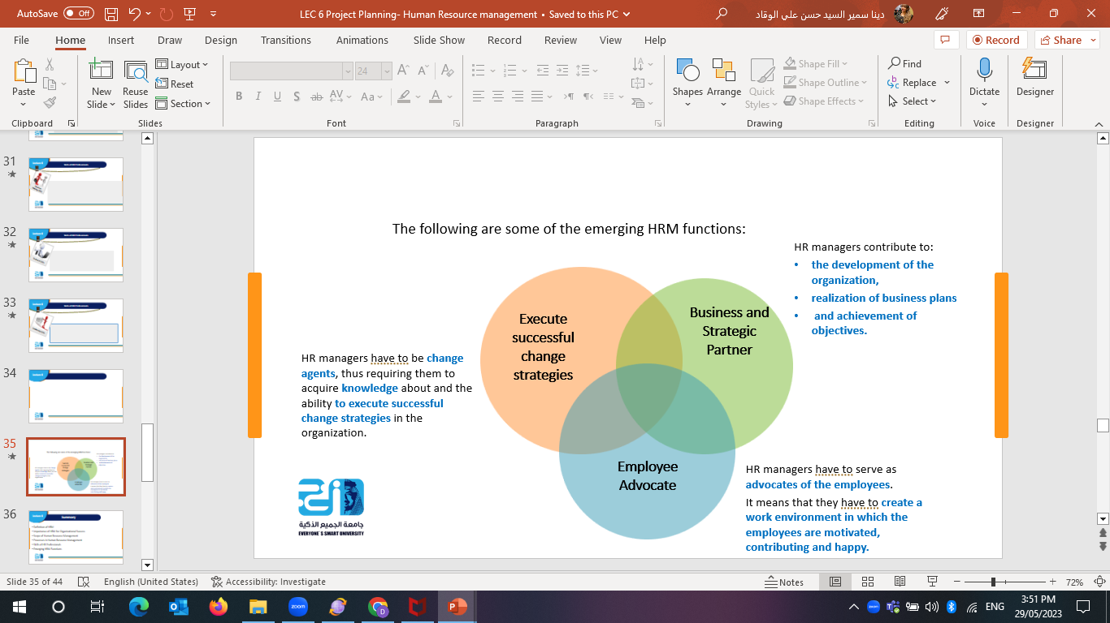

Emerging HRM Functions

Slide 36
Summary
Definition of HRM
Importance of HRM for Organizational Success
Scope of Human Resource Management
Processes in Human Resource Management
Skills of HR Professionals
Emerging HRM Functions

Slide 37


Slide 38
Questions
Which of the following is the correct abbreviation of HRM? Human Resource Management Human Resourcefulness Management Human Relation Management Humanistic Relation Management
Which of the following correctly defines the Human Resource Department? Service department Functional department Line department Authority department

Slide 39
Questions
What is the need for Human Resource Planning? All Answers are correct For undergoing an effective employee development program To represent a base for recruitment To represent a base for selection policy
What does Technical Skills refer to? specialized skills take a variety of decisions. communicating, and negotiating All answers are incorrect

Slide 40
Questions
Which of the following is NOT a scope of HRM? Quality management Training and development Payroll management Grievance handling
Which of the following is an aspect of HRM which deals with working conditions and amenities at workplace? Employee welfare Personnel management industrial relations Performance Management

Slide 41
Questions
The various skills of HR professionals are------------ All answers are correct HR skills Decision making skills Technical skills
HRM is the process of managing people in organizations in a structured and thorough manner. this Definition of HRM is--- Traditional Definition Contemporary Definition Traditional and Contemporary Definition Fact- based Definition

Slide 42
Questions
attracting applicants that match a certain Job Criteria. this is--- Recruitment Selection Training and Development All answers are incorrect.
Which of the following is the correct abbreviation of PMS? Performance Management System Performance Management Resourcefulness Performance Management Relation Humanistic Relation Management

Slide 43
Questions
Communicating, negotiating and team development., Those skills are--- HR skills Decision making skills. Technical skills leadership skills
HRM Functions are---- All answers are correct. Execute successful change strategies Employee Advocate Business and Strategic Partner

Slide 44
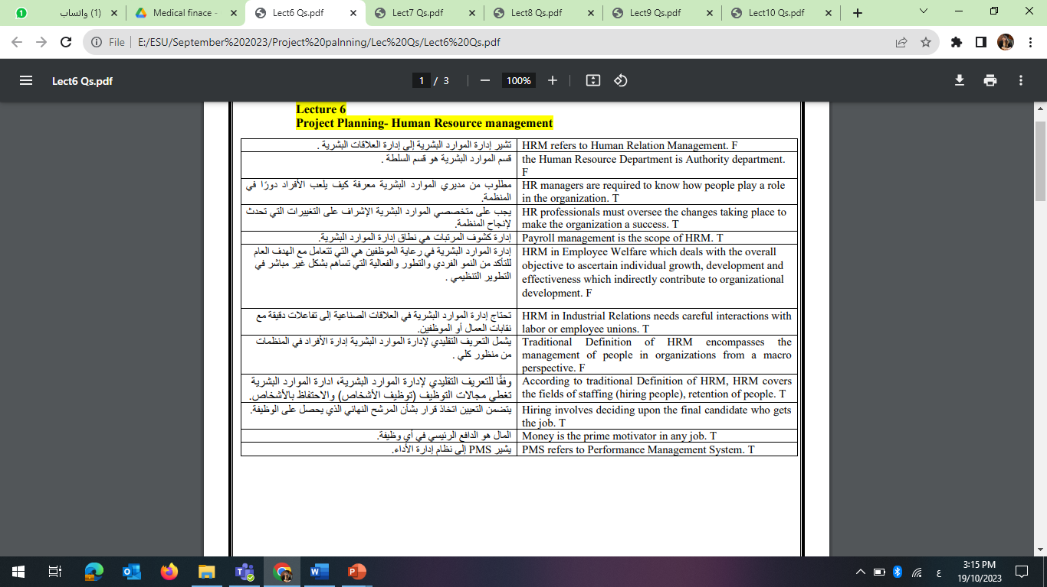
Questions

Slide 45
Questions

Slide 46



Thank You

