Slide 1




Research Methodology in Computer Science (AI800)
Lecture 2
Introduction to literature Review (part 1)
Prepared by
Dr. Mohammed Anbar
www.midocean.ae

Slide 2

Outlines
Learning Outcomes
Overview
Literature and Research Process
Reviewing the Literature vs literature Review
Implication of incomplete literature review
What is literature Review?
Researching a Topic
Key Points of literature Review
Why literature Review?
Reasons for Reviewing the Literature
Importance of literature Review
Types of literature Review
Organization of literature review
Content of a Literature Review
Literature Review Forms
Component of Review Articles
Evaluating the Literature
Contributions to the Existing Literature
Writing literature Review
www.midocean.ae

Slide 3
Learning Outcomes
To understand the purpose and basic requirements of literature review.
To learn tips for organizing an effective literature review.
To identify potential goals for conducting a literature review.
To help you on develop strategies for inventing, organizing, and drafting a literature review.
To become familiar with the steps of a literature review
www.midocean.ae

Slide 4
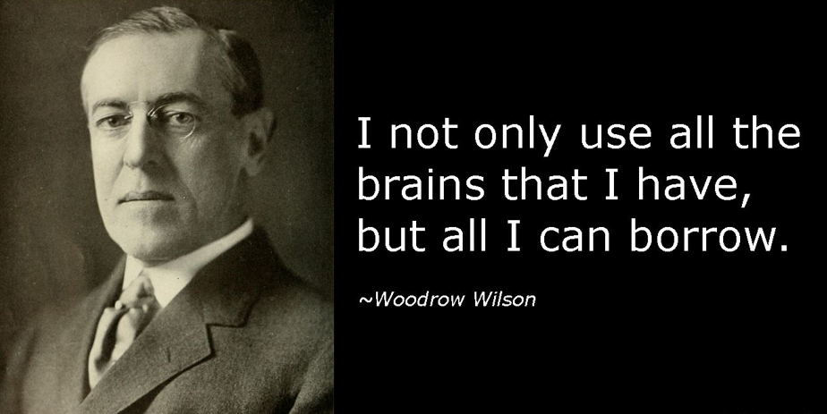
Overview
Research may be done alone – but it is never done in isolation. The production of new knowledge is fundamentally dependent on past knowledge
www.midocean.ae

Slide 5

Writing an Effective literature Review
What is the research question or objective?
What is the scope of the research?
What is the relevant literature on the topic?
What research methods will be employed?
Are there any ethical considerations to address?
Before starting your research, ask the following questions:
www.midocean.ae

Slide 6



The bottom Line….
www.midocean.ae

Slide 7
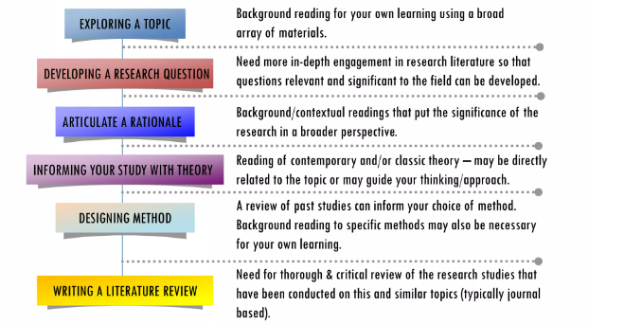
Literature and Research Process
www.midocean.ae

Slide 8
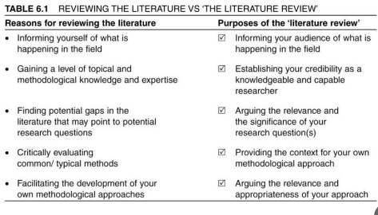
Reviewing the Literature vs literature Review
www.midocean.ae

Slide 9


Implication of incomplete literature review
www.midocean.ae

Slide 10

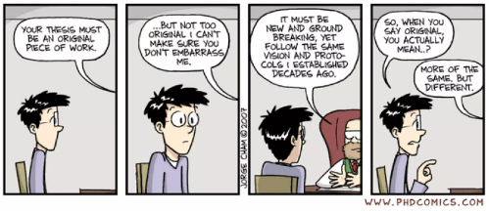
Implication of incomplete literature review (cont. )
www.midocean.ae

Slide 11

What is literature Review?
a critical analysis and synthesis of existing research and scholarly articles on a particular topic or research question. (Clare & Hamilton, 2003, p. 8)
a protracted task that provides an assessment of a body of research that address a research questions. (Bell, 1999, p. 93)
FINK, A., 1998. Conducting literature research reviews: from paper to internet. Thousand Oaks, CA: Sage., p.3
www.midocean.ae

Slide 12
What is literature Review? (cont. )
A literature review in computer science is a comprehensive survey and critical analysis of existing research, publications, and scholarly works relevant to a specific area or topic within the field of computer science.
A literature review in computer science involves synthesizing information from various sources to provide a coherent and structured narrative. This synthesis helps to establish connections between different studies and form a unified understanding of the topic.
FINK, A., 1998. Conducting literature research reviews: from paper to internet. Thousand Oaks, CA: Sage., p.3
www.midocean.ae

Slide 13
What is literature Review? (cont. )
In academic and research contexts, synthesizing information often involves reviewing multiple sources, such as research papers, articles, or data, and then summarizing, comparing, and drawing conclusions from them.
It goes beyond simply summarizing individual sources and aims to create a new understanding or perspective that emerges from the synthesis of these sources.
Effective information synthesis requires critical thinking, analytical skills, and the ability to identify key insights or trends from a range of sources.
FINK, A., 1998. Conducting literature research reviews: from paper to internet. Thousand Oaks, CA: Sage., p.3
www.midocean.ae

Slide 14
What is literature Review? (cont. )
A literature review is reading other people's writings before we start our own research. Understanding the present requires knowledge of the past.
A literature review can open the door to a more effective investigation.
A literature review avoids repetitions.
FINK, A., 1998. Conducting literature research reviews: from paper to internet. Thousand Oaks, CA: Sage., p.3
www.midocean.ae

Slide 15


What is literature Review? (cont. )
READ PUBLISHED WORK
Examine a variety of print- and web-based materials.
INTERPRETATION
Discuss the significance and interpret the evidence they have provided in each piece of literature instead of just listing the works of others.
SYNTHESIS
Creating "integrated whole" : a convincing justification for the research you are doing
www.midocean.ae

Slide 16
Researching a Topic
Start with your area of interest but stay away from subjects that are:
  too general
  too specific
  overused
  outdated
  do not warrant further investigation
It is impossible to read all research that has ever been published in your field.
To avoid drowning in information, it's important to read only what interests you.
www.midocean.ae

Slide 17
Key Points of literature Review
Theory
Tell me what the research say…
Methodology
Tell me how the research was carried out…
Tell me what is missing or the gap that research intends to fill….
Research Gap
FINK, A., 1998. Conducting literature research reviews: from paper to internet. Thousand Oaks, CA: Sage., p.3
www.midocean.ae

Slide 18
Why literature Review?
To demonstrate understanding of the subject matter –identifying, summarizing and critically assessing past research that is relevant to your work.
To gain a comprehensive understanding of the existing knowledge and research on a particular topic.
To identify gaps in the current literature, highlight areas that need further investigation, and provide a foundation for new research.
To build upon previous studies and theories, ensuring that their own work contributes to the broader academic conversation.
www.midocean.ae

Slide 19

Reasons for Reviewing the Literature
Shows how your study fills the “gap”: provide a basis for making critical decisions regarding the direction of research.
The necessity and rationale of your study: setting a theoretical framework – Literature review is the foundations for your study, since the rest of your work will build upon the ideas and existing research you discuss.
Set boundaries of your study: Developing a methodology by determining the scope and specific objective of existing research, you can make sure you adopt the most appropriate methods for your own work.
www.midocean.ae

Slide 20
Importance of literature Review
The literature review plays a crucial role in academic research and has several key importance:
Establishing Context: Provides the context and background for the research study, helping readers understand the broader field in which the research is situated.
Defining the Scope of Research: Helps to narrow down and define the specific focus of the research project by identifying key concepts, theories, and areas of interest.
Identifying Gaps in Knowledge: Reveals areas where the existing research is lacking or where further investigation is needed, thereby justifying the need for the current study.
Evaluating Previous Research: Allows for a critical assessment of the quality, methodology, and findings of previous studies, providing a basis for the researcher to build upon or challenge existing knowledge.
Synthesizing Information: Involves summarizing and synthesizing a wide range of sources to create a cohesive and comprehensive overview of the current state of knowledge on a particular topic.
www.midocean.ae

Slide 21
Importance of literature Review (Cont.)
Understanding Theoretical Frameworks: Highlights the theoretical models, frameworks, and concepts that have been used in previous research, providing a foundation for the current study.
Supporting Methodological Choices: Informs the selection of research methodologies by showcasing approaches that have been successful in similar studies.
Providing Empirical Evidence: If applicable, it presents the empirical evidence provided by studies, including experimental designs, data sources, and statistical analyses employed.
Identifying Conflicting Evidence: Helps to identify areas of disagreement or conflicting findings within the existing literature, prompting further investigation or analysis.
Demonstrating Scholarly Familiarity: Demonstrates that the researcher is familiar with and has thoroughly reviewed the relevant literature in the field, establishing their credibility as a scholar.
Guiding Hypothesis Formulation: Aids in the formulation of hypotheses or research questions by providing a foundation of knowledge upon which the research can build.
www.midocean.ae

Slide 22
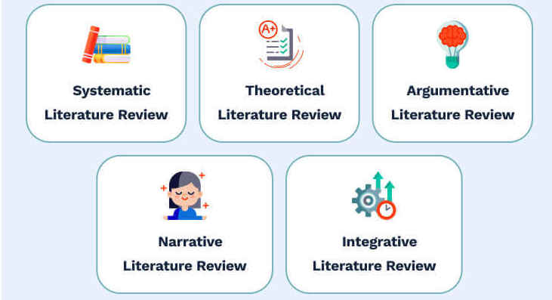
Types of literature Review
implies gathering theories which are apply to studied ideas or concepts.
starts with a problem statement. Then, you select and study the topic-related literature to confirm or deny the stated question.
Identifies, evaluates, and appraises the studied topic.
Indicates possible gaps and concludes the body of literature.
generates new statements around the existing research.
www.midocean.ae

Slide 23
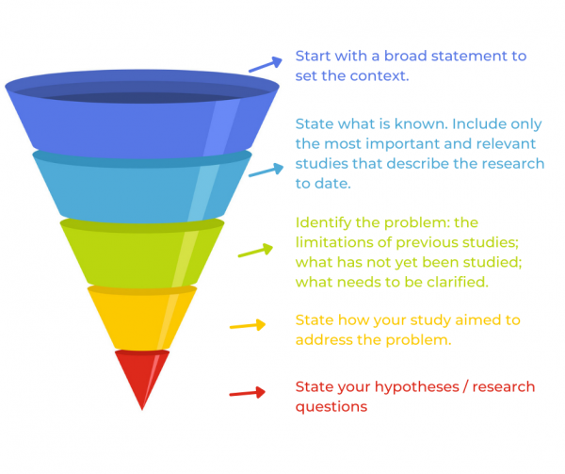
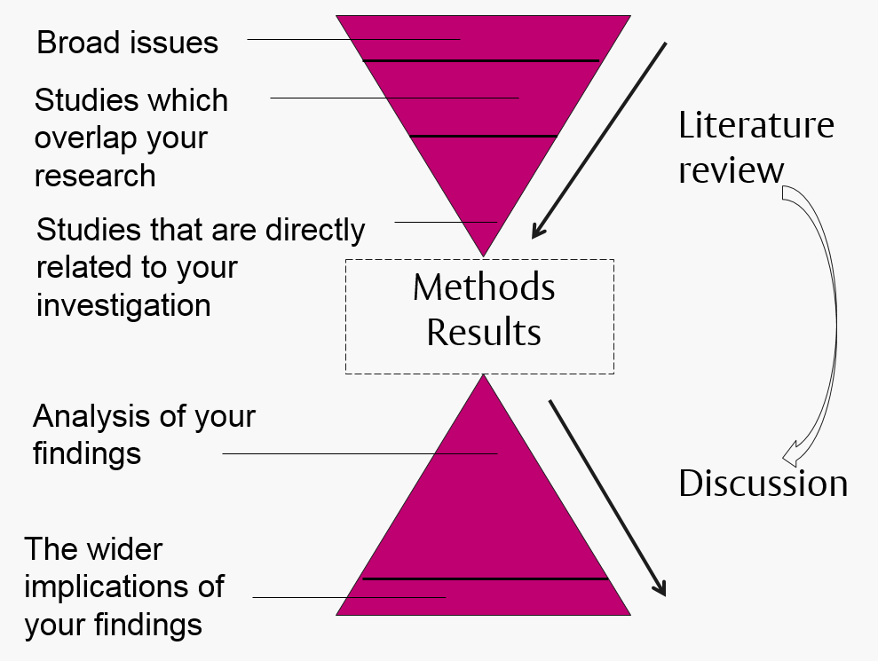
Organization of literature review
A general organization of literature review looks like a funnel
  Broader topics
  Subtopics
  Studies like yours
www.midocean.ae

Slide 24
Content of a Literature Review
Relevant literature can be found in a variety of formats, including books, book chapters, journal articles that have been published, papers or presentations that have been given at conferences, theses, or doctoral dissertations.
When choosing sources consider:
Is it scholarly work?
Does it relate to the topic?
Is it theoretically grounded?
(Sheperis, Young, and Daniels, 2017)
www.midocean.ae

Slide 25
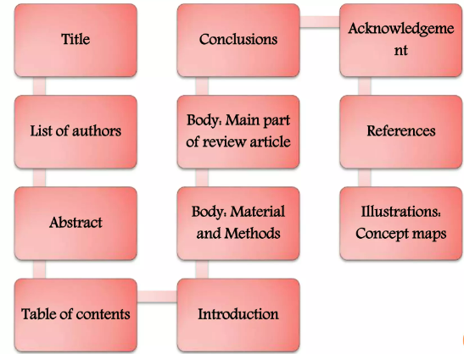
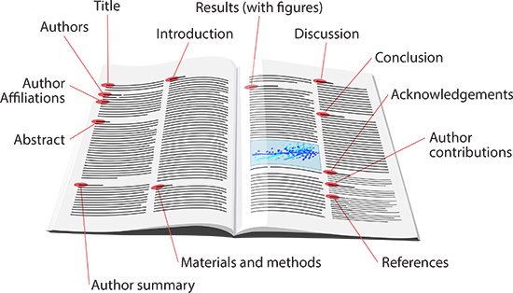
Component of Review Articles
www.midocean.ae

Slide 26
Organizing/Outlining
In all methods, relationships between elements (e.g., subject, theme, author, etc.) must be shown.
Methods for organizing the Review of literature
By subject (if lit review covers more than one subject)
By theme, idea, trend, theory, or major research studies
By author
Chronological
  By publication date
  By trend
  Methodological
  Focuses on the methods of the researcher, e.g., qualitative versus quantitative approaches
  Broader topics
  Subtopics
www.midocean.ae

Slide 27
Evaluating the Literature
You must look through all the available information about interest and ask:
  Are there gaps in existing research?
  What are the benefits of previous studies, and how will a new study add to the existing body of knowledge?
  What are the restrictions of the study that is being considered?
(Sheperis, Young, and Daniels, 2017)
www.midocean.ae

Slide 28

Writing literature Review
www.midocean.ae

Slide 29
Guidelines for Creating a Literature Review
Create an outline and process goals to guide work for the project.
Process goals are objectives needed to accomplish a task.
Break the assignment into manageable pieces.
Work on one task at a time.
The use of section headers creates clear and logical flow.
Organize the existing research by points of relevance and elaborate on conclusions in the existing body of research.
Organize by theoretical foundation and draw relationships between the current project and previous studies.
Rules of Thumb:
  There should be a source for every citation and a citation for every source.
  If a source is in your reference list, it should be used somewhere in the body of your paper.
(VanderMey et al., 2011; Sheperis et al., 2017)
www.midocean.ae

Slide 30
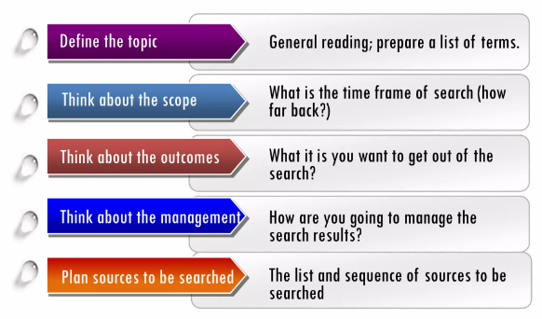
Planning for Literature Search
(VanderMey et al., 2011; Sheperis et al., 2017)
www.midocean.ae

Slide 31
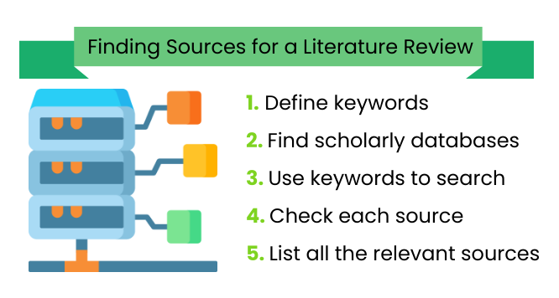
Steps for Writing literature Review .
Where do I look for resources for my literature review?
What Type of Literature Review Am I Writing?
www.midocean.ae

Slide 32
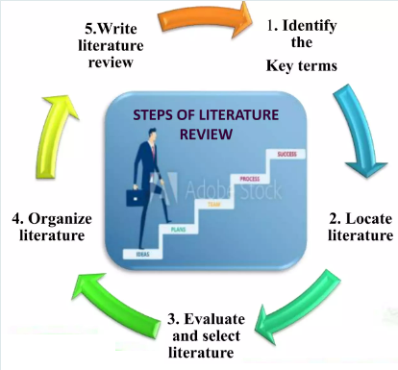
Steps for Writing literature Review (cont.).
Steps to follow when conducting a literature review:
Identify the key terms:
  identify what you already know and what you need to find out.
  List keywords and Synonyms related to your topic.
Locate literature:
  Identify relevant sources
  Search for literature.
Evaluate and select literature:
  Read and Record: Read strategically, read critically, and record important points.
  Evaluate the quality of the literature
Organize literature : Organize and synthesize the literature: Introduction, body and conclusion
Write literature Review.
www.midocean.ae

Slide 33
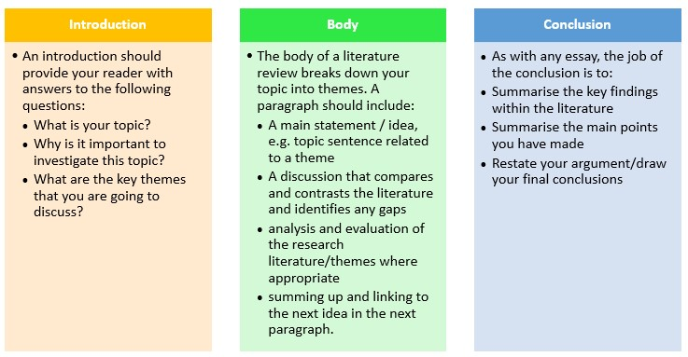
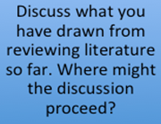
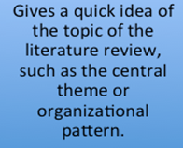
Elements of Writing The Literature Review
www.midocean.ae

Slide 34
Making links between studies
In all methods, relationships between elements (e.g., subject, theme, author, etc.) must be shown.
Agreements
Similarly, author B points to…
Likewise, author C makes the case that…
Author D also makes this point…
Again, it is possible to see how author E agrees with author D…
Disagreements
However, author B points to…
On the other hand, author C makes the case that…
Conversely, Author D argues…
Nevertheless, what author E suggests…
  Broader topics
  Subtopics
www.midocean.ae

Slide 35
References
Eaves, S., Sheperis, C. J., Craft, S., Frasier, R., & Wells, D. (2008). Reviewing the literature. In B. T. Erford (Ed.), Research and evaluation in counseling. Lahaska, PA: Lahaska Press.
Sheperis, C.J., Young, J.S. & Daniels M.H. (2017). Counseling research: Quantitative, qualitative, and mixed methods (2nd ed.). Boston, MA: Pearson. ISBN-13: 978-0-13-402509-4
VanderMey, R., Meyers, V., Van Rys, J., Kemper, D., & Sebrank, P. (2011). The college writer: A guide to thinking, writing, and researching (4th ed.). Boston: Houghton Mifflin.
Abd Karim Alias (2010). A brief guide to doing a literature review. Retrieved from http://www.slideshare.net/akarim717/doing-a- literature-review6432447?qid=ea37aecb-065c- 4ac3-8975-03bd20e0a570&v=&b=&from_search=1
Teoh Yew Heng. Seminar on how to write a research plan & tackling a literature review
https://proofed.com/writing-tips/5-reasons-the-literature-review-is-crucial/
Prof. Mani Maran Ratnam – How to write a report in journal format
www.midocean.ae

Slide 36



Thank You

