Slide 1


  Master of Financial Technology
FNT 615
Finance Concepts

Slide 2



Capital Budgeting
Chapter 6
www.midocean.ae

Slide 3

Chapter
Intended Learning Outcomes
06
After reading this chapter, you should be able to:
  Discuss the difficulty encountered in finding profitable projects in competitive markets and the importance of the search.
  Determine whether a new project should be accepted or rejected using the payback period, the net present value, the profitability index, and the internal rate of return.
  Explain how the capital-budgeting decision process changes when a dollar limit is placed on the capital budget.
www.midocean.ae

Slide 4
Profitability Index - PI

Slide 5
Profitability Index
The profitability index (PI), or benefit–cost ratio, is the ratio of the present value of the future free cash flows to the initial outlay.
Although the NPV investment criterion gives a measure of the absolute dollar desirability of a project, the profitability index provides a relative measure of an investment proposal’s desirability— that is, the ratio of the present value of its future net benefits to its initial cost.

Slide 6
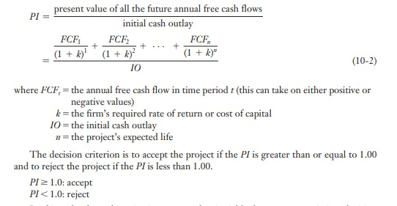

Slide 7
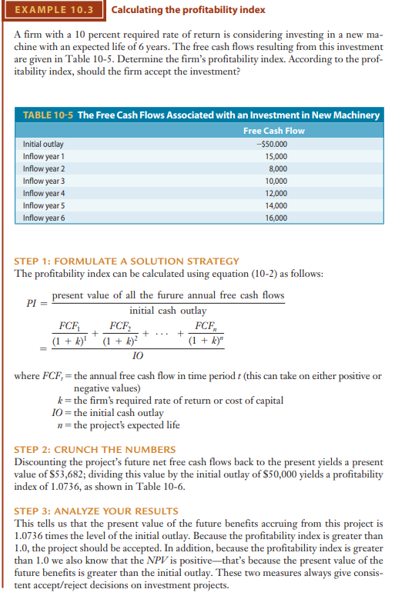

Slide 9
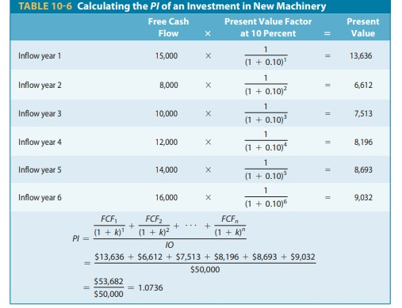

Slide 10
Concept Check
Calculate
1- Profitability index if the discount rate is 7 %
Year | Cash Flow
0 | 80,000
1 | 30,000
2 | 20,000
3 | 25,000
4 | 20,000
5 | 15,000
6 | 15,000

Slide 11
Concept Check
Year | Cash Flow | Discount Factor (1/ (1+r)^t) | Discounted Cash Flow
0 | 80,000 | 1.0000 | -80000
1 | 30,000 | 0.9346 | 28037
2 | 20,000 | 0.8734 | 17469
3 | 25,000 | 0.8163 | 20407
4 | 20,000 | 0.7629 | 15258
5 | 15,000 | 0.7130 | 10695
6 | 15,000 | 0.6663 | 9995
Cash outflows
Cash Inflows
PI = Sum of all discount CASHINFLOWS / intial cash outflows
= 101,861 / 80,000
= 1.273

Slide 12
Internal Rate of Return- IRR

Slide 13
The internal rate of return (IRR)
The internal rate of return (IRR) attempts to answer the question, what rate of return does this project earn?
For computational purposes, the internal rate of return is defined as the discount rate that equates the present value of the project’s free cash flows with the project’s initial cash outlay.
Mathematically, the internal rate of return is defined as the value IRR in the following equation: IRR = the rate of return that equates the present value of the project’s free cash flows with the initial outlay

Slide 14
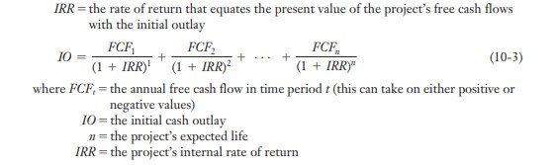
IRR

Slide 15
Viewing the NPV–IRR Relationship:
The Net Present Value Profile Perhaps the easiest way to understand the relationship between the IRR and the NPV value is to view it graphically through the use of a net present value profile.
A net present value profile is simply a graph showing how a project’s NPV changes as the discount rate changes.
To graph a project’s net present value profile, you simply need to determine the project’s NPV, first using a 0 percent discount rate, then slowly increasing the discount rate until a representative curve has been plotted. How does the IRR enter into the net present value profile? The IRR is the discount rate at which the NPV is zero.
Let’s look at an example of a project that involves an after-tax initial outlay of
$105,517 with free cash flows expected to be $30,000 per year over the project’s 5-year life.

Slide 16
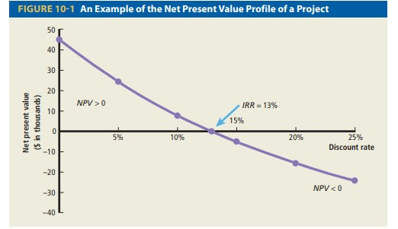

Slide 17
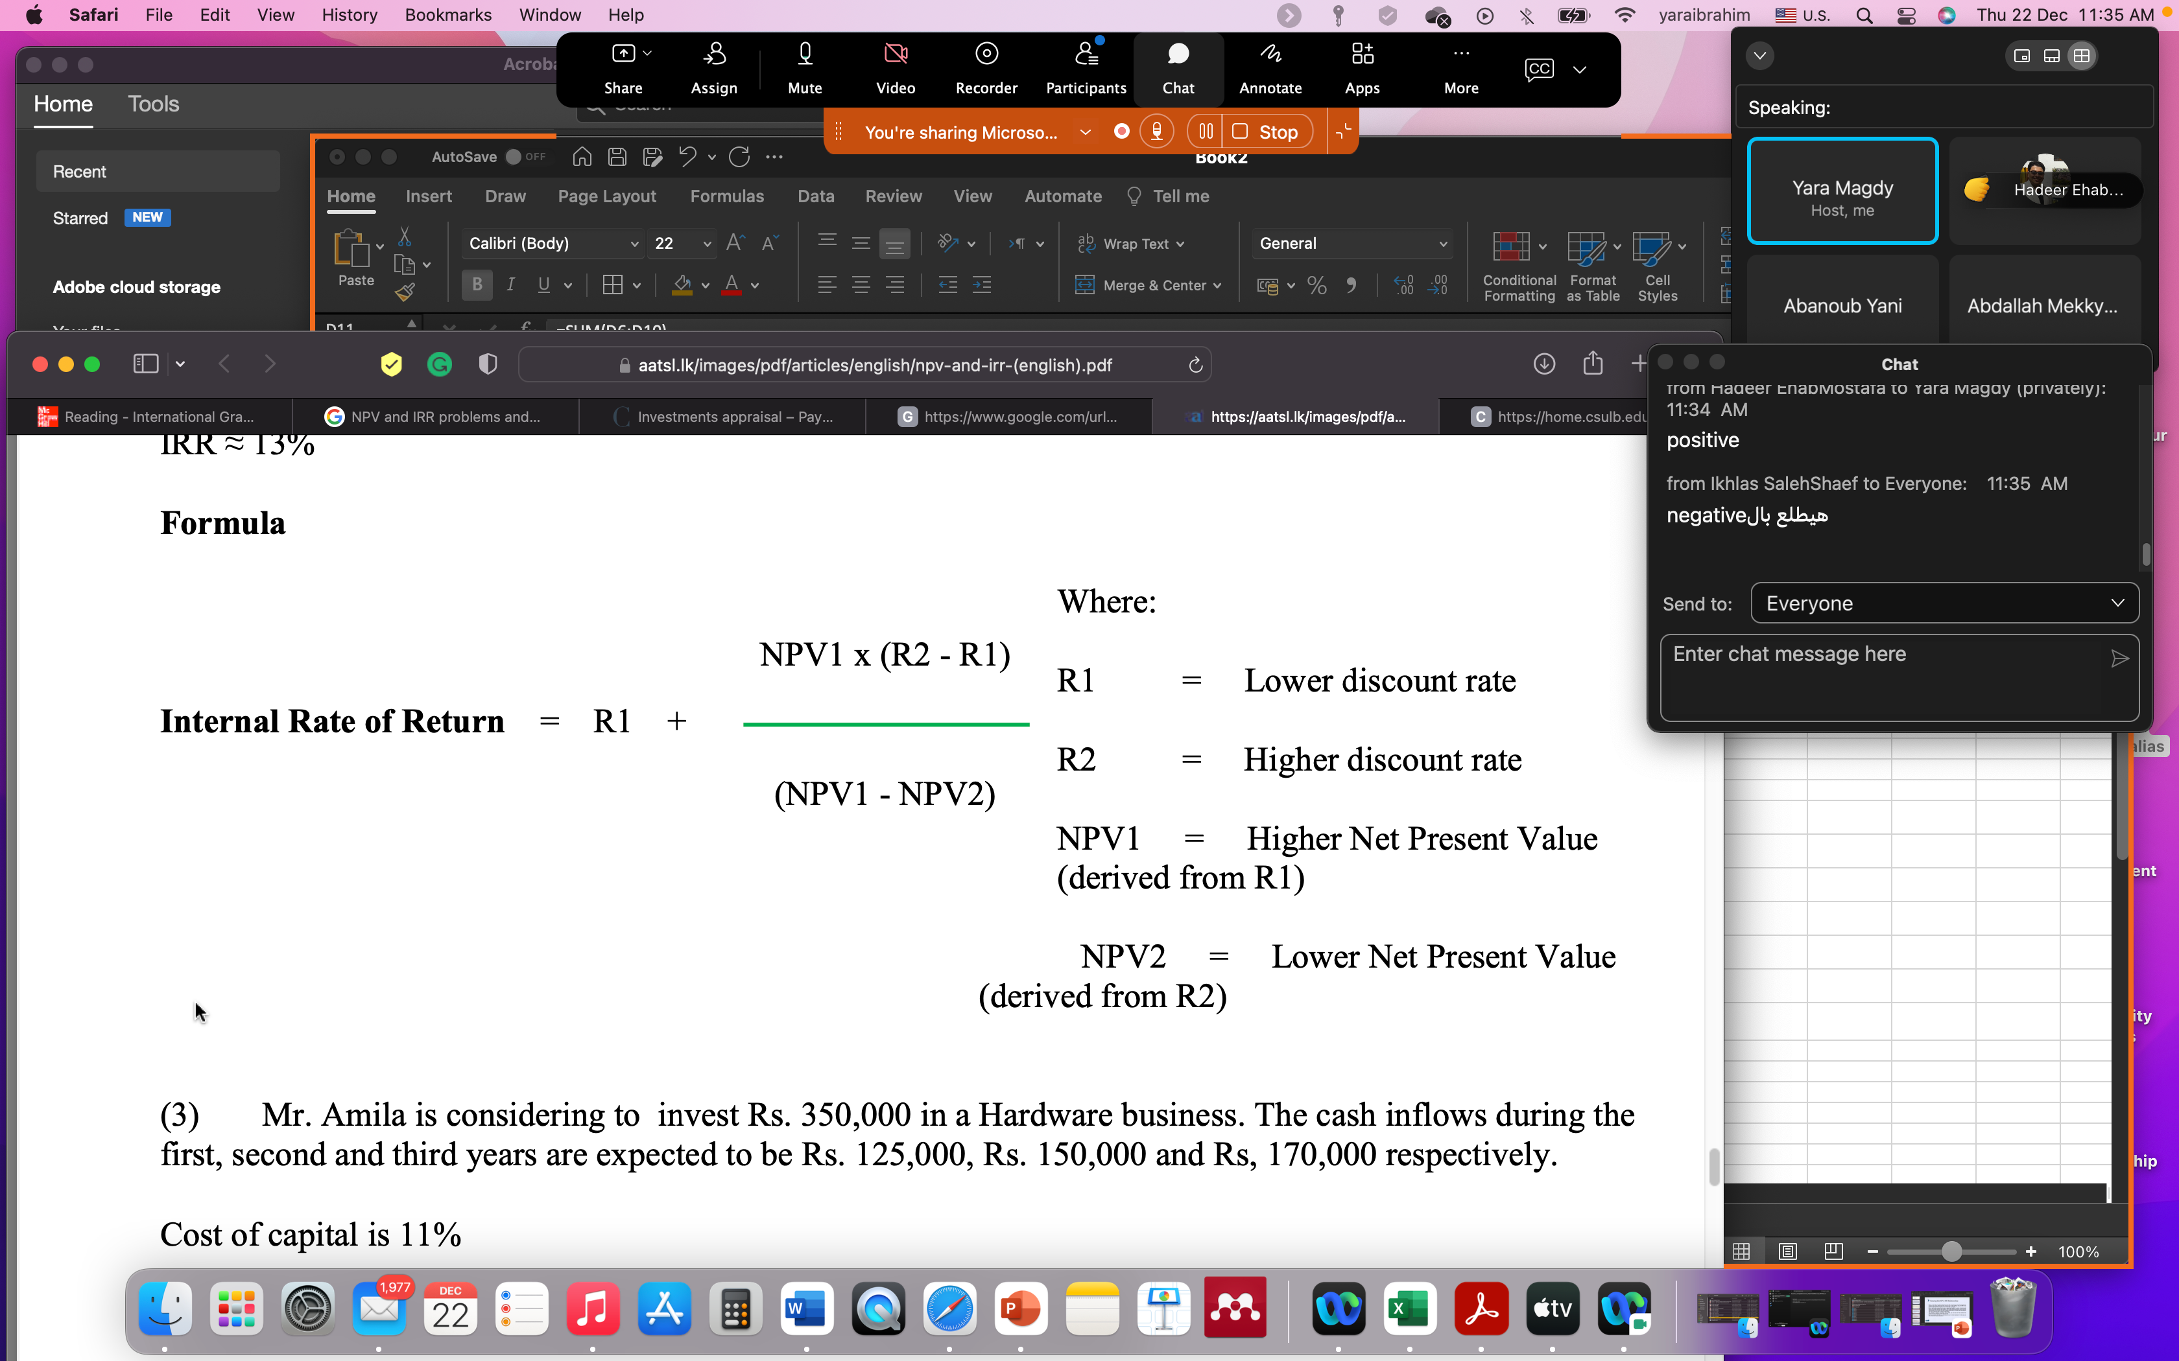

Slide 18
Viewing the NPV–IRR Relationship:
Where is the IRR in this figure? Recall that the IRR is the discount rate that equates the present value of the inflows with the present value of the outflows; thus, the IRR is the point at which the NPV is equal to zero—in this case, 13 percent.
This is exactly the process that we use in computing the IRR for a series of uneven cash flows—we simply calculate the project’s NPV using different discount rates and the discount rate that makes the NPV equal to zero is the project’s IRR. From the net present value profile you can easily see how a project’s NPV varies in versely with the discount rate—as the discount rate is raised, the NPV drops.
By analyzing a project’s net present value profile, you can also see how sensitive the project is to your selection of the discount rate.
The more sensitive the NPV is to the discount rate, the more important it is that you use the correct one in your calculations

Slide 19
Example
Year | Cash Flow
0 | -50,000
1 | 15,000
2 | 8,000
3 | 10,000
4 | 12,000
5 | 14,000
6 | 16,000

Slide 20
R1= 5 %, NPV1 ( Positive NPV)
Year | Cash Flow | Discount Factor @ 5% | DCF
0 | -50,000 | 1 | -50000
1 | 15,000 | 0.952380952 | 14286
2 | 8,000 | 0.907029478 | 7256
3 | 10,000 | 0.863837599 | 8638
4 | 12,000 | 0.822702475 | 9872
5 | 14,000 | 0.783526166 | 10969
6 | 16,000 | 0.746215397 | 11939
R1 | 0.05 | NPV 1 | 12962

Slide 21
R 2 = 20 % , NPV 2 ( Negative NPV)
Year | Cash Flow | Discount Factor @ 20% | DCF
0 | -50,000 | 1 | -50000
1 | 15,000 | 0.833333333 | 12500
2 | 8,000 | 0.694444444 | 5556
3 | 10,000 | 0.578703704 | 5787
4 | 12,000 | 0.482253086 | 5787
5 | 14,000 | 0.401877572 | 5626
6 | 16,000 | 0.334897977 | 5358
R2 | 0.20 | NPV 2 | -9386

Slide 22
IRR | 0.137 | 13.7%

Slide 23

Note
IRR manual calculation is an estimate not an accurate number.
To obtain an exact IRR, you should use excel.

Slide 24
NPV @ IRR
Year | Cash Flow | Discount Factor @ 13.7% | DCF
0 | -50,000 | 1 | -50000
1 | 15,000 | 0.879507476 | 13193
2 | 8,000 | 0.7735334 | 6188
3 | 10,000 | 0.680328408 | 6803
4 | 12,000 | 0.598353921 | 7180
5 | 14,000 | 0.526256747 | 7368
6 | 16,000 | 0.462846743 | 7406
R | 13.70% | NPV | -1862
Not zero

Slide 25
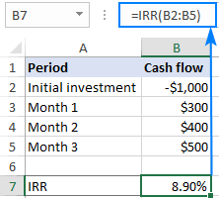
IRR Excel Funtion

Slide 26
IRR using Excel is 12.383%
Year | Cash Flow | Discount Factor @ 12.383% | DCF
0 | -50,000 | 1 | -50000
1 | 15,000 | 0.889810406 | 13347
2 | 8,000 | 0.791762559 | 6334
3 | 10,000 | 0.704518564 | 7045
4 | 12,000 | 0.62688795 | 7523
5 | 14,000 | 0.557811421 | 7809
6 | 16,000 | 0.496346407 | 7942
R | 13.70% | NPV | 0

Slide 27
Summary

Slide 28
Capital Budgeting In Practice
We should consider several investment criteria when making decisions
NPV and IRR are the most commonly used primary investment criteria
Payback is a commonly used secondary investment criteria
9-28
Notes:
Even though payback and AAR should not be used to make the final decision, we should consider the project very carefully if they suggest rejection. There may be more risk than we have considered or we may want to pay additional attention to our cash flow estimations. Sensitivity and scenario analysis can be used to help us evaluate our cash flows.
The fact that payback is commonly used as a secondary criterion may be because short paybacks allow firms to have funds sooner to invest in other projects without going to the capital markets.
Why are smaller firms more likely to use payback as a primary decision criterion?
small firms don’t have direct access to the capital markets and therefore find it more difficult to estimate discount rates based on funds cost;
the AAR is the project-level equivalent to the ROA measure used for analyzing firm profitability; and
(3) some small firm decision-makers may be less aware of DCF approaches than their large firm counterparts.
When managers are judged and rewarded primarily on the basis of periodic accounting figures, there is an incentive to evaluate projects with methods such as payback or average accounting return. On the other hand, when compensation is tied to firm value, it makes more sense to use NPV as the primary decision tool.

Slide 29
Summary – DCF Criteria
Net present value
  Difference between market value and cost
  Take the project if the NPV is positive
  Has no serious problems
  Preferred decision criterion
Internal rate of return
  Discount rate that makes NPV = 0
  Take the project if the IRR is greater than the required return
  Same decision as NPV with conventional cash flows
  IRR is unreliable with nonconventional cash flows or mutually exclusive projects
Profitability Index
  Benefit-cost ratio
  Take investment if PI > 1
  Cannot be used to rank mutually exclusive projects
  May be used to rank projects in the presence of capital rationing
9-29
Notes:
For IRR, we assume a conventional investment project. For a financing project, we accept if the IRR is less than the “required” rate.

Slide 30
Summary – Payback Criteria
Payback period
  Length of time until initial investment is recovered
  Take the project if it pays back within some specified period
  Doesn’t account for time value of money, and there is an arbitrary cutoff period
Discounted payback period
  Length of time until initial investment is recovered on a discounted basis
  Take the project if it pays back in some specified period
  There is an arbitrary cutoff period
9-30

Slide 31
Concept Check

Slide 32
Case Study
Consider that a publisher is planning to publish one book this year; either an accounting book or an economics book. Using the Capital Budgeting Techniques help the publisher to make the best decision. Discount rate is 10%. Assuming that the payback period accepted for the publisher is 3.5 years.
 | Accounting book | Economics book
 | Annual cash flows | Annual cash flows
Investment at time 0 | (450) | (600)
Net cash inflows year 1 | 160 | 240
Net cash inflows year 2 | 160 | 200
Net cash inflows year 3 | 160 | 160
Net cash inflows year 4 | 100 | 105
Net cash inflows year 5 | 100 | 105
Net cash inflows year 6 | 50 | 100

Slide 33
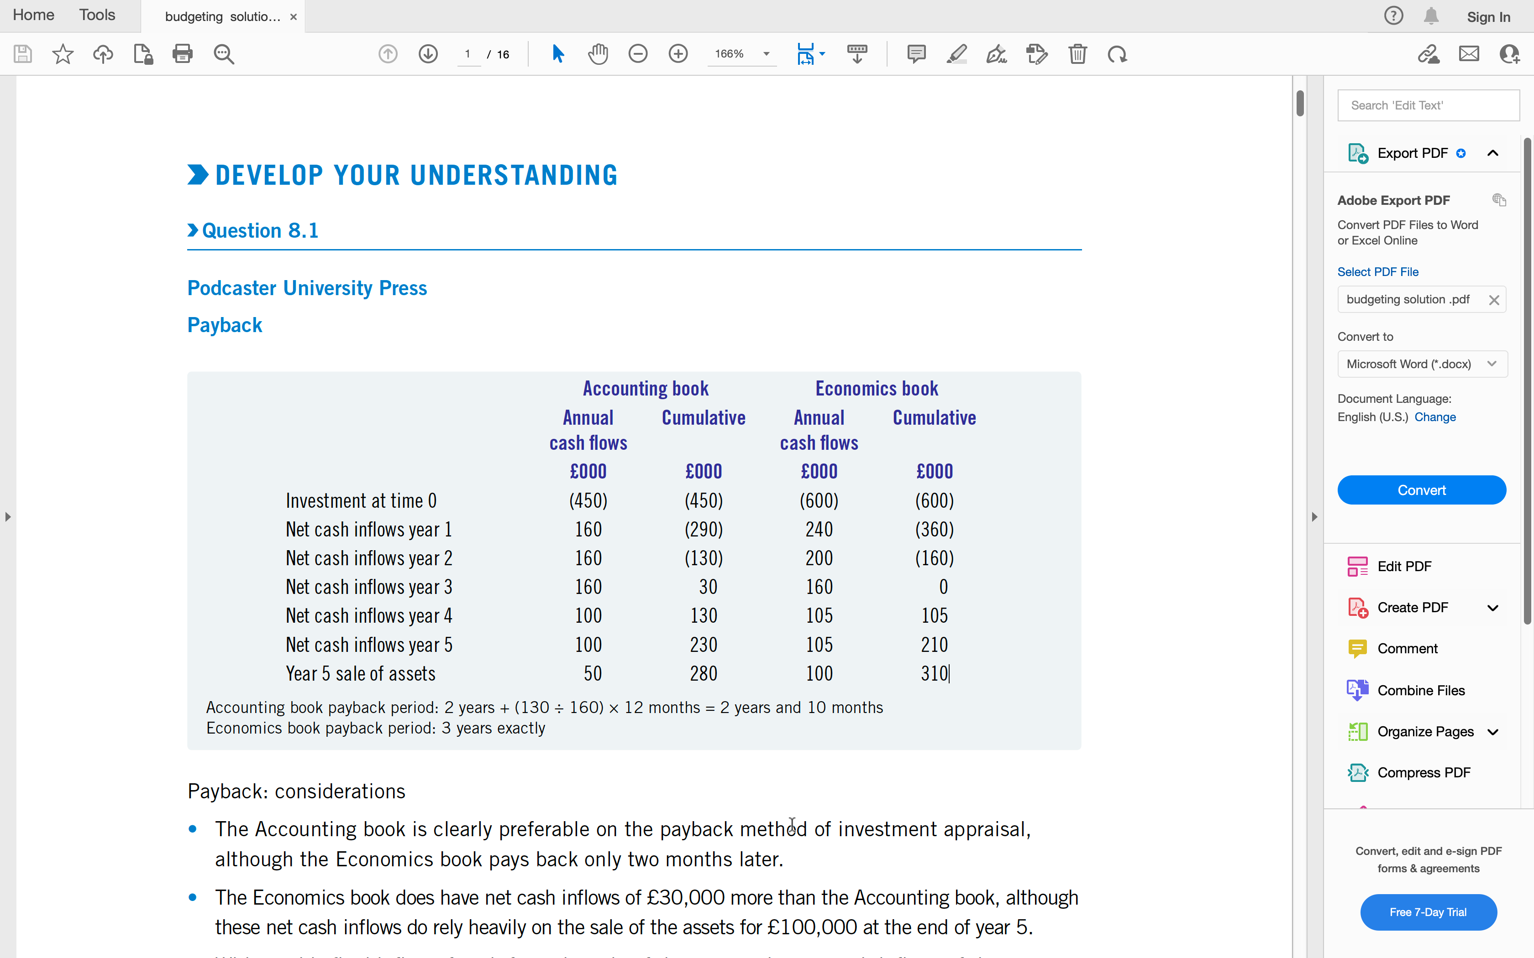

Slide 34
Payback: considerations
The Accounting book is clearly preferable on the payback method of investment appraisal, although the Economics book pays back only two months later.
The Economics book does have net cash inflows of £30,000 more than the Accounting book, although these net cash inflows do rely heavily on the sale of the assets for £100,000 at the end of year 5.
Without this final inflow of cash from the sale of the assets, the net cash inflows of the Accounting book would be £230,000 (£280,000 − £50,000 cash from sale of the assets) compared with £210,000 (£310,000 − £100,000 cash from sale of the assets) for the Economics book.

Slide 35
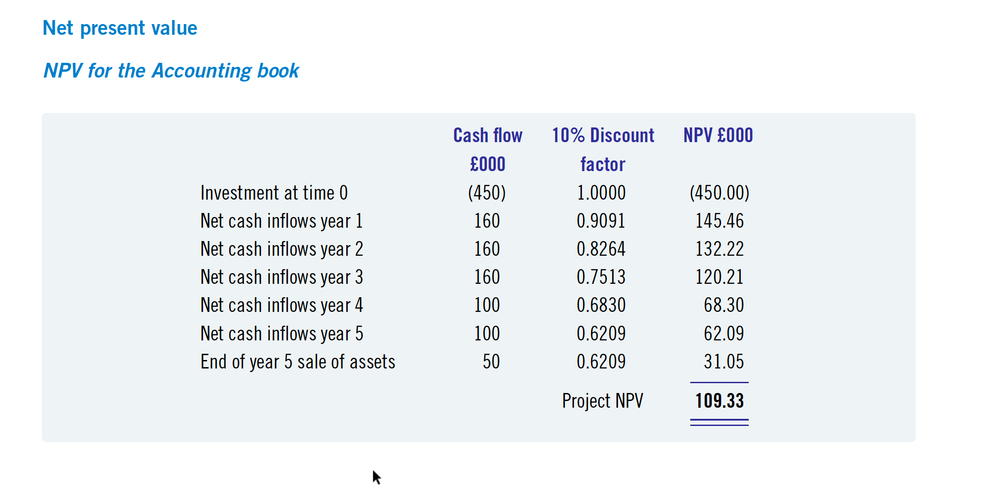

Slide 36
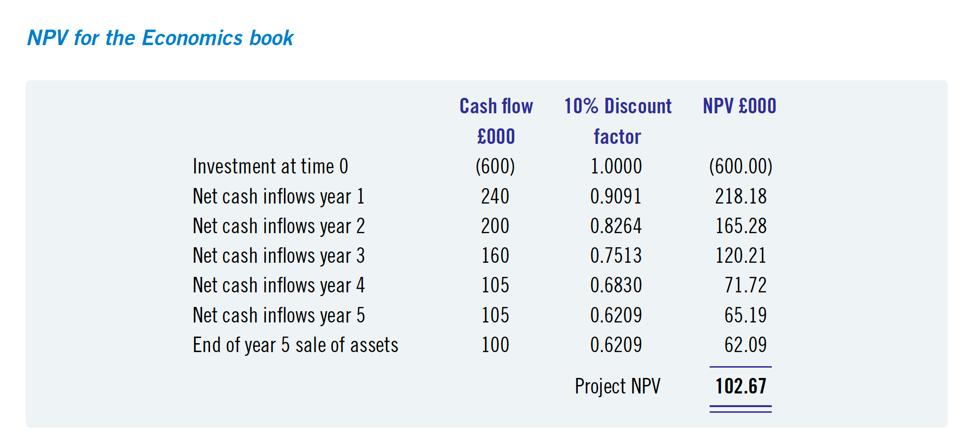

Slide 37
Net present value: considerations
The Accounting book has the higher net present value, so this book should be accepted instead of the Economics book.
The Accounting book breaks even on a net present value basis towards the end of year 4.
The Economics book breaks even on a net present value basis only at the end of year 5.

Slide 38
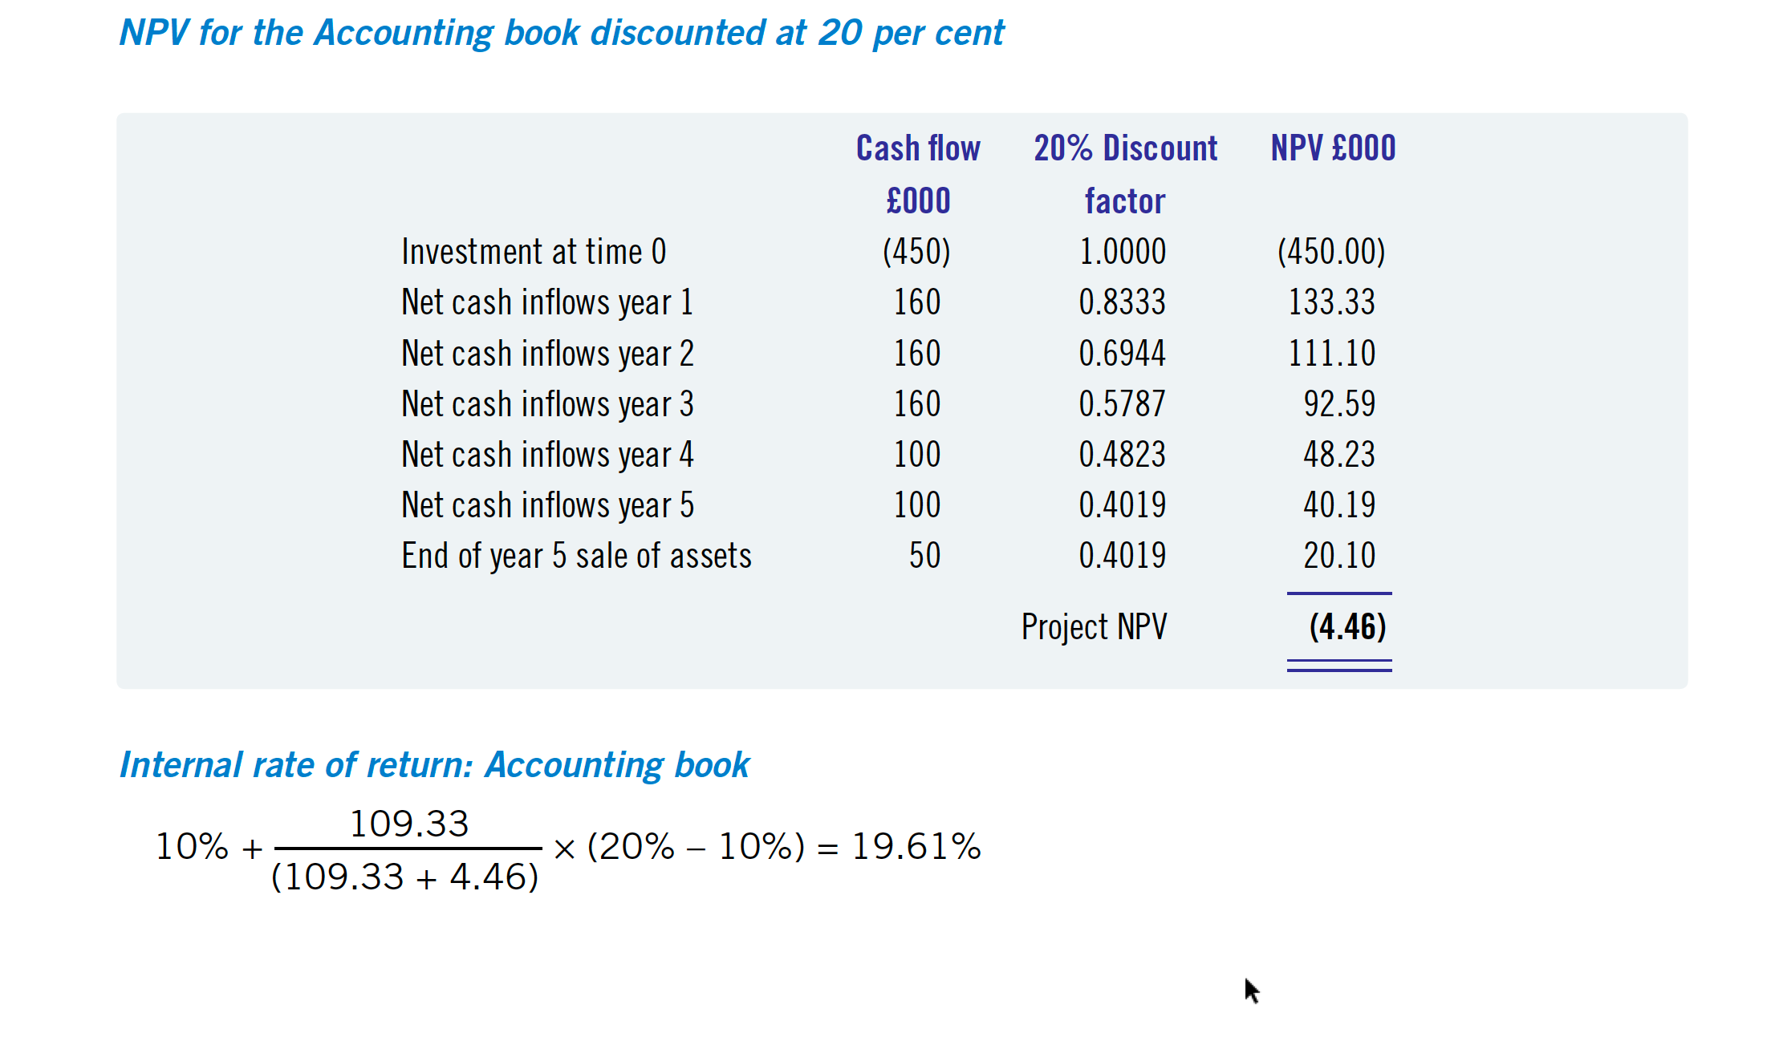

Slide 39
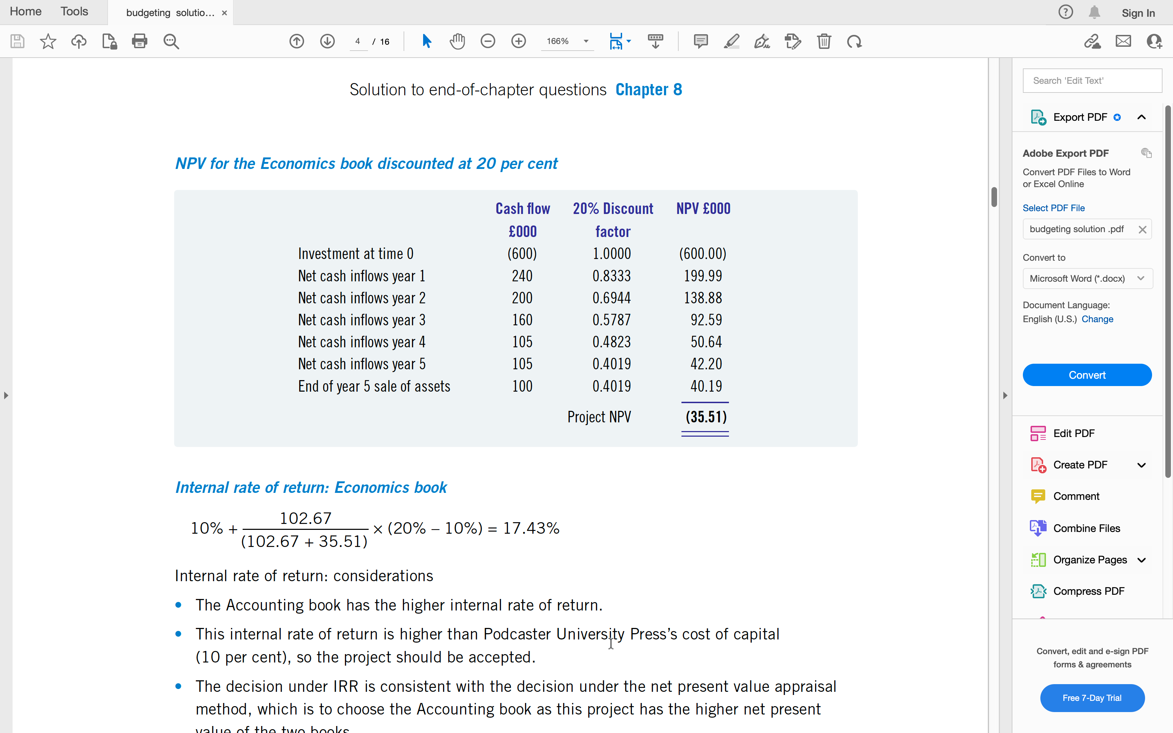

Slide 40
Internal rate of return: considerations
The Accounting book has the higher internal rate of return.
This internal rate of return is higher than publisher’s cost of capital (10 per cent), so the project should be accepted.
The decision under IRR is consistent with the decision under the net present value appraisal method, which is to choose the Accounting book as this project has the higher net present value of the two books.

Slide 41
Case Study 2
Swanson Industries has a project with an initial cost of $52,125. As a result of this project, cash flow will generate $12,000/year for the next 8 years.
The company has a cost of capital of 12%.
Given the discount rates and the future cash flows of this project, should the company accept the project?

Slide 42
Payback Method (PB)
– computes the amount of time required to recoup the initial investment
– a cutoff period is established
Advantages:
– easy to use (“quick and dirty” approach)
– emphasizes liquidity
Disadvantages:
– ignores inflows after the cutoff period and fails to consider the time value of money
– is inferior to the other 2 methods

Slide 43
NPV
Period | Annual Cash Flows | Discounted @ 12% Cash Flows | Cumulative Cash Flows
0 | $ (52,125) | $ (52,125.00) | $ (52,125.00)
1 | $ 12,000 | $ 10,714.29 | $ (41,410.71)
2 | $ 12,000 | $ 9,566.33 | $ (31,844.38)
3 | $ 12,000 | $ 8,541.36 | $ (23,303.02)
4 | $ 12,000 | $ 7,626.22 | $ (15,676.80)
5 | $ 12,000 | $ 6,809.12 | $ (8,867.68)
6 | $ 12,000 | $ 6,079.57 | $ (2,788.11)
7 | $ 12,000 | $ 5,428.19 | $ 2,640.08
8 | $ 12,000 | $ 4,846.60 | $ 7,486.68
 | NPV | $ 7,486.68
the present value of the cash inflows minus the present value of the cash outflows
the cash inflows are discounted back over the life of the investment
the basic discount rate is usually the firm’s cost of capital (WACC)

Slide 44
Period | Annual Cash Flows | Discounted @ 12% Cash Flows | Cumulative Cash Flows
0 | $ (52,125) | $ (52,125.00) | $ (52,125.00)
1 | $ 12,000 | $ 10,714.29 | $ (41,410.71)
2 | $ 12,000 | $ 9,566.33 | $ (31,844.38)
3 | $ 12,000 | $ 8,541.36 | $ (23,303.02)
4 | $ 12,000 | $ 7,626.22 | $ (15,676.80)
5 | $ 12,000 | $ 6,809.12 | $ (8,867.68)
6 | $ 12,000 | $ 6,079.57 | $ (2,788.11)
7 | $ 12,000 | $ 5,428.19 | $ 2,640.08
8 | $ 12,000 | $ 4,846.60 | $ 7,486.68
 | PI | $ 1.05
Profitability Index
The profitability index (PI), or benefit–cost ratio, is the ratio of the present value of the future free cash flows to the initial outlay.

Slide 45
– represents a yield on an investment or an interest rate
– requires calculating the interest rate that equates the cash outflows (cost) with the cash inflows
– is the interest rate where the cash outflows equal the cash inflows (or NPV = 0
Where:
R1 = Lower discount rate
R2 = Higher discount rate
NPV1 = Higher Net Present Value (derived from R1)
NPV2 = Lower Net Present Value (derived from R2)
IRR = 12% + ( (7487)*( 20%-12%) / ( 7487-(-6079))
= 16%
Period | Annual Cash Flows | Discounted @ 12% Cash Flows | Discounted @ 20% Cash Flows
0 | $ (52,125) | $ (52,125) | $ (52,125)
1 | $ 12,000 | $ 10,714 | 10000
2 | $ 12,000 | $ 9,566 | 8333.3333
3 | $ 12,000 | $ 8,541 | 6944.4444
4 | $ 12,000 | $ 7,626 | 5787.037
5 | $ 12,000 | $ 6,809 | 4822.5309
6 | $ 12,000 | $ 6,080 | 4018.7757
7 | $ 12,000 | $ 5,428 | 3348.9798
8 | $ 12,000 | $ 4,847 | 2790.8165
Net Present Value= |  | $ 7,487 | $ (6,079)
Internal Rate of Return = R1 + | NPV1 x (R2 - R1)
 | (NPV1 - NPV2)

Slide 46


Thank You

