Slide 2

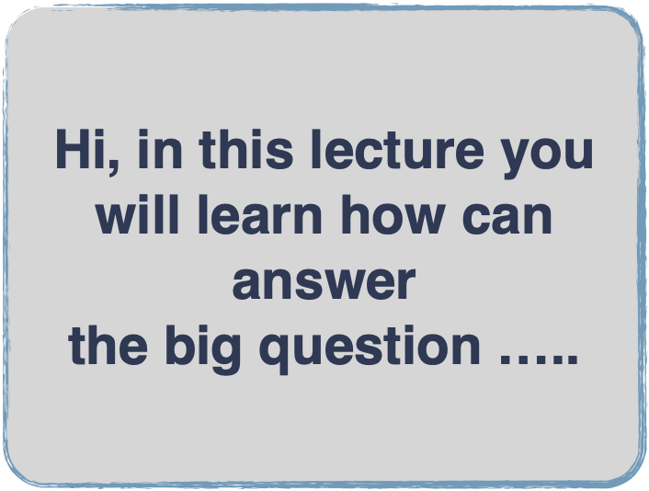


Welcome on board of the professional quality track
Having the project -fit to the PFS-QP ,
And its integration success factors between the DFT and Project technical
Transformation SC and SF of the PFS-QP to the Project fit quality standard ….

Slide 3
Now where are we
We are at the beginning of the project initiation stage with input of having the HPMQS which is having the required standard performance
And why we need it :
simple to bypass the dark side of the Project technicality and the PLC dead points and satisfying the customers

Slide 4
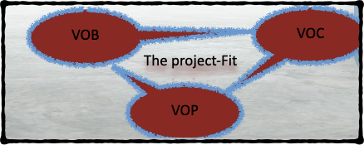

What is fittest project system agreeable with the designed DFT of the PFS-QP for having the BSA
Fit to theBPP
Fit to the customers
Fit to HPMQS
Fit to PM
S

Slide 5


The project fit
It is the fittest project structure that will balance between the VOC,VOP and VOB by fulfilling the DFT success criteria with the most effective project technicality success factors to compliance with PFS-QP for ensuring the benefits delivery by having the efficient business value added (BVA)
Developed by Dr.Mahmoud Ibrahim @2023

Slide 6
The benefits of the Project fit
Limited scope creeping problem
Delivering PVA(project value added) during the interdependencies and dependencies project operations
Efficient efforts and well managing the project work packages
Integrate effectively the DFT with the project technicality
Guarantee the project success

Slide 7
The target of this stage
1-Developing the project fit dimensions by identifying
  1- project goal statement
  2- project clear scope
  3- project fit success criteria
  4- project fit C&C success factors
  5-acceptance criteria
    2- selecting the fittest project to have project fit quality plan

Slide 8

Lecture outline
1st section content :
The baseline of the stage
2nd section contents :
-Identifying the project goal statement
-Identifying the boundaries Scope of the Project-fit
-Identifying the Project -fit success criteria
Identifying the complication and complexity project fit
success factors
3rd section content :
“The project fit selective process

Slide 9
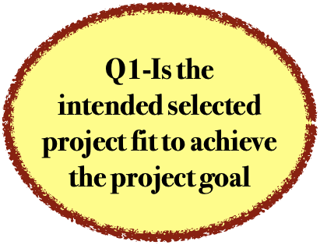
1-Identifying clear the project goal statement

Slide 10
Project Purpose or Justification
The purpose of the project is to provide an answer to the first fundamental question of the HPMQS:
-“What is intended to be realized or accomplished by the project?”
-What the project intends to do to address the problem or improvement opportunity identified.
A project has one goal. The goal gives purpose and direction to the project.

Slide 11
The Project-Fit goal statement
It defines the final deliverable or outcome of the project so that everyone understands what is to be accomplished in clear terms.
it will be used as a continual point of reference for any questions that arise regarding scope or purpose.
It must not contain any language or terminology that might not be understandable to anyone

Slide 12
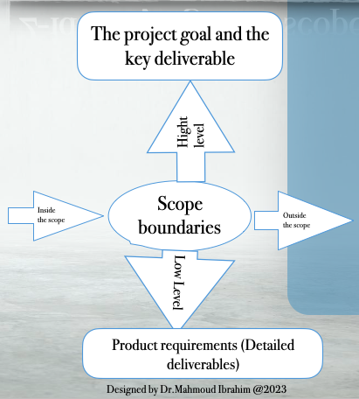
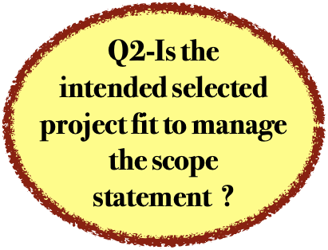
2-identifying clear scope statements
Inside the scope

Slide 13
1- Defining The project scope boundaries
-If you don’t know what you are delivering and what the boundaries of the project are, you have no chance for success.
-If you have not done a good job of defining scope, managing scope will be almost impossible.
-There are two levels of defining scope - high-level and low-level.and two dimension inside the scope and out side the scope

Slide 14
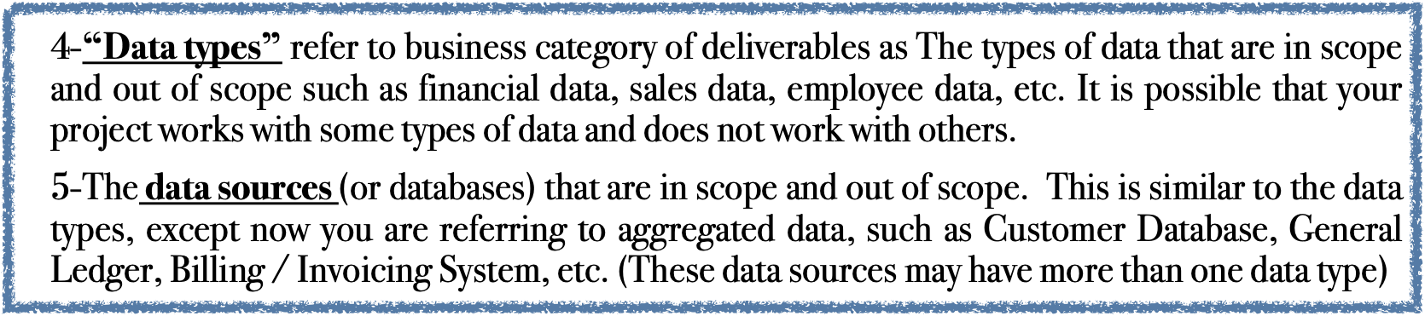
The project boundaries success factors :
1-The organizations that are in scope and out of scope. In some cases, the organizations involved in the project help to define the boundaries. For instance, your project may be applicable to the Human Resources and Accounting Departments, but the Manufacturing Division might be out of scope.
2- The major functionality that is in scope and out of scope. For instance, decision support and management reporting might be in scope, while overnight batch processing might be out of scope.
3—The major life-cycle processes that are in scope and out of scope.

Slide 15
2-Defining the scope level
1- project objectives and the key - deliverables are a part of the high-level scope,
2-The product requirements describe the functional and non-functional characteristics of the deliverables then define scope at a low-level including description of the deliverables in more detail.
Once the project starts, most scope changes effect the requirements of the both the product and the project.

Slide 16
3-Validated the Aligning Objectives and Scope
1-When you have completed creating your objectives and scope, go back and make sure that they are all in alignment.
2-You should ensure the whole objectives that make references to deliverables that are well defined in your scope
3-you don’t want to include deliverables in your project scope that do not help to achieve the project objectives.
If you are proposing to build deliverables that do not help you achieve your project objectives, you would need to ask yourself why. Since the objectives describe the purpose of the project and are used to validate project success, why would you want to build deliverables that do not help you achieve your objectives?
5-If the objectives and the deliverables in your scope section are not aligned, you need to determine how to bring them into alignment.

Slide 17
4- getting approval on the Scope statements
The purpose of defining scope is to clearly describe and gain agreement on the logical boundaries of your project.
- Scope statements are used to define what is within the boundaries of the project and what is outside those boundaries.
The more aspects of scope you can identify, the better off your project will be.

Slide 18
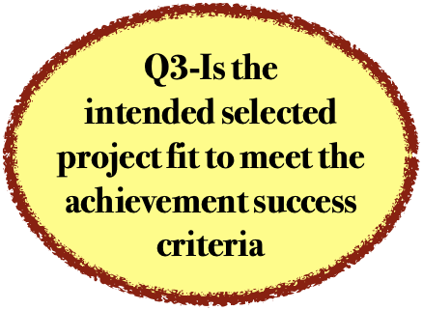
3-Identifying the achievement success criteria for having BVA

Slide 19
1-Identifying the “achievement success criteria”
Identifying the project success criteria relates to the HPMQS :
“How will the realized or accomplished outcome of the project be recognized as intends to do to address?”,
“Why do we want to undertake this project?”
What type of authorization is given ?

Slide 20
2-determine The types of “achievement success criteria
1. Increased revenue—As a part of the success criteria, that increase should be measured as a percentage of a specific revenue number.
2. Reduced costs—Again, this criterion can be stated as a money currency amount or a percentage of some specific cost. Be careful here because quite often a cost reduction means staff reductions. Staff reductions do not mean the shifting of resources to other places in the enterprise business. Moving staff from one area to another is not a cost reduction.
3. Improved product or service—Here ,It is usually expressed as percentage improvement in customer satisfaction or a reduction in the product defects or a reduction in the frequency or type of customer complaints.
strategic role of the project technicality .All projects should support the company intended strategic goals.
As illustrated in the previous lectures , the intended strategic plan of the performing the project work should be considered as a factor when making project selection decisions and prioritization.
Project closure guidelines or requirements: e.g., final project audits, project evaluations, product validations, and acceptance criteria.
Financial controls procedures: e.g., time reporting, required expenditure and disbursement reviews, accounting codes, and standard contract provisions.
Issue and defect management procedures defining issue and defect controls, issue and defect identification and resolution, and action item tracking. Change control procedures, including the steps by which official company standards, policies, plans, and procedures—or any project documents—will be modified, and how any changes will be approved and validated.
Risk control procedures, including risk categories, probability definition and impact, and probability and impact matrix.
Procedures for approving and issuing work authorizations.

Slide 21
3-Developing the “achievement success criteria statement”
It is a statement of the business addedvalue to be achieved, and therefore, it provides a basis for Project management to authorize the project.
It is essential that the success criteria be quantifiable and measurable, and if possible, expressed in terms of business value.

Slide 22
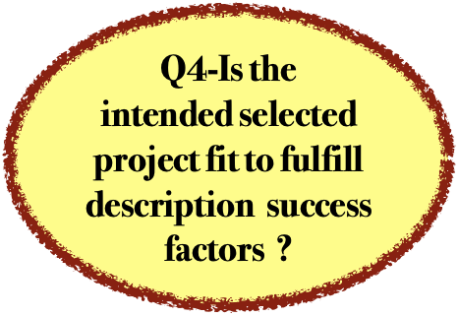
4-Identifying the project description (complication and complexity )
project-fit
success factors

Slide 23
Is your project complicated and complex.
Complicated is related to projects that have a large amount of parts that are interconnected and interdependent.
Complex on the other hand, is related to projects where each individual part can change and where each change might or not affect the other parts

Slide 24
project description
-A poor project description will create incomplete or faulty understanding, which will directly affect the success to deal with that system.
The Project Management Institute (PMI), which is dedicated to share best practices on project management, states that “complexity is a characteristic of a program or project or its environment that is difficult to manage due to human behavior, system behavior, and ambiguity” (PMI, 2014, p. 12)

Slide 25
complexity problems
problems that complexity can bring to projects, like
1- overestimation of benefits,
2- underestimation of costs,
5-the lack of right resources to manage the project, and
6- the lack of proper tools to manage complex projects,
7-leading to overwork and
8-low performance

Slide 26
complicating problems
1-Being in the loopholes of the scope ,time and cost
2-failure to meet client requirements,
3-misalignment between stakeholders with different and competing views and goals,
4-Maximizing the project complexity

Slide 27
 | DFT success factors for initiating the project
Organizational Capability | It is related to how capable (structurally, technically) an organization is of managing the project and delivering the required product and selection of project personnel
Speed to Market: | how fast the product can and should enter the market. The less time there is to manage and deliver a product, the more layers of complexity and complicate the project
Innovation to Market: | It s related to the level of innovation or uniqueness of the product generated by the project during the timeframe from when its creation to its release. Innovation level impacts market-related activities, time, and effort to define and “freeze” requirements. The higher the innovation level, the more difficult it is to establish and keep the requirements as originally defined.
Dependency and InterdependencY | It deals with the relationship between the elements that make up the project. This relationship can be one of dependency (in which project plans are dependent on one another) and/or interdependency (in which project stages is mutually dependent on others). In complex projects, you might not know what the result of an interaction between the elements of that project will be
Stakeholder Interaction: | It deals with the interaction between stakeholders and how this might impact the project. Stakeholders have different interests in the project and interaction among them could be a challenge.  They might have different (and some times conflicting) interests, motivations, and power levels.
Cultural Differences and Resistance | Project Team and stakeholders might have different cultural backgrounds. The possible cultural differences can impact the project and create resistance around tasks that need to be performed. The more cultural clashes exist, the more complexity is added to interactions between stakeholders.

Slide 28
Project technicality success factors
 | PjT success factors for initiating the project
Project Timeframe | Project Timeframe is related to the duration of the project, specifically when durations are extended due to the complexity of the project itself. Have a direct effect on how complexity, was identified as a dimension by both project team members and stakeholders.
Knowledge and Experience | It is related to how much knowledge and/or experience a key decision maker or project manager has regarding all elements of the product and work that needs to be done on that project.
Product and Project Size | It is related to both the size of the product, service, or result produced by the project, or to the work that needs to be done to deliver the product, service, or result, as well as to the size of the project itself.
Technology | It is not limited to information technology but refers to any technology that needs to be used on a specific project. Normally technology complexity is found on projects that use a new or untried technology. The less the team or performing organization knows or has used that technology, the more complex the project will become.

Slide 29
PLC success factors
 | Complicated PLC success factors
Clarity of Goals: | It defines how well defined the goals of the project are and the impact it has on how the project will be managed and how decisions will be made. The lack of clear goals results in a diverse set off assumptions by various . So that different stakeholders may interpret it very differently.
Project Management Maturity Level: | It addresses the degree of the maturity that the organization has achieved in project management. The assumption is that more mature organizations will be better able to manage complicated projects and deliver the right product with the right BVA
Project Description: | It focuses on the level of difficulty and challenged when describing the project scope boundaries and levels , interactions, and components.

Slide 30
 | Complex PMPs success factorsdimensions
Degree of Trust: | It examines the degree to which existing stakeholders have a trusting relationship with one another (i.e., supplier and project team; senior management and project team). On a project in which the project manager does not trust the team—and for that reason does not share sensitive but important information—there is an additional level of complexity due to the lack of transparency and clear communication. The more trust is existed among the stakeholders, the less complex their interactions.
Risk: | A proper risk assessment can allow an organization to set up the proper structure to manage a complex project. the more risks—specially the unknown ones—the more complex a project might be.
Uncertainty | the level of uncertainty existing, not just in a project but also in the product, or in the development process. It cannot be forecast the outcome of the interactions between elements, which makes managing such project very challenging.
Communication Quality | the quality of the communication on the project, factoring in both direct and indirect elements. “ Direct” communication refers to written or spoken words . “Indirect” communication refers to the understanding of the meaning of the delivered message
Budgetary Constraints: | Normally all projects are limited with regard to budget. This dimension is related to how it constrains the ability to manage the project and what level of experience the project manager needs to have with projects of this size (budget-wise).

Slide 31
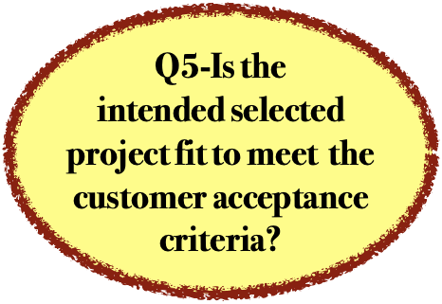
5—Identifying the customer acceptance criteria

Slide 32
1-identify the acceptance criteria
First, you need to identify the acceptance criteria which provide the basis for measuring the completion of project deliverables, prior to final sign off by the customer.

Slide 33
3-Creating an Acceptance Plan
A core problem of Project Management is that a deliverable is not 100% complete until the customer has accepted it
To ensure that all project deliverables are accepted (i.e. "signed-off on") as complete for your project, you need to document an Acceptance Plan.

Slide 34
the Acceptance Management Process will comprise the following steps:
Complete Deliverable
Request Acceptance Test
Schedule Acceptance Test
Complete Acceptance Test
Complete Acceptance Form
Request Acceptance Form Approval
Review Acceptance Form
Approved Acceptance Form

Slide 35
3- scheduling the acceptance tests,
which are undertaken to measure the percentage completion of each deliverable against the criteria specified.

Slide 36
4-document the process
document the process for gaining final signoff by the customer, to confirm that the deliverables produced fully meet the acceptance criteria agreed. The following sections describe in more detail how to create an Acceptance Plan for your project.

Slide 37
Deliverables | Acceptance Criteria | Acceptance Standards
List each project deliverable here | For each deliverable, list the criteria which must meet to ensure that the customer signs off on it as 100% complete. | For each deliverable, list the standards that must be met to ensure that the customer signs off on the deliverables as 100% complete.
Implement a common set of processes | The new processes provide common: | The new processes enable branch officers to:
 | 1.Guidelines and standards for customer services 2.Processes and procedures for resolution of client issues 3.Rules and criteria for budget approval | Improve levels of customer service More efficiently monitor and resolve client problems and issues Clearly communicate to customers the fundamental rules and criteria for approving service
Note: You may wish to use criteria and standards which relate to the:
-Time to build the deliverables (see your Project Plan)
-Cost of building the deliverables (see your Financial Plan)
-Quality of the deliverables to be built (see your Quality Plan)

Slide 38
the project fit selective process ”

Slide 39
The project selection process
1-Project identification.
Project identification means the planning of clear and specific project , but potential improvement opportunities vital to the organization.
2- Project qualification .
Project qualification means the translation of an identified improvement opportunity into project charter format for recognizing its completeness and the ability to assess its potential as a viable project.
(Note: Some organizations tend to combine the qualification and identification processes.)

Slide 40
3-Project Selection.
Project selection means a qualified project has met BPP and is considered suitable for execution later.
4-Project Prioritization.
Project prioritization means that a selected project will be independently assessed against specific criteria in order to establish a rank score.
Rank scores of other projects will be compared and a final ranking of projects will be established as the most potential project .
(Note: Some organizations tend to combine the selection and prioritization processes.)

Slide 41
5-Project Assignment ( the most fit project to product the right fit deliverable ) .
Project assignment means that a prioritized project and a resource are available to be matched with the product quality plan .
a-If the matching is successful, the resource is assigned to the project and the project gets under way.
b- ( if no project is fitting ). Project closure means that a project has been terminated for one of two reasons:
No successful completion or no longer viable .

Slide 42

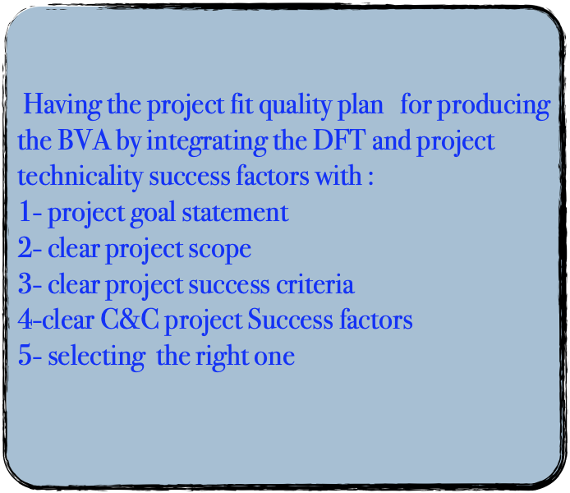
Thanks for paying attention

Slide 43




Thank You

