Slide 1


Managing People and Organizations
Prepared by Dr. Usama Al-Fendi
MGM603
Managing People and Organizations
Lecture 10

Slide 2

Lecture
Learning Outcomes
10
Describe the nature of decision making and distinguish it from problem solving.
Discuss the rational approach to decision making.
Identify and discuss the primary behavioral aspects of decision making.
Discuss group decision making in organizations.
Discuss the nature of creativity and relate it to decision making and problem solving.
www.midocean.ae

Slide 3
Lecture
Decision Making and Problem Solving
10
Sequence of the chapter
This chapter describes many different perspectives of decision making.
We start by examining the nature of decision making and distinguishing it from problem solving.
Next, we describe several different approaches to understanding the decision-making process. We then identify and discuss related behavioral aspects of decision making.
Next we discuss the major elements of group decision making.
Finally, we discuss creativity, a key ingredient in many effective decisions..
www.midocean.ae

Slide 4
Lecture
Decision Making and Problem Solving
10
The Nature of Decision Making
Decision making | A decision maker’s actions are guided by a goal. Each of several alternative courses of action is linked with various outcomes. Information is available on the alternatives, on the likelihood that each outcome will occur, and on the value of each outcome relative to the goal. The decision maker chooses one alternative on the basis of his or her evaluation of the information. Decisions made in organizations can be classified according to frequency and to information conditions.
www.midocean.ae

Slide 5
Lecture
Decision Making and Problem Solving
10
The Nature of Decision Making
Decision making | In a decision-making context, frequency is how often a particular decision situation recurs, and information conditions describe how much information is available about the likelihood of various outcomes.
www.midocean.ae

Slide 6
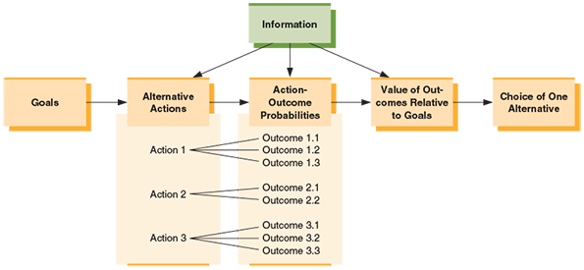
Lecture
Decision Making and Problem Solving
10
The Nature of Decision Making
Figure 8.1.
Elements of Decision Making
A decision maker has a goal, evaluates the outcomes of alternative courses of action in terms of the goal, and selects one alternative to be implemented.
www.midocean.ae

Slide 7
Lecture
Decision Making and Problem Solving
10
Types of Decisions
 | The frequency of recurrence determines whether a decision is programmed or nonprogrammed. A programmed decision recurs often enough for decision rules to be developed. A decision rule tells decision makers which alternative to choose once they have predetermined information about the decision situation. The appropriate decision rule is used whenever the same situation is encountered. Programmed decisions usually are highly structured; that is, the goals are clear and well known, the decision-making procedure is already established, and the sources and channels of information are clearly defined
www.midocean.ae

Slide 8
Lecture
Decision Making and Problem Solving
10
Types of Decisions
 | Example: Airlines use established procedures when an airplane breaks down and cannot be used on a particular flight. Passengers may not view the issue as a programmed decision because they experience this situation relatively infrequently. But the airlines know that equipment problems that render a plane unfit for service arise on a recurring basis. Each airline has its own set of clear and defined procedures to use in the event of equipment problems. A given flight may be delayed, cancelled, or continued on a different plane, depending on the nature of the problem and other circumstances (such as the number of passengers booked, the next scheduled flight for the same destination, the availability of another plane, and so forth).
www.midocean.ae

Slide 9

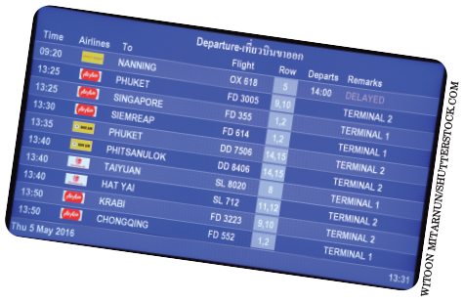
Lecture
Decision Making and Problem Solving
10
Developers targeted this tract of land as a future site for a shopping plaza. After much analysis, demographic and geographic research, and surveying, the developer selected this site.
Airlines often use programmed decision rules to help make decisions about such things as flight cancellations and delays. For instance, if a plane dedicated to a particular flight has a mechanical problem that will take several days to repair and the airline has no other planes available, its decision rule may indicate that the flight needs to be canceled. However, if protocols suggest the plane can be repaired in a few hours then the flight is likely to simply be delayed.
www.midocean.ae

Slide 10
Lecture
Decision Making and Problem Solving
10
Types of Decisions
 | 2- A nonprogrammed decision: A decision that recurs infrequently and for which there is no previously established decision rule and it requires problem solving Problem solving is a special form of decision making in which the issue is unique; it often requires developing and evaluating alternatives without the aid of a decision rule Nonprogrammed decisions are poorly structured because information is ambiguous, there is no clear procedure for making the decision, and the goals are often vague.
www.midocean.ae

Slide 11
Lecture
Decision Making and Problem Solving
10
Types of Decisions
 | Example For instance, in 2015 a popular ice cream maker, Blue Bell Creameries, learned that its production facilities were infected with listeria, a potentially dangerous bacteria. This was the first serious health problem the firm had ever encountered and managers faced considerable ambiguity in deciding how to respond. One key element of nonprogrammed decisions is that they require good judgment on the part of leaders and decision makers.
www.midocean.ae

Slide 12
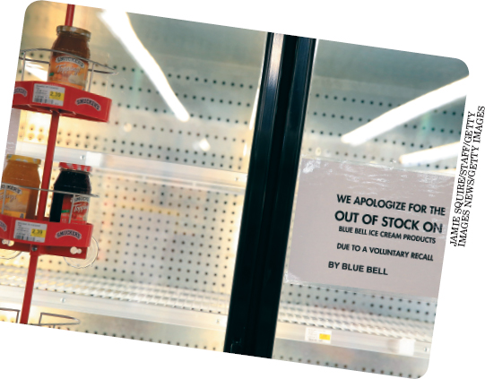
Lecture
Decision Making and Problem Solving
10
Types of Decisions
Nonprogrammed decisions are required when an unusual or complex situation arises that requires problem solving and judgment. When Blue Bell creameries discovered bacteria in one of its production facilities in 2015 its managers shut down all Blue Bell facilities while they worked to eradicate the bacteria. The entire process took months and cost the firm millions of dollars.
www.midocean.ae

Slide 13
Lecture
Decision Making and Problem Solving
10
Table 8.1. Characteristics of Programmed and Nonprogrammed Decisions
Types of Decisions
CHARACTERISTICS | PROGRAMMED DECISIONS | NONPROGRAMMED DECISIONS
Type of decision | Well-structured | Poorly structured
Frequency | Repetitive and routine | New and unusual
Goals | Clear, specific | Vague
Information | Readily available | Not available, unclear Channels
Consequences | Minor | Major
Organizational level | Lower levels | Upper levels
Time for solution | Short | Relatively long
Basis for solution | Decision rules, set | Judgment and creativity
 | Procedures
www.midocean.ae

Slide 14
Lecture
Decision Making and Problem Solving
10
Decision-Making Conditions
Decision-Making Conditions | Decisions are made to bring about desired outcomes, but the information available about those outcomes varies. The range of available information can be considered as a continuum whose endpoints represent complete certainty—when all alternative outcomes are known—and complete uncertainty, when all alternative outcomes are unknown. Points between the two extremes create risk—the decision maker has some information about the possible outcomes and may be able to estimate the probability of their occurrence.
www.midocean.ae

Slide 15

Lecture
Decision Making and Problem Solving
10
Decision-Making Conditions
Decision-making conditions range from certainty to risk to uncertainty. For instance, if a firm is planning to launch a new video game for PlayStation, managers will need to assess factors associated with risk and uncertainty when developing their marketing budget.
www.midocean.ae

Slide 16
Lecture
Decision Making and Problem Solving
10
Decision-Making Conditions
Decision-Making Conditions | Different information conditions present different challenges to the decision maker. For example, suppose the marketing manager of PlayStation is trying to determine whether to launch an expensive promotional effort for a new video. For simplicity, assume there are only two alternatives: to promote the game or not to promote it.
www.midocean.ae

Slide 17
Lecture
Decision Making and Problem Solving
10
Decision-Making Conditions
Decision-Making Conditions | Under a condition of certainty, the manager knows the outcomes of each alternative. If the new game is promoted heavily, the company will realize a $10 million profit. Without promotion, the company will realize only a $2 million profit. Here the decision is simple: Promote the game.
www.midocean.ae

Slide 18
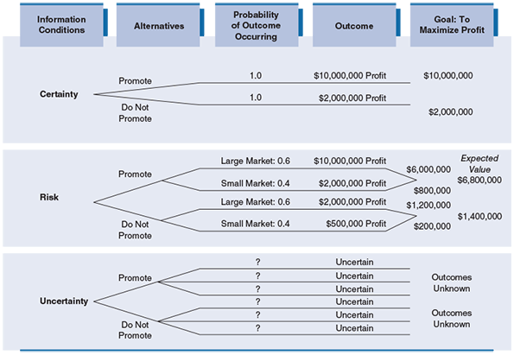
Lecture
Decision Making and Problem Solving
10
Decision-Making Conditions
Alternative Outcomes under Different Decision-Making Conditions
The three decision-making conditions of certainty, risk, and uncertainty for the decision about whether to promote a new video game to the market.
www.midocean.ae

Slide 19
Lecture
Decision Making and Problem Solving
10
Decision-Making Conditions
Decision-Making Conditions | Under a condition of risk, the decision maker cannot know with certainty what the outcome of a given action will be but has enough information to estimate the probabilities of various outcomes. Thus, working from information gathered by the market research department, the marketing manager in our example can estimate the likelihood of each outcome in a risk situation. In this case, the alternatives are defined by the size of the market.
www.midocean.ae

Slide 20
Lecture
Decision Making and Problem Solving
10
Decision-Making Conditions
Decision-Making Conditions | The probability for a large video game market is 0.6 and the probability for a small market is 0.4. The manager can calculate the expected value of the promotional effort based on these probabilities and the expected profits associated with each. To find the expected value of an alternative, the manager multiplies each outcome’s value by the probability of its occurrence.
www.midocean.ae

Slide 21
Lecture
Decision Making and Problem Solving
10
Decision-Making Conditions
Decision-Making Conditions | The sum of these calculations for all possible outcomes represents that alternative’s expected value. In this case, the expected value of alternative 1—to promote the new game—is as follows: The expected value of alternative 2—not to promote the new game—is $1,400,000 (see Figure 8.2). The marketing manager should choose the first alternative, because its expected value is higher. The manager should recognize, however, that although the numbers look convincing, they are based on incomplete information and are only estimates of probability.
www.midocean.ae

Slide 22
Lecture
Decision Making and Problem Solving
10
Decision-Making Conditions
 | The decision maker who lacks enough information to estimate the probability of outcomes (or perhaps even to identify the outcomes at all) faces a condition of uncertainty. In the PlayStation example, this might be the case if sales of video games had recently collapsed and it was not clear whether the precipitous drop was temporary or permanent, nor when information to clarify the situation would be available. Under such circumstances, the decision maker may wait for more information to reduce uncertainty or rely on judgment, experience, and intuition to make the decision. Of course, it is also important to remember that decision making is not always so easy to classify in terms of certainty, risk, and uncertainty.
www.midocean.ae

Slide 23
Lecture
Decision Making and Problem Solving
10
Approach to Decision Making
 | Several approaches to decision making offer insights into the process by which managers arrive at their decisions. The rational approach is appealing because of its logic and economy. Yet these very qualities raise questions about this approach because decision making often is not a wholly rational process. The rational decision-making approach A systematic, step-by-step process for making decisions It further assumes that the organization is dedicated to making logical choices and doing what makes the most sense economically and that it is managed by decision makers who are entirely objective and have complete information.
www.midocean.ae

Slide 24
Lecture
Decision Making and Problem Solving
10
Approach to Decision Making
Approach to Decision Making | 2. The behavioral approach, meanwhile, attempts to account for the limits on rationality in decision making. Of course, as we will see, many managers combine rationality with behavioral processes when making decisions.
www.midocean.ae

Slide 25
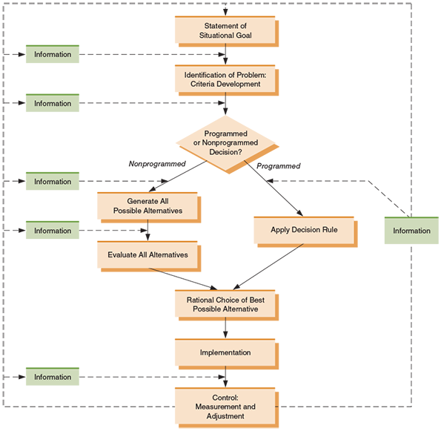
Lecture
Decision Making and Problem Solving
10
Steps in Rational Decision Making
Figure 8.3. The Rational Decision-Making Approach
The rational model follows a systematic, step-by-step approach from goals to implementation, measurement, and control.
www.midocean.ae

Slide 26
Lecture
Decision Making and Problem Solving
10
Steps in Rational Decision Making
State the Situational Goal | State the Situational Goal The rational decision-making process begins with the statement of a situational goal—that is, a goal for a particular situation. for example The goal of a marketing department,, may be to obtain a certain market share by the end of the year.
www.midocean.ae

Slide 27
Lecture
Decision Making and Problem Solving
10
Steps in Rational Decision Making
State the Situational Goal | 2. Identify the Problem The purpose of problem identification is to gather information that bears on the goal. If there is a discrepancy between the goal and the actual state, action may be needed. In the marketing example, the group may gather information about the company’s actual market share and then compare it with the desired market share. A difference between the two represents a problem that necessitates a decision. Reliable information is very important in this step. Inaccurate information can lead to an unnecessary decision or to no decision when one is required.
www.midocean.ae

Slide 28
Lecture
Decision Making and Problem Solving
10
Steps in Rational Decision Making
State the Situational Goal | 3. Determine the Decision Type Next, the decision makers must determine whether the problem represents a programmed or a nonprogrammed decision. If a programmed decision is needed, the appropriate decision rule is invoked, and the process moves on to the choice among alternatives. A programmed marketing decision may be called for if analysis reveals that competitors are outspending the company on print advertising.
www.midocean.ae

Slide 29
Lecture
Decision Making and Problem Solving
10
Steps in Rational Decision Making
State the Situational Goal | Because creating print advertising and buying space for it are well-established functions of the marketing group, the problem requires only a programmed decision. Although it may seem simple to diagnose a situation as programmed, apply a decision rule, and arrive at a solution, mistakes can still occur. Choosing the wrong decision rule or assuming the problem calls for a programmed decision when a nonprogrammed decision actually is required can result in poor decisions.
www.midocean.ae

Slide 30
Lecture
Decision Making and Problem Solving
10
Steps in Rational Decision Making
State the Situational Goal | 4- Generate Alternatives The next step in making a nonprogrammed decision is to generate alternatives. The rational process assumes that decision makers will generate all the possible alternative solutions to the problem. However, this assumption is unrealistic because even simple business problems can have scores of possible solutions. Decision makers may rely on education and experience as well as knowledge of the situation to generate alternatives. In addition, they may seek information from other people such as peers, subordinates, and supervisors. Decision makers may analyze the symptoms of the problem for clues or fall back on intuition or judgment to develop alternative solutions
www.midocean.ae

Slide 31
Lecture
Decision Making and Problem Solving
10
Steps in Rational Decision Making
State the Situational Goal | 5- Evaluate Alternatives Evaluation involves assessing all possible alternatives in terms of predetermined decision criteria. The ultimate decision criterion is “Will this alternative bring us nearer to the goal?” In each case, the decision maker must examine each alternative for evidence that it will reduce the discrepancy between the desired state and the actual state. The evaluation process usually includes: describing the anticipated outcomes (benefits) of each alternative, evaluating the anticipated costs of each alternative, and estimating the uncertainties and risks associated with each alternative.
www.midocean.ae

Slide 32
Lecture
Decision Making and Problem Solving
10
Steps in Rational Decision Making
State the Situational Goal | 6- Choose an Alternative Choosing an alternative is usually the most crucial step in the decision-making process. Choosing consists of selecting the alternative with the highest possible payoff, based on the benefits, costs, risks, and uncertainties of all alternatives. In the PlayStation promotion example, the decision maker evaluated the two alternatives by calculating their expected values. Following the rational approach, the manager could choose the alternative with the largest expected value.
www.midocean.ae

Slide 33
Lecture
Decision Making and Problem Solving
10
Steps in Rational Decision Making
Steps in Rational Decision Making | 6- Choose an Alternative An important part of the choice phase is the consideration of contingency plans—alternative actions that can be taken if the primary course of action is unexpectedly disrupted or rendered inappropriate. Planning for contingencies is part of the transition between choosing the preferred alternative and implementing it.
www.midocean.ae

Slide 34
Lecture
Decision Making and Problem Solving
10
Steps in Rational Decision Making
Steps in Rational Decision Making | In developing contingency plans, the decision maker usually asks such questions as “What if something unexpected happens during the implementation of this alternative?” or “If the economy goes into a recession, will the choice of this alternative ruin the company?” or “How can we alter this plan if the economy suddenly rebounds and begins to grow?”
www.midocean.ae

Slide 35
Lecture
Decision Making and Problem Solving
10
Steps in Rational Decision Making
Steps in Rational Decision Making | 7- Implement the Plan Implementation puts the decision into action. It builds on the commitment and motivation of those who participated in the decision-making process (and may actually bolster individual commitment and motivation). To succeed, implementation requires the proper use of resources and good management skills. Following the decision to promote the new PlayStation game heavily,
www.midocean.ae

Slide 36
Lecture
Decision Making and Problem Solving
10
Steps in Rational Decision Making
Steps in Rational Decision Making | for example, the marketing manager must implement the decision by assigning the project to a work group or task force. The success of this team depends on the leadership, the reward structure, the communications system, and group dynamics. Sometimes the decision maker begins to doubt a choice already made This doubt is called post-decision dissonance, closely related to cognitive dissonance To reduce the tension created by the dissonance, the decision maker may seek to rationalize the decision further with new information.
www.midocean.ae

Slide 37

Lecture
Decision Making and Problem Solving
10
Steps in Rational Decision Making
Contingency plans are often developed as a part of rational decision making. For instance, suppose a decision is made based on the assumption that stock prices will increase consistently for the next 24 months. What happens if stock prices begin to decline? A contingency plan might be developed to account for this unexpected economic disruption
www.midocean.ae

Slide 38
Lecture
Decision Making and Problem Solving
10
Steps in Rational Decision Making
Steps in Rational Decision Making | 8- Control: Measure and Adjust In the final stage of the rational decision-making process, the outcomes of the decision are measured and compared with the desired goal. If a discrepancy remains, the decision maker may restart the decision-making process by setting a new goal (or reiterating the existing one). The decision maker, unsatisfied with the previous decision, may modify the subsequent decision-making process to avoid another mistake. Changes can be made in any part of the process, as Figure 8.3 illustrates by the arrows leading from the control step to each of the other steps. Decision making therefore is a dynamic, self-correcting, and ongoing process in organizations.
www.midocean.ae

Slide 39
Lecture
Decision Making and Problem Solving
10
Steps in Rational Decision Making
 | Strengths and Weaknesses of the Rational Approach The rational approach has several strengths. It forces the decision maker to consider a decision in a logical, sequential manner, and the in-depth analysis of alternatives enables the decision maker to choose on the basis of information rather than emotion or social pressure. But the rigid assumptions of this approach often are unrealistic. The amount of information available to managers usually is limited by either time or cost constraints, and most decision makers have limited ability to process information about the alternatives. In addition, not all alternatives lend themselves to quantification in terms that will allow for easy comparison. Finally, because they cannot predict the future, it is unlikely that decision makers will know all possible outcomes of each alternative.
www.midocean.ae

Slide 40
Lecture
Decision Making and Problem Solving
10
Evidence-Based Decision Making
Evidence-Based Decision Making | While rational decision-making perspectives have been around for decades, some experts (most notably Jeffrey Pfeffer and Robert Sutton) have recently called for a renewed focus on rationality. This new focus has been called evidence-based management. Evidence-based management (EBM) is defined as the commitment to identify and utilize the best theory and data available to make decisions. Advocates of this approach encourage the use of five basic “principles”:
www.midocean.ae

Slide 41
Lecture
Decision Making and Problem Solving
10
Evidence-Based Decision Making
 | Evidence-based management (EBM) principles: Face the hard facts, and build a culture in which people are encouraged to tell the truth, even if it’s unpleasant. Be committed to “fact-based” decision making—which means being committed to getting the best evidence and using it to guide actions. Treat your organization as an unfinished prototype—encourage experimentation and learning by doing. Look for the risks and drawbacks in what people recommend (even the best medicine has side effects). Avoid basing decisions on untested but strongly held beliefs, what you have done in the past, or uncritical “benchmarking” of what winners do.
www.midocean.ae

Slide 42
Lecture
Decision Making and Problem Solving
10
The Behavioral Approach to Decision Making
The Behavioral Approach to Decision Making | Whereas the rational approach assumes that managers operate logically and rationally, the behavioral approach acknowledges the role and importance of human behavior in the decision-making process. Herbert A. Simon was one of the first experts to recognize that decisions are not always made with rationality and logic.
www.midocean.ae

Slide 43
Lecture
Decision Making and Problem Solving
10
The Behavioral Approach to Decision Making
The Behavioral Approach to Decision Making | Simon was subsequently awarded the Nobel Prize in economics. Rather than prescribing how decisions should be made, his view of decision making, now called the administrative model of decision making, describes how decisions often actually are made. (Note that Simon was not advocating that managers use the administrative model but was instead describing how managers actually do make decisions.) Our Understand Yourself feature will give you some quick insights into how emotion can also affect how we make decisions.
www.midocean.ae

Slide 44
Lecture
Decision Making and Problem Solving
10
The Administrative Model
The Administrative Model | One crucial assumption of the administrative model is that decision makers operate with bounded rationality rather than with the perfect rationality assumed by the rational approach. Bounded rationality is the idea that although individuals may seek the best solution to a problem, the demands of processing all the information bearing on the problem, generating all possible solutions, and choosing the single best solution are beyond the capabilities of most decision makers. Thus, they accept less-than-ideal solutions based on a process that is neither exhaustive nor entirely rational.
www.midocean.ae

Slide 45
Lecture
Decision Making and Problem Solving
10
The Administrative Model
The Administrative Model | For example, one study found that under time pressure, groups usually eliminate all but the two most favorable alternatives and then process the remaining two in great detail. Thus, decision makers operating with bounded rationality limit the inputs to the decision-making process and base decisions on judgment and personal biases as well as on logic. The administrative model is characterized by the use of procedures and rules of thumb, suboptimizing, and satisficing.
www.midocean.ae

Slide 46
Lecture
Decision Making and Problem Solving
10
The Administrative Model
 | Suboptimizing is knowingly accepting less than the best possible outcome. Frequently, given organizational constraints, it is not feasible to make the ideal decision in a real-world situation. The decision maker often must suboptimize to avoid unintended negative effects on other departments, product lines, or decisions.
www.midocean.ae

Slide 47
Lecture
Decision Making and Problem Solving
10
The Administrative Model
 | for example An automobile manufacturer,, can cut costs dramatically and increase efficiency if it schedules the production of one model at a time. Thus, the production group’s optimal decision is single-model scheduling. But the marketing group, seeking to optimize its sales goals by offering a wide variety of models, may demand the opposite production schedule: short runs of entirely different models. The groups in the middle—design and scheduling—may suboptimize the benefits the production and marketing groups seek by planning long runs of slightly different models. This is the practice of the large auto manufacturers such as General Motors and Ford, which make multiple body styles in different models on the same production line
www.midocean.ae

Slide 48
Lecture
Decision Making and Problem Solving
10
The Administrative Model
 | The final feature of the behavioral approach is satisficing: examining alternatives only until a solution that meets minimal requirements is found and then ceasing to look for a better one. The search for alternatives usually is a sequential process guided by procedures and rules of thumb based on previous experiences with similar problems. The search often ends when the first minimally acceptable choice is encountered. The resulting choice may narrow the discrepancy between the desired and the actual states, but it is not likely to be the optimal solution. As the process is repeated, incremental improvements slowly reduce the discrepancy between the actual and desired states.
www.midocean.ae

Slide 49
Lecture
Decision Making and Problem Solving
10
Other Behavioral Forces in Decision Making
Other Behavioral Forces in Decision Making | In addition to those behavioral elements identified in the administrative model, the manager should also be aware of other behavioral forces that can affect decision making as well. These include political forces, intuition, escalation of commitment, risk propensity, and ethics. Prospect theory is also relevant.
www.midocean.ae

Slide 50
Lecture
Decision Making and Problem Solving
10
Other Behavioral Forces in Decision Making
 | Political Forces in Decision Making Political forces can play a major role in how decisions are made. A coalition is an informal alliance of individuals or groups formed to achieve a common goal. This common goal is often a preferred decision alternative. For example, coalitions of stockholders frequently band together to force a board of directors to make a certain decision. Indeed, many of the recent power struggles between management and dissident shareholders at Dell Computer have relied on coalitions as each side tried to gain the upper hand against the other
www.midocean.ae

Slide 51
Lecture
Decision Making and Problem Solving
10
Other Behavioral Forces in Decision Making
Other Behavioral Forces in Decision Making | Intuition Intuition is an innate belief about something without conscious consideration. Managers sometimes decide to do something because it “feels right” or they have a hunch. This feeling is usually not arbitrary, however. Rather, it is based on years of experience and practice in making decisions in similar situations. An inner sense may help managers make an occasional decision without going through a full-blown rational sequence of steps.
www.midocean.ae

Slide 52
Lecture
Decision Making and Problem Solving
10
Other Behavioral Forces in Decision Making
Other Behavioral Forces in Decision Making | Intuition The best-selling book by Malcolm Gladwell entitled Blink: The Power of Thinking without Thinking made strong arguments that intuition is both used more commonly and results in better decisions than had previously been believed. On the other hand, some experts challenge this view and suggest that underlying understanding and experience make intuition mask the true processes used to make quick decisions.
www.midocean.ae

Slide 53

Lecture
Decision Making and Problem Solving
10
Other Behavioral Forces in Decision Making
A variety of behavioral forces can affect decision making, including intuition and escalation of commitment. For example, these managers are using their intuition to make a decision about whether or not recent upward trends in prices are likely continue or if a downturn is more likely in the coming months.
www.midocean.ae

Slide 54



Thank You

