Slide 1


Six-Sigma
(DMAIC Methodology)
Part I
Prepared by Dr. Hesham Mousli
MHA623
Healthcare Quality
Lecture 7

Slide 2

Our Roadmap
Quality improvement methodologies Overview
Common planning tools
Six-Sigma methodology
1
3
5
2
4
6
Planning phase orientation
PDCA cycle
Accreditation overview

Slide 3

Intended Objectives
Chapter
07
Understand the principles of Six Sigma and the DMAIC methodology in healthcare quality improvement.
Identify key components of the Define and Measure phases and their role in process optimization.
Apply tools such as SIPOC, Pareto charts, and check sheets to assess and improve healthcare processes.
Analyze real-world healthcare challenges and formulate structured problem-solving approaches.

Slide 4

DMAIC Methodology
Define (D)
Chapter

Slide 5
DMAIC Methodology
Chapter
07
Define Phase:
  The purpose of the Define phase is to delineate the business problem and scope the project and process to be improved.

Slide 6
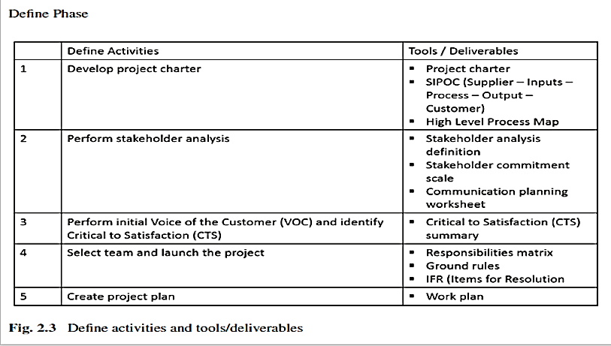

Slide 7
Define Phase
Chapter
07
Develop project charter:
  Project Charter Components:
    Problem Statement:
      Clearly describe the business problem or challenge.
      Specify the impacted process and its measurable effects.
    Customers/Stakeholders:
      Identify internal and external customers and stakeholders affected by the problem or process.

Slide 8
Define Phase
Chapter
07
  Project Charter Components:
    Critical to Satisfaction (CTS):
      Define what is important to each customer/stakeholder group, focusing on:
        Quality (CTQ): Defects or quality issues.
        Delivery: Timeliness.
        Cost: Financial impact.

Slide 9
Define Phase
Chapter
07
Project Charter Components:
  Quantifiable Goal: Define a measurable target for improvement, even if preliminary, specifying what will be measured and enhanced.
  Scope Statement: Define the process to be improved, specifying what is included/excluded and the timeframe for activities and data collection.
  Projected Benefits: Identify potential financial gains (savings, revenue growth, cost reduction, COPQ) and intangible benefits (e.g., morale improvement, waste elimination).

Slide 10
Define Phase
Chapter
07
Project Charter Components:
  Potential Risks: List possible risks impacting project success, assessing their likelihood (high, medium, low).
  Project Resources:
    Champion: Director-level or above to remove barriers.
    Finance: Representative to validate financial benefits.
    Team/Support: Members providing data, information, or direct project support.

Slide 11
Define Phase
Chapter
07
SIPOC (Suppliers-Input-Process-Output-Customer):
  SIPOC is a tool used in the Define phase to scope a project and understand a process. It maps the relationships between suppliers, inputs, process steps, outputs, and customers.
  Key points:
    Suppliers: Provide inputs to the process.
    Inputs: Resources or materials used in the process.
    Process: 5-7 high-level steps that transform inputs into outputs.
    Outputs: Results or products of the process.
    Customers: Recipients of the outputs.

Slide 12
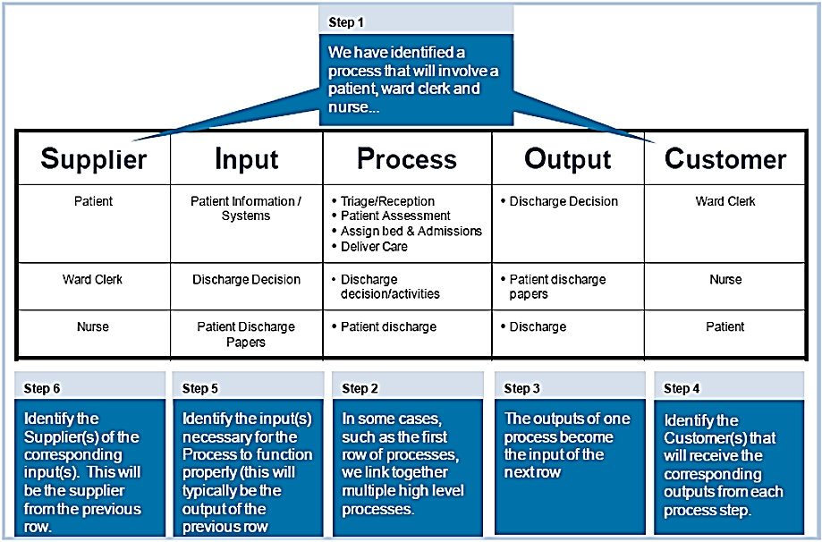

Slide 13
Define Phase
Chapter
07
Perform stakeholder analysis:
  Identify Customers and Stakeholders:
    Key to defining process quality, as quality is determined by meeting and exceeding their expectations.
    Stakeholders include peers, subordinates, supervisors, internal groups, suppliers, and external customers.
  Understand Their Impact and Concerns:
    Analyze stakeholder groups, their roles, how they are affected by the process, and their specific concerns.

Slide 14
Define Phase
Chapter
07
Perform Initial Voice of Customer (VOC) and Identify Critical to Satisfaction (CTS):
  Collect customer feedback through surveys, interviews, or research.
  Pick key quotes explaining why customers choose you.
  Group similar ideas and find common themes.
  Clarify unclear points by following up with customers.
  Identify what matters most to customers (CTS) from their feedback.
  Fill any missing information gaps.

Slide 15
Define Phase
Chapter
07
Select Team and Launch the Project:
  Select Team: Choose members with process knowledge and commitment to the project.
  Define Roles: Clearly outline each member's responsibilities.
  Establish Ground Rules: Brainstorm and set behavioral expectations for team interaction.
  Launch Project: Ensure clarity on roles and rules from the start.

Slide 16
Define Phase
Chapter
07
Generate the Project Plan:
  Develop the Six-Sigma Project Plan: Final step in the Define phase.
  Plan Resources, Time, and Effort: Allocate necessary resources and timelines.
  Track Progress: Use tools like Excel or Microsoft Project to monitor task completion.
  Conduct Risk Analysis: Identify potential risks to ensure project success.

Slide 17
DMAIC Methodology
Measure (M)
Chapter

Slide 18
Measure Phase
Chapter
07
Measure Phase:
  The purpose of the Measure phase is to understand and document the current state of the processes to be improved, collect the detailed voice of the Customer information, baseline the current state, and validate the measurement system.

Slide 19
Measure Phase
Chapter
07
Measure Phase Activities & Tools:
  Define Detailed VOC: Capture and document customer requirements and feedback.
  Define VOP & Current Performance: Analyze and record current process metrics.
  Validate Measurement System: Ensure data collection accuracy and reliability.
  Define COPQ: Identify and quantify costs of poor quality or inefficiencies.

Slide 20
Measure Phase
Chapter
07
Define Detailed Voice of Customer (VOC):
  Definition: VOC captures customer expectations and requirements.
  Examples:
    Responsiveness (e.g., turnaround time).
    Error rates (e.g., no errors in paychecks).
  Data Collection Methods:
    Interviews, surveys, focus groups, complaint cards, warranty data, competitive shopping.

Slide 21
Measure Phase
Chapter
07
Data Collection Plan:
  Purpose: Ensure accurate measurement of Critical-to-Satisfaction (CTS) metrics.
  Steps:
    Define the Critical to Satisfaction (CTS).
    Develop metrics.
    Identify data collection and analysis mechanisms.
    Develop sampling plans and instructions.

Slide 22
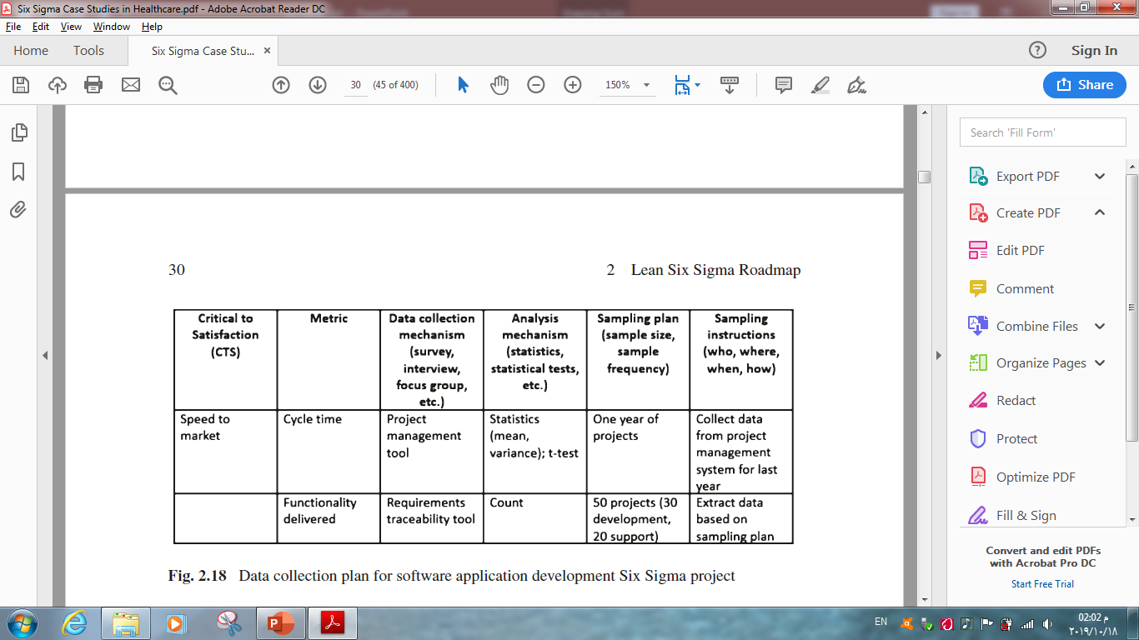

Slide 23
Measure Phase
Chapter
07
Define VOP & Current Performance:
  Purpose: Assess current process performance.
  Tools: Pareto charts, benchmarking, check sheets, histograms, statistics.

Slide 24
Measure Phase
Chapter
07
Operational Definition of Metrics:
  Purpose: Ensure accurate measurement of Critical-to-Satisfaction (CTS) metrics.
  Definition: Clear description of how metrics are measured.
  Key Points:
    Identifies what and how to measure.
    Ensures consistency in measurement.

Slide 25
Measure Phase
Chapter
07
Benchmarking:
  Definition: Review best practices to improve processes.
  Key Points:
    Focus on processes, not just industry.
    Ensure comparisons are "apples to apples."

Slide 26
Measure Phase
Chapter
07
Check Sheet:
  Purpose: Collect data on defects for root cause analysis.
  Steps:
    Choose a characteristic to track (e.g., defect types).
    Set up the check sheet.
    Collect data.

Slide 27
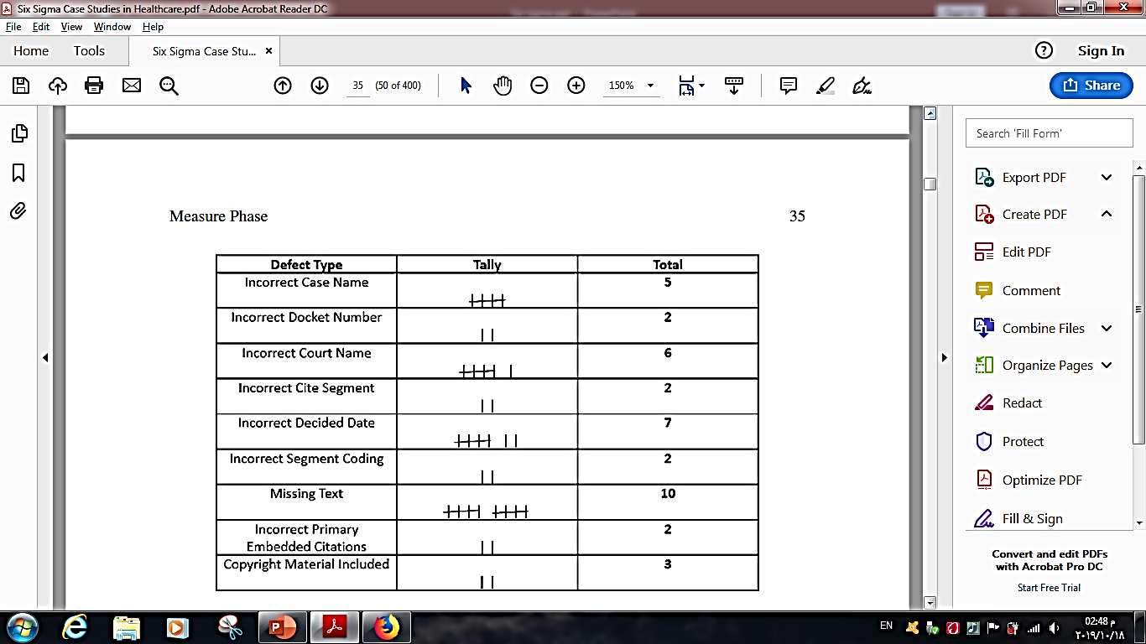

Slide 28
Measure Phase
Chapter
07
Pareto Chart:
  Purpose: Identify critical areas causing most problems (80/20 rule).
  Steps:
    1. Define data categories.
    2. Determine relative importance (e.g., dollars, occurrences).
    3. Collect data and compute cumulative frequency.
    4. Plot bar graph in descending order.

Slide 29
Medication Error Type | Frequency | Cumulative Frequency | Cumulative Percentage (%)
Dose missed | 92 | 92 | 21.4%
Wrong time | 83 | 175 | 40.7%
Wrong drug | 76 | 251 | 58.4%
Overdose | 59 | 310 | 72.1%
Wrong patient | 53 | 363 | 84.4%
Wrong route | 27 | 390 | 90.7%
Wrong calculation | 16 | 406 | 94.4%
Duplicated drugs | 9 | 415 | 96.5%
Underdose | 7 | 422 | 98.1%
Wrong IV rate | 4 | 426 | 99.1%
Technique error | 3 | 429 | 99.8%
Unauthorized drug | 1 | 430 | 100%

Slide 30
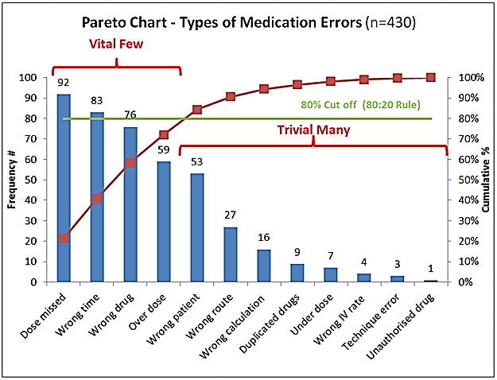

Slide 31
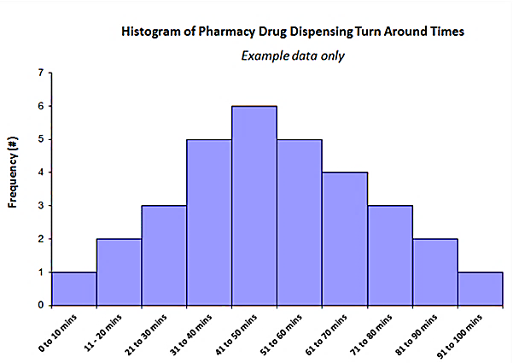
Measure Phase
Chapter
07
Histogram:
  Purpose: Visualize data distribution (centering, shape, variance).
  Key Point: First step in understanding data distribution.

Slide 32
Measure Phase
Chapter
07
Statistics:
  Purpose: Assess VOP using statistical metrics.
  Key Metrics:
    Mean (average).
    Standard deviation (variation).
    Normal Distribution: 99.997% of data within Six Sigma.

Slide 33
Measure Phase
Chapter
07
Define COPQ (Cost of Poor Quality):
  Purpose: Identify and quantify costs of inefficiencies or defects.
  Key Areas:
    Internal failures.
    External failures.
    Prevention costs.

Slide 34
Practical Example
Reducing Medication Errors in Inpatient Wards
Chapter
07
Define Phase:
  Problem Statement: High rate of medication errors during administration.
  Stakeholders: Patients, nurses, pharmacists, hospital management.
  Critical-to-Satisfaction (CTS): Ensure accurate medication dispensing and administration.

Slide 35
Practical Example
Reducing Medication Errors in Inpatient Wards
Chapter
07
Measure Phase:
  Data Collection Methods:
    Review incident reports on medication errors.
    Conduct direct observations of medication administration.
    Use electronic health records (EHR) to track prescription discrepancies.

Slide 36
Practical Example
Reducing Medication Errors in Inpatient Wards
Chapter
07
Measure Phase:
  Key Metrics to Measure:
    Frequency of errors (e.g., wrong drug, wrong dose, wrong time, wrong patient).
    Percentage of medication errors per total administered doses.
    Average time spent on medication administration per patient.

Slide 37
Practical Example
Reducing Medication Errors in Inpatient Wards
Chapter
07
Measure Phase:
  Tools Used:
    Check Sheets: Track medication errors by type, shift, and department.
    Pareto Charts: Identify the most common causes (e.g., unclear prescriptions, look-alike drugs).
    Histogram: Visualize trends in medication errors over time.

Slide 38
Wrap Up
Chapter
07
Six Sigma DMAIC methodology is a structured approach to healthcare process improvement.
The Define phase focuses on problem identification, stakeholder analysis, and goal setting.
The Measure phase ensures accurate data collection to assess current performance.
Tools like SIPOC, Pareto charts, and check sheets help visualize and analyze process inefficiencies.

Slide 39
Wrap Up
Chapter
07
Identifying Critical-to-Satisfaction (CTS) factors aligns improvements with stakeholder needs.
Root cause analysis is essential for designing effective, sustainable interventions.
Continuous monitoring and evaluation are key to maintaining process improvements.
Implementing Six Sigma in healthcare enhances patient safety, efficiency, and quality outcomes.

Slide 40



Thank You

