Slide 1


Overview of Management-1
Prepared by Dr. Magdy Alhaj
Principle of Management
MGM 111
Lecture 1

Slide 2




Overview of Management-1
Lecture 1
Principle of Management
MGM 111
Prepared by
Dr. Magdy Alhaj
www.midocean.ae

Slide 3

Chapter
01
Learning Outcome
Explain the meaning of management
Understand organization and its performance
Explain the Managers and their types
Summarize the essential roles of managers
Describe the essential skills for managers
www.midocean.ae

Slide 4
Chapter
01
What is Management?
• Management is the process of working with people and resources to accomplish organizational goals.
• Management is the attainment of organizational goals in an effective and efficient manner through planning, organizing, leading and controlling organizational resources. (Daft,2012)
• Organizational resources include men(human beings), money, machines and materials.
www.midocean.ae

Slide 5
Chapter
01
What is Management? Cont.…
• Management is the art of getting things done through other people.
Mary Parker Follet (1868-1933)
• Management is the art of getting things done through and with people in formally organized group. (Koontz)
• Management is the process of planning, organizing, commanding, coordinating and controlling. (Fayol,1930)
• Management is the process of planning, organizing, leading and controlling, the efforts of organization members and of using all other organizational resources to achieve organizational goals.
www.midocean.ae

Slide 6
The Nature of Management
Chapter
01
Management is concerned with using the resources of the organization to reach the organization’s objectives.
Management’s purpose is to use these resources effectively and efficiently so that the objectives of the organization are achieved with a minimum of cost.
Management activities share some common characteristics:
  All activities occur within the context of an organization.
  Managers are in charge of the organization’s resources—people, equipment, finances, data—and of using these resources to help the organization reach its objectives.
www.midocean.ae

Slide 7
Chapter
Characteristics of Management
01
Management is a distinct process.
Management is an organized activity
Management aims at the accomplishment of predetermined objectives.
Management is both a science and an art.
Management is a group activity
Management principles are universal in nature
Management integrates human and other resources.
www.midocean.ae

Slide 8
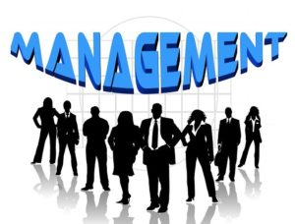
Chapter
01
Why Study Management?
To maximize the utilization of scarce resources
To face the increasing competition for inputs and outputs
To enhance the quality of the products and services
To adopt/plan for the changes in the business environment
Helps people deal with their bosses and coworkers
Opens a path to a well-paying job and a satisfying career
Management offers challenging, exciting and creative opportunities for meaningful and fulfilling work.
www.midocean.ae

Slide 9
Chapter
What is an Organization?
01
A group of people who work together in a structured way for a shared purpose (Cambridge Advanced Learners Dictionary)
An organization is a deliberate arrangement of people to accomplish some specific purpose.
(Robbins and Coulter, 2007)
An organization is a two or more people who work together in a structured way to achieve a specific goal or set of goals. (Stoner and Freeman,2009)
www.midocean.ae

Slide 10
Chapter
What is an Organization? Cont.
01
An Organization is – An arrangement of people and resources to accomplish some specific purpose
An organization can be any structured body such as department, business, company in private or public sector or nonprofit association.
Common Characteristics of Organizations
– Have a distinct purpose (goal)
– Composed of people
– Have a deliberate structure
www.midocean.ae

Slide 11
What is an Organization?
organization
people
resource
Goals and objectives
www.midocean.ae

Slide 12
Chapter
Organizational Performance
01
• A measure of how efficiently and effectively managers use available resources to satisfy customers and achieve organizational goals
Efficiency – A measure of how well or how productively resources are used to achieve a goal
Effectiveness – A measure of the appropriateness of the goals an organization is pursuing and the degree to which they are achieved
www.midocean.ae

Slide 13
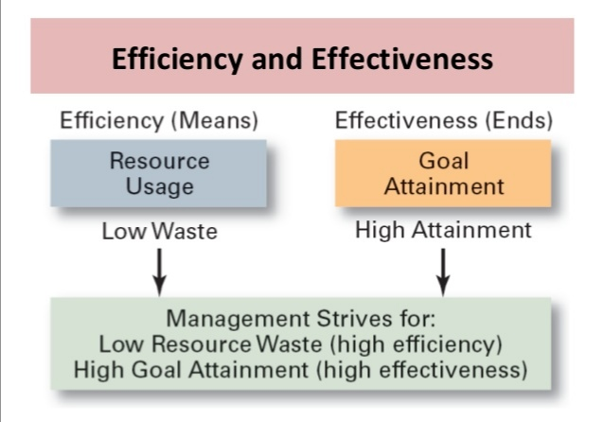

Slide 14
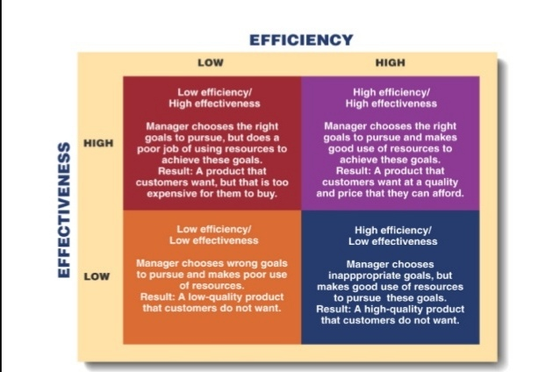

Slide 15
Chapter
Manager/s
01
The people responsible for supervising the use of an organization’s resources to meet its goals.
(Stoner, Freeman and Gilbert, 2008)
Someone who coordinates and oversees the work of other people so that organizational goals can be accomplished.
(Robbins and Coulter, 2012)
Someone whose primary responsibility is to carry out the management process.
(Griffin,2012) 12/26/14 16Contemporary Management
www.midocean.ae

Slide 16
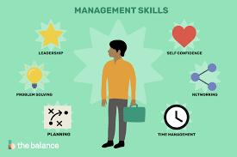
Chapter
Management Skills
01
General skills:
  Interpersonal skills
  Technical skills
  Conceptual skills
Specific skills:
  Job knowledge
  Oral communication
  Problem analysis
  Cooperativeness
  Negotiation
  Initiative
www.midocean.ae

Slide 17

Chapter
What Resources does a Manager use?
01
Human Resources-the people. Your most valuable resource!
Financial Resources-the money, the budget
Physical Resources-the buildings, the equipment, supplies
Information-computers, reports
www.midocean.ae

Slide 18

Chapter
Types of Managers
01
The Level of Authority (Levels of Managers)
First line managers
Middle managers
Top managers
Scope of the Activities
Functional managers
General managers
Responsibility of the Activities
Line managers
Staff managers
www.midocean.ae

Slide 19
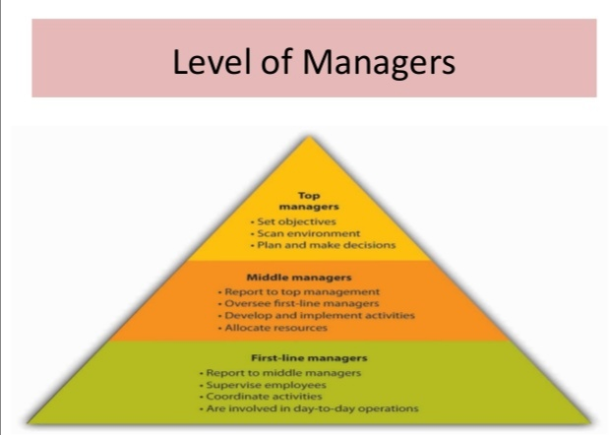

Slide 20
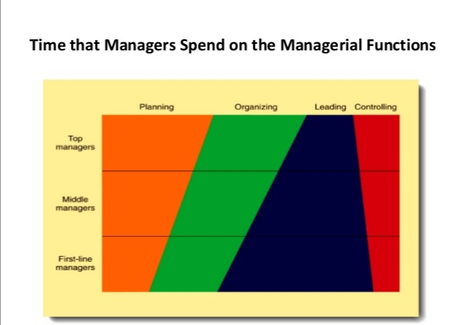

Slide 21
Chapter
Differences Among Managers
01
The Three Levels of Management
  Top managers
    CEO, president, or vice president
  Middle managers
    Production manager, marketing manager, HR manager or financial manager
  First-line managers
    Crew leader, supervisor, head nurse, or office manager
  Non-management operative employees
    Workers in the organization who are supervised by first-line managers
www.midocean.ae

Slide 22

Levels of Management
Chapter
01
Top Management
Executives-CEO, CFO, COO, Presidents, Vice Presidents
Manage the entire organization or major parts
Develop the purpose, the goals, strategies, long-term plans
Report to board of directors or other executives
Supervise middle managers
www.midocean.ae

Slide 23
Chapter
Levels of Management
1
Middle Managers
Managers and department heads
Implement top manager’s strategies by developing short-term plans
Report to executives
Supervise first-line managers
www.midocean.ae

Slide 24
Levels of Management
Chapter
01
First-Line Managers
Supervisors, crew leaders, office managers
Implement middle manager’s plans
Report to middle managers
Supervise operative employees
www.midocean.ae

Slide 25
Chapter
Manager’s Roles
01
1. Interpersonal role
2. Informational role
3. Decisional role
www.midocean.ae

Slide 26
Chapter
Management Roles
01
Henry Mintzberg described ten specific management roles that can be placed into three broad categories:
  Interpersonal roles involve interaction with others who are external or internal to the organization, at the same level as the manager, or at higher or lower levels.
  Informational roles focus on obtaining data that are important for the decisions the manager makes.
  Decisional roles deal primarily with the allocation of resources to reach organizational objectives.
www.midocean.ae

Slide 27
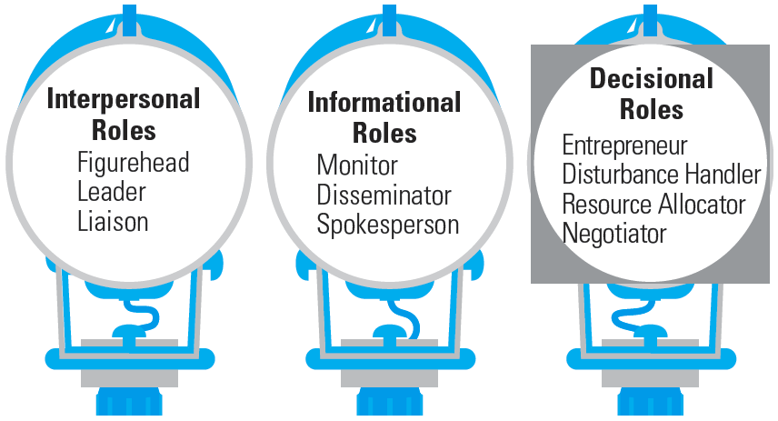
Ten Roles Managers Play
Chapter
01
www.midocean.ae

Slide 28
Chapter
Interpersonal role
01
Roles that managers assume to provide direction and supervision to both employees and the organization as a whole
Figurehead—symbolizing the organization’s mission and what it is seeking to achieve.
Leader—training, counseling, and mentoring high employee performance.
Liaison—linking and coordinating the activities of people and groups both inside and outside the organization.
www.midocean.ae

Slide 29

Chapter
Informational role
1
Roles associated with the tasks needed to obtain and transmit information in the process of managing the organization.
Monitor—analyzing information from both the internal and external environment.
Disseminator—transmitting information to influence the attitudes and behavior of employees.
Spokesperson—using information to positively influence the way people in and out of the organization respond to it.
www.midocean.ae

Slide 30
Chapter
Decisional role
1
Roles associated with methods managers use in planning strategy and utilizing resources
Entrepreneur—deciding which new projects or programs to initiate and to invest resources in.
Disturbance handler—managing an unexpected event or crisis
Resource allocator—assigning resources between functions and divisions, setting the budgets of lower managers.
Negotiator—reaching agreements between other managers, unions, customers, or shareholders.
www.midocean.ae

Slide 31

Managerial Skills
Chapter
01
Technical skills
Human skills
Conceptual skills
Interpersonal Skills
Decision-making Skills
www.midocean.ae

Slide 32

Chapter
Technical skills
01
Technical skills
A persons’ knowledge and ability to make effective use of any process or technique constitutes his technical skills.
Example: Engineer, Accountant, Data entry operator, Lawyer, Doctor etc.
www.midocean.ae

Slide 33
Chapter
Technical skills
01
“Business skills”
Using methods and techniques to perform a task
Keeping up with the latest technology in your job
www.midocean.ae

Slide 34

Chapter
Human skills
01
Human skills
• An individuals’ ability to cooperate with other members of the organization and work effectively in teams.
Example: Interpersonal relationships, solving people’s problem and acceptance of other employees.
www.midocean.ae

Slide 35

Conceptual skills
Chapter
1
Conceptual skills
“Ability of an individual to analyze complex situations and to rationally process and interpret available information”
Example: Idea generation and analytical process of information.
www.midocean.ae

Slide 36
Chapter
Interpersonal Skills
1
“People skills”
Your relationships with all individuals and groups
Understanding
Communicating
Motivating
Resolving conflict
Working as a team member
Ethics
www.midocean.ae

Slide 37
Decision-making Skills
Chapter
1
Select alternatives to solve problems
Take advantage of opportunities
Be able to conceptualize, diagnose and analyze
Use math skills
Manage time
www.midocean.ae

Slide 38
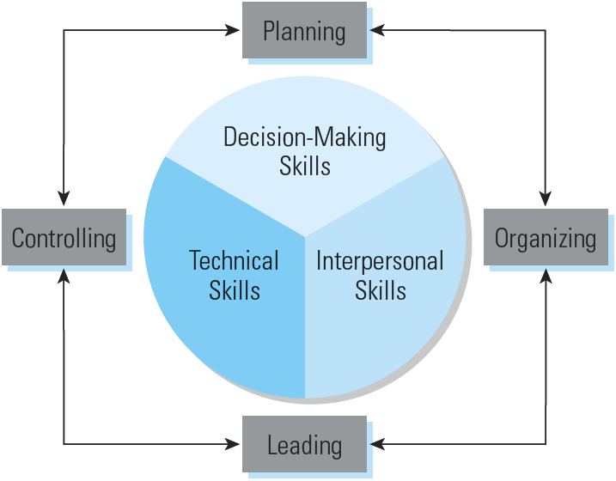
Management Skills and Functions

Slide 39
Chapter
Mistakes Managers Make
1
Insensitive to others
Arrogant (over confidence)
Betrayal (disloyalty) of trust
Overly (excessively) ambitions
Specific performance problems with the business
Over managing: unable to delegate or build a team
Unable to staff effectively
Unable to think strategically
Unable to adapt to boss with different style
Over dependent on advocate or mentor
www.midocean.ae

Slide 40
What make managers successful?
Reading and acquiring knowledge
Hard work
Ethical consciousness (awareness)
Smart work
Perseverance (firmness)
Out of box thinking
Collaborative relationship
Patience
www.midocean.ae

Slide 41



Thank You

