Slide 1

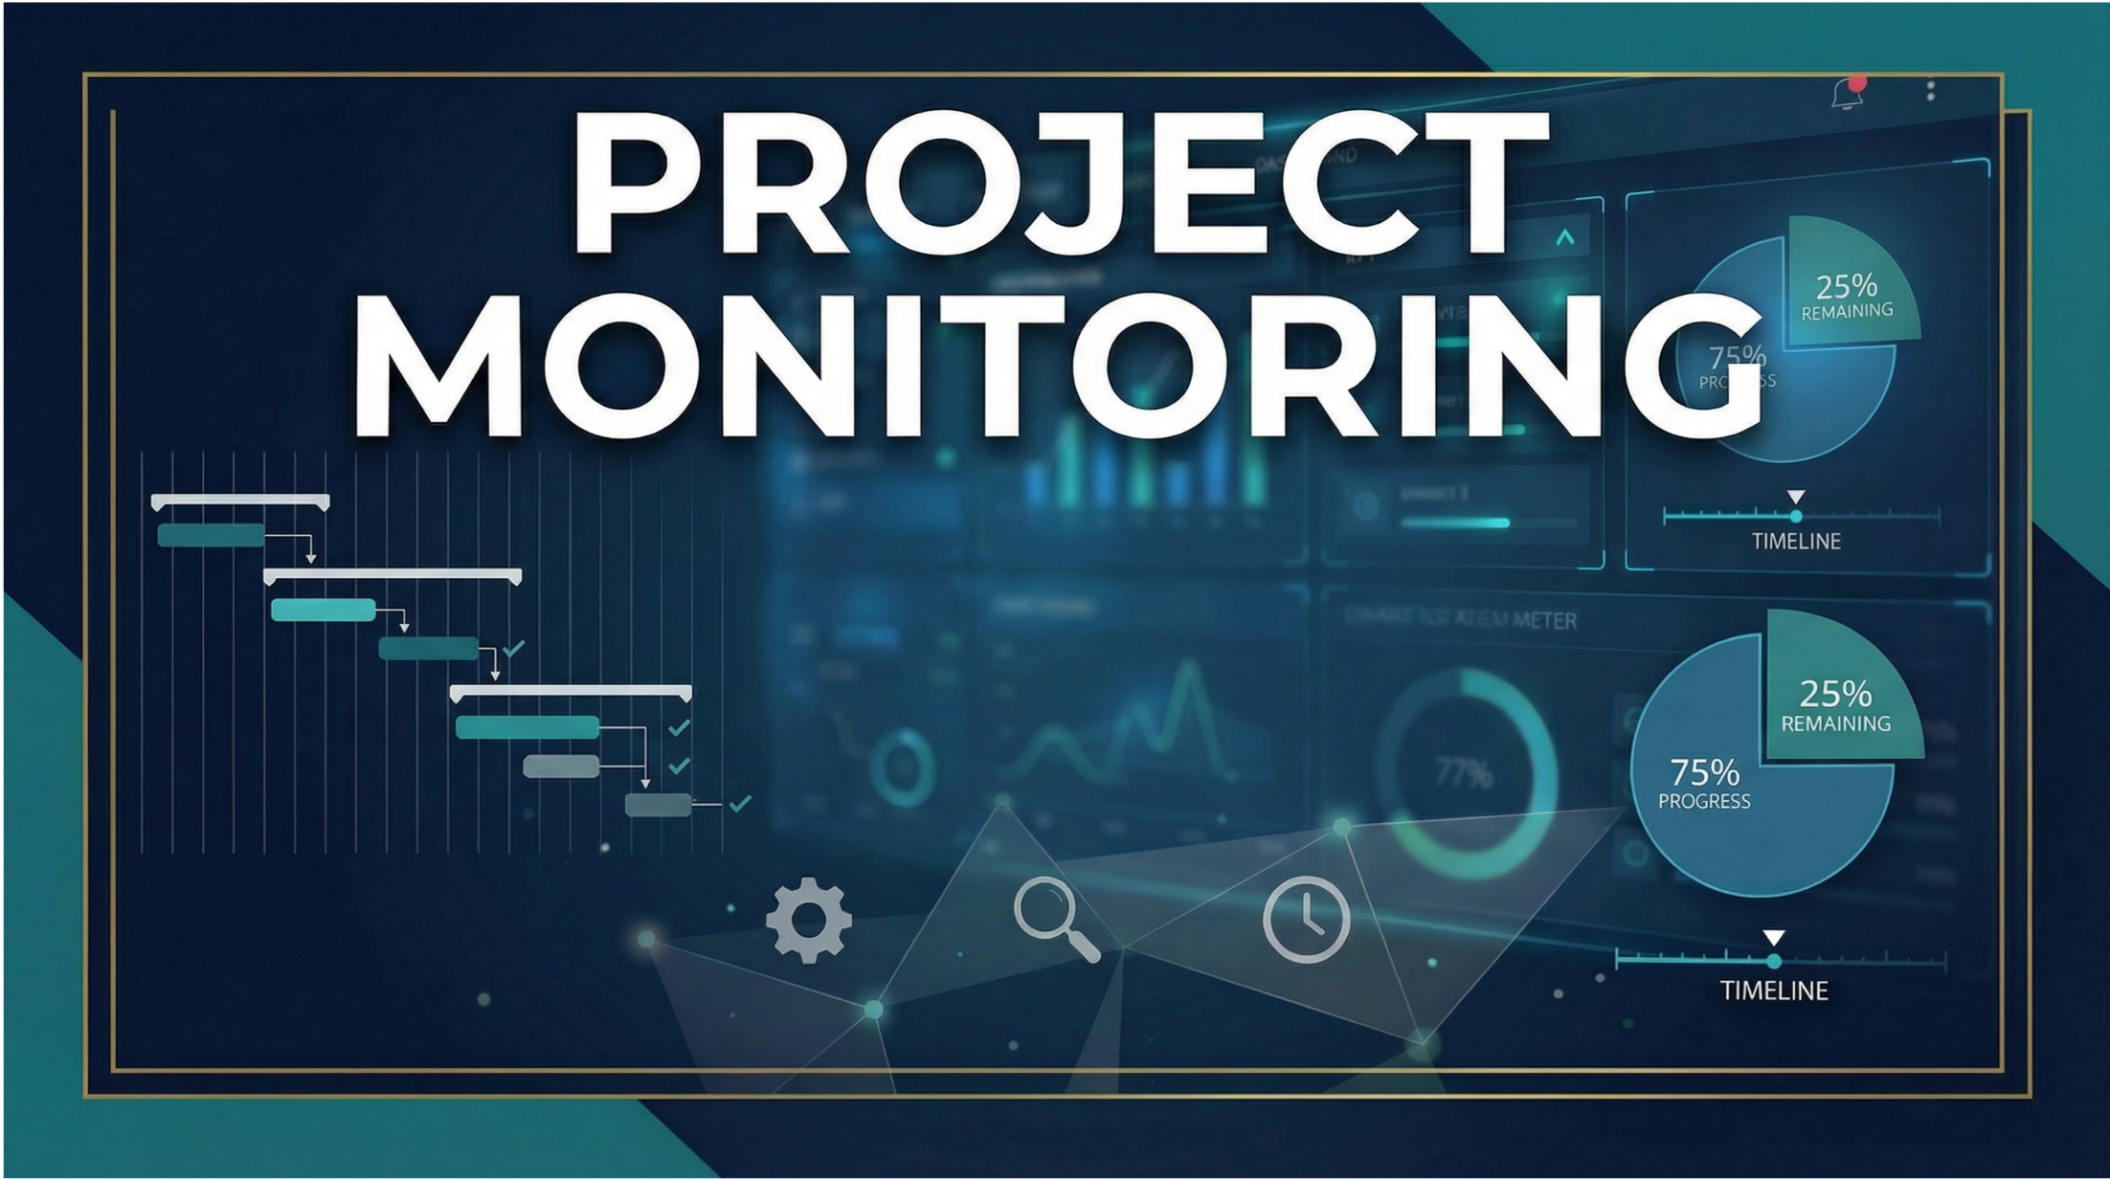

PROJECT MONITORING
PMG333
Lecture 04
COST& TIME MONITORING 2
Prepared by
Dr. Bassel alhassan

Slide 2
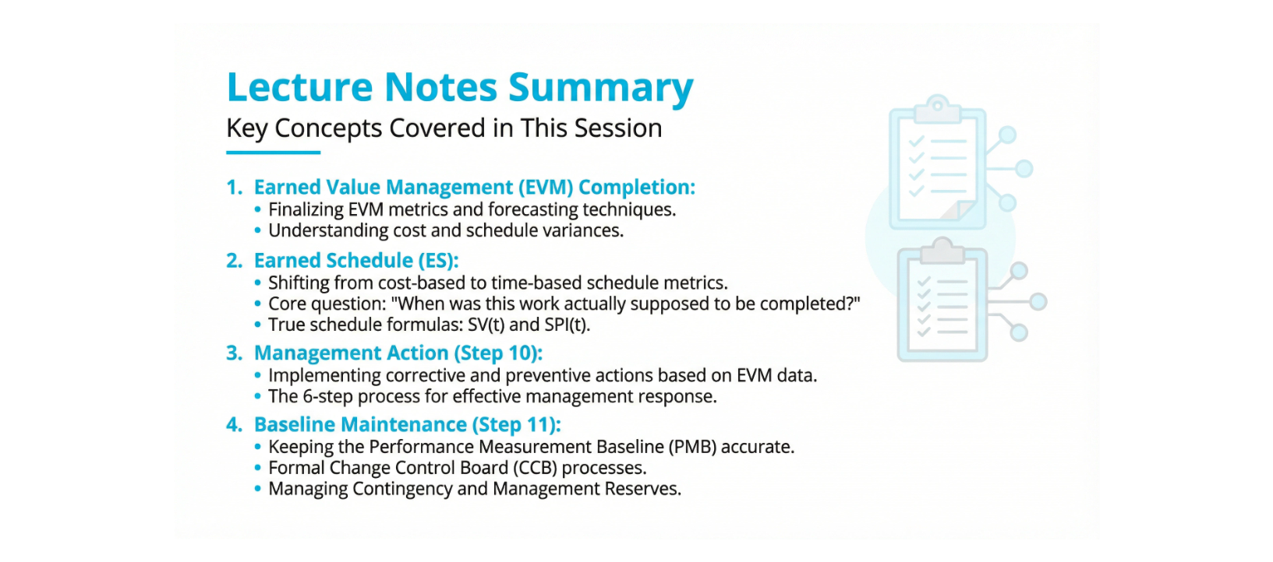
Lecture
04
Lecture contents
1 - 2

Slide 3
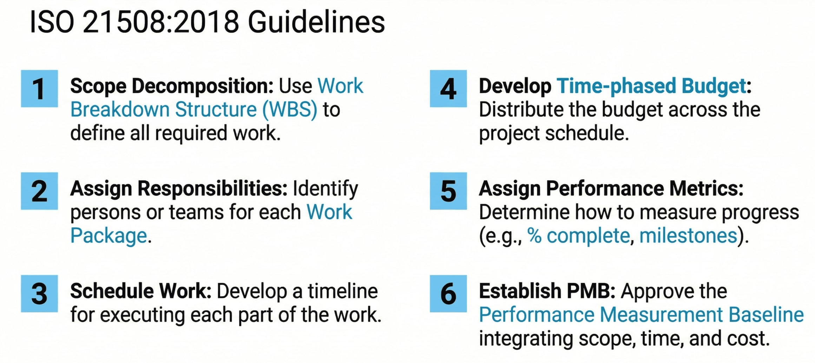
Lecture
04
Review of Previous Session
1 - 3

Slide 4
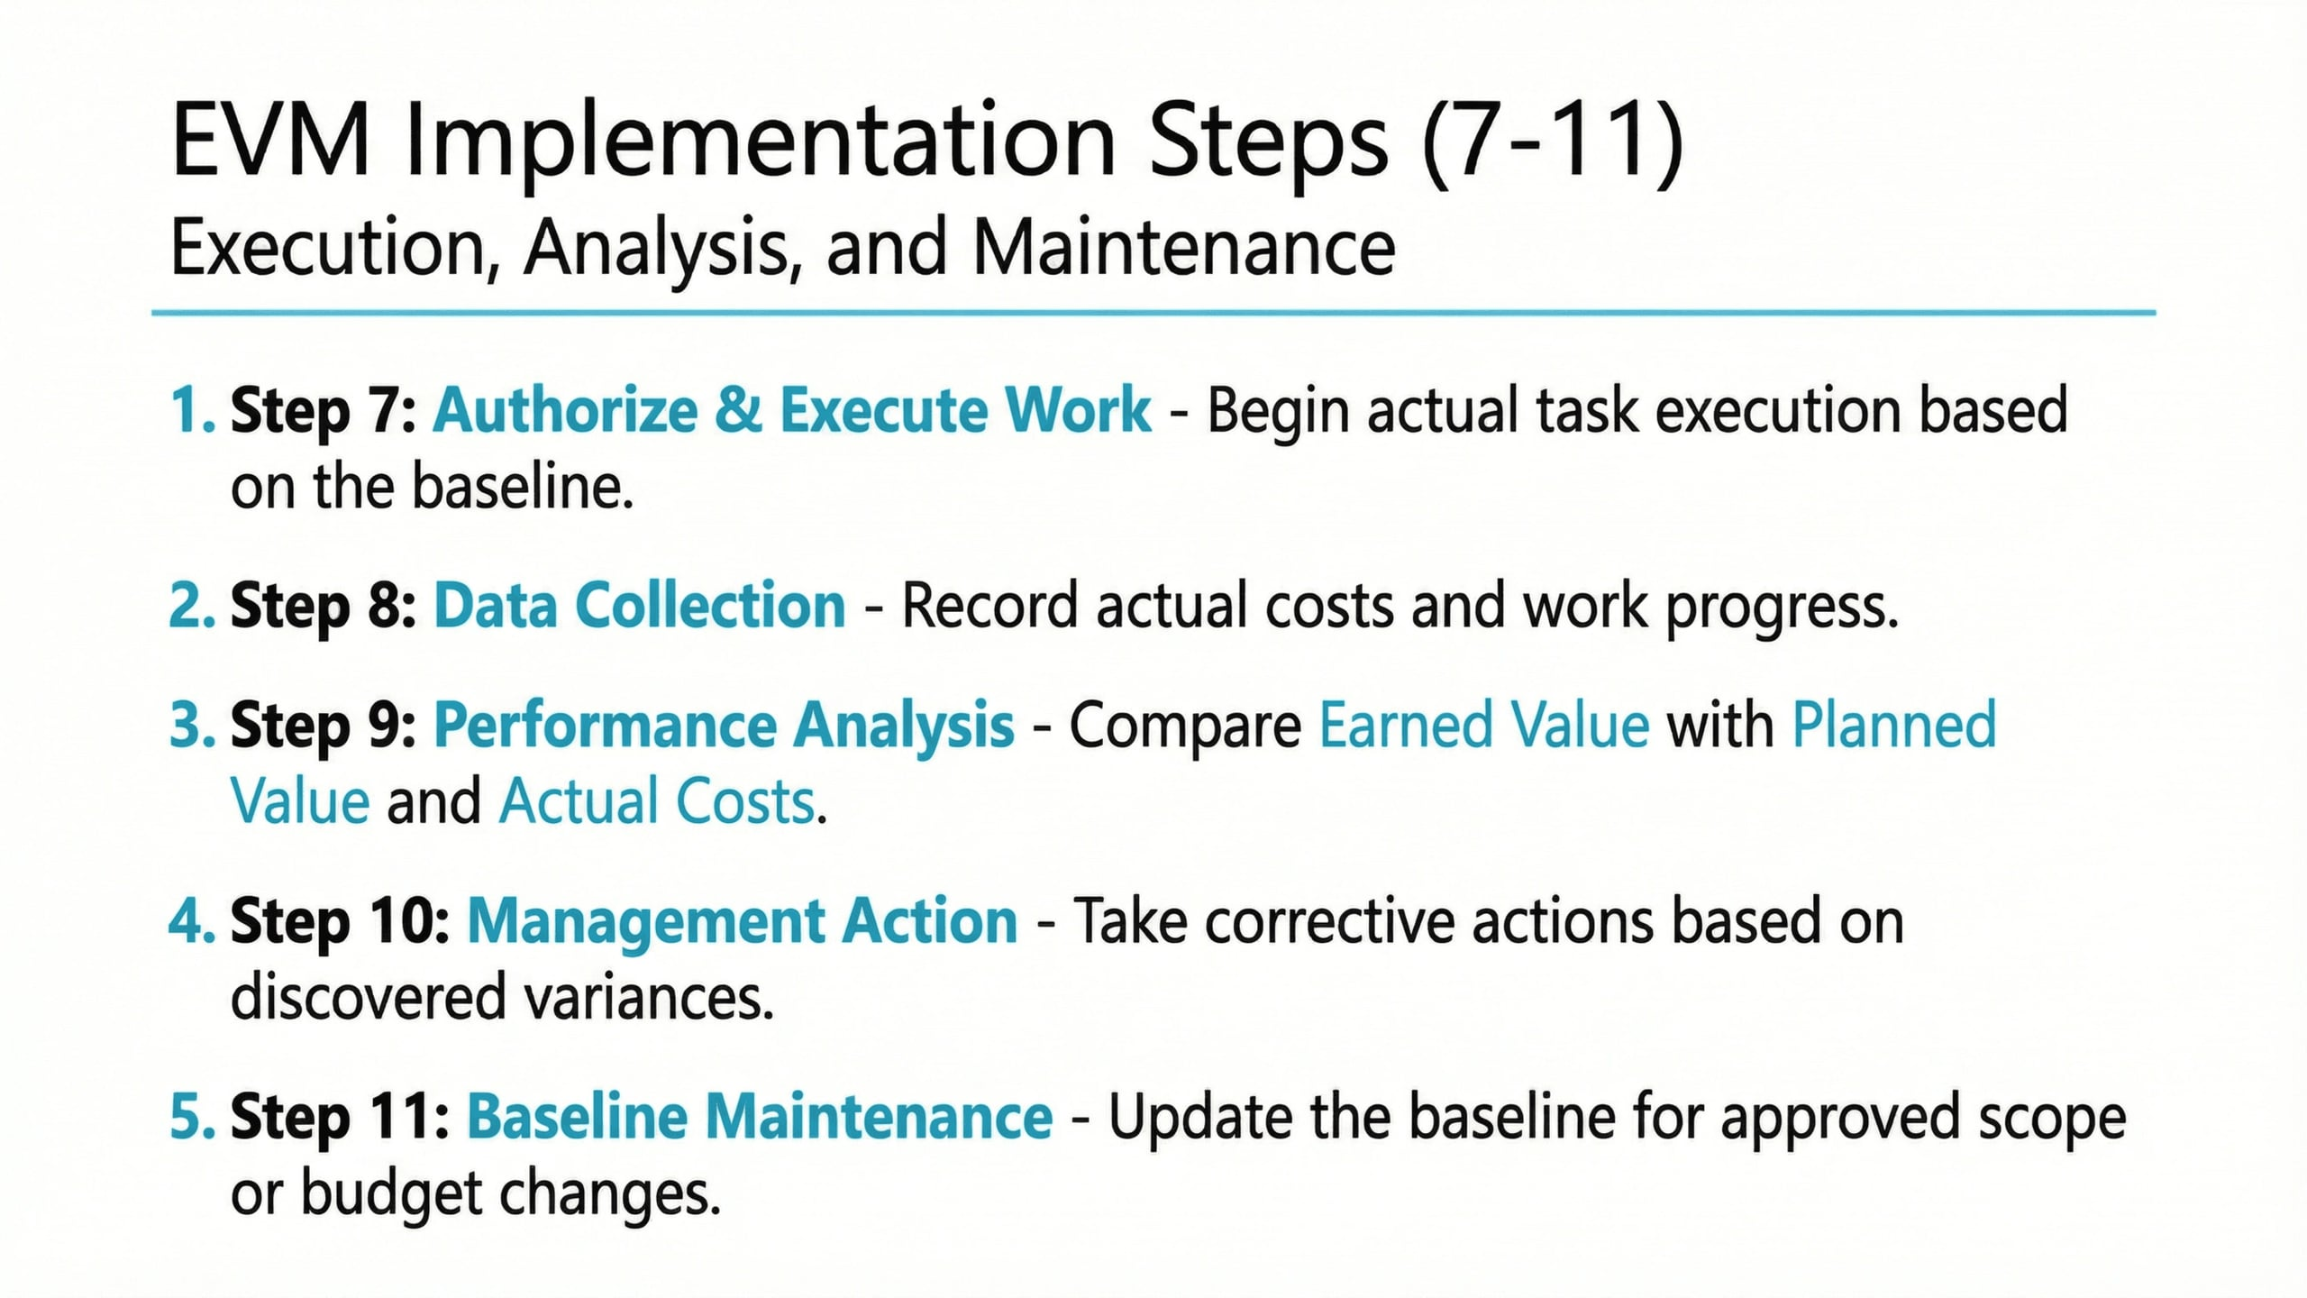
Lecture
04
Review of Previous Session
1 - 4

Slide 5
Lecture
04
Earned value Management completion
1 - 5

Slide 6
Lecture
04
The Three Core Components of EVM
1 - 6

Slide 7
Lecture
04
Performance Indeces
1 - 7

Slide 8
Lecture
04
Assess Deviation
1 - 8

Slide 9
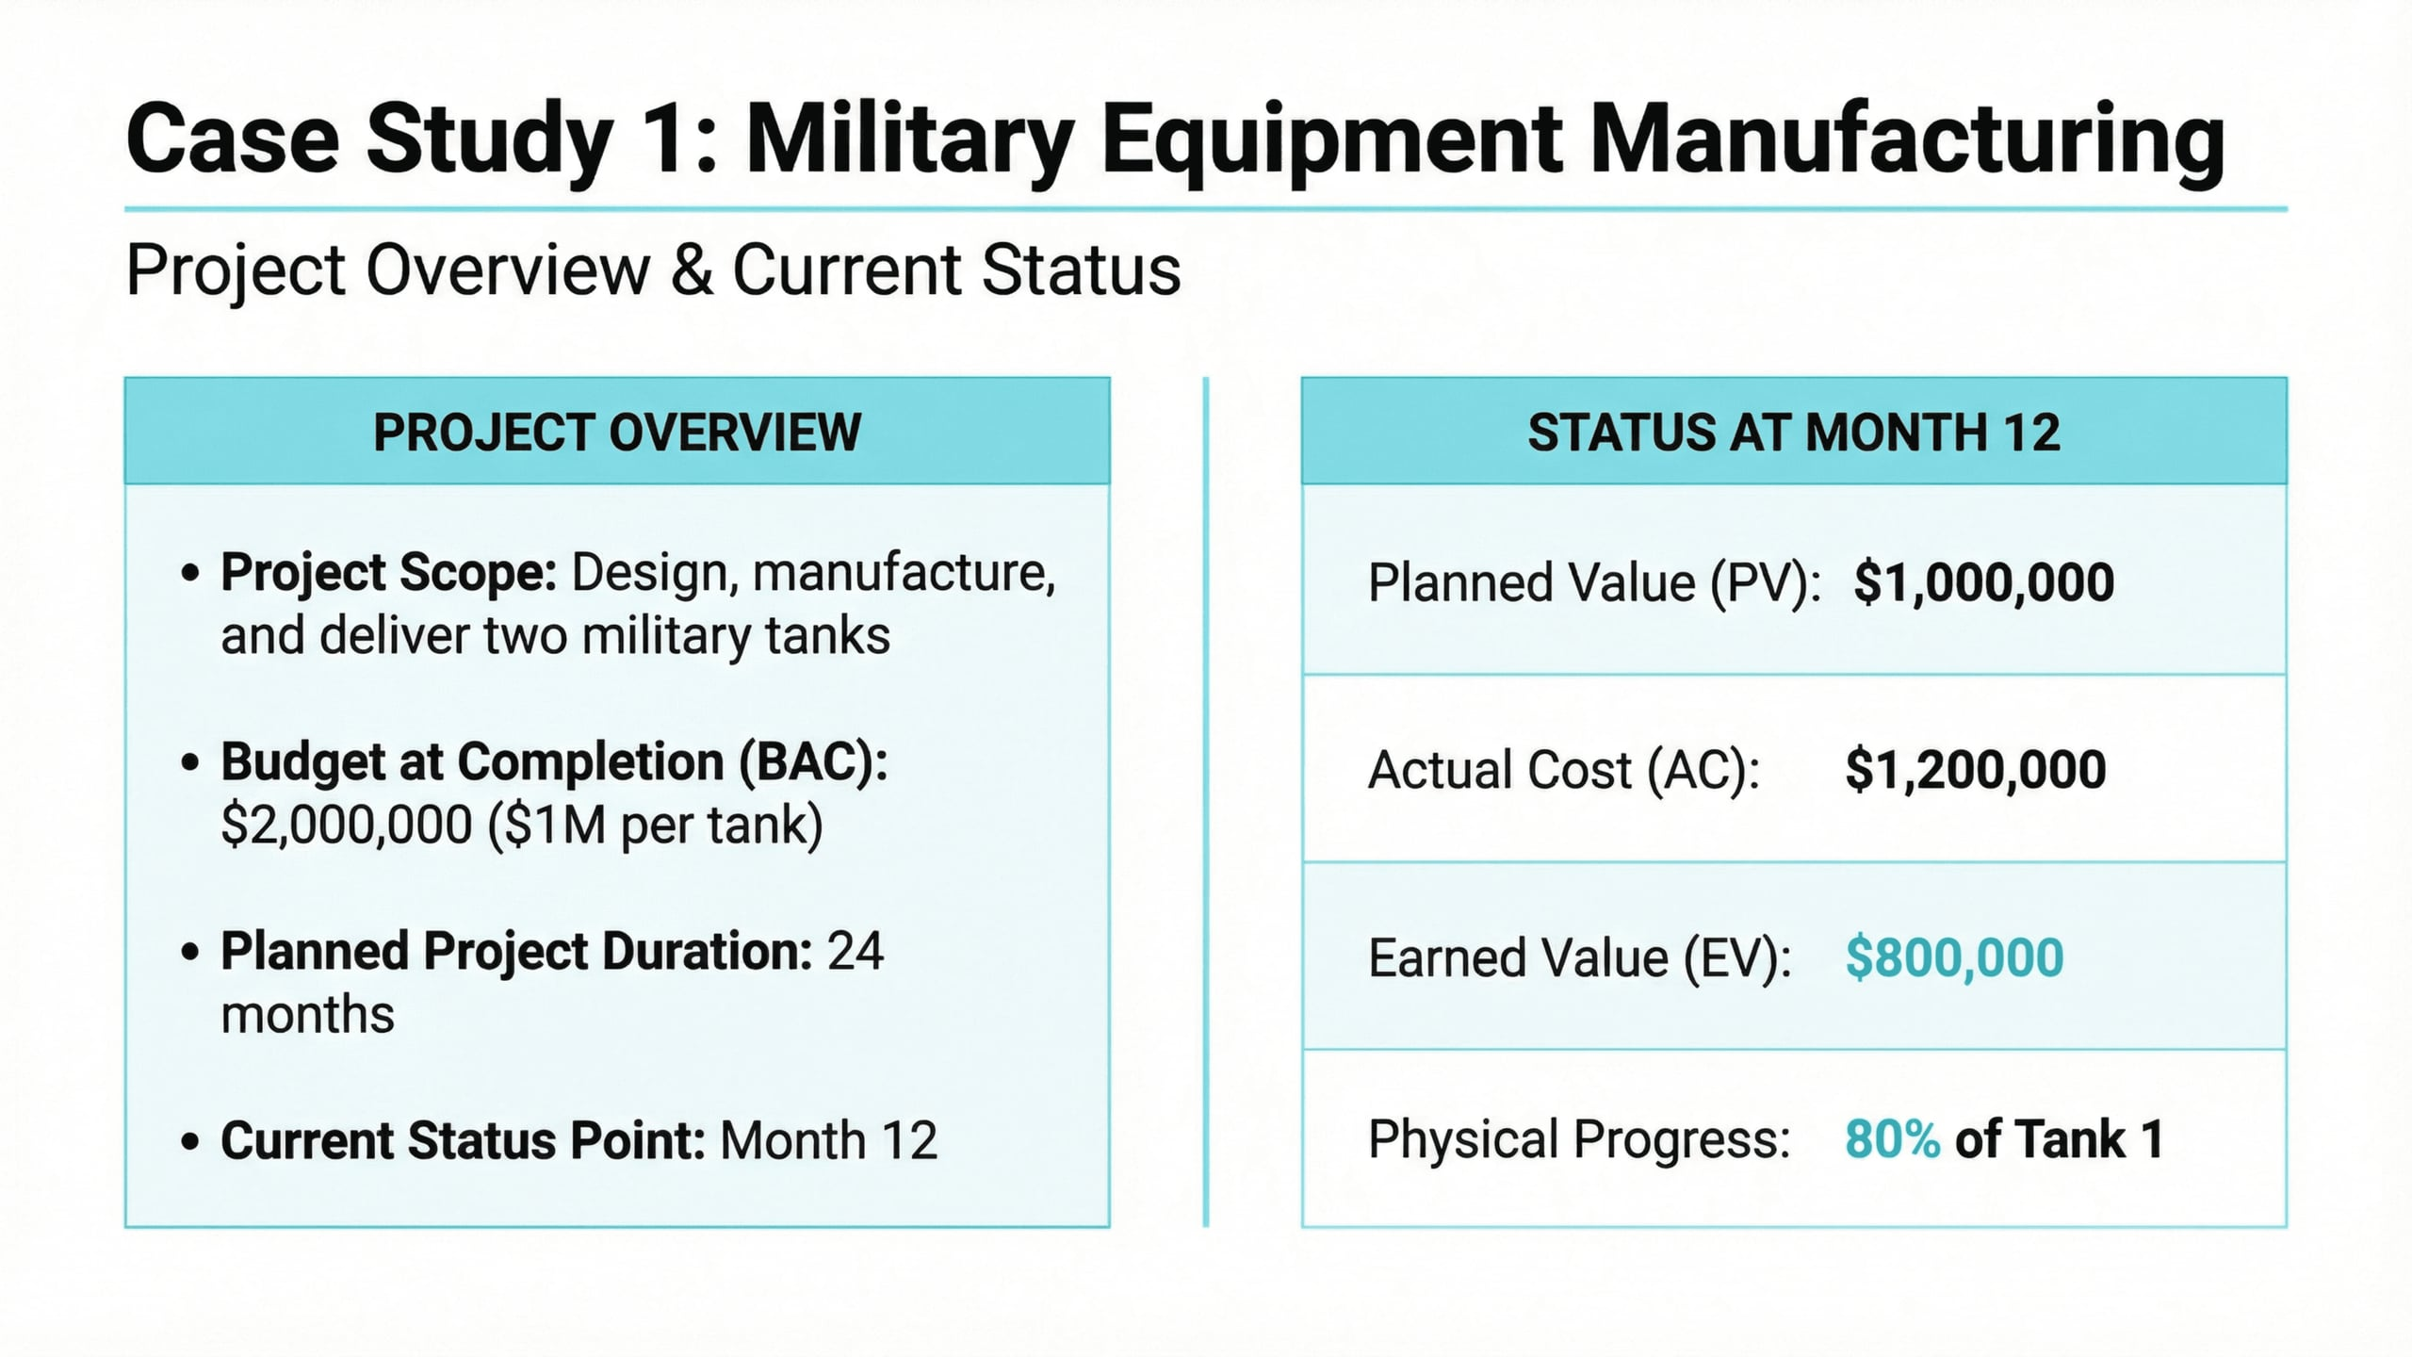
Lecture
04
Case Study: Military Equipment Manufacturing
1 - 9

Slide 10
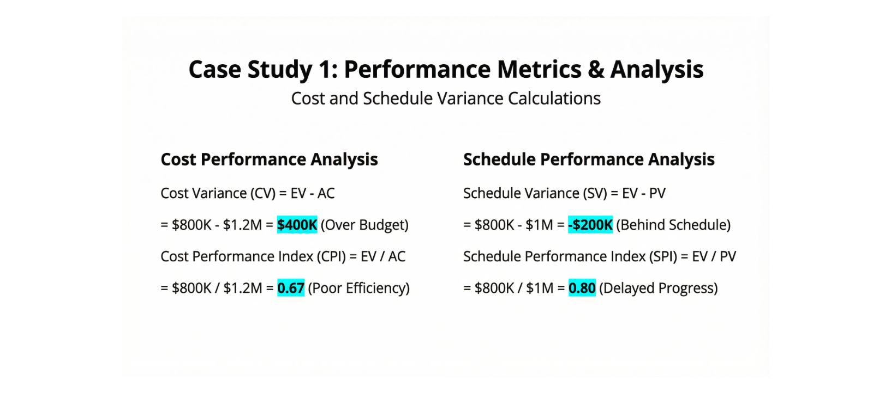
Lecture
04
Case Study: Military Equipment Manufacturing
1 - 10

Slide 11
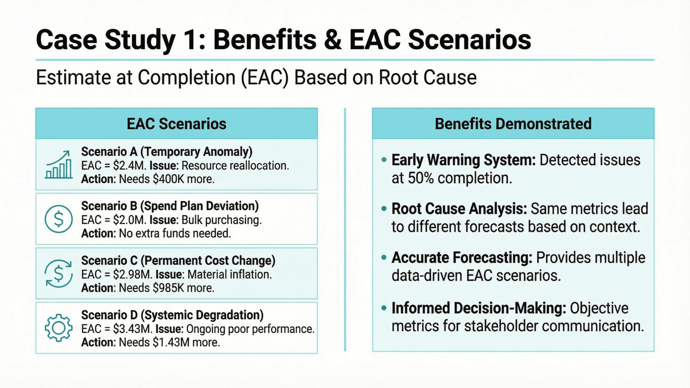
Lecture
04
Case Study: Military Equipment Manufacturing
1 - 11

Slide 12
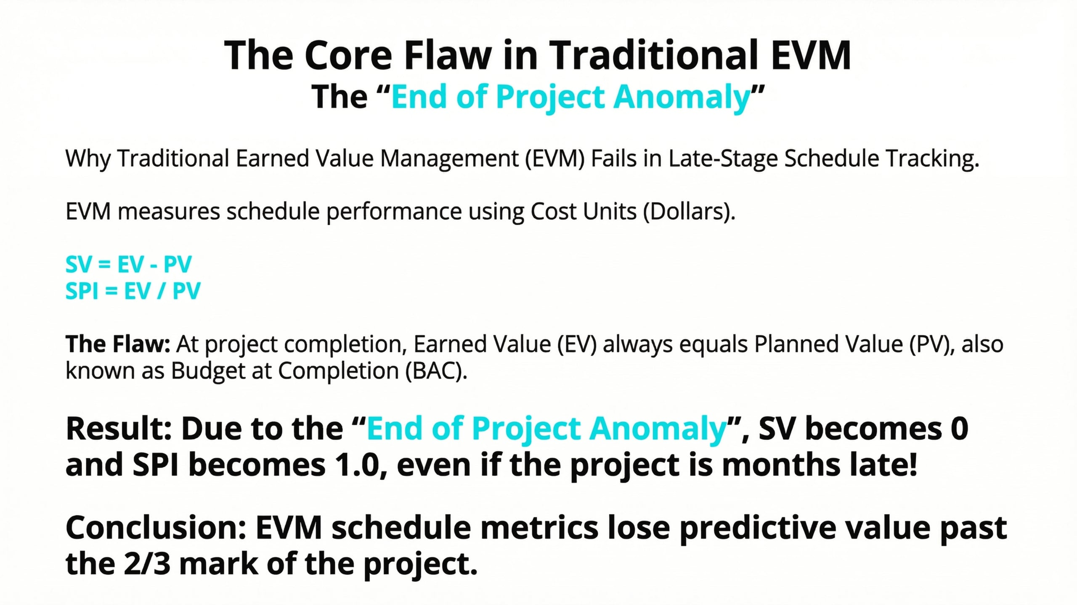
Lecture
04
The Core Flow in Traditional EVM
1 - 12

Slide 13
Lecture
04
1 - 13

Slide 14
Lecture
04
The Flaw in Traditional EVM
1 - 14

Slide 15
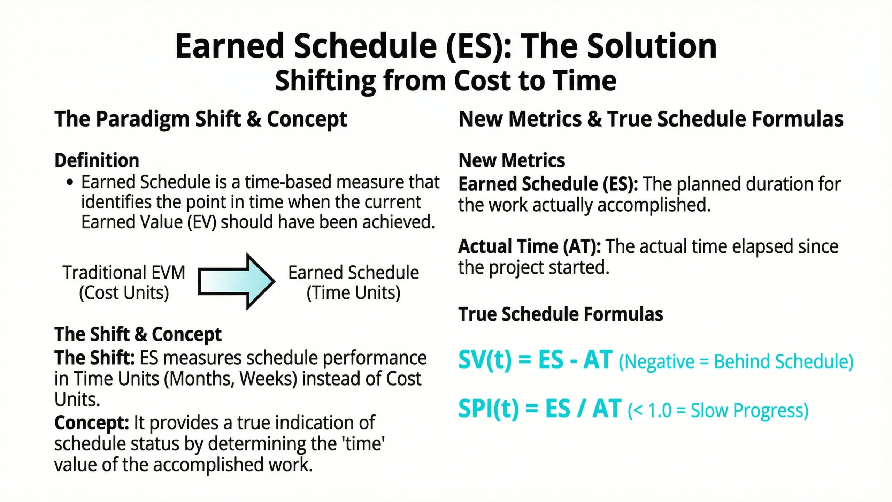
Lecture
04
Earned Schedule (ES)
1 - 15

Slide 16
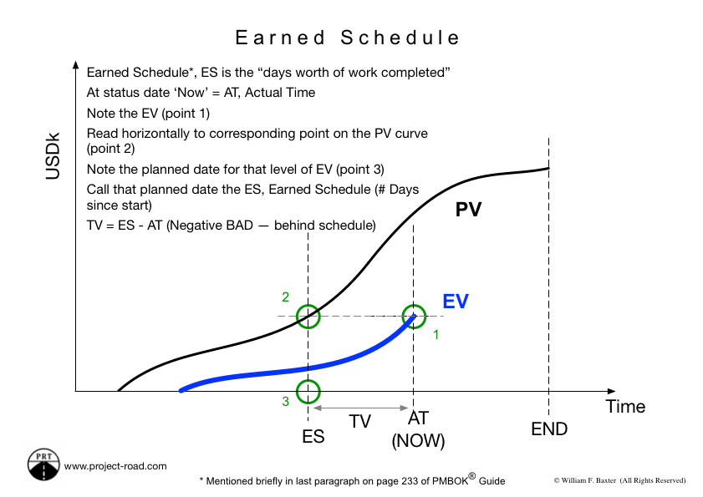
Lecture
04
Earned Schedule Graph
1 - 16

Slide 17
Lecture
04
EVM vs ES
1 - 17

Slide 18
Lecture
04
Earned Schedule Initiated
1 - 18

Slide 19
Lecture
04
Discussion of Schedule Value Scenarios
1 - 19

Slide 20
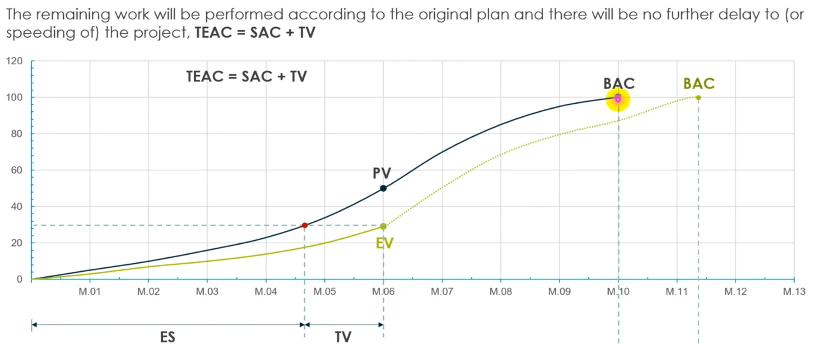
Lecture
04
Forecasting of Completion Time Scenario 1
1 - 20

Slide 21
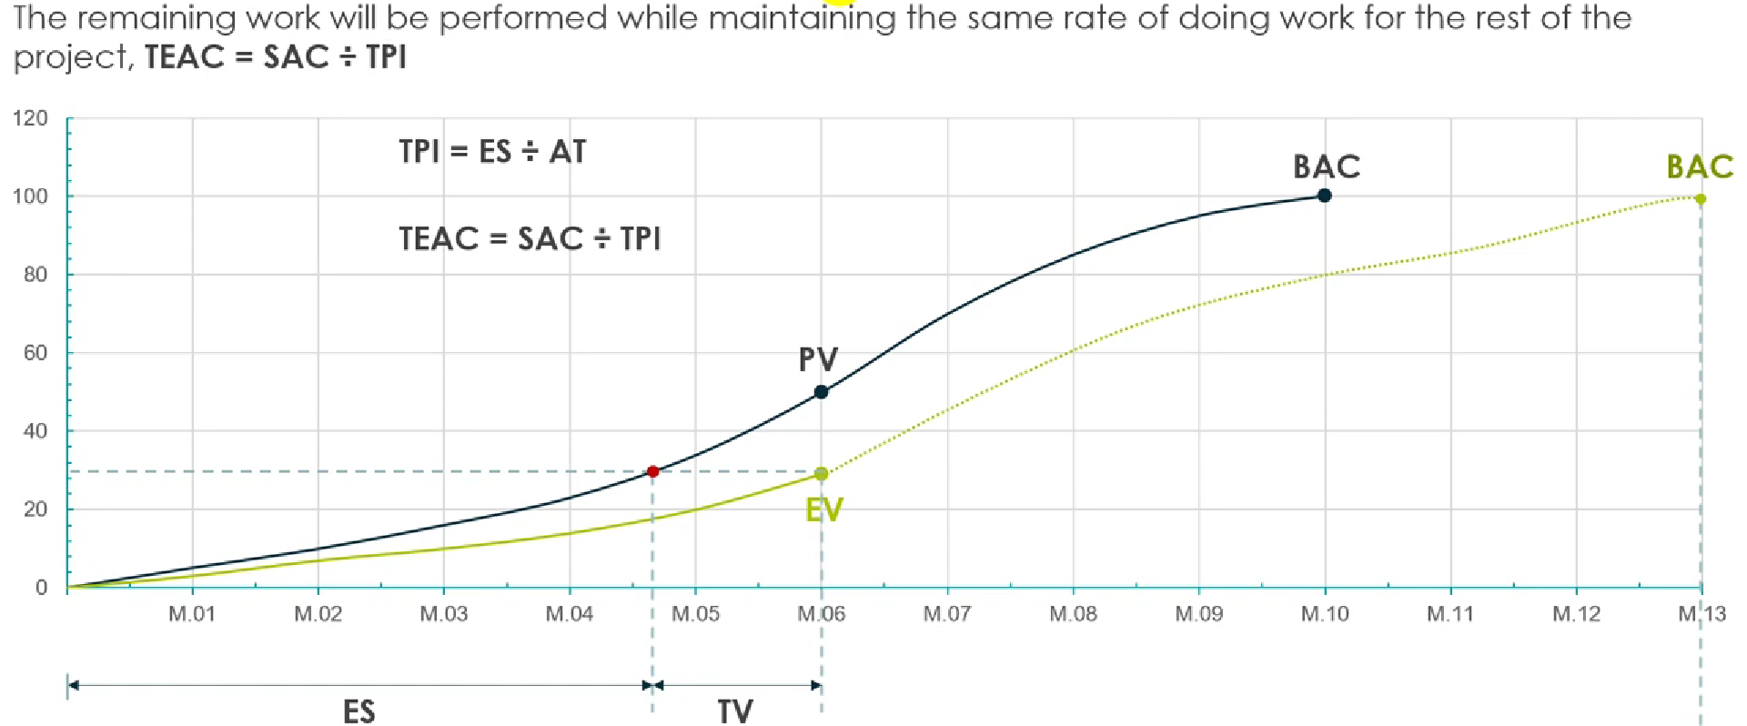
Lecture
04
Forecasting of Completion Time Scenario 2
1 - 21

Slide 22
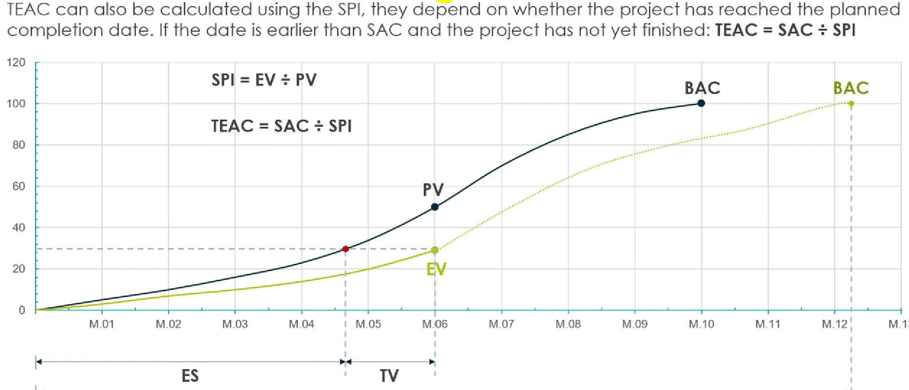
Lecture
04
Forecasting of Completion Time Scenario 3
1 - 22

Slide 23
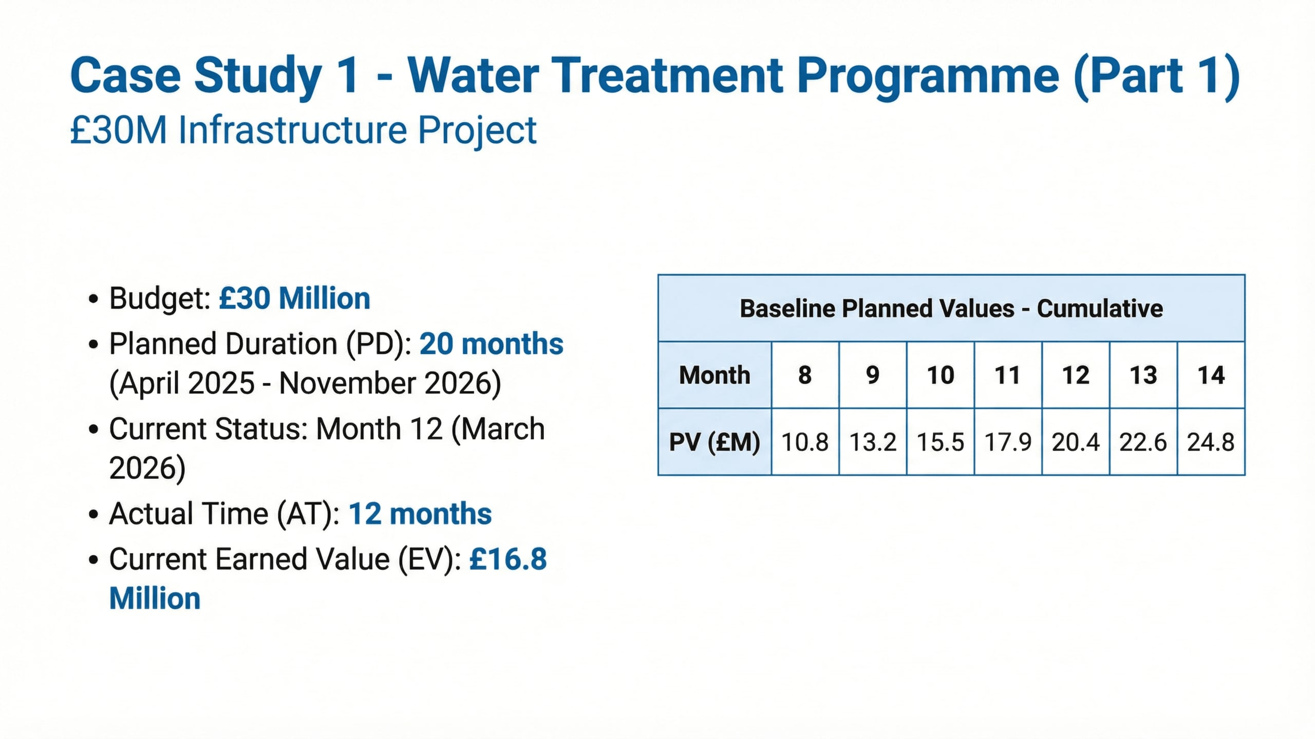
Lecture
04
Case Study 1 – Water Treatment Program
1 - 23

Slide 24
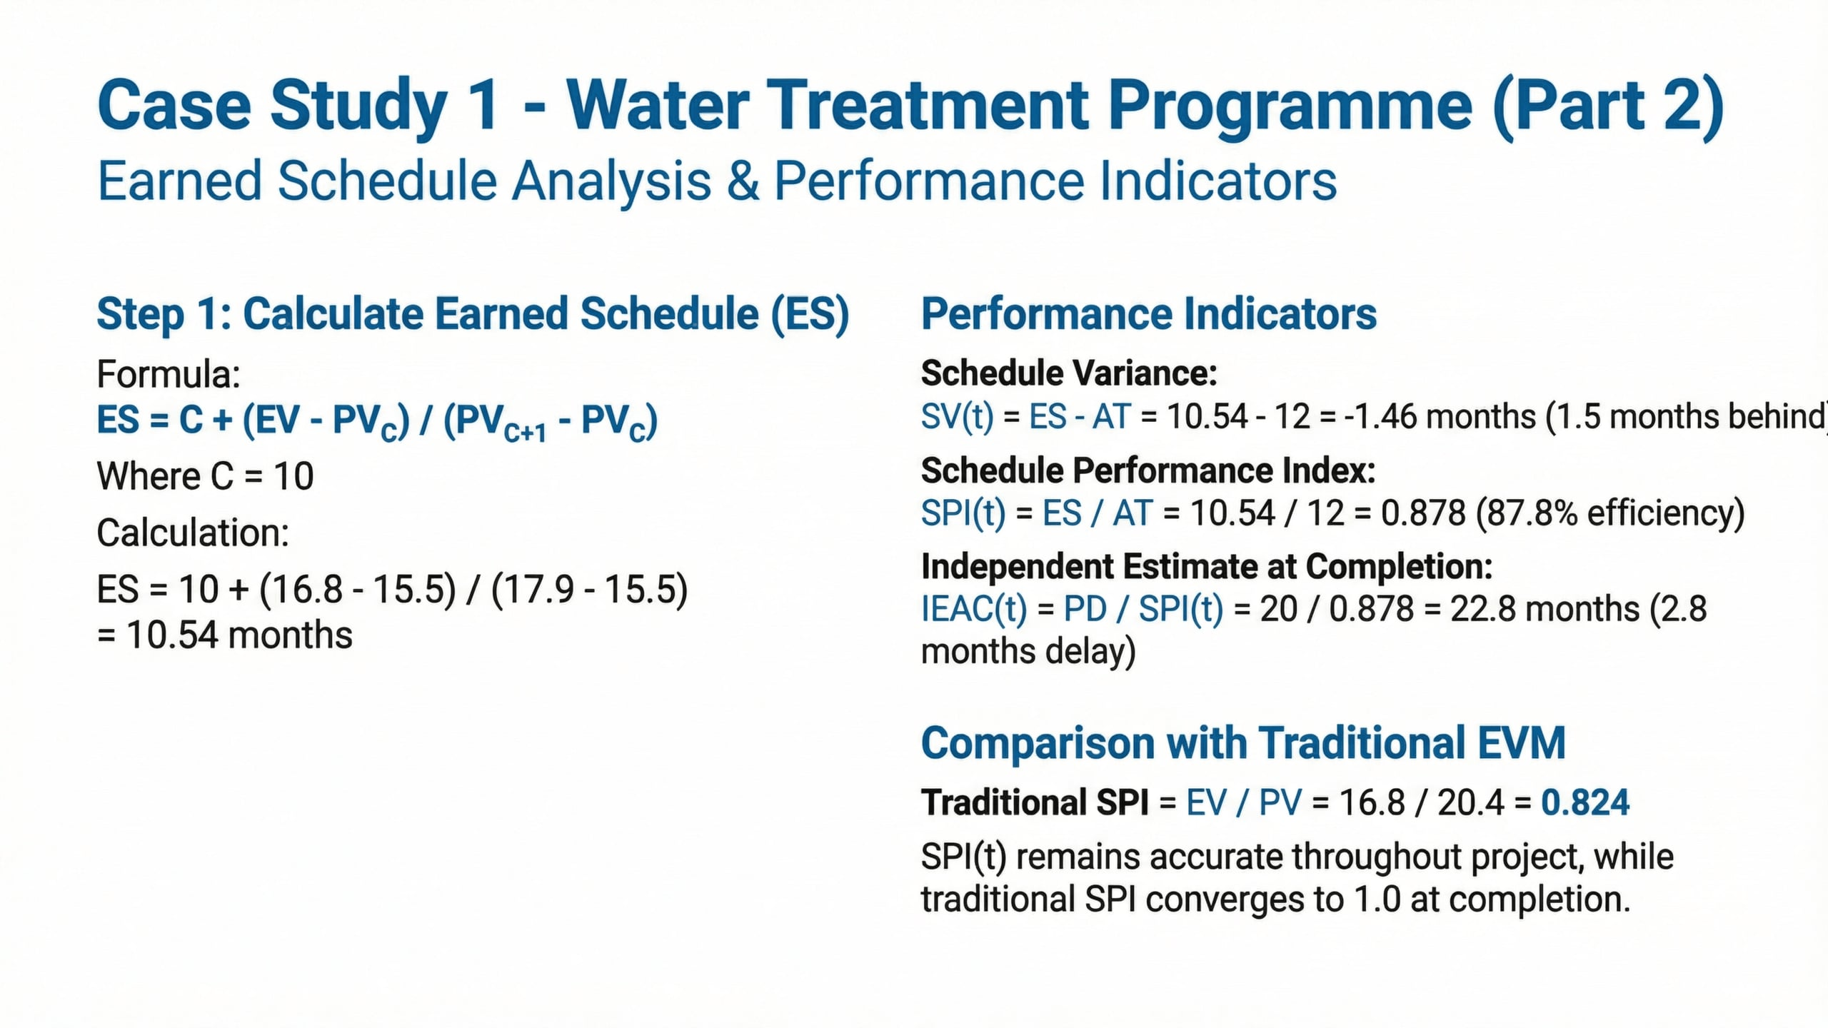
Lecture
04
Case Study 1 – Water Treatment Program
1 - 24

Slide 25
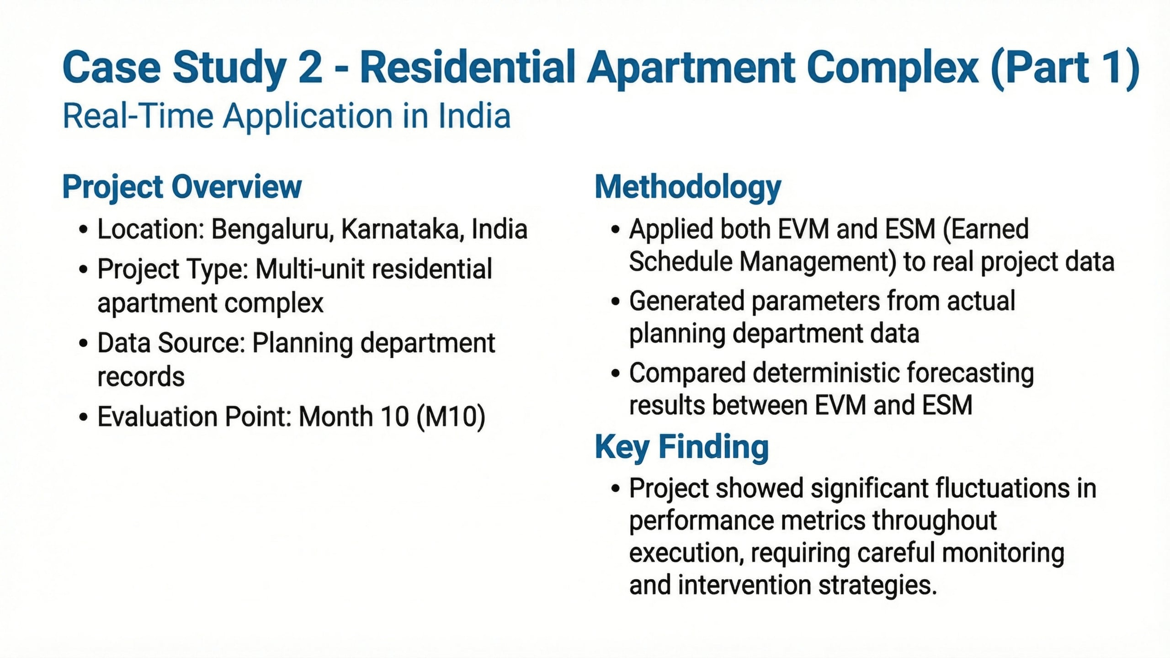
Lecture
04
Case Study 2- Residential Apartment Complex
1 - 25

Slide 26
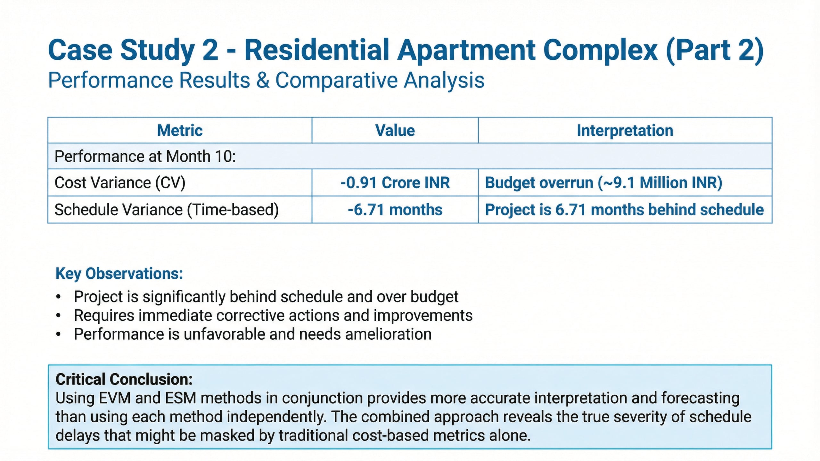
Lecture
04
Case Study 2- Residential Apartment Complex
1 - 26

Slide 27
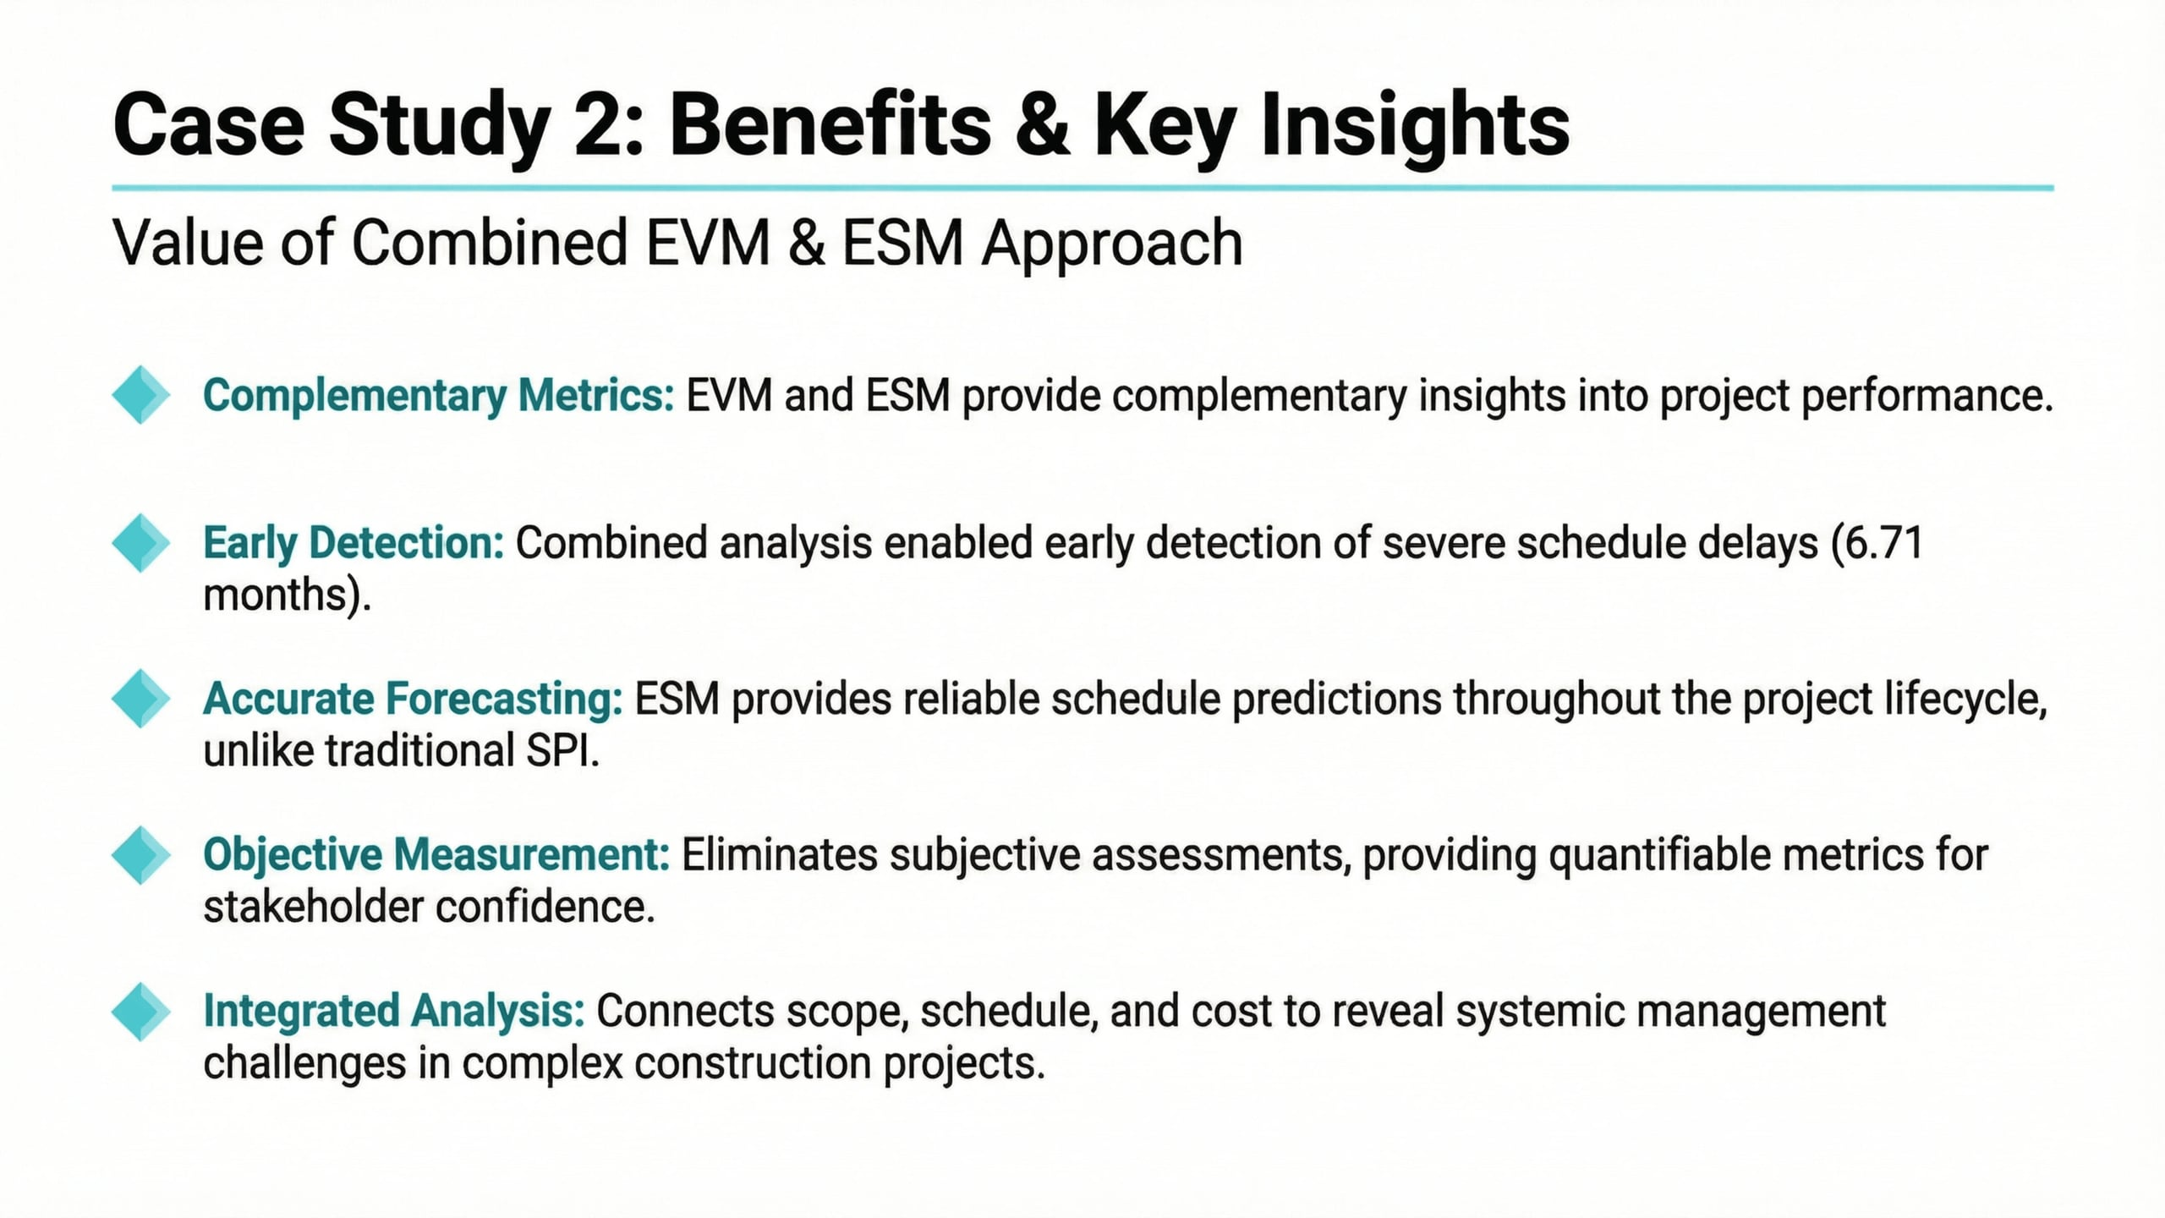
Lecture
04
Case Study 2- Residential Apartment Complex
1 - 27

Slide 28
Lecture
04
Step 10: Management Action
1 - 28

Slide 29
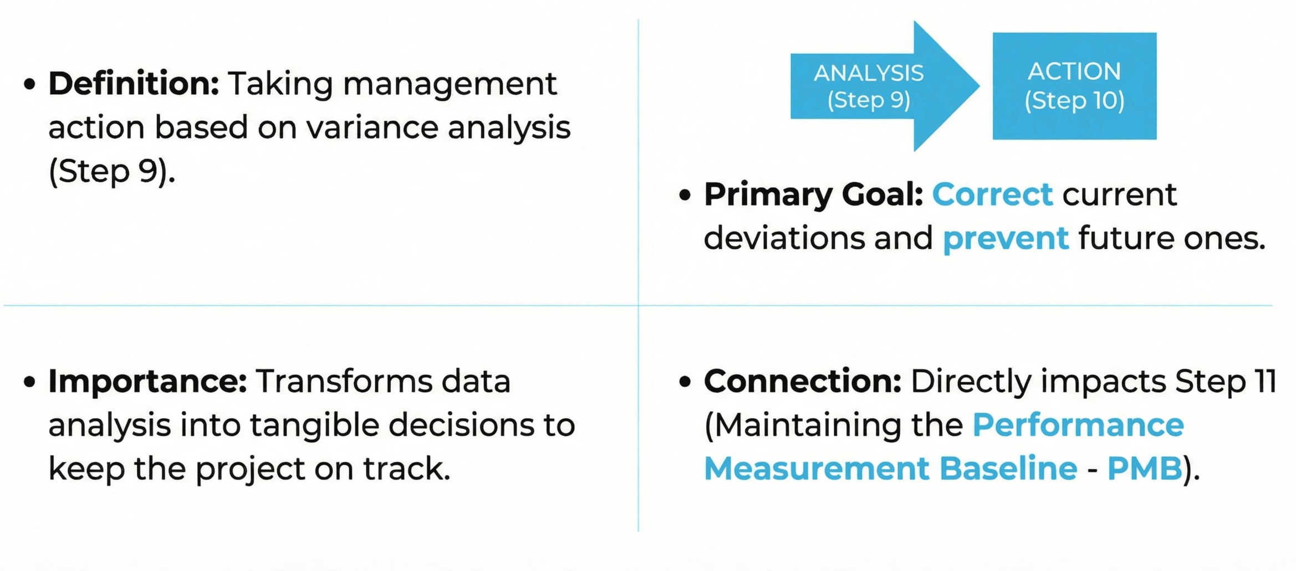
Lecture
04
Management Action
1 - 29

Slide 30
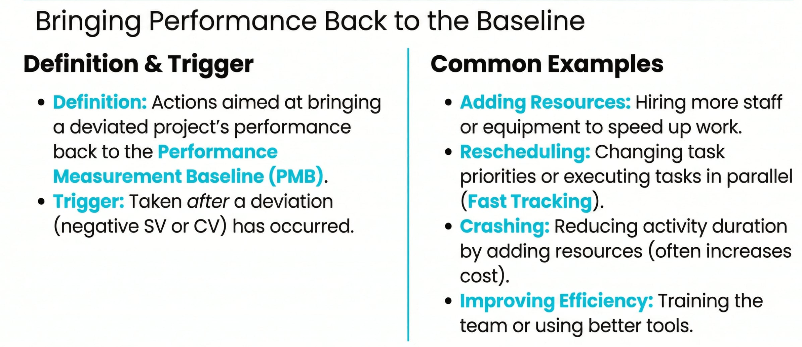
Lecture
04
Corrective Actions
1 - 30

Slide 31
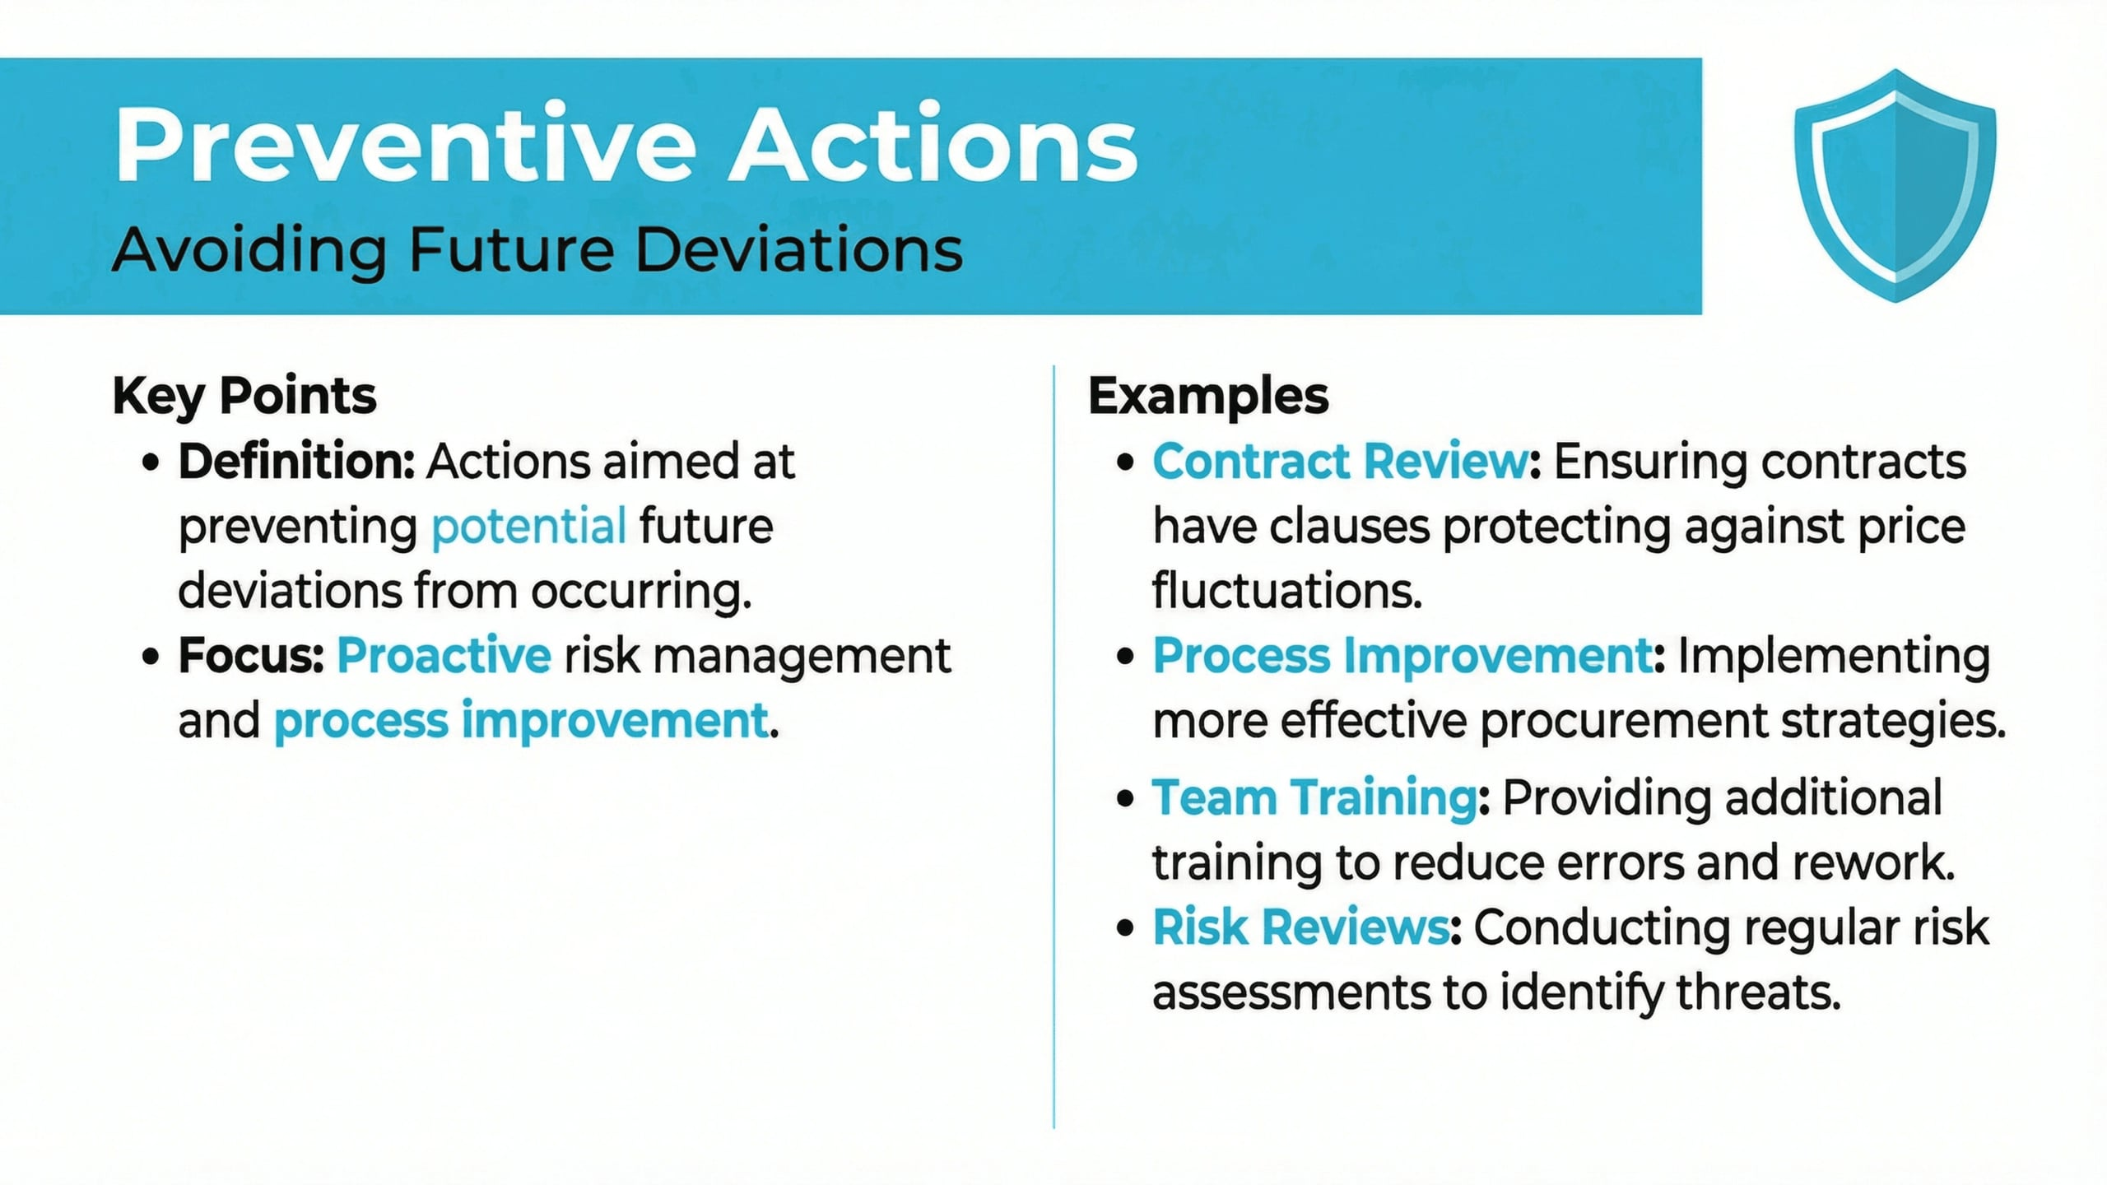
Lecture
04
Preventive Actions
1 - 31

Slide 32
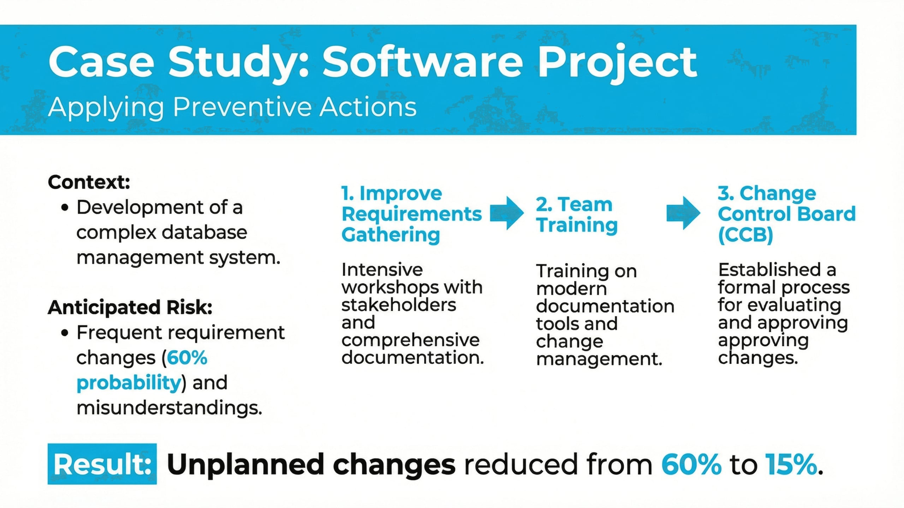
Lecture
04
Case Study: Software Project
1 - 32

Slide 33
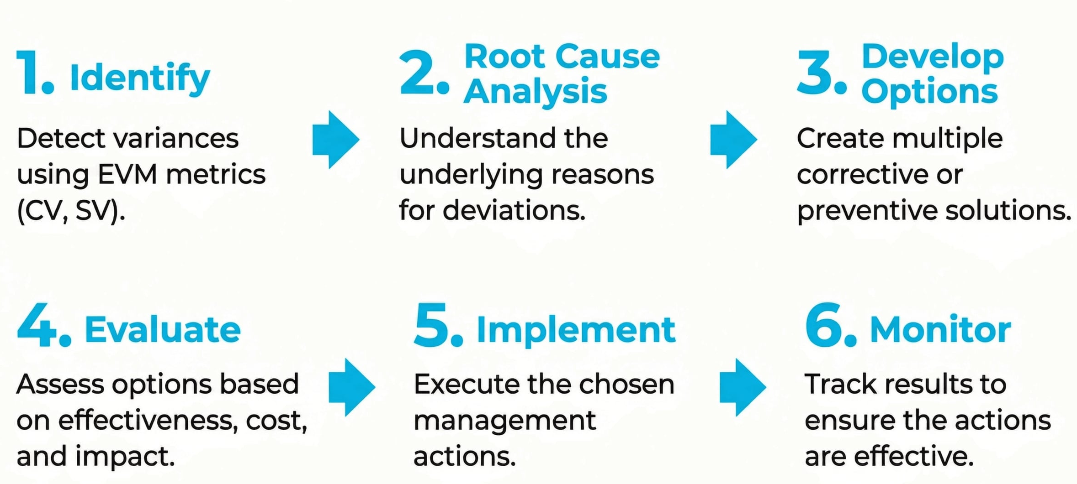
Lecture
04
The 6-Step Action Process
1 - 33

Slide 34
Lecture
04
Step 11: Baseline Maintenance
1 - 34

Slide 35
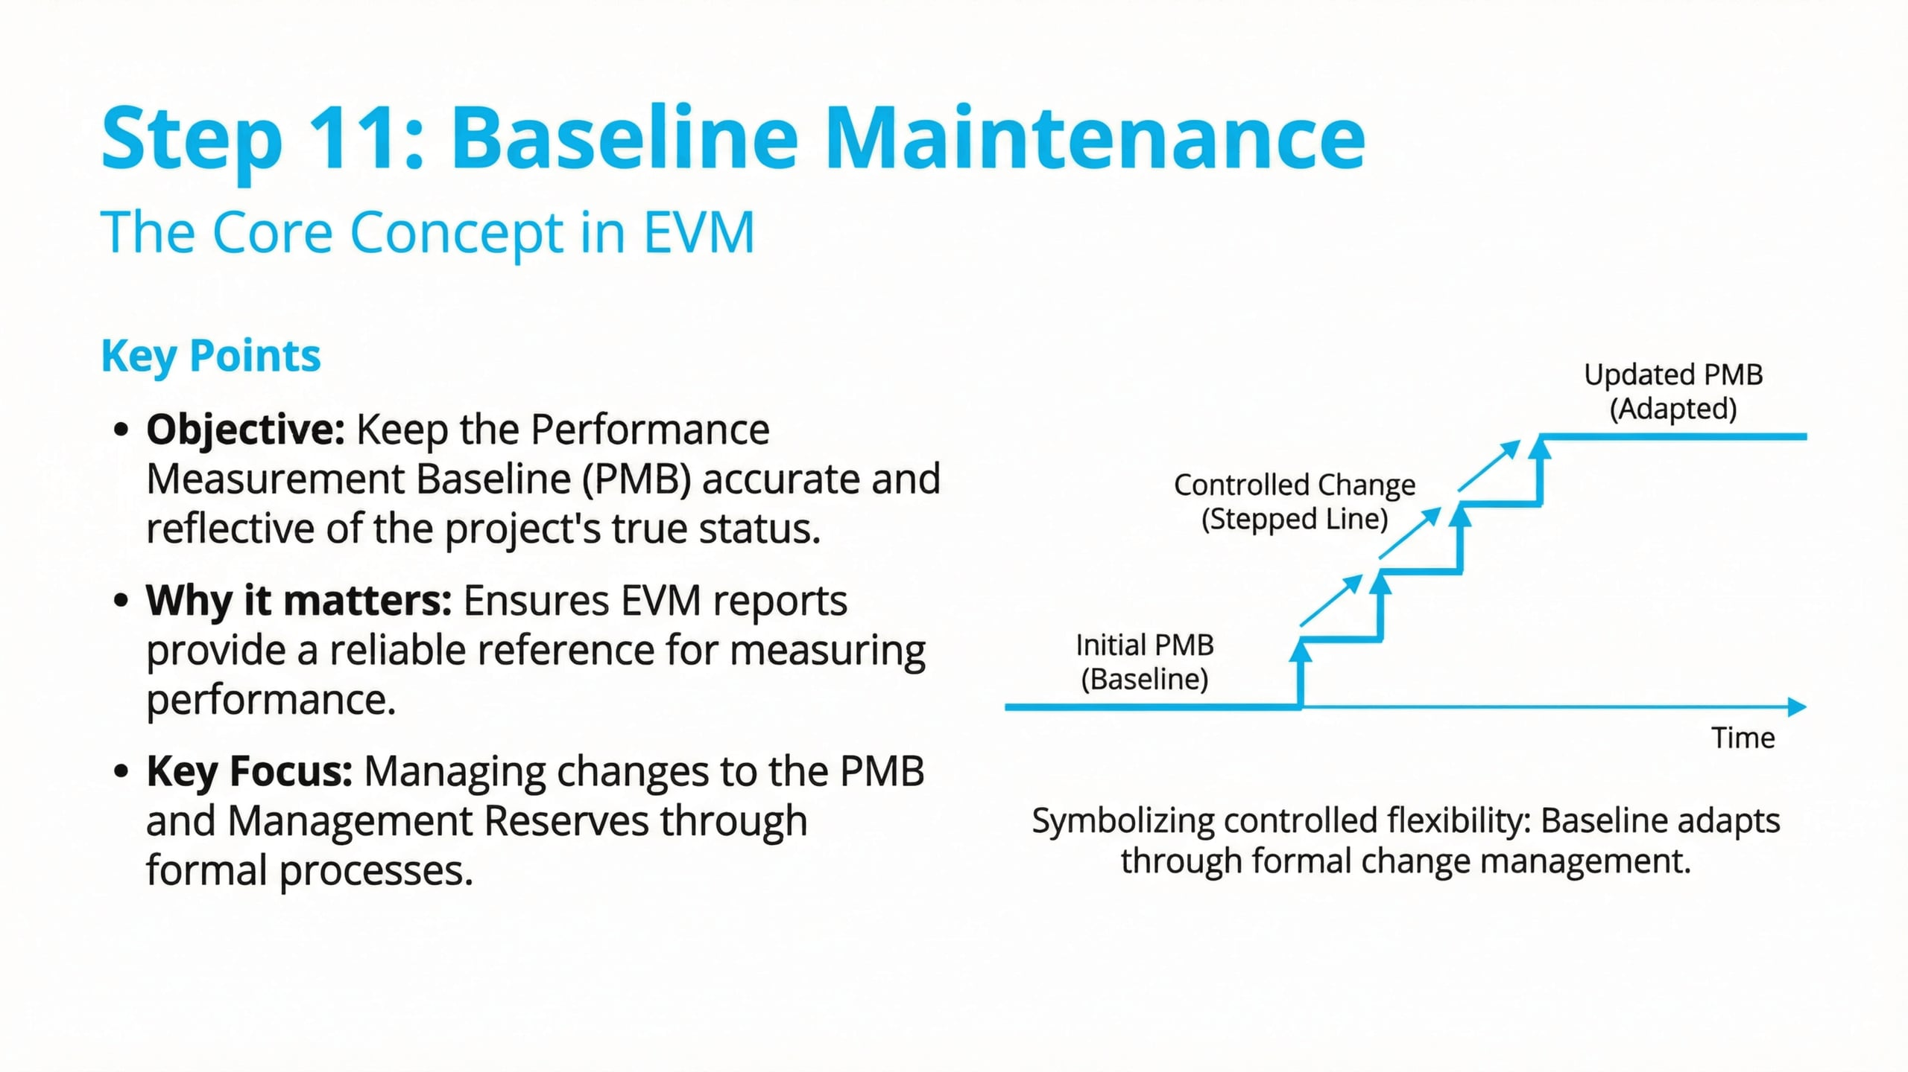
Lecture
04
Baseline Maintenance
1 - 35

Slide 36
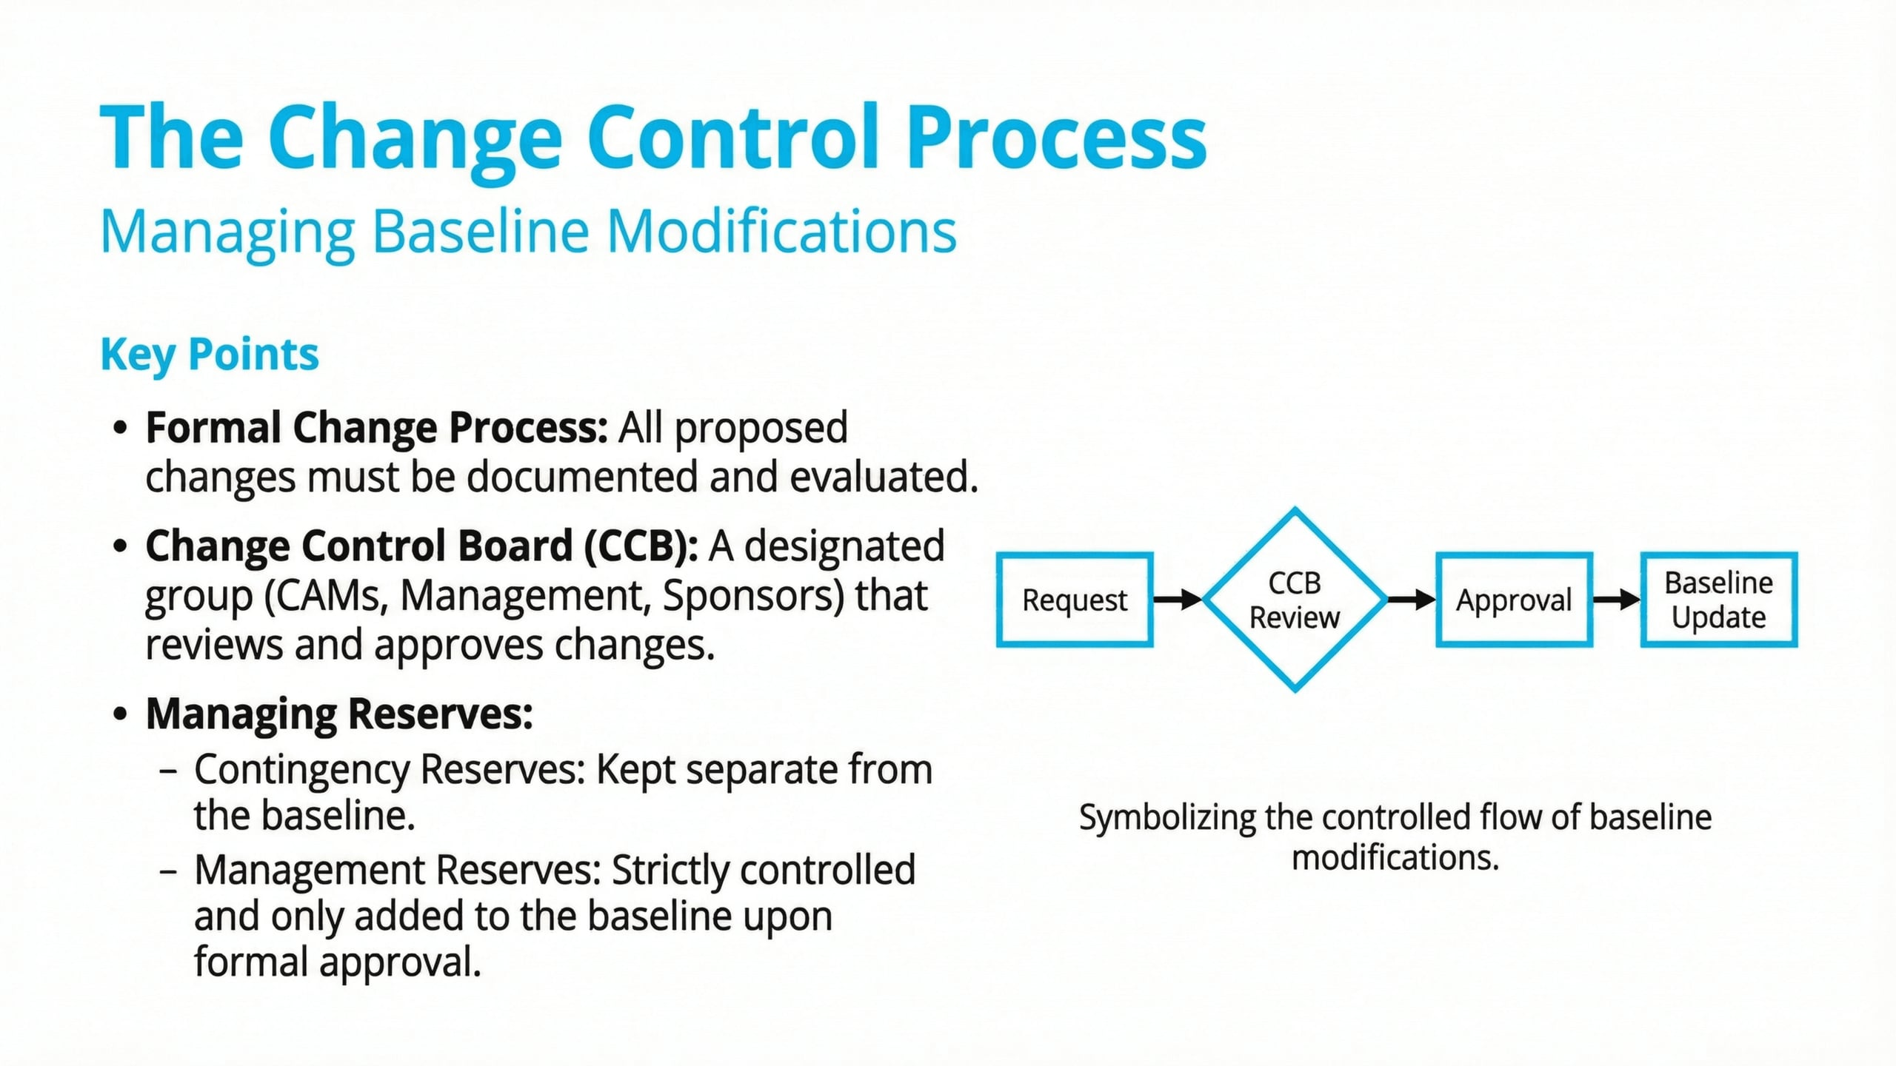
Lecture
04
The Change Control Process
1 - 36

Slide 37
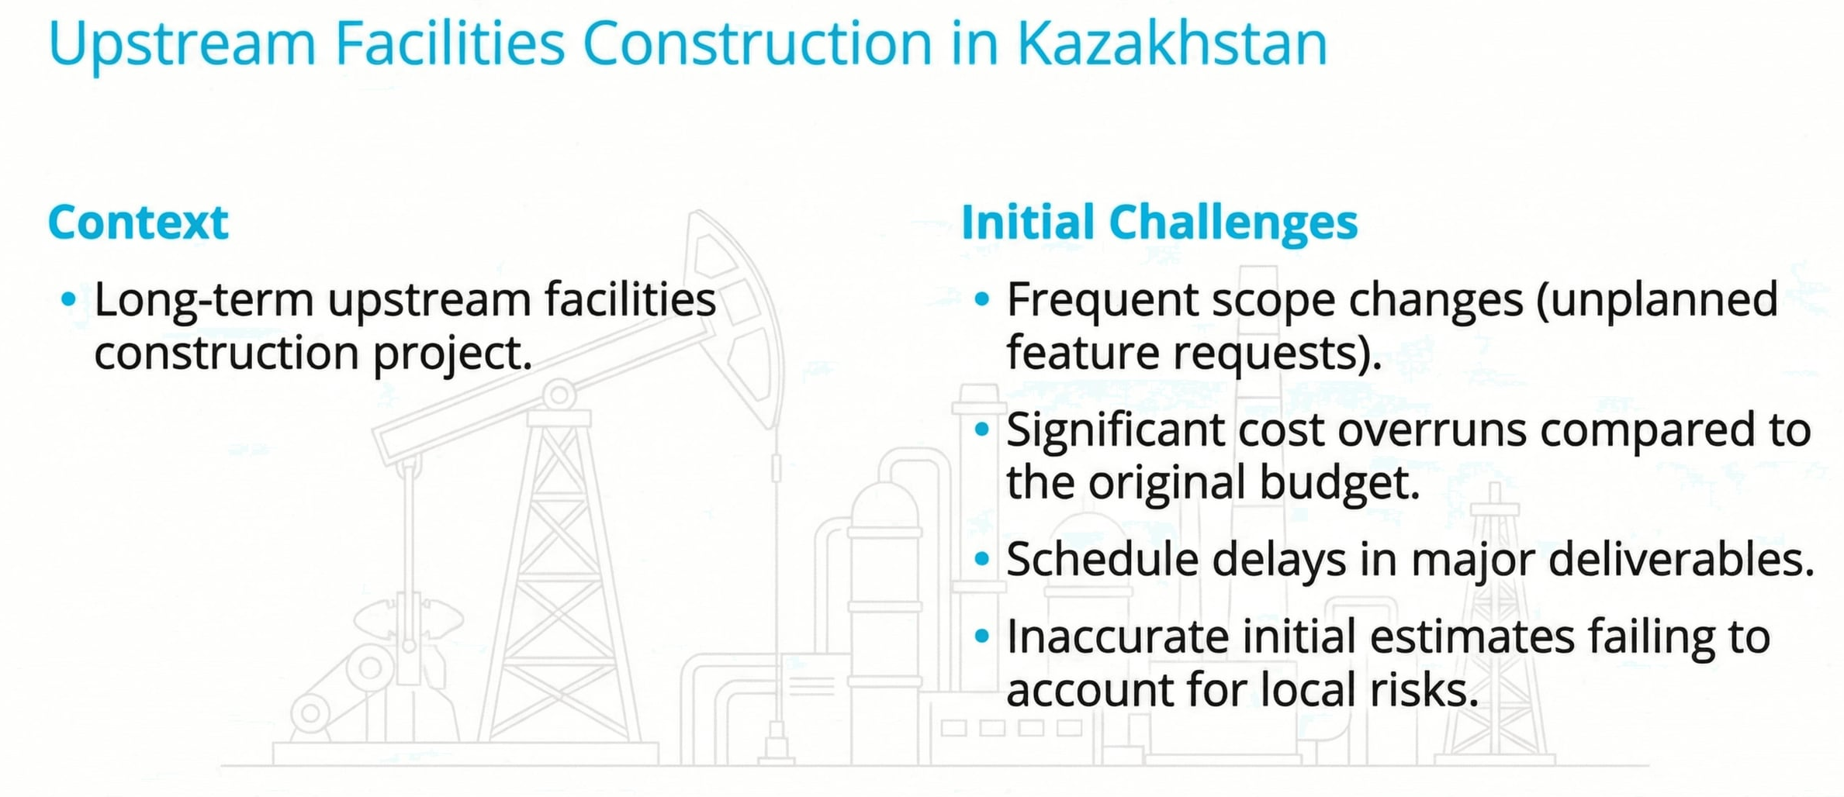
Lecture
04
Case Study: Oil & Gas Project
1 - 37

Slide 38
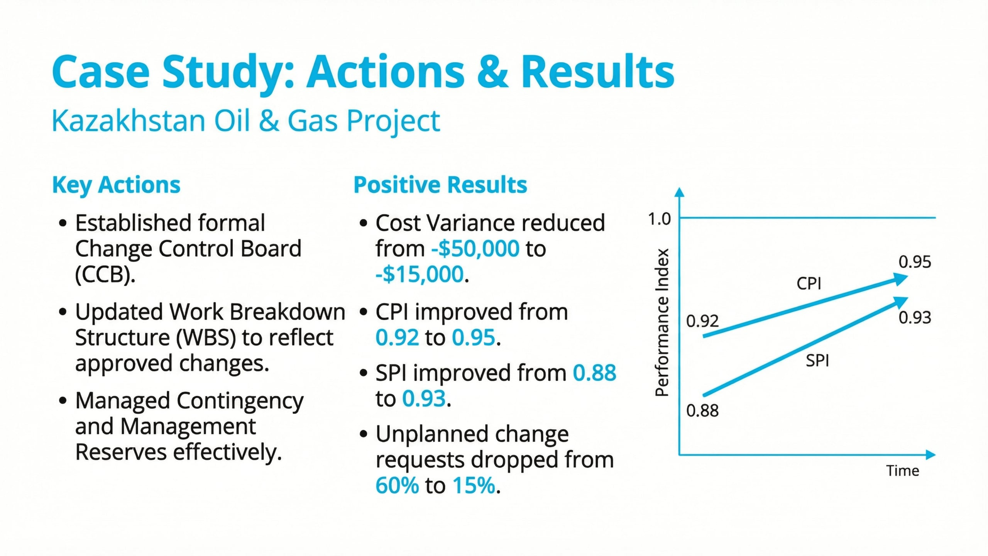
Lecture
04
Case Study: Oil & Gas Project
1 - 38

Slide 39
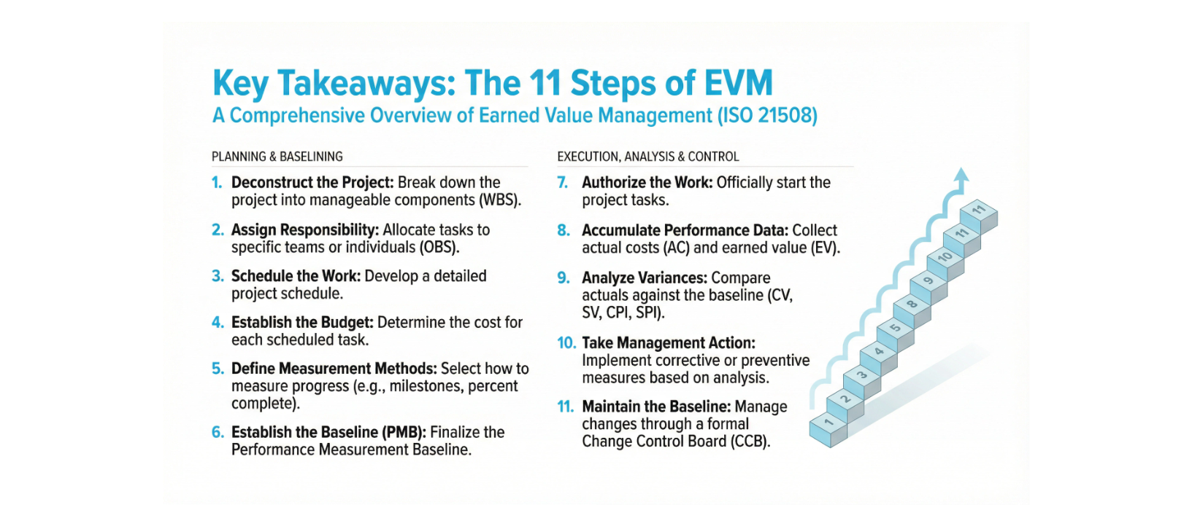
Lecture
04
Key Takeaways
1 - 39

Slide 40


Thank You

