Slide 2
Course Description:
This course addresses the understanding and design of digital systems.
The subject is also known by other names such as logic design, digital logic, digital design and switching circuits.
Examples of digital systems: digital computers, control systems, data communication and many other systems that require electronic digital hardware

Slide 3
DIGITAL Systems
Most of Digital Systems or devices consist of two integrated Components:
  Hardware: which can be defined as a group of Electronic Circuits that execute the program instructions.
  Software: which are used to control the hardware in order to execute the user commands.

Slide 4
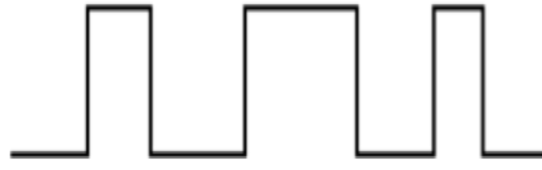
WHAT IS DIGITAL?
Digital describes any system based on discontinuous data or events.
Computers are digital machines because at their most basic level they can distinguish between just two values, 0 and 1, or off and on.
There is no simple way to represent all the values in between, such as 0.25.
All data that a computer processes must be encoded digitally, as a series of
zeroes and ones.

Slide 5
Learning Outcomes:
  Develop an understanding of different numbering systems and the concept behind
  Boolean algebra and the two valued logic.
  Optimize logic functions using any type of minimizing algorithms (Boolean algebra or Karnaugh map).
  Analyze any digital logic circuit either Combinational or Sequential.
  Design digital logic circuits (Define the problem, Determine inputs and outputs,
  Express the outputs as Boolean expressions and implement the outputs.
  Use simulation software for developing and testing digital logic circuits.

Slide 6
Assessment Strategy
The assessment strategy measures the student’s understanding of digital systems and their design.
The assessment is mainly implemented using Examinations to indicate student’s progress in mastery of course content and it includes:
  Weekly quizzes to measure the students understanding to the tpics covered in that week.
  An end-of-semester final examination to measure the student’s mastery in understanding the knowledge and design skills gained through the whole course.

Slide 7
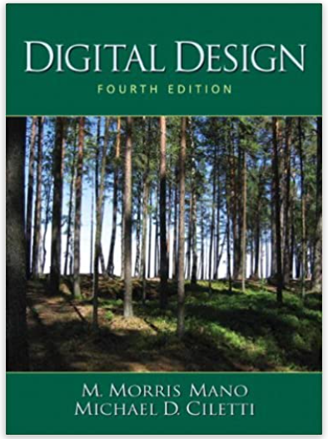
Credit Hours: 4 credit hours
Required Textbook:
M. Mano, M. D. Ciletti “Digital Design”, Prentice Hall.
Most of the material in these pages was originally taken
From the 4th and 5th edition of this textbook.
Lecture notes, power points slides (ppt-pdf) and videos are
additional resources that are prepared by me.

Slide 8
CHAPTER 1
Digital Systems and Binary Numbers
Digital Systems, Binary Numbers, Number-base Conversions, Octal and Hexadecimal Numbers, Complements, Signed Binary Numbers, Binary Codes, Binary Storage and Registers, Binary Logic

Slide 9
CHAPTER 2
Boolean Algebra and Logic Gates
Introduction, Basic Definitions, Axiomatic Definition of Boolean Algebra, Basic Theorems and Properties of Boolean Algebra, Boolean Functions, Canonical and Standard Forms, Other Logic Operations, Digital Logic Gates, Integrated Circuits

Slide 10
What is the difference between the Boolean algebra and arithmetic algebra?
The first obvious difference is that in Boolean algebra we have only (+) and (∙) operators, but we do not have subtraction (-) or division (/) like in mathematics.
The Second Difference, Boolean Algebra use Binary Values only which can be equal either 1 or 0 only, While the Arithmetic variables are numbers that
consist of many decimal digits (1,2,3,4,…).

Slide 11
Logic Gates
There are three fundamental logical operations, from which all other functions, no matter how complex, can be derived. These Basic functions are named:
  AND,
  OR,
  NOT (INVERTER).
Each of these has a specific symbol and a clearly-defined behavior

Slide 12
CHAPTER 3
Gate level Minimization
The Map Method, Two-variable map, Three-variable map, Four-Variable Map, Product of Sums Simplification, Don’t-care Conditions, NAND and NOR Implementation, Other Two-Level Implementations, Exclusive-OR Function

Slide 13
  Complexity of a logic circuit is directly related to the algebraic expression.
  Simplification can be done using algebraic manipulation, but it has issues:
How to know succeeding steps in the manipulative process
Difficult to determine whether the simplest expression has been achieved.
  To obtain the simplest implementation for a given function, we will cover a graphical technique using Karnaugh maps (K-maps)

Slide 14
CHAPTER 4
Combinational Logic
Introduction, Combination Circuits, Analysis Procedure, Design Procedure, Binary Adder-Subtractor, Decoders, Encoders, Multiplexers

Slide 15
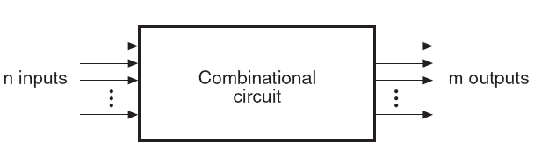
A combinational logic circuit is a connected arrangement of:
  A set of n Boolean inputs,
  A set of m Boolean outputs, and
  Logic gates and interconnections
Block Diagram of Combinational Circuit

Slide 16
CHAPTER 5
Synchronous Sequential Logic
Introduction, Sequential Circuits, Storage Element: Latches and Flip-Flops, Analysis of Clocked Sequential Circuits , Design Procedure

Slide 17
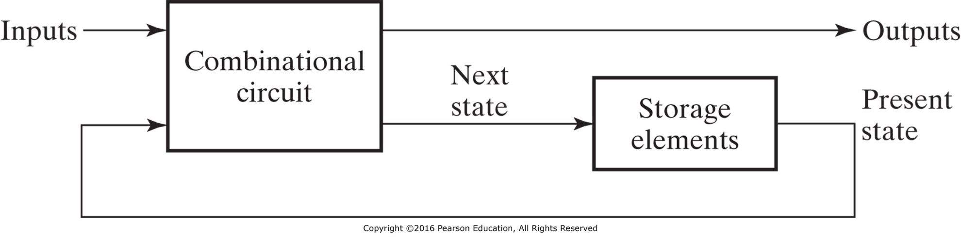
A sequential circuit consists of a combinational circuit to which memory elements are connected to form a feedback path.

Slide 18
CHAPTER 6
Hardware Simulation
Use simulation software such as Logisim, HDL for developing and testing digital logic circuits.

Slide 19


