Slide 1



Strategies for
Recognizing Opportunities
Prepared by Dr. Mohamed Soliman
ENT624
Entrepreneurial Strategy
Lecture 3

Slide 2



Learning Objectives
1. Understand the role of creative thinking and behavior as entrepreneurs discover and refine entrepreneurial opportunities.
2. Know the three strategies for innovation available to entrepreneurs.
3. Enhance the entrepreneurial mind-set necessary to recognize opportunities
4.Use the model of opportunity identification, including scanning the environment; discovering needs, problems, and opportunities in the industry and marketplace; and generating ideas for new products, services, technologies, and processes.
5. Learn the sources of ideas and opportunities for new ventures.
6. Learn and conduct the Opportunity SEARCH process for idea generation.
7. Build an entrepreneurial culture that supports creativity and innovation.

Slide 3
Creativity and Entrepreneurship: Turning Ideas into New Venture Opportunities
All successful businesses began with the foundation of a good idea.
The idea may first have been just a glimmer, an unorganized series of thoughts or insights that are then refined to determine if they can be formed into a viable new venture opportunity.

Slide 4
Entrepreneurships are built on the generation of novel and useful ideas.
An idea, opportunity, or solution is creative, if it is novel and useful.
Creativity, part of the entrepreneurial mind-set, is one of the most fundamental dimensions of strategic entrepreneurship.

Slide 5
Consider all the ways entrepreneurs need to use creativity:
Generating ideas for new (or improved) products, services, technologies, and processes.
Finding an identifiable market to which the products and services will appeal.
Identifying a problem that calls out for an innovative solution.
Determining how to implement the opportunities they identify.

Slide 6
Consider all the ways entrepreneurs need to use creativity:
5) Persuading others of the value of the idea, so that they invest in, buy from, or form alliances with the new venture (For more on the broad application of creativity to entrepreneurial problem solving).
6) Retaining the entrepreneurial spirit as the firm grows, reinventing and renewing the organization so that it stays on the innovative edge.

Slide 7
Innovation
Innovation is the outcome of creativity.
It is the solution to a problem or the way to embrace an opportunity.
It is the product, service, technology, or process that emerges from creative thinking along with an application that results in new venture formation or reinvention in an existing firm.

Slide 8
Three innovative strategies entrepreneurs can select :
• Imitative innovation strategies involve taking an idea that somebody else has already discovered and
building a new venture around that idea.

Slide 9
• Evolutionary innovation strategies involve taking an idea and offering a way to do something better (or quicker, cheaper, or with more choices) than it is done presently.
• Revolutionary innovation strategies reject existing ideas and present a way to do something radically different from the way they are done now.

Slide 10
Ideas into Opportunities
Opportunity recognition : the process through which entrepreneurs search, capture, and refine new ideas that lead to business opportunities.
While many entrepreneurs describe having a “Eureka!” moment, the likelihood that a viable opportunity or “great idea” simply popped into mind is slim.
Rather, ideas are the result of scanning and interpreting the environment around us.

Slide 11
Ideas into Opportunities (cont.)
You may recall seeing a new product or service in a store—or perhaps, listening to or reading an advertisement in media such as television, radio, newspapers, magazines, or the Internet—and thinking, “Why didn't I think of that?”
Individuals and teams that are idea prone have learned to be aware of the cues that surround them and to actively search for and make connections between environmental stimuli and market need.

Slide 12
Researchers believe opportunity recognition is one of the most important behaviors of entrepreneurs.
Entrepreneurship as a field of study is increasingly being denned as the nexus, or the connecting link, between enterprising individuals and valuable opportunities.

Slide 13
Entrepreneurial opportunities
are characterized by the introduction of new goods, services, raw materials, markets, and methods of organizing through the formation of new relationships.
can be differentiated from other types of opportunities in that they involve the creation or identification of new ends and means unnoticed by other market participants.

Slide 14
Entrepreneurial alertness
It means that entrepreneurs have a special set of observational and cognitive skills that help them identify good opportunities.
For example, if the owner of a clothing store notices that clients ask for particular brands or sizes not offered in the store, he might contact his manufacturers or designers to inquire about purchasing these to keep customers satisfied and coming back, and this additional stock could possibly attract new customers.

Slide 15
Alertness
is part of what makes up the entrepreneurial mind-set, is needed if individuals and management teams intend to become strategic entrepreneurs.
is the ability to embrace risk and cope with ambiguity in the face of uncertainty and change.
Having an entrepreneurial mindset means that you think about business in such a way that uncertainty is viewed as a benefit.
Organizations that can successfully cope with uncertainty are likely to perform better than those that cannot deal with not knowing all the information or the results of decisions.
Therefore, having an entrepreneurial mind-set can become part of a firm's competitive advantage.

Slide 16
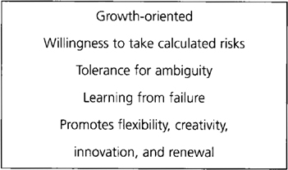
Entrepreneurial Mind-Set Attributes

Slide 17
Sources of Ideas for New Ventures
1. Work Experience
More than half of all ideas for new ventures emerge from the experiences entrepreneurs have working in the industry for employers.
The idea may grow out of observing what customers complain about or what is not yet available to them through the employer's firm or in the industry.
In your own work experience, you may recall thinking that there might be a different way of doing the work, selling the product, or performing the service.

Slide 18
2. Similar Business
Even if you don't have years of work experience in an industry or market, you might see a business in an area that intrigues you because you like certain products or you learn that there is a growing market for this business and you think of a way to expand on the opportunity.

Slide 19
3. Hobby or Personal Interest
Many people find a way to turn their hobbies into successful new ventures, seeing an opportunity to transfer their passion to others with similar interests.

Slide 20
4. Chance Happening, or Serendipity
“Name the greatest of all the inventors. Accident”—Mark Twain.
It was noted that successful entrepreneurs are alert and pay attention to things most people miss.
This increases the likelihood that a good idea or opportunity will not go unnoticed, even if it is a chance happening.
Learning to be observant to cues around them has led many entrepreneurs to discover products and services that arise out of the unexpected.

Slide 21
5. Family and Friends
Ideas can come to you through your conversations with your family and friends, and if you are open to these suggestions, a great business opportunity can result.

Slide 22
6. Education and Expertise
Entrepreneurs are able to identify ideas for new businesses by tapping their own expertise and experiences and offer products and services that others (either consumers or other businesses) are willing to buy.
Another way to use your expertise is to consider what you know rather than what you do as a source of business opportunities.

Slide 23
Which Came First—The Idea or the Ownership Decision?
In the nationwide Panel Study of Entrepreneurial Dynamics, 480 entrepreneurs were asked whether the business idea or the decision to start some kind of business came first. Here are the responses:
The business idea came first 35%
The decision to start a business came first 44%
The idea and the decision occurred simultaneously 20%

Slide 24
What Led to Your Business Idea?
It developed from another idea I was considering 24%
My experience in a particular industry or market 57%
Thinking about solving a particular problem 30%
Discussions with my family and friends 45%
Discussions with existing suppliers or distributors 13%
Discussions with potential or existing investors/lenders 8%
Knowledge or expertise with technology 28%

Slide 25
The entrepreneurs were also asked, “What led to your business idea?”
Work experience in a particular industry or market was the most frequently mentioned source of ideas, followed by discussion with family and friends.
The implication from this data is that there are multiple reasons for the new venture journey, and you can choose the reason that works for you.

Slide 26
The Opportunity SEARCH
The pathway to entrepreneurial opportunities can be described as a creative process that includes six distinct phases.
This approach is designed to help you learn how to more creatively develop and identify ideas that lead to viable new ventures.
The process uses the acronym SEARCH, which will help you remember the necessary steps through which you should proceed.
This process can be applied to ideas that are invented by entrepreneurs, are adapted from other businesses or processes, or that emerge from an analysis of market needs or problems.

Slide 27
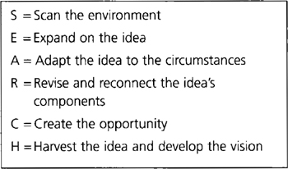
Opportunity SEARCH: A Creative Approach to New Venture Idea Generation

Slide 28
1. Scan the Environment (What trends, needs, or problems can be identified in the environment?)
Ideas for new ventures, or for new products, services, technologies, or business processes around which an entrepreneurial venture is built, emerge from a careful assessment of the external environment.
This assessment includes several components, along with some useful tools to help you ask the right questions and probe for the unexpected solutions, needs, problems, and opportunities in the environment.
The strategic management tool, TOWS (Threats, Opportunities, Weaknesses, and Strengths), which provides a different perspective from a traditional SWOT (Strengths, Weaknesses, Opportunities, and Threats) analysis, allowing the entrepreneur to design strategic solutions to the information discovered through the SWOT analysis.
As you immerse yourself in the environment of your new venture, be careful to notice the threats and opportunities presented by social, economic, political, legal, and other forces that influence what your new venture will be able to do.

Slide 29
Scan the Environment (cont.)
As you try to learn what there is to know about an industry and market that interest you, begin by collecting secondary information, using the Internet, industry research, trade associations, magazines, newsletters, and many other sources.
This is an excellent way to improve your observational skills, so that you can become a better trend-spotter, keeping your “finger on the pulse” of the industry and marketplace.
Thus, scanning the environment is based on effective perception and analysis. This is a very important point because if entrepreneurs used only market analysis results, or relied only on “what they already know (or think they know!),” many great ideas would remain untapped.

Slide 30
Scan the Environment (Example)
Why didn't Ford produce the first minivan?
The idea for the minivan originated at Ford Motor Company with Lee Iacocca and his engineer colleague, Hal Sperlich.
The idea was rejected by Henry Ford II because he believed it would not be a market success.
Remember, this was the Ford that had just produced the enormously successful Mustang, and the image of a sports car did not fit with a new “boxy” car designed for a family.
Iacocca and Sperlich left Ford after this dispute and went to Chrysler.
It's not an exaggeration to say that the Chrysler minivan was responsible for the company's survival during the downturn of the early 1980s.

Slide 31
Scan the Environment (Example 2)
Why wasn't Barnes & Noble the first to see the potential for on-line book retailing?
Jeff Bezos, founder of http://Amazon.com, saw the opportunity to provide books using technology that capitalized on the method of book distribution.
While Barnes & Noble developed an on-line presence, its core business focus at that time was its stores.
Furthermore, Amazon did not compete on price because other on-line booksellers, such as Barnes & Noble, offered prices comparable to (or even less than) Amazon’s.
What Amazon excels at is building and sustaining a relationship with customers.
When customers return to Amazon's site, they are greeted and offered recommendations based on their preferences.
The experience it has created is akin to walking into the bookstore and having your own salesperson greet you and make suggestions about what you might like.

Slide 32
2. Expand on the Idea
After you have collected information about the environment, you now know much more about the needs and problems encountered in the industry. This will help you build onto your original idea so that it is a better fit to the needs of the environment.
Using the method of divergent thinking, entrepreneurs amplify and elaborate on an idea, identifying what is good about it and enhancing these qualities.
To expand on your idea creatively, consider the following challenges:
- What need or problem can this idea resolve?
- What attributes would make this idea very attractive to the market? Are there any new market segments to which this idea might appeal?
- What experience can this idea create for customers? What is its potential value?
Original idea can expand to include additional, and unexpected solutions for customers.

Slide 33
3. Adapt the Idea to the Circumstances
Many new ventures are founded on the concept of adaptation: taking an idea that exists in some other form, or in some other industry or market, and applying it in a new way.
Adaptation is evolutionary in its approach, and entrepreneurs have successfully launched firms, or even discovered an entirely new application for something that already exists.
Adaptation comes from asking how ideas can be fitted to a new situation.
This relies on a creative process of generating alternative uses and applications.

Slide 34
4. Revise and Reconnect the Idea's Components
It involves revising it idea so that it contains greater potential value.
Entrepreneurs can anticipate and correct some of the weaknesses in the idea.
Some parts of the original idea may not work; others can be enhanced and refined.
Entrepreneurs can prevent some of what is called idea infatuation, a pitfall of the opportunity identification process
Most new products and services are not commercial successes until the second or even third revision.

Slide 35
5. Create the Opportunity
This involves obtaining an accurate understanding of how the intended market will use the idea to fill its need or solve its problem.
Gaining acceptance of the idea is a necessary step in developing the opportunity:
1. Understand your audience: What are the needs of your potential investors, customers, and employees? By framing your idea as a solution to a group's or organization's problem, you can create a potentially successful new venture opportunity.
2. Gain the support of your stakeholders: Entrepreneurs are the experts on their ideas. Without support of your stakeholders , good ideas will never be formed into new venture opportunities.
3. Evaluate the idea's feasibility: using models and methods to help you assess the potential value of the idea.

Slide 36
6. Harvest: Develop the Vision for Implementation
Harvesting the opportunity involves creating the vision for its evaluation and potential implementation.
It means considering what will happen if the idea is put into action.

Slide 37
Harvest: Develop the Vision for Implementation (Cont.)
Here are some key questions that should be asked as entrepreneurs complete the SEARCH process:
• What is the problem or need this opportunity intends to resolve or fill?
• What still needs improvement? evaluation of the opportunity should be designed to provide the information needed for improvement.
• What obstacles does the entrepreneur anticipate?
• What does the entrepreneur want to become known for?
• If the opportunity is harvested, what difference can the new venture make for its intended market?

Slide 38
The Proactive Personality
Do successful entrepreneurs possess the ability to search for and find opportunities more readily than other people?
defined as the capability of acting in such a way as to influence change in the environment.
“scan for opportunities, show initiative, take action and persevere until they reach closure by bringing about change”.

Slide 39
The Proactive Personality
Explain the importance of the proactive personality and prospector strategy in supporting innovative activities in new ventures?
Proactive owners tended to employ a prospector strategy, in which they search the marketplace for new products, services, and technologies.
They are the creators of change in their industries, relying on environmental scanning and long-range forecasting to help them identify new opportunities critical to their success.

Slide 40
Proactive entrepreneurs are opportunistic, and by using a prospector strategy, they were able to:
- engage in innovative targeting (e.g., new or improved products, venturing into new markets, using new channels of distribution),
- developing innovative systems for their organizations (e.g., new ways of organizing or managing), and
- creating innovative boundary supports (new methods of financing, integrating new information technology).

Slide 41
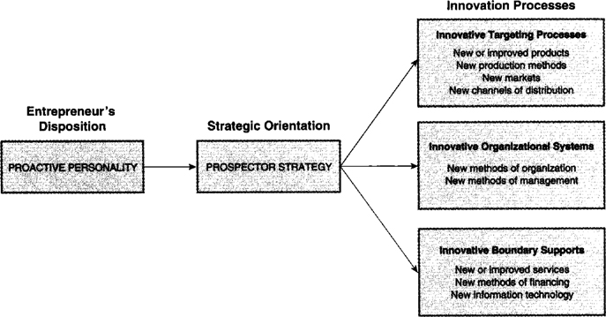
Proactive Entrepreneur Personality, Prospector Strategy, and Innovations

Slide 42
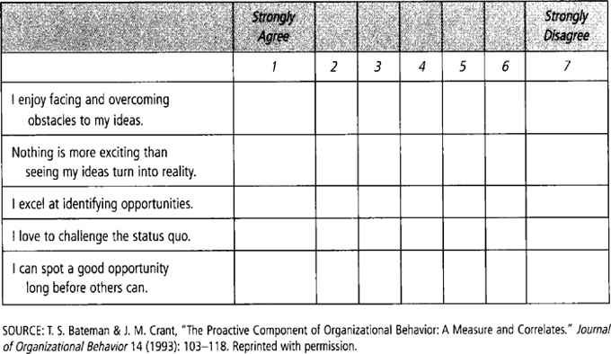
Use the following scale to assess your own degree of proactivity

Slide 43
Building Entrepreneurial Culture to Support Creativity & Innovation
Innovative organization does not automatically develop out of an innovative business idea or opportunity.
Entrepreneurs have to model creative leadership, deliberately set expectations, and reinforce them to the stakeholders of the new venture.

Slide 44
New ventures are founded on creativity, but many lose their creative edge as the firm continues.
It is important to found the firm on core values that support innovative behavior.
To build a new venture culture that embraces creative thinking and behavior, entrepreneurs must institute a set of norms that reinforce curiosity, experimentation, and learning.
A prohibitive culture is one that keeps ideas and opportunities from emerging and being put into practice.
An inquisitive culture is one that seeks to discover what's right about new ideas and concepts.

Slide 45
Prohibitive Versus Inquisitive Culture
Prohibitive Culture | Inquisitive Culture
Allow only formal meetings and interactions: Ideas are shared at scheduled times | Encourage informal meetings and conversations: Ideas are shared anywhere, anytime
Expect and reward only success | Recognize and reward “nice tries”
Encourage your team or your employees to hold knowledge closely | Encourage your team or employees to share knowledge freely
Frown on risk taking | Value risk taking and experimentation
Reinforce behaviors that uphold tradition: “We've always done it this way” | Reinforce behaviors that question tradition: “Why do we always do it that way?”
Closely monitor the work and time of others: Don't trust them, they will slack off | Allow others to perform their work the way they believe is best: Trust in their expertise
Encourage interaction with insiders only | Encourage interaction with customers and others outside your organization
Focus on internal processes and short-term performance | Focus on external changes and long-term performance

Slide 46
Recap
Role of creativity to identify opportunities
3 innovative strategies to identify opportunities
Entrepreneurial mind-set to recognize opportunities
Model of opportunities identification
Sources of ideas & opportunities
SEARCH process
Entrepreneurial culture

Slide 47
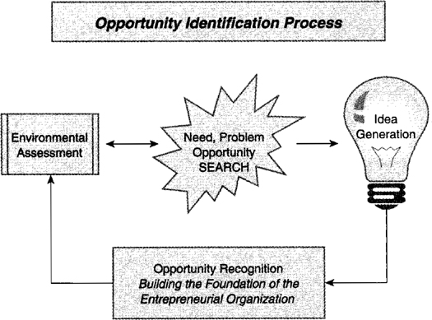

Slide 48
Summary
1. Understand the role of creative thinking and behavior as entrepreneurs discover and refine entrepreneurial opportunities
• Creativity is the generation of novel and useful ideas. Entrepreneurs use creativity to generate ideas for new products and services, to identify markets for them, to determine how to
implement the ideas, to persuade investors and other stakeholders of the value of the ideas, and to retain the entrepreneurial culture necessary for innovation as the firm grows.
• Opportunity recognition is one of the most basic entrepreneurial behaviors.
2. Know the three strategies for innovation available to entrepreneurs
• Imitative strategies take an idea that somebody else has already discovered and build a business around that idea.
• Evolutionary strategies take an idea and offer a way to do something slightly different than it is done now.
• Revolutionary innovation strategies reject existing ideas and present a way to do things that is radically different.

Slide 49
Summary
3. Enhance the entrepreneurial mind-set necessary to recognize opportunities
• Entrepreneurial alertness means that entrepreneurs have a special set of observational and thinking skills that help them identify good opportunities.
• Among some of the most common characteristics successful entrepreneurs share is the ability to embrace risk and cope with ambiguity in the face of uncertainty and change.
4. Use the model of opportunity identification, including:
scanning the environment; discovering needs, problems, and opportunities in the industry and marketplace; and generating ideas for new products, services, technologies, and processes.
Begin by scanning the environment, leading to the emergence of needs, problems, and opportunities. Generate ideas that can solve problems or capitalize on opportunities.

Slide 50
Summary
5. Learn the sources of ideas and opportunities for new ventures
• Ideas for new business come from a variety of sources, including work experience (the most common source), observation of a similar business, hobbies or personal interests, a chance happening, discussions with family and friends, and sales education and experience.
• A majority of entrepreneurs who have been included in studies knew they wanted to start a business and were highly motivated to find business ideas.

Slide 51
Summary
6. Learn and conduct the Opportunity SEARCH process for idea generation.
• Scan the environment: What trends, needs, or problems can you observe and learn about?
• Expand on the idea: Use divergent thinking to ask how your idea could be built upon, appeal to a new market segment, or add value in new ways.
• Adapt the idea to the circumstances: What alternate uses or applications of your idea are possible? How can it be fitted to new situations?
• Revise and reconnect the idea's components: Use experimentation and trial-and-error to refine your idea and make it better.
• Create the opportunity: How will your stakeholders use the idea? Can it be turned into an opportunity to solve their problems and fill their needs? Do you have support?
• Harvest the idea and develop the vision: Build the vision for implementing the opportunity. What still needs improvement? What obstacles do you anticipate? What do you hope to learn through evaluation of the opportunity and early testing of its feasibility?

Slide 52
Summary
7. Build an entrepreneurial culture that supports creativity and innovation
• Entrepreneurs set the culture of their organization and determine whether it embraces change, experimentation, and creativity.
A prohibitive culture is one that keeps ideas and opportunities from emerging and being put into practice.
An inquisitive culture is one that seeks to discover what's right about new ideas and concepts.

Slide 53



Thank You

