Slide 1


Entrepreneurship
Prepared by Dr. Thana Ahmed
Lecture 1
The Foundations of Entrepreneurship

Slide 2
Chapter
01
Learning Objectives
Define entrepreneurship and its role in business around the world.
1
Describe the entrepreneurial profile.
2
Describe the benefits of entrepreneurship.
3
Describe the drawbacks of entrepreneurship.
4
Explain the forces that are driving the growth of entrepreneurship.
5

Slide 3
Chapter
01
Learning Objectives
Explain the cultural diversity of entrepreneurship.
1
Describe the important role that small businesses play in nations’ economy.
2
Put failure into the proper perspective.
3
Explain how an entrepreneur can avoid becoming another failure statistic.
4
6
7
8
9

Slide 4

Introduction
Entrepreneurship has become increasingly important for businesses of all sizes around the world.
It opens new opportunities and possibilities for the businesses to create values for themselves and for the society at large.
Despite its popularity, studies suggest that the scope of entrepreneurship remains unknown, and therefore the prospects of entrepreneurial activities remains not fully realised.
This chapter highlights some aspects concerning the concept of entrepreneur, entrepreneurship, entrepreneurial process and finally the entrepreneurship opportunities and challenges.

Slide 5

Introduction
Entrepreneurs have always been present, however their behavioural patterns were different in different periods of time.
The word entrepreneur was derived from the French word “entreprendre”, which means “to undertake” (Kuratko, 2016).
The usage of the term entrepreneur can be traced from 1755, wherein an entrepreneur was described to “buy the country produce from those who bring it or to order it to be brought on their account. They pay a certain price to resell wholesale or retail at an uncertain price” (Cantillon, 1931, p.51; Hamilton & Harper, 1994).
Entrepreneur from the very beginning, was principally an independent speculator of the commodity (Hamilton & Harper, 1994).

Slide 6



What is entrepreneurship?
Entrepreneurship
The process of designing, launching and running a new business, which typically begins as a small business, such as a startup company, offering a product, process or service for sale or hire.

Slide 7

Definition of Entrepreneurship
“Entrepreneurship is the creation of organisations. In behavioural approaches to the study of entrepreneurship, an entrepreneur is seen as a set of activities involved in organisation creation, while in trait approaches an entrepreneur is a set of personality traits and characteristics” Gartner (1988, p.11)

Slide 8

What Is an Entrepreneur?
Entrepreneur:
  One who creates a new business in the face of risk and uncertainty for the purpose of achieving profit and growth by identifying opportunities and assembling the necessary resources to capitalize on them.

Slide 9

Other definitions of entrepreneur
To date, several definitions have been penned to describe an entrepreneur. And some of them are mentioned herewith:
“Entrepreneur is someone who manages all the necessary resources to produce and market a product which responds to the market scarcity “(Leibenstein, 1968; Bull & Willard, 1993).
“Entrepreneurs are individuals who recognize opportunities where others see chaos contradiction, and confusion. They are aggressive catalysts for change within the marketplace” Kuratko (2016, p.3)
“Entrepreneur is the person who carries out new combinations, causing discontinuity. The role is completed when the function is completed. The person may be an employee with an existing organization or may start a new venture. An investor per se only risks capital for a return.” Bull & Willard (1993, p. 186)

Slide 10

Case study: Rent the Runway
Jenn Hyman came up with the idea for a designer clothing rental business, Rent the Runway after she witnessed one of her sister’s “closet full of clothes, but nothing to wear” moments
When she returned to school, she shared her idea with a suitemate, Jenny Fleiss, and the two collegiate entrepreneurs launched the company that rents high-end, designer clothing, accessories, and jewelry to customers at a fraction of the regular retail price.
To test their business model, they used their savings to purchase 100 dresses and set up a pop-up shop on campus that proved to be a hit. The shop’s success convinced the entrepreneurial pair that their business idea was valid and led them to conduct focus groups with more than 1,000 women, which gave them valuable insight into refining their business model and pricing strategy.

Slide 11

Case study: Rent the Runway
Since starting Rent the Runway in 2009, Hyman and Fleiss have raised nearly $55 million of venture capital firms and assembled an inventory of tens of thousands of dresses from more than 170 designers, such as Nicole Miller, Vera Wang, Versace, and Dolce and Gabbana.
Customers go online, select the dress they want, enter their size (a backup size comes free), and specify the rental date; returns are as easy as dropping the dress into a prepaid return envelope. Rent the Runway, which became cash-flow positive in less than one year, has more than 3 million members, and financial experts estimate its value at $240 million.
“We deliver Cinderella moments,” says Hyman.

Slide 12
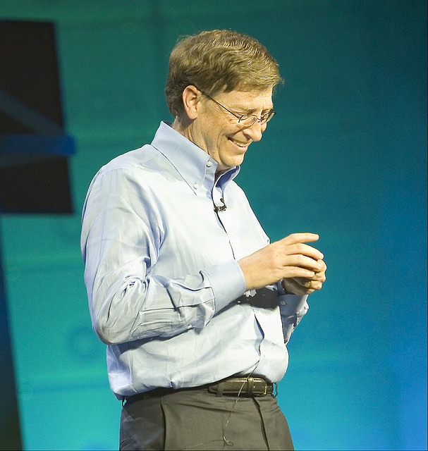
Characteristics of an Entrepreneur
Entrepreneurs are vision-oriented people
Entrepreneurs have a high need in achievement
Entrepreneurs do not rely on fate or luck, however they try to control their own lives
Entrepreneurs undertake moderate risks, which is why they look for high earning on their investments
Entrepreneurs have the abilities to deal with several ambiguous situations in their ventures. They face these ambiguous situations and circumstances regularly because they do certain jobs and tasks which are entirely new by nature.
Entrepreneurs have the tendency to be productive and efficient with in a given period of time. However, at times, they might be seen as inflexible individuals in team-work.

Slide 13
Characteristics of Entrepreneurs
Desire for responsibility
Preference for moderate levels of risk: risk eliminators
Self-reliance
Confidence in their ability to succeed
Determination
Desire for immediate feedback
High level of energy
Future orientation
    Opportunity entrepreneurs
    Necessity entrepreneurs
    Serial entrepreneurs
Skilled at organizing
Value achievement over money

Slide 14
Characteristics of Entrepreneurs
Entrepreneurs tend to exhibit:
  A high degree of commitment
  Tolerance for ambiguity (غموض)
  Creativity
  Flexibility
  Resourcefulness
  Bootstrapping is a strategy that involves conserving money and cutting costs during start-up so that entrepreneurs can pour every available dollar into their businesses
  A willingness to work hard
  Tenacity (الاصرار والعناد)

Slide 15
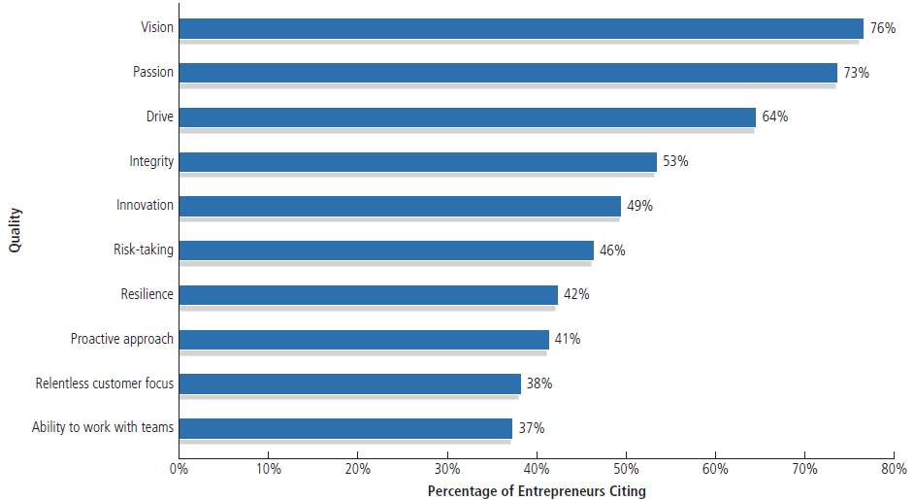
Most Important Qualities of an Entrepreneur
الشغف
المرونة
الاستباقية
متصلب الرأي
Notes:
No single set of characteristics describes successful entrepreneurs. Anyone can become an entrepreneur.

Slide 16

AL BAIK CASE STUDY
In September 1974, the late Shakkour AbuGhazalah renovated an old warehouse he was renting and opened the first pressure fried chicken restaurant in the Kingdom of Saudi Arabia. It was located on Old Airport Road, in Jeddah. The concept was new to the area, and business was slow at the beginning. He was serving not more than 100 customers per day during the first 90 days after opening. Within one-year, long lines were starting to form outside his restaurant and there was no looking back.In 1984, and after three years of extensive research, the 18 secret herbs and spices recipe was successfully developed. In 1986, Albaik was registered as a trademark in Saudi Arabia.

Slide 17
Characteristics of Entrepreneurs
Opportunity entrepreneurs: start businesses because they spot an opportunity in the marketplace.
Necessity entrepreneurs: start businesses because they cannot find work any other way.
Serial entrepreneurs: repeatedly start businesses and grow them to a sustainable size before striking out again.

Slide 18
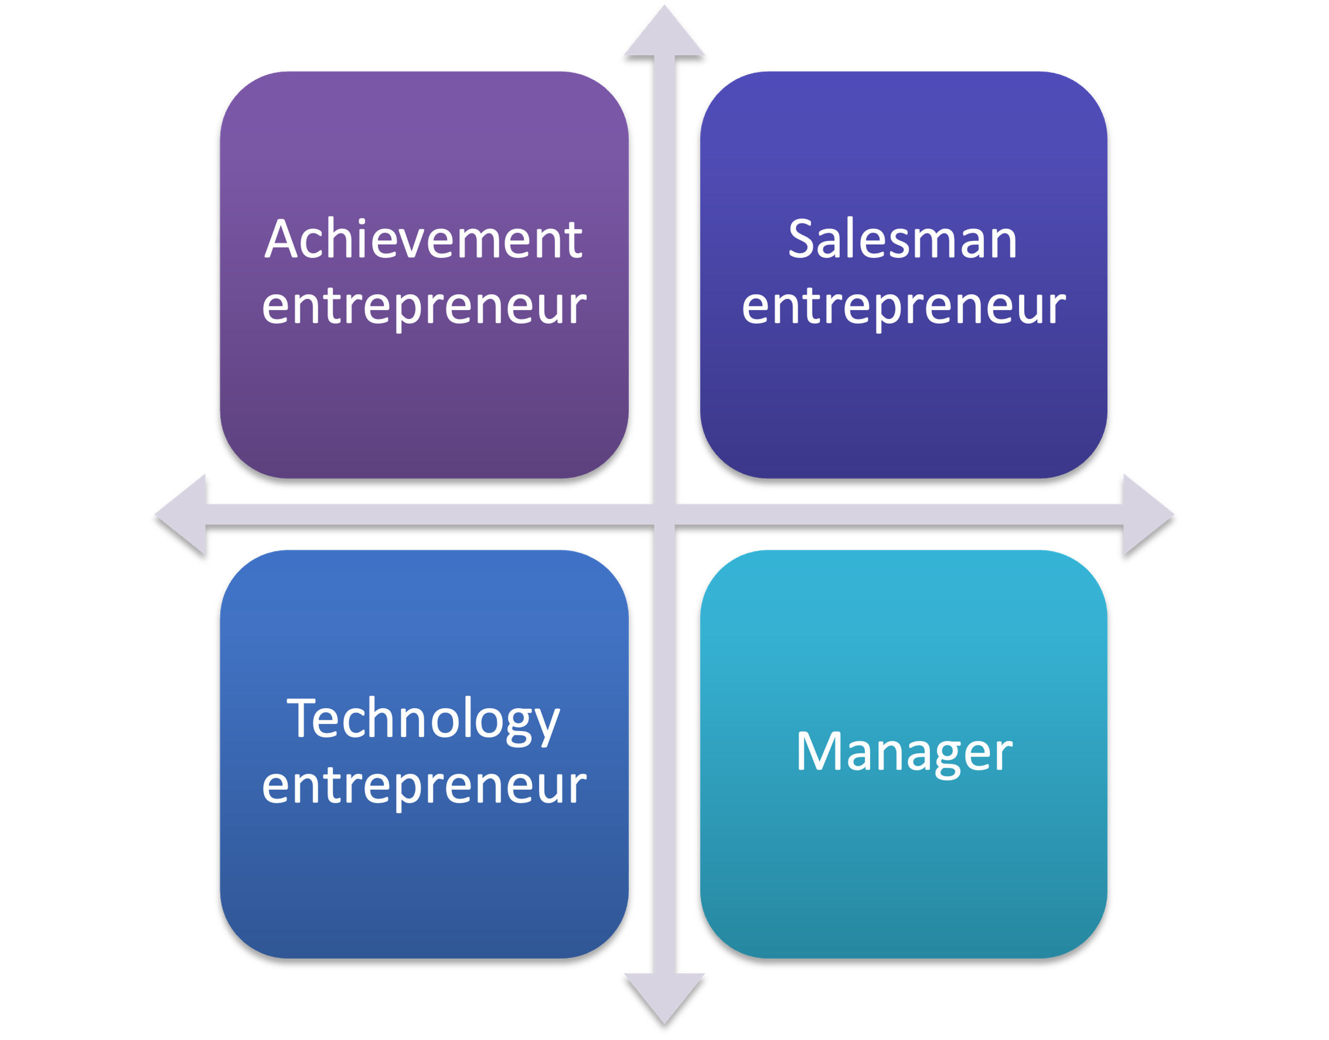
Types of Entrepreneurship
There are generally four entrepreneurial types:
Source: Adapted from Carsrud & Brannback, 2007)

Slide 19

Types of Entrepreneurship
Achievement entrepreneur
Primarily associated with the desire to achieve.
These types of individuals are usually having an enormous amount of energy and capabilities to take charge.
They take initiatives and do not wait for things to happen.
They often possess the leadership qualities and have a great sense of commitment and responsibility in their ventures.
These types of individuals are good in several in several business related aspects and they try to accomplish their objectives, whilst heading their missions. (Carsrud & Brannback, 2007).

Slide 20

Types of Entrepreneurship
Salesman entrepreneur:
These individuals possess skills to interact with people and have very good soft side of the management aspects.
These people are typified for having the feelings of the consumers’ needs and wants.
They usually use the soft sales approach whilst pursuing the growth of their ventures.
They have enormous talent for connecting with people and spend most of their time in marketing their products/services and permit other people to manage their businesses.
These individuals therefore devote their time to understand who and how are the consumers in the market.
They develop a proper vision for marketing and sales practices to reach wider consumer groups. (Carsrud & Brannback, 2007).

Slide 21

Types of Entrepreneurship
Technology entrepreneur:
Individuals belong to this category, are generally idea developers.
These individuals often possess great ideas
They have the capabilities to develop innovative processes and invent novel products or services for niche markets.
As these individuals possess qualities to create several ideas they have a good analytical intelligence and take calculated risks in their ventures
Although these individuals possess good analytical intelligence to make way through several situations, however, at times their missions can become a bit idealistic. (Carsrud & Brannback, 2007).

Slide 22

Types of Entrepreneurship
Manager:
These types of individuals possess the qualities of taking charge of the missions.
Individuals belonging to this type of entrepreneurship are very competitive by nature but not as co-operative as one would expect in a team work.
They are usually found to take positions of high authority, such as external investors or sometimes act as board of directors.
They prefer to work in larger organisations than small entrepreneurial businesses.
They seek comfort in making effective marketing strategies, but not necessary selling products or services.
Their ways to sell are different, they employ logic and carefully thought persuasions, as mechanisms to sell their ideas.
They have rich experiences, strong management skills and possess strength in managing existing businesses (Carsrud & Brannback, 2007).

Slide 23
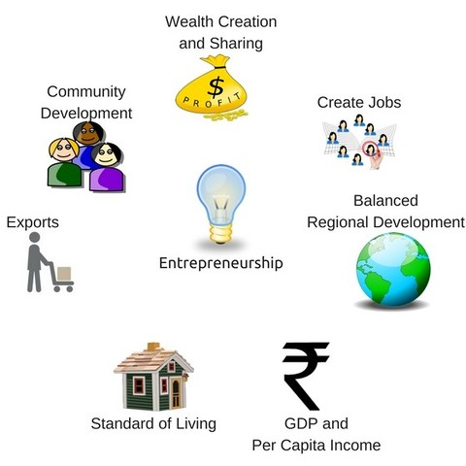
Entrepreneurship and economic development
In the modern day markets, the term entrepreneur has been closely linked with economic development.
An economic development can emerge due to several reasons, which includes:
  the launch of new source of procurement for raw materials or materials
  the introduction of a new production mechanism
  the introduction of a new quality of product, or a novel product
  the opening of new market
  the re-organisation of a business.
The management of all these aspects are carried by an enterprise, and the people whose functions are to carry out these activities are called entrepreneurs (Bull & Willard, 1993)

Slide 24

The World of the Entrepreneur
Every month U.S. entrepreneurs launch 514,000 new businesses (One reason the U.S. economy has been so successful over time ).
GEM study: 12.7% (one in eight people) of adult population in the United States is actively involved in trying to start a new business.
Notes:
GEM= Global Entrepreneurship Monitor

Slide 25


Global Entrepreneurship Monitor (GEM):
  A global study conducted by a consortium of universities
  It aims to analyze the level of entrepreneurship occurring in a wide basket of countries.
  It measures entrepreneurship through both surveys and interviews to field experts , conducted by the teams of each country.

Slide 26
Entrepreneurial Activity across the Globe
The Total Entrepreneurial Activity Index (TEA index) is the sum of the number of persons starting a business (starting entrepreneurs) and the number of owners of businesses that were established less than 3.5 years before the reference date (young entrepreneurs), as a percentage of the labor force.
The TEA is an index for the degree of new entrepreneurship by country and is calculated as the percentage of people who undertake such activities in comparison to the labor force (population aged 18-64 years)

Slide 27

Entrepreneurship in KSA

Slide 28
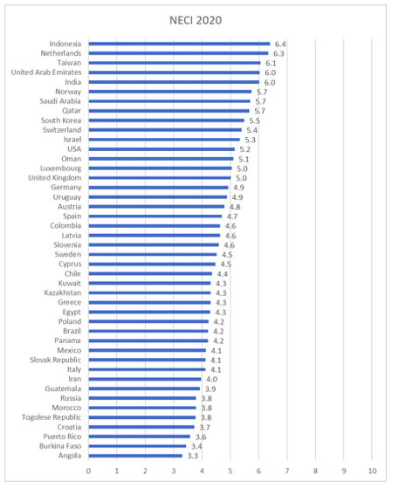
Entrepreneurship activities across the Globe

Slide 29
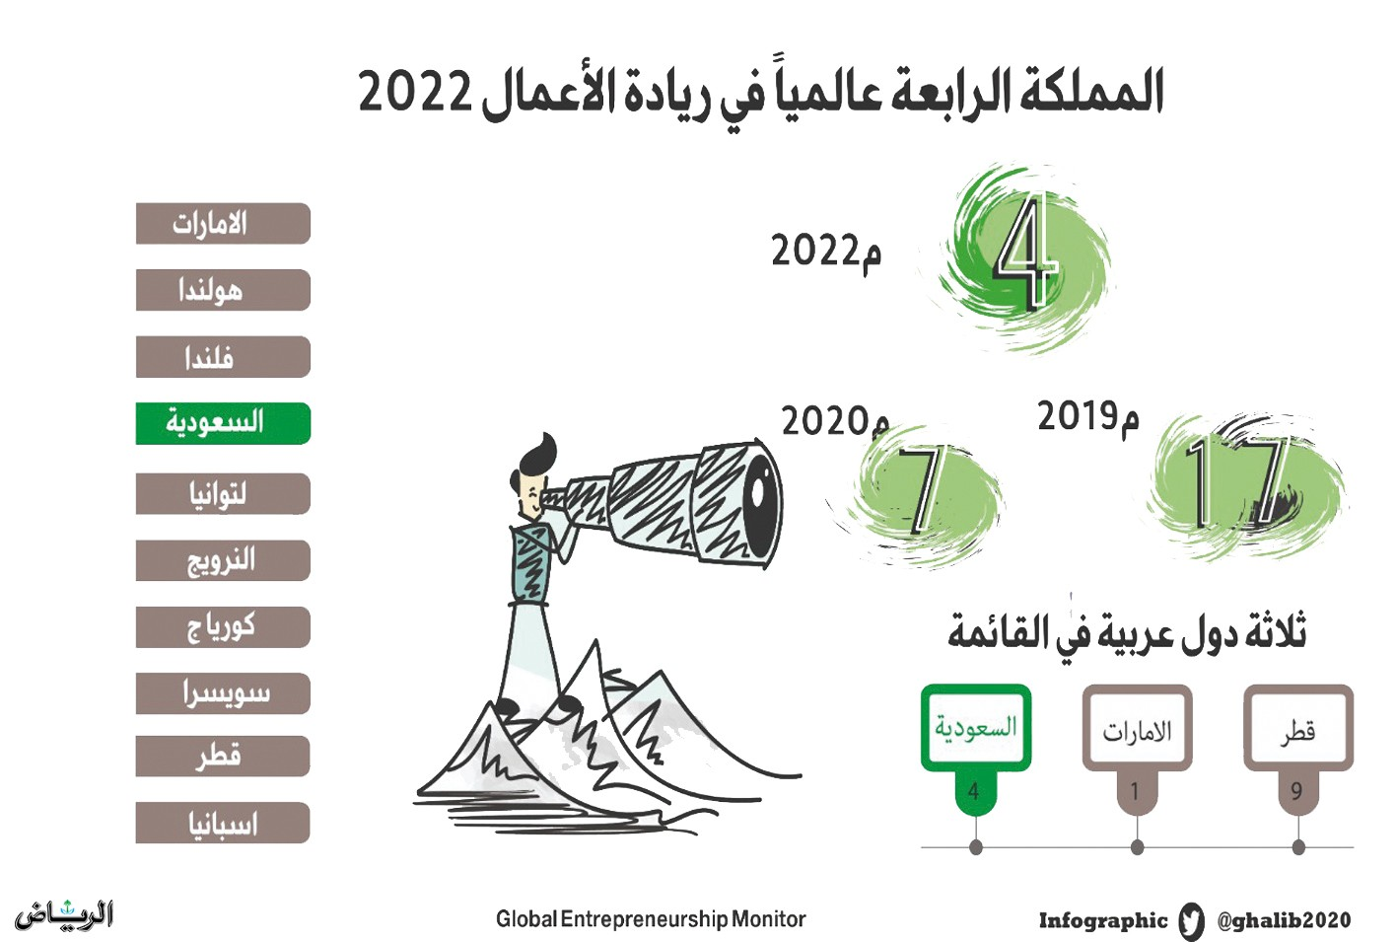

Slide 30
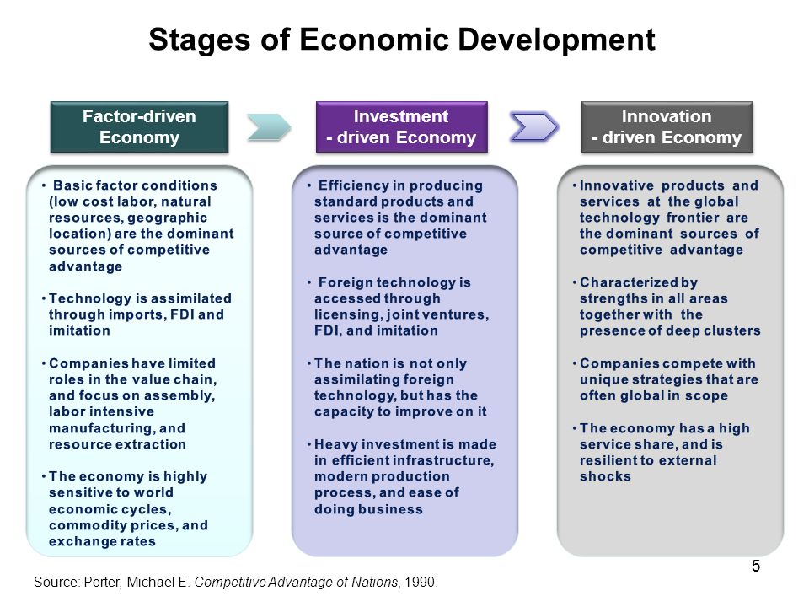


Slide 31

Stages of Economic Development
Factor-driven economy:
Countries compete primarily on the use of unskilled labor and natural resources and companies compete on the basis of price as they buy and sell basic products or commodities.
Examples: Egypt, Algeria, Palestine, Pakistan

Slide 32

Stages of Economic Development
Efficiency-driven economy:
Growth is based on the development of more efficient production processes and increased product quality.
Examples: Croatia, Brazil, China, Russia, Tunisia

Slide 33

Stages of Economic Development
Innovation-driven economy:
Companies compete by producing and delivering new and different products and services by using the most sophisticated processes.
Examples: USA, United Kingdom, Japan, Republic of Korea.

Slide 34

Benefits of Entrepreneurship
The opportunity to:
  Create your own destiny.
  Make a difference.
  Reach your full potential.
  Reap (يجني) impressive profits.
  Contribute to society and to be recognized for your efforts.
  Do what you enjoy and to have fun at it.

Slide 35
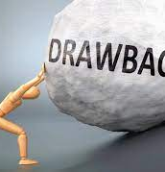
Drawbacks of Entrepreneurship
Uncertainty of income
The entrepreneur is the last one to be paid, as employees must be paid first
Risk of losing your entire investment
Long hours and hard work
Lower quality of life until the business gets established
High levels of stress

Slide 36
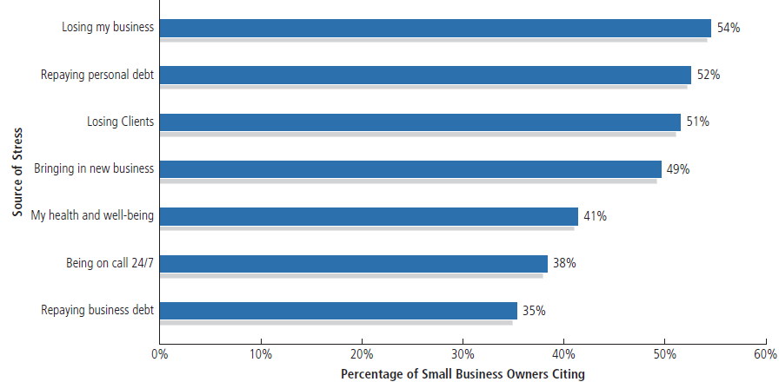
Sources of Stress for Entrepreneurs
Notes:
Starting and managing your own business can be a very rewarding experience, but it can also be highly stressful!

Slide 37
Demographic and environmental factors
Many people start their business in age of 24-44.
Entrepreneurs as heroes
Economic growth that spanned most of the 80s created significant amount of wealth among people of this age group and many business opportunities.
Shift to a service economy
In US service sector (low start-up cost) produce 80% of the jobs and 64% of GDP (Gross Domestic Product): a monetary measure of the market value of all final goods and services produced in a period (quarterly or yearly). Used to determine the economic performance of a whole country or region, and to make international comparisons.

Slide 38
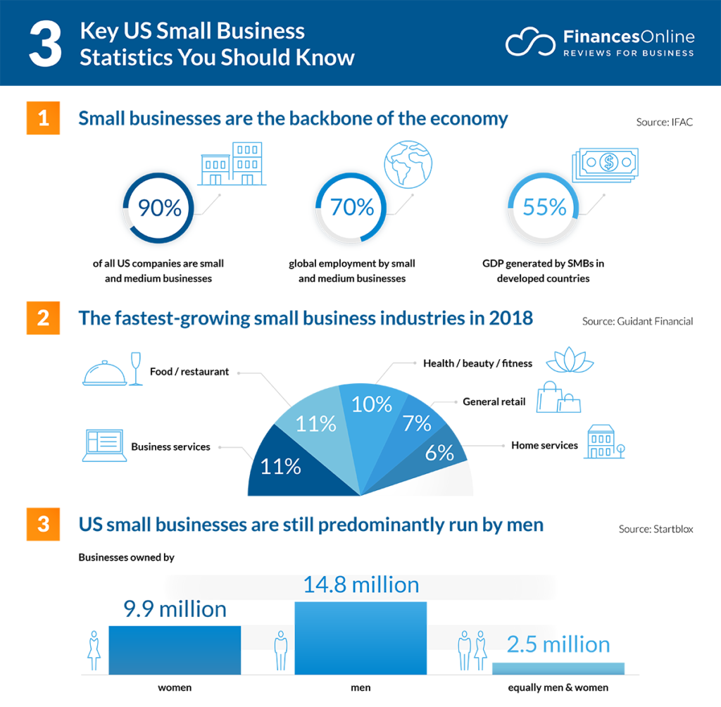
Demographic and environmental factors

Slide 39
Demographic and environmental factors
Technology advancements: Technology has changed the ways to do business, such as computers, voice mail, e-commerce, fax,…..
Independent lifestyle
The Internet (www), cloud computing, and mobile marketing. Cloud computing: Internet-based subscription or pay-per-use software services that allow business owners to use a variety of business applications, from database management and inventory control to customer relationship management and accounting.
International opportunities

Slide 40

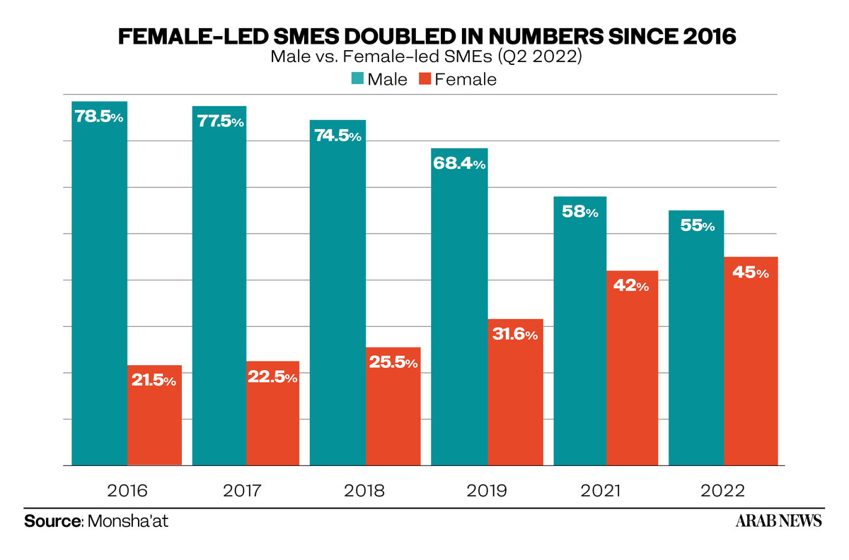
The Cultural Diversity of Entrepreneurship
Young entrepreneurs
Women entrepreneurs
Minority-owned enterprises
Immigrant entrepreneurs
Part-time entrepreneurs

Slide 41

Women-Owned Businesses
In its bid to fulfill Vision 2030, the Kingdom of Saudi Arabia has been encouraging more women to join the workforce and take up leadership roles. Hence, it should come to no surprise that commercial registrations by woman had jumped to 112% over the past six years.
Indeed, in 2021, it was revealed that the Kingdom's ministry of commerce had issued a total of 139,754 commercial records. In contrast, there were just 65,912 records in 2015. The total number of commercial registrations were said to have reached 817,930. In fact, the record numbers are an indication of just how much women are now part of the workforce across the Kingdom. According to statistics by Brookings, women only made up around 15% of the workforce in 2014, with that number jumping to around 33% by 2020.
https://www.abouther.com/node/46931/people/features/112-increase-commercial-registrations-saudi-women-over-last-six-years

Slide 42
The Cultural Diversity of Entrepreneurship
Home-based businesses
Family businesses
Copreneurs: entrepreneurial couples who work together as co-owners of their businesses.
Corporate castoffs
Corporate dropouts
Retiring baby boomers

Slide 43
The Cultural Diversity of Entrepreneurship
Corporate castoffs:
Those individuals who are unemployed and are highly educated and skilled and had corporate executive jobs.
Corporate dropouts:
Executives who leave the corporate to pursue their own dreams and aspirations by starting their own businesses.

Slide 44
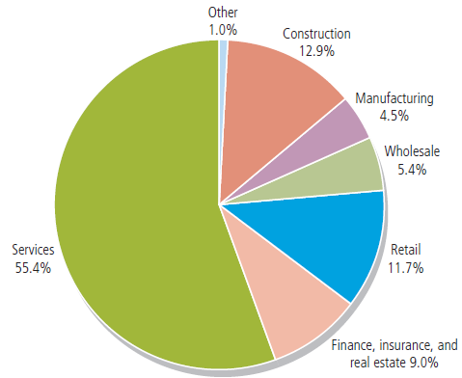
Small Businesses by Industry
Notes:
The majority of small businesses are concentrated in the service, construction, and retail industries.

Slide 45
Enrepreneurship Process
Identify an opportunity
Establish a vision
Persuade others
Gather resources
Create new venture, product or market
Change/adapt with time
The process of entrepreneurship can be observed through the six-stage process:
Source: Lall & Sahai (2007, p.16)

Slide 46
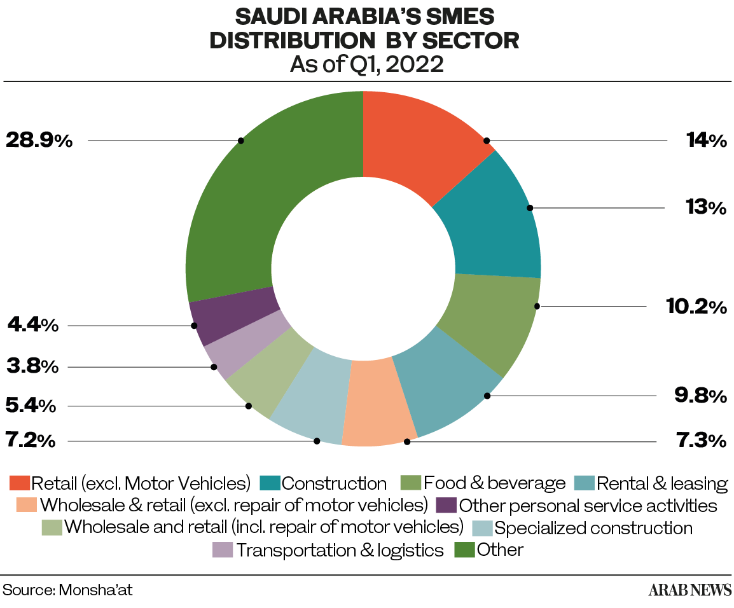
The Power of Small Businesses
Small businesses (employs less than 100 people)

Slide 47

The Power of Small Businesses
  Small businesses:
    Produce 46% of the US nation’s private GDP.
    Account for 47% of business sales.
    Create 16 times more patents per employees than large companies.

Slide 48
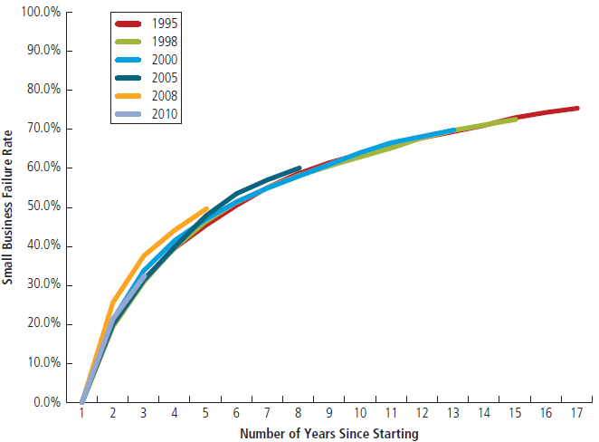
Putting Failure into Perspective
Entrepreneurs are not paralyzed by the prospect of failure.
Failure: a natural part of the creative process.
Successful entrepreneurs learn to fail intelligently.

Slide 49

Avoiding the Pitfalls of Small Business Failure
Know your business in depth
Build a viable business model – and test it
Develop a solid business plan
Understand financial statements
Manage financial resources
Learn to manage people effectively
Set your business apart from the competition
Maintain a positive attitude

Slide 50
Avoiding the Pitfalls of Small Business Failure
Management mistakes
Lack of experience
Poor financial control
Weak marketing efforts
Failure to develop a strategic plan
The Ten Deadly Mistakes of Entrepreneurship:
  Uncontrolled growth
  Poor location
  Improper inventory control
  Incorrect pricing
  Inability to make the “entrepreneurial transition”

Slide 51

Entrepreneurs:
      Are an important part of the free enterprise system
      Are a diverse and talented group of people
      Represent a cross-section of society as a whole
      Are able to enhance the profitability of their businesses through acquiring additional knowledge and experience

Slide 52


