Slide 1

Mathematics
Prepared by Dr.Israa Lewaa
Lecture 2
MAT 112
Exponential ang Logarithmic Functions

Slide 2
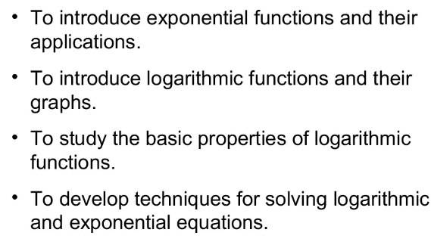

Lecture
02
Chapter Objectives

Slide 3
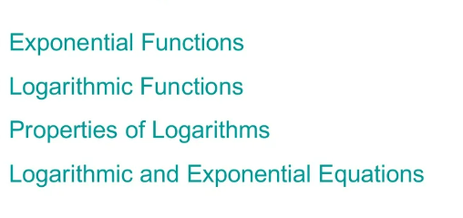
Lecture
02
Chapter Outline

Slide 4
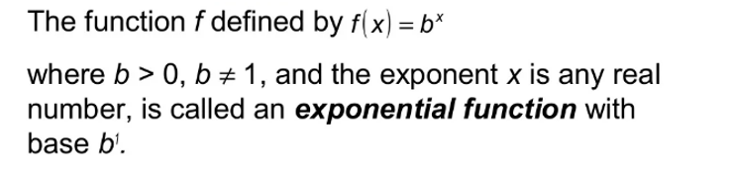
Lecture
02
1. Exponential Functions

Slide 5
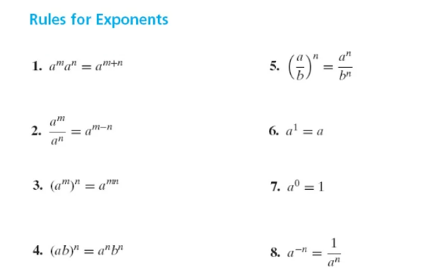
Lecture
02
1. Exponential Functions

Slide 6
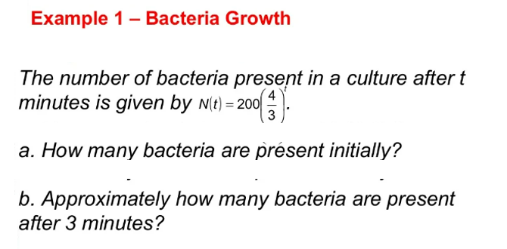
Lecture
02
Example

Slide 7
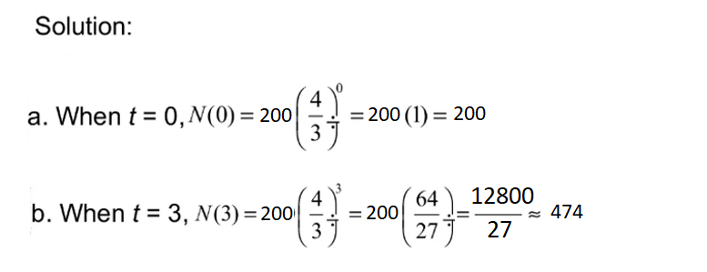
Lecture
02
Solution

Slide 8
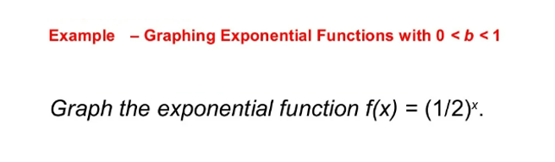
Lecture
02
Example

Slide 9
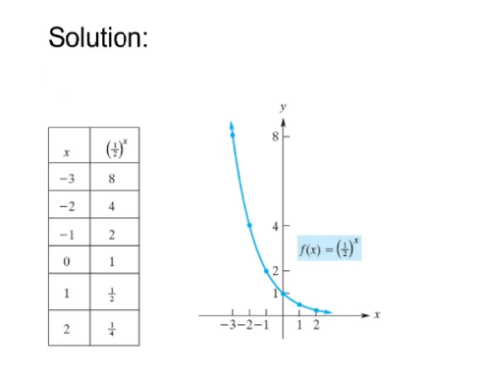
Lecture
02
Example

Slide 10
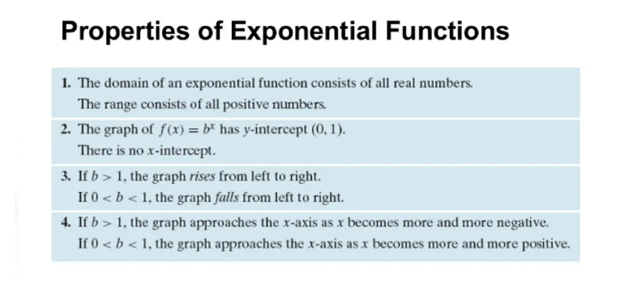
Lecture
02
Properties of Exponential Functions

Slide 11
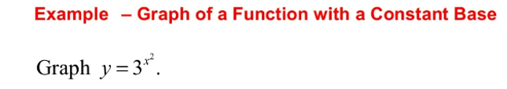
Lecture
02
Example

Slide 12
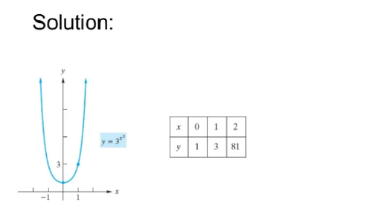
Lecture
02
Solution

Slide 13
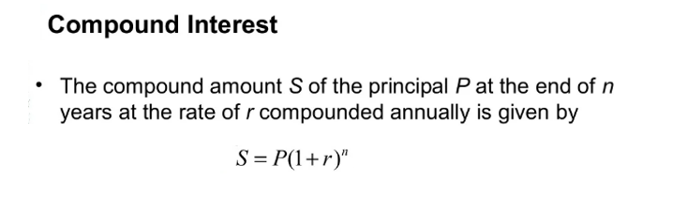
Lecture
02
Compound Interest

Slide 14
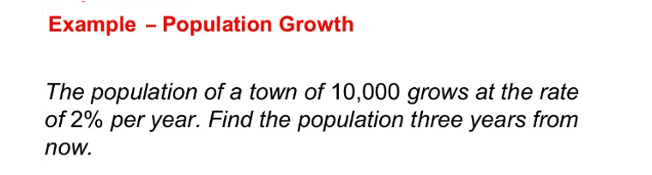
Lecture
02
Example

Slide 15
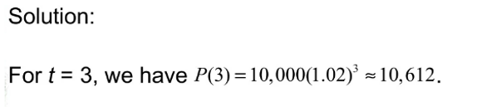
Lecture
02
Solution

Slide 16
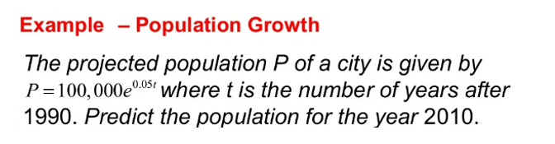
Lecture
02
Example

Slide 17
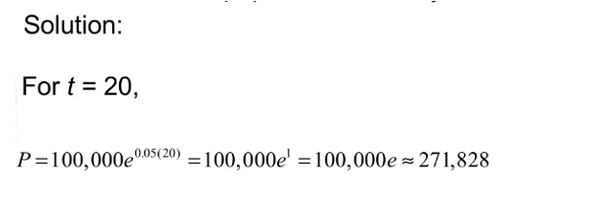
Lecture
02
Solution

Slide 18
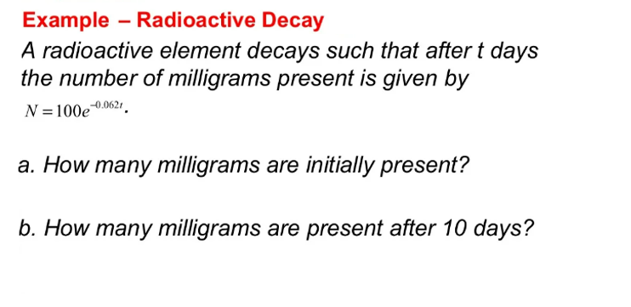
Lecture
02
Example

Slide 19
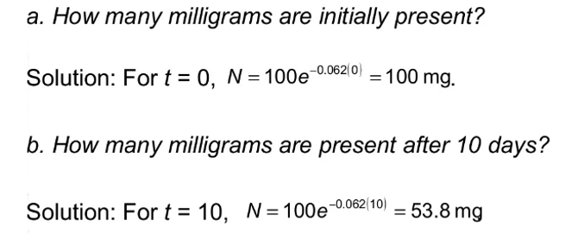
Lecture
02
Solution

Slide 20
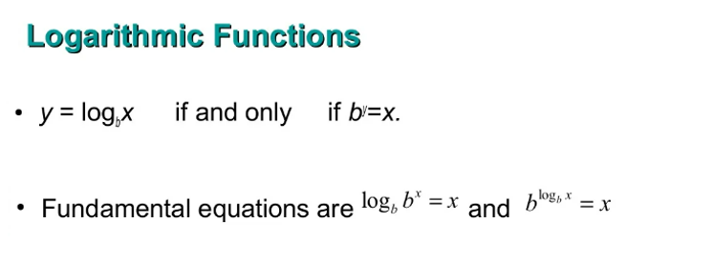
Lecture
02
Logarithmic Functions

Slide 21
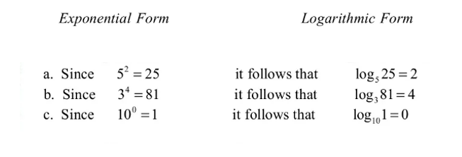
Lecture
02
Converting from Exponential to Logarithmic form

Slide 22
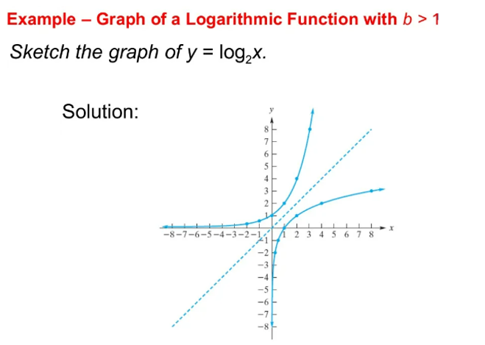
Lecture
02
Example

Slide 23
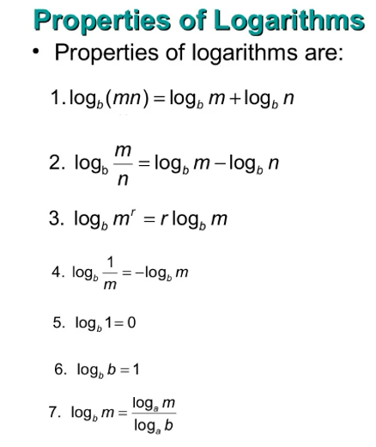
Lecture
02
Properties of Logarithms

Slide 24
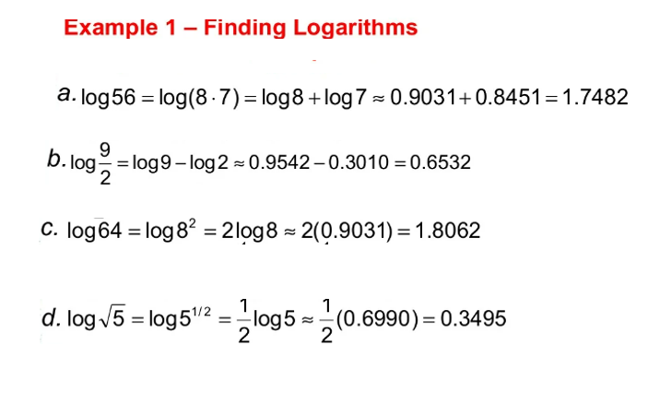
Lecture
02
Example

Slide 25
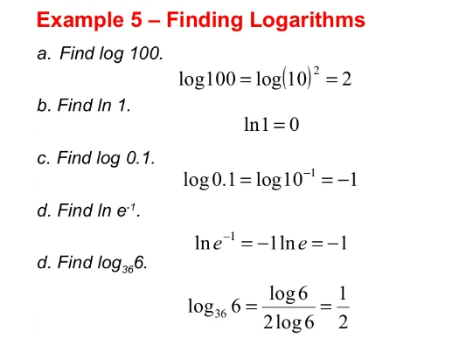
Lecture
02
Example

Slide 26
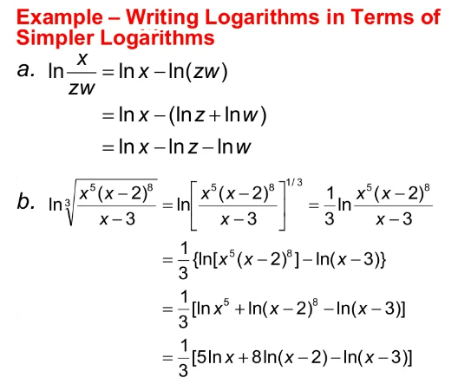
Lecture
02
Example

Slide 27
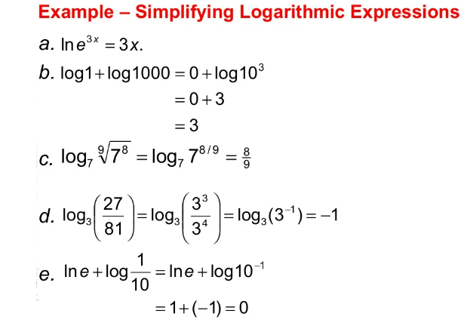
Lecture
02
5. Graphs in Rectangular coordinates

Slide 28
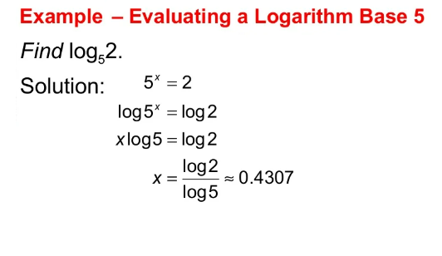
Lecture
02
Example

Slide 29
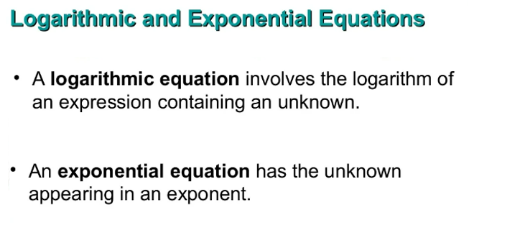
Lecture
02
Logarithmic and Exponential Equations

Slide 30
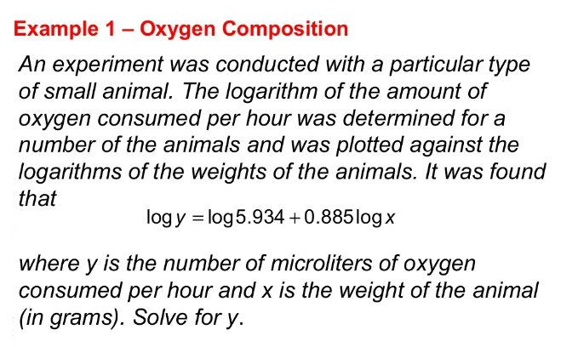
Lecture
02
Example

Slide 31
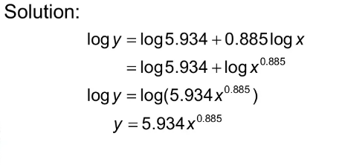
Lecture
02
6. Symmetry

Slide 32
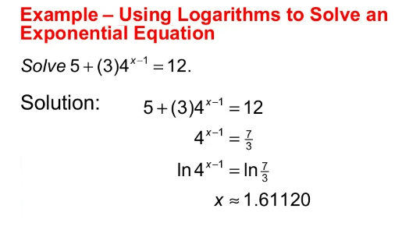
Lecture
02
Example 5

Slide 33
Lecture
02
Example
Find y
Log (y) = 2 log (5) + 3 log (x)

Slide 34
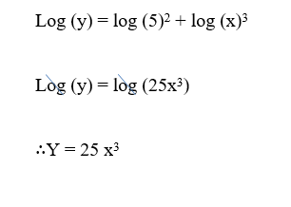
Lecture
02
Solution

Slide 35

Lecture
02
Chapter Summary
How to graph Exponential Functions

Slide 36
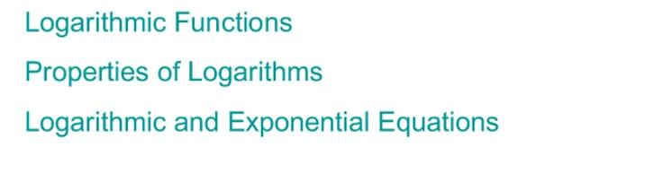
Lecture
02
Chapter Summary

