Slide 1



Network Layer
Lecture 4
CCNA – Introduction to Networks V7.0 (ITN)
Prepared by
Dr. Abdelrhman Ahmed

Slide 2
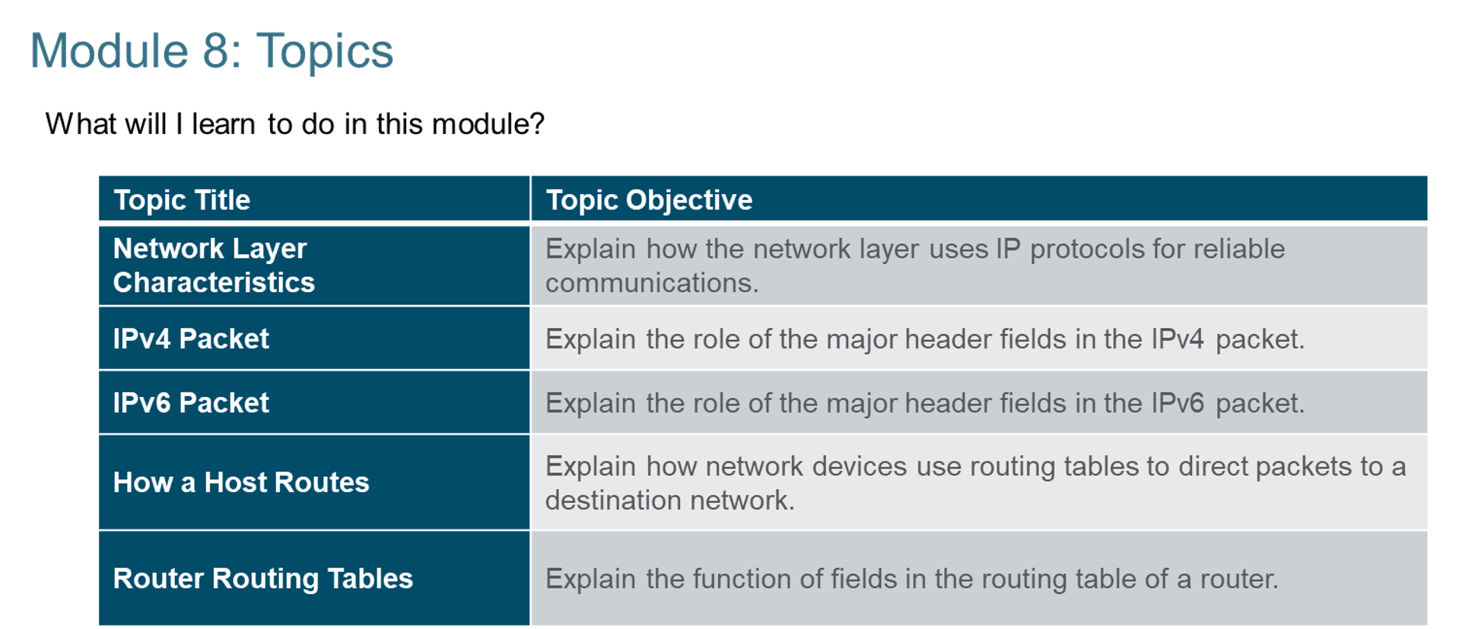
Chapter
Module Objectives
04

Slide 3
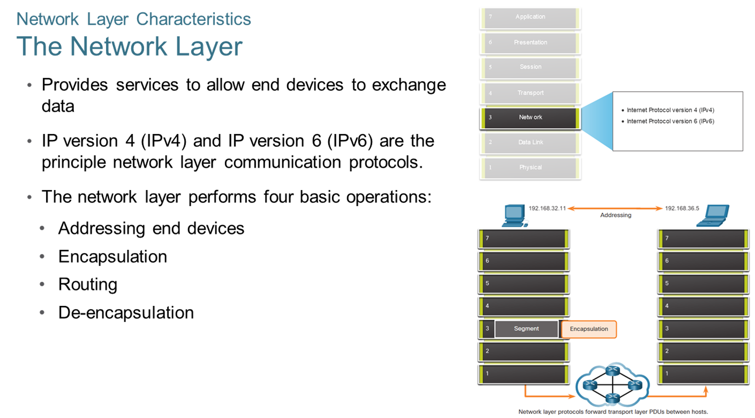
Chapter
Network Layer Characteristics
04

Slide 4
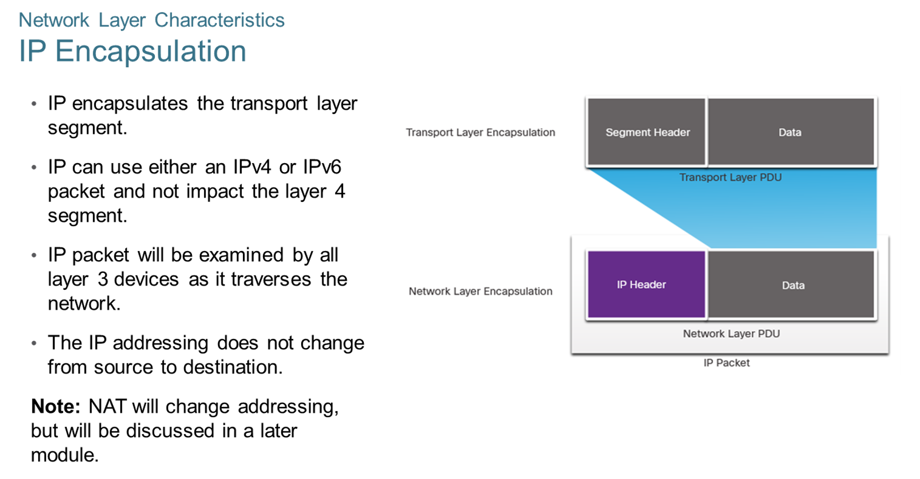
Chapter
Network Layer Characteristics
04

Slide 5
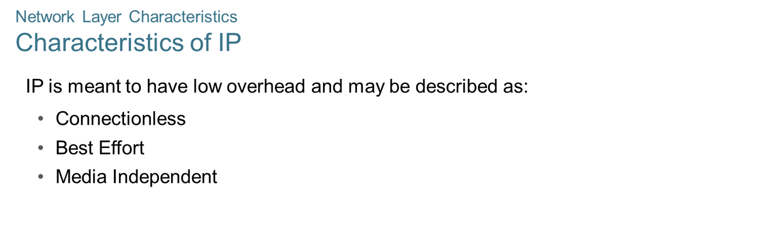
Chapter
Network Layer Characteristics
04

Slide 6
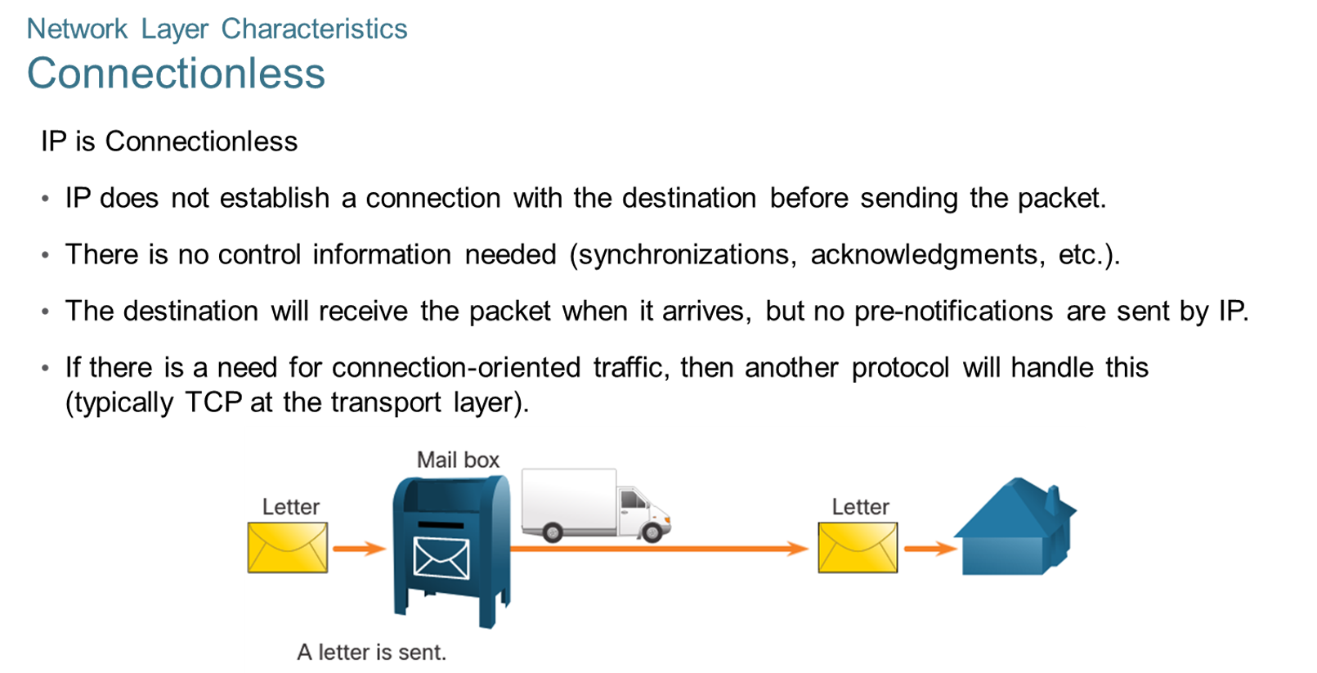
Chapter
Network Layer Characteristics
04

Slide 7
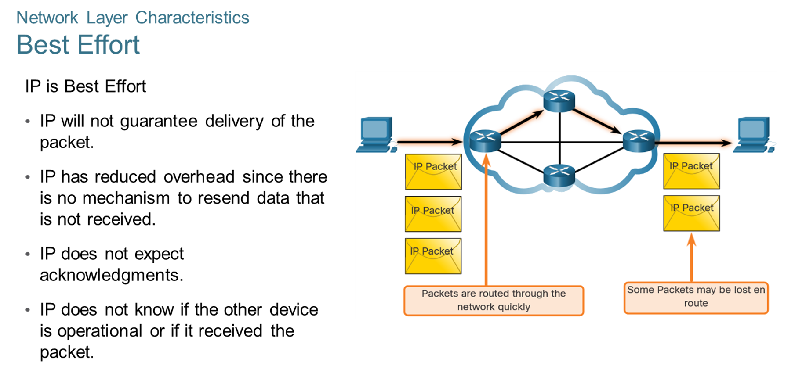
Chapter
Network Layer Characteristics
04

Slide 8
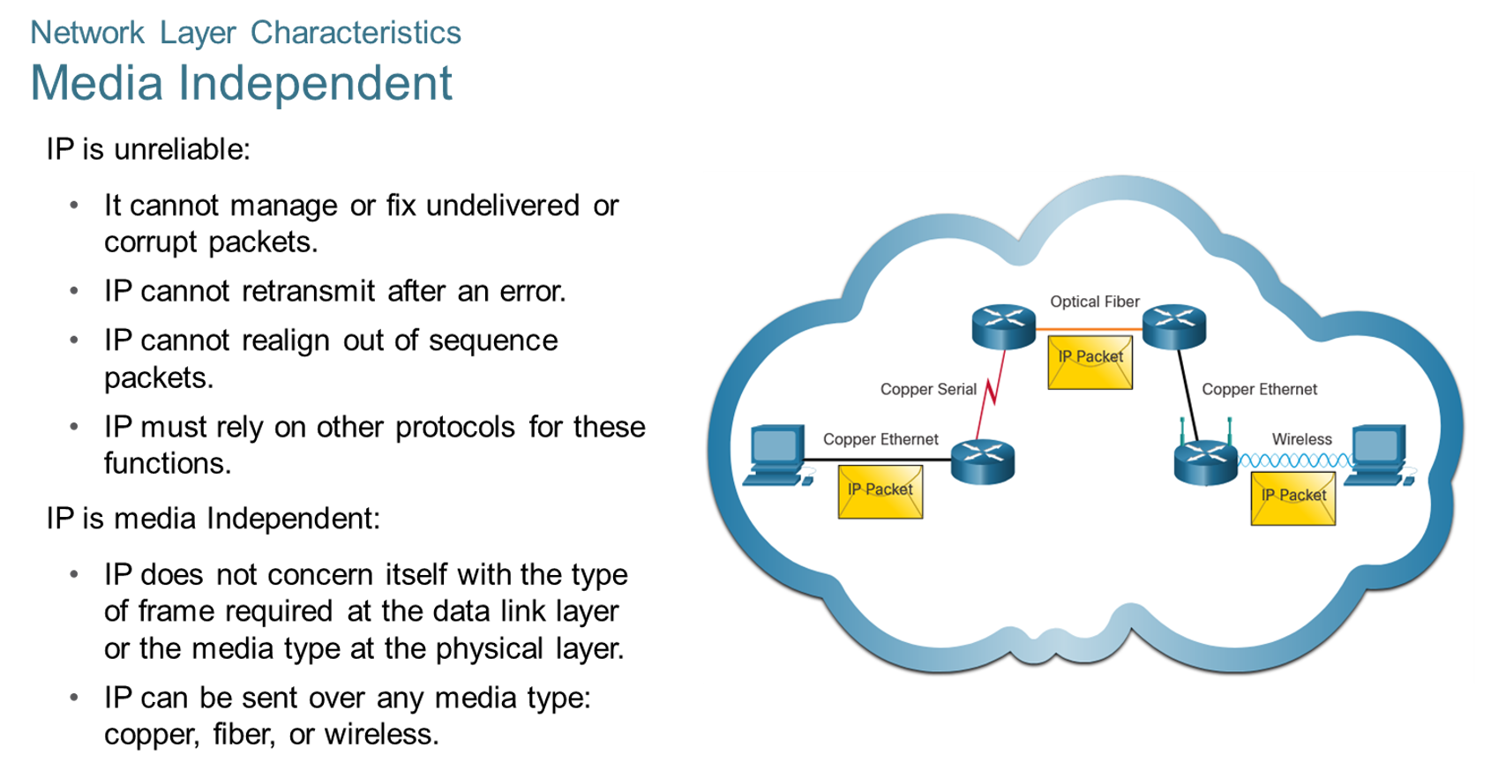
Chapter
Network Layer Characteristics
04

Slide 9
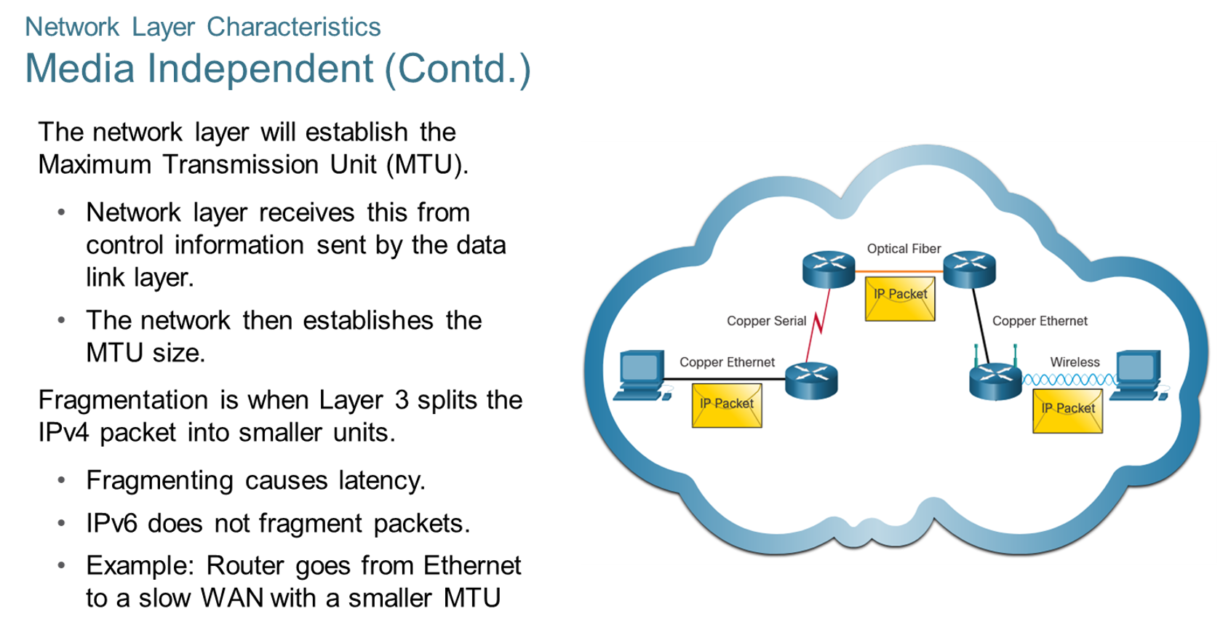
Chapter
Network Layer Characteristics
04

Slide 10
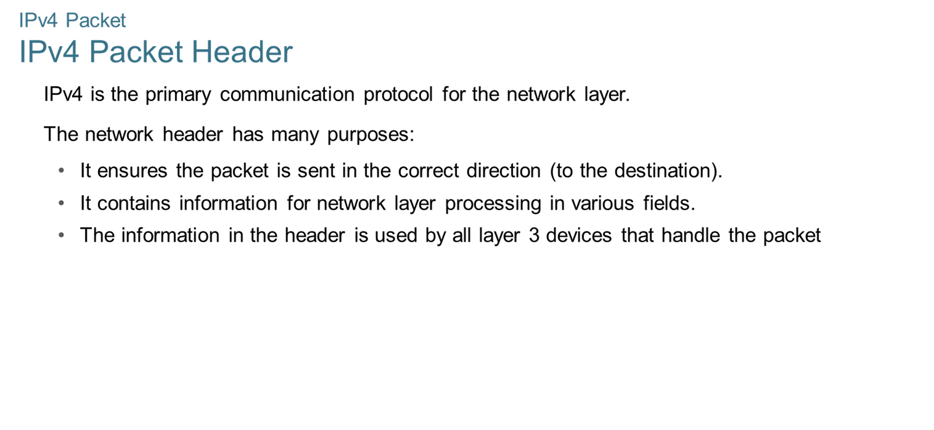
Chapter
IPv4 Packet
04

Slide 11
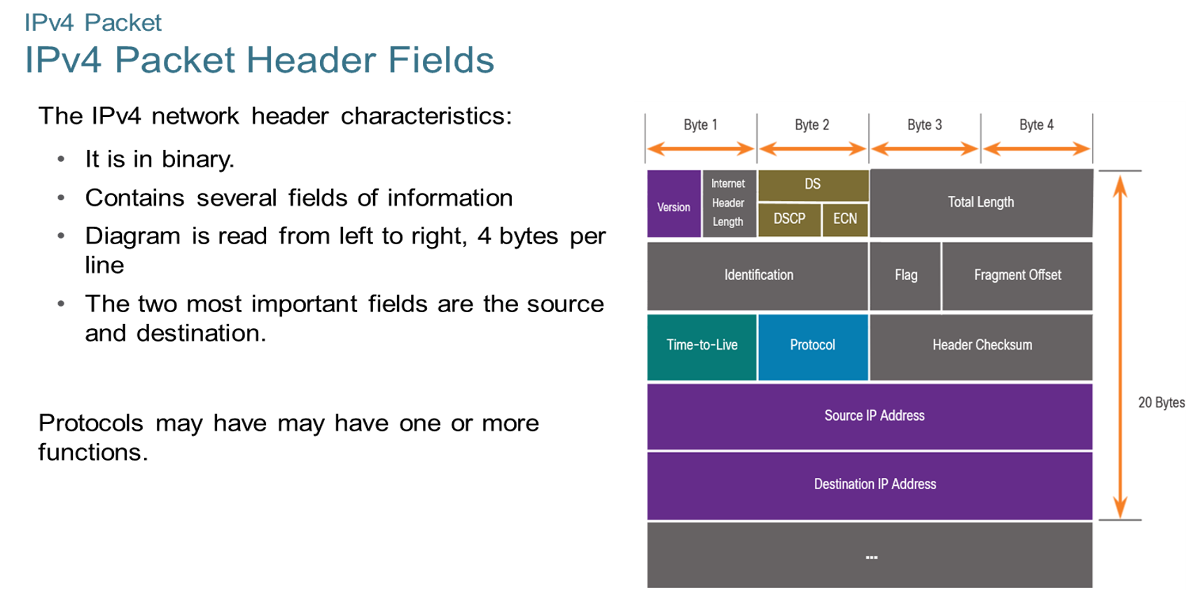
Chapter
04
IPv4 Packet

Slide 12
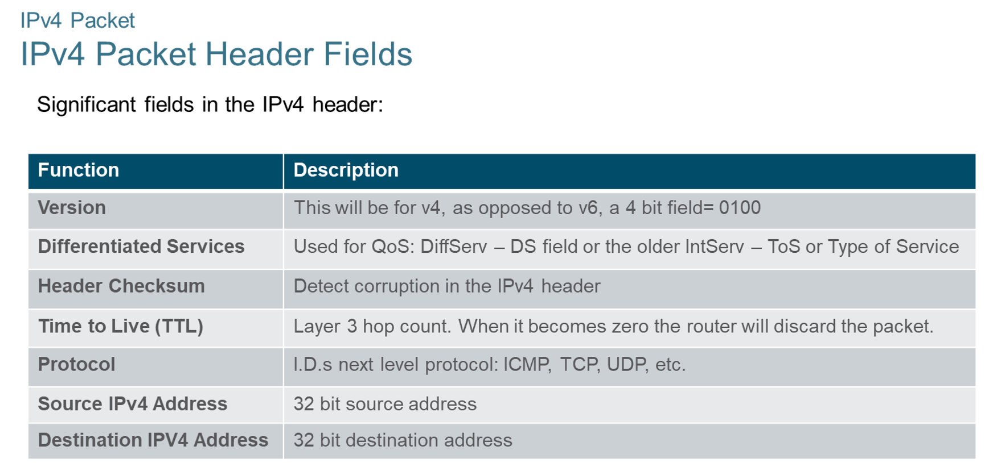
Chapter
IPv4 Packet
04

Slide 13
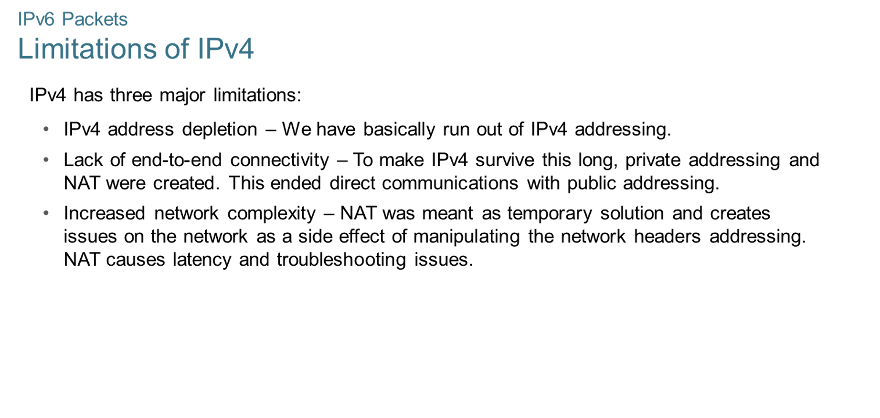
Chapter
IPv4 Packets
04

Slide 14
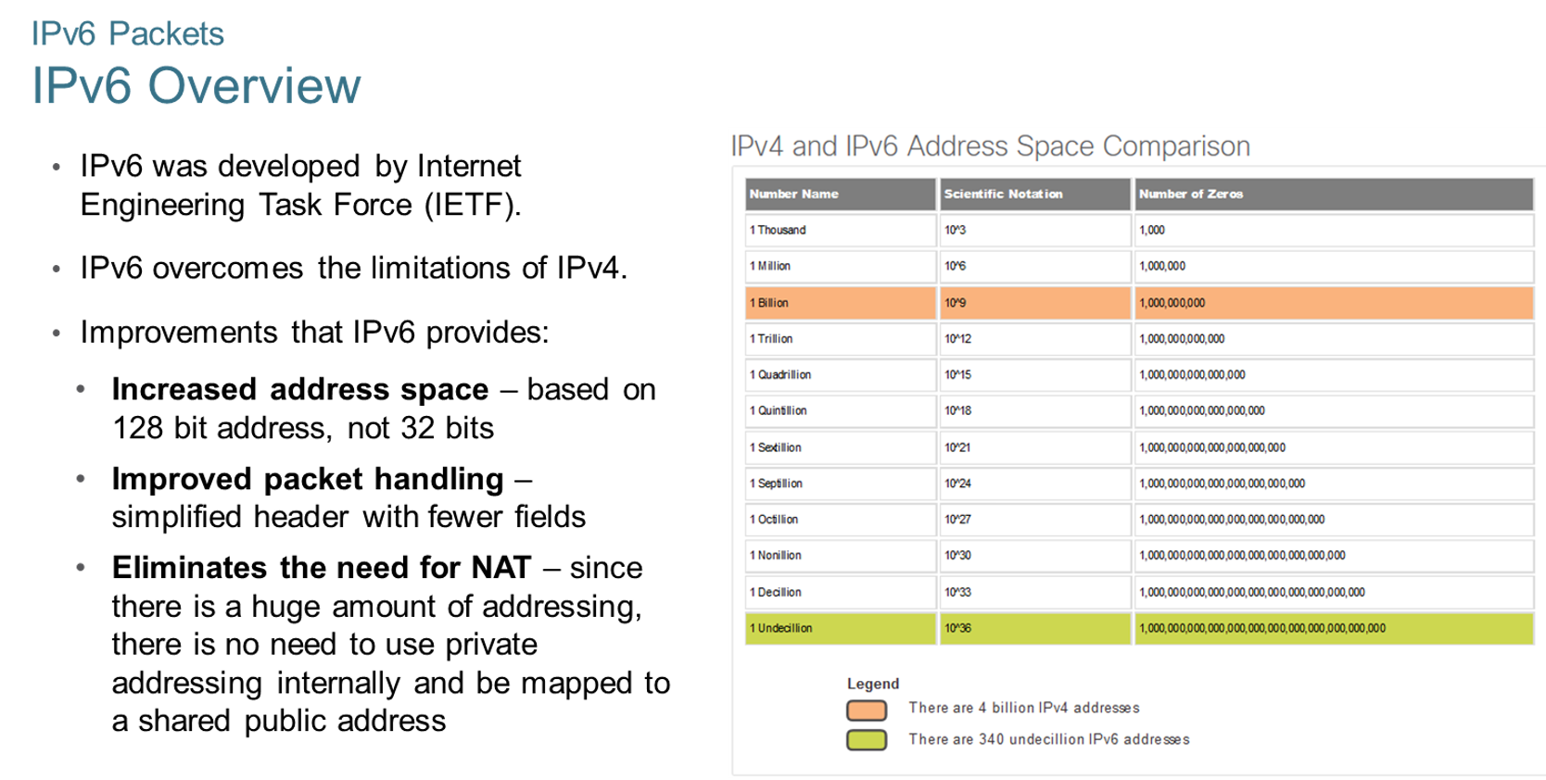
Chapter
IPv4 Packets
04

Slide 15
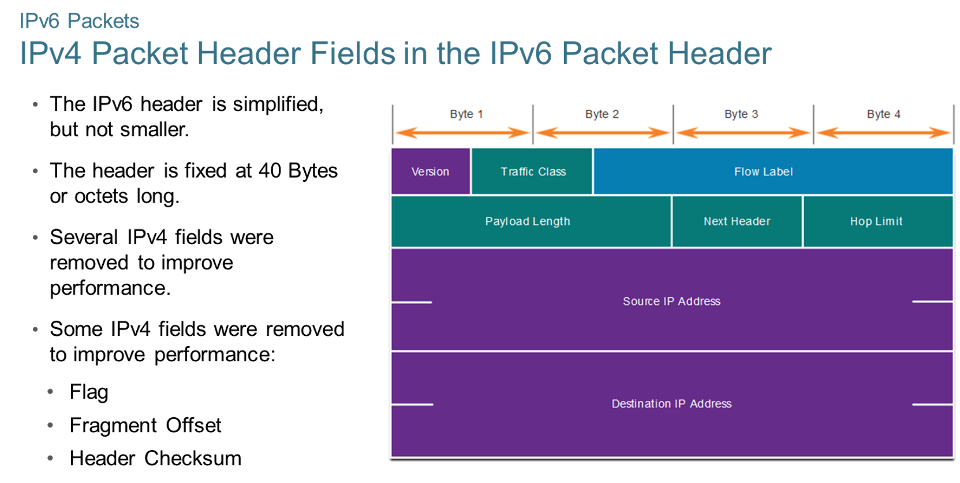
Chapter
IPv4 Packets
04

Slide 16
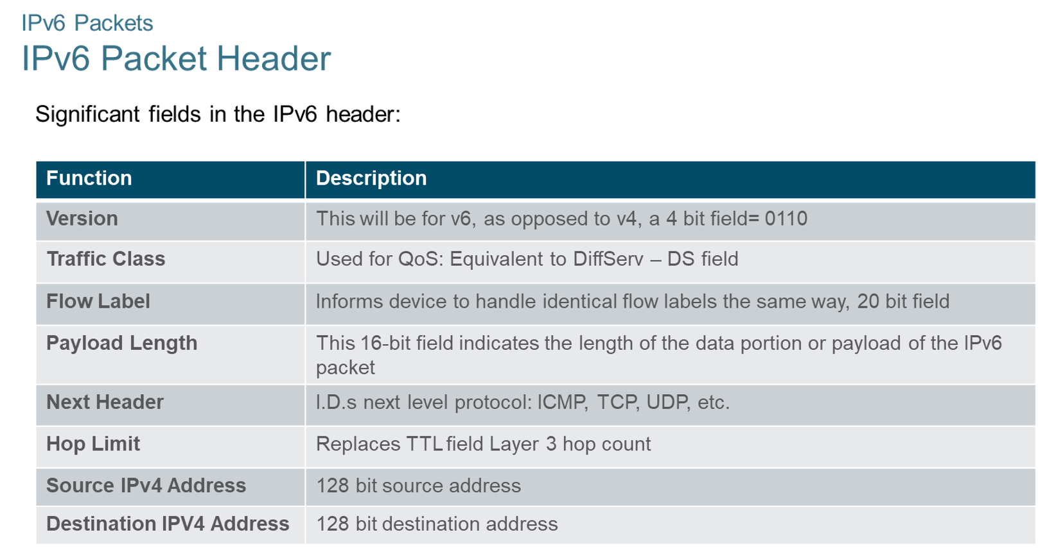
Chapter
IPv4 Packets
04

Slide 17
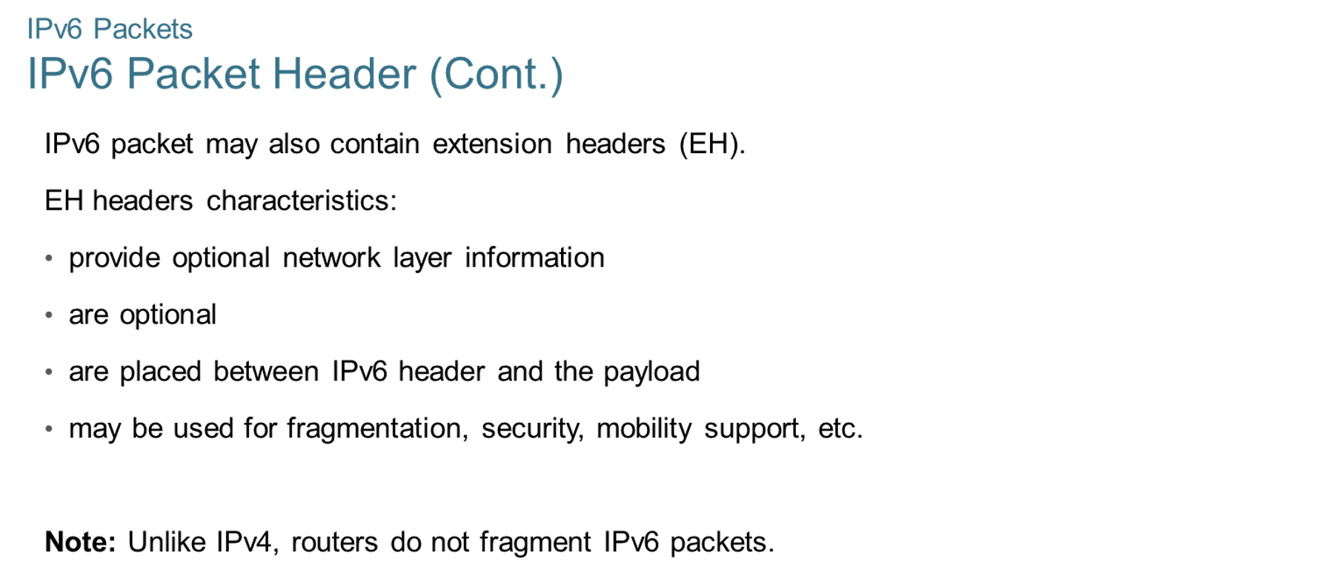
Chapter
IPv4 Packets
04

Slide 18
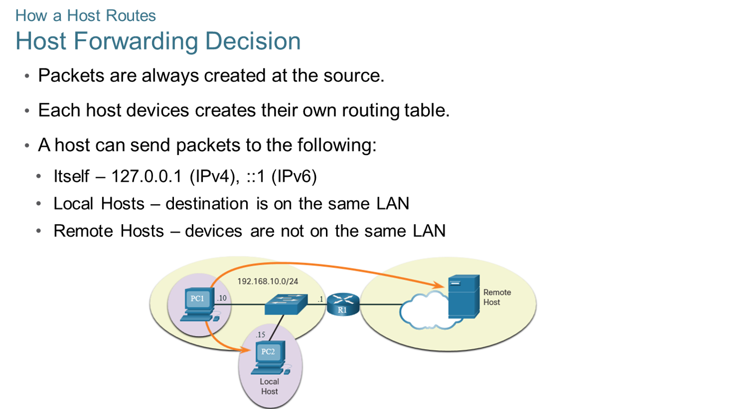
Chapter
How a Host Routes
04

Slide 19
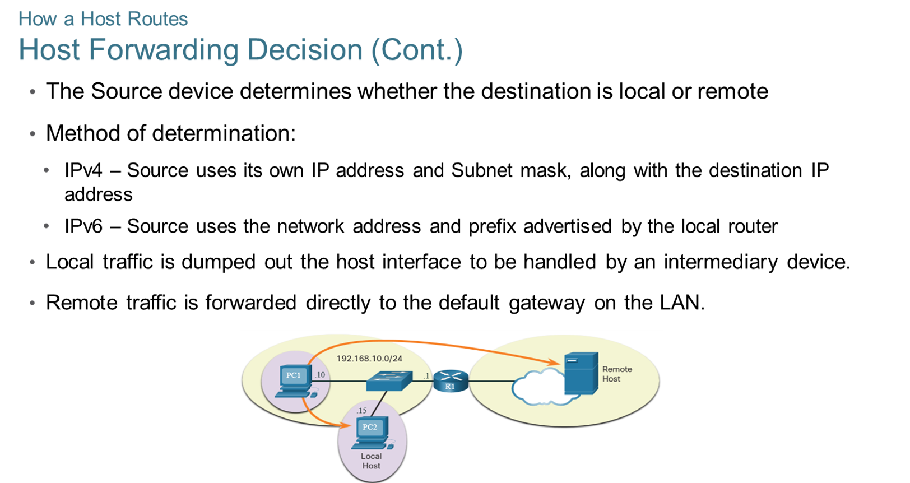
Chapter
How a Host Routes
04

Slide 20
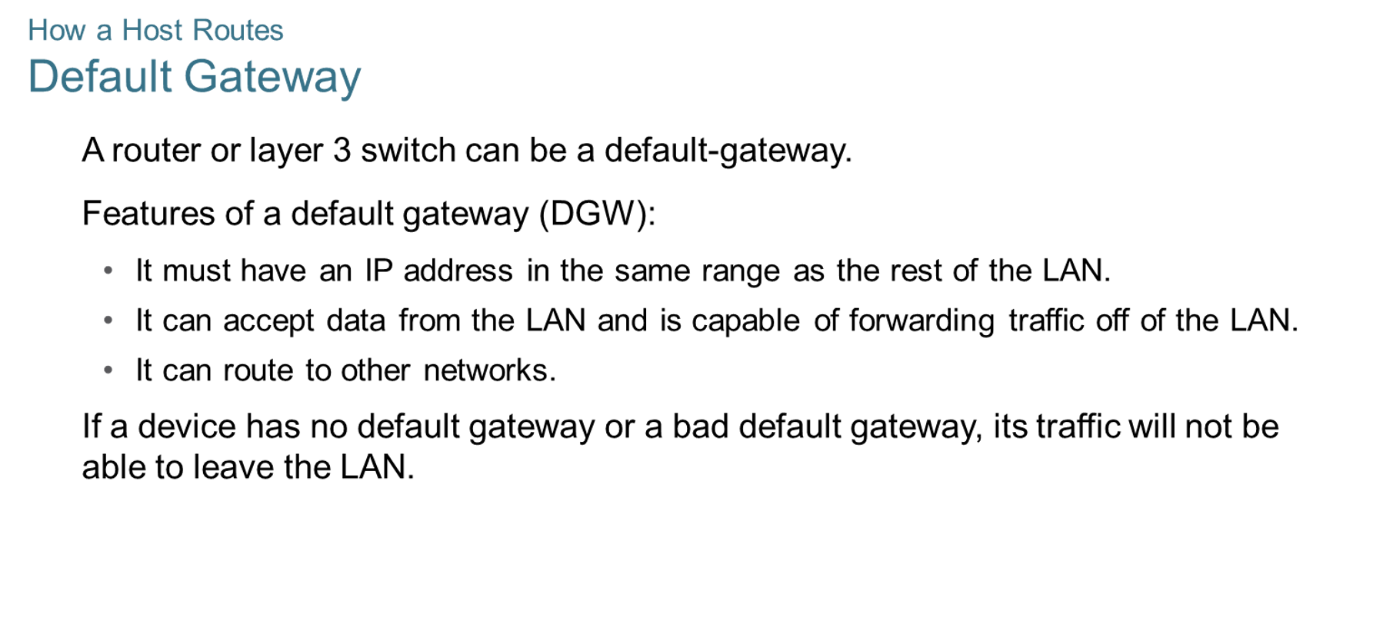
Chapter
How a Host Routes
04

Slide 21
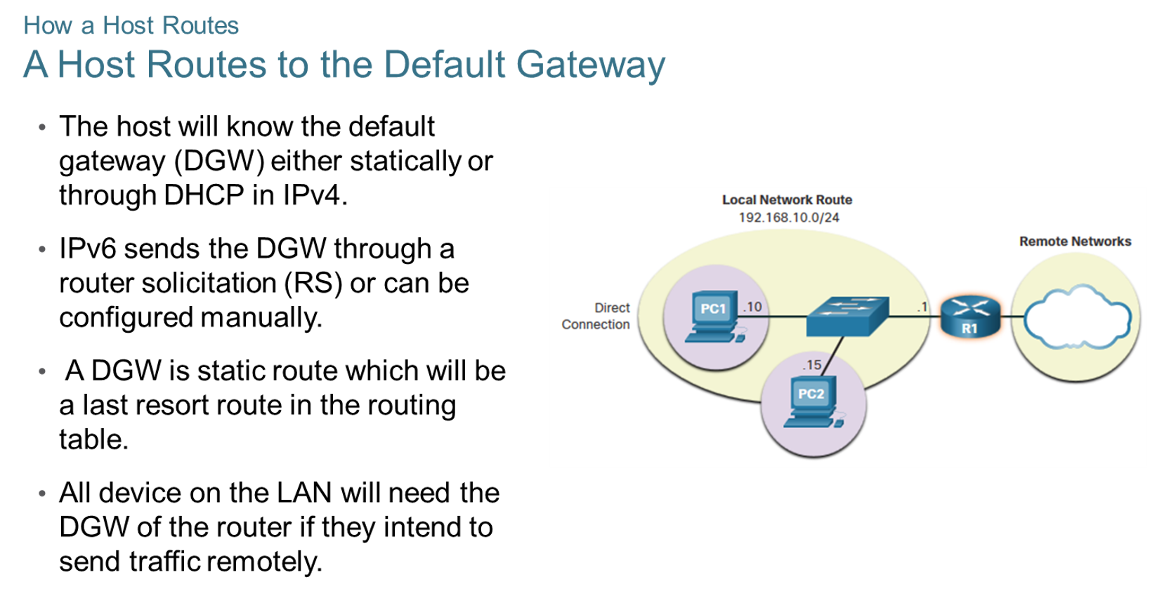
Chapter
How a Host Routes
04

Slide 22
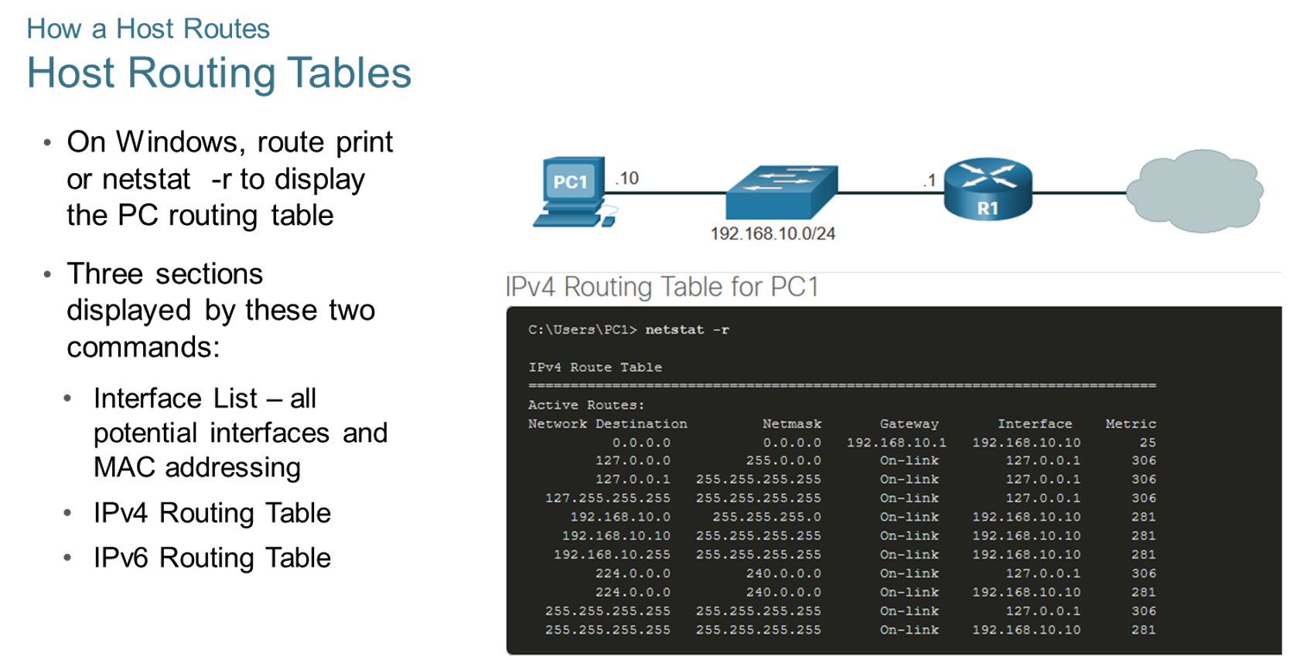
Chapter
How a Host Routes
04

Slide 23
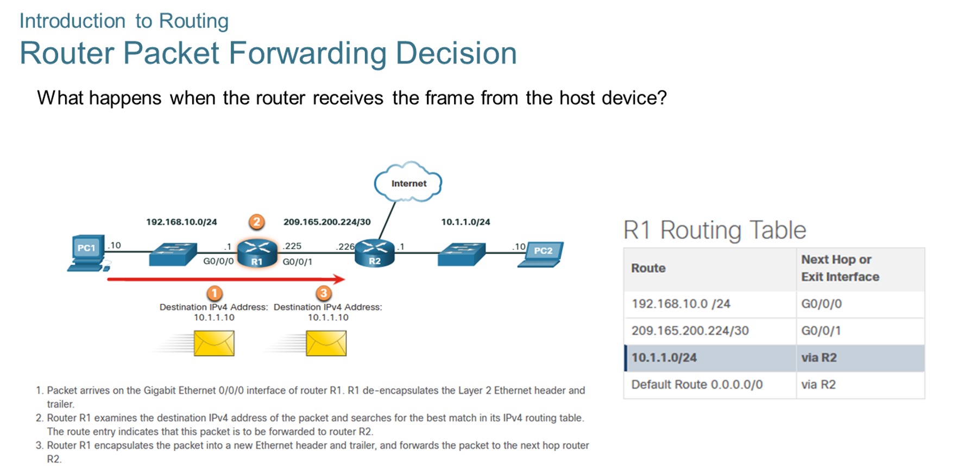
Chapter
Introduction to Routing
04

Slide 24
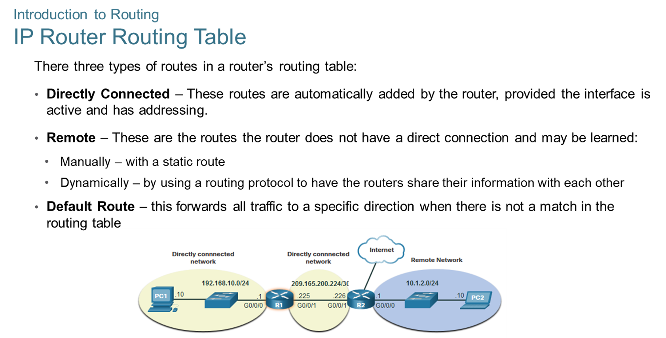
Chapter
Introduction to Routing
04

Slide 25
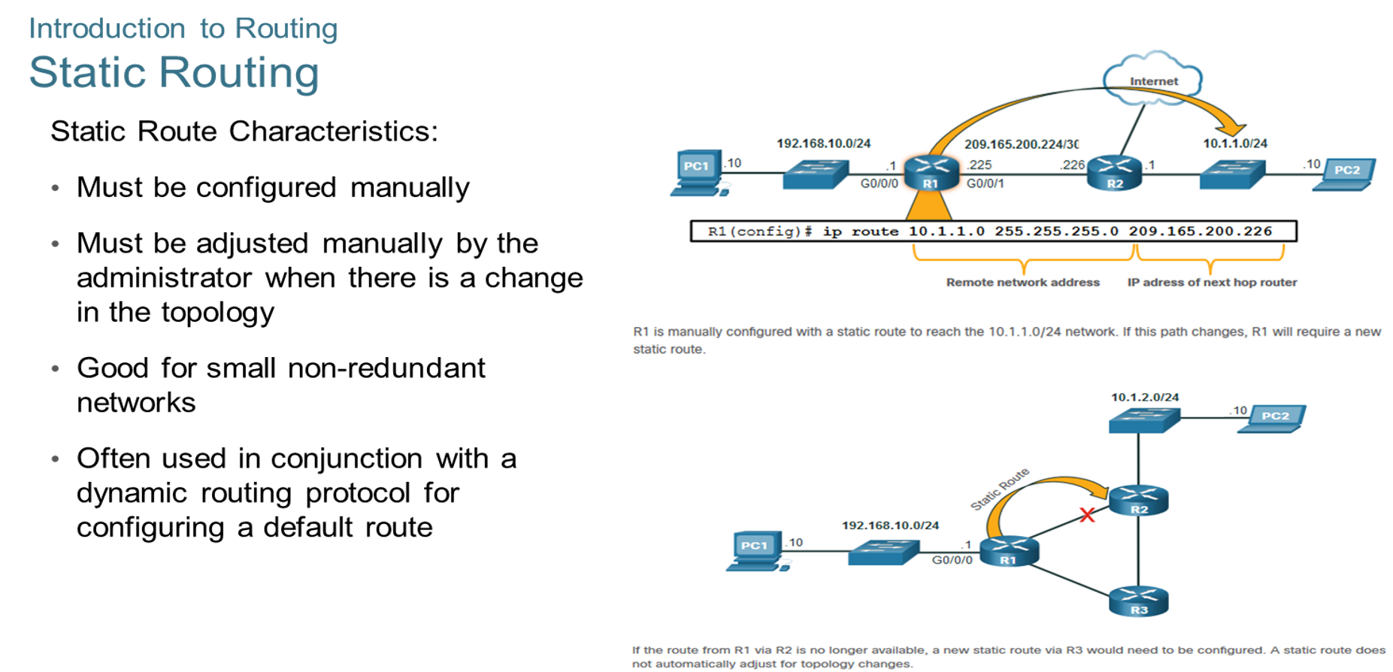
Chapter
Introduction to Routing
04

Slide 26
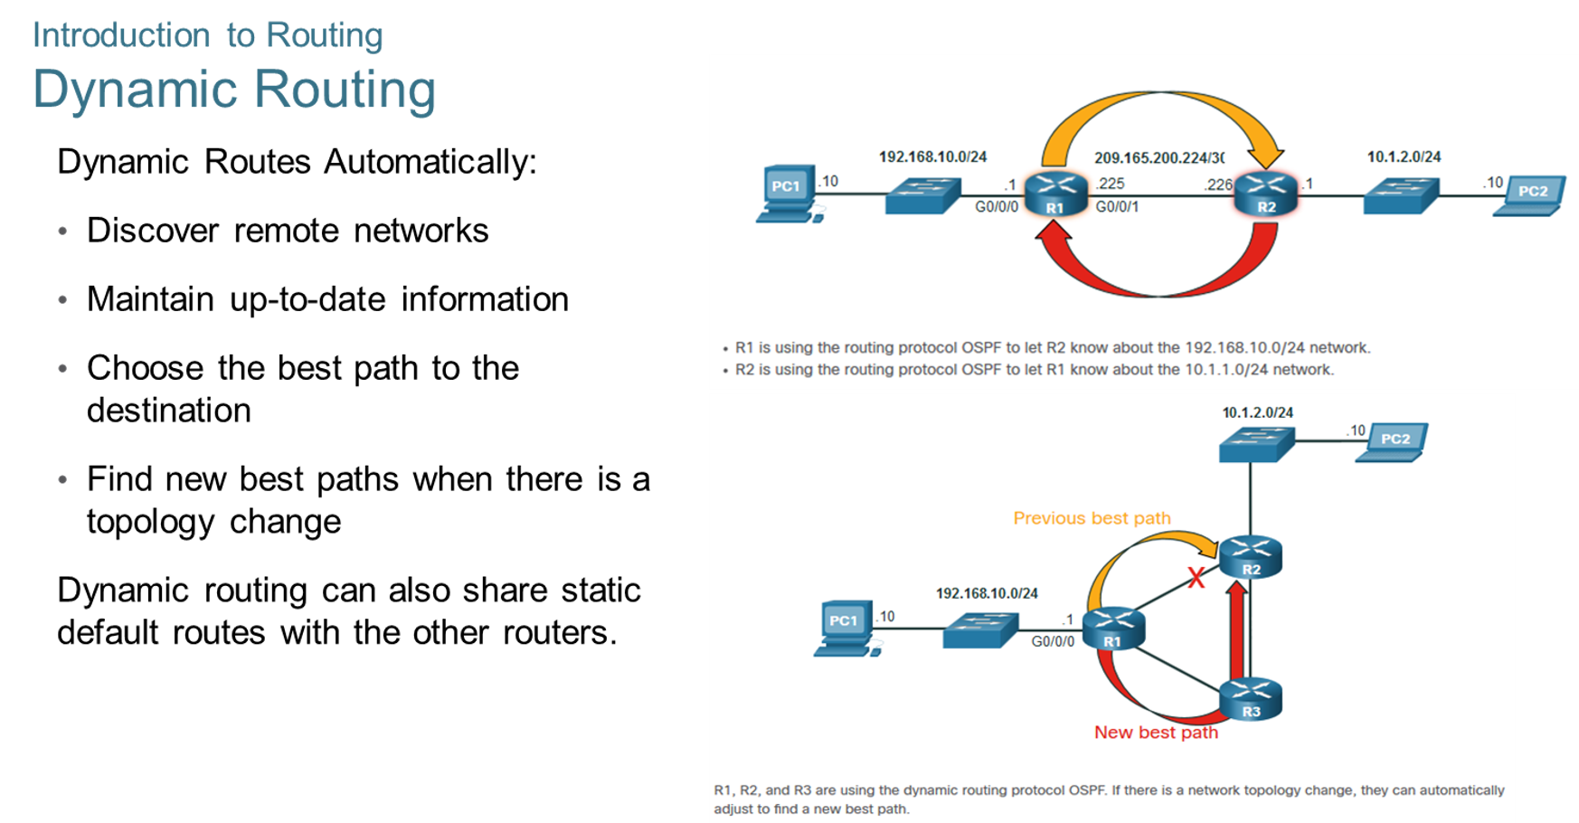
Chapter
Introduction to Routing
04

Slide 27
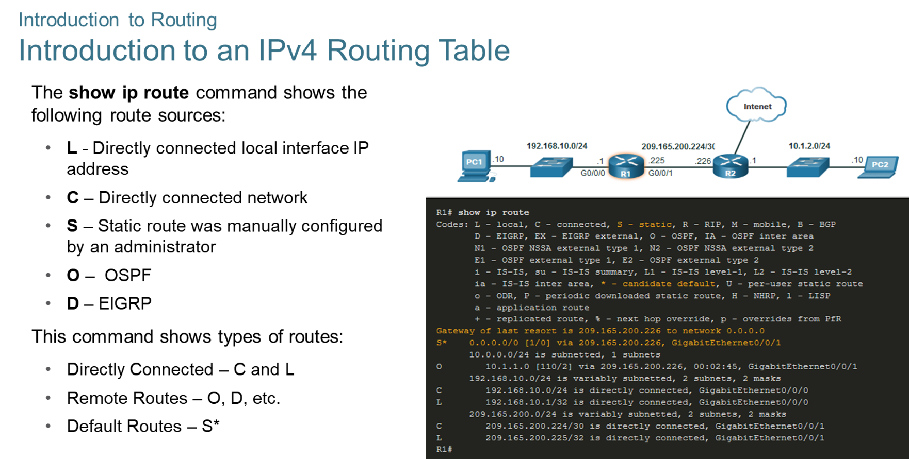
Chapter
Introduction to Routing
04

Slide 28



Thank You

