Slide 1



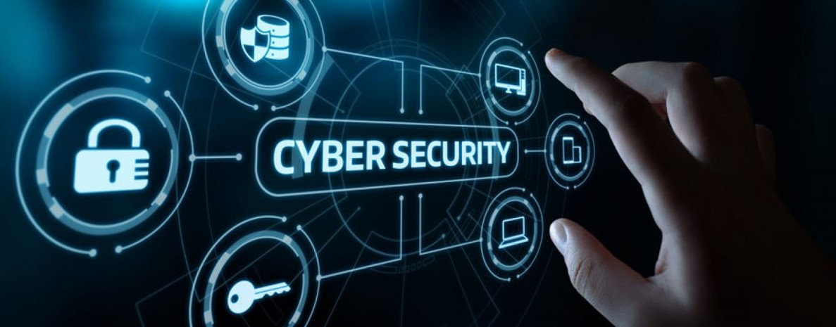

Lecture: #10
Secure Online Shopping and
Cybersecurity Standards
Dr. Redhwan M. A. Saad
Head of Cybersecurity Department
Faculty of Informatics
Midocean University
CyberSecurity Fundamentals (CYB670)
www.midocean.ae

Slide 2

Chapter
Outline – Part 1
10
    Secure Online Shopping and Internet Browsing
Introduction
HTTP Protocol Websites
Secure Electronic Transactions (SET)
Web Fraud Detection Systems
Browser Cache Clearing
Frequent Password Changes
Updating OS
Updating Apps
Useful Tips on Safe Browsing & Online Shopping
2
www.midocean.ae
Cybersecurity Fundamentals, Dr. Redhwan M. A. Saad

Slide 3

Chapter
Introduction
10
Total global sales through e-commerce amounted to as much as $2.84 trillion in 2018, according to the Statista information. It is expected to cross the $4.48 trillion mark by 2021. The total number of online buyers was about 1.66 billion people in 2017. The increase in the online shopping is gigantic and it will keep growing for many years to come.
Meanwhile, the number of internet users has increased tremendously across the globe. As of April 2023, there were 5.18 billion internet users worldwide, which amounted to 64.6 percent of the global population. Of this total, 4.8 billion, or 59.9 percent of the world's population, were social media users.
With this huge digital population of the world, the volume of both risk and opportunity has increased tremendously. The biggest risk for this huge digital population is the cybercrimes.
3
www.midocean.ae
Cybersecurity Fundamentals, Dr. Redhwan M. A. Saad

Slide 4
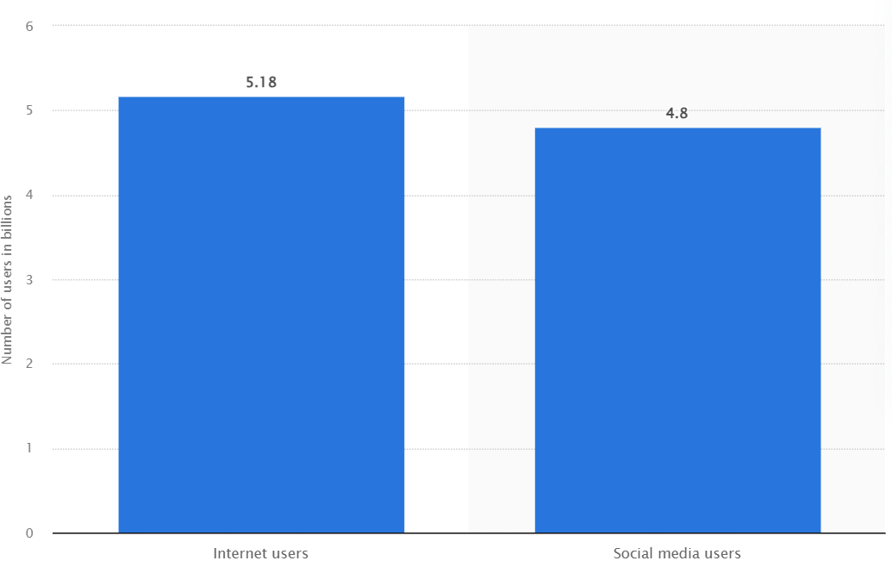
Chapter
Introduction
10
Number of internet and social media users worldwide as of April 2023 - © Statista 2023
4
www.midocean.ae
Cybersecurity Fundamentals, Dr. Redhwan M. A. Saad

Slide 5
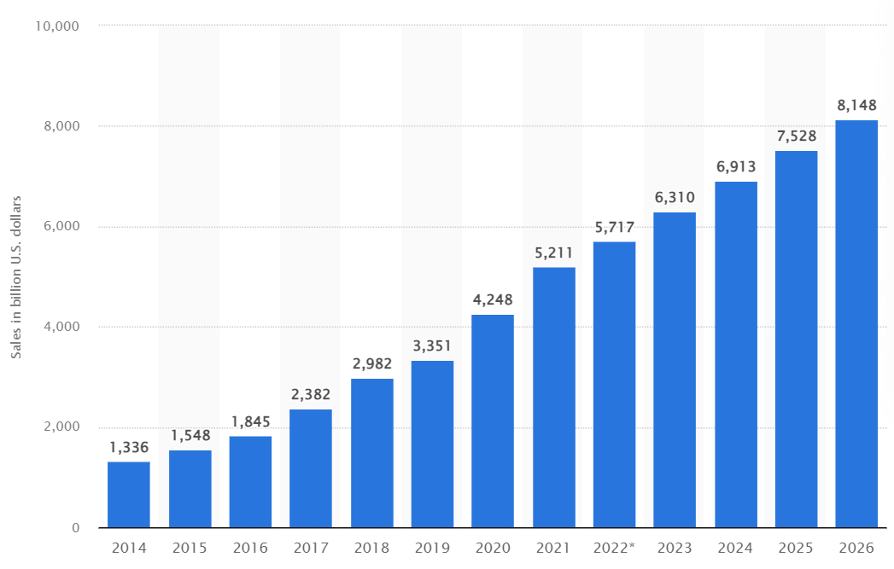
Chapter
Introduction
10
Retail e-commerce sales worldwide from 2014 to 2026 © Statista 2023
5
www.midocean.ae
Cybersecurity Fundamentals, Dr. Redhwan M. A. Saad

Slide 6
Chapter
Introduction
10
It is very important to note that cyber criminals are highly creative, technically sound, and cunning. They exploit every aspect of an online user including the way he/she uses the internet, types of tools, financial credentials, personal information, and many others things.
According to the FBI Internet Crime Complaint Center, more than 300 thousand complaints were received in 2017 regarding the online crimes. The total cost of those criminal activities amounted to about $1.4 billion to the complainants in 2017 in the USA only.
So, it is highly recommended to all necessary measures related to the online shopping and internet browsing to keep the digital criminals at bay.
6
www.midocean.ae
Cybersecurity Fundamentals, Dr. Redhwan M. A. Saad

Slide 7
Chapter
Introduction
10
The main points that are normally exploited by the cyber criminals include the following:
Introduction of poisonous links by using the black SEO
Malicious links and emails for phishing purpose
Text messages and popup notifications
Identity theft techniques
Social engineering methods
Software vulnerabilities to send virus, Trojan horse, and worms
Operating system vulnerabilities
Vulnerabilities in browsers
Fake websites and offers
Exploit your personal information that you provide
Rogue and public access point vulnerabilities
Use of weak passwords
And yes, your carelessness
Bad password management
So always take special care while shopping online or even browsing the internet and follow the security guidelines to avoid any cyberattack on you.
7
www.midocean.ae
Cybersecurity Fundamentals, Dr. Redhwan M. A. Saad

Slide 8
Chapter
Secure Online Shopping and Internet Browsing
10
The major things and activities that will help you enjoy the secure online shopping and internet browsing.
HTTPS Protocol Websites
Secure Electronic Transactions (SET)
Web Fraud Detection Systems
Browser Cache Clearing
Frequent Password Changes
Updating OS
Updating Apps
Useful Tips on Safe Browsing & Online Shopping
8
www.midocean.ae
Cybersecurity Fundamentals, Dr. Redhwan M. A. Saad

Slide 9

Chapter
HTTP Protocol Websites
10
Initially, the websites used the HTTP protocol for the communication between server and client. The web browsers are normally the clients of HTTP communication and the web server applications are the server of this communication.
HTTP protocol is considered as insecure nowadays because of the nature of plain text communication between client and server over the internet.
The use of HTTP protocol has been replaced by the HTTPS or HTTP (secure) protocol, which include the capabilities of encrypted communication between server and client over the communication link.
9
www.midocean.ae
Cybersecurity Fundamentals, Dr. Redhwan M. A. Saad

Slide 10
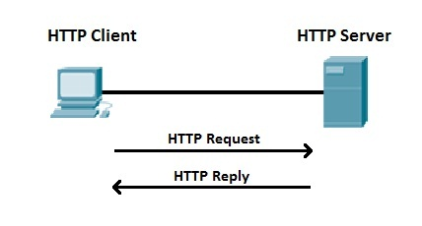
Chapter
HTTP Protocol Websites
10
HTTP protocol can easily be converted to the HTTPS protocol by adding the Secure Socket Layer SSL encryption protocol. We will describe the step by step method on how to install SSL certificate to convert the HTTP protocol to HTTPS on the websites later in this section too. Before that, let’s explain the HTTP protocol in detail.
Hypertext Transfer Protocol precisely HTTP is an application layer communication protocol that is used for establishing the internet communication between client and server. A client is any software browser that is used to send the request for accessing certain resources located on the web server.
The web server has the sever part of the HTTP protocol that provides response to the requests originated from the HTTP client.
10
www.midocean.ae
Cybersecurity Fundamentals, Dr. Redhwan M. A. Saad

Slide 11
Chapter
HTTP Protocol Websites
10
The communication transactions of HTTP client/server are listed below:
Client (web browser) sends HTTP request to server
Server takes the request and starts app to process HTTP request
Generates and sends back the required response requested by the client
Client receives the response to display on the browser
In this request/response communication client can request for the website (HTML) page, database, JavaScript file, JPG images or style sheets. The response of the server will include the HTML files, JSON/XML files, JS files, JPG file or CSS files.
11
www.midocean.ae
Cybersecurity Fundamentals, Dr. Redhwan M. A. Saad

Slide 12
Chapter
HTTP Protocol Websites
10
Let’s talk about the following versions of HTTP related security protocols:
Hypertext Transfer Protocol Secure (HTTPS)
Installing Security Certificate on Windows IIS Server (See appendix)
How SSL Encryption Works?
12
www.midocean.ae
Cybersecurity Fundamentals, Dr. Redhwan M. A. Saad

Slide 13
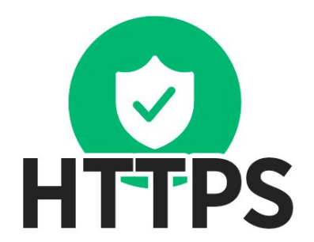
Chapter
Hypertext Transfer Protocol Secure (HTTPS)
10
If you use the HTTP protocol on your website, then the data you receive and send is transported is subject to external threats like Man in The Middle MITM attacks, eavesdropping of the communication and credential theft etc.
For secure online shopping and internet browsing, HTTPS protocol-based websites should be used to prevent any cyber-criminal activities.
13
www.midocean.ae
Cybersecurity Fundamentals, Dr. Redhwan M. A. Saad

Slide 14
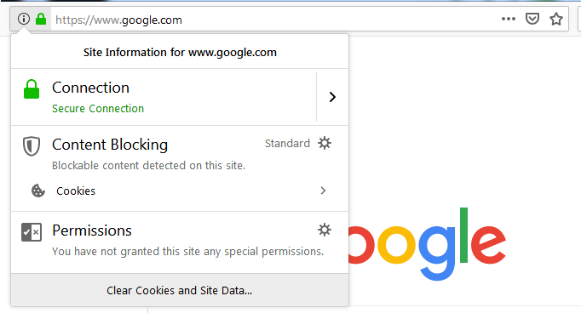
Chapter
Hypertext Transfer Protocol Secure (HTTPS)
10
The website that uses HTTPS protocol and is secure to surf and shop can be identified by the following marks:
The address bar shown HTTPS://
A lock sign appears on the address bar before website URL
To know details about the website security, click either lock icon in Google Chrome or symbol in Mozilla Firefox on the address bar. The details appear as shown in the image.
14
www.midocean.ae
Cybersecurity Fundamentals, Dr. Redhwan M. A. Saad

Slide 15
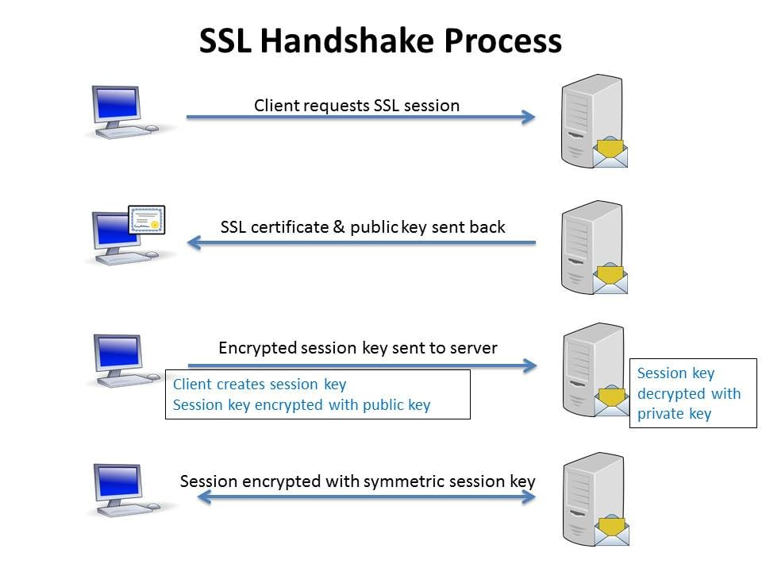
Chapter
Hypertext Transfer Protocol Secure (HTTPS)
10
How SSL Encryption Works?…
The domain name bound with the desired certificate will create a socket layer of communication between the supported browsers and the website communication port number 443. The secure communication between a web browser and website through SSL communication socket takes place in the following steps:
Browser sends the HTTP request to prove the SSL/TLS certificate targeting 443 port on the web server
The website server sends response with the certificate chain, which includes the primary certificate, intermediate certificate and root certificate of the certificate authority
All browsers have public keys and related information of all certificate authorities (CAs)
Compares with the information with the local SSL information to verify the certificate
15
www.midocean.ae
Cybersecurity Fundamentals, Dr. Redhwan M. A. Saad

Slide 16
Chapter
Hypertext Transfer Protocol Secure (HTTPS)
10
How SSL Encryption Works?…
When the public key of the server is verified in terms of validity and authority, it sends the its own public key to the server
On the basis of public key received from browser and the private key of the server, an encrypted message will be created and sent out through port 443 to the browser
The browser decrypts the message with the help of public key
Thus, the communication over SSL link starts
It is important to note that encrypted transmission of data over the internet is becoming the fundamental requirement for safe browsing of the internet. Any website without encryption is considered as risky for the security of your data and system.
16
www.midocean.ae
Cybersecurity Fundamentals, Dr. Redhwan M. A. Saad

Slide 17
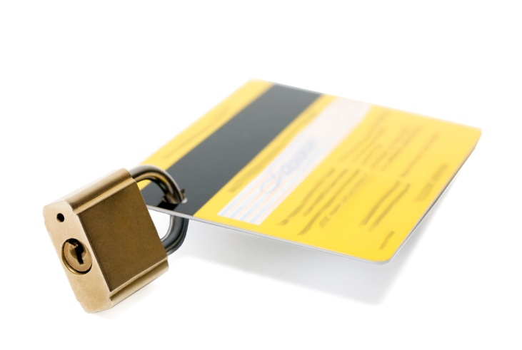
Chapter
Secure Electronic Transactions SET
10
Secure Electronic Transactions (SET) is a comprehensive communication protocol for maintaining the full security of the online payments and financial transactions
SET is a consolidated online financial transaction protocol to carry out the secure online transactions such as online shopping, online bill payment, money transfer, and others
17
www.midocean.ae
Cybersecurity Fundamentals, Dr. Redhwan M. A. Saad

Slide 18
Chapter
Secure Electronic Transactions SET
10
Main features of SET technology ...
SET technology was developed to offer the full security to the valuable data, personal information, and bank authorization. The main features of SET protocol are listed below:
Maintains high-level of personal information confidentiality
Maintains high-level data integrity
Incorporates merchant authorization
Incorporates the authentication of cardholder’s account
Uses dual-signature mechanism for authentication and authorization
Uses separate message digest DM algorithms for order information and payment information
Powered by a large number of financial organizations
18
www.midocean.ae
Cybersecurity Fundamentals, Dr. Redhwan M. A. Saad

Slide 19
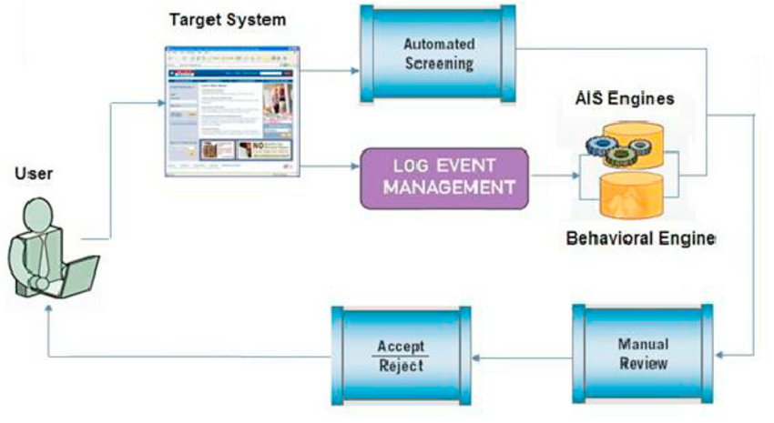
Chapter
Web Fraud Detection System
10
Web Fraud Detection System (WFDS) is a software-based system, which uses the latest technologies such as artificial intelligence and the latest scoring methodologies to find out the authenticity of the transaction.
19
www.midocean.ae
Cybersecurity Fundamentals, Dr. Redhwan M. A. Saad

Slide 20
Chapter
Web Fraud Detection System
10
What algorithms are used in WFDS Systems? …
Web fraud detection system WFDS is a software system, which uses the latest software technologies for detecting the fraudulent transaction. It uses the scoring system, which scores the transactions with the help of some algorithms known as the scoring algorithms. The main scoring algorithms used by the WFDS systems are listed below:
Predictive Behavioral Scoring Model
Rule-Based Scoring Model
Hybrid Scoring Model
These scoring methods use the user behavior, using pattern or both pattern and behavior are used collectively to assess the web transactions.
20
www.midocean.ae
Cybersecurity Fundamentals, Dr. Redhwan M. A. Saad

Slide 21

Chapter
Browser Cache Clearing
10
Normally, all types of browsers cache the information about the browsing history, browsing information like forms, data, and other information that you browse through.
The browsers save certain forms and data retrieved from the online sources. Those forms and offline data saved in the browsers cache memory load, when you visit the related URLs. You can also load those resources offline, if saved for that purpose.
21
www.midocean.ae
Cybersecurity Fundamentals, Dr. Redhwan M. A. Saad

Slide 22
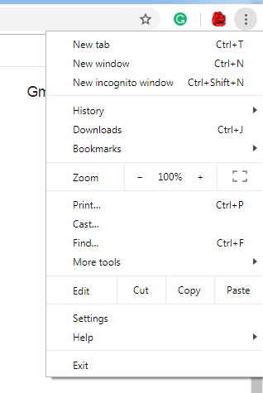
Chapter
Browser Cache Clearing
10
Google Chrome…
To clear the cache of Google Chrome browser, take the following steps.
Run the Google Chrome browser
Click the symbol located at the right corner of the screen. The list of the options appears as shown .
22
www.midocean.ae
Cybersecurity Fundamentals, Dr. Redhwan M. A. Saad

Slide 23
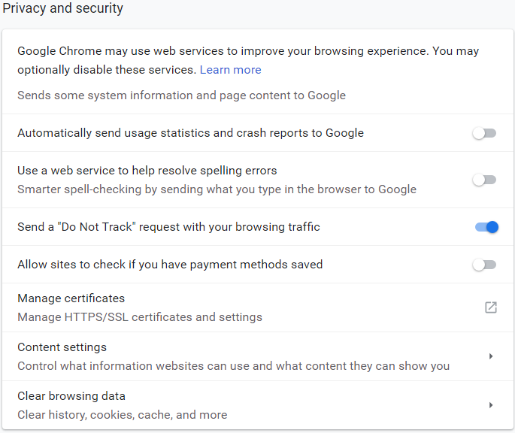
Chapter
Browser Cache Clearing
10
Google Chrome…
Click the Settings option from the list. The Setting page appears.
Scroll down to the Advanced option and click it.
Privacy and Security category appears as shown below
23
www.midocean.ae
Cybersecurity Fundamentals, Dr. Redhwan M. A. Saad

Slide 24
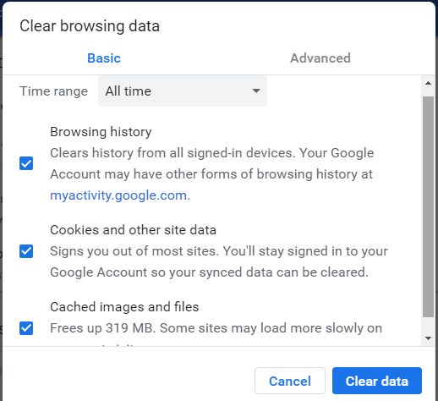
Chapter
Browser Cache Clearing
10
Google Chrome…
Scroll down and click to the Clear browsing data option. The Clear Browsing Data window with different options such as browsing history, cookies and other site data, and cached images and files appears.
24
www.midocean.ae
Cybersecurity Fundamentals, Dr. Redhwan M. A. Saad

Slide 25
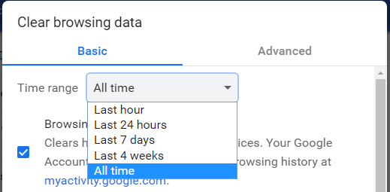
Chapter
Browser Cache Clearing
10
Google Chrome…
Select the checkbox against the Cached images and files option.
Click the All time dropdown arrow to display time range options. The dropdown time options appear as shown below.
25
www.midocean.ae
Cybersecurity Fundamentals, Dr. Redhwan M. A. Saad

Slide 26

Chapter
Frequent Passwords Changes
10
The effective password management is very fundamental in maintaining high level of security for online browsing and shopping.
The frequent change of the passwords is one of the important components of effective password management.
You should always choose the strongest password that has at least 14 characters that should also include:
Capital and lower-case alphabetic letters
Numeric characters
Special symbols
26
www.midocean.ae
Cybersecurity Fundamentals, Dr. Redhwan M. A. Saad

Slide 27
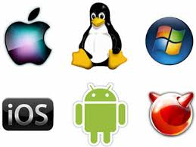
Chapter
Updating OS
10
The hackers continuously strive to break the operating system security by exploiting the vulnerabilities
For making your online shopping and internet browsing experience safe, secure, and free of worries, always keep your operating system up to date by downloading and installing the latest updates released by the concerned teams of operating systems.
27
www.midocean.ae
Cybersecurity Fundamentals, Dr. Redhwan M. A. Saad

Slide 28

Chapter
Updating Apps
10
Many applications are designed to search for the updates automatically and prompt the user about that update to download. But in many cases, the third-party applications don’t update automatically on the computers.
The examples of computer applications include:
Google Browser (Google Chrome)
Microsoft Skype
Email Application
Adobe Acrobat
Java Applications
Adobe Flash
And many others
28
www.midocean.ae
Cybersecurity Fundamentals, Dr. Redhwan M. A. Saad

Slide 29

Chapter
Useful Tips on Safe Browsing & Online Shopping
10
There are certain useful tips and guidelines for safe browsing and online shopping, which are listed below:
Always use your personal data carefully and professionally
Avoid to click unsolicited links and promotions
Never use public networks for shopping purposes
Always use secure connection with firewall enabled
Always keep your privacy settings open/active
Think twice before you download any software
Avoid freebies and tempting offers
Always use strong passwords
Change your passwords within 60 or 90 days
Always visit the secure websites that use https protocol
Always shop from the trusted websites
Keep your OS and applications up to date
Clear your browser cache and browsing history regularly
Keep antivirus and anti-spyware up to date
Check you online shopping and bank statements regularly
29
www.midocean.ae
Cybersecurity Fundamentals, Dr. Redhwan M. A. Saad

Slide 30
Chapter
Useful Tips on Safe Browsing & Online Shopping
10
Don’t follow the links in the phishing emails
Try to use blurring software tools that blur your personal information while shopping
Mobile apps for trusted merchants are better for shopping as compared to the online shopping through browser
Try to use digital wallets rather than the credit or debit cards
Try to pay through gift vouchers and other such prepaid cards for shopping
Check the credibility of the merchant
Send complaints immediately, if you find any suspicious activity on your account
Read delivery and return policy of the merchant carefully
Read privacy statements carefully
Maintain a record of your online purchases
Last but not the least, use your common sense always!
30
www.midocean.ae
Cybersecurity Fundamentals, Dr. Redhwan M. A. Saad

Slide 31
Chapter
Outline - Part 2
10
Cybersecurity Standards
Introduction
ISO/IEC27001 &27002 Standards
Information Security Forum ISF Standards
Payment Card Industry Data Security Standard PCI/DSS
31
www.midocean.ae
Cybersecurity Fundamentals, Dr. Redhwan M. A. Saad

Slide 32
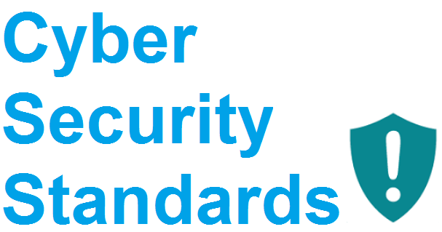
Chapter
Introduction
10
Industrial standards play a very critical role in all types of industries. The standards are the defined guidelines, best practices and rules to achieve any certain objective in that particular industry.
In this chapter, we will talk about a few important standards that deal with the cyber security in the field of information and communication technology commonly referred to as ICT.
There are many standard organizations, industry alliances and government authorities that devise different types of standards for different activities related to information and communication technology.
The standard organizations develop standard through deep research with the help of the industry experts in the field of information technology. They develop certain formulas and criteria for different things, activities and procedures.
32
www.midocean.ae
Cybersecurity Fundamentals, Dr. Redhwan M. A. Saad

Slide 33
Chapter
Introduction
10
A few formulas and criteria for different procedures and activities are listed below.
Security of the code of the web environment
Criteria for the testing of the computer code
Assessment of the vulnerabilities in the web environments
Possible impact of the vulnerabilities on the industries and the end-users
Ways to avert any kinds of security threat
The assessment of the level of risk
Assessing and implementing secure communication
How to deal with the potential threats
What preemptive measures can help avert any possible cyber threats
And much more
33
www.midocean.ae
Cybersecurity Fundamentals, Dr. Redhwan M. A. Saad

Slide 34
Chapter
Introduction
10
In the nutshell, the cyber security standards identify the most suitable ways and industry best practices that are implemented to establish an effective cyber security. The detailed documents of the guidelines are also created; those documents establish the relationship between other security standards and guidelines. A detailed scope of work, roles, implementation procedure and audit process are created for smooth adoption of the standards in the organizations.
This is an international standard offered by ISO. It is also accepted all over the world. The organizations from any part of the world can adopt this standard for establishing information security control.
Let’s discuss a few very important cyber-security standards that are commonly adopted in the field of information and communication technology.
ISO/IEC 27001 & 27002 Standards
Information Security Forum ISF Standards
Payment Card Industry Data Security Standard (PCI/DSS)
34
www.midocean.ae
Cybersecurity Fundamentals, Dr. Redhwan M. A. Saad

Slide 35
Chapter
ISO/IEC 27001 & 27002 Standards
10
These two standards deal with the information technology control within the IT organizations. This standard is developed by the International Organization of Standards commonly referred to as ISO. These standards are also written as ISO 2700X, which denotes both the cyber security standards as mentioned above.
The objectives of this standard include:
Establishing information security controls
Reduce the security risk in the organization
Streamline the cyber security procedures
Selection of the information security controls
Management of information security controls
Implementation and monitoring of the information security controls
35
www.midocean.ae
Cybersecurity Fundamentals, Dr. Redhwan M. A. Saad

Slide 36
Chapter
ISO/IEC 27001 & 27002 Standards
10
These standards allow the company to take the following steps:
Choose the right controls over the information security processes for the organizations that are defined in the recommendations
Implement the already accepted controls that have already been used and proven in different industries for IT controls
Develop new information security controls that are in compliance with the set criteria in the ISO standards and also suit the requirements of the organization
36
www.midocean.ae
Cybersecurity Fundamentals, Dr. Redhwan M. A. Saad

Slide 37
Chapter
ISO/IEC 27001 & 27002 Standards
10
These standards are constantly revised in the changed environment of the security threat and security risk profiles. So, always have a look at the revised versions of the standards.
ISO also provides certificates to the organizations that fully adopt these standards and implement them in accordance with the set criteria. The organization also audits the implementation of the standards on a regular basis. ISO certification requires charges even to access the detailed requirements.
There are four modules based on fixed prices, which will allow the IT organizations to achieve the certification of the ISO information security control standards. ISO has also a wide range of their consultant companies that world all over the world and deal with the organizations that are interested in the implementation of information security control standards.
37
www.midocean.ae
Cybersecurity Fundamentals, Dr. Redhwan M. A. Saad

Slide 38
Chapter
Information Security Forum ISF Standard
10
Information Security Forum ISF is an IT governance organization that devises good practices for the organizations to deal with the risks associated to the information technology security. The main focus of this organization is to provide the industry with the risks of the existing as well as the emerging security threats.
The major areas that the ISF good practices cover include the following:
Risk associated with the Agile software development methodology
Privacy of information and the intelligence about the emerging threats
Security aspects of Industrial Control Systems (ICS)
Assessing and establishing the co-relationship between the operational risk and the information risk
38
www.midocean.ae
Cybersecurity Fundamentals, Dr. Redhwan M. A. Saad

Slide 39
Chapter
Information Security Forum ISF Standard
10
This is also an international set of good practice acceptable worldwide. These standards help the organizations in:
Helping the leaders and teams exploit new areas for improving productivity and efficiency while maintaining high-level of security against information risks
Preparing the organizations to preempt the potential threats to reduce the risk through agility and preparedness
Identifying the ways to implement the security standards in efficient and effective manner
This set of good practice improves the efficiency, agility, and effectiveness of the security personnel and organization leaders by improving their alertness and innovative thinking. This is a business focused set of good practice.
39
www.midocean.ae
Cybersecurity Fundamentals, Dr. Redhwan M. A. Saad

Slide 40
Chapter
Payment Card Industry Data Security Standard (PCI/DSS)
10
The PCI/DSS standard is focused to the personal information of the online shopper. This standard is developed by the PCI Security Standard Council. The standard was developed to safe guard the bank and card information of the card users who use their cards for online shopping.
This standard directly impacts the millions of the people across world. Security Standard Council helps the financial institutes and merchants to implement the standard guidelines devised by the council so that the card information of the people can be safeguarded easily.
40
www.midocean.ae
Cybersecurity Fundamentals, Dr. Redhwan M. A. Saad

Slide 41
Chapter
Payment Card Industry Data Security Standard (PCI/DSS)
10
The council consists of the following financial organizations:
American Express
MasterCard Inc
Visa Inc
JCB International
Discover Inc
And others
The PCI council focuses on the following organizations to help them safeguard the personal and financial information of the card users.
Point-of-sales (POS) manufacturers
Financial software developers
Financial hardware developers
Merchants of all sizes
Financial institutes/banks
41
www.midocean.ae
Cybersecurity Fundamentals, Dr. Redhwan M. A. Saad

Slide 42
Chapter
Payment Card Industry Data Security Standard (PCI/DSS)
10
The main function of the council through its IT card security standards is to implement the card information security by:
Implementing security related technology, policy, and best practices to the existing and upcoming financial processes used at the merchant and financial institute ends
Helping hardware and software venders to implement the security features and capabilities in their products at the development level.
At present, almost all financial institutes, and merchants implement and follow the PCI/DSS guidelines and standards.
42
www.midocean.ae
Cybersecurity Fundamentals, Dr. Redhwan M. A. Saad

Slide 43



Thank You

Slide 44
Chapter
Appendix
10
Appendix الملحقات
44
www.midocean.ae
Cybersecurity Fundamentals, Dr. Redhwan M. A. Saad

Slide 45
HTTP Protocol Websites
Installing Security Certificate on Windows ISS Server…
The latest version of Windows Internet Information Service (IIS) web server is v10. You need to purchase a digital security certificate commonly known as SSL certificate from the certificate authority and then install on your web server.
To install an SSL server on your website, take the following steps:
Click Start menu, type IIS Manager in search bar, and open IIS manager. IIS Manager page appears
In the left pane connection tree, locate and click the domain name of the web server. The Server Home window appears as shown in the following figure.
Notes:
أحدث إصدار من خادم ويب Windows Internet Information Service (IIS) هو v10. تحتاج إلى شراء شهادة أمان رقمية تُعرف عادةً باسم شهادة SSL من المرجع المصدق ثم تثبيتها على خادم الويب الخاص بك.

Slide 46
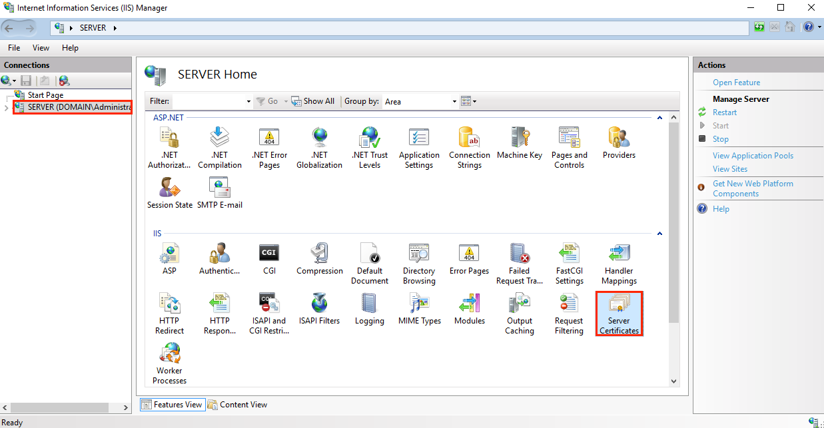
HTTP Protocol Websites
Installing Security Certificate on Windows ISS Server…

Slide 47
HTTP Protocol Websites
Installing Security Certificate on Windows ISS Server…
Double click the Server Certificates icon. The server certificate page with existing list of certificates appears.
On the right-pane, click the Create Certificate Request… link. The Request Certificate wizard with the distinguished name properties appears.
Provide the detailed information about your website, company, organizations detailed physical address and other information required as shown in the following figure.
(Image on the next slide)

Slide 48
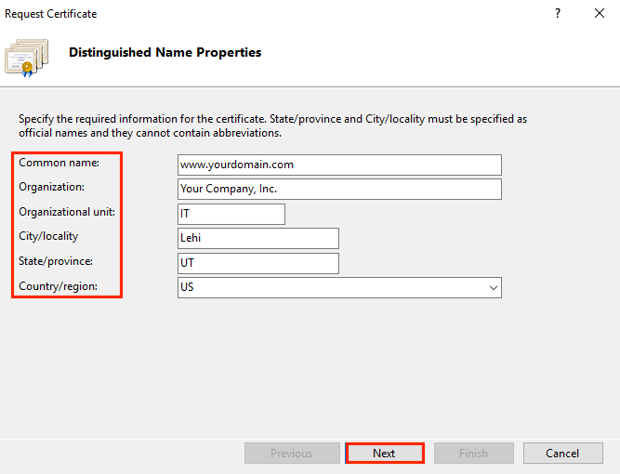
HTTP Protocol Websites
Installing Security Certificate on Windows ISS Server…
Click the Next button, when the required fields are filled with the valid information. The Cryptographic Service Provider Properties page appears.

Slide 49
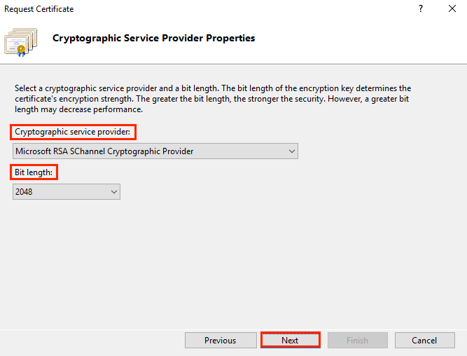
HTTP Protocol Websites
Installing Security Certificate on Windows ISS Server…
Fill-up the name of the cryptographic service provider and the required SSL security bit length in the respective fields as shown below.

Slide 50
HTTP Protocol Websites
Installing Security Certificate on Windows ISS Server…
Click the Next button. The File Name page appears.
Choose the file name and location where you want to save that CSR file
Click the Finish button. The CSR file will be created at the desired location.
Open the CSR file and copy the entire text file and use the copied text to place order to the certificate authority (CA) website
After some verifications, the CA will send you SSL Security Certificate through email
Save the SSL Security Certificate on your computer
Go to the Server Certificates page again.

Slide 51
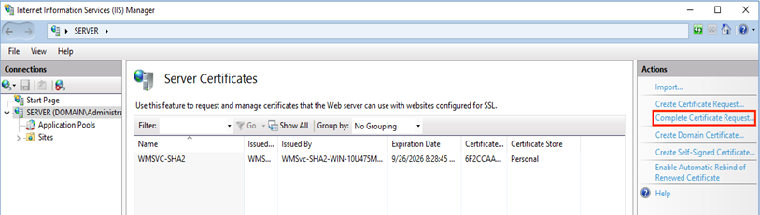
HTTP Protocol Websites
Installing Security Certificate on Windows ISS Server…
Click the Complete Certificate Request… link in the right-page (Action), as shown in the above snapshot image. The Specify Certificate Authority Response page appears.

Slide 52
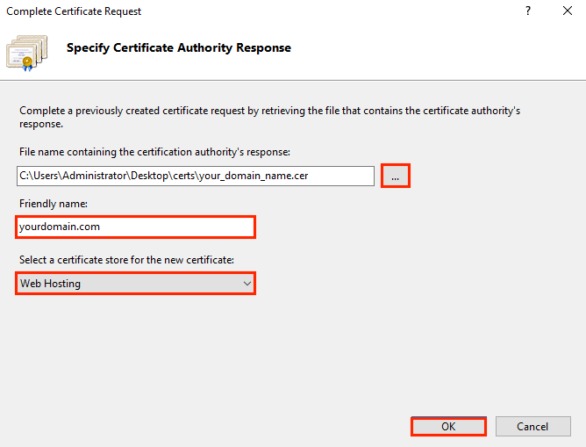
HTTP Protocol Websites
Installing Security Certificate on Windows ISS Server…
Enter the domain name of your website, select the hosting provider’s name, and locate the certificate file response received from the certificate authority (CA) as shown in the following figure.

Slide 53
HTTP Protocol Websites
Installing Security Certificate on Windows ISS Server…
Click the OK button, once you are done with entering the required information. The SSL certificate is installed on your server successfully
Now, you need to assign the newly installed SSL to the desired website
On the Internet Information Service IIS Manager page, expand the Server (Domain) Administration page to locate the Sites option.
Click the Sites link in the left-page. The list of the existing websites appears
Click the desired website. In our example, it is Default Web Site option. The home page of the desired website appears as shown in the following image.

Slide 54
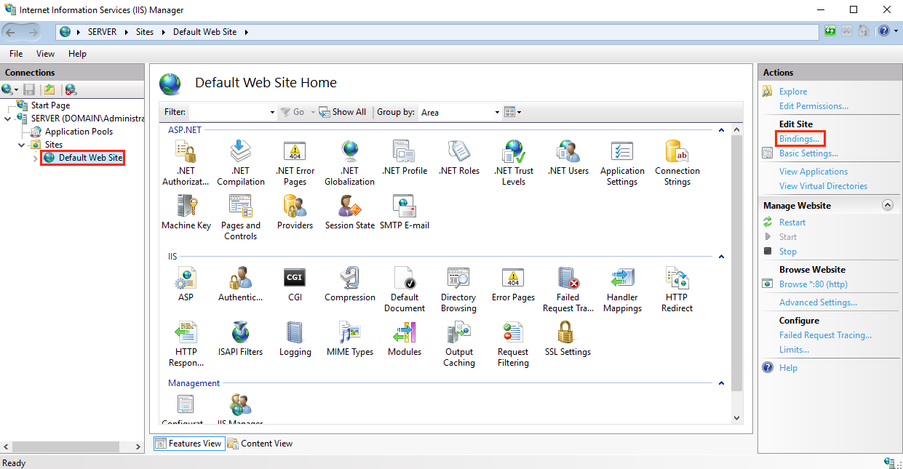
HTTP Protocol Websites
Installing Security Certificate on Windows ISS Server…

Slide 55
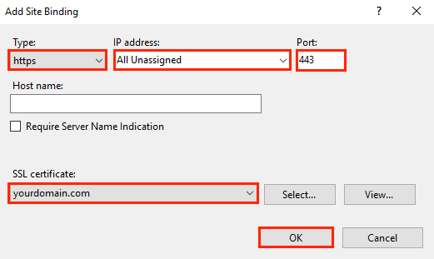
HTTP Protocol Websites
Installing Security Certificate on Windows ISS Server…
Click the Bindings… under Edit Site option in the right-pane (Actions). The Site Bindings window appears
Click the Add… button. The Add Site Binding window appears as shown in the following snapshot.

Slide 56
HTTP Protocol Websites
Installing Security Certificate on Windows ISS Server…
Choose HTTPS in the type field, the All Assigned option in the IP address field, and 443 in the port field
Select the domain name for which you want bind the SSL certificate in SSL Certificate field.
Click the OK button, when done with the data entry. Your website has been bound with the SSL certificate and you are ready to go.
You can also install multiple SSL certificates on your server and bind them with the multiple domain names of the websites by repeating the same step by step process as mentioned above.

