Slide 1


Ethical Hacking Course
Master of Science in Cybersecurity
Orientation show
عرض توجيهي
Dr. Kamal Alieyan
Everyone Smart University
Faculty of IT – 2023/2024

Slide 2
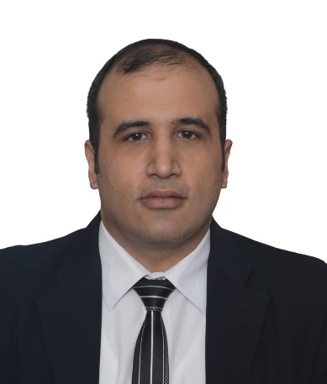

Who Am I?
Dr. Kamal Alieyan
  Assistant Professor in Cybersecurity
    Ph.D from USM, Malaysia, Jun. 2018.
    M.Sc from “University of Arab Academy for Banking and Financial Science”/ Jordan, Sep.2005.
    B.Sc from “Mu’tta University” / Jordan, Jun.2003.

Slide 3



Who Am I?
  How to reach me
    By email at kamal@esu.ac.ae
    ( please include “Ethical Hacking Course” in subject line)
  Office hours
  Discussion Time (Sunday at 9:00- 10:30 PM) every week
https://scholar.google.com/scholar?hl=en&as_sdt=0%2C5&q=Kamal+Alieyan&btnG=&oq=kama
https://www.scopus.com/authid/detail.uri?authorId=57000386100
https://orcid.org/0000-0002-9021-3151

Slide 4
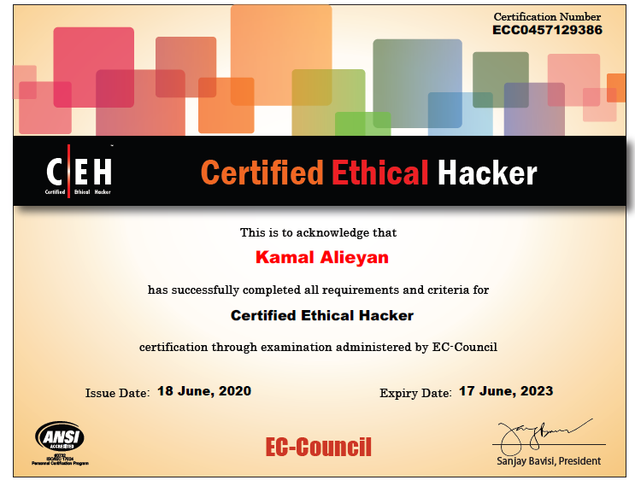
Certifications CEH

Slide 5
The course that will be taught

Slide 6
Primary Goal of This Course
  This course designed to help students to establish and govern minimum standards for credentialing entry-level information security specialists in ethical hacking measures.
  Inform the public that credentialed individuals meet or exceed the minimum standards.
  Reinforce ethical hacking as a unique and self-regulating profession.

Slide 7
Outline of Course
This course aims to:
  Provide students with concepts of:-
  Module 01 – Information Security Fundamentals
  Module 02 – Ethical Hacking Fundamentals
  Module 03 – Information Security Threats and Vulnerability Assessment
  Module 04 – Password Cracking Techniques and Countermeasures
  Module 05 – Social Engineering Techniques and Countermeasures
  Module 06 – Network Level Attacks and Countermeasures
  Module 07 - Web Application Attacks and Countermeasures
  Module 08 – Wireless Attacks and Countermeasures
  Module 09 – Mobile Attacks and Countermeasures
  Module 10 – IoT and OT Attacks and Countermeasures

Slide 8
Units of Course Contents
  Lecture Structure:
# | Course Unit | No.of. Weeks | Contact Hours
1 | Lecture_1_ Module 01 – Information Security Fundamentals | 1st | 3
2 | Lecture_2_ Module 02 – Ethical Hacking Fundamentals | 2nd | 3
3 | Lecture_3_Module 03 – Information Security Threats | 3 | 3
4 | Lecture_4_ Module 03 Vulnerability and Vulnerability Assessment Module 04- Password Cracking Techniques and Countermeasures | 4 | 3
5 | Lecture_5_Module 05 Social Engineering Techniques and Countermeasures | 5 | 3
6 | Lecture_6 Module 06- Network Level Attacks and Countermeasures | 6 | 3
7 | Lecture_7 Module 07- Web Application Attacks and Countermeasures | 7 | 3
8 | Lecture_8 Module 07 - SQL Injection Attacks and Countermeasures Module 08 Wireless Attacks and Countermeasures | 8 | 3
9 | Lecture_9_Module 09 Mobile Attacks and Countermeasures | 9 | 3
10 | Lecture_10_Module 10 IoT and OT Attacks and Countermeasures | 10 | 3

Slide 9
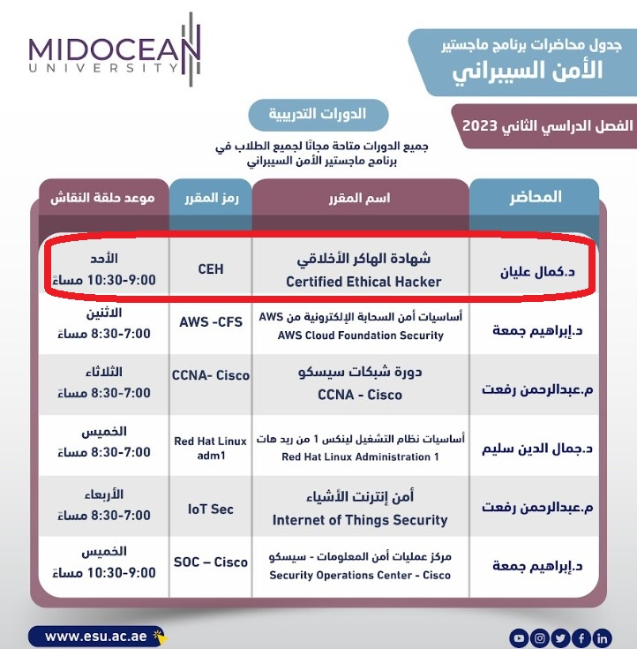
Academic Calendar

Slide 10
Academic Calendar
الفترة الزمنية التعليمية في الفصل الدراسي الصيف تكون مدة ١٣أسبوع
(منهم أسبوعين للاختبار النهائي)

Slide 11
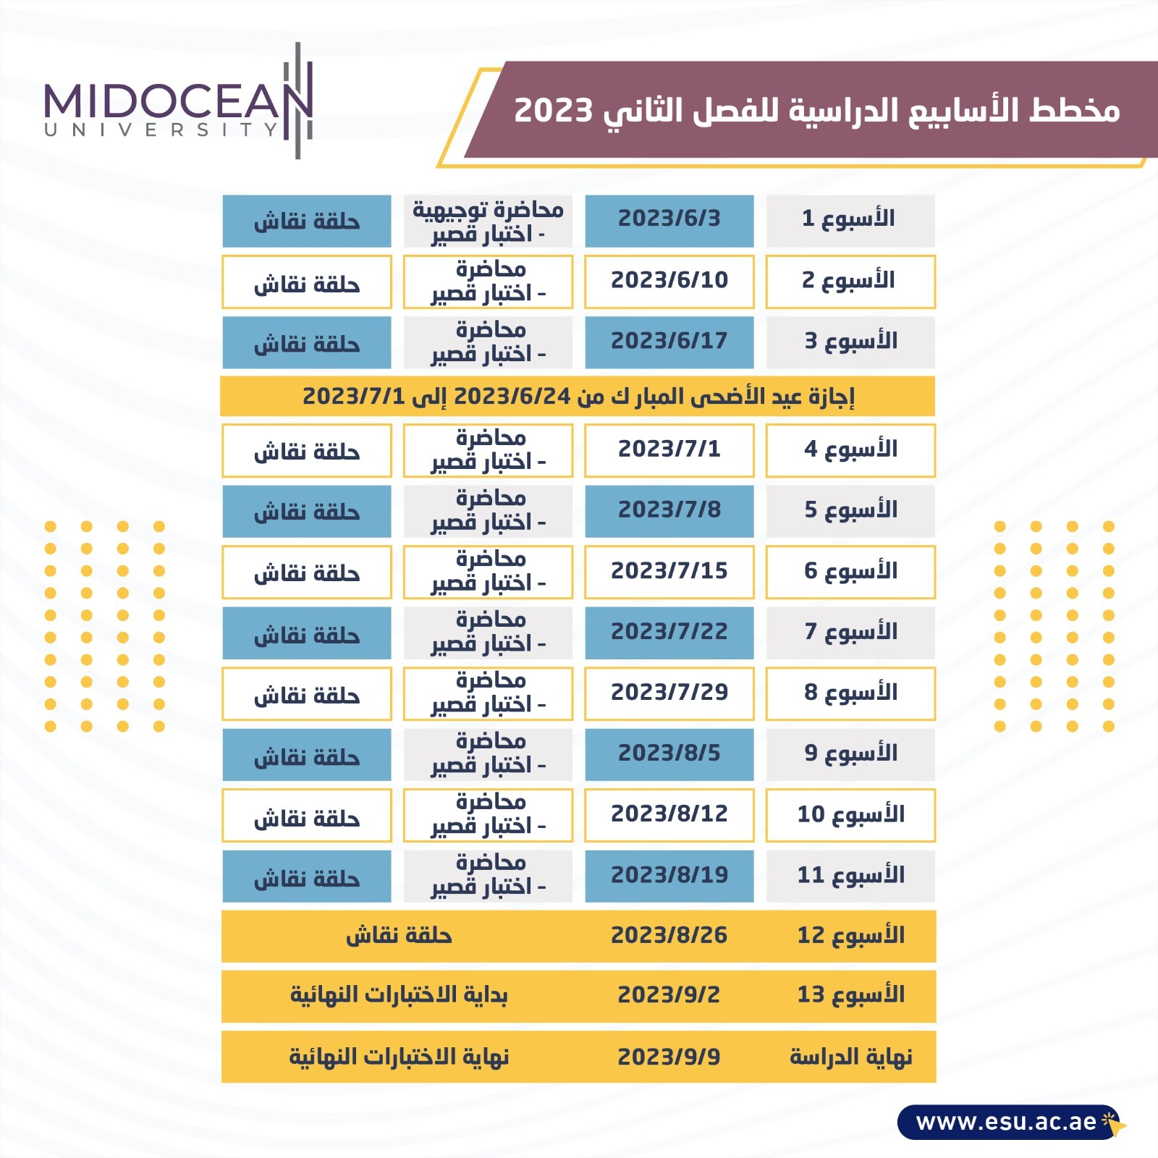
Academic Calendar

Slide 12
Course Information
  Assessment Method:
Short Exam
  80% marks
    Count of short Exam 10 (Weekly)
    8 Marks for every each of short Exam.
  20% Final Examination
-- اللغة الأساسية في المحاضرات هي:
اللغة الإنجليزية
-- الاختبارات باللغة الإنجليزية مع وجود
ترجمة للسؤال.

Slide 13


