Slide 1

CCNA (200-301) Cisco Certified Network Associate
Prepared by Eng. Taghreed Elsayed
Lecture 7
EIGRP

Slide 2

Chapter
03
EIGRP (Enhanced Interior Gateway Routing Protocol)
EIGRP (Hybrid Routing Protocol): merges the features of distance vector routing and link-state routing protocol.
Use partial updates.
Classless routing protocol.
Multicast address protocol (224.0.0.10)
Use three tables like OSPF:
Neighbors table: contains all direct connected routers satisfy neighbors relation ship condition.
Topology table :contains all information about routers and their routes.
Routing table : contains information about the best route calculated from topology table.

Slide 3
Chapter
03
EIGRP (Enhanced Interior Gateway Routing Protocol)
EIGRP use Diffusion Update Algorithm (DUAL): to calculate best route from topology table.
Successor :calculate best route and store it routing table.
Feasible successor( back up route ) : this route is kept on topology table if successor failed , Feasible successor would put on routing table .
Hello and Hold Down timers
Routers running EIGRP exchange periodical packets called hello packets to:
1.Create neighbors relationship
2.Maintain neighbors relationship
Hello interval is the timer between every hello packets and depend on bandwidth of interface

Slide 4
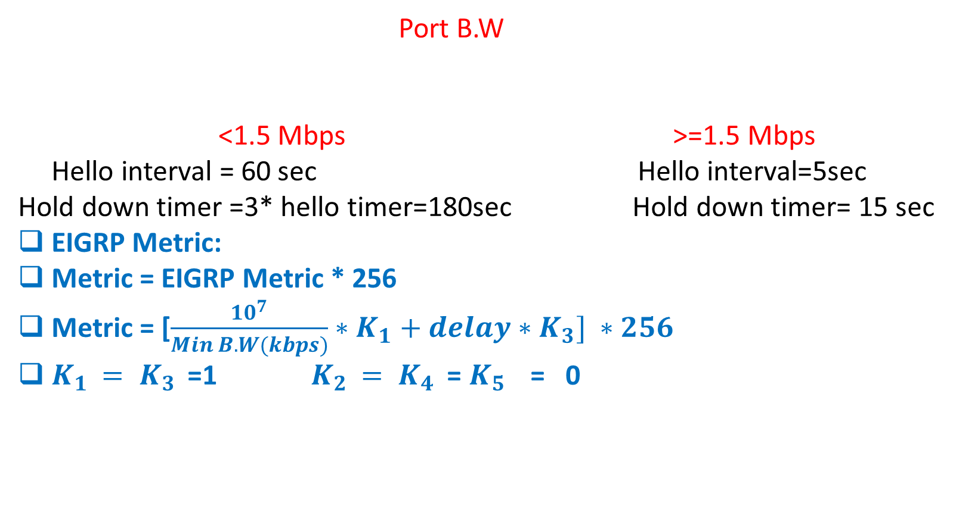
Chapter
03
EIGRP (Enhanced Interior Gateway Routing Protocol)
Port B.W
<1.5 Mbps >=1.5 Mbps
Hello interval = 60 sec Hello interval=5sec
Hold down timer =3* hello timer=180sec Hold down timer= 15 sec
EIGRP Metric:
Metric = EIGRP Metric * 256
Metric = [$\frac{{10}^{7}}{Min B.W(kbps)}∗K_{1}+delay∗K_{3}] ∗256$
$K_{1 }{= K}_{3 }$ =1 $K_{2 }{= K}_{4 }$ = $K_{5 }$ = 0

Slide 5
Chapter
03
EIGRP (Enhanced Interior Gateway Routing Protocol)
Metric parameters =
1.B.W
2.Delay
3.Load
4.Reliability
5.MTU(maximum transmission unit)
EIGRP Neighbors Relationship Conditions:
Routers must use the same subnet numbers and subnet mask on the common link between them
Routers must be on the same AS(autonomous system)
Routers must use same k-values on metric calculation

Slide 6
Chapter
03
EIGRP (Enhanced Interior Gateway Routing Protocol)
EIGRP Route Summarization
Route summarization is a method of representing multiple networks with a single summary address. It is often used in large networks with many subnets because it reduces the number of routes that the routers must maintain and minimizes routing updates. Two methods for summarizing routes exist:
automatic summarization
manual summarization.

Slide 7
Chapter
03
EIGRP (Enhanced Interior Gateway Routing Protocol)
EIGRP automatic summarization
Depending on your IOS version, the EIGRP auto-summary feature might be enabled or disabled by default (it is more likely to be disabled in modern IOS versions).
When auto-summary is enabled, routes are summarized to the classful boundary in the routing updates.
To better understand the concept of auto-summarization, consider the following example.

Slide 8
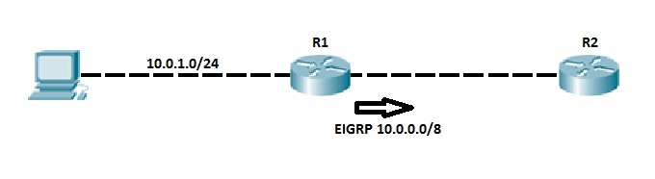
Chapter
03
EIGRP (Enhanced Interior Gateway Routing Protocol)
Router R1 and R2 are running EIGRP. Router R1 has the locally connected subnet 10.0.1.0/24 that is advertised to the router R2. Because of the auto summary feature, the router R1 summarizes the network 10.0.1.0/24 before sending the route to R2. With the auto summary feature turned on, R1 sends the classful route 10.0.0.0/8 to R2 instead of the more specific 10.0.1.0/24 route.

Slide 9
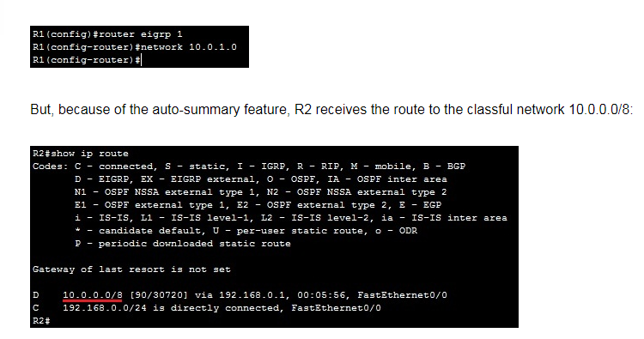
Chapter
03
EIGRP (Enhanced Interior Gateway Routing Protocol)
On R1, we have configured the following network statement:

Slide 10
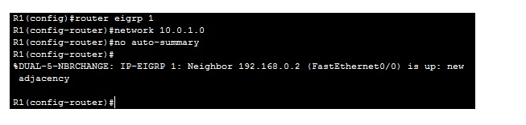
Chapter
03
EIGRP (Enhanced Interior Gateway Routing Protocol)
The auto summary feature can cause problems with discontinuous networks. This is why this feature is usually turned off (it is much better to use manual summarization to control exactly where and how summarization affects the network).
Use the no auto-summary command to ensure it is turned off (it may already be disabled by default):

Slide 11
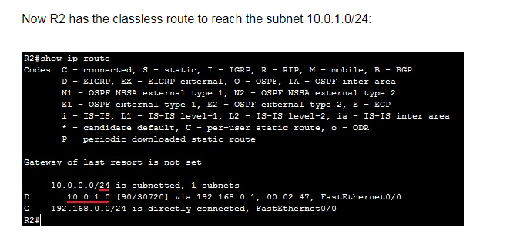
Chapter
03
EIGRP (Enhanced Interior Gateway Routing Protocol)

Slide 12
Chapter
03
EIGRP (Enhanced Interior Gateway Routing Protocol)
EIGRP manual summarization
One of the advantages of EIGRP over some other routing protocols (like OSPF) is that manual summarization can be done on any router within a network. A single route can be used to represent multiple routes, which reduces the size of routing tables in a network.
Manual summarization is configured on a per-interface basis. The syntax of the command is:

Slide 13
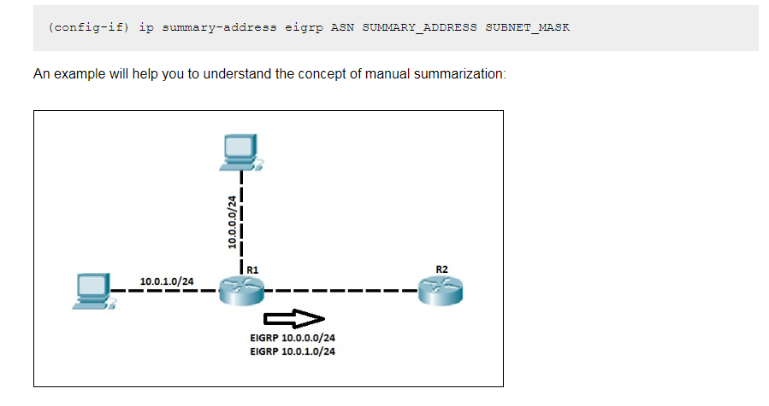
Chapter
03
EIGRP (Enhanced Interior Gateway Routing Protocol)

Slide 14
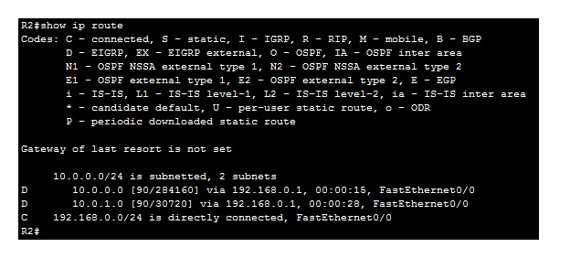
Chapter
03
EIGRP (Enhanced Interior Gateway Routing Protocol)
Router R1 and R2 are running EIGRP. Router R1 (on the left) has two directly connected subnets: 10.0.0.0/24 and 10.0.1.0/24. EIGRP advertises these subnets as two separate routes.
R2 now has two routes for two subnets, which can be confirmed by using the show ip route command on R2:

Slide 15
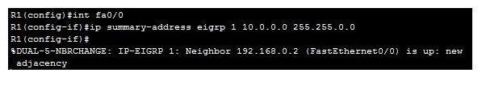
Chapter
03
EIGRP (Enhanced Interior Gateway Routing Protocol)
We could configure R1 to advertise only one summary route for both subnets, which helps reduce R2’s routing table. To do this, the following command can be used:
Now, R1 is sending only one route to reach both subnets to R2. We can verify that by using the show ip route command on R2:

Slide 16
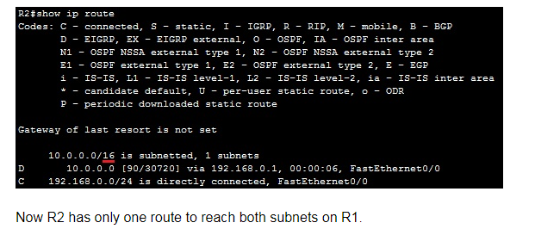
Chapter
03
EIGRP (Enhanced Interior Gateway Routing Protocol)

Slide 17
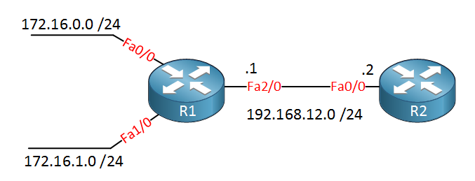
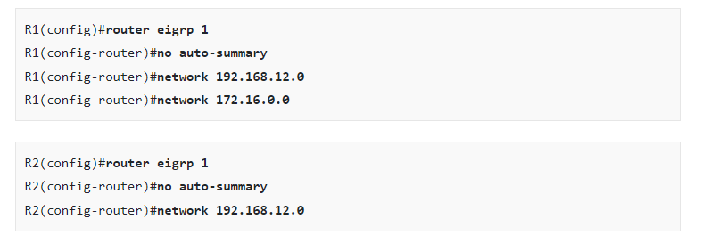
Chapter
03
EIGRP (Enhanced Interior Gateway Routing Protocol)

Slide 18
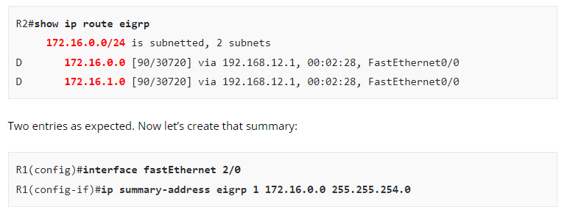
Chapter
03
EIGRP (Enhanced Interior Gateway Routing Protocol)

Slide 19
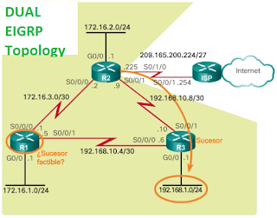
Chapter
03
EIGRP (Enhanced Interior Gateway Routing Protocol)
EIGRP DUAL The Diffusion Update Algorithm
Successor calculation:
1.AD(advertised distance):
the cost send from R1 TO R2
R2 tells to R1 the cost to reach 192.168.1.4
2.FD(feasible distance) :summation of
FD(R1) = AD(R1) + Cost(R2-R1)
FD (R3)=AD(R3) + Cost(R2-R3)

Slide 20
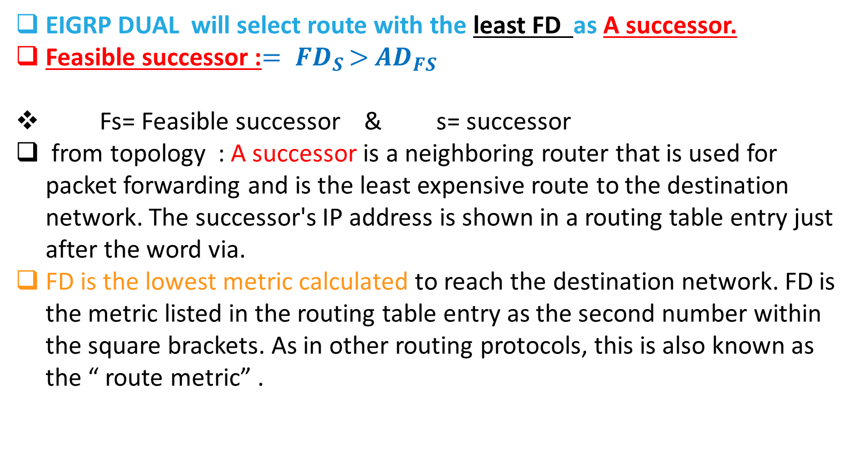
Chapter
03
EIGRP (Enhanced Interior Gateway Routing Protocol)
EIGRP DUAL will select route with the least FD as A successor.
Feasible successor :${= FD}_{S }>{ AD}_{FS }$
Fs= Feasible successor & s= successor
from topology : A successor is a neighboring router that is used for packet forwarding and is the least expensive route to the destination network. The successor's IP address is shown in a routing table entry just after the word via.
FD is the lowest metric calculated to reach the destination network. FD is the metric listed in the routing table entry as the second number within the square brackets. As in other routing protocols, this is also known as the “ route metric” .

Slide 21
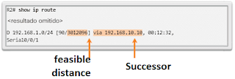
Chapter
03
EIGRP (Enhanced Interior Gateway Routing Protocol)
Analyze the routing table for R2 in above Image and note that the best EIGRP route for the 192.168.1.0/24 network is through router R3 and that the feasible distance is 3 012 096.

Slide 22
Chapter
03
EIGRP (Enhanced Interior Gateway Routing Protocol)
FEASIBLE SUCCESSORS, FEASIBILITY CONDITION AND DISTANCE REPORTED
DUAL can converge quickly after a change in the topology, because it can use backup routes to other networks without recalculating DUAL. These backup routes are known as " feasible successors " (FS).
An FS is a neighbor that has a backup route without loops to the same network as the successor and satisfies the feasibility condition (FC). The successor of R2 for the 192.168.1.0/24 network is R3, which provides the best route or the lowest metric to the destination network.
Note in Figure 1 that R1 provides an alternative route, but is it an FS? Before R1 can be an FS for R2, it must meet the FC (feasible conditions ).

Slide 23
Chapter
03
EIGRP (Enhanced Interior Gateway Routing Protocol)
The FC is met when the notified distance (AD) from a neighbor to a network is less than the feasible distance from the local router to the same destination network.
If the reported distance is shorter. The reported distance is simply a feasible distance from the EIGRP neighbor to the same destination network.
The reported distance is the metric that a router informs a neighbor about its own cost to that network.

Slide 24
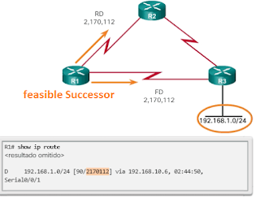
Chapter
03
EIGRP (Enhanced Interior Gateway Routing Protocol)
EXAMPLES: Feasible Successor
In following figure, the feasible distance from R1 to 192.168.1.0/24 is 2 170 112.
R1 informs R2 that its FD at 192.168.1.0/24 is 2 170 112.
From the perspective of R2, 2 170 112 is the AD of R1.

Slide 25
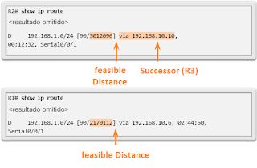
Chapter
03
EIGRP (Enhanced Interior Gateway Routing Protocol)
R2 uses this information to determine if R1 meets the FC and therefore can be an FS.
As shown in following image, because the AD of R1 (2 170 112) is lower than the FD of R2 (3 012 096), R1 meets the FC.

Slide 26
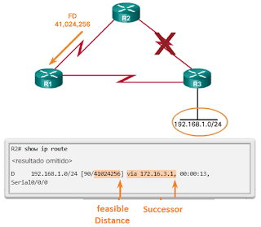
Chapter
03
EIGRP (Enhanced Interior Gateway Routing Protocol)
R1 is now an FS for R2 to the 192.168.1.0/24 network.
If there is an error in the route from R2 to 192.168.1.0/24 through R3 (successor), R2 immediately installs the route through R1 (FS) in its routing table.
R1 becomes the new successor for the route of R2 to
this network, as shown in Image below.

Slide 27

Chapter
03
EIGRP (Enhanced Interior Gateway Routing Protocol)
As shown in Image, the first sub-entry in the result shows the successor:
via 192.168.10.10 : address of the next hop of the successor, R3. This address is shown in the routing table.
3012096 : FD at 192.168.1.0/24. It is the metric shown in the IP routing table.
2816 : RD of the successor; It is the cost of R3 to reach this network.
Serial 0/0/1 : output interface used to reach this network, which is also shown in the routing table.

Slide 28
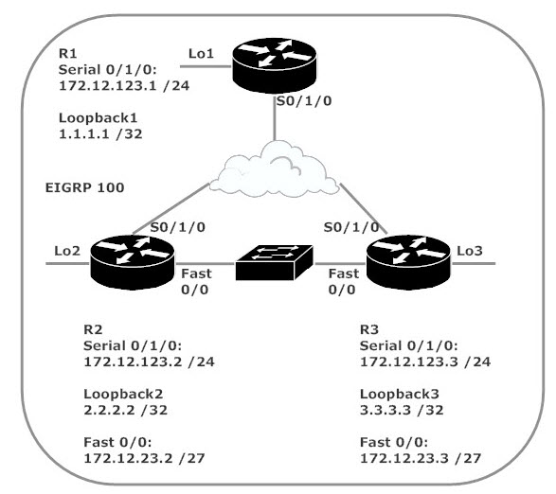
Chapter
03
EIGRP (Enhanced Interior Gateway Routing Protocol)
EGIRP Load balance
1.Equal cost load balance
2.UN equal cost load balance
Equal cost load balance
If the Dual find more than one route have
the same cost , it will use by default 4 routes
for load balancing

Slide 29
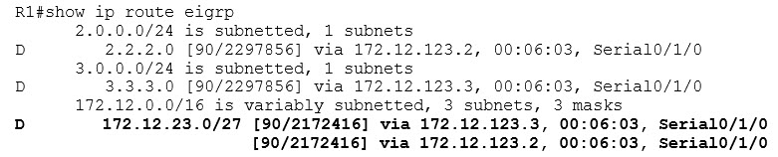
Chapter
03
EIGRP (Enhanced Interior Gateway Routing Protocol)
There are two paths to 172.12.23.0 /27 thanks to equal-cost load balancing, a default behavior of EIGRP.
Since the metric for these two paths to 172.12.23.0 /27 is exactly the same (2172416), both paths are put into the EIGRP route table and the load to that network is balanced over the two paths.

Slide 30
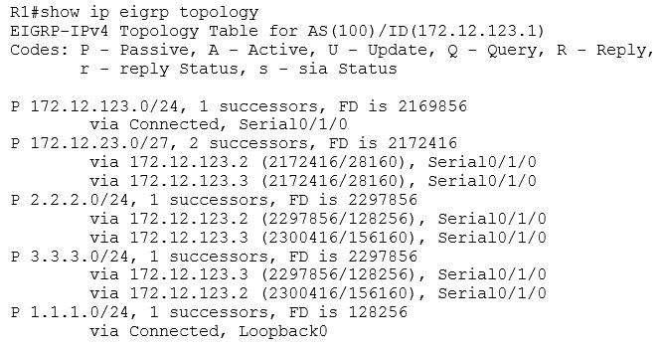
Chapter
03
EIGRP (Enhanced Interior Gateway Routing Protocol)

Slide 31
Chapter
03
EIGRP (Enhanced Interior Gateway Routing Protocol)
Before we look at R1’s topology table, a quick reminder:
all routes in the EIGRP route table are successors, and you’ll find feasible successors and successors in the EIGRP topology table.
When equal-cost load balancing is in effect, you’ll see multiple successors for the same route in the topology table. Here, we see two successors for 172.12.23.0/27, and both are in the EIGRP route table, since their metrics are exactly the same.

Slide 32
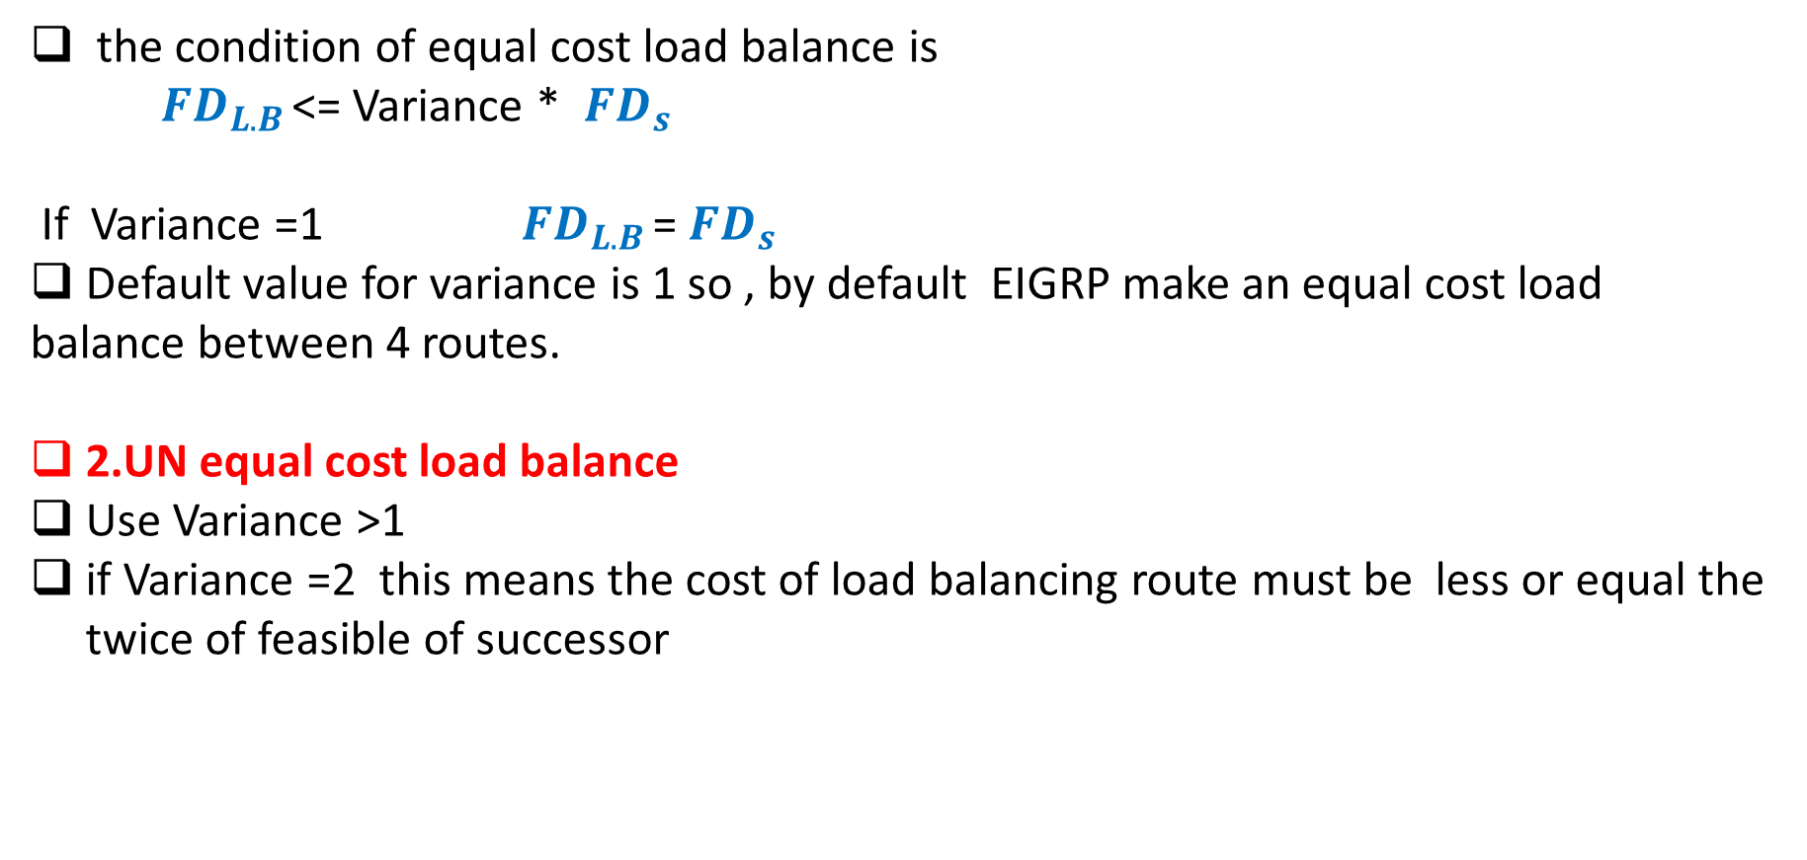
Chapter
03
EIGRP (Enhanced Interior Gateway Routing Protocol)
the condition of equal cost load balance is
${ FD}_{L.B }$<= Variance * ${FD}_{s }$
If Variance =1 ${ FD}_{L.B }$= ${FD}_{s }$
Default value for variance is 1 so , by default EIGRP make an equal cost load
balance between 4 routes.
2.UN equal cost load balance
Use Variance >1
if Variance =2 this means the cost of load balancing route must be less or equal the twice of feasible of successor

Slide 33
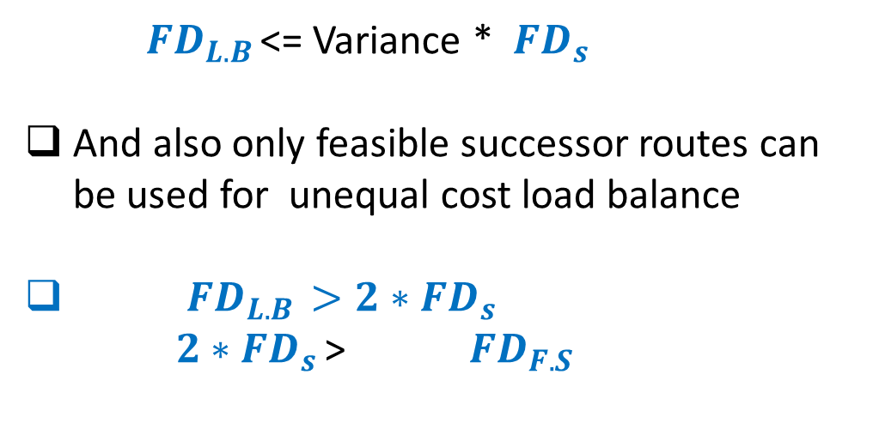
Chapter
03
EIGRP (Enhanced Interior Gateway Routing Protocol)
${ FD}_{L.B }$<= Variance * ${FD}_{s }$
And also only feasible successor routes can be used for unequal cost load balance
${ FD}_{L.B } >2∗{FD}_{s }$
$2∗{FD}_{s }$> ${ FD}_{F.S}$

Slide 34
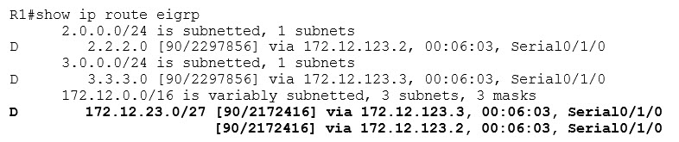
Chapter
03
EIGRP (Enhanced Interior Gateway Routing Protocol)
R1’s routing table shows EIGRP equal-cost load balancing in action. The metrics for the two available paths to 172.12.23.0 /27 are exactly the same, so both paths are in the routing table.

Slide 35
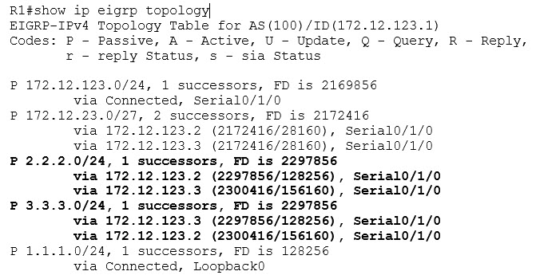
Chapter
03
EIGRP (Enhanced Interior Gateway Routing Protocol)
Checking R1’s EIGRP topology table,
we note there are two entries for both 2.2.2.0 /24 and 3.3.3.0 /24. Each route has one successor and one feasible successor.

Slide 36
Chapter
03
EIGRP (Enhanced Interior Gateway Routing Protocol)
Our routing would be more efficient if we balanced the load from R1 to 2.2.2.0 /24 over those two available paths.
The metrics of those two paths are so close (2297856 and 2300416) that it doesn’t make sense to leave one idle while letting the other path handle the full load for traffic heading for 2.2.2.0 /24.
That’s where EIGRP unequal-cost load balancing comes in. EIGRP runs equal-cost load balancing by default, but unequal-cost balancing requires a little configuration,

Slide 37

Chapter
03
EIGRP (Enhanced Interior Gateway Routing Protocol)
Enables unequal-cost load balancing in EIGRP. The variance command is a multiplier and has a default value of 1. Using variance is a two-step process:
The router will multiple the Feasible Distance of the route by the variance value.
Any feasible successor with a metric less than that new value will be entered into the routing table.

Slide 38

Chapter
03
EIGRP (Enhanced Interior Gateway Routing Protocol)
The successor has a metric of 2297856. By setting the EIGRP variance to 2 on R1, any route to 2.2.2.0 /24 with a metric of less than 4595712 (2 x 2297856) will be entered into the EIGRP routing table and will participate in unequal-cost load sharing.
The only feasible successor to that route has a metric of 2300416, so it certainly qualifies! Let’s run variance 2 on R1.

Slide 39
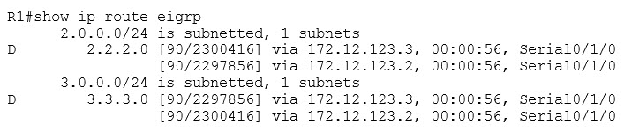
Chapter
03
EIGRP (Enhanced Interior Gateway Routing Protocol)
The feasible successor and successor are also showing up for R3’s loopback network. This illustrates a very important point regarding variance, and you got to watch out for it – it’s an all-or-nothing command.
When you change variance, you’re changing it for your router’s entire EIGRP configuration. (That’s one of the important variance tips I mentioned at the top of the page. The second one’s coming up.)

Slide 40
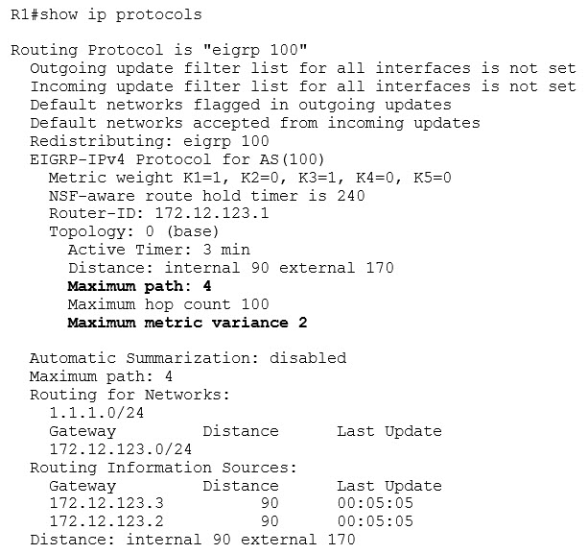
Chapter
03
EIGRP (Enhanced Interior Gateway Routing Protocol)

