Slide 1

Prepared by
Dr. Hamada I. AbdulWakel
Lecture 4
CYB615
Network Programming

Slide 2
Module4: Socket Programming using
Python – Part I

Slide 3


Lecture 4
Agenda
The Client/Server Programming.
Communication Protocols.
TCP Socket Programming in Python.

Slide 4
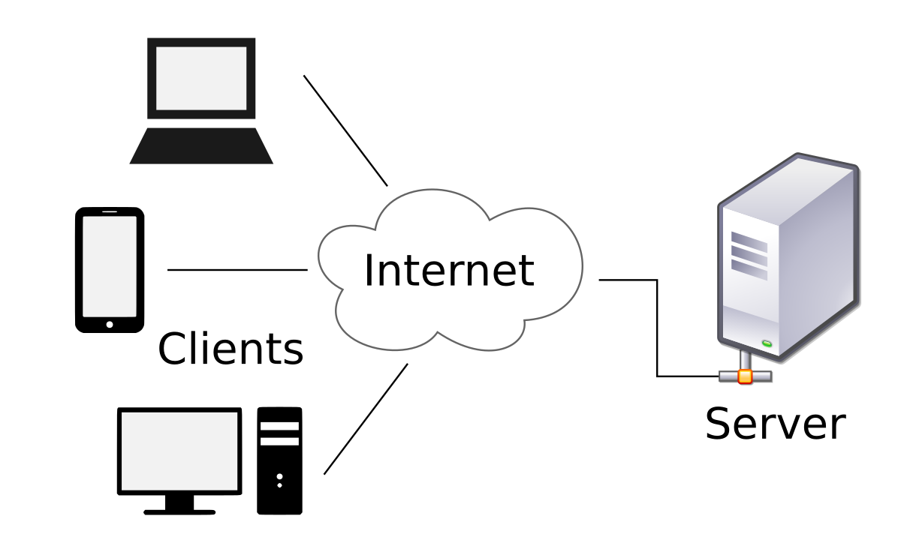
Lecture 4
The Client-Server Programming Model
Every network application is based on the client-server model.
An application consists of a server process and one or more client processes.
A server manages some resource, and it provides some service for its clients by manipulating that resource.

Slide 5
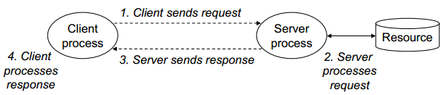
Lecture 4
The Client-Server Programming Model
Cont'd
A client-server transaction consists of four steps.
  When a client needs service, it initiates a transaction by sending a request to the server.
  The server receives the request, interprets it, and manipulates its resources in the appropriate way.
  The server sends a response to the client, and then waits for the next request.
  The client receives the response and manipulates it.

Slide 6
Lecture 4
Communication Protocols
Although a computer usually has:
  A single physical connection to the network.
  Data could be sent by different applications to them do so through the use of ports configured on the same physical network connection.
When data is to be transmitted over the internet to an application, it requires that we specify the address of the destination computer as well as the application's port number.
A computer's address is a 32-bit IP address. The port number is a 16-bit number ranging from 0 to 65,535, with ports 0-1023 restricted by well-known applications like HTTP and FTP.

Slide 7
Lecture 4
Communication Protocols
Cont'd
Every packet (of data) has:
  Source IP, Source Port, Destination IP, and Destination Port.
Allows computing devices and applications to send data via a network and verify its delivery.
There are two types of client-server application communication protocol:
  Transmission Control Protocol (TCP).
  User Datagram Protocol (UDP).

Slide 8
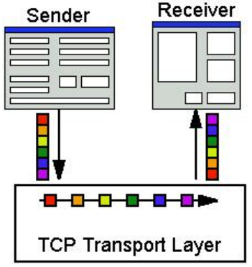
Lecture 4
Transmision Control Protocol (TCP)
A connection-oriented protocol that provides a reliable flow of data between end-to-end connection.
  Three-way handshake. "Wanna connect?" "Sure!" "Alright then!"
Slow overhead time of setting up.
Retransmission.
  Bigger overhead.
In-order delivery.
Congestion control.
  Delays transmission when network is congested.
  Data doesn't always get sent out immediately
  (i.e., voice chat).

Slide 9
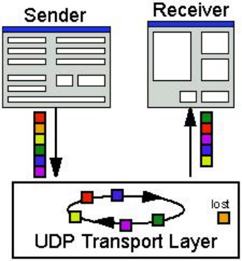
Lecture 4
User Datagram Protocol (UDP)
Connection-less protocol that sends independent packets of data (datagrams), from one computer to another.
  No connection to create and maintain.
Faster since no overhead of setting up a connection.
Small packet sizes.
No compensation for lost packets.
Packets can arrive out of order.
No error recovery.
No congestion control.

Slide 10
Lecture 4
Socket Module in Python
Both protocols (UDP, PCP) are supported using "sockets".
  A socket is a file-like object.
  Allows data to be sent and received across the network like a file.
  But it also includes functions to accept and establish connections.
  Before two machines can establish a connection, both must create a socket object.

Slide 11
Lecture 4
Socket Module in Python
Cont'd
Socket basic methods:
  socket() to create a socket object.
  gethostname() to return a string containing the hostname.
  gethostbyname() to know the current machine's IP address.
  connect() to connect to a remote socket at an address.
  bind() to bind the socket to an address.
  listen() to listens for the connection made to the socket.
  accept() to accept a connection.
  close() to close the socket connection.

Slide 12
Lecture 4
Server Socket Creation Steps
To create a socket server, follow the following steps:
  Import socket module.
  Create a socket object.
  Get current machine name.
  Get port number for connection.
  Bind with the address.
  Determine number of allowed connections.
  Listen for connections.
  Connect and accept from clients.
  Send & receive messages.
  Close the connection.

Slide 13
Lecture 4
Client Socket Creation Steps
To create a socket server, follow the following steps:
  Import socket module.
  Create a socket object.
  Identify the server machine name (i.e., hostname).
  Identify the server port number.
  Connect to the server.
  Send & receive messages.
  Close the connection.

Slide 14
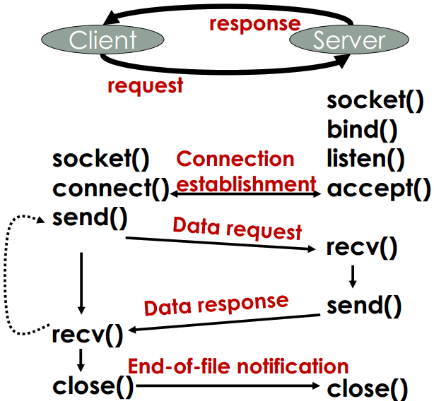
Lecture 4
Major System Calls

Slide 15
Lecture 4
Working With TCP Socket Example
import socket
# create a TCP socket
soc = socket.socket(socket.AF_INET, socket.SOCK_STREAM)
print("Socket succesfully created!")

Slide 16
Lecture 4
Working With TCP Socket Error Handing Example
Cont'd
import socket
# create a TCP socket
try:
soc = socket.socket(socket.AF_INET, socket.SOCK_STREAM)
print("Socket succesfully created!")
except socket.error as err:
print("Failed to create a socket!")
print(f"Reason: {err}")

Slide 17
Lecture 4
Working With TCP Socket Error Handing Example
Cont'd
…...
target_host = input("Enter the target host name to connect: ")
target_port = input("Enter the target port: ")
try:
sock.connect((target_host, int(target_port)))
print(f"Socket Connected to {target_host} on port: {target_port}")
except socket.error as err:
print(f"Failed to connect to {target_host} on port {target_port}")
print("Reason: {str(err)}")

Slide 18
Lecture 4
Simple Server Socket Code
import socket
soc = socket.socket()
print("socket created")
# server and client in the same machine
soc.bind((socket.gethostname(), 5485))
soc.listen(3) #accepts three connection
print("Waiting for connections .....")

Slide 19
Lecture 4
Simple Server Socket Code
Cont'd
.....
while True:
#return client socket and address
clientSoc, clientAddre = soc.accept()
name = clientSoc.recv(1024).decode()
print("Connected with", clientAddre, name)
clientSoc.send(("Welcome we are connected :) " + name).encode())
clientSoc.close()

Slide 20
Lecture 4
Simple Client Socket Code
import socket
soc = socket.socket()
soc.connect((socket.gethostname(), 5485))
name = input("Enter your name? ")
soc.send(name.encode())
print(soc.recv(1024).decode())
soc.close()

Slide 21
Lecture 4
Sheet
Exercise 1:
Using this link
https://we-xpats.com/en/job/me/sa/search/?area=3411
Create a web scraping application to get the available jobs in Makkah.

Slide 22
Lecture 4
Sheet
Exercise 2:
Create a client/server application that pretends to be a calculator. It begins by asking the client about his name and age, then ask him to enter two numbers and the operation he want to perform. The server should calculate the result of the required operation and send it to the client.

Slide 23
THANK YOU

